Slide 1
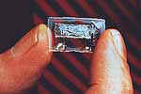
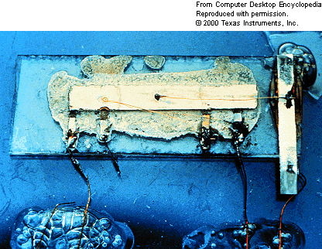
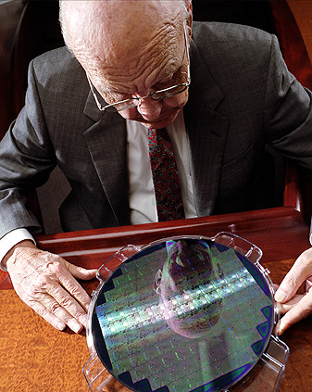
Integrated Circuits
First IC – 1959, Jack Kilby, Texas Instruments
Nobel Prize 2000
The first integrated circuit
Jack Kilby holding a semiconductor wafer

Slide 2
Integrated Circuits
Complex circuits including thousands of diodes, transistors, resistors and capacitors in a chip of semiconductor
Allows miniaturisation – important where weight and space are critical
Miniaturisation also reduces time delay of signals, improved response times and high frequency applications.
Simultaneous fabrication of devices, reduced cost
Interconnects are made on a single rigid substrate, minimize failures due to soldered connections.

Slide 3
Moore’s Law
Came from Gordon Moore, co founder of Fairchild Semiconductors, and ex-CEO of Intel.
Basically says that processing power doubles every 2 years with cost reducing， and number of transistors on a circuit doubling every 18 months.
This is an observation and not really a law.
We’ve pretty much reached the end of this![see the next 2 slides].
So what will replace this?

Slide 4
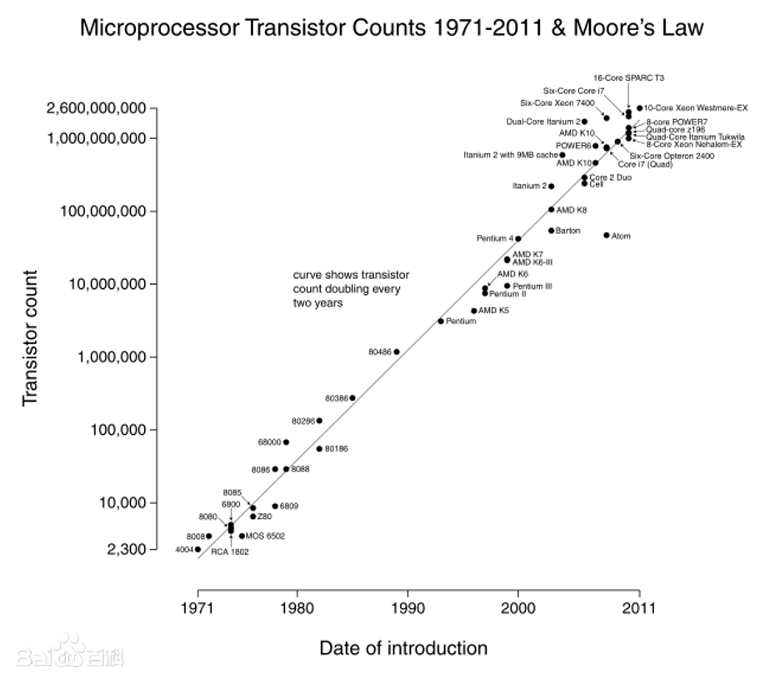

Slide 5
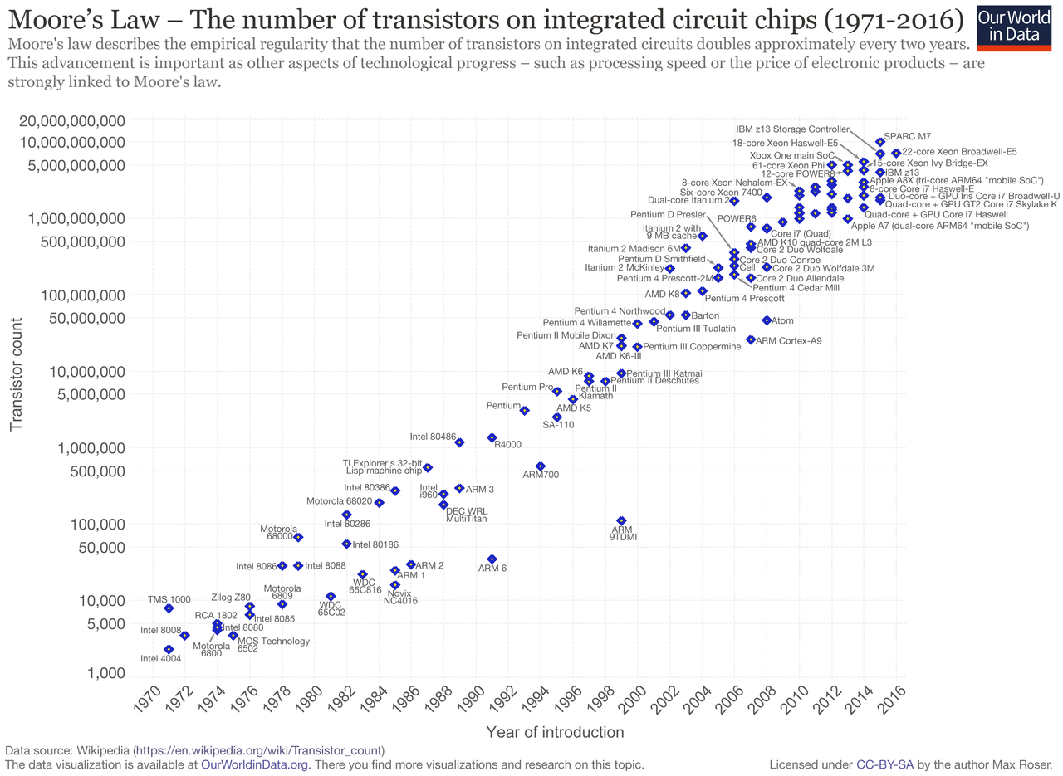

Slide 6
Replacement for Moore’s Law?
Increased functionality – see things like OSC- systems on a chip
The use of Tri-gate [see next slide]
Quantum computing
The use of graphene and carbon nanotubes.
Nanomagnetic logic
But, quantum computing – which is still in the very early stage, the last 2 are not yet viable.

Slide 7
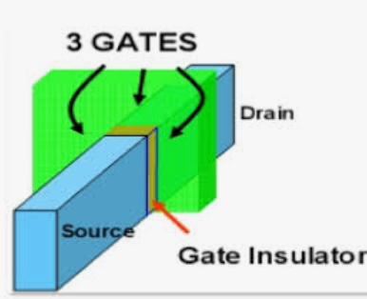
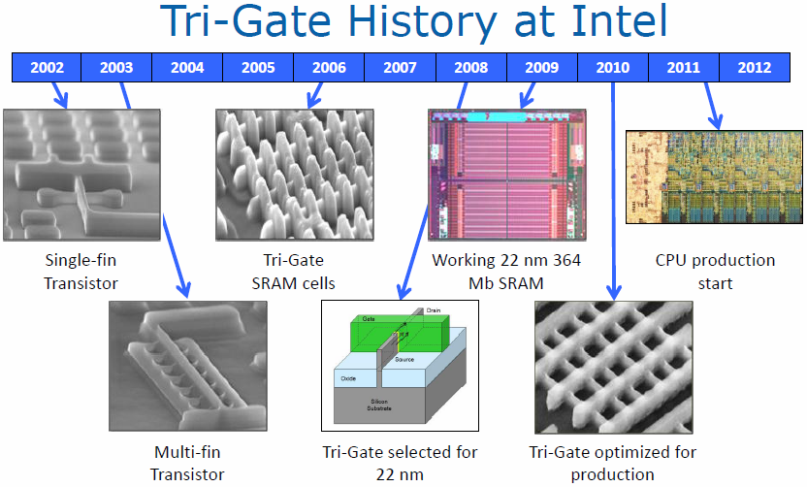
https://www.notebookcheck.net/Review-Intel-Ivy-Bridge-Quad-Core-Processors.73624.0.html
Notes:
3D三维晶体管3-D Tri-Gate三维晶体管相比于32nm平面晶体管可带来最多37%的性能提升，而且同等性能下的功耗减少一半，这意味着它们更加适合用于小型掌上设备。
公司重新为芯片设计了电子开关(即晶体管)，在过去开关是平面的，现在增加了第三维， 它由硅基向上突出。例如，当土地有限，要增加办公室就可以盖摩天大楼。新的3D晶体管道理与此相似。半个多世纪以来，晶体管一直都在使用2-D平面结构，现在终于迈入了3-D三维立体时代。

Slide 8
The Tri-Gate design is considered 3D because the gate wraps around a raised source-to-drain channel, called a "fin," instead of residing on top of the channel in the traditional 2D planar design. In addition, multiple fins are used, which provide greater control of each state.

Slide 9
Semiconductor Manufacturing - overview
The next slides show the various steps in the manufacture of semiconductors.
These are overview slides only, many of the technologies have changed, for instance the wavelength of light used in the lithography process, BUT the basics are still the same.
Much of this is from my personal prior experience in the semiconductor industry.

Slide 10
Other things to note!
Some of feature sizes mentioned are very large, comparatively speaking, to state of the art.
So 0.1 μm is massive compare to current CPU features size of 14 nm!
Specialised chips such as memory and GPU’s are nearing 10 nm!
However advanced the methods, the basics remain the same.

Slide 11
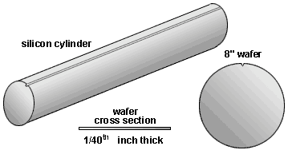
Fabrication Technology - Wafers and Ingots
All silicon processes use wafers. Wafers are thin slices from a cylinder of lightly doped, extremely pure silicon called ingots. The doping is normally on the order of 10¹³ dopants/cm³.

Slide 12
Wafers can be made in various sizes ranging from 1 inch (25.4 mm) to 11.8 inches (300 mm), and thicknesses of the order of 0.5 mm. Generally, they are cut from a semiconductor crystal ingot (boule) using a diamond blade or diamond wire, then polished on one or both faces.

Slide 13
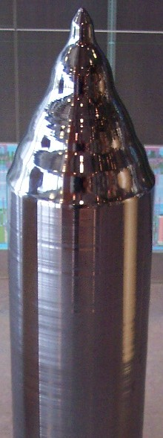
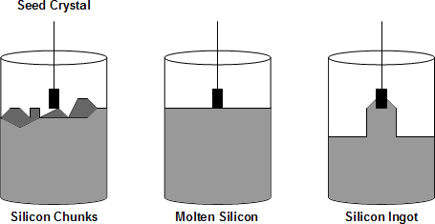
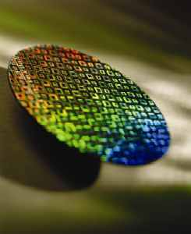
Wafers and Ingots
Manufacturing of silicon ingot
Silicon Ingot
Silicon Wafer

Slide 14
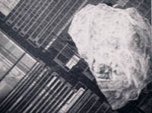
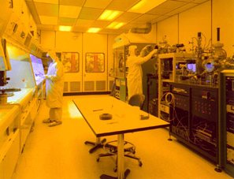
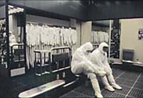
Manufacturing environment
Clean rooms
A grain of salt on a microprocessor
NASA
Intel

Slide 15
Manufacturing environment
Store personal items.
Discard any gum, candy, etc.
Remove any makeup with cleanroom soap and water.
Take a drink of water to wash away throat particles.
Cover any facial hair with a surgical mask or beard/mustache lint-free （不起毛） cover.
Put on a lint-free head cover.
Clean shoes with shoe cleaners.
Put shoe cover on over shoes.
Clean any small, pre-approved items to be taken inside.
Pick up booties（短靴）.

Slide 16
Manufacturing environment
Sit on "dirty" side of bench.
Put on one bootie (over plastic shoe cover).
Swing bootied foot to "clean" side of bench.
Put on other bootie on "dirty" side.
Swing bootied foot to "clean" side.
Enter main gowning room（净化服房间）.
Set aside badge（徽章）, pager, and any other items to be taken inside.
Put on nylon gowning gloves.
Obtain bunny suit and belt from hanger.
Put on bunny suit without letting it touch the floor.
Put on belt.

Slide 17
Manufacturing environment
Tuck bunny suit pant legs into booties.
Fasten snaps（纽扣） at top of booties.
Attach filter unit to belt.
Attach battery pack to belt.
Plug filter unit into battery pack.
Obtain helmet, safety glasses, and ID badge from rack（架子）.
Put on helmet.
Tuck helmet skirt into bunny suit.
Zip up（拉上拉链） bunny suit at shoulders.
Attach helmet hose to filter unit.
Tighten knob at back of helmet.
Put on ID badge.

Slide 18
Manufacturing environment
Put on pager.
Put on safety glasses.
Obtain disposable(一次性的） scope shield（遮光罩）.
Remove protective covering from both sides of scope shield.
Undo front helmet snaps（扣子）.
Attach face shield to helmet.
Re-snap front helmet snaps.
Examine attire(着装） in mirror.
Put on latex （乳胶） gloves.
Enter the cleanroom.

Slide 19
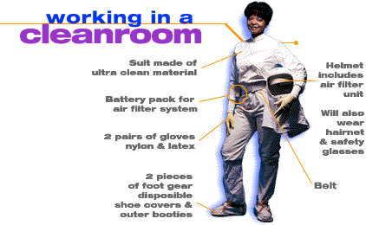

Slide 20
Fabrication Technology
The seven main steps to make an integrated circuit (IC):
Planarize
Photolithography
Doping
Annealing
Grow SiO₂
Deposit metal
Bond
Each step or series of steps may be repeated many times in different combinations to produce the complicated structures found in modern microprocessors.
The following slides describe each step.
Please note that these slides are to give you an overview of the process. The actual process are secret to the various manufacturers

Slide 21
1. Planarization
Before a mask can be applied, the surface needs to be exceptionally smooth so that ions can be implanted at precise depths. The process of making the surface smooth is called planarization (sometimes called chemical-mechanical polishing), and it normally involves a combination of chemical etching and mechanical grinding（研磨）.
We are grinding something so smooth that the greatest bump should be no more than the minimum device geometry.
So for a 0.1μm process, the bumps are to be smaller than 0.1μm. This is tiny compared to the size of the wafer: at this ratio, if the bumps were 1m high, then the wafer would be the size of the earth!

Slide 22
Wafer Polishing CMP
A process called chemical mechanical polishing (CMP) is performed on the wafers to improve their planarity and ensure that all the wafers are of the same thickness.
Here the wafer is held in a rotating holder and pressed onto a rotating polishing pad. Slurry（悬浮液） and water are added to create an abrasive （有研磨作用的） medium which slowly and evenly （均匀的）grinds and smoothens down the surface of the wafer.

Slide 23
Wafer Polishing CMP
The slurry used is typically silica particles in a sodium hydroxide solution (NaOH).
The particles have diameters of less than 100Å so that scratches and gouges are not an issue.
After polishing the wafers are cleaned using a mixture of HCL （hydrochloric acid）, H₂O₂ （hydrogen peroxide）and H₂SO₄ （sulfuric acid）to ensure the surface is contaminant free.

Slide 24
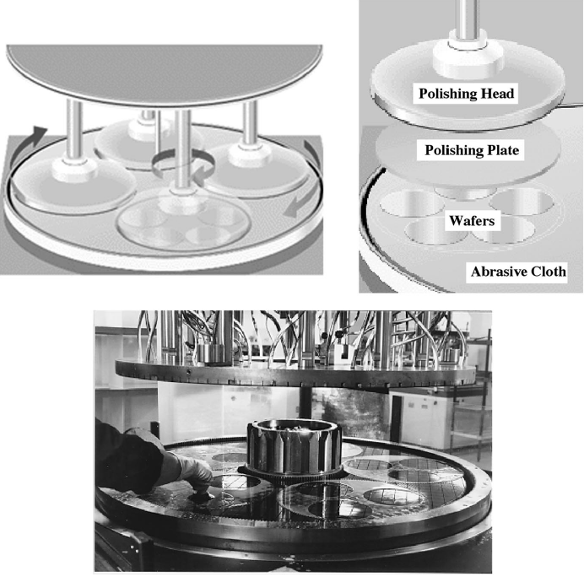

Slide 25
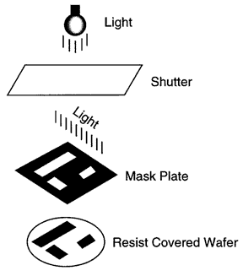
2. Photolithography
The basic principle of photolithography is that a chemical called a photoresist can have its chemical properties changed by exposure to light (or more commonly UV, but now tending to even smaller wavelengths). This change in the photoresist makes it either
resistant to removal by an organic solvent. (negative photoresist)
Susceptible to removal by a solvent (positive photoresist)
Which parts of the wafer are exposed to the light is controlled by shining the light through a colored mask, protecting some areas, exposing others.
Notes:
正胶-光照后容易被洗掉

Slide 26
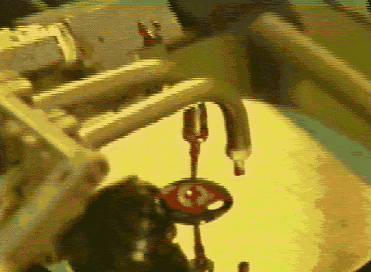
Photolithography
Before applying the photoresist, a layer of silicon dioxide (SiO₂)is grown (details later) to act as a barrier and to protect the wafer beneath.
The photoresist is applied as a liquid onto the spinning disk, and the centrifugal force（离心力） spreads it out evenly.
After exposure to the light, the photoresist is washed. Assuming negative photoresists, the photoresist exposed to the light remains after being washed by the solvent.
The wafer is then baked, hardening the photoresist.
Acid (normally HF) is applied, as before, using the spinning technique, which eats the SiO₂ to reveal holes in the photoresist leading to the wafer.
The photoresist then acts as a barrier, a protector, to anything that we try to apply to the silicon. This allows us to treat the entire wafer as one, knowing that after using the photoresist only the exposed areas will be affected.
Every time we make a modification to the silicon structure, add P type doping, add N type, add metal, we perform an additional cycle of
apply photoresist
expose to light source
remove photoresist
bake

Slide 27
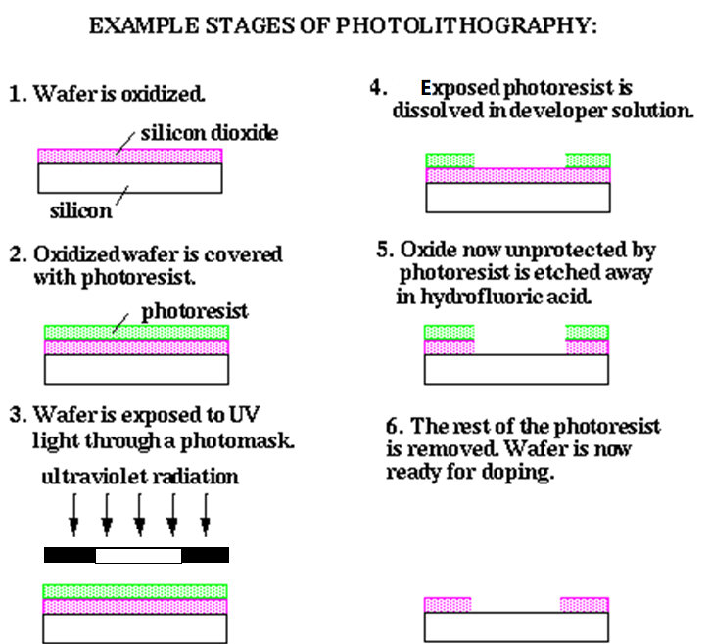

Slide 28
3. Doping
After baking the photoresist, there are now holes in the protective layer through which we can access the silicon beneath.
One of the most important tasks is to add dopant. This lets us change the lightly doped bulk material (e.g. p type) to n and maybe later back to p again.
There are two techniques for doing this: diffusion implantation and ion implantation.

Slide 29
Diffusion implantation
In diffusion implantation, the wafer is placed inside a heated furnace, heating the wafer to approximately 1000ºC. A gas containing the dopant is passed over the heated wafer.
At these temperatures, the dopants can diffuse into the silicon as the heat has weakened the crystalline bonds of the silicon.
The doping is greatest at the surface and then diffuses into the material with a gaussian distribution. However, the dopant diffuses not only down into the material, but also sideways, under our protected regions. This is the great weakness of this approach: sharp changes in doping are hard to obtain, so device sizes have to be big enough to accept that the edges may be blurred a little.

Slide 30
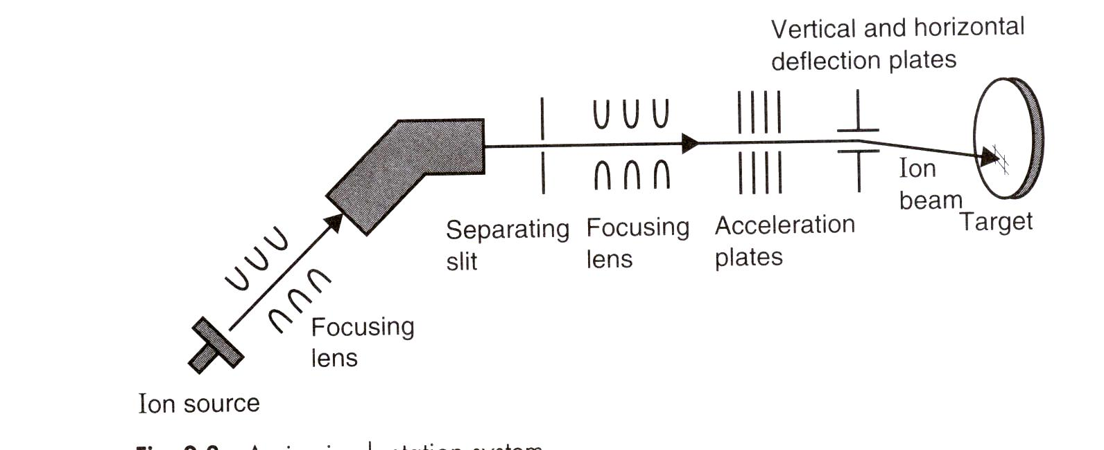
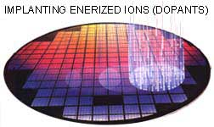
Doping
(b) Ion Implantation
The other technique, ion implantation, involves bombarding the surface of the wafer with dopant ions. In the photoresist+SiO₂ covered regions, the ions are absorbed by these materials. In the unprotected regions, the high-energy ions enter the wafer.
This process can be very tightly set, as the depth of doping and the quantity of doping can be independently controlled. The depth of the dopants depends primarily on the energy of the ions, how fast they impact, and the quantity we send at the wafer.

Slide 31
Doping
The other great benefit of ion implantation is that sideways diffusion of the dopants is a lot smaller than with the diffusion approach. Two problems arise from ion implantation, however:
1. Lattice Damage
The high energy impacts of the dopant ions can distort and damage the crystalline lattice structure of the silicon. Each of these dopant atoms hits a silicon atom at high speed, moves it and takes its place, hence the damage. In this shape, it’s not very useful as a semiconductor.

Slide 32
2、Narrow Doping Profile
Unless you vary the kinetic energy of the dopants, which you won’t, most of the dopants will penetrate on average the same distance into the silicon, resulting in a highly doped band under the surface of the wafer.
The solution to both of these problems is annealing.

Slide 33
4. Annealing
Annealing is the process of heating the silicon up to where the lattice structure begins to weaken, about 1000ºC. It’s left there for 15-30 minutes. The heat vibrates the atoms, and the bonds in the crystalline structure realign themselves in their most stable form.
This corrects any lattice damage and encourages the diffusion of any bands of concentrated dopants. This is good when allowed to happen for just a little while, but if left too long in this heated stage, then all the p and n type dopants continue to diffuse until you lose all structure!

Slide 34
Annealing is only done after all processing steps have been completed. Repeated annealing would encourage the diffusion of all the earlier steps.

Slide 35
Annealing
Dopant Atoms
Silicon Atoms
Dopant Atoms
Silicon Atoms
Post Implant – Pre anneal
Post Implant – Post anneal

Slide 36
5. Growing SiO₂ and Etching
Silicon dioxide SiO₂ is very important in the IC industry as it is an excellent insulator. Being able to grow silicon dioxide is very important.
There are many ways to grow silicon dioxide on the surface of silicon, but it is most often done through a process known as thermal oxidation. Thermal oxidation consists of exposing the silicon to oxidizing agents such as water and oxygen at elevated temperatures. This process has good control over the thickness and properties of the SiO₂ layer.

Slide 37
SiO₂ can always be grown. Oxidizing a p-type region, an n-type region or an intrinsic region will produce a SiO₂ region. It doesn’t matter to an insulator if it has some p- or n-type impurities.
After the photolithography stage, the exposed silicon dioxide layer may be removed by etching. There are 2 types of etching:
Wet Etching
Dry Etching

Slide 38
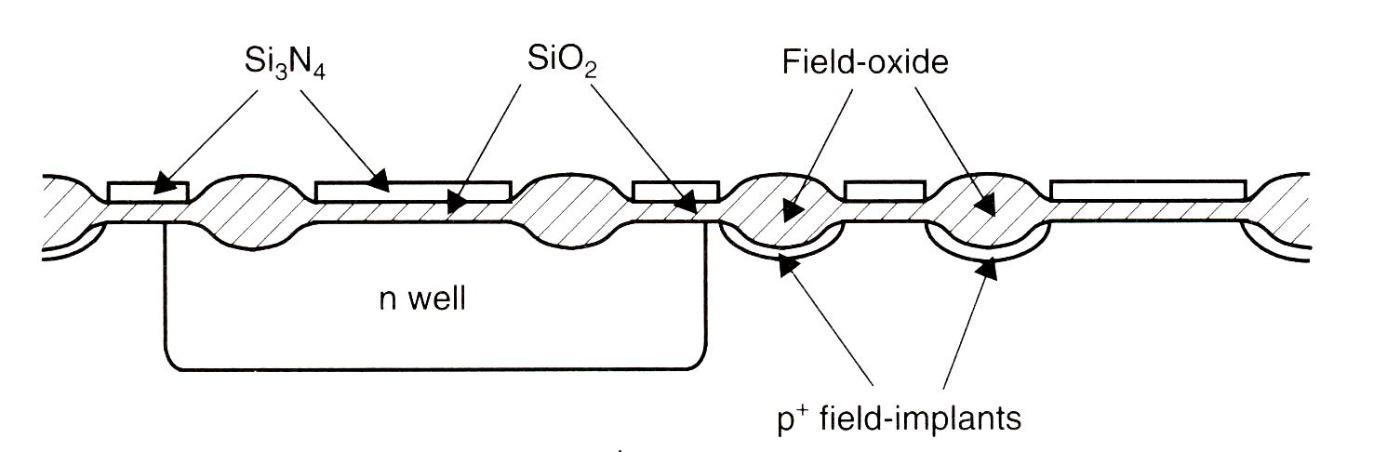
Growing SiO₂
Oxidation makes the silicon oxide grow in volume compared to the pure silicon, a factor of 2.2, so in cross-sectional views, you’ll see a bulge due to the SiO_{2.}

Slide 39
5. Growing SiO₂ and Etching
Etching is the process whereby unwanted material is removed from a wafer.
The material removed can be metal, an insulator, polymers or defects.
There are 2 processes within the fab which allow us to get rid of this unwanted matter.

Slide 40
Wet Etching
Here the wafers are immersed in a chemical bath.
The chemical reacts with the surface of the wafer removing all the un-necessary film.
Dry Etching
In this process the wafers are placed into a vacuum chamber
A plasma is produced using gases that can both physically and chemically etch the wafer.
Both wet and dry etching is used throughout the fab. While they both in theory do the same job, the results produced from them are very different.

Slide 41
5. Growing SiO₂ and Etching
 | Wet Etch | Dry Etch
Etch profile | Isotropic – the chemical in the bath etch the same in all directions | Directional – by control on the power, bias and pressure a dry etch can be very directional
Equipment | Can be very basic, doesn’t need to take up much space | Needs to have chambers, pumps, handler units etc.
Processing time | Can immerse all 24 wafers in a lot at one time | Generally one wafer at a time in a chamber
Etch Control | Wafers need to be removed from the etch and dump rinsed to clean off the etchant | Stop the plasma and the etching stops immediately
Material Consumption | Liquid baths that sometimes get dumped after every process step | Gas are run at low pressure and low flow typically, so consumption isn’t too high
Defects | Can have a high number of defects | Tends to be quite clean since the etch is performed under vacuum

Slide 42
Dry Vs Wet Etching
The most significant difference between wet and dry etching is the etch profile
 | Wet Etch | Dry Etch
Etch profile | Isotropic – the chemical in the bath etch the same in all directions | Directional – by control on the power, bias and pressure, a dry etch can be in one direction only
Etchant Direction
Mask
Etchant Direction
Mask
Wafer
Wafer
Wet Etching
Dry Etching

Slide 43
6. Depositing Metal
Metal needs to be very tightly controlled on a chip. If it enters the dopant mix, it would severely damage any attempted doping. Even trace amounts, especially of copper, would be enough to destroy semiconductor action.
We need to connect terminals of devices together with metal. Traditionally, aluminum has been used as it has less tendency to diffuse into the silicon over the operational lifetime of the device.
It is also important to pick a metal with as little resistance as possible, as wires are usually very narrow and can be very long, resulting in a very large resistance.

Slide 44
Depositing Metal
One piece of terminology used in the semiconductor industry is squares.
Consider a piece of wire,
of fixed depth:
d
L
W

Slide 45
Depositing Metal
The depth of a wire in a semiconductor process is fixed, so the equation for resistance is:

Slide 46
where the ratio of L/W is called the number of squares in the wire. The resulting resistance is then given as
R= (resistivity per depth d) × number of squares:

Slide 47
How much resistance?
To visualize what squares mean, consider the wire on the right. Assuming its resistivity is 1Ω per square, then R = 17 Ω.

Slide 48
Depositing Metal
Thin film deposition -
Evaporation systems
Sputtering systems
Wafers
Tungsten Filament
Aluminium Vapour
Aluminium Charge
High Current Source
Evaporation

Slide 49
PVD - Sputtering
Sputtering is a process whereby atoms are knocked off a target in a plasma(ionised gas) and made to land on the wafer. As more of the target lands on the wafer, the layers build up into a thin continuous films.
Ions in the plasma crash into the target knocking off “chunks” of the material
Aluminium Target
These pieces of the target fall onto the wafer.
Plasma
As more and more material lands on the wafer, a thin film is eventually built up.
Wafer
Pedestal

Slide 50
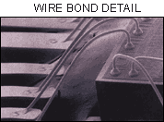
7. Bonding
The last process that a chip undergoes is bonding. Right at the top of the chip big metal pads are added. Thin gold wires are soldered to these; the other ends are brought to the pins of a plastic or ceramic package that will hold the chip, and let us access the silicon device inside.
On chips with lots of pins, bonding becomes very difficult, requiring complicating pin geometries and complex packages. A good example is an Intel processor.

Slide 51
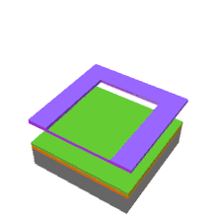
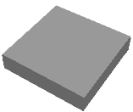
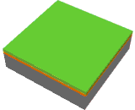
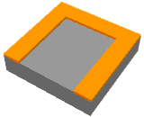
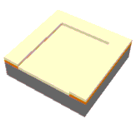
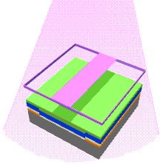
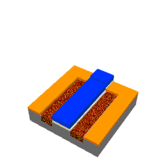
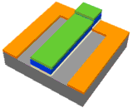
Exposed photoresist is dissolved
Etching of SiO₂
Silicon
With a layer of SiO₂ and photoresist
Mask applied and UV light
SiO₂ layer, and photoresist layer
Photoresist dissolved exposing the polysilicon and silicon dioxide
New mask applied and UV light
Doping

Slide 52
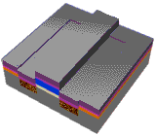
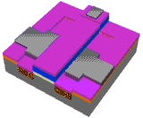
The layering and masking processes are repeated, creating windows that allow for connections to be made between the layers.
Atoms of metal are deposited on the wafer, filling the windows. Another masking and etching stage leaves strips of the metal that make the electrical connections.
Roughly 20 layers are connected to form the microprocessor's circuitry in a three-dimensional structure.

Slide 53
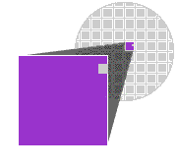
Note: We’ve looked at only a tiny portion of a microprocessor. In reality, making microprocessors is much more complex, demanding more than 250 steps. Consequently, hundreds of identical microprocessors are created in batches on a single wafer.
On the wafer, the microscopic circuitry of each and every microprocessor is tested. Then the wafer is cut with a diamond saw, separating the microprocessors.

Slide 54
[Aside: Multi-Level Chips]
As chip technology has gotten better, more and more layers of metal can be deposited. These layers are separated by SiO₂ to ensure that they don’t short-circuit.
Metal tracks on different layers connect to each other by via’s or contact studs（螺柱）, which are made in the same way as before: make a mask, leave a hole in the oxide and photoresist, fill it with metal, and then proceed with your next layer of metal.

Slide 55
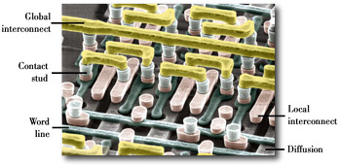
In the figure below, acid has been used to etch away all the oxide, so we can see just the metal tracks, colored for clarity.

Slide 56
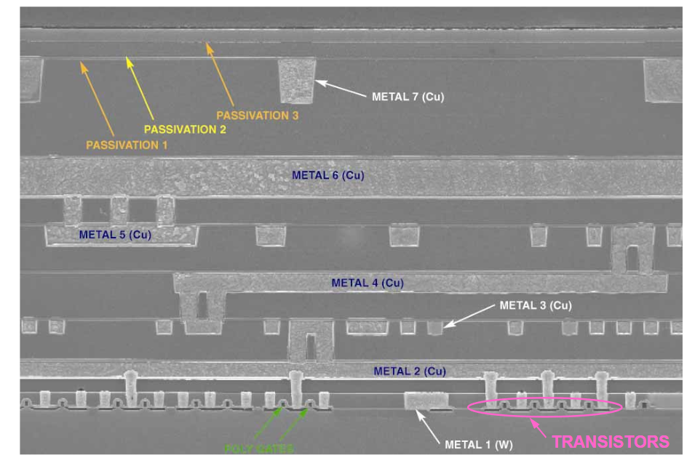
Cross Section of a CPU

Slide 57
Other Materials used in Semiconductor Manufacturing
In lecture 7 you saw images of Silicon, the most commonly used material for semiconductor manufacturing, bur there are others.
The next few slides, for completeness, will shown you these.
We’ll see images for Germanium and GaAs

Slide 58
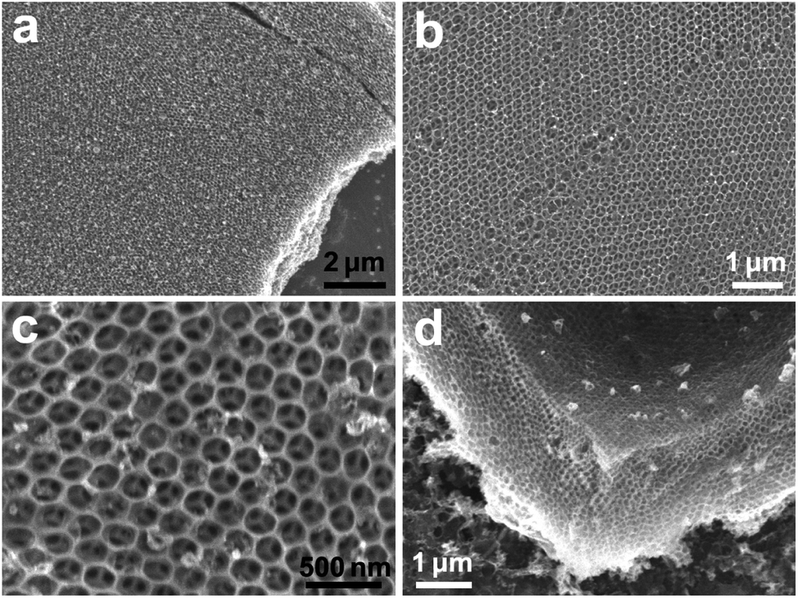
Germanium at different magnification levels, a very regular lattice so very stable.

Slide 59
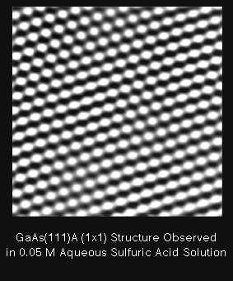
Gallium Arsenide (GaAs)
Sorry couldn’t find one at the level I wanted ☹ but again note the
Very regular lattice

