Slide 1
EE113 BJT Operation
Jinling Yu

Slide 2
Overview
The transistor must surely rate as one of the most important inventions of the twenty century.
There are two basic types of transistor: the bipolar junction transistor, and the field-effect transistor (or FET).
It is worth noting that while the majority of transistors used today are MOSFET (metal-oxide -semiconductor field effect transistor) style, BJT (Bipolar Junction Transistor) is commonly used.
The transistor is capable of performing two functions. Firstly, it can amplify an electrical signal. Secondly, it can be used as a switch, i.e., it has two distinct stable states which correspond to the device being ‘ON’ or ‘OFF’.

Slide 3
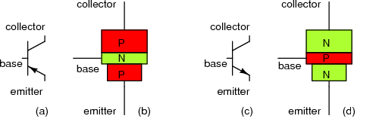
BJT Circuit Symbols, Types
and (c) are the circuit symbols for the BJT types. You need to know these, without the names attached.
The emitter always has the arrow, the collector is always on the same side as the emitter, the base is always on its own.

Slide 4
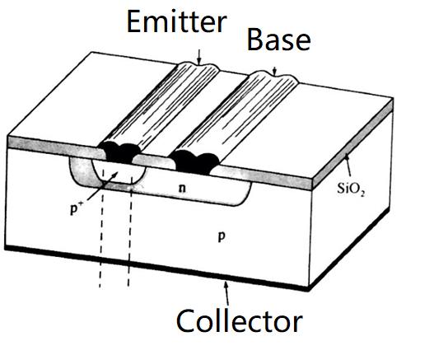
A diagram for the p-n-p BJT

Slide 5
Bi-Polar Junction Transistors (BJT)
This is a direct follow-on from the simple diode but it has three connections instead of the two that a diode has.
It is made of P and N material but is a sandwich style construction and will be either a PNP or a NPN setup.
It is a three-terminal device, that is it needs three connections to function, unlike the diode which needs only two connections.
The three connections are called the EMITTER (发射极）, the BASE （基级） and the COLLECTOR （集电极）, and are connected as shown in figure on the pervious slide.
The centre connection is always the BASE. This figure also has the circuit symbols.
Unlike a diode, when the BJT is working on the active mode, one set of the PN junctions is forward biased [BE] while the other set if reversed biased [BC].

Slide 6
BJT Information
BJTs are called bi-polar as there is current flow in 2 PN junctions and the overall current flow is due to both the electrons and holes.
It is a current controlled current source. The current in the base controls the amount of current flowing from the emitter to the collector.
Recall the operation of a PN junction and that it forms a depletion layer which can prevent the flow of current. The base forms a depletion layer on BOTH sides and prevents, or allows charge carriers to pass through.
It requires both the base and the collector-emitter sides to be connected. Adjust the various voltages in the BJT to confirm this.

Slide 7
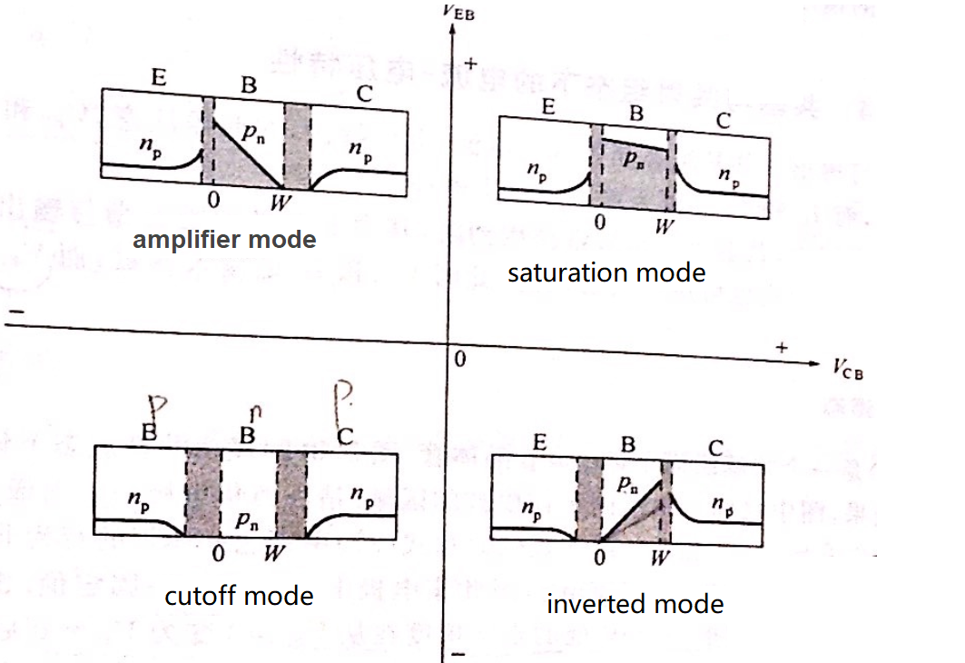
There are four working modes for a BJT

Slide 8
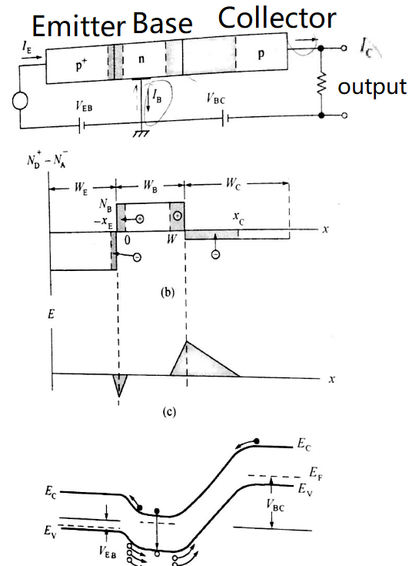
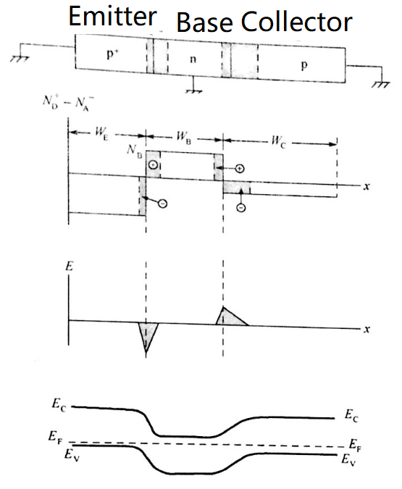
BJT under equilibrium state
BJT working at amplifier mode

Slide 9
At the amplifier mode, the junction between the emitter and the base is now forward biased, whereas the junction between the base and collector is reverse biased.
A significant number of valence holes in the emitter can flow into the base region.
Since the base region is very narrow and the doping concentration is much lower than that of the emitter, only a small proportion of these holes recombine with the electrons in the base. The rest are swept down into the collector.

Slide 10
Each time a hole recombines with an electron in the base region, and it will leave behind an uncompensated positive donor ion.
The positive charge accumulates and so inhibits the flow of holes. But in the transistor an electrical contact is made to the base region. This allows a current of electrons to flow into the base so that the base remains electrically neutral, i.e., the number of electrons drawn into the base exactly compensates those that are lost due to recombination.
I_{E}=I_{B}+I_{C}

Slide 11
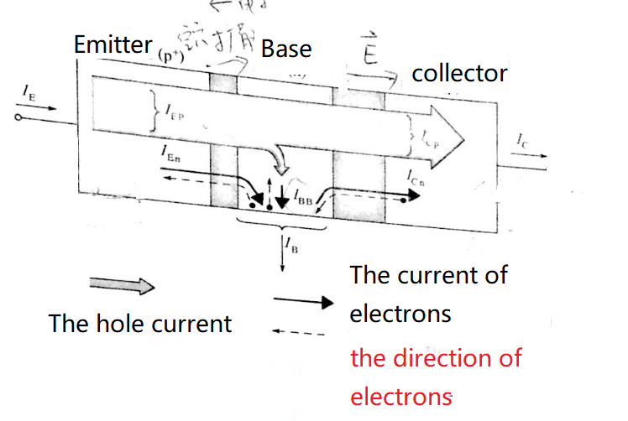
I_{E}=I_{B}+I_{C}
Let us look at the above scenario from a slightly different viewpoint.
Let us suppose that we supply a electric current I_{B} to the base of the transistor. This makes the base negatively charged, and so lower the potential barrier between the emitter and the base, which in turn causes an increased current of holes to flow from the emitter into the base. If we assume that only 1% of the holes recombine in the base, then the electron current from the emitter to the base, I_{E}, must be 100 times larger than I_{B} in order that the base remains neutral.
Consequently, the output current flowing from the collector, IC, is about 99 times larger than the input current to the base I_{B}.
The current gain of the amplifier, β, is defined as the ratio of the change in the output current, ΔI_{C}, to the change in the input current, ΔI_{B}, i.e.,
β = ΔI_{C}/ ΔI_{B}

Slide 12
The bi-polar transistor can therefore be used to amplify an analogue signal, since a small change in the base current produces a corresponding, but much larger, change in the collector current.

Slide 13
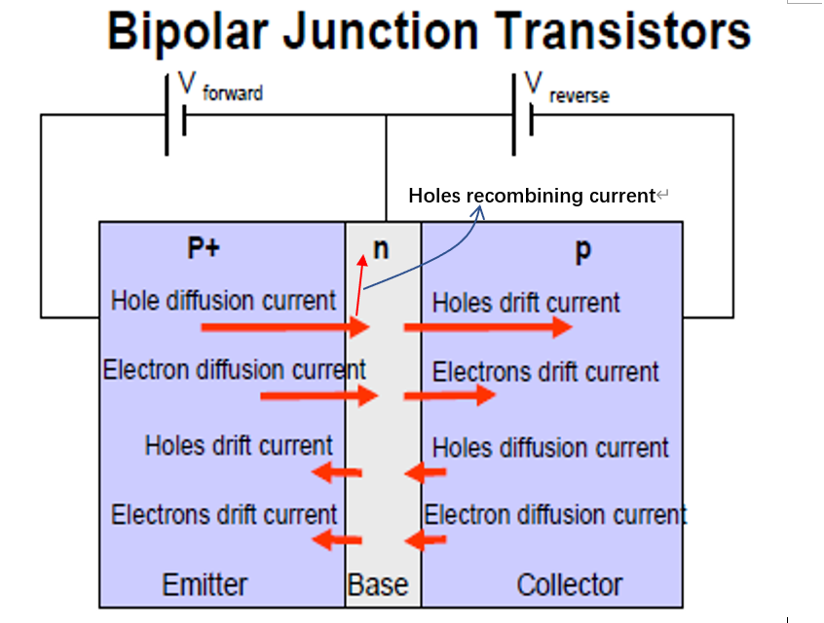
BJT Current Flows – All current Flows
Some of these currents are large and therefore important,
other not so much.

Slide 14
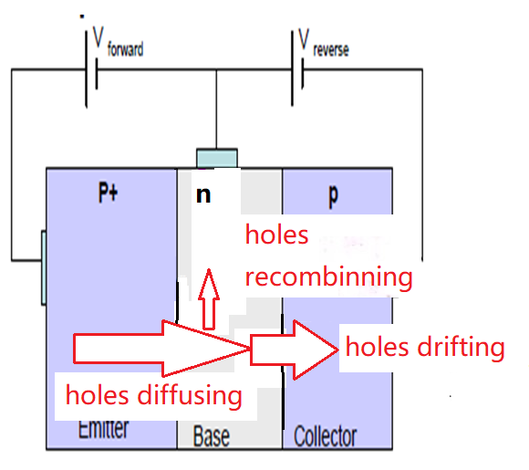
BJT Current Flows – Simplified
We can see that there are 3 main current flows, from the base, from emitter to the base and from the base to the collector.
This is a little different for a NPN setup.

Slide 15
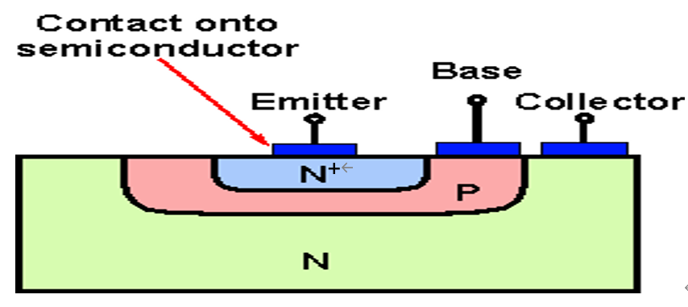
BJT Construction
The construction of a BJT in the semiconductor manufacturing process is a little tricky so we will merely show it in a completed format rather than go through the steps.
Notes:
Compare this to FET and try to figure out how you might make a planar version of this!

Slide 16
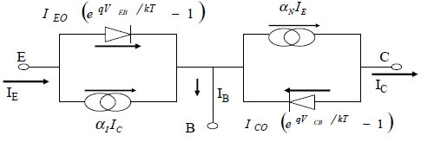
BJT: Ebers-Moll Model
α_{I} is the gain when the emitter is used as an emitter, and the collector is used as a collector.
α_{N} is the gain when the emitter is used as a collector, and the collector is used as an emitter.
As it is a mix of 2 PN junctions we can model a BJT as such.
This is called the Ebers-Moll model and is very often used in simulation packages. You should be aware that the model is limited in its ability to predict BJT behaviour.
Notes:
对于理想BJT(本征晶体管)的EM1模型，实际上是基于正向和反向工作的两个PN结的叠加、并分别用两个p-n结二极管来代表发射结和集电结这样一种概念而建立起来的，即是采用两个二极管(正偏二极管的电流为If，反偏二极管的电流为Ir)和两个电流源(αfIf和αrIr)来表示一个理想的BJT(αf和αr分别是正向和反向电流增益)，这就可给出基本E-M模型的直流大信号等效电路。对于实际的BJT，在本征晶体管模型的基础上，还需要考虑其他一些因素的影响。实际BJT的直流大信号E-M模型需要加上与各个电极相应的串联电阻。而实际BJT的交流大信号E-M模型还进一步增添了两个结的耗尽层电容(CE，CC)和表征Early效应的电流源(电流等于VECIC/VA)。

Slide 17
BJT Operational Regions
BJT’s have 4 regions of operation:
Active Region – where the transistor act as an amplifier and I_{C} = βI_{B}
Saturation Region – where the transistor is fully on, and acts as a switch, and I_{C}= I(saturation), which is the max current that the system can take.
Cut-off- where the transistor is fully off and acting as a switch with I_{C}=0.
Inverted Region- The collector is used as a emitter, and the emitter is used as a collector. This mode is also called inverted amplifier mode.

Slide 18
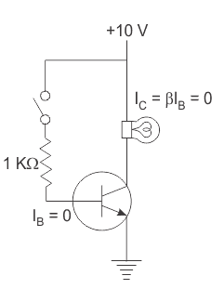
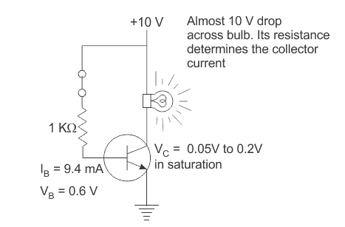
Applications of BJT’s
Switch – a correct signal into base allows current to flow between the collector and emitter.
Open circuit, no voltage to the base,
Very high resistance in the CE section, no light on
Voltage to the base, large current flows in the base.
Resistance in the CE section drops, light goes on.

Slide 19
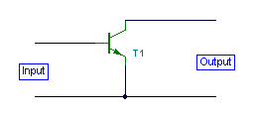
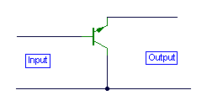
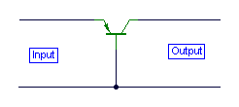
Applications of BJT’s - Amplifiers
3 configuration of the BJT, where one terminal is common to both input and output signal.
You should know the 3 configurations and their advantages.
Common emitter:
Medium input impedance,
Medium output impedance,
High voltage gain,
Hight current gain.
Common Base:
Low input impedance,
High output impedance,
High voltage gain,
Unity current gain
Common collector:
High input impedance,
Very low output impedance,
Unity voltage gain,
High current gain.

Slide 20
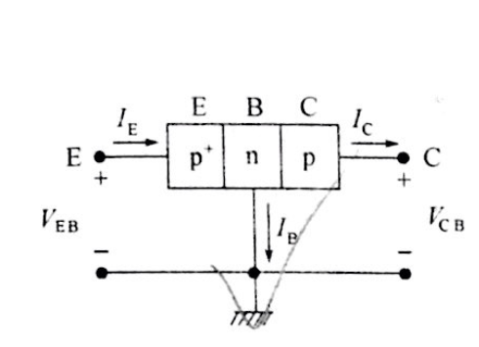
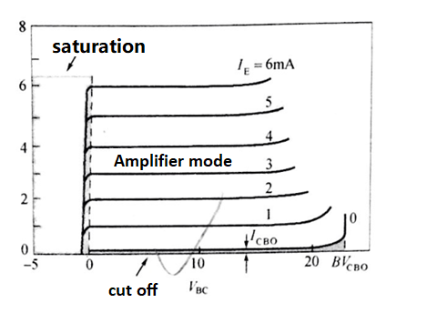
Common Base:
Input: I_{E}
output: I_{C}
I_{C}
Amplifier mode: The junction between the emitter and the base is now forward biased, and the junction between the base and collector is revised biased. V_{EB}>0, V_{BC}>0
Cut-off mode: The junction between the emitter and the base is now reversed biased, and the junction between the base and collector is revised biased. V_{EB}<0, V_{BC}>0
Saturation mode: The junction between the emitter and the base is now forward biased, and the junction between the base and collector is forward biased. V_{EB}>0, V_{BC}<0
Notes:
The junction between the emitter and the base is now forward biased. 输入阻抗小，因为是正向偏置。输出阻抗大，因为是反向偏置

Slide 21
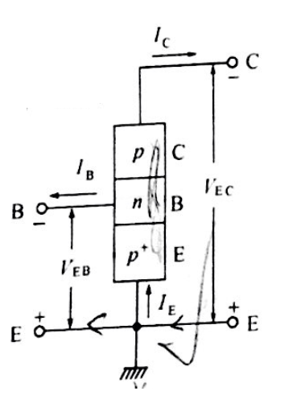
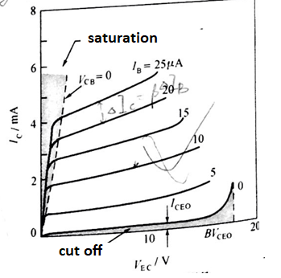
Common emitter :
Input: I_{B}
output: I_{C}
V_{EC}=V_{EB}+V_{BC}
V_{BC}=V_{EC}-V_{EB}
Amplifier mode: The junction between the emitter and the base is now forward biased, and the junction between the base and collector is revised biased. V_{EB}>0, V_{BC}>0
Cut-off mode: The junction between the emitter and the base is now reversed biased, and the junction between the base and collector is revised biased. V_{EB}<0, V_{BC}>0
Saturation mode: The junction between the emitter and the base is now forward biased, and the junction between the base and collector is forward biased. V_{EB}>0, V_{BC}<0

Slide 22
Early effect: The Early effect, named after its discoverer James M. Early, is the variation in the effective width of the base in a bipolar junction transistor (BJT) due to a variation in the applied base-to-collector voltage. A greater reverse bias across the collector–base junction, for example, increases the collector–base depletion width, thereby decreasing the width of the charge carrier portion of the base. As a result, the gradient of the minority carrier density in the base region is increased, leading to larger diffusion current. Therefore, the gain is also increased.

Slide 23
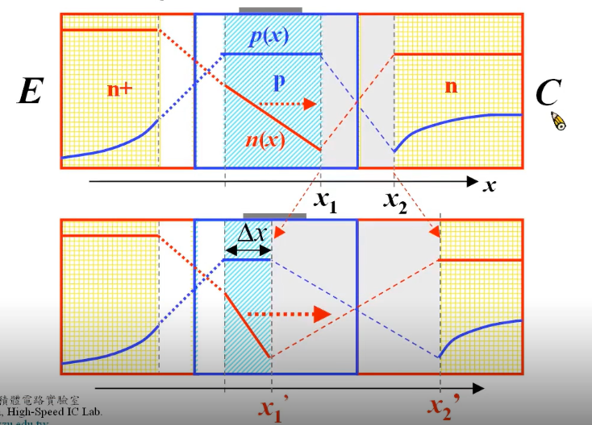
Smaller V_{EC}
Larger V_{EC}

Slide 24
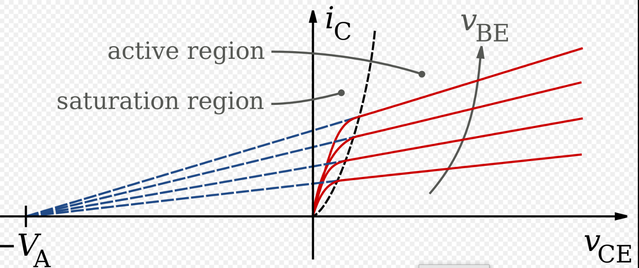
Due to Early effect, the increase of V_{EC} will lead to the increase of I_{C}.

Slide 25
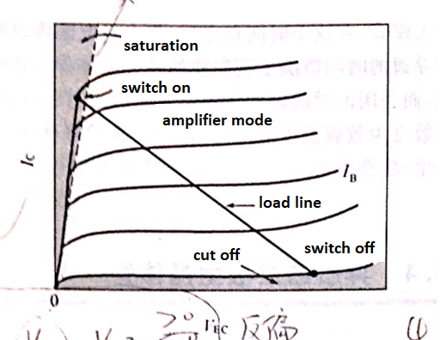
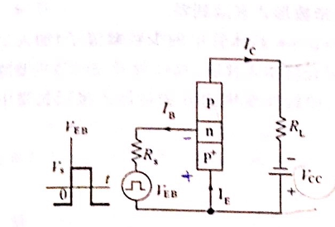
BJT used as a switch
V_{EC}=V_{EB}+V_{BC}
V_{BC}=V_{EC}-V_{EB}
Switch off (Cut-off mode): The junction between the emitter and the base is now reversed biased, and the junction between the base and collector is revised biased. V_{EB}<0, V_{BC}>0
Switch on (Saturation mode): The junction between the emitter and the base is now forward biased, and the junction between the base and collector is forward biased. V_{EB}>0, V_{BC}<0

Slide 26
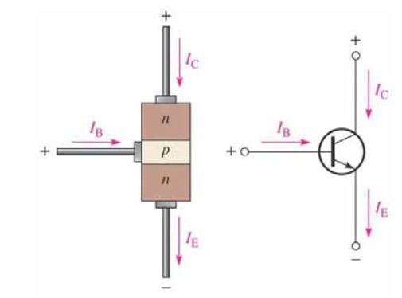
BJT Current equations:
The following equations are the basis for BJT operation:
I_{E} = I_{C} + I_{B}
α = I_{C} / I_{E}
β = I_{C} / I_{B}

Slide 27
BJT – Issues and Nonidealities
All of the equations of operation of the BJT are for ideal circumstances, we need to be aware of the 4 main nonidealities can cause problems.
Base Narrowing – this is when the width of the base shrinks in size due to the depletion regions getting bigger when voltage is applied to base and collector-emitter circuits. This will cause a limit to the amount of current that can flow. It can also cause something called ‘Punch-Through’ which leads to the removal of the amplification effect.
Notes:
第二个限制机制是base punch through。当集电极－基极耗尽区穿过基区和基极－发射极的耗尽区重叠时就会发生punch through。这个一旦发生，载流子就能直接从发射极流到集电极，这时电流就只受neutral collector和发射极的电阻的限制。

Slide 28
BJT – Issues and Nonidealities
Thermal Runaway – this is where current flowing in the collector heats the BJT. This increases the amplification factor, which causes more current to flow. This leads to more heat and continues until the device is destroyed. It can be prevented by placing a resistor between the emitter and ground.

Slide 29
BJT – Issues and Nonidealities
Avalanche Failure – same as a diode, too large a reverse bias voltage will cause current to flow due to impact ionisation – in simple terms the field drags the charges across the depletion layer by brute force.
Parasitic Elements – not sure much an issue for discrete devices but for multiple BJTs on an IC. The simple presence of other components can cause issues for the performance of a single BJT.

Slide 30
Practice
1、Draw the energy diagram of a p-n-p BJT under the equilibrium state.
2、What are the 2 configurations of BJT’s? Give the correct circuit symbol for each of them.
3、What are each of the connections on a BJT called?
4、What controls the current flow in a BJT?
5、Draw a labelled diagram of the Eber-Moll model of a BJT
6、Explain what “base narrowing” is in a BJT.

