Slide 1
EE113 Field Effect Transistors (FET)
Jinling Yu

Slide 2
Field Effect Transistors – FET’s
Please note that what follows is a summary of the working of FET, Field Effect Transistors, with an emphasis on the JFET and MOSFET
Main types of FET’s – you do not need to know the details of the operation of the FET’s listed below merely that there exist. We will look at the bolded ones in detail.
There are some equations in this section however there are NO derivations of those equations. So, don’t worry ☺.
JEFT – Junction Field Effect Transistor.
MESFET – Metal-Semiconductor Field Effect Transistor.
MOSFET – Metal-Oxide-Semiconductor Field Effect Transistor.
IGFET – Insulated Gate Field Effect Transistor.
MISFET – Metal-Insulator-Semiconductor Field Effect Transistor.

Slide 3
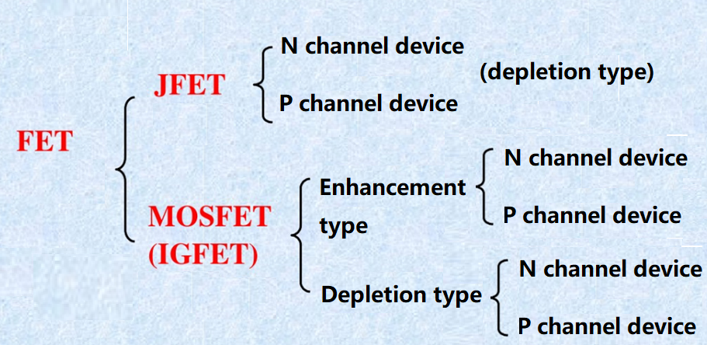

Slide 4
The Junction Field Effect Transistor - JFET
Simplest FET around.
FET’s are unipolar devices, that is the current is due to one type of carrier.
3 terminal device consisting of a DRAIN, SOURCE and GATE. It is a voltage controlled current device.
Made of a sandwich of 3 layers – the top and bottom layers are the same while the centre is different.
The top and bottom layers are connected together. This is known as the GATE.
Current flows though the Drain – Source CHANNEL.
In N-Channel type FET’s, the electrons carry the current.
In P-Channel type FET’s, the holes carry the current.

Slide 5
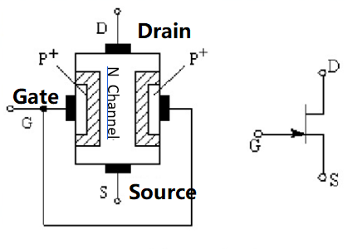
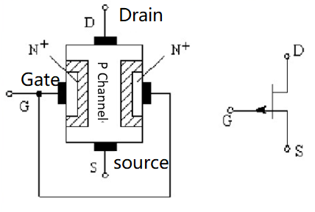
Structure of JFET
N channel JFET
P channel JFET

Slide 6
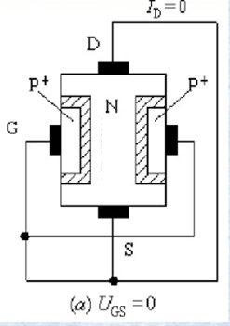
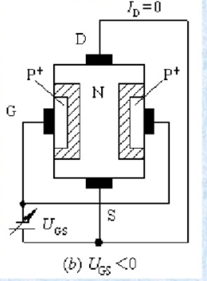
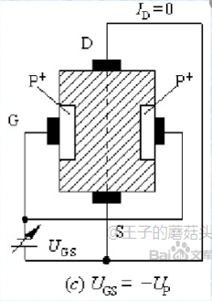
Working principle: the control of channel by V_{GS}
For I_{D}=0, If V_{GS} <0, the depletion width of the two junctions will increase, which will narrow down the channel.
If the reverse bias V_{GS} is so large that the channel between source and drain is blocked off. This is called PINCH-OFF. The pinch-off voltage can be denoted as V_{p.} For N channel JFET, V_{p}<0.

Slide 7
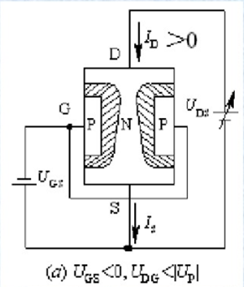
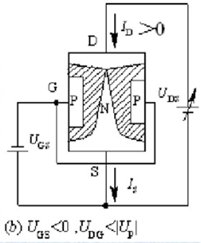
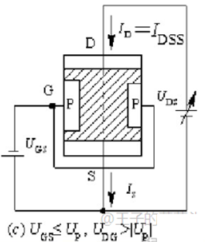
Working principle: when there are both V_{GS} and V_{DS}
(a) Not pinch-off, V_{GS}<0, V_{DG}<|V_{P}|
(b) pinch-off begins, V_{GS}<0, V_{DG} =|V_{P}|
(c) Totally pinch-off, V_{GS}≤V_{P}, V_{DG} >|V_{P}|

Slide 8
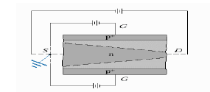
JFET Operation
As this is a PNP device it has TWO depletion layers!
Recall that depletion layers are formed when P and N materials come into contact with each other.
Recall also that the width of the depletion layer can be changed, increased or decreased, depending in the voltage that is
applied to the junction.
In the JFET, the gate is to control, in effect, the width of the depletion layer.
If the gate is 0 V (V_{GS}=0 V) with a voltage applied to the source and drain channel, current will increase linearly with the drain voltage V_{DS}.
If a reverse bias voltage is connected to the gate, i.e., the p-type material, then the width of the depletion layer increases. Compared to V_{GS} = -0 V, the current is decreased for the same V_{DS}.
If the reverse bias is so large that the channel between source and drain is blocked off, the current become saturated. This is called PINCH-OFF.

Slide 9
Characteristics
(1) There is only one type of carriers which contributes to the current, so the FET is also called “one-polar transistor”.
(2) The gate and the channel is reversed biased, which will result in large input impedance.
(3) JFET is a voltage controlled current device. I_{D} is controlled by V_{GS}.
(4) Before Pinch-off, I_{D} increases almost linearly with V_{DS}; After Pinch-off, I_{D} is saturated.

Slide 10

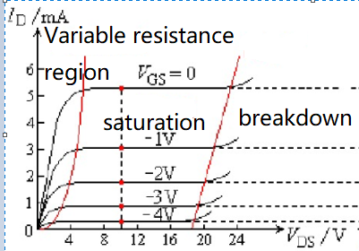
output characteristic curve
As the |V_{GS}| increases, the FET will pinch off at lower V_{DS}, and the I_{D} decrease for the same V_{DS}.

Slide 11

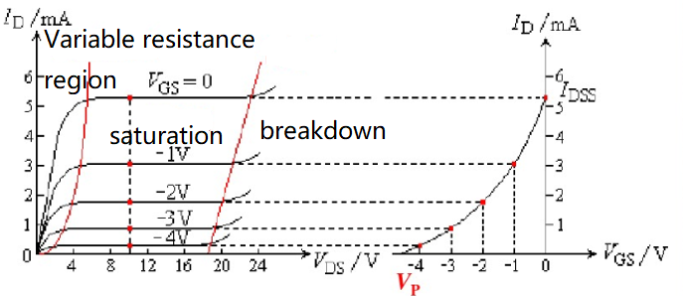
Transfer curve of FET

Slide 12
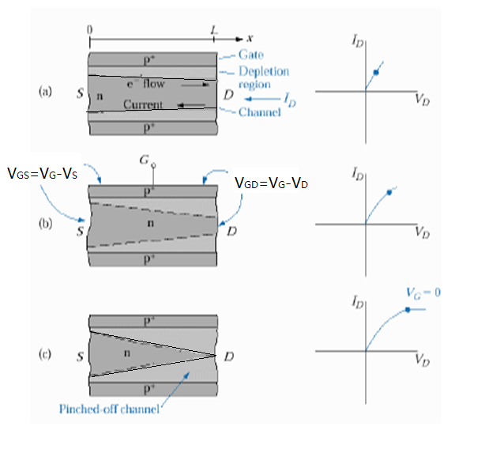
JFET Operational Regions
3 areas of operation:
(a) When V_{DG}<< |Vp|, the I_{D} current linearly increase with V_{D}
(b) When V_{DG}<|Vp| but is close to |Vp|, the current I_{D} tends to saturate.
(c) When V_{DG}=|Vp|, the channel pinches off, the current I_{D} is saturated.
由于电子在耗尽区内的飘移速度已达到饱和速度，不再随着电场的增大而增大，所以漏极电流达到饱和。
Notes:
由于电子在耗尽区内的飘移速度已达到饱和速度，不再随着电场的增大而增大，所以漏极电流达到饱和。

Slide 13
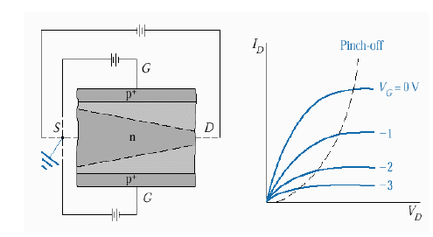
JFET Operational Regions
The figures across and the previous slide, show graphically how the current flow changes depending on the voltage applied to the gate and / or to the DS junction.
What is important here is that the point at which the channel is pinched-off can be determined via an equation! This voltage is called, naturally enough, the PINCH-OFF VOLTAGE, Vp.
It depends almost solely on the WIDTH of the depletion layer. The base formula for this width calculation is that of a standard PN junction; find it in the PN section notes.

Slide 14
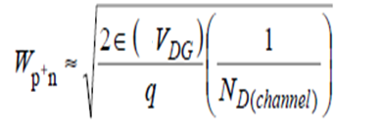
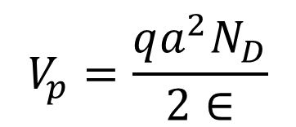
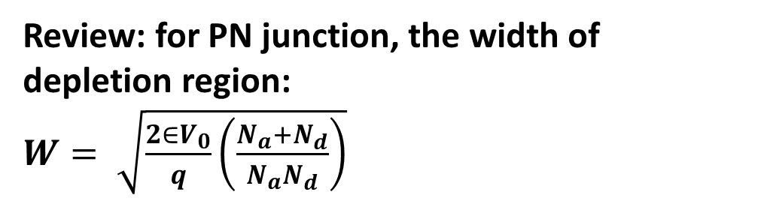
JFET formulas
This describes source voltage in terms of the drain current and channel resistance, just a direct application of Ohm’s Law
Here V_{D} is the voltage of drain.
This describes the width of the JFET channel depending on applied gate voltage.
This describes the pinch off voltage.
Here a is the thickness of the channel.
You need to be able to use these equations.
V_{S} = V_{D} – I_{D}R_{CHANNEL}
$$V_{p}=\frac{qa^{2}N_{D}}{2∈}$$
Review: for PN junction, the width of depletion region:
$W= \sqrt{\frac{2∈V_{0}}{q}\left(\frac{N_{a}{+N}_{d}}{N_{a}N_{d}}\right)}$

Slide 15
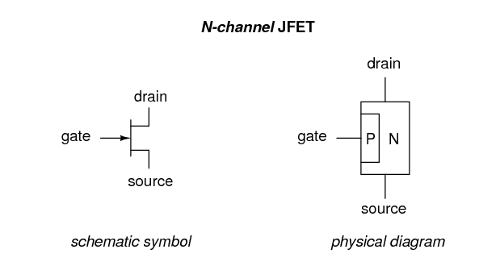
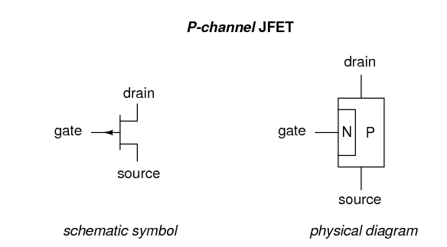
FET Circuit Symbols, Types

Slide 16

多选题
10分
For JFET, which of the following states is correct
A
Only one type of carriers contribute to the current.
B
Two types of carriers contribute to the current.
C
It is a voltage controlled current device.
D
It is a current controlled current device.
提交

Slide 17
填空题
10分
The full name for JFET is [填空1]
正常使用填空题需3.0以上版本雨课堂
作答

Slide 18
主观题
10分
Draw a fully labelled diagram of JFET and briefly explain how it functions.
正常使用主观题需2.0以上版本雨课堂
作答

Slide 19
主观题
10分
For a JFET, show what happens the drain current, I_{D}, as both gate voltage, V_{G} and drain voltage, V_{D}, are varied.
正常使用主观题需2.0以上版本雨课堂
作答

Slide 20
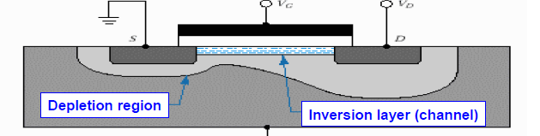
MOSFET – most common type of FET
The schematic diagram of a MOSFET

Slide 21
Characteristics of MOSFET
It has 3 main parts:
The GATE, where the controlling voltage is applied and is either metal or a heavily doped semiconductor.
The insulation layer which is directly under the gate and insulators the gate from the current channel.
The bulk material, also known as the substrate, (the wafer) and is where the channel is formed. It is lightly doped.
The source and drain are doped and are of a dopant that is opposite to that of the bulk material. Therefore a depletion region forms, which are indicated by the greyish areas.

Slide 22
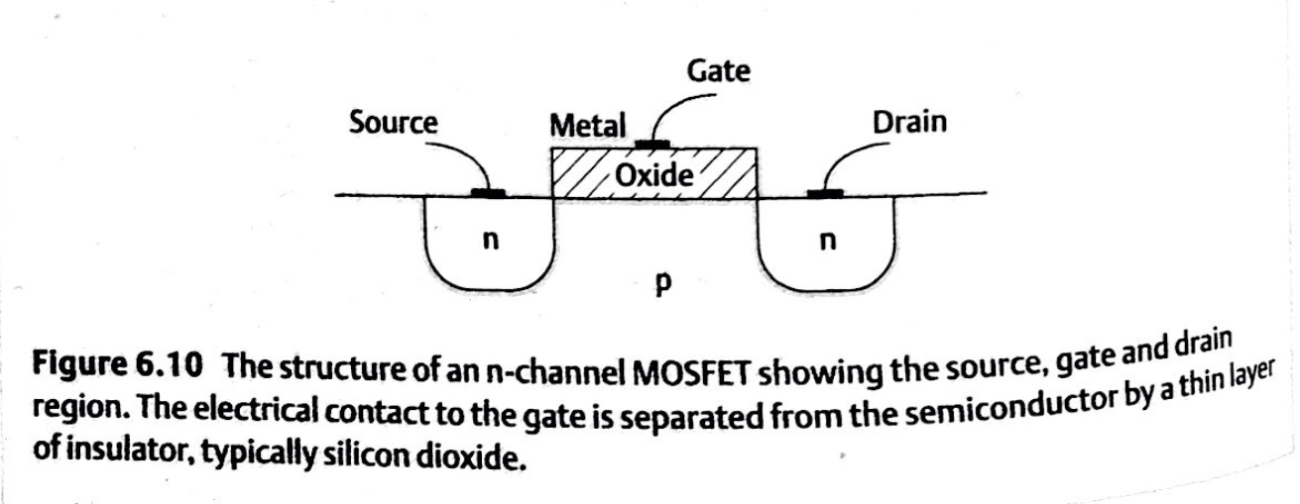

Slide 23
There are 2 types of MOSFET’s：
Enhancement – where the voltage on the gate attracts
carriers to the underside of the oxide from the bulk material
, making a inversion layer, which cause current to flow.
So Gate voltage ON to allow current to flow.
Depletion – where the application of gate voltage STOPS
the current flow.
It is important to note that the channel name is the type of
carrier that carry's the current.
Hence a N-Channel are electron and the bulk material would
be a P-type

Slide 24
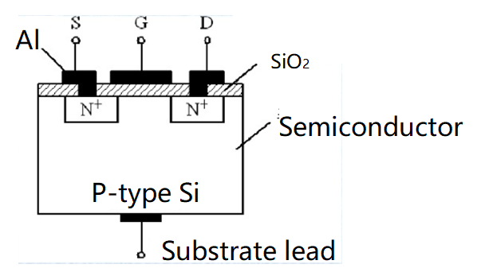
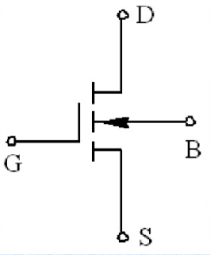
Enhancement-type N-channel MOSFET

Slide 25
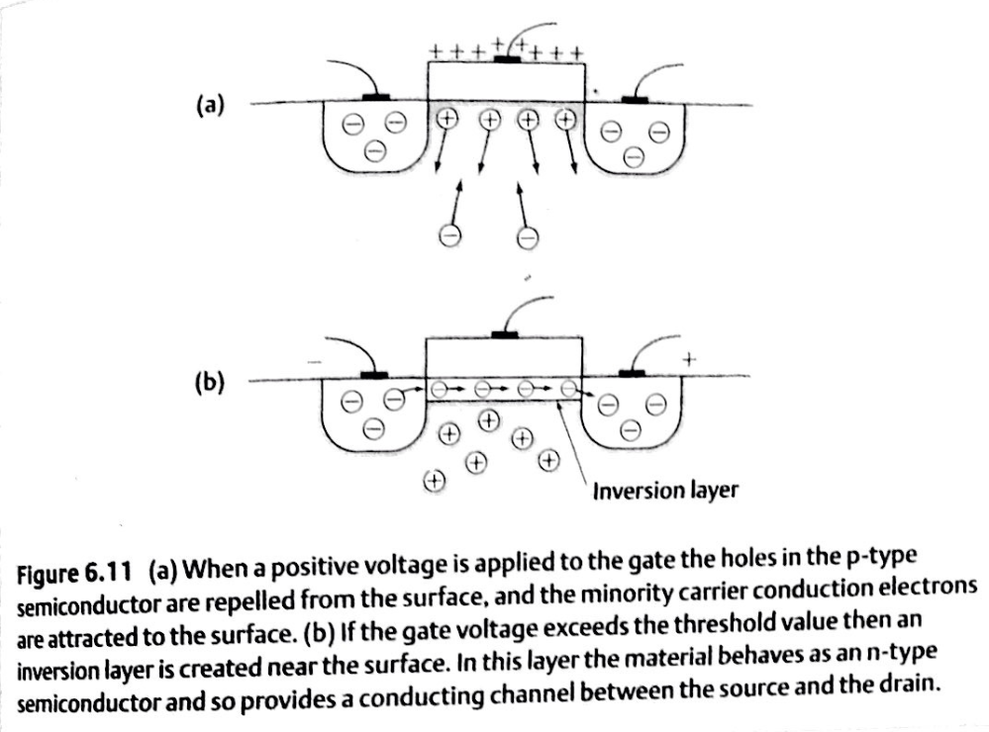

Slide 26
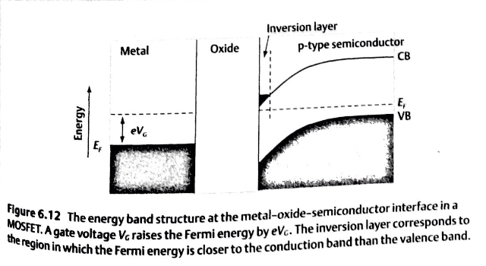
Energy diagram for the Enhancement-type N-channel MOSFET under positive gate voltage

Slide 27
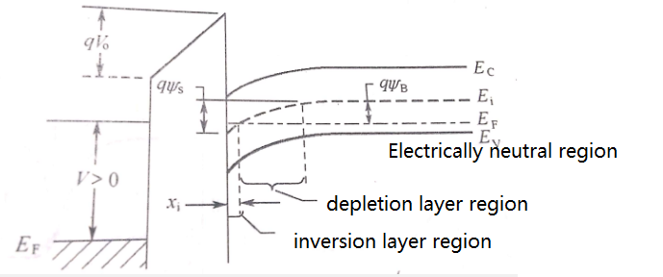

Slide 28
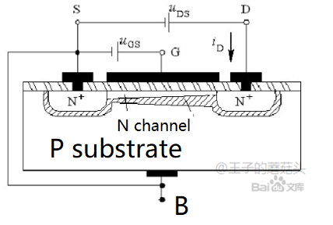
When V_{GS}>V_{T,} we find that there is a region close to the surface in which the concentration of conduction electrons exceeds the concentration of holes. In other words, although the material is doped with acceptors, it behaves as though it is an n-type semiconductor. This region is known as an inversion layer.
Here V_{T} is the threshold voltage.
So V_{GS}>V_{T,} an inversion layer presents, which provides a channel for carriers to flow from drain to source.

Slide 29
MOSFET – How does it work?
Let us discuss n-channel enhancement MOSFET’s.
So how does the channel form to allow current to flow?
As a positive voltage is applied to the gate, it attracts free carries from the bulk material to the underside of the oxide layer.
When enough charge carriers are present, it overcomes the charge of the bulk layer, thus the charge here is INVERTED.
This allows a conductive channel between the source and drain. As the gate voltage increases then the size of the channel increases.

Slide 30
MOSFET – How does it work?
Remember that the conductive channel is still resistive, and this means that the voltage will drop as you move across this channel (Remember the JFET voltage drop equation?). This means that the width of the channel will vary as you move across the channel.
When the absolute value of the voltage between the gate and drain gets larger than a certain value (that is the threshold voltage) then the conductive channel is pinched-off. Remember what happened to the current flow in a JFET?
The JFET voltage drop equation: V_{S} = V_{C} – I_{D}R_{CHANNEL}

Slide 31
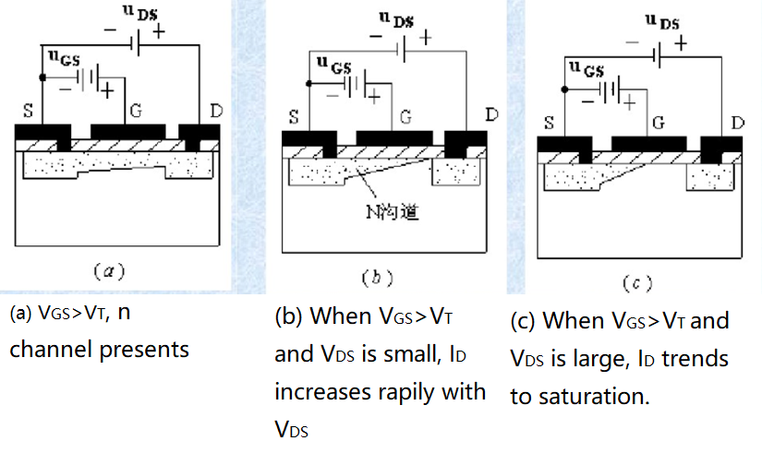

Slide 33
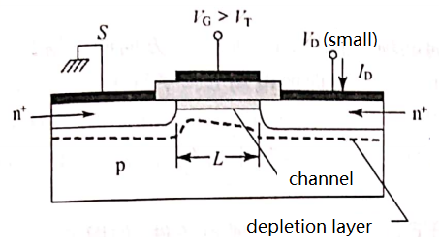
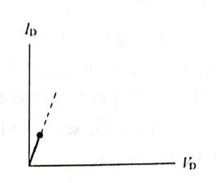
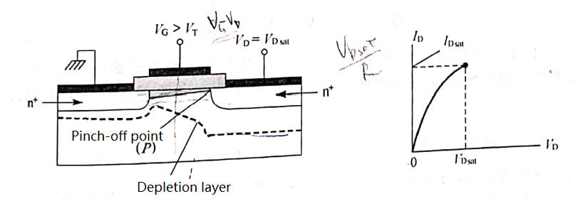
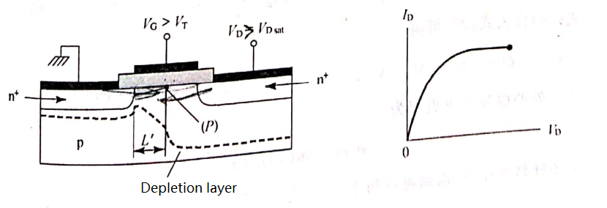
V_{G}>V_{T}, and V_{D} <<V_{sat}
(that is V_{G}>V_{T} and V_{GD}>>V_{T})
I_{D} increases linearly with V_{D}.
V_{G}>V_{T}, and V_{D} = V_{sat}
(that is V_{G}>V_{T} and V_{GD}=V_{T})
The channel pinches off,
and the source drain current
I_{D} begins to saturate.
V_{G}>V_{T}, and V_{D} > V_{sat}
(that is V_{G}>V_{T} and V_{GD}<V_{T})
The channel is narrowed down,
and the source drain current
I_{D} saturates.

Slide 34
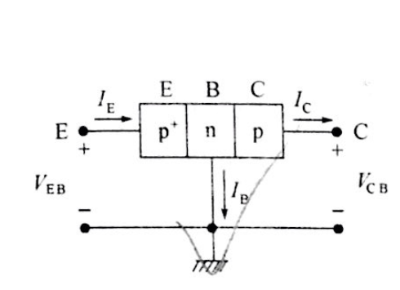
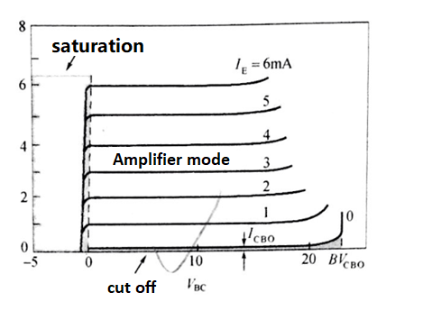
Comparisons between BJT and MOSFET

Slide 35
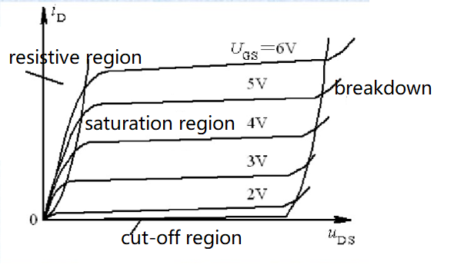
Output characteristic curve for Enhancement-type N-channel MOSFET

Slide 36
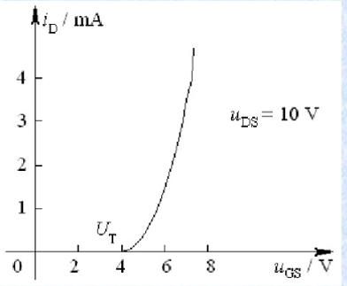
Transfer curve for Enhancement-type N-channel MOSFET
When V_{GS}>V_{T,} n-channel presents, and currents can flow through this channel.
As the V_{GS} increases(V_{GS}>V_{T}）, the width of the n-channel increase, and the concentration of electrons in the n-channel increases, leading to rapid increase of I_{D}.

Slide 37
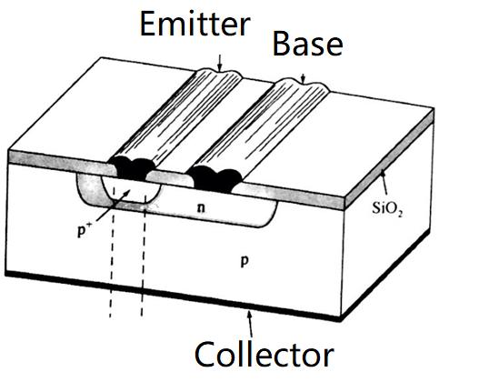
Most important difference between MOSFET and JFET or BJT’s
The most important difference here, compared to JFET or BJT’s, is that there is NO direct physical connection from the controlling part, the GATE, to the current channel.

Slide 38
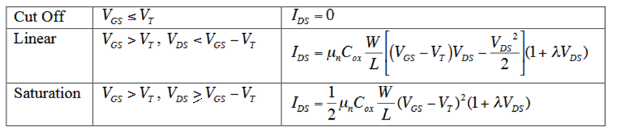
Equations for the enhancement-type n-channel MOSFET
A little more complicated than the JFET or BJT, mainly due to the effects of the capacitance layers that are formed.
V_{GS}-V_{DS}=V_{GD}
So the lamda, λ, in the equation is a device parameter with units of V⁻¹, and is related to something called the Early voltage. It is very small so for day to day use you can ignore it.
C_{ox} is the capacitance, μ_{n} is the mobility of electrons, W is the width of the n-channel, and L is the length of the n-channel. V_{T} is the threshold voltage.
The issue of capacitance, both known and parasitic, are significant issues for FET’s but is outside the scope of this course.

Slide 39
主观题
10分
What is the main difference between the MOSFET and JFET?
正常使用主观题需2.0以上版本雨课堂
作答

Slide 40
主观题
10分
Draw the output curve and transfer curve of a enhancement-type n-channel MOSFET? Draw a fully-labeled a enhancement-type n-channel MOSFET.
正常使用主观题需2.0以上版本雨课堂
作答

Slide 41
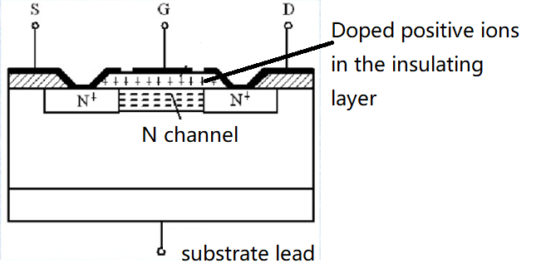
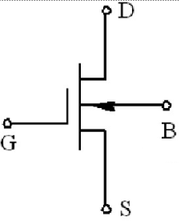
Depletion-type N-channel MOSFET
There is a n-channel when V_{GS}=0
When applied positive gate voltage, i.e. V_{GS}>0, the width of the n-channel increases, leading to larger I_{D} current.
When applied negative gate voltage, i.e. V_{GS}<0, the width of the n-channel decrease. The resistance of the channel increase, leading to smaller I_{D} current.

Slide 42
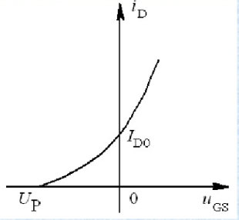
Transfer curve for depletion-type N-channel MOSFET

Slide 43
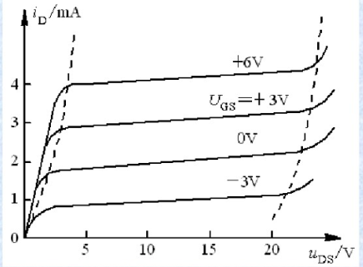
Output characteristic curve for depletion-type N-channel MOSFET

Slide 44
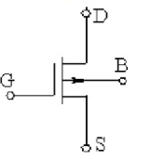
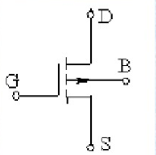
P-channel MOSFET
There are two types p-channel MOSFET. One is enhancement-type P-channel MOSFET, the other one is depletion-type P-channel MOSFET.
Their circuit symbols are:
Enhancement-type P-channel MOSFET
depletion-type P-channel MOSFET

Slide 45
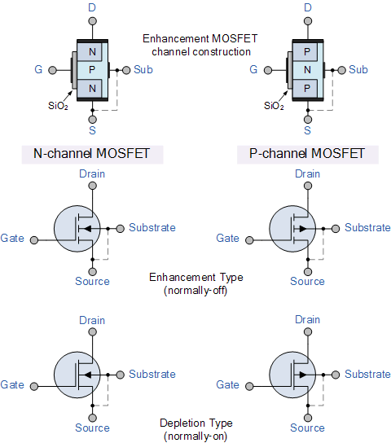
MOSFET Circuit Symbols, Types

Slide 46
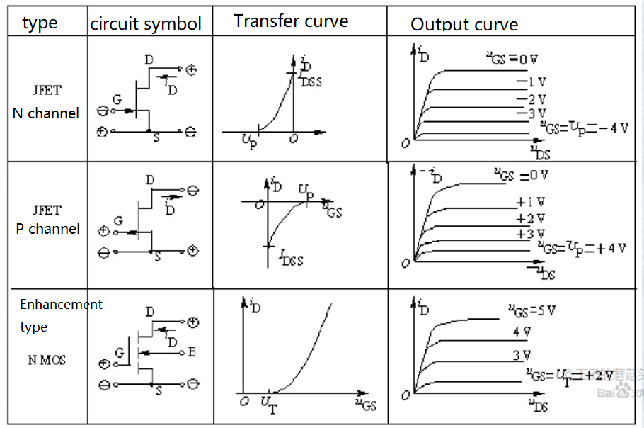
Comparisons of different FETs

Slide 47
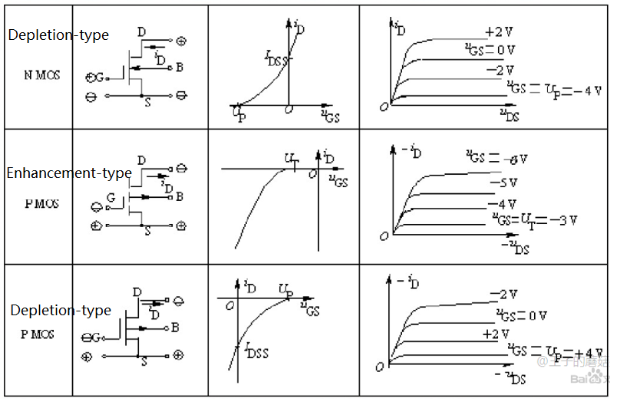

Slide 48
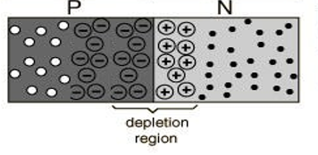
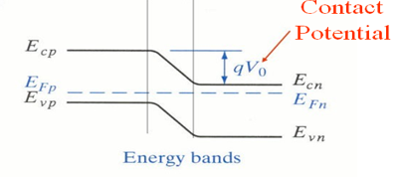
Review

Slide 49
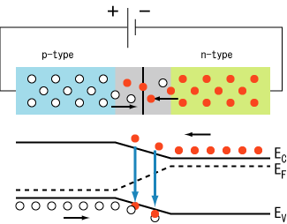
PN junction under positive bias

Slide 50

PN junction under negative bias

Slide 51

PN junction I-V curve

Slide 52


BJT

Slide 53

BJT

Slide 54
FET: JFET and MOSFET
When V_{DG}=|Vp|, the channel pinches off, the current I_{D} is saturated.

Slide 55
Depletion-type N-channel MOSFET

Slide 56
Enhancement-type N-channel MOSFET

Slide 57
Practice:
1、Draw a fully diagram of a MOSFET, indicating the important regions in this device.
2、Show what happens the drain current, I_{D}, as both gate voltage, V_{G} and drain voltage, V_{D}, are varied.
3、Draw a fully labelled diagram of JFET and briefly explain how it functions.
4、For a JFET explain why the depletion layer width varies across the source drain channel.

