Slide 1

Why Program?
Chapter 1
Python for Everybody
www.py4e.com

Slide 2

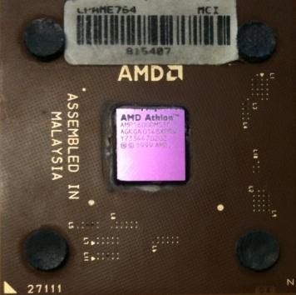
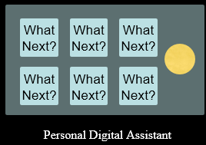
Computers Want to be Helpful...
We are surrounded in our daily lives with computers ranging from laptops to cell phones. We can think of these computers as our “personal assistants” who can take care of many things on our behalf. The hardware in our current-day computers is essentially built to continuously ask us the question, “What would you like me to do next?
Programmers add an operating system and a set of applications to the hardware and we end up with a Personal Digital Assistant that is quite helpful and capable of helping us do many different things
Our computers are fast and have vast amounts of memory and could be very helpful to us if we only knew the language to speak to explain to the computer what we would like it to “do next”. If we knew this language, we could tell the computer to do tasks on our behalf that were repetitive. Interestingly, the kinds of things computers can do best are often the kinds of things that we humans find boring and mind-numbing.
What
Next?

Slide 3
Computers Want to be Helpful...
Computers are built for one purpose - to do things for us
But we need to speak their language to describe what we want them to do.
Users have it easy - someone already put many different programs (instructions) into the computer and users just pick the ones they want to use
What
Next?
What
Next?
What
Next?
What
Next?
What
Next?
What
Next?
What
Next?
Personal Digital Assistant

Slide 4
Programmers Anticipate Needs
professional programming can be a very rewarding job both financially and personally. Building useful, elegant, and clever programs for others to use is a very creative activity.
Your computer，Personal Digital Assistant (PDA) or smart phone usually contain many different programs from many different groups of programmers, each competing for your attention and interest. They try their best to meet your needs and give you a great user experience in the process.
In some situations, when you choose a piece of software, the programmers are directly compensated because of your choice.

Slide 5
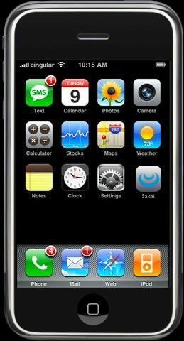
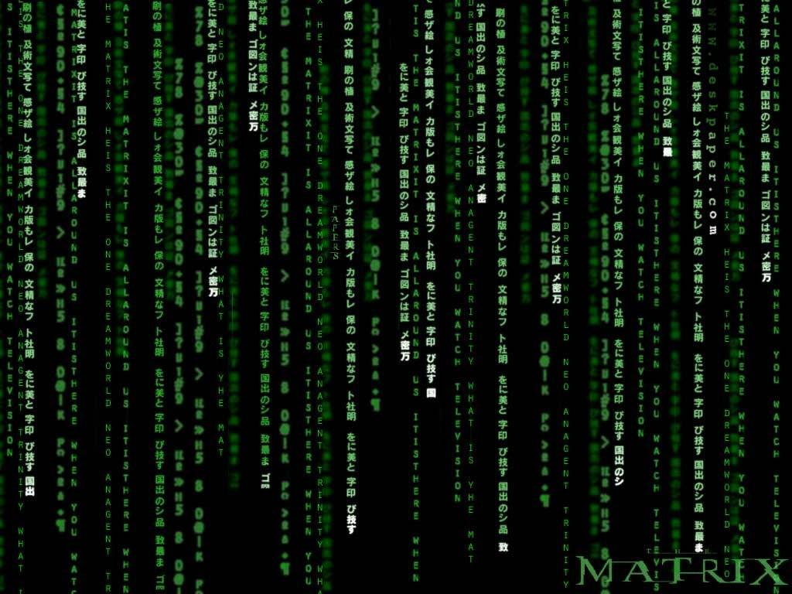
Programmers Anticipate Needs
iPhone applications are a market
iPhone applications have over 3 billion downloads
Programmers have left their jobs to be full-time iPhone developers
Programmers know the ways of the program
Pick
Me!
Pick
Me!
Pick
Me!
Pick
Me!
Pick
Me!
Pay
Me!

Slide 6
Users vs. Programmers
Users see computers as a set of tools - word processor, spreadsheet, map, to-do list, etc.
Programmers learn the computer “ways” and the computer language
Programmers have some tools that allow them to build new tools
Programmers sometimes write tools for lots of users and sometimes programmers write little “helpers” for themselves to automate a task

Slide 7
Why be a Programmer?
Writing programs (or programming) is a very creative and rewarding activity. You can write programs for many reasons, ranging from making your living to solving a difficult data analysis problem to having fun to helping someone else solve a problem.
We are the user and programmer : For now, our primary motivation is not to make money or please end users, but instead for us to be more productive in handling the data and information that we will encounter in our lives. When you first start, you will be both the programmer and the end user of your programs.
A programming job: As you gain skill as a programmer and programming feels more creative to you, your thoughts may turn toward developing programs for others.

Slide 8
Why be a Programmer?
To get some task done - we are the user and programmer
- Clean up survey data
To produce something for others to use - a programming job
- Fix a performance problem in the Sakai software
- Add a guestbook to a web site

Slide 9
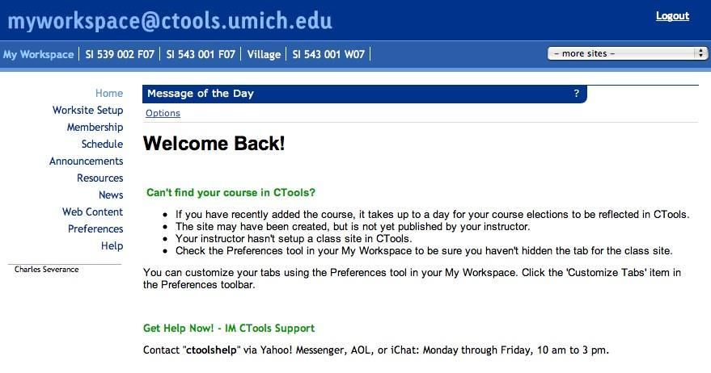

User
Computer
Hardware + Software
Programmer
Data
Information
Networks
....
From a software creator’s point of view, we build the software. The end users (stakeholders/actors) are our. But the data, information, and networks are our problem to solve on their behalf. The hardware and software are our friends and allies in this quest.

Slide 10
What is Code? Software? A Program?
A sequence of stored instructions
- It is a little piece of our intelligence in the computer
- We figure something out and then we encode it and then give it to someone else to save them the time and energy of figuring it out
A piece of creative art - particularly when we do a good job on user experience

Slide 11
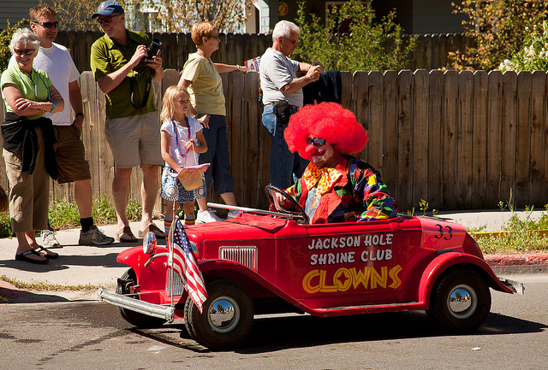
Programs for Python...
It might be easiest to understand what a program is by thinking about a problem that a program might be built to solve, and then looking at a program that would solve that problem.
Lets say you are doing Social Computing research on weibo posts and you are interested in the most frequently used word in a series of posts. You could print out the stream of weibo posts and pore over the text looking for the most common word, but that would take a long time and be very mistake prone.
For example, look at the following text about a clown and a car. Look at the text and figure out the most common word and how many times it occurs.
the clown ran after the car and the car ran into the tent and the tent fell down on the clown and the car
Notes:
For example, look at the following text about a clown and a car. Look at the text
and figure out the most common word and how many times it occurs.

Slide 12
Programs for Python...
Then imagine that you are doing this task looking at millions of lines of text. Frankly it would be quicker for you to learn Python and write a Python program to count the words than it would be to manually scan the words.
We present a simple program to find the most common word in a text file.
the clown ran after the car and the car ran into the tent and the tent fell down on the clown and the car

Slide 13
name = input('Enter file:')
handle = open(name)
counts = dict()
for line in handle:
words = line.split()
for word in words:
counts[word] = counts.get(word,0) + 1
bigcount = None
bigword = None
for word,count in counts.items():
if bigcount is None or count > bigcount:
bigword = word
bigcount = count
print(bigword, bigcount)
A short “story” about how to count words in a file in Python
python words.py
Enter file: words.txt
to 16
python words.py
Enter file: clown.txt
the 7

Slide 14
Programs for Python...
This is a good example of how Python and the Python language are acting as an intermediary between the end user and the programmer. Python is a way for us to exchange useful instruction sequences (i.e., programs) in a common language that can be used by anyone who installs Python on their computer.
Neither of us are talking to Python, instead we are communicating with each other through Python..

Slide 15
Hardware Architecture
Notes:
Before we start learning the language we speak to give instructions to computers
to develop software, we need to learn a small amount about how computers are
built.

Slide 16
Generic
Computer
Before we start learning the language we speak to give instructions to computers to develop software, we need to learn a small amount about how computers are built. If you were to take apart your computer or cell phone and look deep inside, you would find these parts.
What
Next?
Software
Input
and Output
Devices
Central
Processing
Unit
Secondary
Memory
Main
Memory
Notes:
Before we start learning the language we speak to give instructions to computers
to develop software, we need to learn a small amount about how computers are
built. If you were to take apart your computer or cell phone and look deep inside,
you would find the following parts:

Slide 17
Definitions
What
Next?
Central Processing Unit: is the part of the computer that is built to be obsessed with “what is next?” If your computer is rated at 3.0 Gigahertz, it means that the CPU will ask “What next?” three billion times per second. You are going to have to learn how to talk fast to keep up with the CPU.
Input Devices: Keyboard, Mouse, Touch Screen
Output Devices: Screen, Speakers, Printer, DVD Burner

Slide 18
Definitions
Main Memory: Fast small temporary storage - lost on reboot - aka RAM, is used to store information that the CPU needs in a hurry. The main memory is nearly as fast as the CPU. But the information stored in the main memory vanishes when the computer is turned off.
Secondary Memory: Slower large permanent storage - lasts until deleted - disk drive / memory stick, is also used to store information, but it is much slower than the main memory. The advantage of the secondary memory is that it can store information even when there is no power to the computer.Examples of secondary memory are disk drives or flash memory (typically found in USB sticks and portable music players

Slide 19
Definitions
Network Connection: These days, most computers also have a Network Connection to retrieve information over a network. We can think of the network as a very slow place to store and retrieve data that might not always be “up”. So in a sense, the network is a slower and at times unreliable form of Secondary Memory

Slide 20
Generic
Computer
As a programmer, your job is to use and orchestrate each of these resources to solve the problem that you need to solve and analyze the data you get from the solution. As a programmer you will mostly be “talking” to the CPU and telling it what to do next. Sometimes you will tell the CPU to use the main memory, secondary memory, network, or the input/output devices.
What
Next?
Software
Input
and Output
Devices
Central
Processing
Unit
Secondary
Memory
if x< 3: print
Main
Memory

Slide 21
Generic
Computer
You need to be the person who answers the CPU’s “What next?” question. you must write down your instructions in advance. We call these stored instructions a program and the act of writing these instructions down and getting the instructions to be correct programming.
What
Next?
Software
Input
and Output
Devices
Central
Processing
Unit
Secondary
Memory
01001001
00111001
Main
Memory
Machine
Language

Slide 22
Python as a Language

Slide 23
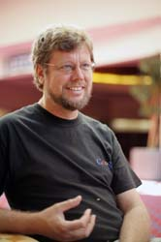
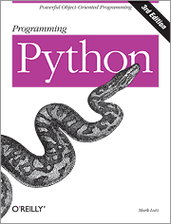
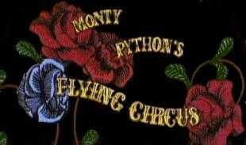
Python is a high-level language intended to be relatively straightforward for humans to read and write and for computers to read and process. The Python language was initially developed by Guido van Rossum.

Slide 24
In a sense, you need two skills to be a programmer:
- First, you need to know the programming language (Python), you need to know the vocabulary and the grammar. You need to be able to spell the words in this new language properly and know how to construct well-formed “sentences” in this new language.
- Second, you need to “tell a story”. In writing a story, you combine words and sentences to convey an idea to the reader. In programming, our program is the “story” and the problem you are trying to solve is the “idea”.

Slide 25
Early Learner: Different Errors
We need to learn the Python language so we can communicate our instructions to Python. In the beginning we will make lots of mistakes.
As your programs become increasingly sophisticated, you will encounter three general types of errors: Syntax errors, Logic errors and Semantic errors

Slide 26
Syntax errors
- These are the first errors you will make and the easiest to fix. A syntax error means that you have violated the “grammar” rules of Python. Python does its best to point right at the line and character where it noticed it was confused. The only tricky bit of syntax errors is that sometimes the mistake that needs fixing is actually earlier in the program than where Python noticed it was confused.
- When Python says “SyntaxError: invalid syntax”, it is simply saying, “You seemed to say something but I just don’t understand what you meant, but please keep talking to me (>>>).”
>>> primt 'Hello world!' File "<stdin>", line 1 primt 'Hello world!' ^ SyntaxError: invalid syntax
>>> primt ('Hello world') Traceback (most recent call last): File "<stdin>", line 1, in <module> NameError: name 'primt' is not defined
>>> I hate you Python! File "<stdin>", line 1 I hate you Python! ^ SyntaxError: invalid syntax >>> if you come out of there, I would teach you a lesson File "<stdin>", line 1 if you come out of there, I would teach you a lesson ^ SyntaxError: invalid syntax
Notes:
The >>> prompt is the Python interpreter’s way of asking you

Slide 27
Logic errors and Semantic errors
Logic errors: A logic error is when your program has good syntax but there is a mistake in the order of the statements or perhaps a mistake in how the statements relate to one another. A good example of a logic error might be,“take a drink from your water bottle, put it in your backpack, walk to the library, and then put the top back on the bottle.”
Semantic errors: A semantic error is when your description of the steps to take is syntactically perfect and in the right order, but there is simply a mistake in the program. The program is perfectly correct but it does not do what you intended for it to do.
A simple example would be if you were giving a person directions to a restaurant and said, “. . . when you reach the intersection with the gas station, turn left and go one mile and the restaurant is a red building on your left.” The instructions were syntactically correct, they sadly contained a small but undetected semantic error.”.

Slide 28
Talking to Python

Slide 29
Talking to Python
how to start a conversation with Python

Slide 30
Talking to Python
Before you can converse with Python, you must first install the Python software on your computer and learn how to start Python on your computer. The programming language translators of Python fall into two general categories: (1) interpreters and (2) compilers.
Interpreter: An interpreter reads the source code of the program as written by the programmer, parses the source code, and interprets the instructions on the fly. Python is an interpreter and when we are running Python interactively, we can type a line of Python (a sentence) and Python processes it immediately and is ready for us to type another line of Python. It is the nature of an interpreter to be able to have an interactive conversationas shown after.
Compiler: A compiler needs to be handed the entire program in a file,and then it runs a process to translate the high-level source code into machine language and then the compiler puts the resulting machine language into a file for later execution.

Slide 31
In this mode it prompts for the next command with the primary prompt, usually three greater-than signs (>>>);
In this mode it prompts for the next command with the primary prompt, usually three greater-than signs (>>>);
csev$ python3
Python 3.5.1 (v3.5.1:37a07cee5969, Dec 5 2015, 21:12:44) [GCC 4.2.1 (Apple Inc. build 5666) (dot 3)] on darwinType "help", "copyright", "credits" or "license" for more information.
>>>
What next?
At some point, you will be in a terminal or command window and you will type python and the Python interpreter will start executing in interactive mode, which means the commands are read from a tty(teletype). In this mode, it prompts for the next command with the primary prompt, usually three greater-than signs (>>>);

Slide 32
csev$ python3
Python 3.5.1 (v3.5.1:37a07cee5969, Dec 5 2015, 21:12:44) [GCC 4.2.1 (Apple Inc. build 5666) (dot 3)] on darwinType "help", "copyright", "credits" or "license" for more information.
>>> x = 1
>>> print(x)
1
>>> x = x + 1
>>> print(x)
2
>>> exit()
We need to pick a name for that value to be remembered and we can use that symbolic name to retrieve the value later. We use the term variable to refer to the labels we use to refer to this stored data.
This is a good test to make sure that you have Python correctly installed. Note that quit() also works to end the interactive session. Typing an end-of-file character (Control-D on Unix, Control-Z on Windows) at the primary prompt causes the interpreter to exit with a zero exit status

Slide 33
What Do We Say?

Slide 34
Elements of Python
There are some low-level conceptual patterns that we use to construct programs.
Vocabulary / Words - Variables and Reserved words (Chapter 2)
Sentence structure - valid syntax patterns (Chapters 3-5)
Story structure - constructing a program for a purpose

Slide 35
name = input('Enter file:')
handle = open(name)
counts = dict()
for line in handle:
words = line.split()
for word in words:
counts[word] = counts.get(word,0) + 1
bigcount = None
bigword = None
for word,count in counts.items():
if bigcount is None or count > bigcount:
bigword = word
bigcount = count
print(bigword, bigcount)

Slide 36
Reserved Words
the Python vocabulary is actually pretty small. We call this “vocabulary” the “reserved words”. These are words that have very special meaning to Python. You cannot use reserved words as variable names / identifiers. The reserved words in the language where humans talk to Python are as follows:
False class return is finally
None if for lambda continue
True def from while nonlocal
and del global not with
as elif try or yield
assert else import pass
break except in raise

Slide 37
Sentences or Lines
x = 2
x = x + 2
print(x)
Assignment statement
Assignment with expression
Print statement
Variable
Operator
Constant
Function
- A variable is a name that refers to a value
- Operators are special symbols that represent computations like addition and multiplication.
- Fixed values such as numbers, letters, and strings, are called “constants” because their value does not change
- A function is a named sequence of statements that performs a computation.

Slide 38
Programming Paragraphs

Slide 39
Python Scripts
Interactive Python is good for experiments and programs of 3-4 lines long.
Typing commands into the Python interpreter is a great way to experiment with Python’s features, but it is not recommended for solving more complex problems. Most programs are much longer, so we type them into a file and tell Python to run the commands in the file.
we use a text editor to write the Python codes into a file, which is called a script. By convention, Python scripts have names that end with .py.

Slide 40
Interactive versus Script
Interactive
- You type directly to Python one line at a time and it responds. Even though we are typing these commands into Python one line at a time, Python is treating them as an ordered sequence of statements with later statements able to retrieve data created in earlier statements.
Script
- You enter a sequence of statements (lines) into a file using a text editor and tell Python to execute the statements in the file.

Slide 41
Program Steps or Program Flow
Like a recipe or installation instructions, a program is a sequence of steps to be done in order.
Some steps are conditional - they may be skipped.
Sometimes a step or group of steps is to be repeated.
Sometimes we store a set of steps to be used over and over as needed several places through out the program

Slide 42
Program Steps or Program Flow
There are some low-level conceptual patterns that we use to construct programs.
Input / Output - In our initial programs, our input will come from the user typing data on the keyboard. Output, display the results of the program on a screen or store them in a file or perhaps write them to a device like a speaker to play music or speak text.
Sequential execution - Perform statements one after another in the order they are encountered in the script.
Conditional execution - Check for certain conditions and then execute or skip a sequence of statements.
Repeated execution - Perform some set of statements repeatedly, usually with some variation.
Reuse - Write a set of instructions once and give them a name and then reuse those instructions as needed through out your program.

Slide 43
Sequential Steps
x = 2
Program:
x = 2
print(x)
x = x + 2
print(x)
Output:
2
4
print(x)
x = x + 2
print(x)
When a program is running, it flows from one step to the next. As programmers, we set up “paths” for the program to follow.

Slide 44
Conditional Steps
x = 5
In order to write useful programs, we almost always need the ability to check conditions and change the behavior of the program accordingly. Conditional statements give us this ability.
x < 10 ?
Yes
print('Smaller')
Program:
x = 5
if x < 10:
print('Smaller')
if x > 20:
print('Bigger')
print('Finis')
No
Output:
Smaller
Finis
x > 20 ?
Yes
print('Bigger')
No
print('Finis')

Slide 45
Repeated Steps
n = 5
Computers are often used to automate repetitive tasks. Repeating identical or similar tasks without making errors is something that computers do well and people do poorly.
No
n > 0 ?
Yes
Output:
5
4
3
2
1
Blastoff!
Program:
n = 5
while n > 0 :
print(n)
n = n – 1
print('Blastoff!')
print(n)
n = n -1
print('Blastoff')
Loops (repeated steps) have iteration variables that change each time through a loop.

Slide 46
name = input('Enter file:')
handle = open(name, 'r')
counts = dict()
for line in handle:
words = line.split()
for word in words:
counts[word] = counts.get(word,0) + 1
bigcount = None
bigword = None
for word,count in counts.items():
if bigcount is None or count > bigcount:
bigword = word
bigcount = count
print(bigword, bigcount)
Sequential
Repeated
Conditional

Slide 47
name = input('Enter file:')
handle = open(name, 'r')
counts = dict()
for line in handle:
words = line.split()
for word in words:
counts[word] = counts.get(word,0) + 1
bigcount = None
bigword = None
for word,count in counts.items():
if bigcount is None or count > bigcount:
bigword = word
bigcount = count
print(bigword, bigcount)
A short Python “Story” about how to count words in a file
A word used to read data from a user
A sentence about updating one of the many counts
A paragraph about how to find the largest item in a list

Slide 48
Glossary
assignment A statement that assigns a value to a variable.
concatenate To join two operands end to end.
comment Information in a program that is meant for other programmers (or anyone reading the source code) and has no effect on the execution of the program.
evaluate To simplify an expression by performing the operations in order to yield a single value
expression A combination of variables, operators, and values that represents a single result value.
floating point A type that represents numbers with fractional parts.
integer A type that represents whole numbers.
keyword A reserved word that is used by the compiler to parse a program; you cannot use keywords like if, def, and while as variable names.
mnemonic A memory aid. We often give variables mnemonic names to help us remember what is stored in the variable.
modulus operator An operator, denoted with a percent sign (%), that works on integers and yields the remainder when one number is divided by another.
operand One of the values on which an operator operates.
operator A special symbol that represents a simple computation like addition,multiplication, or string concatenation.
rules of precedence The set of rules governing the order in which expressions involving multiple operators and operands are evaluated
statement A section of code that represents a command or action. So far, the statements we have seen are assignments and print expression statement.
string A type that represents sequences of characters.
type A category of values. The types we have seen so far are integers (type int),floating-point numbers (type float), and strings (type str).
variable A name that refers to a value.

Slide 49
Exercises
Exercise 1: What is the function of the secondary memory in a computer?
a) Execute all of the computation and logic of the program
b) Retrieve web pages over the Internet
c) Store information for the long term, even beyond a power cycle
d) Take input from the user

Slide 50
Exercises
Exercise 2: What is wrong with the following code:
>>> primt 'Hello world!'
File "<stdin>", line 1
primt 'Hello world!'
^
SyntaxError: invalid syntax
>>>

Slide 51
Exercises
Exercise 3: Where in the computer is a variable such as “x” stored after the following Python line finishes?
x = 123
a) Central processing unit
b) Main Memory
c) Secondary Memory
d) Input Devices
e) Output Devices

Slide 52
Exercises
Exercise 4: What will the following program print out:
x = 43
x = x + 1
print(x)
a) 43
b) 44
c) x + 1
d) Error because x = x + 1 is not possible mathematically

