Slide 1

Variables, Expressions, and Statements
Chapter 2
Python for Everybody
Notes:
Note from Chuck. If you are using these materials, you can remove the UM logo and replace it with your own, but please retain the CC-BY logo on the first page as well as retain the acknowledgement page(s) at the end.

Slide 2
Constants
Fixed values such as numbers, letters, and strings, are called “constants” because their value does not change
Numeric constants are as you expect
String constants use single quotes (') or double quotes (")
>>> print(123)
123
>>> print(98.6)
98.6
>>> print('Hello world')
Hello world

Slide 3
Variables
A variable is a named place in the memory where a programmer can store data and later retrieve the data using the variable “name”.
Programmers get to choose the names of the variables
You can change the contents of a variable in a later statement
x = 12.2
y = 14
z = 'the variable'
x
12.2
y
14
z
the variable

Slide 4
Variables
A variable is a named place in the memory where a programmer can store data and later retrieve the data using the variable “name”
Programmers get to choose the names of the variables
You can change the contents of a variable in a later statement
100
x = 12.2
y = 14
z = 'the variable'
x
12.2
y
14
x = 100
z
the variable

Slide 5
Python Variable Name Rules
Variable names can be arbitrarily long. They can contain both letters and numbers, but they cannot start with a number. It is legal to use uppercase letters, but it is a good idea to begin variable names with a lowercase letter
The underscore character ( _ ) can appear in a name. It is often used in names withmultiple words, such as `my_name` or `airspeed_of_unladen_swallow`. Variable names can start with an underscore character, but we generally avoid doing this unless we are writing library code for others to use.

Slide 6
Python Variable Name Rules
Must start with a letter or underscore _
Must consist of letters, numbers, and underscores
Case Sensitive
Good: spam eggs spam23 _speed
Bad: 23spam #sign var.12
Different: spam Spam SPAM

Slide 7
Mnemonic Variable Names
Since we programmers are given a choice in how we choose our variable names, there is a bit of “best practice”
The word “mnemonic” means “memory aid”. We choose mnemonic variable names to help us remember why we created the variable in the first place. Mnemonic variable names can get in the way of a beginning programmer’s ability to parse and understand code.
This can confuse beginning students because well-named variables often “sound” so good that they must be keywords
http://en.wikipedia.org/wiki/Mnemonic

Slide 8
the following three programs are identical interms of what they accomplish, but very different when you read them and try to understand them.
x1q3z9ocd = 35.0
x1q3z9afd = 12.50
x1q3p9afd = x1q3z9ocd * x1q3z9afd
print(x1q3p9afd)
What is this bit of code doing?

Slide 9
the following three programs are identical interms of what they accomplish, but very different when you read them and try to understand them.
x1q3z9ocd = 35.0
x1q3z9afd = 12.50
x1q3p9afd = x1q3z9ocd * x1q3z9afd
print(x1q3p9afd)
a = 35.0
b = 12.50
c = a * b
print(c)
What are these bits of code doing?

Slide 10
the following three programs are identical interms of what they accomplish, but very different when you read them and try to understand them.
The Python interpreter sees all three of these programs as exactly the same but humans see and understand these programs quite differently.
Humans will most quickly understand the intent of the third program because the programmer has chosen variable names that reflect their intent regarding what data will be stored in each variable.
x1q3z9ocd = 35.0
x1q3z9afd = 12.50
x1q3p9afd = x1q3z9ocd * x1q3z9afd
print(x1q3p9afd)
a = 35.0
b = 12.50
c = a * b
print(c)
hours = 35.0
rate = 12.50
pay = hours * rate
print(pay)
What are these bits of code doing?

Slide 11
Statements
x = 2
x = x + 2
print(x)
Assignment statement
Assignment with expression
Print statement
Variable
Operator
Constant
Function
A statement is a unit of code that the Python interpreter can execute. We have seen two kinds of statements: print being an expression statement and assignment statement.

Slide 12
Sentences or Lines
x = 2
x = x + 2
print(x)
Assignment statement
Assignment with expression
Print statement
Variable
Operator
Constant
Function
- A variable is a name that refers to a value
- Operators are special symbols that represent computations like addition and multiplication.
- Fixed values such as numbers, letters, and strings, are called “constants” because their value does not change
- A function is a named sequence of statements that performs a computation.

Slide 13
Sentences or Lines
When you type a statement in interactive mode, the interpreter executes it and displays the result, if there is one.
A script usually contains a sequence of statements. If there is more than one statement, the results appear one at a time as the statements execute.
print(1)
x = 2
print(x)
1
2

Slide 14
Assignment Statements
We assign a value to a variable using the assignment statement (=)
An assignment statement consists of an expression on the right-hand side and a variable to store the result
x = 3.9 * x * ( 1 - x )

Slide 15
0.6
x
A variable is a memory location used to store a value (0.6)
0.6
0.6
x = 3.9 * x * ( 1 - x )
0.4
The right side is an expression. Once the expression is evaluated, the result is placed in (assigned to) x.
0.936

Slide 16
0.6 0.936
A variable is a memory location used to store a value. The value stored in a variable can be updated by replacing the old value (0.6) with a new value (0.936).
x
0.6
0.6
x = 3.9 * x * ( 1 - x )
0.4
The right side is an expression. Once the expression is evaluated, the result is placed in (assigned to) the variable on the left side (i.e., x).
0.936

Slide 17
Expressions…

Slide 18
Numeric Expressions
Operators are special symbols that represent computations like addition and multiplication. The values the operator is applied to are called operands.
An expression is a combination of values, variables, and operators. A value all by itself is considered an expression, and so is a variable.
Because of the lack of mathematical symbols on computer keyboards - we use “computer-speak” to express the classic math operations
Asterisk is multiplication
Exponentiation (raise to a power) looks different than in math
Operator | Operation
+ | Addition
- | Subtraction
* | Multiplication
/ | Division
** | Power
% | Remainder

Slide 19
Numeric Expressions
>>> xx = 2
>>> xx = xx + 2
>>> print(xx)
4
>>> yy = 440 * 12
>>> print(yy)
5280
>>> zz = yy / 1000
>>> print(zz)
5.28
>>> jj = 23
>>> kk = jj % 5
>>> print(kk)
3
>>> print(4 ** 3)
64
Operator | Operation
+ | Addition
- | Subtraction
* | Multiplication
/ | Division
** | Power
% | Remainder
4 R 3
5
23
20
3

Slide 20
Order of Evaluation
When we string operators together - Python must know which one to do first
When more than one operator appears in an expression, the order of evaluation depends on the rules of precedence. For mathematical operators, Python follows mathematical convention.
This is called “operator precedence”
Which operator “takes precedence” over the others?
x = 1 + (2 * 3 - 4 / 5 ** 6)

Slide 21
Operator Precedence Rules
Highest precedence rule to lowest precedence rule:
Parentheses are always respected - Parentheses have the highest precedence and can be used to force an expression to evaluate in the order you want.
Exponentiation (raise to a power) - Exponentiation has the next highest precedence
Multiplication, Division, and Remainder - which also have the same precedence
Addition and Subtraction
Left to right - Operators with the same precedence are evaluated from left to right
Parenthesis
Power
Multiplication
Addition
Left to Right

Slide 22
>>> x = 1 + 2 ** 3 / 4 * 5
>>> print(x)
11.0
>>>
1 + 2 ** 3 / 4 * 5
1 + 8 / 4 * 5
Parenthesis
Power
Multiplication
Addition
Left to Right
1 + 2 * 5
1 + 10
11

Slide 23
Operator Precedence
Parenthesis
Power
Multiplication
Addition
Left to Right
Remember the rules top to bottom
When writing code - use parentheses
When writing code - keep mathematical expressions simple enough that they are easy to understand
Break long series of mathematical operations up to make them more clear

Slide 24
What Does “Type” Mean?
In Python variables, literals, and constants have a “type”
Python knows the difference between an integer number and a string
For example “+” means “addition” if something is a number and “concatenate” if something is a string
>>> ddd = 1 + 4
>>> print(ddd)
5
>>> eee = 'hello ' + 'there'
>>> print(eee)
hello there
concatenate = put together

Slide 25
Type Matters
Python knows what “type” everything is
Some operations are prohibited
You cannot “add 1” to a string
We can ask Python what type something is by using the type() function
>>> eee = 'hello ' + 'there'
>>> eee = eee + 1
Traceback (most recent call last): File "<stdin>", line 1, in <module>TypeError: Can't convert 'int' object to str implicitly
>>> type(eee)
<class'str'>
>>> type('hello')
<class'str'>
>>> type(1)
<class'int'>
>>>

Slide 26
Several Types of Numbers
Numbers have two main types
- Integers are whole numbers: -14, -2, 0, 1, 100, 401233
- Floating Point Numbers have decimal parts: -2.5 , 0.0, 98.6, 14.0
>>> xx = 1
>>> type (xx)
<class 'int'>
>>> temp = 98.6
>>> type(temp)
<class'float'>
>>> type(1)
<class 'int'>
>>> type(1.0)
<class'float'>
>>>

Slide 27
Type Conversions
>>> print(float(99) + 100)
199.0
>>> i = 42
>>> type(i)
<class'int'>
>>> f = float(i)
>>> print(f)
42.0
>>> type(f)
<class'float'>
>>>
When you put an integer and floating point in an expression, the integer is implicitly converted to a float
You can control this with the built-in functions int() and float()

Slide 28
Integer Division
Integer division produces a floating point result
>>> print(10 / 2)
5.0
>>> print(9 / 2)
4.5
>>> print(99 / 100)
0.99
>>> print(10.0 / 2.0)
5.0
>>> print(99.0 / 100.0)
0.99
in Python2.x
>>> print 59 / 60
0
This was different in Python 2.x
The division operator in Python 2.0 would divide two integers and truncate the result to an integer

Slide 29
Integer Division
The modulus operator works on integers and yields the remainder when the first operand is divided by the second.
you can check whether one number is divisible by another: if x % y is zero, then x is divisible by y.
You can also extract the right-most digit or digits from a number. For example, x % 10 yields the right-most digit of x (in base 10). Similarly, x % 100 yields the last two digits.
>>> quotient = 7 // 3
>>> print(quotient)
2
>>> remainder = 7 % 3
>>> print(quotient)
1

Slide 30
String Conversions
You can also use int() and float() to convert between strings and integers
You will get an error if the string does not contain numeric characters
>>> sval = '123'
>>> type(sval)
<class 'str'>
>>> print(sval + 1)
Traceback (most recent call last): File "<stdin>", line 1, in <module>
TypeError: Can't convert 'int' object to str implicitly
>>> ival = int(sval)
>>> type(ival)
<class 'int'>
>>> print(ival + 1)
124
>>> nsv = 'hello bob'
>>> niv = int(nsv)
Traceback (most recent call last): File "<stdin>", line 1, in <module>
ValueError: invalid literal for int() with base 10: 'x'
>>> sval = '123hello‘
>>> ival = int(sval)
Traceback (most recent call last):
File "<pyshell#2>", line 1, in <module>
int('123h')
ValueError: invalid literal for int() with base 10: '123hello'

Slide 31
String Operations
>>> first = 'Test'
>>> second = '150'
>>> print(first + second )
Test150
>>> first = 'Test '
>>> second = 3
>>> print(first * second )
Test Test Test
The + operator works with strings, but it is not addition in the mathematical sense. Instead it performs concatenation, which means joining the strings by linking them end to end.
The * operator also works with strings by multiplying the content of a string by an integer.

Slide 32
User Input
Sometimes we would like to take the value for a variable from the user via their keyboard. Python provides a built-in function called input that gets input from the keyboard
When this function is called, the program stops and waits for the user to type something. When the user presses Return or Enter, the program resumes and input returns what the user typed as a string.

Slide 33
User Input
We can instruct Python to pause and read data from the user using the input() function
The input() function returns a string
nam = input('Who are you? ')
print('Welcome', nam)
Who are you? Chuck
Welcome Chuck

Slide 34
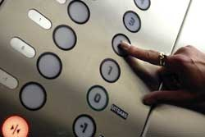
Converting User Input
If we want to read a number from the user, we must convert it from a string to a number using a type conversion function
Later we will deal with bad input data
inp = input('Europe floor?')
usf = int(inp) + 1
print('US floor', usf)
Europe floor? 0
US floor 1

Slide 35
Comments in Python
As programs get bigger and more complicated, they get more difficult to read. Formal languages are dense, and it is often difficult to look at a piece of code and figure out what it is doing, or why.
For this reason, it is a good idea to add notes to your programs to explain in natural language what the program is doing. These notes are called comments, and in Python they start with the # symbol:

Slide 36
Comments in Python
Anything after a # （hash）is ignored by Python
Why comment?
- Describe what is going to happen in a sequence of code
- Document who wrote the code or other ancillary information
- Turn off a line of code - perhaps temporarily

Slide 37
# Get the name of the file and open it
name = input('Enter file:')
handle = open(name, 'r')
# Count word frequency
counts = dict()
for line in handle:
words = line.split()
for word in words:
counts[word] = counts.get(word,0) + 1
# Find the most common word
bigcount = None
bigword = None
for word,count in counts.items():
if bigcount is None or count > bigcount:
bigword = word
bigcount = count
# All done
print(bigword, bigcount)

Slide 38
Summary
Type
Variables (mnemonic)
Operators
Operator precedence
Integer Division
Conversion between types
User input
Comments (#)

Slide 39


Exercises
Exercise 1: Write a program that uses input to prompt a user for theirname and then welcomes them.
Exercise 2: Write a program to prompt the user for hours and rate per hour to compute gross pay.
We won’t worry about making sure our pay has exactly two digits after the decimal place for now. If you want, you can play with the built-in Python round function to properly round the resulting pay to two decimal places.

Slide 40
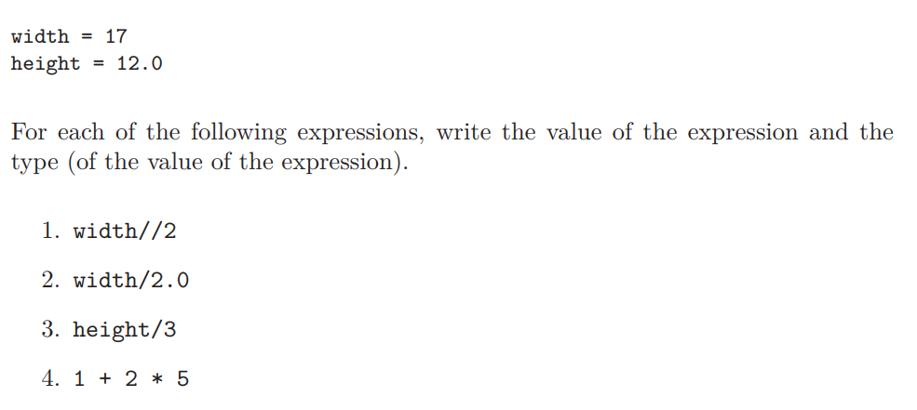
Exercises
Exercise 3: Assume that we execute the following assignment statements:
Use the Python interpreter to check your answers.

Slide 41
Exercises
Exercise 4: Write a program which prompts the user for a Celsius temperature, convert the temperature to Fahrenheit, and print out the converted temperature.

