Slide 1
EE113 Fabrication – Devices
Jinling Yu

Slide 2
What’s in Lecture
Look at how some of the most common devices are manufactured
Resistor,
Capacitors,
Inductors,
MOSFET’s,

Slide 3
Making a Resistor
Resistors are the easiest component to manufacture.
In our case a less doped semiconductor will reduce conductivity.
The longer you make such a material the greater its resistance is.
However, this means that resistors need a lot of space, relativity speaking, on a semiconductor substrate.
Resistors are long areas of low dopant. They take up a lot of space on a wafer.

Slide 4
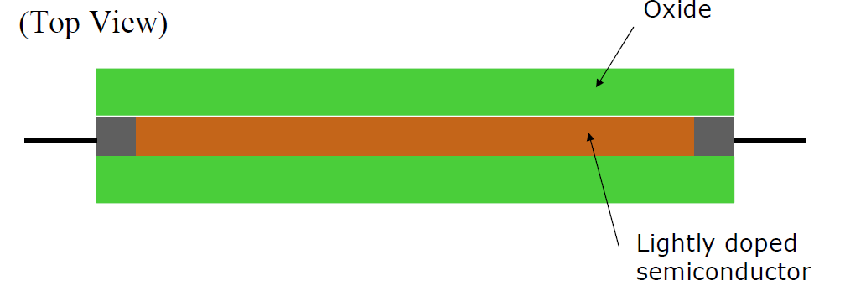
Making a Resistor - Diagram

Slide 5
Making a Capacitor
Capacitors are also easy to manufacture. They are Layers of metal and insulating material.
Capacitance is found anywhere where there is a pattern of conducting and non-conducting layers.
It just needs 2 layers of metal separated by an insulator, or in this case a dielectric material which is the oxide layer deposited during a manufacturing process.
Adding more layers and alternating the polarity at each layer increases the capacitance.
Basically the bigger the area the more capacitance.
It is interesting that you can mistakenly cause capacitance effects, called parasitic capacitance, during the manufacture of more complicated devices such as MOSFET’s and pn junction.
The parasitic capacitance is bad from a performance viewpoint as energy is required to move charge across a capacitor, and it normally reduces the frequency that a device can operate at.

Slide 6
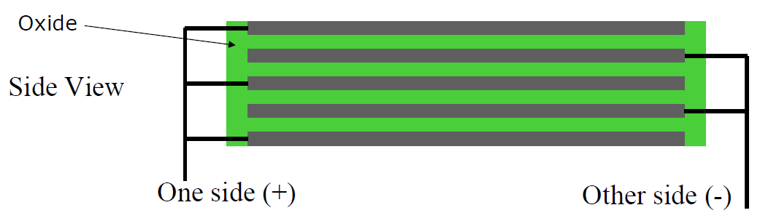
Making a Capacitor - Diagram

Slide 7
Making an Inductor
Not an easy thing to do.
Inductors use coils but these are 3D shapes, very hard to achieve in 2D.
You can make a flat coil but these give poor performance and are ‘leaky’ that is to say that they lose power and interfere with other devices easily.
You can have parasitic inductor due to the placement and pattern of wires, often felt at high frequencies.
Avoid putting these onto a semiconductor circuit if possible.

Slide 8
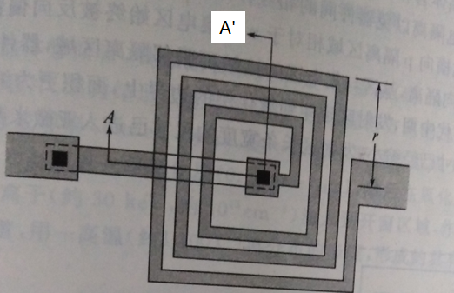
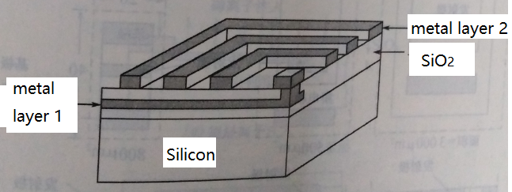
The perspective view along A and A’ point
Top view of the spiral inductors on Si substrate

Slide 9
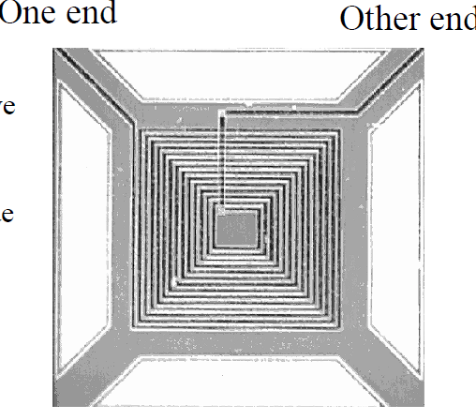
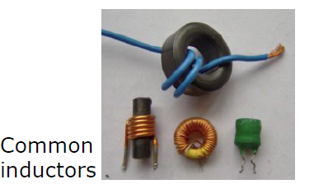
Inductors - Diagram

Slide 10
Making a MOSFET
In the next number of slides we are going to go through the creation of a MOSFET (Metal Oxide Semiconductor Field Effect Transistor).
This is the most common form of transistor.
Typically most CPU’s, GPU’s and other performance IC’s are created using MOSFET’s.
Intel’s i7-600k has almost 2 BILLION transistors with a gate size of about 14nm (this is a node size not the actual length between the gates).
Well they actually use a tri-gate – so electrons can flow in 3D, Intel managed to effectively wrap the gate around as opposed to a straight through design.
GPU’s can have up to 15 BILLION transistor but this is due to having much larger chip sizes but still at 14 nm technology nodes.

Slide 11
Making a MOSFET – 10 steps!
Planarized n-type bulk silicon
Grow an SiO₂ buffer, called Field Oxide, each size of where the transistor will be. This helps to protect the device.
Deposit SiO₂ followed by polysilicon, p+, over the entire wafer.
Apply a mask to protect the centre piece, use HF(hydrofluoric) acid to remove everything else. Now we have a gate.
Mask again and apply a light doped , p-, layer but it is small near the gate.
Grow some protective oxide around the empty space on the gate called an oxide spacer.

Slide 12
Now deposit a heavily doped, p+, region up to the oxide space and over the previous deposits. You now have a p+, p- and N type materials all in contact with each other.
Grow more SiO2 over the entire wafer for protection.
Another masking process to allow holes to reach the gate section and the p+ region either side of the gate.
Deposit metal, normally tungsten, into the holes. Grow more oxide.
Now have your gate, source and drain constructed!

Slide 13
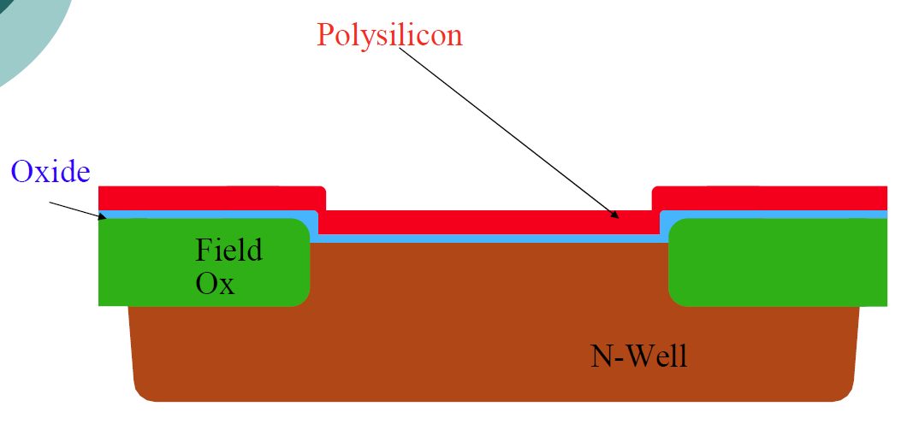
MOSFET – after 3 steps

Slide 14
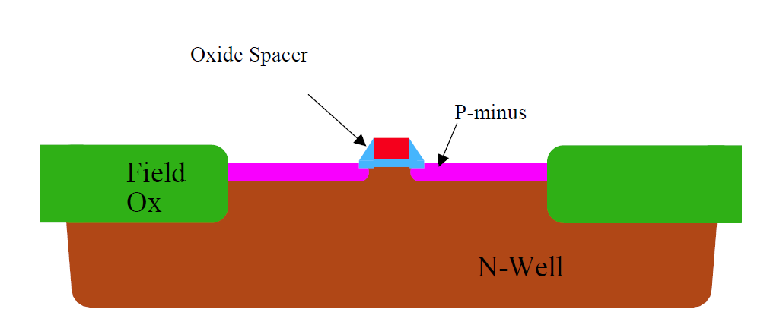
MOSFET – after 6 steps

Slide 15
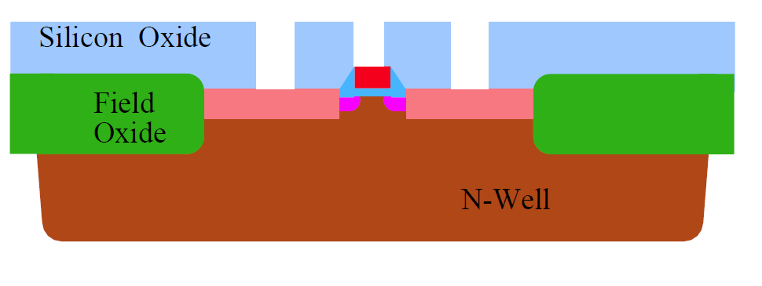
MOSFET – after 10 steps

Slide 16
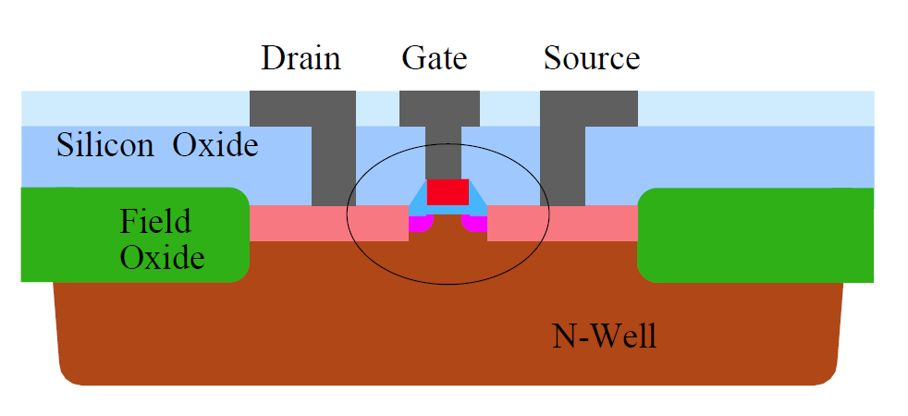
MOSFET – after 10 steps

Slide 17
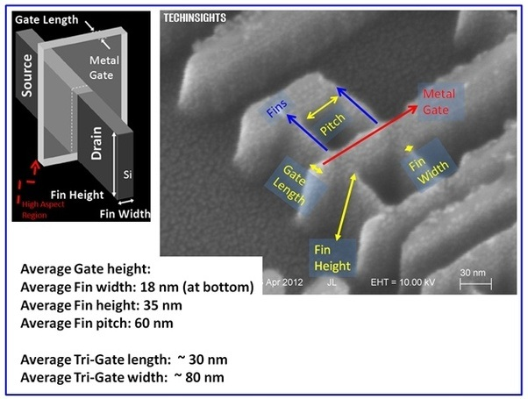
MOSFET – Actual SEM image

