Slide 1

Strings
Chapter 5
Python for Everybody
www.py4e.com
Notes:
Note from Chuck. If you are using these materials, you can remove the UM logo and replace it with your own, but please retain the CC-BY logo on the first page as well as retain the acknowledgement page(s) at the end.

Slide 2
String Data Type
>>> str1 = "Hello"
>>> str2 = 'there'
>>> bob = str1 + str2
>>> print(bob)
Hellothere
>>> str3 = '123'
>>> str3 = str3 + 1
Traceback (most recent call last): File "<stdin>", line 1, in <module>
TypeError: cannot concatenate 'str' and 'int' objects
>>> x = int(str3) + 1
>>> print(x)
124
>>>
A string is a sequence of characters
A string literal uses quotes 'Hello' or "Hello"
For strings, + means “concatenate”
When a string contains numbers, it is still a string
We can convert numbers in a string into a number using int()

Slide 3
Reading and Converting
>>> name = input('Enter:')
Enter:Chuck
>>> print(name)
Chuck
>>> apple = input('Enter:')
Enter:100
>>> x = apple – 10
Traceback (most recent call last): File "<stdin>", line 1, in <module>
TypeError: unsupported operand type(s) for -: 'str' and 'int'
>>> x = int(apple) – 10
>>> print(x)
90
We prefer to read data in using strings and then parse and convert the data as we need
This gives us more control over error situations and/or bad user input
Input numbers must be converted from strings

Slide 4
Looking Inside Strings
We can get at any single character in a string using an index specified in square brackets
The index value must be an integer and starts at zero
The index value can be an expression that is computed
b
a
n
a
n
a
0
1
2
3
4
5
>>> fruit = 'banana'
>>> letter = fruit[1]
>>> print(letter)
a
>>> x = 3
>>> w = fruit[x - 1]
>>> print(w)
n

Slide 5
A Character Too Far
You will get a python error if you attempt to index beyond the end of a string
So be careful when constructing index values and slices
>>> zot = 'abc'
>>> print(zot[5])
Traceback (most recent call last): File "<stdin>", line 1, in <module>
IndexError: string index out of range
>>>

Slide 6
Strings Have Length
The built-in function len gives us the length of a string，i.e., the number of characters in a string
b
a
n
a
n
a
0
1
2
3
4
5
>>> fruit = 'banana'
>>> print(len(fruit))
6

Slide 7
len Function
>>> fruit = 'banana'
>>> x = len(fruit)
>>> print(x)
6
A function is some stored code that we use. A function takes some input and produces an output.
def len(inp):
blah
blah
for x in y:
blah
blah
'banana'
(a string)
6
(a number)

Slide 8
Looping Through Strings
A lot of computations involve processing a string one character at a time. Often they start at the beginning, select each character in turn, do something to it, and continue until the end.
Using a while statement, an iteration variable, and the len function, we can construct a loop to look at each of the letters in a string individually
fruit = 'banana'
index = 0
while index < len(fruit):
letter = fruit[index]
print(index, letter)
index = index + 1
0 b
1 a
2 n
3 a
4 n
5 a

Slide 9
Looping Through Strings
The loop condition is index < len(fruit), so when index is equal to the length of the string, the condition is false, and the body of the loop is not executed. The last character accessed is the one with the index len(fruit)-1, which is the last character in the
fruit = 'banana'
index = 0
while index < len(fruit):
letter = fruit[index]
print(index, letter)
index = index + 1
0 b
1 a
2 n
3 a
4 n
5 a

Slide 10
Looping Through Strings
Exercise 1: Write a while loop that starts at the last character in the string and works its way backwards to the first character in the string, printing each letter on a separate line, except backwards.
fruit = 'banana'
index = 0
while index < len(fruit):
letter = fruit[index]
print(index, letter)
index = index + 1
Everybody write the code in the class

Slide 11
Looping Through Strings
A definite loop using a for statement is much more elegant
The iteration variable is completely taken care of by the for loop
b
a
n
a
n
a
fruit = 'banana'
for letter in fruit:
print(letter)

Slide 12
Looping Through Strings
A definite loop using a for statement is much more elegant
The iteration variable is completely taken care of by the for loop
Each time through the loop, the next character in the string is assigned to the variable letter. The loop continues until no characters are left.
fruit = 'banana'
for letter in fruit :
print(letter)
b
a
n
a
n
a
index = 0
while index < len(fruit) :
letter = fruit[index]
print(letter)
index = index + 1

Slide 13
Looping and Counting
This is a simple loop that loops through each letter in a string and counts the number of times the loop encounters the 'a' character
word = 'banana'
count = 0
for letter in word :
if letter == 'a' :
count = count + 1
print(count)

Slide 14
Looking Deeper into in
The iteration variable “iterates” through the sequence (ordered set)
The block (body) of code is executed once for each value in the sequence
The iteration variable moves through all of the values in the sequence
Iteration variable
Six-character string
for letter in 'banana' :
print(letter)

Slide 15
Yes
Done?
No
b
a
n
a
n
a
Advance letter
print(letter)
for letter in 'banana' :
print(letter)
The iteration variable “iterates” through the string and the block (body) of code is executed once for each value in the sequence

Slide 16
Using in as a Logical Operator
>>> fruit = 'banana'
>>> 'n' in fruit
True
>>> 'm' in fruit
False
>>> 'nan' in fruit
True
>>> if 'a' in fruit :
... print('Found it!')
...
Found it!
>>>
The in keyword can also be used to check to see if one string is “in” another string
The in expression is a logical expression that returns True or False and can be used in an if statement

Slide 17
More String Operations

Slide 18
Slicing Strings
M
o
n
t
y
P
y
t
h
o
n
0
1
2
3
4
5
6
7
8
9
10
11
We can also look at any continuous section of a string using a colon operator
The second number is one beyond the end of the slice - “up to but not including”
If the second number is beyond the end of the string, it stops at the end
>>> s = 'Monty Python'
>>> print(s[0:4])
Mont
>>> print(s[6:7])
P
>>> print(s[6:20])
Python
s[m:n]: The operator returns the part of the string from the “n-th” character to the “m-th”character, including the first but excluding the last.

Slide 19
Slicing Strings
M
o
n
t
y
P
y
t
h
o
n
0
1
2
3
4
5
6
7
8
9
10
11
If we leave off the first number or the last number of the slice, it is assumed to be the beginning or end of the string respectively
>>> s = 'Monty Python'
>>> print(s[:2])
Mo
>>> print(s[8:])
thon
>>> print(s[:])
Monty Python

Slide 20
Slicing Strings
M
o
n
t
y
P
y
t
h
o
n
0
1
2
3
4
5
6
7
8
9
10
11
If the first index is greater than or equal to the second the result is an empty string, represented by two quotation marks:''
>>> s = 'Monty Python'
>>> print(s[2:2])
''

Slide 21
Slicing Strings
Exercise 2: Given that fruit is a string “banana”, what does fruit[:] mean?
fruit[:]
fruit[2:4]
fruit[2:]
fruit[:4]
fruit[2:7]

Slide 22
String Concatenation
When the + operator is applied to strings, it means “concatenation”
>>> a = 'Hello'
>>> b = a + 'There'
>>> print(b)
HelloThere
>>> c = a + ' ' + 'There'
>>> print(c)
Hello There
>>>

Slide 23
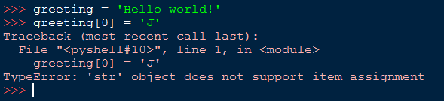
String are immutable
If you attempt to user the operator on the leff side of an assignment , with the intention of changing a character in a string. You will get an error. The “object” in this case is the string and the “item” is the character you tried to assign. The reason for the error is that strings are immutable, which means you can’t change an existing string.

Slide 24
String Comparison
The comparison operators work on strings. To see if two strings are equal:
if word == 'banana':
print('All right, bananas.')
if word < 'banana':
print('Your word,' + word + ', comes before banana.')
elif word > 'banana':
print('Your word,' + word + ', comes after banana.')
else:
print('All right, bananas.')
Other comparison operations are useful for putting words in alphabetical order:

Slide 25
String Library
Strings are an example of Python objects. An object contains both data (the actual string itself) and methods, which are effectively functions that are built into the object and are available to any instance of the object.

Slide 26
String Library
Python has a number of string functions which are in the string library
These functions are already built into every string - we invoke them by appending the function to the string variable
These functions do not modify the original string, instead they return a new string that has been altered
>>> greet = 'Hello Bob'
>>> zap = greet.lower()
>>> print(zap)
hello bob
>>> print(greet)
Hello Bob
>>> print('Hi There'.lower())
hi there
>>>

Slide 27
Python has a function called dir which lists the methods available for an object. The type function shows the type of an object and the dir function shows the available methods.
>>> stuff = 'Hello world'
>>> type(stuff)
<class 'str'>
>>> dir(stuff)
['capitalize', 'casefold', 'center', 'count', 'encode', 'endswith', 'expandtabs', 'find', 'format', 'format_map', 'index', 'isalnum', 'isalpha', 'isdecimal', 'isdigit', 'isidentifier', 'islower', 'isnumeric', 'isprintable', 'isspace', 'istitle', 'isupper', 'join', 'ljust', 'lower', 'lstrip', 'maketrans', 'partition', 'replace', 'rfind', 'rindex', 'rjust', 'rpartition', 'rsplit', 'rstrip', 'split', 'splitlines', 'startswith', 'strip', 'swapcase', 'title', 'translate', 'upper', 'zfill']

Slide 28
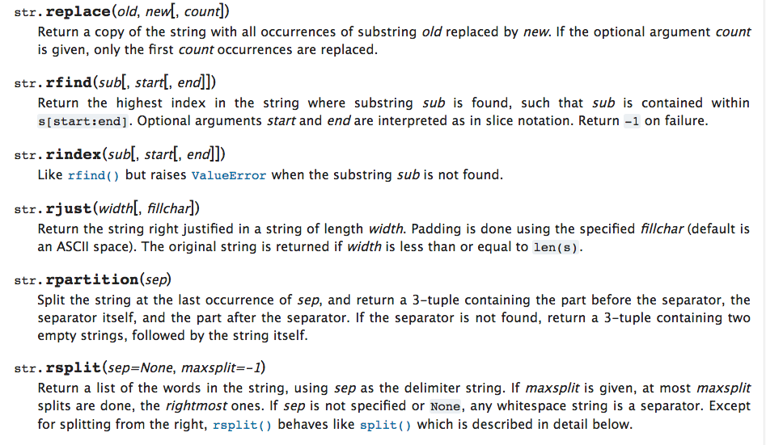

Slide 29





Slide 30

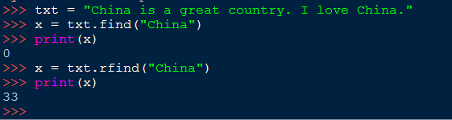
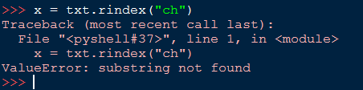
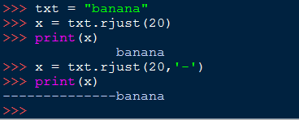

Slide 31


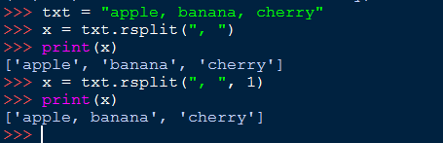

Slide 32
String Library
str.capitalize()
str.center(width[, fillchar])
str.endswith(suffix[, start[, end]])
str.find(sub[, start[, end]])
str.lstrip([chars])
str.replace(old, new[, count])
str.lower()
str.rstrip([chars])
str.strip([chars])
str.upper()

Slide 33
Searching a String
b
a
n
a
n
a
We use the find() function to search for a substring within another string
find() finds the first occurrence of the substring
If the substring is not found, find() returns -1
Remember that string position starts at zero
0
1
2
3
4
5
>>> fruit = 'banana'
>>> pos = fruit.find('na')
>>> print(pos)
2
>>> aa = fruit.find('z')
>>> print(aa)
-1

Slide 34
Making everything UPPER CASE
You can make a copy of a string in lower case or upper case
Often when we are searching for a string using find() we first convert the string to lower case so we can search a string regardless of case
>>> greet = 'Hello Bob'
>>> nnn = greet.upper()
>>> print(nnn)
HELLO BOB
>>> www = greet.lower()
>>> print(www)
hello bob
>>>

Slide 35
Search and Replace
The replace() function is like a “search and replace” operation in a word processor
It replaces all occurrences of the search string with the replacement string
>>> greet = 'Hello Bob'
>>> nstr = greet.replace('Bob','Jane')
>>> print(nstr)
Hello Jane
>>> nstr = greet.replace('o','X')
>>> print(nstr)
HellX BXb
>>>

Slide 36
Stripping Whitespace
Sometimes we want to take a string and remove whitespace at the beginning and/or end
lstrip() and rstrip() remove whitespace at the left or right
strip() removes both beginning and ending whitespace
>>> greet = ' Hello Bob '
>>> greet.lstrip()
'Hello Bob '
>>> greet.rstrip()
' Hello Bob'
>>> greet.strip()
'Hello Bob'
>>>

Slide 37
Prefixes
>>> line = 'Please have a nice day'
>>> line.startswith('Please')
True
>>> line.startswith('p')
False

Slide 38
Parsing and Extracting
Often, we want to look into a string and find a substring. For example, we want to pull out only the second half of the address (i.e., uct.ac.za) from each line, we can do this by using the find method and string slicing
21
31
From stephen.marquard@uct.ac.za Sat Jan 5 09:14:16 2008
>>> data = 'From stephen.marquard@uct.ac.za Sat Jan 5 09:14:16 2008'
>>> atpos = data.find('@')
>>> print(atpos)
21
>>> sppos = data.find(' ',atpos)
>>> print(sppos)
31
>>> host = data[atpos+1 : sppos]
>>> print(host)
uct.ac.za

Slide 39
Two Kinds of Strings
Python 2.7.10
>>> x = '이광춘'
>>> type(x)
<type 'str'>
>>> x = u'이광춘'
>>> type(x)
<type 'unicode'>
>>>
Python 3.5.1
>>> x = '이광춘'
>>> type(x)
<class 'str'>
>>> x = u'이광춘'
>>> type(x)
<class 'str'>
>>>
In Python 3, all strings are Unicode

Slide 40
Summary
String type
Read/Convert
Indexing strings []
Slicing strings [2:4]
Looping through strings with for and while
Concatenating strings with +
String operations
String library
String comparisons
Searching in strings
Replacing text
Stripping white space

