Slide 1
Regular Expressions
Chapter 11
Python for Everybody
www.py4e.com
Notes:
Note from Chuck. If you are using these materials, you can remove the UM logo and replace it with your own, but please retain the CC-BY logo on the first page as well as retain the acknowledgement page(s) at the end.

Slide 2
Regular Expressions
This task of searching and extracting is so common that Python has a very powerful library called regular expressions that handles many of these tasks quite elegantly. The reason we have not introduced regular expressions earlier in the book is because while they are very powerful, they are a little complicated and their syntax takes some getting used to.
http://en.wikipedia.org/wiki/Regular_expression

Slide 3
Regular Expressions
In computing, a regular expression, also referred to as “regex” or “regexp”, provides a concise and flexible means for matching strings of text, such as particular characters, words, or patterns of characters. A regular expression is written in a formal language that can be interpreted by a regular expression processor.
http://en.wikipedia.org/wiki/Regular_expression

Slide 4
Understanding Regular Expressions
Very powerful and quite cryptic
Fun once you understand them
Regular expressions are a language unto themselves
A language of “marker characters” - programming with characters
It is kind of an “old school” language - compact

Slide 5
Regular Expression Quick Guide
^ Matches the beginning of a line
$ Matches the end of the line
. Matches any character
\s Matches whitespace
\S Matches any non-whitespace character
* Repeats a character zero or more times
*? Repeats a character zero or more times (non-greedy), Applies to the immediately preceding character(s) and indicates to match one or more times in “non-greedy mode”.
+ Repeats a character one or more times
+? Repeats a character one or more times (non-greedy), Applies to the immediately preceding character(s) and indicates to match one or more times in “non-greedy mode”.
[aeiou] Matches a single character in the listed set
[^XYZ] Matches a single character not in the listed set
[a-z0-9] The set of characters can include a range
( Indicates where string extraction is to start
) Indicates where string extraction is to end
https://www.py4e.com/lectures3/Pythonlearn-11-Regex-Handout.txt

Slide 6
The Regular Expression Module
Before you can use regular expressions in your program, you must import the library using “import re”
The simplest use of the regular expression library is the search() function. You can use re.search() to see if a string matches a regular expression, similar to using the find() method for strings
You can use re.findall() to extract portions of a string that match your regular expression, similar to a combination of find() and slicing.

Slide 7
Using re.search() Like find()
hand = open('mbox-short.txt')
for line in hand:
line = line.rstrip()
if line.find('From:') >= 0:
print(line)
import re
hand = open('mbox-short.txt')
for line in hand:
line = line.rstrip()
if re.search('From:', line) :
print(line)
We open the file, loop through each line, and use the regular expression search() to only print out lines that contain the string “From:”. This program does not use the real power of regular expressions, since we could have just as easily used line.find() to accomplish the same result.

Slide 8
Using re.search() Like startswith()
hand = open('mbox-short.txt')
for line in hand:
line = line.rstrip()
if line.startswith('From:') :
print(line)
import re
hand = open('mbox-short.txt')
for line in hand:
line = line.rstrip()
if re.search('^From:', line) :
print(line)
The power of the regular expressions comes when we add special characters to the search string that allow us to more precisely control which lines match the string. Adding these special characters to our regular expression allow us to do sophisticated matching and extraction while writing very little code. For example, the caret character is used in regular expressions to match “the beginning” of a line. Note that regular
expressions contain special action characters that give us more control

Slide 9
Wild-Card Characters
The most commonly used special character is the dot character or period.
The dot character matches any character
If you add the asterisk character, the character is “any number of times”
Many times
Match the start of the line
X-Sieve: CMU Sieve 2.3
X-DSPAM-Result: Innocent
X-DSPAM-Confidence: 0.8475
X-Content-Type-Message-Body: text/plain
^X.*:
Match any character

Slide 10
Fine-Tuning Your Match
Depending on how “clean” your data is and the purpose of your application, you may want to narrow your match down a bit
X-Sieve: CMU Sieve 2.3
X-DSPAM-Result: Innocent
X-: Very Short
X-Plane is behind schedule: two weeks
One or more times
Match the start of the line
^X-\S+:
Match any non-whitespace character

Slide 11
More examples
In the following example, the regular expression F..m: would match any of the strings “From:”, “Fxxm:”, “F12m:”, or “F!@m:” since the dot characters in the regular expression match any character
import re
hand = open('mbox-short.txt')
for line in hand:
line = line.rstrip()
if re.search('^F..m:', line):
print(line)

Slide 12

More examples
This is particularly powerful when combined with the ability to indicate that a character can be repeated any number of times using the * or + characters in your regular expression. These special characters mean that instead of matching a single character in the search string, they match zero-or-more characters (in the case of the asterisk) or one-or-more of the characters (in the case of the plus sign).
The search string ˆFrom:.+@ will successfully match lines that start with “From:”, followed by one or more characters (.+), followed by an at-sign. So this will match the following line:
import re
hand = open('mbox-short.txt')
for line in hand:
line = line.rstrip()
if re.search('^'From:.+@‘,line):
print(line)
You can think of the .+ wildcard as expanding to match all the characters between the colon character and the at-sign.

Slide 13
Matching and Extracting Data
re.search() returns a True/False depending on whether the string matches the regular expression
If we actually want the matching strings to be extracted, we use re.findall() to extract all of the substrings which match a regular expression
[0-9]+
>>> import re
>>> x = 'My 2 favorite numbers are 19 and 42'
>>> y = re.findall('[0-9]+',x)
>>> print(y)
['2', '19', '42']
One or more digits

Slide 14
Matching and Extracting Data
When we use re.findall(), it returns a list of zero or more sub-strings that match the regular expression
>>> import re
>>> x = 'My 2 favorite numbers are 19 and 42'
>>> y = re.findall('[0-9]+',x)
>>> print(y)
['2', '19', '42']
>>> y = re.findall('[AEIOU]+',x)
>>> print(y)
[]

Slide 15
Warning: Greedy Matching
The repeat characters (* and +) push outward in both directions (greedy) to match the largest possible string
One or more characters
>>> import re
>>> x = 'From: Using the : character'
>>> y = re.findall('^F.+:', x)
>>> print(y)
['From: Using the :']
^F.+:
First character in the match is an F
Last character in the match is a :
Why not 'From:' ?

Slide 16
Non-Greedy Matching
Not all regular expression repeat codes are greedy! If you add a ? character, the + and * chill out a bit...
One or more characters but not greedy
>>> import re
>>> x = 'From: Using the : character'
>>> y = re.findall('^F.+?:', x)
>>> print(y)
['From:']
^F.+?:
First character in the match is an F
Last character in the match is a :

Slide 17
Fine-Tuning String Extraction
For example, we want to pull the email addresses from the following line:
From stephen.marquard@uct.ac.za Sat Jan 5 09:14:16 2008
>>> import re
>>> x = “From stephen.marquard@uct.ac.za Sat Jan 5 09:14:16 2008”
>>> y = re.findall('\S+@\S+', x)
>>> print(y)
['stephen.marquard@uct.ac.za’]
\S+@\S+
At least one non-whitespace character

Slide 18
Fine-Tuning String Extraction
You can refine the match for re.findall() and separately determine which portion of the match is to be extracted by using parentheses. Parentheses are not part of the match - but they tell where to start and stop what string to extract
From stephen.marquard@uct.ac.za Sat Jan 5 09:14:16 2008
>>> y = re.findall('\S+@\S+',x)
>>> print(y)
['stephen.marquard@uct.ac.za']
>>> y = re.findall('^From (\S+@\S+)',x)
>>> print(y)
['stephen.marquard@uct.ac.za']
^From (\S+@\S+)

Slide 19

More examples
This following program uses findall() to find the lines with email addresses in them and extract one or more addresses from each of those lines. we are looking for substrings that have at least one non-whitespace character, followed by an at-sign, followed by at least one more whitespace character. The \S+ matches as many non-whitespace characters as possible.
import re
s = 'A message from csev@umich.edu to cwen@iupui.edu about meeting @2PM'
lst = re.findall('\S+@\S+', s)
print(lst)
The findall() method searches the string in the second argument and returns a list of all of the strings that look like email addresses. We are using a two-character sequence that matches a non-whitespace character (\S).

Slide 20
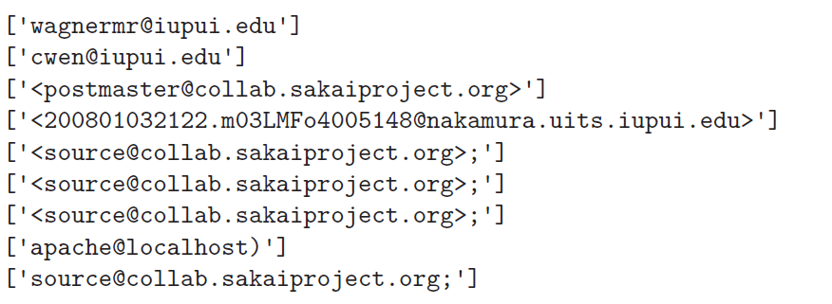
More examples
We can use this regular expression in a program to read all the lines in a file and print out anything that looks like an email address as follows:
If we run the program on mbox.txt we get the following output
import re
hand = open('mbox-short.txt')
for line in hand:
line = line.rstrip()
x = re.findall('\S+@\S+', line)
if len(x) > 0:
print(x)

Slide 21
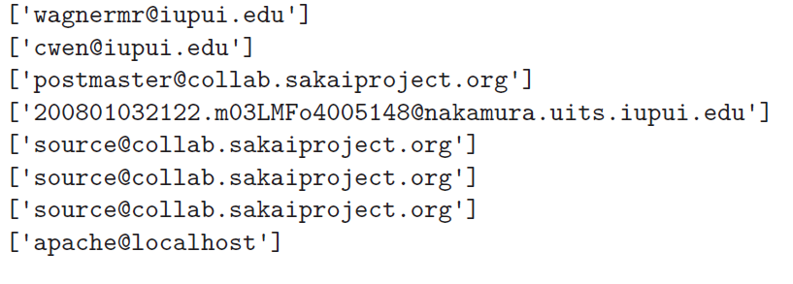
More examples
Some of the email addresses have incorrect characters like “<” or “;” at the beginning or end. Let’s declare that we are only interested in the portion of the string that starts and ends with a letter or a number
import re
hand = open('mbox-short.txt')
for line in hand:
line = line.rstrip()
x = re.findall('[a-zA-Z0-9]\S+@\S+[a-zA-Z]', line)
if len(x) > 0:
print(x)
we are looking for substrings that start with a single lowercase letter, uppercase letter, or number “[a-zA-Z0-9]”, followed by zero or more non-blank characters (\S*), followed by an at-sign, followed by zero or more non-blank characters (\S*), followed by an uppercase or lowercase letter. Note that we switched from + to * to indicate zero or more non-blank characters since [a-zA-Z0-9] is already one non-blank character.

Slide 22
String Parsing Examples
21
31
From stephen.marquard@uct.ac.za Sat Jan 5 09:14:16 2008
>>> data = 'From stephen.marquard@uct.ac.za Sat Jan 5 09:14:16 2008'
>>> atpos = data.find('@')
>>> print(atpos)
21
>>> sppos = data.find(' ',atpos)
>>> print(sppos)
31
>>> host = data[atpos+1 : sppos]
>>> print(host)
uct.ac.za
Extracting a host name - using find and string slicing

Slide 23
The Double Split Pattern
Sometimes we split a line one way, and then grab one of the pieces of the line and split that piece again
From stephen.marquard@uct.ac.za Sat Jan 5 09:14:16 2008
words = line.split()
email = words[1]
pieces = email.split('@')
print(pieces[1])
stephen.marquard@uct.ac.za
['stephen.marquard', 'uct.ac.za']
'uct.ac.za'

Slide 24
The Regex Version
From stephen.marquard@uct.ac.za Sat Jan 5 09:14:16 2008
import re
lin = 'From stephen.marquard@uct.ac.za Sat Jan 5 09:14:16 2008'
y = re.findall('@([^ ]*)',lin)
print(y)
['uct.ac.za']
'@([^ ]*)'
Look through the string until you find an at sign

Slide 25
The Regex Version
From stephen.marquard@uct.ac.za Sat Jan 5 09:14:16 2008
import re
lin = 'From stephen.marquard@uct.ac.za Sat Jan 5 09:14:16 2008'
y = re.findall('@([^ ]*)',lin)
print(y)
['uct.ac.za']
'@([^ ]*)'
Match non-blank character
Match many of them

Slide 26
The Regex Version
From stephen.marquard@uct.ac.za Sat Jan 5 09:14:16 2008
import re
lin = 'From stephen.marquard@uct.ac.za Sat Jan 5 09:14:16 2008'
y = re.findall('@([^ ]*)',lin)
print(y)
['uct.ac.za']
'@([^ ]*)'
Extract the non-blank characters

Slide 27
Even Cooler Regex Version
From stephen.marquard@uct.ac.za Sat Jan 5 09:14:16 2008
import re
lin = 'From stephen.marquard@uct.ac.za Sat Jan 5 09:14:16 2008'
y = re.findall('^From .*@([^ ]*)',lin)
print(y)
['uct.ac.za']
'^From .*@([^ ]*)'
Starting at the beginning of the line, look for the string 'From '

Slide 28
Even Cooler Regex Version
From stephen.marquard@uct.ac.za Sat Jan 5 09:14:16 2008
import re
lin = 'From stephen.marquard@uct.ac.za Sat Jan 5 09:14:16 2008'
y = re.findall('^From .*@([^ ]*)',lin)
print(y)
['uct.ac.za']
'^From .*@([^ ]*)'
Skip a bunch of characters, looking for an at sign

Slide 29
Even Cooler Regex Version
From stephen.marquard@uct.ac.za Sat Jan 5 09:14:16 2008
import re
lin = 'From stephen.marquard@uct.ac.za Sat Jan 5 09:14:16 2008'
y = re.findall('^From .*@([^ ]*)',lin)
print(y)
['uct.ac.za']
'^From .*@([^ ]*)'
Start extracting

Slide 30
Even Cooler Regex Version
From stephen.marquard@uct.ac.za Sat Jan 5 09:14:16 2008
import re
lin = 'From stephen.marquard@uct.ac.za Sat Jan 5 09:14:16 2008'
y = re.findall('^From .*@([^ ]*)',lin)
print(y)
['uct.ac.za']
'^From .*@([^ ]+)'
Match non-blank character
Match many of them

Slide 31
Even Cooler Regex Version
From stephen.marquard@uct.ac.za Sat Jan 5 09:14:16 2008
import re
lin = 'From stephen.marquard@uct.ac.za Sat Jan 5 09:14:16 2008'
y = re.findall('^From .*@([^ ]*)',lin)
print(y)
['uct.ac.za']
'^From .*@([^ ]+)'
Stop extracting

Slide 32
Spam Confidence
If we want to find numbers on lines that start with the string X-DSPAM-Confidence
X-DSPAM-Confidence: 0.8475
X-DSPAM-Confidence: 0.0000
we want lines that start with X-DSPAM-Confidence, followed by a colon (:) and then a space. After the space we are looking for one or more characters that are either a digit (0-9) or a period [0-9.]+. Note that inside the square brackets, the period matches an actual period (i.e., it is not a wildcard between the square brackets).
'^X-DSPAM-Confidence: ([0-9.]+)'

Slide 33
Spam Confidence
import re
hand = open('mbox-short.txt')
numlist = list()
for line in hand:
line = line.rstrip()
stuff = re.findall('^X-DSPAM-Confidence: ([0-9.]+)', line)
if len(stuff) != 1 :
continue
num = float(stuff[0])
numlist.append(num)
print('Maximum:', max(numlist))
python ds.py
Maximum: 0.9907

Slide 34
More examples
If we wanted to extract all of the revision numbers (the integer number at the end of these lines) using the same technique as above, we could write the following program:
Details: http://source.sakaiproject.org/viewsvn/?view=rev&rev=39772
import re
hand = open('mbox-short.txt')
for line in hand:
line = line.rstrip()
x = re.findall('^Details:.*rev=([0-9.]+)', line)
if len(x) > 0:
print(x)
we are looking for lines that start with Details:, followed by any number of characters (.*), followed by rev=, and then by one or more digits. We want to find lines that match the entire expression but we only want to extract the integer number at the end of the line, so we surround [0-9]+ with parentheses.

Slide 35
Escape Character
If you want a special regular expression character to just behave normally (most of the time) you prefix it with '\'
>>> import re
>>> x = 'We just received $10.00 for cookies.'
>>> y = re.findall('\$[0-9.]+',x)
>>> print(y)
['$10.00']
At least one or more
\$[0-9.]+
A real dollar sign
A digit or period

Slide 36
Summary
Regular expressions are a cryptic but powerful language for matching strings and extracting elements from those strings
Regular expressions have special characters that indicate intent

