Slide 1

Conditional Execution
Chapter 3
Python for Everybody
www.py4e.com
Notes:
Note from Chuck. If you are using these materials, you can remove the UM logo and replace it with your own, but please retain the CC-BY logo on the first page as well as retain the acknowledgement page(s).

Slide 2
Conditional Steps
x = 5
In order to write useful programs, we almost always need the ability to check conditions and change the behavior of the program accordingly
x < 10 ?
Yes
Program:
x = 5
if x < 10:
print('Smaller')
if x > 20:
print('Bigger')
print('Finis')
Output:
Smaller
Finis
No
print('Smaller')
x > 20 ?
Yes
No
print('Bigger')
print('Finis')

Slide 3
Comparison Operators
The boolean expression after the if statement is called the condition
Boolean expressions ask a question and produce a Yes or No result which we use to control program flow
Boolean expressions using comparison operators evaluate to True / False or Yes / No
Comparison operators look at variables but do not change the variables
Python | Meaning
< | Less than
<= | Less than or Equal to
== | Equal to
>= | Greater than or Equal to
> | Greater than
!= | Not equal
Remember: “=” is used for assignment.

Slide 4
Comparison Operators
The if statement ends with a colon character (:) and the line(s) after the if statement are indented.
x = 5
if x == 5 :
print('Equals 5')
if x > 4 :
print('Greater than 4')
if x >= 5 :
print('Greater than or Equals 5')
if x < 6 :
print('Less than 6')
if x <= 5 :
print('Less than or Equals 5')
if x != 6 :
print('Not equal 6')
Equals 5
Greater than 4
Greater than or Equals 5
Less than 6
Less than or Equals 5
Not equal 6

Slide 5
Logical Operators
There are three logical operators: and, or, and not. The semantics (meaning) of these operators is similar to their meaning in English
x > 0 and x < 10
is true only if x is greater than 0 and less than 10.
n%2 == 0 or n%3 == 0
is true if either of the conditions is true, that is, if the number is divisible by 2 or 3

Slide 6
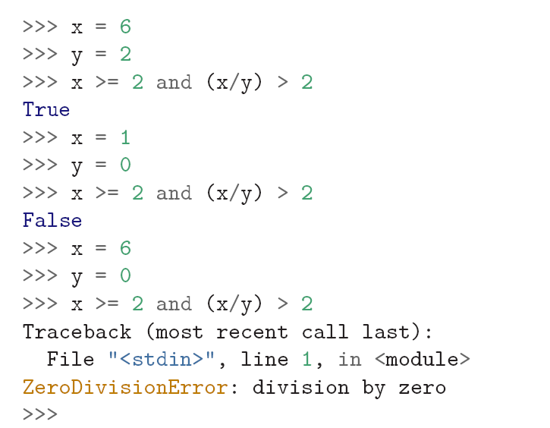
Logical Operators
When Python is processing a logical expression, it evaluates the expression from left to right, When Python detects that there is nothing to be gained by evaluating the rest of a logical expression, it stops its evaluation and does not do the computations in the rest of the logical expression. When the evaluation of a logical expression stops because the overall value is already known, it is called short-circuiting the evaluation.
if x is less than 2, the expression x >= 2 is False and so the whole expression is False regardless of whether (x/y) > 2 evaluates to True or False.
Notes:
Because of the definition of and

Slide 7
One-Way Decisions
x = 5
print('Before 5')
if x == 5 :
print('Is 5')
print('Is Still 5')
print('Third 5')
print('Afterwards 5')
print('Before 6')
if x == 6 :
print('Is 6')
print('Is Still 6')
print('Third 6')
print('Afterwards 6')
Yes
x == 5 ?
Before 5
Is 5
Is Still 5
Third 5
Afterwards 5
Before 6
Afterwards 6
No
print('Is 5’)
print('Still 5')
print('Third 5')

Slide 8
Indentation
Increase indent after an if statement or for statement (after : )
Maintain indent to indicate the scope of the block (which lines are affected by the if/for)
Reduce indent back to the level of the if statement or for statement to indicate the end of the block
Blank lines are ignored - they do not affect indentation
Comments on a line by themselves are ignored with regard to indentation

Slide 9
Warning: Turn Off Tabs!!
Atom automatically uses spaces for files with ".py" extension (nice!)
Most text editors can turn tabs into spaces - make sure to enable this feature
- NotePad++: Settings -> Preferences -> Language Menu/Tab Settings
- TextWrangler: TextWrangler -> Preferences -> Editor Defaults
Python cares a *lot* about how far a line is indented. If you mix tabs and spaces, you may get “indentation errors” even if everything looks fine

Slide 10
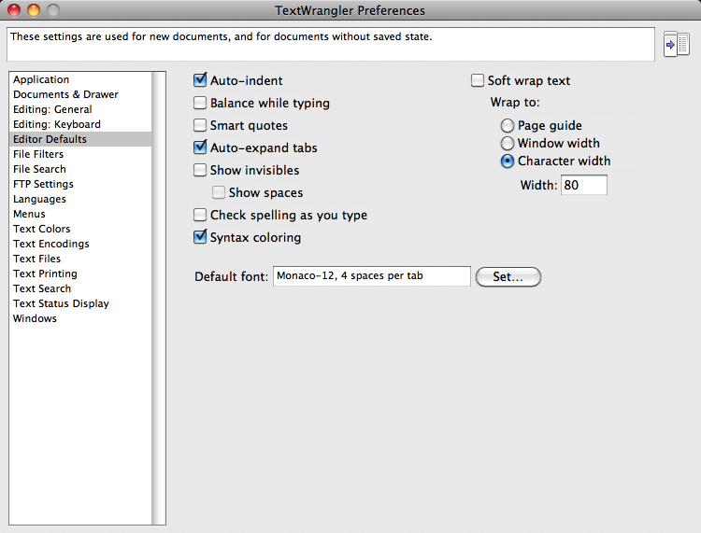

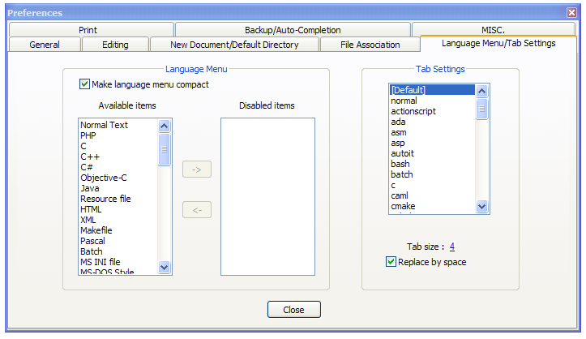
This will save you much unnecessary pain.

Slide 11
increase / maintain after if or for
decrease to indicate end of block
x = 5
if x > 2 :
print('Bigger than 2')
print('Still bigger')
print('Done with 2')
for i in range(5) :
print(i)
if i > 2 :
print('Bigger than 2')
print('Done with i', i)
print('All Done')

Slide 12
Think About begin/end Blocks
x = 5
if x > 2 :
print('Bigger than 2')
print('Still bigger')
print('Done with 2')
for i in range(5) :
print(i)
if i > 2 :
print('Bigger than 2')
print('Done with i', i)
print('All Done')

Slide 13
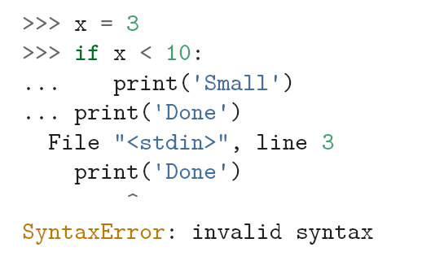
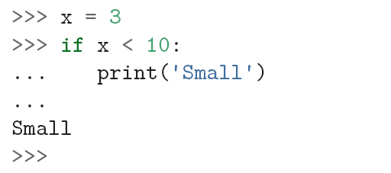
if statement in the Python interpreter
If you enter an if statement in the Python interpreter, the prompt will change from three chevrons to three dots to indicate you are in the middle of a block of statements, as shown below:
When using the Python interpreter, you must leave a blank line at the end of a block, otherwise Python will return an error:
HINT: A blank line at the end of a block of statements is not necessary when writing and executing a script, but it may improve readability of your code.

Slide 14
Nested Decisions
One conditional can be nested within another
x > 1
yes
x = 42
if x > 1 :
print('More than one')
if x < 100 :
print('Less than 100')
print('All done')
no
print('More than one’)
x < 100
yes
no
print('Less than 100')
The outer conditional contains one branch, which contains a simple statement and another if statement.
print('All Done')

Slide 15
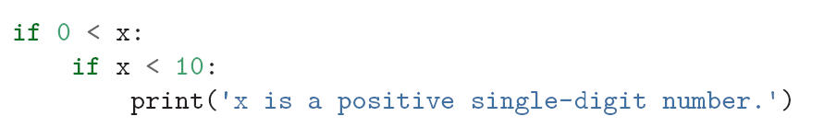
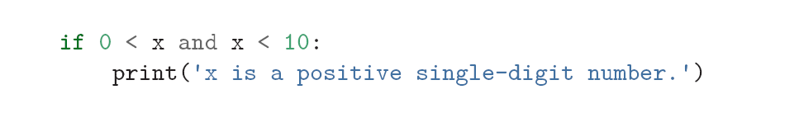
Nested Decisions
Logical operators often provide a way to simplify nested conditional statements. The print statement is executed only if we make it past both conditionals, so we can get the same effect with the and operator

Slide 16
Two-way Decisions
x = 4
Sometimes we want to do one thing if a logical expression is true and something else if the expression is false
It is like a fork in the road - we must choose one or the other path but not both
no
x > 2
yes
print('Not bigger')
print('Bigger')
print('All Done')

Slide 17
Two-way Decisions with else:
x = 4
x = 4
if x > 2 :
print('Bigger')
else :
print('Smaller')
print('All done')
no
x > 2
yes
print('Not bigger')
print('Bigger')
print('All Done')

Slide 18
Visualize Blocks
x = 4
no
x > 2
yes
x = 4
if x > 2 :
print('Bigger')
else :
print('Smaller')
print('All done')
print('Not bigger')
print('Bigger')
print('All Done')

Slide 19
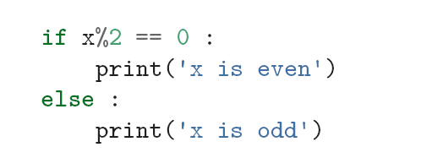
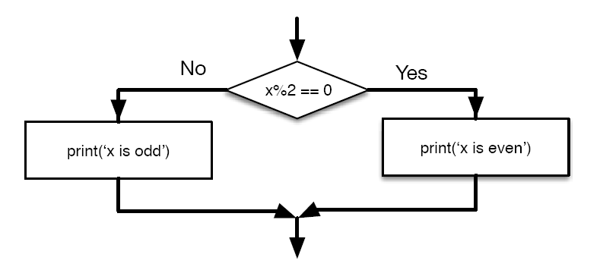
Two-way Decisions with else:
If the remainder when x is divided by 2 is 0, then we know that x is even, and the program displays a message to that effect. If the condition is false, the second set of statements is executed.

Slide 20
More Conditional Structures…

Slide 21
Multi-way/Chained conditionals
Sometimes there are more than two possibilities and we need more than two branches. One way to express a computation like that is a chained conditional
yes
x < 2
print('small')
no
yes
if x < 2 :
print('small')
elif x < 10 :
print('Medium')
else :
print('LARGE')
print('All done')
x < 10
print('Medium')
no
print('LARGE')
print('All Done')

Slide 22
x = 0
Each condition is checked in order. If the first is false, the next is checked, and so on. If one of them is true, the corresponding branch executes, and the statement ends. Even if more than one condition is true, only the first true branch executes
yes
x < 2
print('small')
no
yes
x = 0
if x < 2 :
print('small')
elif x < 10 :
print('Medium')
else :
print('LARGE')
print('All done')
x < 10
print('Medium')
no
print('LARGE')
print('All Done')

Slide 23
x = 5
yes
x < 2
print('small')
x = 5
if x < 2 :
print('small')
elif x < 10 :
print('Medium')
else :
print('LARGE')
print('All done')
no
yes
x < 10
print('Medium')
no
print('LARGE')
print('All Done')

Slide 24
x = 20
yes
x < 2
print('small')
x = 20
if x < 2 :
print('small')
elif x < 10 :
print('Medium')
else :
print('LARGE')
print('All done')
no
yes
x < 10
print('Medium')
no
print('LARGE')
print('All Done')

Slide 25
There is no limit on the number of elif statements. If there is an else clause, it has to be at the end, but there doesn’t have to be one.
if x < 2 :
print('Small')
elif x < 10 :
print('Medium')
elif x < 20 :
print('Big')
elif x < 40 :
print('Large')
elif x < 100:
print('Huge')
else :
print('Ginormous')
# No Else
x = 5
if x < 2 :
print('Small')
elif x < 10 :
print('Medium')
print('All done')

Slide 26
Multi-way Puzzles
Which will never print regardless of the value for x?
if x < 2 :
print('Below 2')
elif x < 20 :
print('Below 20')
elif x < 10 :
print('Below 10')
else :
print('Something else')
if x < 2 :
print('Below 2')
elif x >= 2 :
print('Two or more')
else :
print('Something else')

Slide 27
The try / except Structure
There is a conditional execution structure built into Python to handle these types of expected and unexpected errors called “try / except”. The idea of try and except is that you know that some sequence of instruction(s) may have a problem and you want to add some statements to be executed if an error occurs. These extra statements (the except block) are ignored if there is no error
You surround a dangerous section of code with try and except
If the code in the try works - the except is skipped
If the code in the try fails - it jumps to the except section

Slide 28
$ python3 notry.py
Traceback (most recent call last): File "notry.py", line 2, in <module> istr = int(astr)ValueError: invalid literal for int() with base 10: 'Hello Bob'
The program stops here
$ cat notry.py
astr = 'Hello Bob'
istr = int(astr)
print('First', istr)
astr = '123'
istr = int(astr)
print('Second', istr)
All
Done

Slide 29
Handling an exception with a try statement is called catching an exception. When the first conversion fails - it just drops into the except: clause and the program continues.
astr = 'Hello Bob'
try:
istr = int(astr)
except:
istr = -1
print('First', istr)
astr = '123'
try:
istr = int(astr)
except:
istr = -1
print('Second', istr)
$ python tryexcept.py
First -1
Second 123
When the second conversion succeeds - it just skips the except: clause and the program continues.

Slide 30
try / except
astr = 'Bob'
astr = 'Bob'
try:
print('Hello')
istr = int(astr)
print('There')
except:
istr = -1
print('Done', istr)
print('Hello')
istr = int(astr)
print('There')
istr = -1
In general, catching an exception gives you a chance to fix the problem, or try again, or at least end the program gracefully.
print('Done', istr)
Safety net

Slide 31
Sample try / except
rawstr = input('Enter a number:')
try:
ival = int(rawstr)
except:
ival = -1
if ival > 0 :
print('Nice work')
else:
print('Not a number')
$ python3 trynum.py
Enter a number:42
Nice work
$ python3 trynum.py
Enter a number:forty-two
Not a number
$

Slide 32
Summary
Comparison operators == <= >= > < !=
Indentation
One-way Decisions
Two-way decisions: if: and else:
Nested Decisions
Multi-way decisions using elif
try / except to compensate for errors

Slide 33
Exercise
Rewrite your pay computation to give the employee 1.5 times the hourly rate for hours worked above 40 hours.
Enter Hours: 45
Enter Rate: 10
Pay: 475.0
475 = 40 * 10 + 5 * 15

Slide 34
Exercise
Rewrite your pay program using try and except so that your program handles non-numeric input gracefully.
Enter Hours: 20
Enter Rate: nine
Error, please enter numeric input
Enter Hours: forty
Error, please enter numeric input

