Slide 1
Networked Programs
Chapter 12
Python for Everybody
www.py4e.com

Slide 2
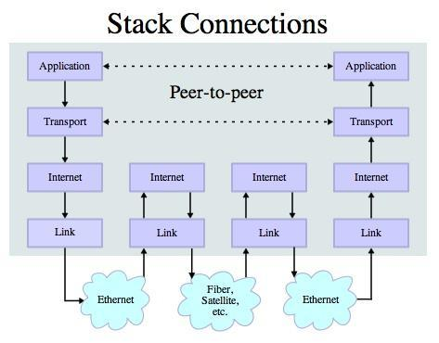
Transport Control Protocol (TCP)
Built on top of IP (Internet Protocol)
Assumes IP might lose some data - stores and retransmits data if it seems to be lost
Handles “flow control” using a transmit window
Provides a nice reliable pipe
Source: http://en.wikipedia.org/wiki/Internet_Protocol_Suite

Slide 3

TCP Connections / Sockets
“In computer networking, an Internet socket or network socket is an endpoint of a bidirectional inter-process communication flow across an Internet Protocol-based computer network, such as the Internet.”
Process
Process
Internet

Slide 4
TCP Port Numbers
A port is an application-specific or process-specific software communications endpoint
It allows multiple networked applications to coexist on the same server
There is a list of well-known TCP port numbers

Slide 5


www.umich.edu
Incoming
E-Mail
25
blah blah blah blah
Login
23
74.208.28.177
80
Web Server
443
Personal
Mail Box
109
110

Slide 6
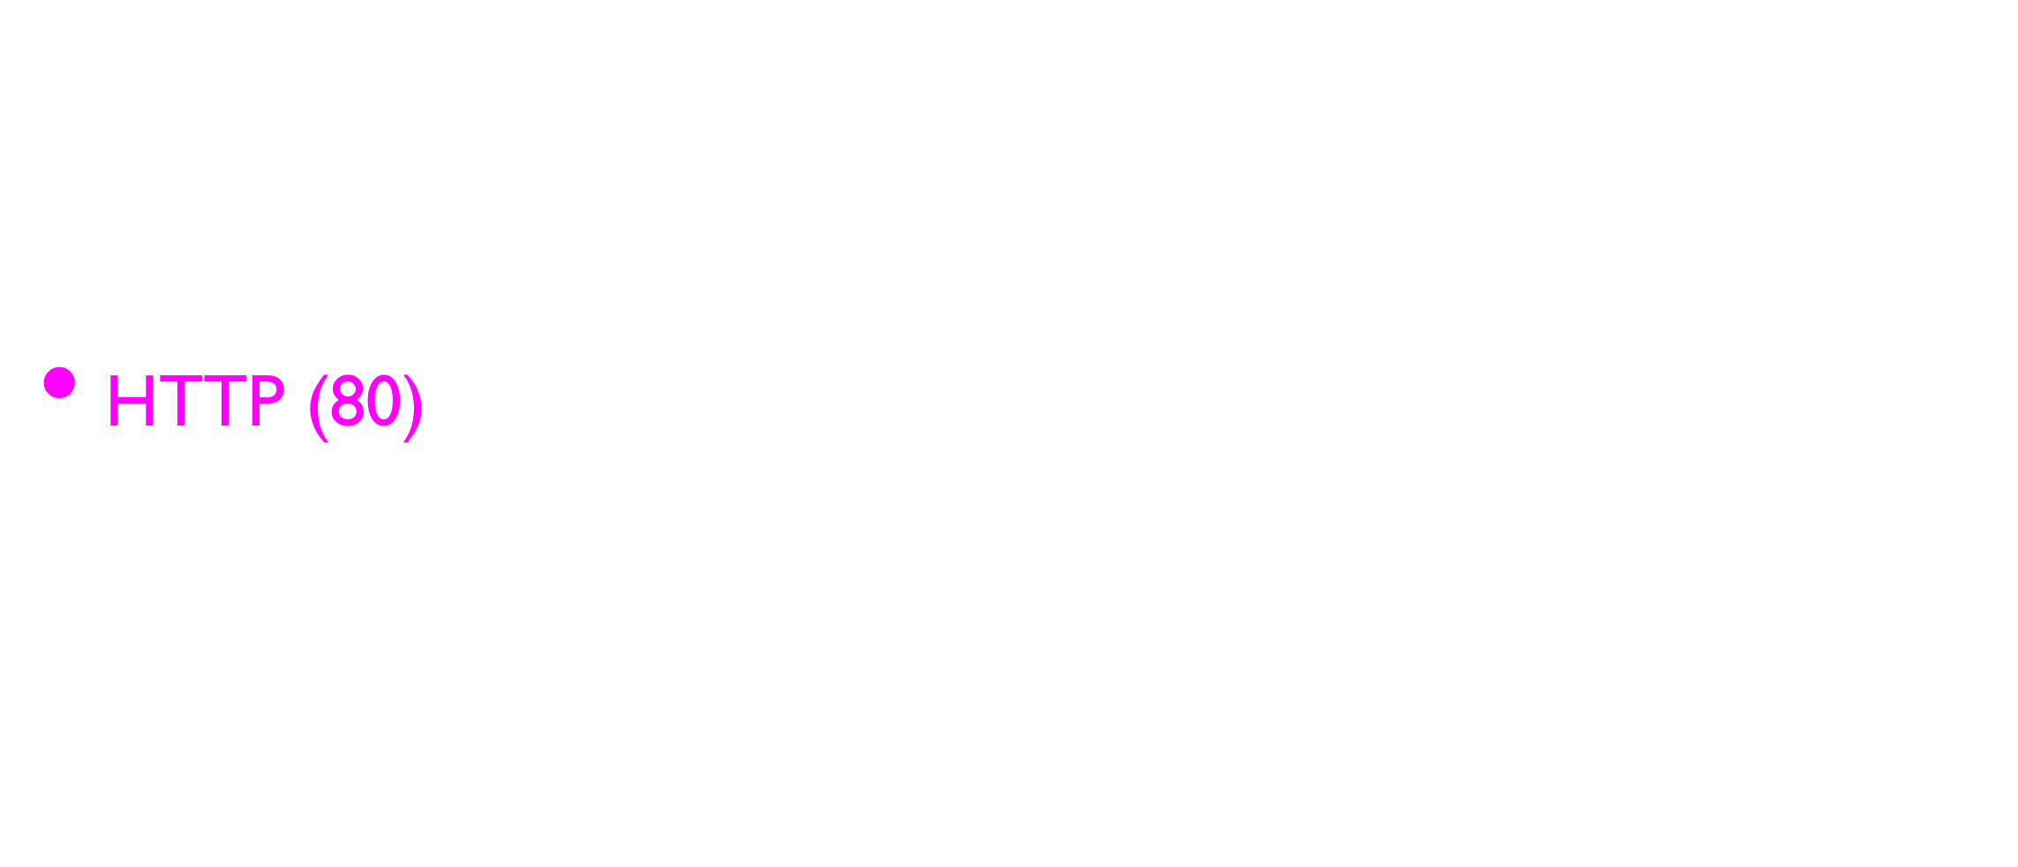
Common TCP Ports
Notes:
Internet mail access protocol
Post office protocol 3

Slide 7

Sometimes we see the port number in the URL if the web server is running on a “non-standard” port.

Slide 8
Sockets in Python
Python has built-in support for TCP Sockets which makes it very easy to make network connections and retrieve data over those sockets in a Python program
import socket
mysock = socket.socket(socket.AF_INET, socket.SOCK_STREAM)
mysock.connect( ('data.pr4e.org', 80) )
Host
Port
http://docs.python.org/library/socket.html

Slide 9
Sockets in Python
A socket is much like a file, except that a single socket provides a two-way connection between two programs. You can both read from and write to the same socket. If you write something to a socket, it is sent to the application at the other end of the socket. If you read from the socket, you are given the data which the other application has sent.
If the programs on both ends of the socket simply wait for some data without sending anything, they will wait for a very long time, so an important part of programs that communicate over the Internet is to have some sort of protocol.

Slide 10
Application Protocols

Slide 11
Application Protocol
Since TCP (and Python) gives us a reliable socket, what do we want to do with the socket? What problem do we want to solve?
Application Protocols:A protocol is a set of precise rules that determine who is to go first, what they are to do, and then what the responses are to that message, and who sends next, and so on.

Slide 12
HTTP - Hypertext Transfer Protocol
The dominant Application Layer Protocol on the Internet
Invented for the Web - to Retrieve HTML, Images, Documents, etc.
Extended to be data in addition to documents - RSS, Web Services, etc.
Basic Concept - Make a Connection - Request a document - Retrieve the Document - Close the Connection

Slide 13
HTTP
The HyperText Transfer Protocol is the set of rules to allow browsers to retrieve web documents from servers over the Internet

Slide 14
Getting Data From The Server
Each time the user clicks on an anchor tag with an href= value to switch to a new page, the browser makes a connection to the web server and issues a “GET” request - to GET the content of the page at the specified URL
The server returns the HTML document to the browser, which formats and displays the document to the user

Slide 15

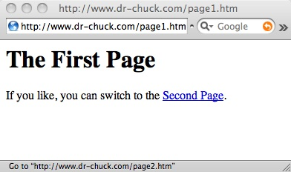
Web Server
80
Browser

Slide 16
Web Server
80
Browser
Click

Slide 17
Request
Web Server
80
GET http://www.dr-chuck.com/page2.htm
Browser
Click

Slide 18
Request
Web Server
80
GET http://www.dr-chuck.com/page2.htm
Browser
Click

Slide 19
Request
Web Server
Response
80
<h1>The Second Page</h1><p>If you like, you can switch back to the <a href="page1.htm">First Page</a>.</p>
GET http://www.dr-chuck.com/page2.htm
Browser
Click

Slide 20
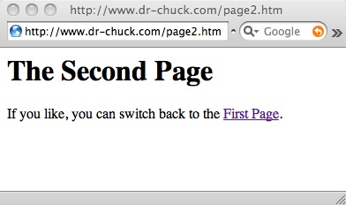
Request
Web Server
Response
80
<h1>The Second Page</h1><p>If you like, you can switch back to the <a href="page1.htm">First Page</a>.</p>
GET http://www.dr-chuck.com/page2.htm
Browser
Click
Parse/
Render

Slide 21
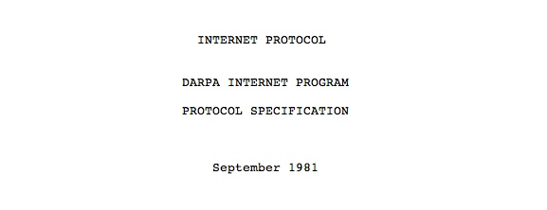
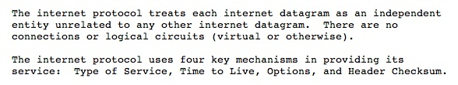
Internet Standards
The standards for all of the Internet protocols (inner workings) are developed by an organization
Internet Engineering Task Force (IETF)
www.ietf.org
Standards are called “RFCs” - “Request for Comments”
Source: http://tools.ietf.org/html/rfc791

Slide 22
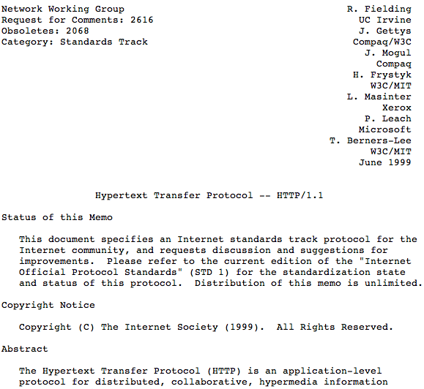
http://www.w3.org/Protocols/rfc2616/rfc2616.txt

Slide 23
Making an HTTP request
Connect to the server like www.dr-chuck.com
Request a document (or the default document)
GET http://www.dr-chuck.com/page1.htm HTTP/1.0
GET http://www.mlive.com/ann-arbor/ HTTP/1.0
GET http://www.facebook.com HTTP/1.0

Slide 24
$ telnet www.dr-chuck.com 80
Trying 74.208.28.177...
Connected to www.dr-chuck.com.Escape character is '^]'.
GET http://www.dr-chuck.com/page1.htm HTTP/1.0
HTTP/1.1 200 OK
Date: Thu, 08 Jan 2015 01:57:52 GMT
Last-Modified: Sun, 19 Jan 2014 14:25:43 GMT
Connection: close
Content-Type: text/html
<h1>The First Page</h1>
<p>If you like, you can switch to
the <a href="http://www.dr-chuck.com/page2.htm">Second Page</a>.</p>
Connection closed by foreign host.
Web Server
Browser

Slide 25
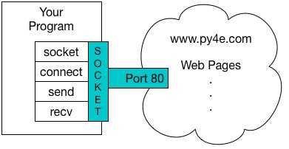
An HTTP Request in Python
import socket
mysock = socket.socket(socket.AF_INET, socket.SOCK_STREAM)
mysock.connect(('data.pr4e.org', 80))
cmd = 'GET http://data.pr4e.org/romeo.txt HTTP/1.0\r\n\r\n'.encode()
mysock.send(cmd)
while True:
data = mysock.recv(512)
if (len(data) < 1):
break
print(data.decode(),end='')
mysock.close()

Slide 26
An HTTP Request in Python
First the program makes a connection to port 80 on the server www.py4e.com. Since our program is playing the role of the “web browser”, the HTTP protocol says we must send the GET command followed by a blank line. \r\n signifies an EOL (end of line), so \r\n\r\n signifies nothing between two EOL sequences. That is the equivalent of a blank line.
Once we send that blank line, we write a loop that receives data in 512-character chunks from the socket and prints the data out until there is no more data to read (i.e., the recv() returns an empty string).

Slide 27
HTTP/1.1 200 OK
Date: Sun, 14 Mar 2010 23:52:41 GMT
Server: Apache
Last-Modified: Tue, 29 Dec 2009 01:31:22 GMT
ETag: "143c1b33-a7-4b395bea"
Accept-Ranges: bytes
Content-Length: 167
Connection: close
Content-Type: text/plain
But soft what light through yonder window breaks
It is the east and Juliet is the sun
Arise fair sun and kill the envious moon
Who is already sick and pale with grief
HTTP Header
while True:
data = mysock.recv(512)
if ( len(data) < 1 ) :
break
print(data.decode())
HTTP Body
The output starts with headers which the web server sends to describe the document. For example, the Content-Type header indicates that the document is a plain text document (text/plain). After the server sends us the headers, it adds a blank line to indicate the end of the headers, and then sends the actual data of the file romeo.txt.

Slide 28
About Characters and Strings…

Slide 29
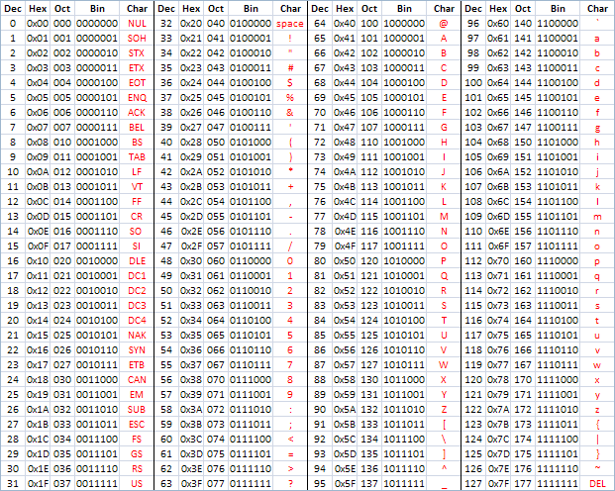
ASCII
American Standard Code for Information Interchange
https://en.wikipedia.org/wiki/ASCII
http://www.catonmat.net/download/ascii-cheat-sheet.png

Slide 30
Representing Simple Strings
Each character is represented by a number between 0 and 256 stored in 8 bits of memory
We refer to "8 bits of memory as a "byte" of memory
The ord() function tells us the numeric value of a simple ASCII character
In the 1960s and 1970s, we just assumed that one byte was one character
>>> print(ord('H'))
72
>>> print(ord('e'))
101
>>> print(ord('\n'))
10
>>>

Slide 31
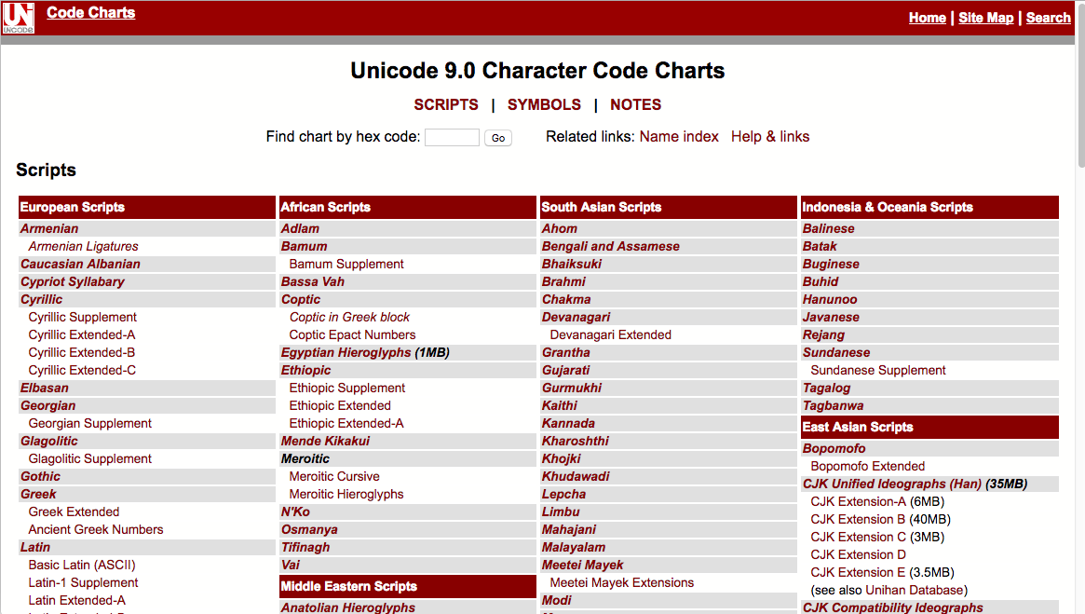
http://unicode.org/charts/

Slide 32
Multi-Byte Characters
To represent the wide range of characters computers must handle we represent characters with more than one byte
UTF-16 – Fixed length - Two bytes
UTF-32 – Fixed Length - Four Bytes
UTF-8 – 1-4 bytes
- Upwards compatible with ASCII
- Automatic detection between ASCII and UTF-8
- UTF-8 is recommended practice for encoding data to be exchanged between systems

Slide 33
Python 3 and Unicode
In Python 3, all strings internally are UNICODE
Working with string variables in Python programs and reading data from files usually "just works"
When we talk to a network resource using sockets or talk to a database we have to encode and decode data (usually to UTF-8)

Slide 34
Python Strings to Bytes
One of the requirements for using the HTTP protocol is the need to send and receive data as bytes objects, instead of strings.
When we talk to an external resource like a network socket we send bytes, so we need to encode Python 3 strings into a given character encoding
When we read data from an external resource, we must decode it based on the character set so it is properly represented in Python 3 as a string
while True:
data = mysock.recv(512)
if ( len(data) < 1 ) :
break
mystring = data.decode()
print(mystring)

Slide 35
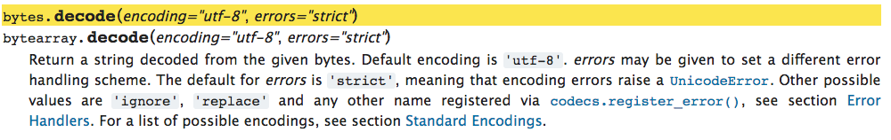
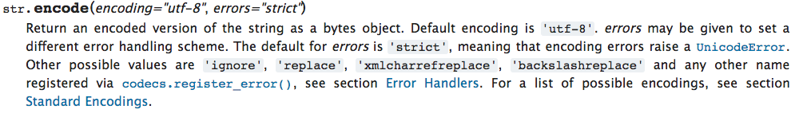
https://docs.python.org/3/library/stdtypes.html#bytes.decode
https://docs.python.org/3/library/stdtypes.html#str.encode

Slide 36
Network
decode()
Bytes
UTF-8
recv()
Socket
String
Unicode
Bytes
UTF-8
encode()
send()

Slide 37
Making HTTP Easier With urllib

Slide 38
Using urllib in Python
Since HTTP is so common, we have a library that does all the socket work for us and makes web pages look like a file
Using urllib, you can treat a web page much like a file. You simply indicate which web page you would like to retrieve and urllib handles all of the HTTP protocol and header details.

Slide 39
import urllib.request, urllib.parse, urllib.error
fhand = urllib.request.urlopen('http://data.pr4e.org/romeo.txt')
for line in fhand:
print(line.decode().strip())
urllib1.py
But soft what light through yonder window breaks
It is the east and Juliet is the sun
Arise fair sun and kill the envious moon
Who is already sick and pale with grief
Once the web page has been opened with urllib.urlopen, we can treat it like a file and read through it using a for loop
When the program runs, we only see the output of the contents of the file. The headers are still sent, but the urllib code consumes the headers and only returns the data to us

Slide 40
Using urllib in Python
As an example, we can write a program to retrieve the data for romeo.txt and compute the frequency of each word in the file as follows：
import urllib.request, urllib.parse, urllib.error
fhand = urllib.request.urlopen('http://data.pr4e.org/romeo.txt')
counts = dict()
for line in fhand:
words = line.decode().split()
for word in words:
counts[word] = counts.get(word, 0) + 1
print(counts)
urlwords.py

Slide 41
Reading Web Pages
import urllib.request, urllib.parse, urllib.error
fhand = urllib.request.urlopen('http://www.dr-chuck.com/page1.htm')
for line in fhand:
print(line.decode().strip())
<h1>The First Page</h1>
<p>If you like, you can switch to the <a href="http://www.dr-chuck.com/page2.htm">Second Page</a>.
</p>
urllib2.py

Slide 42
Reading Binary Files
import urllib.request, urllib.parse, urllib.error
img = urllib.request.urlopen(‘http://data.pr4e.org/cover3.jpg’).read()
fhand = open('cover3.jpg', 'wb')
fhand.write(img)
fhand.close()
This program reads all of the data in at once across the network and stores it in the variable img in the main memory of your computer, then opens the file cover.jpg and writes the data out to your disk. The wb argument for open() opens a binary file for writing only. This program will work if the size of the file is less than the size of the memory of your computer.

Slide 43
Reading Binary Files
import urllib.request, urllib.parse, urllib.error
img = urllib.request.urlopen(‘http://data.pr4e.org/cover3.jpg’)
fhand = open('cover3.jpg', 'wb')
size = 0
while True:
info = img.read(100000)
if len(info) < 1: break
size = size + len(info)
fhand.write(info)
print(size, 'characters copied.')
fhand.close()
In order to avoidrunning out of memory, we retrieve the data in blocks (or buffers) and then write each block to your disk before retrieving the next block. This way the program can read any size file without using up all of the memory you have in your computer

Slide 44
Summary
The TCP/IP gives us pipes / sockets between applications
We designed application protocols to make use of these pipes
HyperText Transfer Protocol (HTTP) is a simple yet powerful protocol
Python has good support for sockets, HTTP, and HTML parsing

