Slide 1




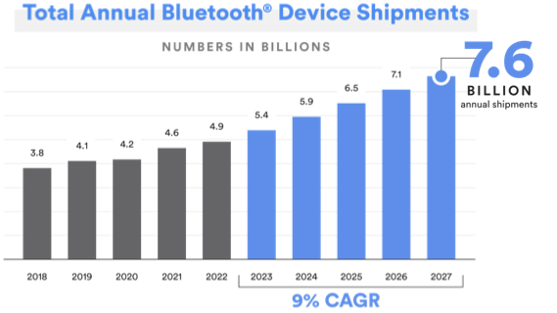
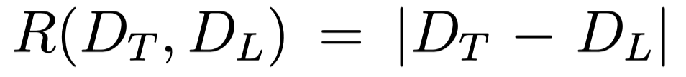
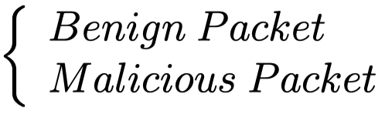

Securing Billion Bluetooth Devices Leveraging Learning-Based Techniques
Hanlin Cai, Yuchen Fang, Jiacheng Huang, Meng Yuan, Zhezhuang Xu*
What is Bluetooth Low Energy? Why Important?
Hybrid Detection Mechanism (BLEGuard)
Bluetooth Low Energy (BLE) is one of the most widely used wireless protocols. It is expected that the number of BLE devices will reach 7.6 billion by 2027.
We combined cyber-physical analysis with learning techniques.
Due to BLE’s inherent security limitations & firmware vulnerabilities, spoofing attacks can easily compromise BLE networks and tamper with privacy data.
What happened in the Bluetooth Low Energy networks?
Physical Network Testbed for BLE
Anomaly Score
Classify
Preliminary Experiment Results
RSSI
Method | Accuracy | FAR | UND
BLEGuard (us) | 99.01 | 2.05 | 0.36
BlueShield [1] | 99.54 | 2.37 | 0.72
Lahmadi [2] | 99.00 | - | -
Our main contributions:
Large-scale dataset
Low online consumption
Reliable offline analysis
Fine-tune feedback design
Cyber-Physical Feature is What We Need!
Used Channel Numbers (UCN): data channels number used during communication.
Advertising Interval (INT): the time gap between two continuous BLE packets.
Received Signal Strength Indicator (RSSI): the signal-to-noise ratio value in exchange.
Carrier Frequency Offset (CFO): offset between designated & actual carrier frequencies.
Dataset and code are publicly available:
https://github.com/BLEGuard/supplement
[1] Wu, et al, BlueShield, RAID’20 [2] Lahmadi, et al, PKDD’20
Seeking PhD Position!

