Slide 1
Big Data Management Analytics Final Project
Mining Data Breach Records from ITRC
Group 14

Slide 2
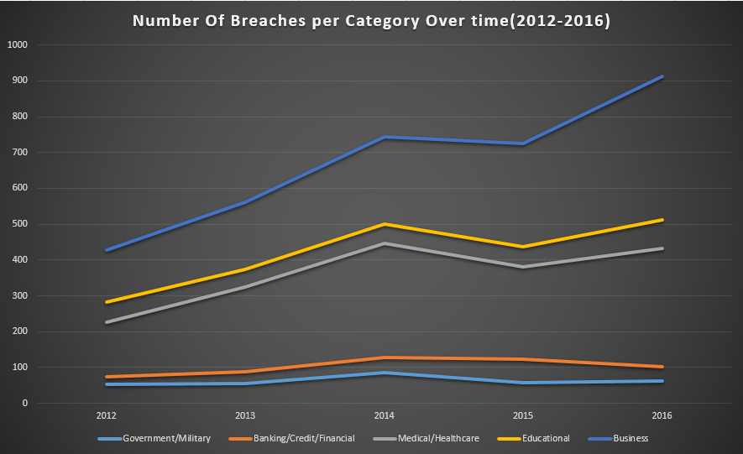
Motivation
Over the past few years, the number of data breaches have increased dramatically. It has become a threat to person and society.
Under this circumstance, we analyze the type and characteristics of data breaches from 2012 to 2016.

Slide 3
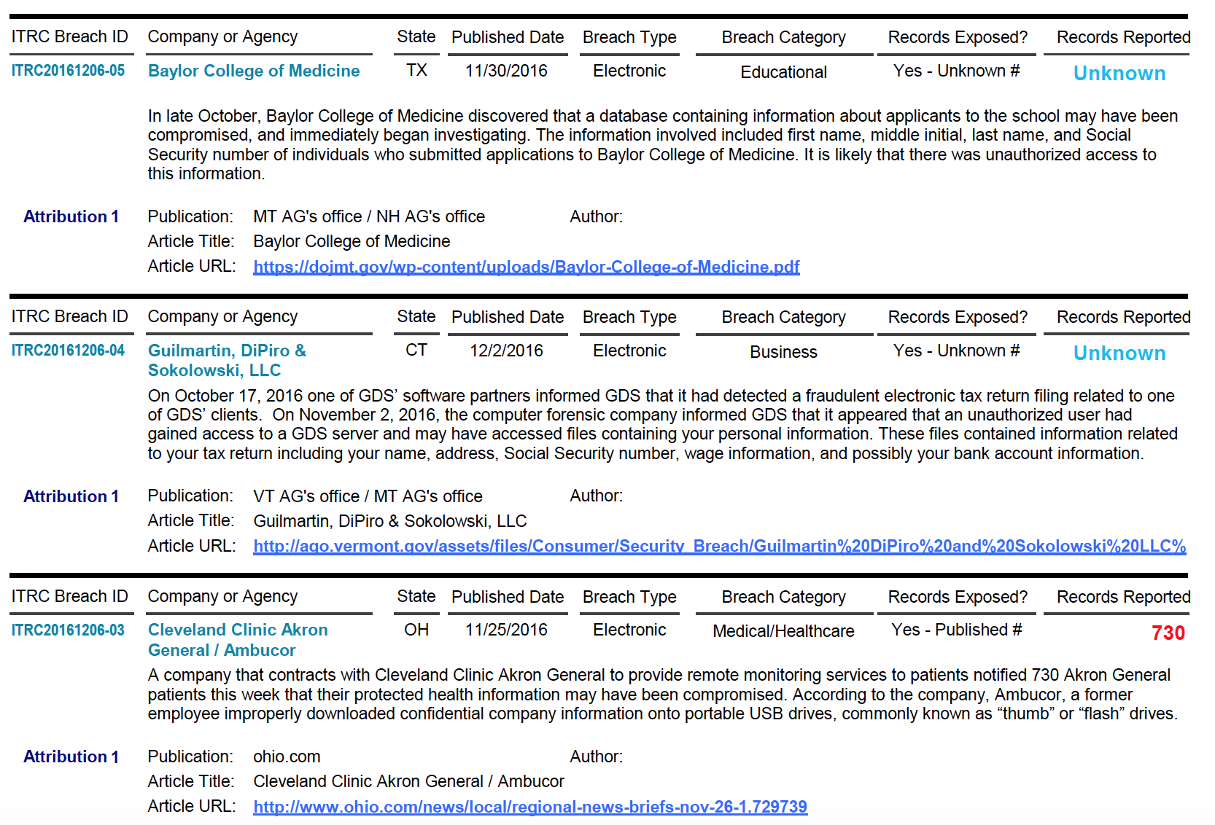
Inspiration
Our inspiration is from the paper “Mining Hospital Data Breach Records”. In addition to the data breaches related to hospital, we also extracted and mined data in business, education, government/military and Financial category.

Slide 4
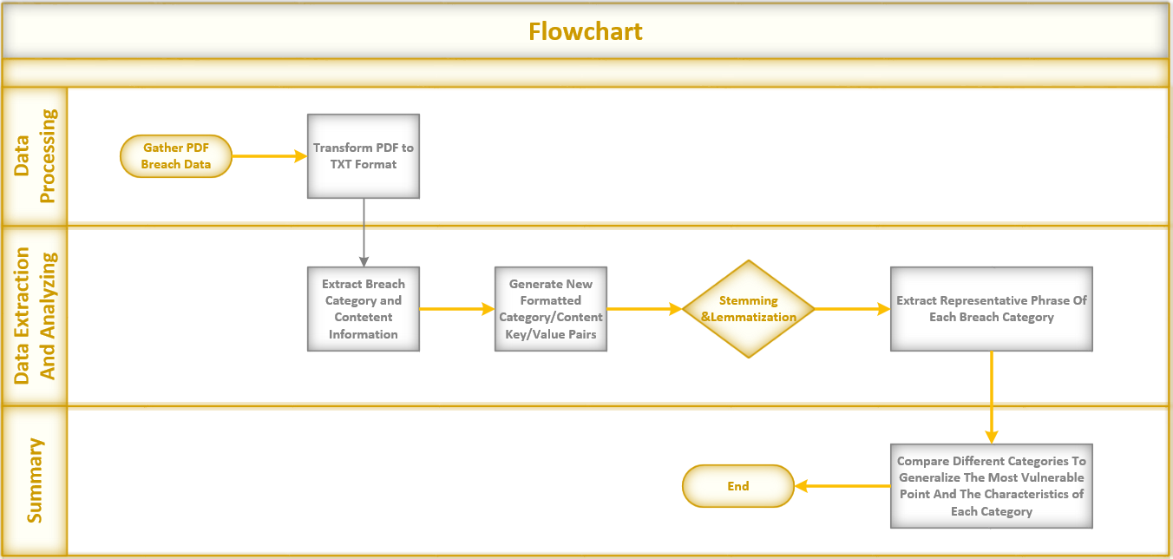
Work Flow

Slide 5
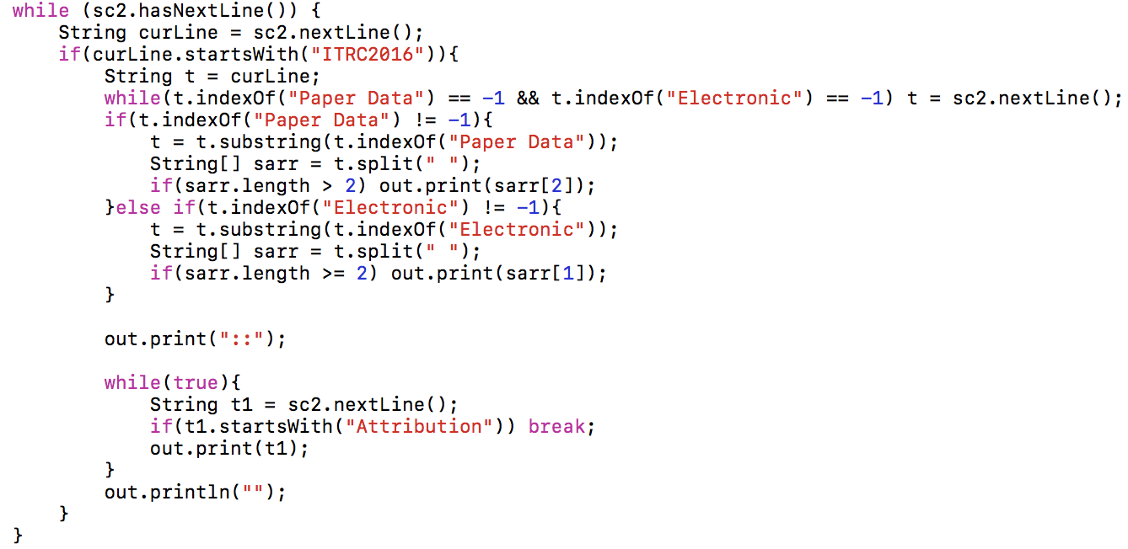
Data Processing
The data are collected from the Identity Theft Resource Center (IRTC), which is an open source database that tracks data breached across a variety of media sources.
In order to mine the data, we transformed the original data files (pdf format) to txt format using Java.
Code Snippet for Data Processing

Slide 6
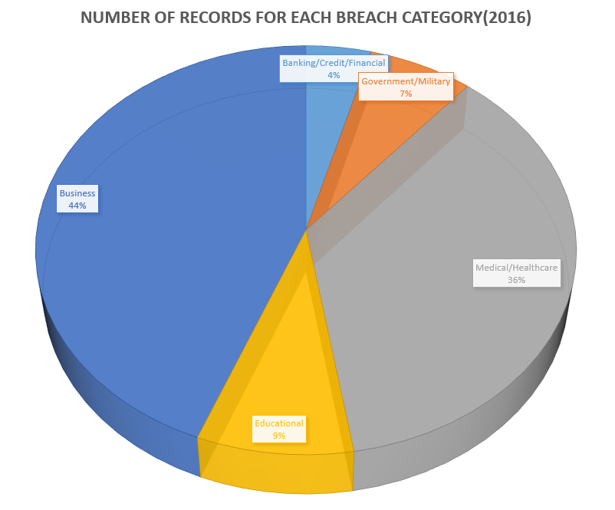
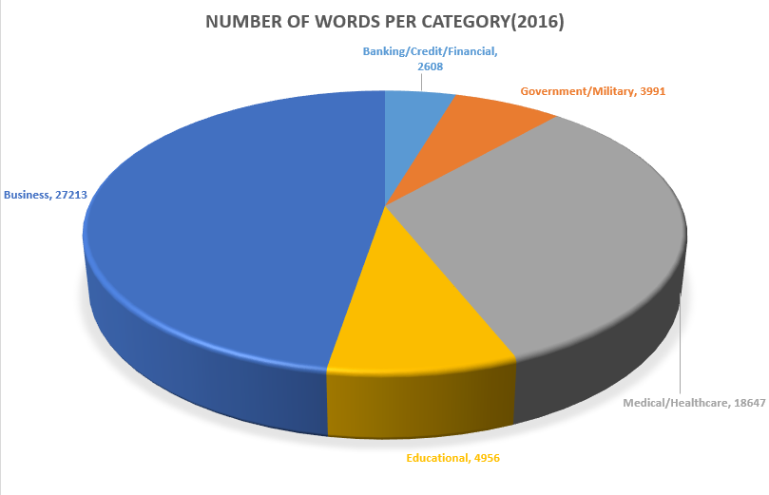
Data Extraction
For each data breach record, first information to extract is the category it belongs to so that we can classify it into the right group.
Then we separate the abstract description about the data breach record. By doing this, we can explore more detailed information about each data breach case.

Slide 7
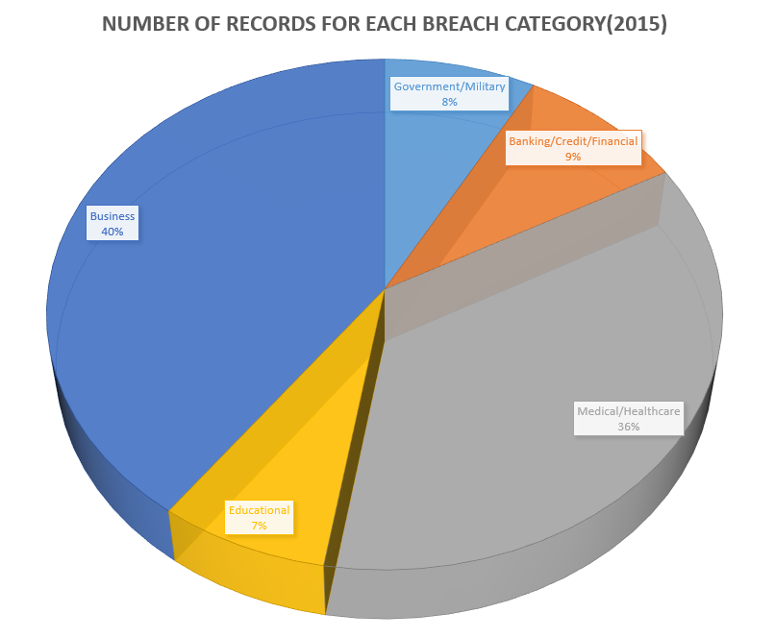
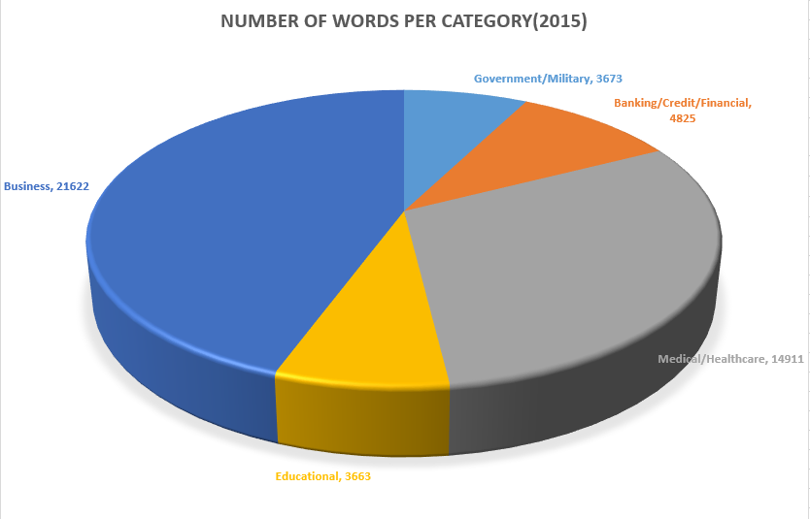

Slide 8
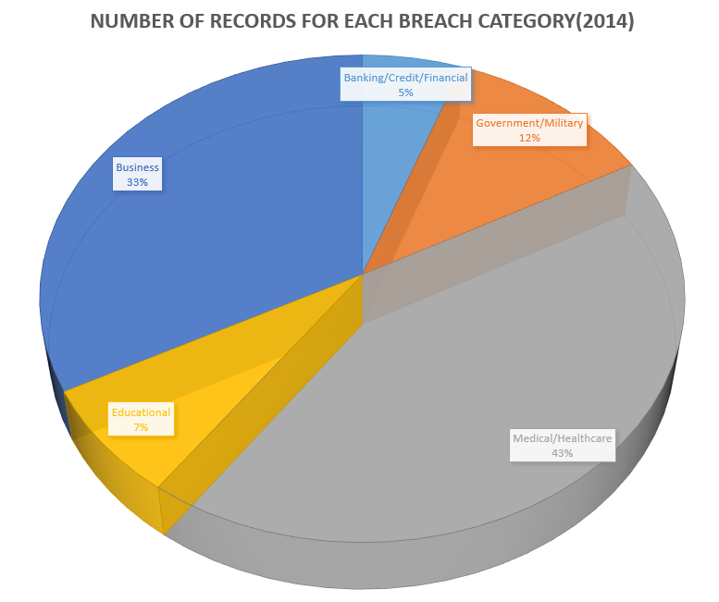
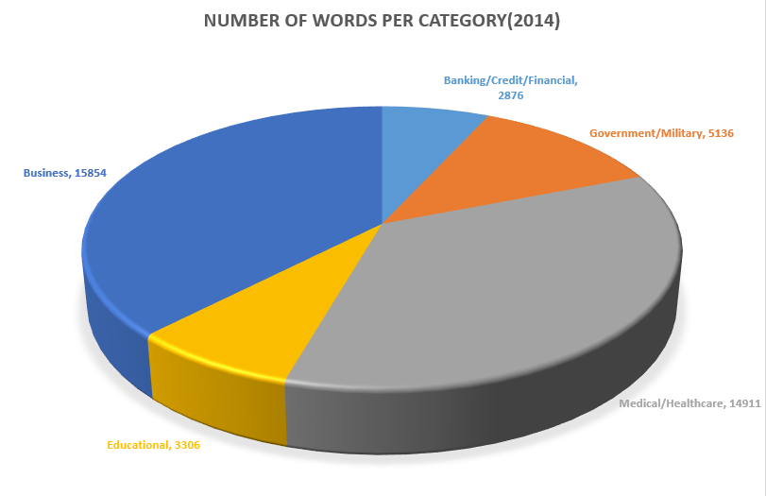

Slide 9
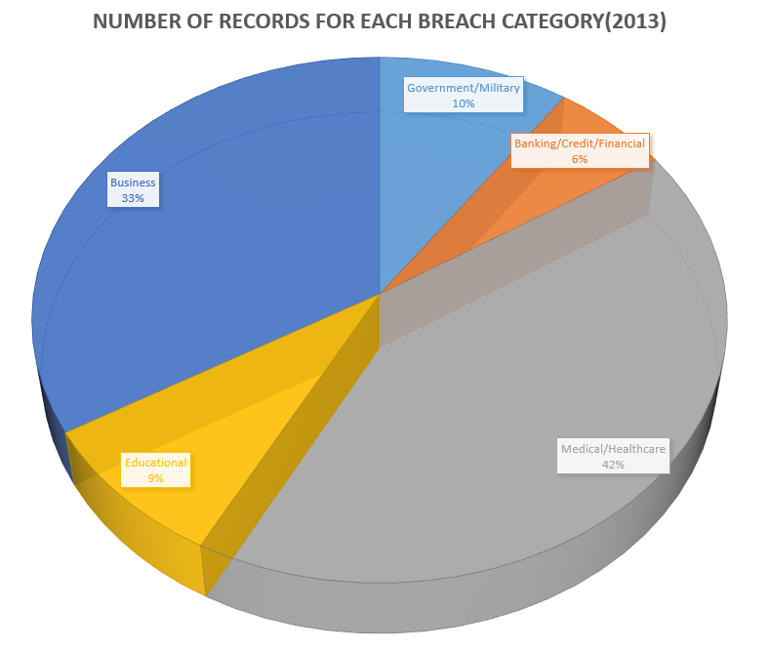
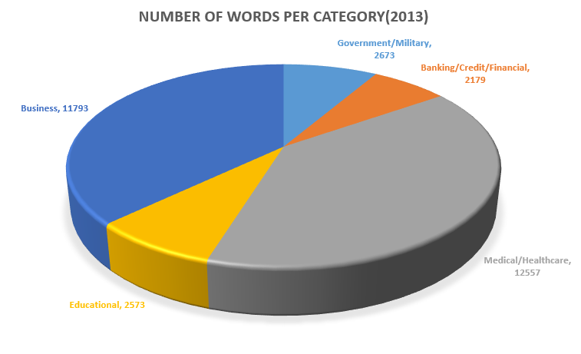

Slide 10
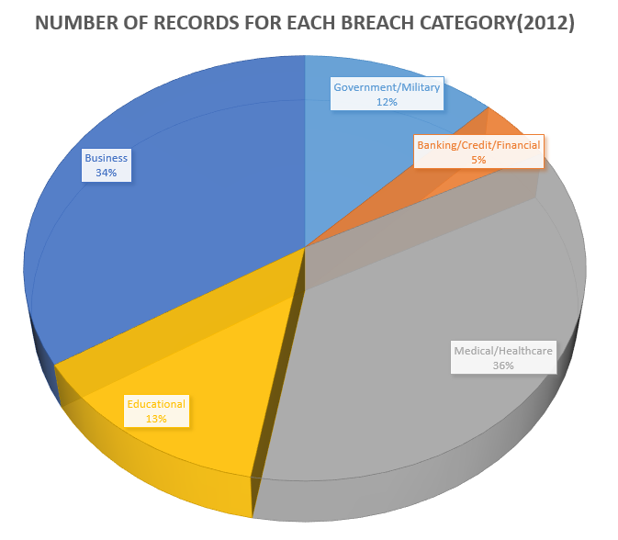
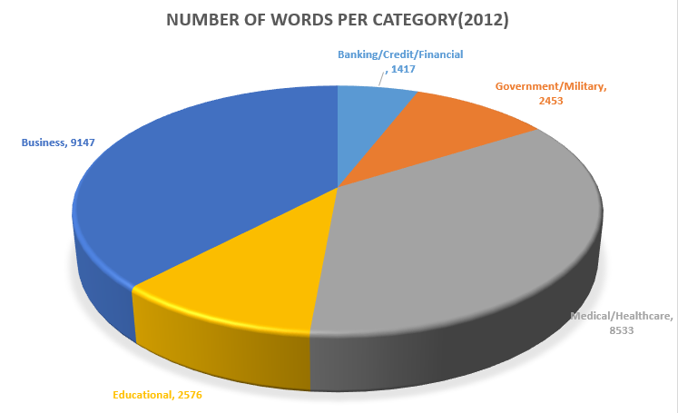

Slide 11
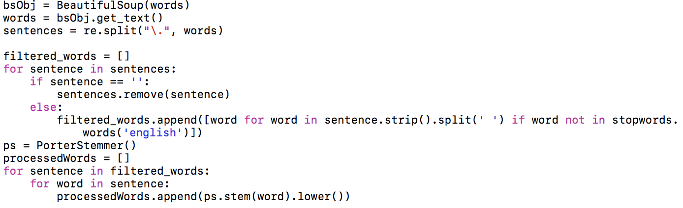
Stemming & Lemmatization
After data extraction, we used spark to stem and lemma the strings, so that we can consider related forms of a word to a common base form when mining.
Code Snippet for Stemming and Lemmatization

Slide 12
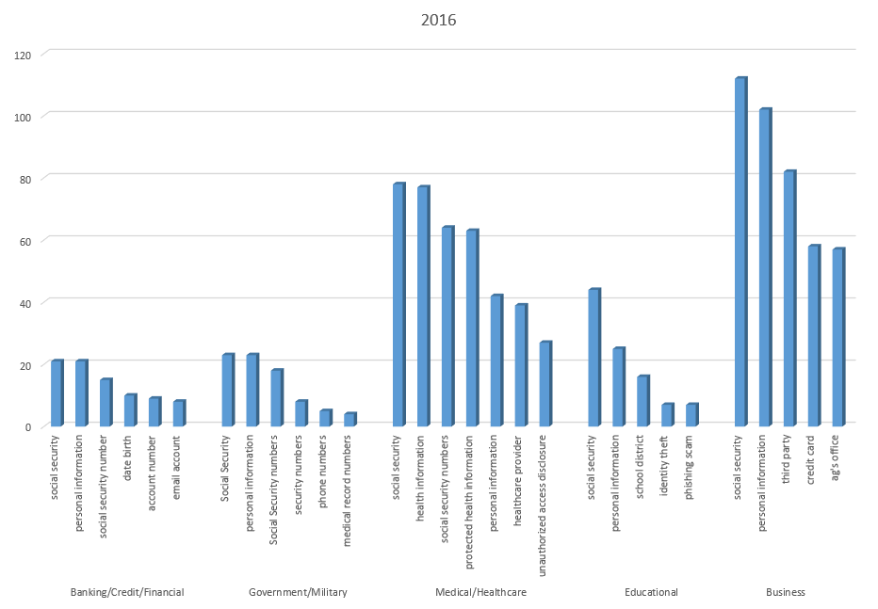
Extract representative phrase of each breach category
From the processed data, the numbers of appearance of each word in each category are calculated using spark. Then representative phrases are extracted from the phrases appear most frequently .

Slide 13
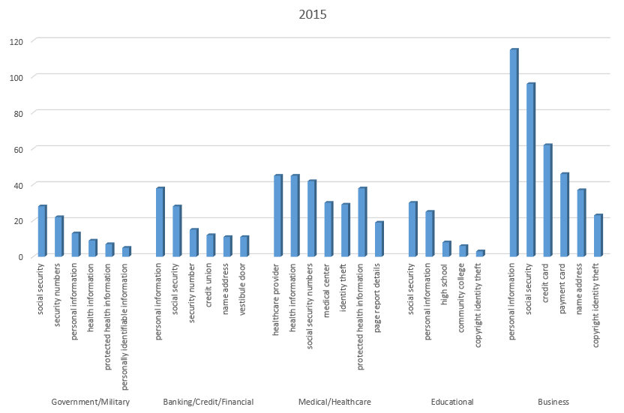

Slide 14
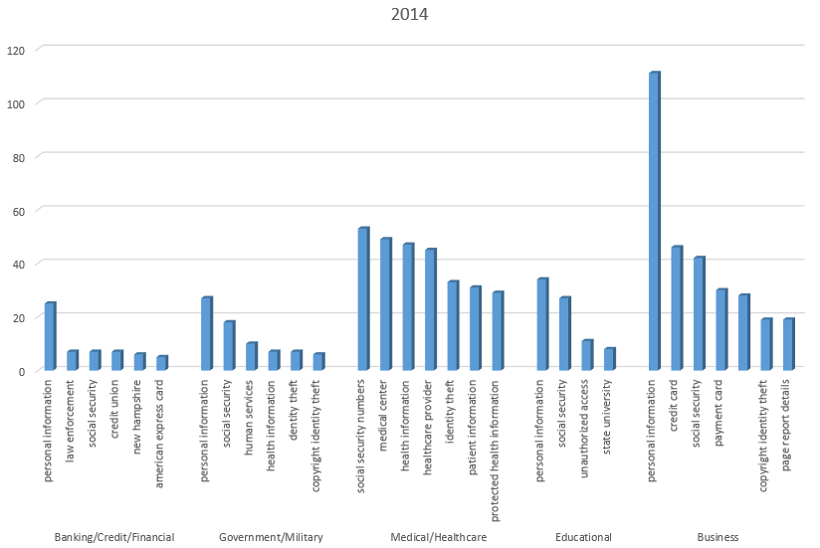

Slide 15
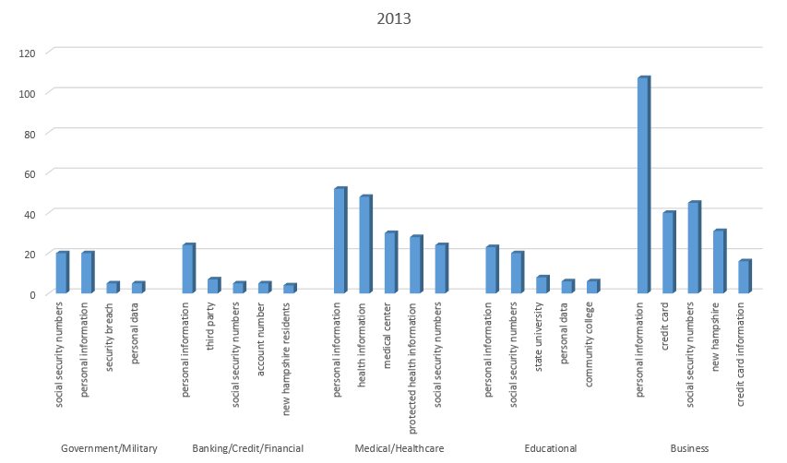

Slide 16
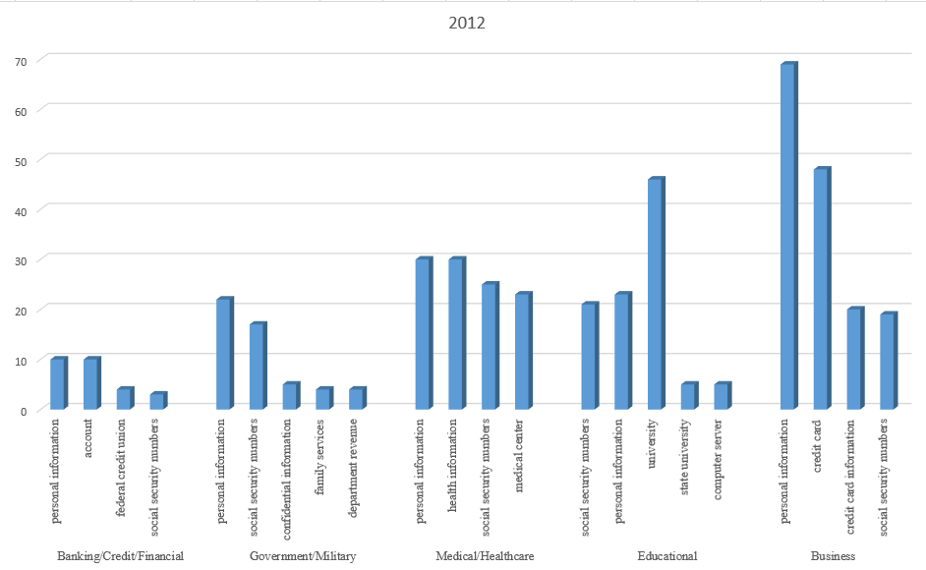

Slide 17
Compare different categories
Most frequent words across categories:
“SSN”, “Personal information”
Most attacked industry:
Business
Financial industry contains lots of data but the breach is the least of all:
Well-protected
Specificity of Frequent words for Each category
Business -> “Credit Card”
Medical/Healthcare -> “Health information”
Educational -> “University”

Slide 18
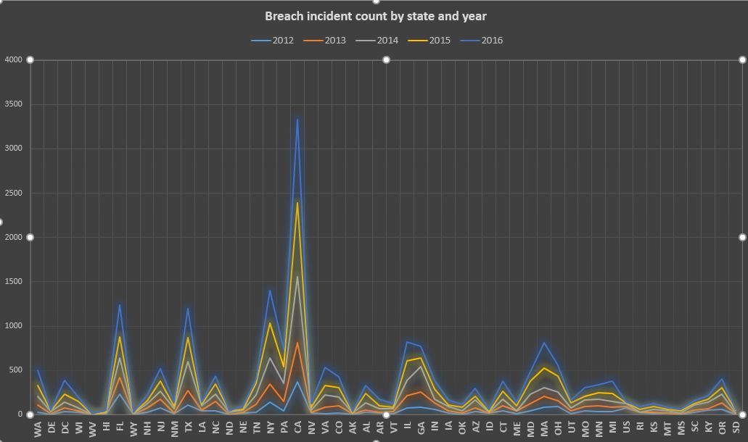
Breach incident count by state and year

Slide 19
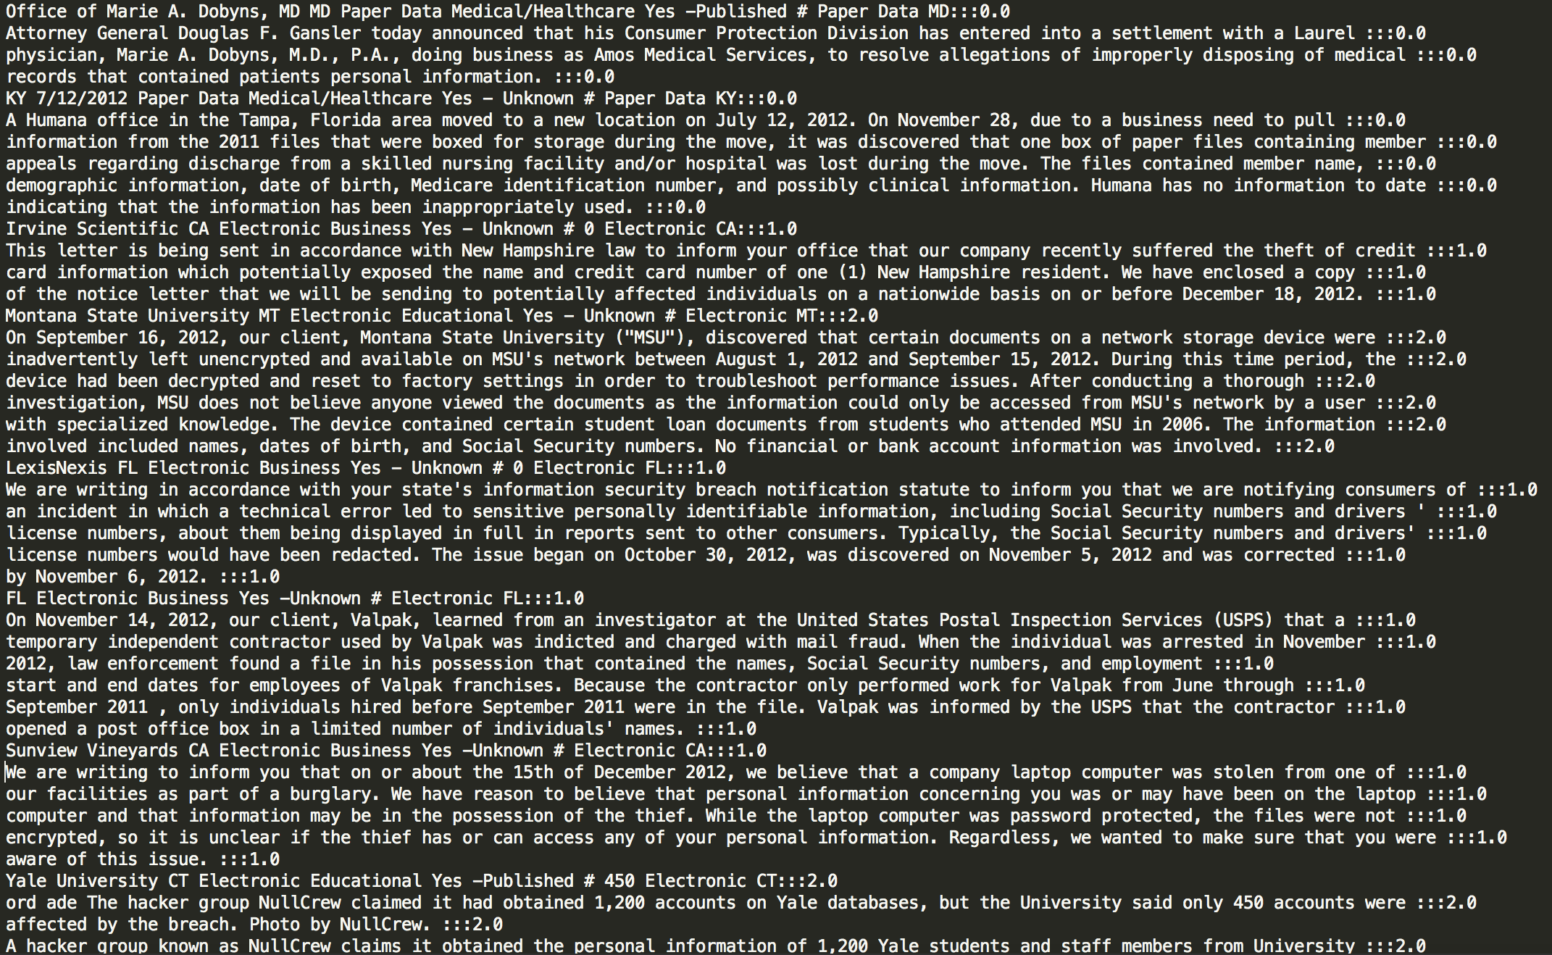
Machine learning/prediction
Since both text and classes are extracted, another analysis can be done is text classification using Naïve Bayes classifier. We labeled all the text with the breach category it belongs to to generate a training data. The format of each line is “text:::label” so that we can separate the two parts easily.

Slide 20
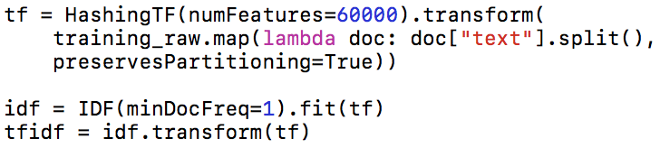

We used Term frequency-inverse document frequency method (TF-IDF) to analyse the data. TF-IDF is a feature vectorization method widely used in text mining to reflect the important of a term to a document in the corpus.
$IDF\left(t, D\right)=\log{\frac{\left|D\right|+1}{DF\left(t, D\right)+1}},$
$TFIDF\left(t, d, D\right)= TF\left(t, d\right)∙IDF(t, D)$

Slide 21
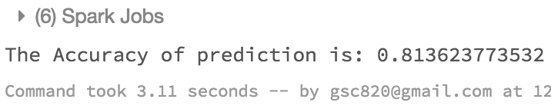
Result of prediction from Machine learning
Finally we used Naive Bayes to train the data, and the accuracy of the prediction is 81.36%.

Slide 22
Limitation
1. Limited data breach category
2. Some categories contains few data
3. Limitation of hardware
4. Limitation of time
Future implementation
Modeling more machine learning techniques, like SVM, Bagging, Random Forest, Adaboost and Gradient Boosting to generate more accurate predictions.
Using more data and more categories;

Slide 23
Gain from this project
Utilize big data and machine learning technique on real-life datasets and obtain useful information and conclusion from the practice;
Data breach has become an increasingly severe problem in many industries with the popularization of Information Technology; Meanwhile, the protection of information in some areas are not good enough to prevent breach; Improving the protection of some key information is very important;

