Slide 1
* After presentation, six pages were added in the end, stating the imperfections and possible improvements of our project
Traffic Engineering with Software Defined Networking
Guangtong Shen Haofan Feng
shen260@purdue.edu feng189@purdue.edu

Slide 2
Project Scope
Interdomain Routing (DC WAN)
Problems with static greedy routing algorithms (e.g. OSPF)
- The “best” path may be congested while other available paths
remain unconsidered
- Local optimal solution may not lead to global optimal
Research Environment: Simplified model of DC WAN:
- A host-to-host demand represents a flow demand
- Openflow virtual switches represent the Edge Routers
- ONOS SDN Controller
Two Traffic Engineering Strategies
Avoid congestion by choosing a path with widest remaining bandwidth
Obtain global maximized throughput of all flow demands using Linear Programming

Slide 3
Key Changes after Last Report
Last Report Completed
Static widest path
- Consider the link bandwidth
- Select path with the widest bottleneck capacity
Dynamic widest path
- Consider the link bandwidth and current traffic in the network
- Select path according to Remaining bandwidth or Utilization
New Progress
Optimal Multipath Bandwidth Allocation
- Consider link bandwidth and flow demands
- Linear programming to maximize total flow throughput

Slide 4
Dynamic Widest Path - Design
A new flow will send packet to controller.
Controller packet processor finds a path using dynamic widest path algorithm:
1. Use Depth First Search to find all paths from source to destination
2. For every path calculate Width of each link: use either
- Link utilization = Current occupied bandwidth / Link capacity
- Remaining Bandwidth = Link capacity - Current occupied bandwidth
3. Select the paths with highest bottleneck Width
4. Select one path with min number of hops
Using Path-Intent of ONOS to automatically install flow rules of the path to each switch
Remove the Path-Intent when the flow is empty for K seconds

Slide 5
Dynamic Widest Path - Limitation
Note that only the traffic already in the network and the link capacity are considered.
The initial demand and demand changes are not considered.
The traffic load change of other flows are not considered until this flow stops and starts later.

Slide 6
Dynamic Widest Path - Implementation of major components
PacketProcessor:
- Reading packet header (SrcIP, DstIP, SrcMac, DstMac)
- Create the traffic selector, i.e. the MATCH field of flow rule
- Find path from SrcIP to DstIP
- Install Path Intent
PathFinder:
- Depth First Search to find all paths from SrcIP to DstIP
- Calculate width of all links of a path and use the bottleneck
width as the width of the path
- Select the widest paths and choose one with min hops
BandwidthCalculator:
- Get link capacity: C
Switch will report its port speed to ONOS when connected.
But in practice we read link capacity from a topology file.
- Get link bw usage: BW
Switch has records of port statistics (Bytes sent and bytes received),
ONOS will query port statics every 5s.
Use the bytes sent & received of the ports in 5s to obtain the link bw usage.
- Remain = C-BW, Utilization = BW/C

Slide 7
Optimal Multipath Bandwidth Allocation
-Design
Objective:
Periodically change bandwidth allocation to keep the overall throughput maximized
Constraints:
Capacity of links
Demand of each <src, dst> pair
Non-negative bandwidth
Variables:
The bandwidth that should be assigned to each path(a <src, dst> pair can have multiple paths)
Coefficients of variables:
Whether a path uses certain links or not,
Whether a path belongs to a certain <src,dst> pair or not

Slide 8
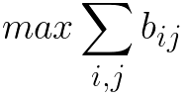
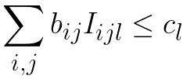
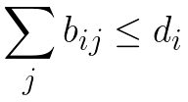

Formula
i is the demand number(a source destination pair), j is the path number within a demand, l is the link number
Objective function:
Constraint functions:
capacity constraint
demand constraint
non-negative constraint:

Slide 9
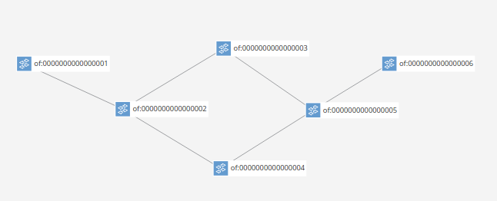
Coefficient Table
 | <1,2> | <2,1> | <2,3> | <3,2> | <2,4> | <4,2> | <3,5> | <5,3> | <4,5> | <5,4> | <5,6> | <6,5>
12356 | 1 | 0 | 1 | 0 | 0 | 0 | 1 | 0 | 0 | 0 | 1 | 0
12456 | 1 | 0 | 0 | 0 | 1 | 0 | 0 | 0 | 1 | 0 | 1 | 0
423 | 0 | 0 | 1 | 0 | 0 | 1 | 0 | 0 | 0 | 0 | 0 | 0
453 | 0 | 0 | 0 | 0 | 0 | 0 | 0 | 1 | 1 | 0 | 0 | 0

Slide 10
Optimal Multipath Bandwidth Allocation
- Implementation
Read link capacity from a text file
Continuously update current flow demands information using packets received by packet processor. The demand information includes source switch, destination switch, and requested bandwidth
Use depth first search to find all paths for each source destination pair
Select a number of paths(or all of the paths) for each demand, each path’s assigned bandwidth is the variable in linear programming
Find coefficients for the variables
Use SCPSolver (a java based linear programming tool) to periodically compute bandwidth allocation that will maximize throughput
Use group table to periodically update the multi path forwarding rule in each switch

Slide 11
Optimal Multipath Bandwidth Allocation - Implement Multipath
Using GROUP of openflow 1.3 to realize multipath
A group has many buckets which each is a forwarding port
For each packet, its flow rule selects one bucket from its group using round robin with weight of the bucket to forward the packet
Should use cpqd because the default mininet’s open virtual switch uses hashing of MATCH field, not supporting weight and randomness.
Translate multipath allocation to GROUP and flow rules
For every flow on each switch:
It may have multiple output ports due to multipath allocation
Each output port creates one bucket with its path bw as weight
Create a group containing the buckets
Create a rule on the switch pointing to the group

Slide 12
Evaluation Methodology
Objective:
Prove strategies working in SDN environment
Prove the improvement of Dynamic Widest Path compared to OSPF: avoid congestion at best effort
Prove the improvement of Optimal Multipath Bandwidth Allocation compared to Dynamic Widest Path: maximized total throughput of all demands

Slide 13
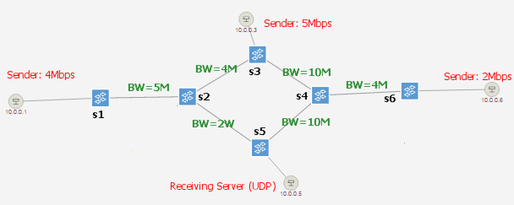
Evaluation Methodology
Dynamic Widest Path Evaluation Plan:
- In a simple graph, add three flows that may congest, in different order.
- See whether a new flow can always find the path with widest remaining bandwidth
- See whether It can avoid congestion which would have happened in OSPF
H1->H5 4Mbps
H3->H5 5Mbps
H6->H5 2Mbps
then
H6->H5 2Mbps
H3->H5 5Mbps
H1->H5 4Mbps

Slide 14
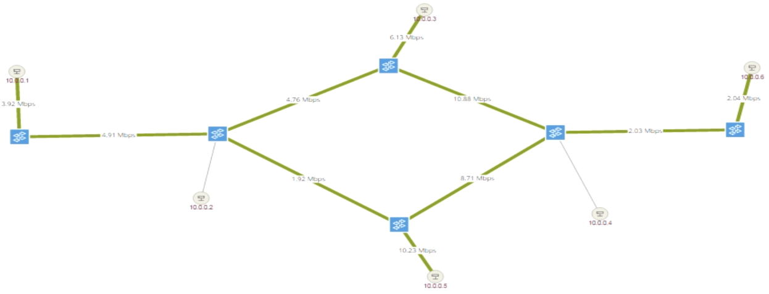
Experimental Results
Sender: 5Mbps
H1->H5 4Mbps
H3->H5 5Mbps
H6->H5 2Mbps
Sender: 2Mbps
Sender: 4Mbps
BW=4M
BW=10M
BW=5M
BW=4M
BW=2M
BW=10M
Total Demand: 11 Mbps
Demand Satisfaction: 11 Mbps
 | 1-2 | 2-1 | 2-3 | 3-2 | 2-5 | 5-2 | 3-4 | 4-3 | 4-5 | 5-4 | 4-6 | 6-4
Capacity | 5 | 5 | 4 | 4 | 2 | 2 | 10 | 10 | 10 | 10 | 5 | 5
Used BW | 4 |  | 4 | 2 | 2 |  | 4+5 | 2 | 4+5 |  |  | 2
Utilization | 80% |  | 100% | 50% | 100% |  | 90% | 20% | 90% |  |  | 40%
H6->H5 2Mbps
H3->H5 5Mbps
H1->H5 4Mbps
Total Demand: 11 Mbps
Demand Satisfaction: 10 Mbps
 | 1-2 | 2-1 | 2-3 | 3-2 | 2-5 | 5-2 | 3-4 | 4-3 | 4-5 | 5-4 | 4-6 | 6-4
Capacity | 5 | 5 | 4 | 4 | 2 | 2 | 10 | 10 | 10 | 10 | 5 | 5
Used BW | 4 |  | 4 |  |  |  | 5+4 |  | 2+5+4 |  |  | 2
Utilization | 80% |  | 100% |  |  |  | 90% |  | 110% |  |  | 40%

Slide 15
Assessment of Widest Remaining Bandwidth
We come up with this simple but practical routing strategy which takes advantage of SDN’s global information.
Pros:
Try its best to avoid congestion and satisfy more flow
demands.
Cons:
- Only one path is selected so the width may not be fully
used. (May Improve using multiple paths)
- No adjustment to established flows so the result may not
be the optimal. (Improve using LP to find global optimal)

Slide 16
Evaluation Methodology
Optimal Throughput Multipath Bandwidth Allocation Evaluation Plan:
Use the same graph, flow demands and flow arriving sequence as in Dynamic Widest Path experiment
See whether the paths and assigned bandwidth can be rearranged when concurrent flow demands change
Compare the throughput using Dynamic Widest Path and Optimal Throughput Multipath Bandwidth Allocation

Slide 17
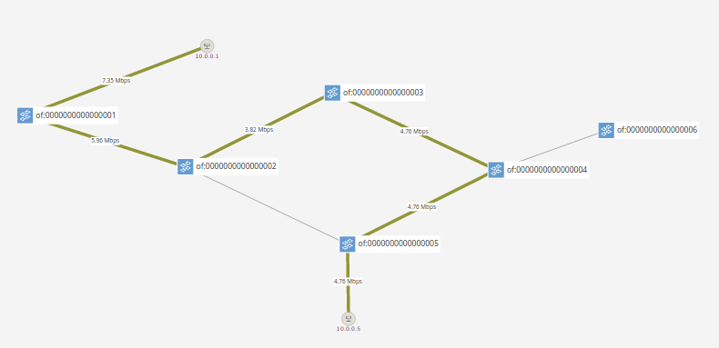
Experimental Result
-Dynamic Widest Path
4M
10M
4M
5M
2M
10M

Slide 18
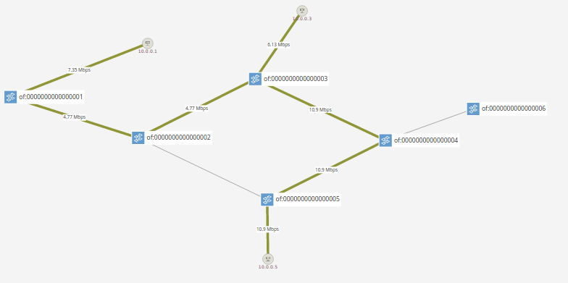
Experimental Result
-Dynamic Widest Path
4M
10M
4M
5M
2M
10M

Slide 19
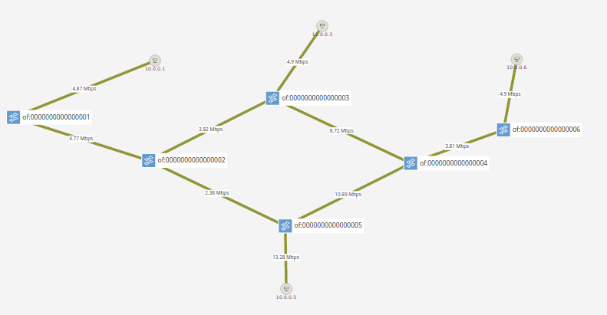
Experimental Result
-Dynamic Widest Path
10M
4M
4M
5M
10M
2M

Slide 20
Experimental Result
-Dynamic Widest Path
time (sec) | src->dst | demand (Mbps) | sustain (sec) | satisfied bandwidth (Mbps)
0 | 1—>5 | 6 | 60 | 4
10 | 3—>5 | 5 | 60 | 5
20 | 6—>5 | 4 | 60 | 2
A new flow can always find the path with widest remaining bandwidth
Avoid congestion compared to static widest path algorithm
When the three demands exist simultaneously, the total throughput is 4 + 5 + 2 = 11 (Mbps)
The previous allocated bandwidth and routes can not be changed.
What will happen if we use multi path and linear programming?

Slide 21
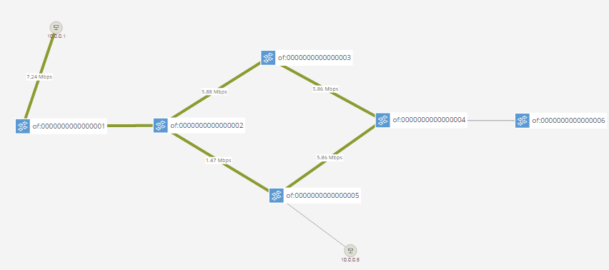
Experimental Result
-Optimal Throughput Multipath Bandwidth Allocation
1->5:
—————————————————-
demand requested: 5.88548583984375
demand satisfied: 5.0
route0 is: 1->2->5;
bw assigned is: 1.0
route1 is: 1->2->3->4->5;
bw assigned is: 4.0
—————————————————-
Send 6Mbps to switch 5
4M
10M
5M
4M
2M
10M

Slide 22
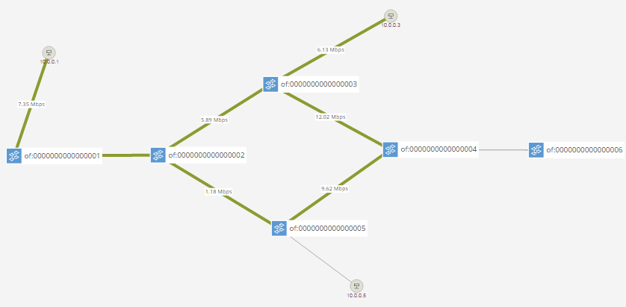
Experimental Result
-Optimal Throughput Multipath Bandwidth Allocation
3->5
——————————————————
demand requested: 4.9049560546875
demand satisfied: 4.9049560546875
route0 is: 3->2->5;
bw assigned is: 0.0
route1 is: 3->4->5;
bw assigned is: 4.9049560546875
——————————————————
1->5
——————————————————-
demand requested: 5.885549926757813
demand satisfied: 5.0
route0 is: 1->2->5;
bw assigned is: 1.0
route1 is: 1->2->3->4->5;
bw assigned is: 4.0
——————————————————
Send 5Mbps to switch 5
Send 6Mbps to switch 5
4M
10M
5M
4M
2M
10M

Slide 23
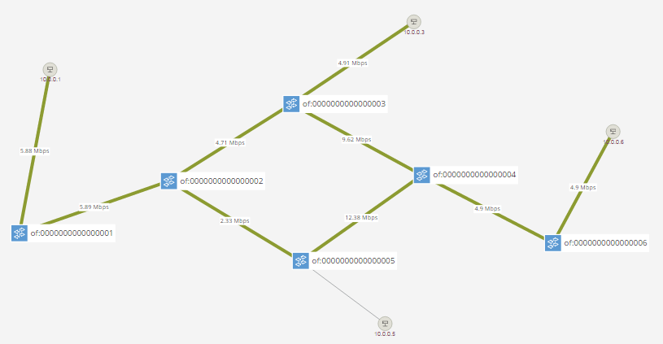
Experimental Result
-Optimal Throughput Multipath Bandwidth Allocation
3->5(rearranged!)
——————————————————
demand requested: 4.9049560546875
demand satisfied: 3.077880859375
route0 is: 3->2->5;
bw assigned is: 0.0
route1 is: 3->4->5;(reduced by 2)
bw assigned is: 3.077880859375
——————————————————
6->5
——————————————————
demand requested: 3.922119140625
demand satisfied: 3.922119140625
route0 is: 6->4->3->2->5;
bw assigned is: 1.0
route1 is: 6->4->5;
bw assigned is: 2.922119140625
——————————————————
1->5
——————————————————
demand requested: 5.88548583984375
demand satisfied: 5.0
route0 is: 1->2->5;
bw assigned is: 1.0
route1 is: 1->2->3->4->5;
bw assigned is: 4.0
——————————————————
Send 5Mbps to switch 5
Send 6Mbps to switch 5
Send 4Mbps to switch 5
4M
10M
5M
4M
2M
10M

Slide 24
Experimental Result
-Optimal Throughput Multipath Bandwidth Allocation
time (sec) | src->dst | demand (Mbps) | sustain (sec) | satisfied bandwidth (Mbps)
0 | 1—>5 | 6 | 60 | 5
10 | 3—>5 | 5 | 60 | 3
20 | 6—>5 | 4 | 60 | 4
When the three demands exist simultaneously, the total throughput is 5 + 3 + 4 = 12 (Mbps)
The previous allocated routes and bandwidth can be changed for the sake of over all throughput

Slide 25
Role Play
Guangtong Shen
Configure the environment:
Install ONOS,
Write mininet topology,
Install cpqd switch,
Create ONOS App
Install Linear programming library
Writing Code Modules:
Create Path Intent in single path routing, with auto-remove
Create Group and flow rules in multi path routing, with auto-renew
Collect Bandwidth usage
DFS search for available paths for widest path and linear programming
Test and Evaluation:
Design evaluation methodology for dynamic widest path
Test and Evaluate multipath allocation

Slide 26
Role Play
Haofan Feng:
Writing Algorithms:
Dynamic Widest Path Selection
Linear programming to periodically calculate the bandwidth assignment for each considered path
Writing Code Modules :
Read link capacity from text file
Collect demand information from packet processor
Create data structure to store multipath allocation result to facilitate translating to groups
Test and Evaluation:
Design testing experiment to prove the correctness of Multipath Linear Programming computational results
Evaluation of dynamic widest path

Slide 27
Next
Demo
Q&A

Slide 28
Thank you very much!

Slide 29
Major Imperfections
We met many challenges in our project. Some are solved such as multipath using cpqd switch. But some are left unsolved, leaving these imperfections:
1. Fixed path problem
In Dynamic Widest Path, the selected path is fixed until the flow stops and rejoins. So the network load changes are not reflected.
2. Lacking bandwidth constraint
In Multipath Optimal Allocation, we only specified the weight for each output port to split traffic to multiple paths. If the input flow rate is larger than its expected allocated bandwidth, all of it will still go through.
3. Demand measuring dilemma
In Multipath Optimal Allocation, we need to keep measuring the flow demand so that the periodic linear programming always use the correct flow demand. Currently our workaround is not installing forwarding rule on the last switch. So the packet will always go to the controller telling it which flow is currently carrying so that the controller knows where to measure the flow demand. The cost is the packet can never reach the destination host.

Slide 30
More about Demand measuring dilemma
Get flow demands:
Currently we get flow demands by obtaining source, destination information from the packet and then use HostService combined with DeviceService to get the bit rate from source host to its egress switch as requested bandwidth of this flow.
This method has two limitations.
First, we can not distinguish between simultaneous flow demands from a same host to several different destinations. Because we get the demand by measuring the bit rate between a source host and its egress switch. So concurrent flows with same source and different destinations will be measured all together and mixed up.
Second, after the first few packets consult the controller and get paths assigned, the subsequent packets will not be forwarded to the controller. So we can not continuously get source and destination information of the flows. So after sometime when we want to recompute the overall bandwidth allocation, we need to first remove all the existing forwarding rules, making all the current existing flows send packets to the controller to consult about routing paths. In this way, we can again collect source and destination information of each flow and combine the information with the measurement of sending rate to perform linear programming and multi path routing. The problem is that packets will keep dropping during the demands obtaining period.

Slide 31
Possible Improvements – 1. Fixed path problem
We used Path Intent (a high level rule which will be translated to flow rule by ONOS) to specify a path.
Tried:
Set a time-out for each intent using Java Timer class.
So the packets will go to Controller again and a new Path Intent will be computed based on current network load.
Why give up:
The time between removing old intent and installing new intent is long and packets will be dropped heavily.
A possible solution: Avoid packet drop by sending it using controller:
After removing Path Intent, packets go to Controller. ONOS can tell the switch which port to send the packet it received without installing a rule. The port can be determined by the last Path Intent and the querying switch. Packets will be forwarded in this way until a new intent is installed successfully.

Slide 32
Possible Improvements – 2. Lacking bandwidth constraint
Tried:
Openflow v1.3 support Meter to limit bandwidth of a flow rule.
But we used Group Buckets to select forwarding ports. Tried to combine each bucket with a meter but failed.
Not tried:
Set both the Group and the Meter limiting total output bandwidth on the flow rule.
Why give up:
The not tried solution is still worth trying. We just have no time on this.
Another Possible Solution:
A most promising but complex way is to use Pipeline – Overflow can install a pipeline of rules and each rule has separate MATCH field and can be combined with a separate Meter. So placing a rule with a Meter limiting total output bandwidth for the flow before the rule with Group should work.

Slide 33
Possible Improvements – 3. Demand measuring dilemma
Tried:
Install a flow rule for the last switch to forwarding packets to host.
Why give up:
There is no way for the Controller to know flow information if all packets have a forwarding rule. We can measure edge port input rate but we can’t know the destination of the flow.
Possible solutions:
Don’t install a rule to destination on the last switch but let ONOS can tell the switch which port to send the packet without installing a rule. All packets are not drop but sent to Controller so the Controller will be heavily load. Not feasible for real application.
For real application, we need to install a program on the host to connect to Controller using REST API, telling the controller its demand.
ONOS support this API: POST /configuration/{component}
(“configuration” is a JSON defined by the OSGI “component” which is our APP)

Slide 34
We believe with enough insight and effort, everything can be solved.

