Slide 1
Outline
1、Deterministic lifting theorem for block sensitivity
2、$Ω\left(n\right)$lower bound for Set Disjointness
3、Intuition of $Ω\left(n\right)$lower bound for Tseitin Formula

Slide 2


Proof overview
$f:\{0,1\}^{n}→\{0,1\}$
There exists a constant $c≥0$ such that the following holds. Let be any boolean function, and let
be low discrepancy gadget function such that $q≥c$. Then
$$g:\left[q\right]×\left[q\right]→\{0,1\}$$
$$P^{CC}\left(f∘g^{n}\right)=Ω(bs\left(f\right)⋅\log{q})$$

Slide 3






Raz-McKenzie’s simulation [RM99,GPW15]
Communication by Alice or Bob
Query
0
1
Convert communication protocol of
$${f∘g}^{n}$$
0
$$(X,Y)$$
1
0
1
0
1
$$Z_i$$
to decision tree for
0
$$f:\{0,1\}^{n}→\{0,1\}$$
1
0
1
To show the simulation is correct,
Thickness Lemma: Average (degree) to worst (degree) reduction (or sunflower lemma [LMMPZ20]) to keep the disperser property:
$$g^{n}\left(X_{I},Y_{I}\right)= {\{0,1\}}^{I}$$
($g$ is gadget function and $I$ is unfixed coordinates)
To show the simulation is efficient,
2) Projection Lemma: Potential function argument and probabilistic method to ensure
$$g\left(X_{i},Y_{i}\right)=Z_{i}$$
and
potential function decreases by at least Ω(log q) in each “query iteration”

Slide 4


Raz-McKenzie’s simulation [RM99,GPW15]
$${f∘g}^{n}$$
$$f:\{0,1\}^{n}→\{0,1\}$$
Communication by Alice or Bob
Query
0
1
0
$$(X,Y)$$
1
0
1
0
1
$$Z_i$$
0
1
0
1
However, Thickness Lemma has gadget size barrier:
Average (degree) to worst (degree) reduction (or sunflower lemma [LMMPZ20]) need q= Ω(n)
Gadget size is a fundamental parameter in lifting theorems and their applications [GP16, GJW16, GR18].

Slide 5



Our simulation
$${f∘g}^{n}$$
$$f:\{0,1\}^{n}→\{0,1\}$$
Communication by Alice or Bob
Query
0
1
Find a communication path of
1
$$(X,Y)$$
$${f∘g}^{n}$$
0
1
0
1
$$Z_i$$
by a decision tree path of
$$f:\{0,1\}^{n}→\{0,1\}$$
1
To show the simulation is correct, we follow the decision tree path in each “query iteration”
To show the simulation is efficient,
2) Projection Lemma: Potential function argument and low-discrepancy property [CFKMP19] to ensure
potential function decreases by at least Ω(log q) in each “query iteration”

Slide 6




Our simulation
$${f∘g}^{n}$$
Communication by Alice or Bob
Query
0
1
Find a long communication path of
$${f∘g}^{n}$$
0
$$(X,Y)$$
0
1
0
1
$$f:\{0,1\}^{n}→\{0,1\}$$
$$Z_i$$
by a long decision tree path of
0
$$f:\{0,1\}^{n}→\{0,1\}$$
How to keep a long path ? Block sensitivity of ( a lower bound of query complexity)
WLOG Assume $bs\left(f,0^{n}\right)=n,$ we could find a query path with $Ω\left(n\right)$length by always answer 0.
We need a new Projection Lemma:
1) Projection condition: $e_{i}∉g^{n}\left(X,Y \right)$
Key Observation: Our projection can be delayed
2) Potential function: density of $0^{n}$
3) Keep $g\left(X_{i},Y_{i}\right)=0$

Slide 7
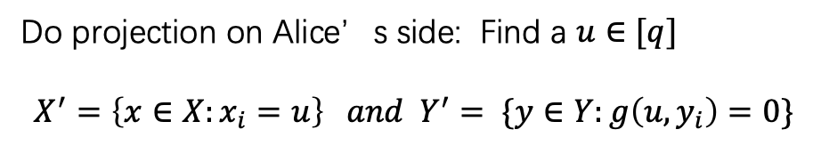


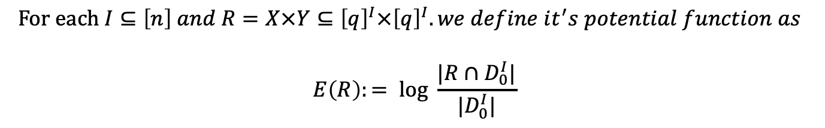

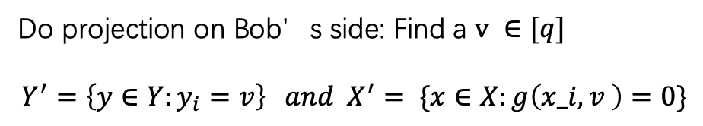
Projection Lemma
WLOG Assume $bs\left(f,0^{n}\right)=n,$
1) Potential function: density of $0^{n}$
We define $D_{0}^{I}≔\{\left(x,y\right)∈{\left[q\right]}^{I}×{\left[q\right]}^{I}:g^{I}\left(x,y\right)=0^{I}\}.$
$$For each I⊆\left[n\right] and R=X×Y⊆{\left[q\right]}^{I}×{\left[q\right]}^{I}. we define it^{′}s potential function as$$
$$E\left(R\right):= log \frac{|R∩D_{0}^{I}|}{|D_{0}^{I}|}$$
2) Projection condition: if $e_{i}∉g^{n}\left(X,Y \right)$, we do projection on $i$and keep $g\left(X_{i},Y_{i}\right)=0$
Y
Do projection on Alice’s side: Find a $u∈[q]$
$$X^{′}=\left\{x∈X:x_{i}=u\right\} and Y^{′}= \{y∈Y:g\left(u,y_{i}\right)=0\}$$
$$X$$
Y’
X
X’
Do projection on Bob’s side: Find a $v ∈[q]$
$$Y^{′}=\left\{y∈Y:y_{i}=v\right\} and X^{′}= \{x∈X:g\left(x_i,v \right)=0\}$$

Slide 8



Potential function argument
$$E\left(R\right):= log \frac{|R∩D_{0}^{I}|}{|D_{0}^{I}|}$$
Assume $bs\left(f,0^{n}\right)=n,$
By average argument,
potential function decrease by at least O(1) in each “communication iteration”
if $e_{i}∉g^{n}\left(X,Y \right)$, we do projection on $i$and keep $g\left(X_{i},Y_{i}\right)=0$
potential function increase by at least Ω(log q) in each “query iteration”
Low-discrepancy gadget: Fix $\left(x_{I∖i} ,y_{I∖i}\right)$with $g^{I∖i}\left(x_{I∖i} ,y_{I∖i}\right)=0^{I∖i}$, If $e_{i}∉g^{I}\left(X_{I},Y_{I} \right)$ then ${|X}_{i}|\left|Y_{i}\right|≤q$
[q]
Y
$|X||Y|≤q$ When 1 $∉g\left(X,Y \right)$
[q]
X
By average argument, either we could do projection on Alice’side or Bob’s side to increase potential function.

Slide 9
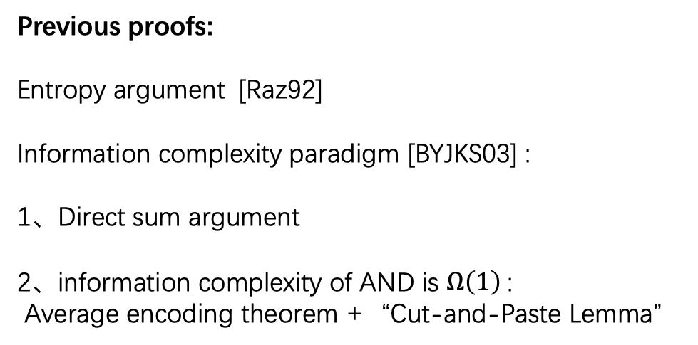
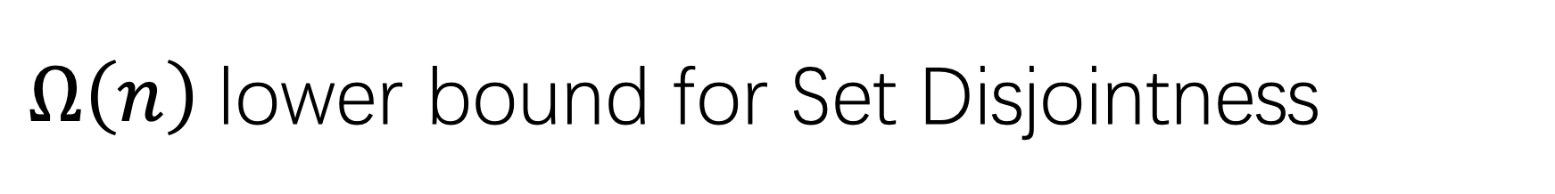
$Ω\left(n\right)$lower bound for Set Disjointness
Previous proofs:
Entropy argument [Raz92]
Information complexity paradigm [BYJKS03] :
1、Direct sum argument
2、information complexity of AND is $Ω\left(1\right)$:
Average encoding theorem +“Cut-and-Paste Lemma”
Our proofs:
Potential function argument:
1、Using entropy as potential function
2、Potential function increase by at least Ω(1) in each “query iteration”:
Projection Lemma + +“Cut-and-Paste Lemma”

Slide 10


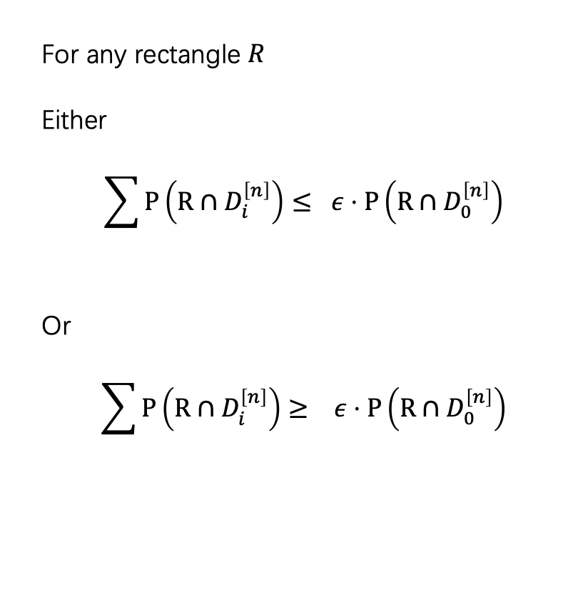
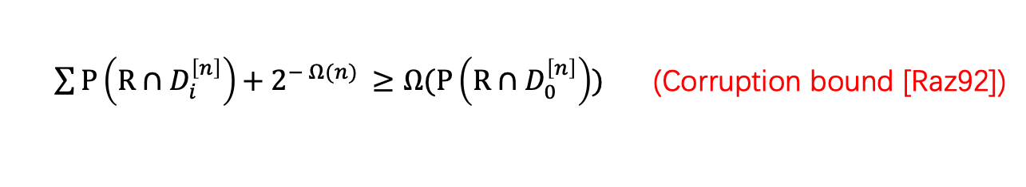


Our goal
Let $P$ be the hard input distribution
$$D_{0}^{\left[n\right]}= \{\left(x,y\right):{ ∧}^{n}\left(x,y\right)=0^{n}\}$$
$$D_{i}^{\left[n\right]}= \{\left(x,y\right):{ ∧}^{n}\left(x,y\right)=e_{i}\}$$
Main Lemma:
$\sum{P\left(R∩D_{i}^{\left[n\right]}\right)}+{ 2}^{− Ω(n)} ≥Ω(P\left(R∩D_{0}^{\left[n\right]}\right))$ (Corruption bound [Raz92])
For any rectangle $R$
Either
$$\sum{P\left(R∩D_{i}^{\left[n\right]}\right)}≤ ε⋅P\left(R∩D_{0}^{\left[n\right]}\right)$$
Or
$$\sum{P\left(R∩D_{i}^{\left[n\right]}\right)}≥ ε⋅P\left(R∩D_{0}^{\left[n\right]}\right)$$
Projection Lemma + “Cut-and-Paste Lemma”
$$P\left(R∩D_{0}^{[n]} \right)≤2^{− Ω(n)}$$

Slide 11
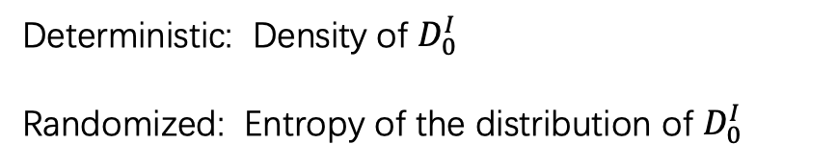

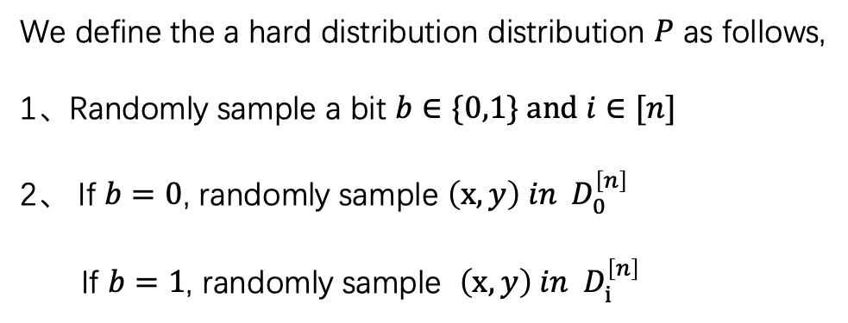
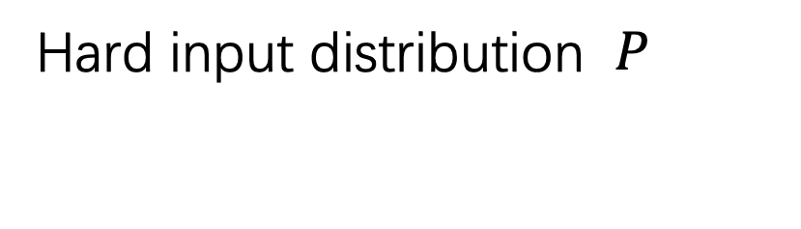
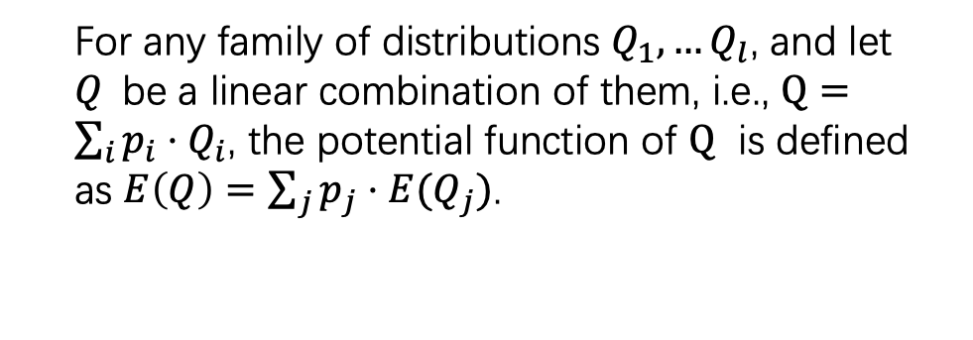

Hard input distribution $P$
Potential function: entropy of $Q$
$Q$ be the distribution of $P$condition on $D_{0}^{I}∩R$
We define the a hard distribution distribution $P$ as follows,
1、Randomly sample a bit $b∈\{0,1\} and i∈[n]$
2、 If $b=0$, randomly sample $\left(x,y\right) in D_{0}^{\left[n\right]}$
If $b=1$, randomly sample $\left(x,y\right) in D_{i}^{\left[n\right]}$
$$E\left(Q\right)=H\left(Q\right)−|I|\log{3}$$
For any family of distributions $Q_{1},…Q_{l}$, and let $Q$be a linear combination of them, i.e., $Q=\sum_{i}{p_{i}⋅Q_{i}}$, the potential function of $Q$ is defined as $E\left(Q\right)=\sum_{j}{p_{j}⋅{E(Q}_{j})}$.
Deterministic: Density of $D_{0}^{I}$
Randomized: Entropy of the distribution of $D_{0}^{I}$

Slide 12









How to do Projection?
$$E\left(Q\right)=H\left(Q\right)−|I|\log{3}$$
$E\left(Q\right)=p_{1}⋅E\left(Q_{1}\right)+p_{2}⋅E(Q_{2})$.
$$Q$$
$$Q_{1}$$
$$X_{i}=0$$
Do projection on Alice’s side
and coordinate $i$
$$Q_{2}$$
$$X_{i}=1$$
$$p_{1}=Q\left(X_{i}=0\right) and p_{2}=Q(X_{i}=1)$$
Similarly, we can do projection on Bob’s side

Slide 13
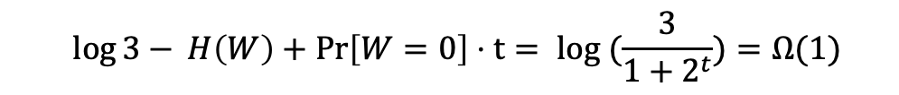
Analysis of Projection Lemma
Our Goal: $E\left(Q_{I∖i}\right)=E\left(Q_{I}\right)+Ω(1)$
Let $W$ be the random variable that $\operatorname{Pr}\left[W=0\right]=p_{1} and\operatorname{Pr}\left[W=1\right]=p_{2}$
Chain Rule of entropy:
$$H\left(Q_{I}\right)=H\left(W\right)+ H\left(Q_{I∖i}\right|W)+ H\left(Q_{i} \right|Q_{I∖i},W)$$
$E\left(Q_{I∖i}\right)=E\left(Q_{I}\right)+log{3 − }$ $H\left(W\right)+\operatorname{Pr}\left[W=0\right]⋅H\left(Q_{i} \right|Q_{I∖i},W=0)$
Since $H\left(Q_{i} \right|Q_{I∖i},W=1)=0$ , we need bound $\log{3− }H\left(W\right)+\operatorname{Pr}\left[W=0\right]⋅H\left(Q_{i} \right|Q_{I∖i},W=0)=Ω(1)$
Let $t<1$be a constant, Assume $H\left(Q_{i} \right|Q_{I∖i},W=0)≤t$
$$\log{3− }H\left(W\right)+\operatorname{Pr}\left[W=0\right]⋅t= log (\frac{3}{1+2^{t}})=Ω(1)$$

Slide 14
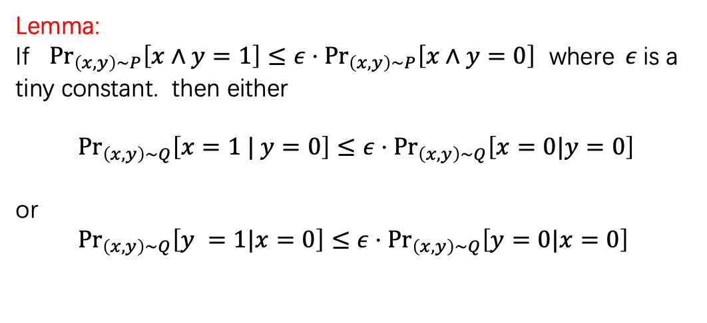

“Cut-and-Paste Lemma”(Connections between bias and potential function)
How to bound $H\left(Q_{i} \right|Q_{I∖i},W=0)≤t$ ?
Y = 0
Y = 1
Lemma:
If ${Pr}_{\left(x,y\right)∼P}\left[x∧y=1\right]≤ε⋅{Pr}_{\left(x,y\right)∼P}\left[x∧y=0\right]$ where$ε$is a tiny constant. then either
$${Pr}_{\left(x,y\right)∼Q}\left[x=1 | y=0\right]≤ε⋅{Pr}_{\left(x,y\right)∼Q}\left[x=0|y=0\right]$$
or
${ Pr}_{\left(x,y\right)∼Q}\left[y =1|x=0\right]≤ε⋅{Pr}_{\left(x,y\right)∼Q}\left[y=0|x=0\right]$
X = 0
0
0
X = 1
0
1
Either entropy loss of X ($H\left(Q_{i} \right|Q_{I∖i}, X_i=0)≤t$) is Ω(1) or entropy loss of Y ($H\left(Q_{i} \right|Q_{I∖i}, Y_i=0)≤t$) is Ω(1)
So, we can do projection either on Alice’s side or Bob’s side.

Slide 15
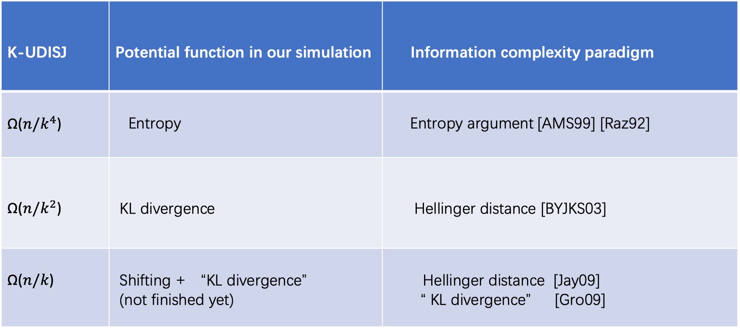
Connections between information complexity
Projection Lemma + Chain Rule
Direct sum argument
K-UDISJ | Potential function in our simulation | Information complexity paradigm
Ω($n/k^{4}$) | Entropy | Entropy argument [AMS99] [Raz92]
Ω($n/k^{2}$) | KL divergence | Hellinger distance [BYJKS03]
Ω($n/k$) | Shifting + “KL divergence” (not finished yet) | Hellinger distance [Jay09] “ KL divergence” [Gro09]

Slide 16

Intuition of $Ω\left(n\right)$lower bound for Tseitin Formula
Raz-McKenzie simulation : Maintain full set : $g^{n}\left(X_{I},Y_{I}\right)= {\{0,1\}}^{I}$
Our simulation in block sensitivity : density of one string with high block sensitivity
Question: How to maintain a subset set which is hard enough to prove lower bounds ?
We try it by use Tseitin Formula as a example

Slide 17
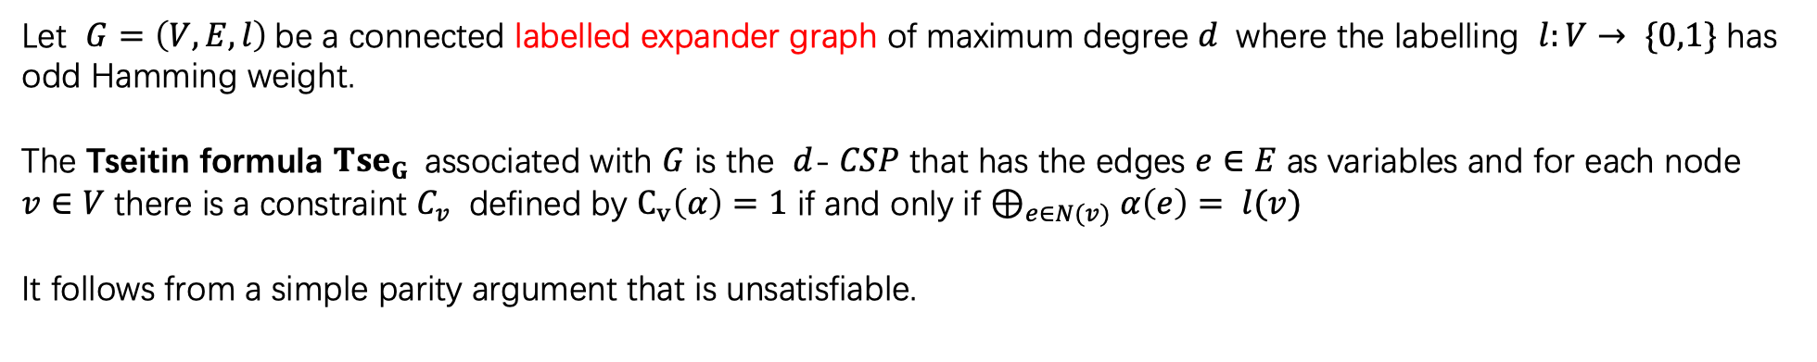
Tseitin Formula
Let $G=\left(V,E,l\right)$be a connected labelled expander graph of maximum degree $d$ where the labelling $l:V→ \{0,1\}$ has odd Hamming weight.
The Tseitin formula $Tse_{G}$associated with $G$ is the $d$-$CSP$ that has the edges $e∈E$ as variables and for each node $v∈V$ there is a constraint $C_{v}$ defined by $C_{v}\left(α\right)=1$ if and only if $⊕_{e∈N(v)}α\left(e\right)= l(v)$
It follows from a simple parity argument that is unsatisfiable.
Communication version: $Tse_{G}∘g^{m}\left(x,y\right) where g is the constant gadget function$
Previous results:
Ω(m$/\log{m}$) lower bound in [GP14] via critical block sensitivity and Ω($m$) lower bound in [PR17] via “degree to rank lifting”

Slide 18
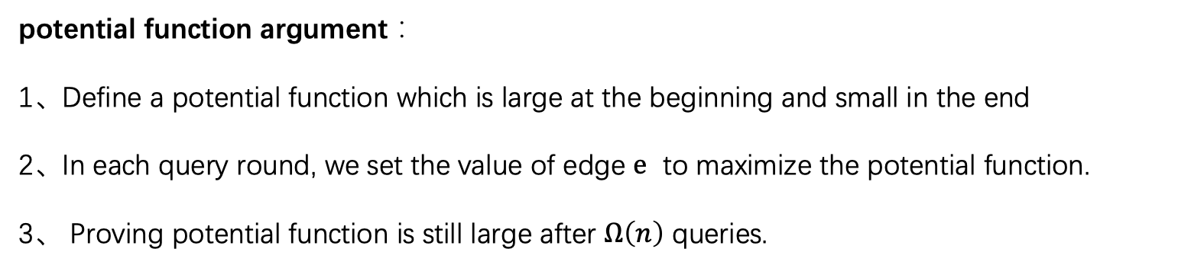

$Ω\left(n\right)$query lower bound for Tseitin Formula
potential function argument：
1、Define a potential function which is large at the beginning and small in the end
2、In each query round, we set the value of edge $e$ to maximize the potential function.
3、 Proving potential function is still large after $Ω\left(n\right)$ queries.

Slide 19
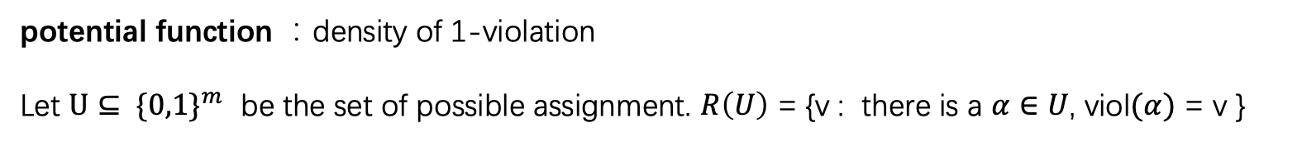


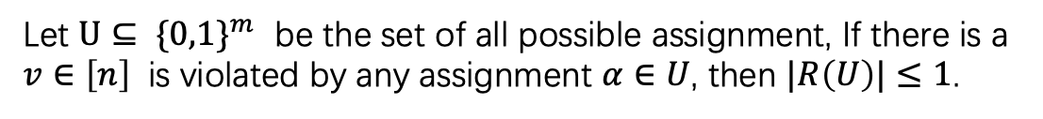
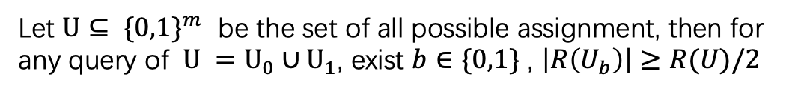
$Ω\left(n\right)$query lower bound for Tseitin Formula
For assignment $α∈{\left\{0,1\right\}}^{m}$， viol$(α)$ be the set of unsatisfiable nodes
potential function ：density of 1-violation
Let $U⊆ \{0,1\}^{m}$ be the set of possible assignment. $R\left(U\right)$ = {v : there is a $α∈U$, viol$(α)$ = v }
Claim 1:
Let $U⊆ \{0,1\}^{m}$ be the set of all possible assignment, then for any query of $U =U_{0}∪U_{1}$, exist $b∈\{0,1\}$ , $\left|R\left(U_{b}\right)\right|≥R(U)/2$
By Claim 1 and Claim 2, we only get a $Ω(log{n) }$lower bound
Claim 2:
Let $U⊆ \{0,1\}^{m}$ be the set of all possible assignment, If there is a $v∈\left[n\right]$ is violated by any assignment $α∈U$, then $|R\left(U\right)|≤1$.

Slide 20
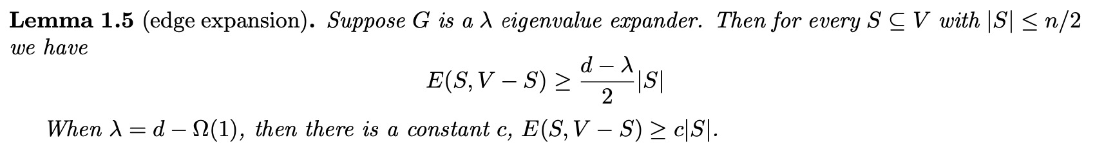
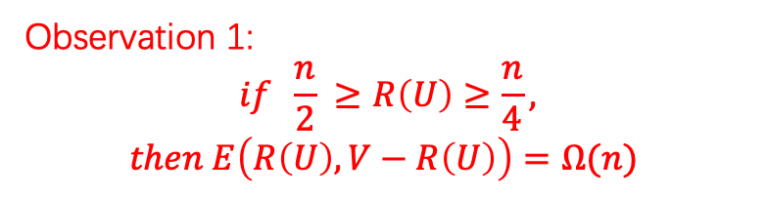

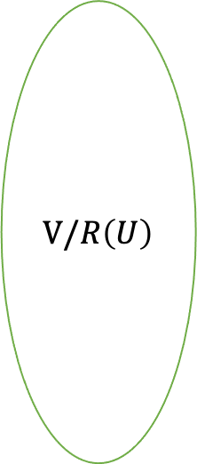
$Ω\left(n\right)$query lower bound for Tseitin Formula
$R\left(U\right)$ = {v : there is a $α∈U$, viol$(α)$ = v }
Gap amplification for $R\left(U\right)$: (Using edge expansion of expander graph to maintain the subset $R\left(U\right)$ )
$$V/R\left(U\right)$$
Observation 1:
$$if \frac{n}{2} ≥R\left(U\right)≥\frac{n}{4},$$
$$then E\left(R\left(U\right),V−R\left(U\right)\right)=Ω(n)$$
$$R\left(U\right)$$

Slide 21
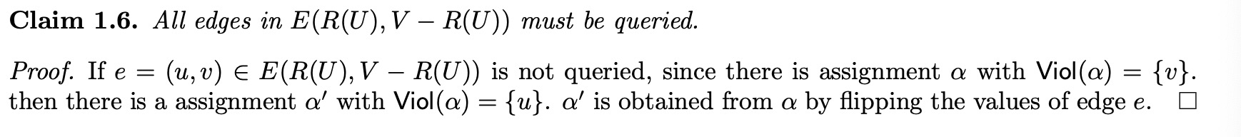
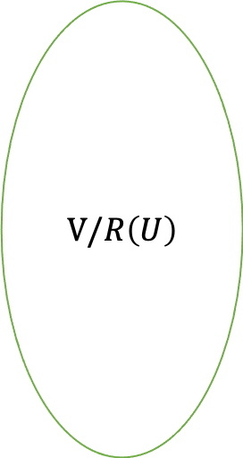

$Ω\left(n\right)$query lower bound for Tseitin Formula
$R\left(U\right)$ = {v : there is a $α∈U$, viol$(α)$ = v }
Gap amplification for $R\left(U\right)$: (Using edge expansion of expander graph to maintain the subset $R\left(U\right)$ )
$$V/R\left(U\right)$$
$$R\left(U\right)$$
Observation 2:

Slide 22
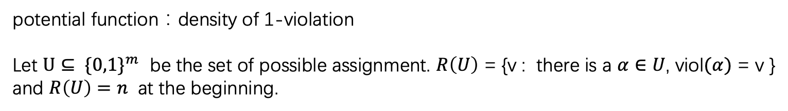
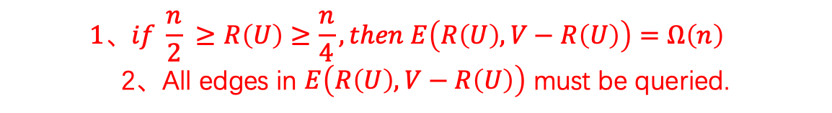
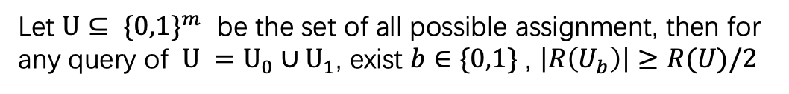
$Ω\left(n\right)$query lower bound for Tseitin Formula
For assignment $α∈{\left\{0,1\right\}}^{m}$， viol$(α)$ be the set of unsatisfiable nodes
potential function：density of 1-violation
Let $U⊆ \{0,1\}^{m}$ be the set of possible assignment. $R\left(U\right)$ = {v : there is a $α∈U$, viol$(α)$ = v } and $R\left(U\right)=n$ at the beginning.
Claim 1:
Let $U⊆ \{0,1\}^{m}$ be the set of all possible assignment, then for any query of $U =U_{0}∪U_{1}$, exist $b∈\{0,1\}$ , $\left|R\left(U_{b}\right)\right|≥R(U)/2$
$$1、if \frac{n}{2} ≥R\left(U\right)≥\frac{n}{4}, then E\left(R\left(U\right),V−R\left(U\right)\right)=Ω\left(n\right)$$
2、All edges in $E\left(R\left(U\right),V−R\left(U\right)\right)$ must be queried.
Gap amplification !
Claim 2:
Let $U⊆ \{0,1\}^{m}$ be the set of all possible assignment, If there is a $v∈\left[n\right]$ is violated by any assignment $α∈U$, then $|R\left(U\right)|≤1$.

Slide 23
Communication lower bound for Tseitin Formula
How to extend the Gap amplification lemma to communication version?

Slide 24
Reference
[Raz92] On the distributional complexity of set disjointness
[RM99] Separation of the monotone nc hierarchy.
[AMS99] The space complexity of approximating the frequency moments
[BYJKS03] An information statistics approach to data stream and communication complexity
[Jay09] Hellinger Strikes Back: A Note on the Multi-party Information Complexity of AND
[Gro09] Asymptotically optimal lower bounds on the NIH-multi-party information complexity of the AND-function and disjointness
[GP14] Communication Lower Bounds via Critical Block Sensitivity
[GPW15] Deterministic Communication vs. Partition Number
[PR17] Strongly exponential lower bounds for monotone computation
[CFKMP19] Query-to-communication lifting using low-discrepancy gadgets

