Slide 1
Communication lower bounds via simulation methods
Guangxu Yang Jiapeng Zhang
Related paper: [YZ22] Simulation Methods in Communication Lower Bounds, Revisited

Slide 2
Part 1: Introduction
The definitions of communication complexity and examples

Slide 3




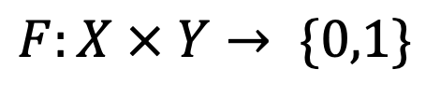
Communication Complexity
$$F:X × Y→ \{0,1\}$$
0
1
0
1
0
1
1
1
Alice
Bob
$$x∈X$$
$$y∈Y$$
$P^{CC}\left(F\right):$ Deterministic communication complexity of F
Minimum number of bits exchanged between Alice and Bob in the worst case.

Slide 4
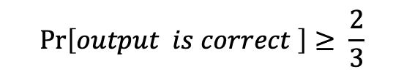

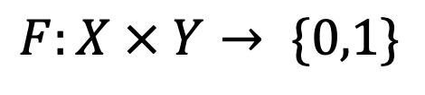
Communication Complexity
$$F:X × Y→ \{0,1\}$$
Public randomness
0
1
0
1
0
1
1
1
$$\operatorname{Pr}\left[output is correct \right]≥ \frac{2}{3}$$
Alice
Bob
$$x∈X$$
$$y∈Y$$
${BPP}^{CC}\left(F\right):$ Randomized communication complexity of F
Minimum number of bits exchanged between Alice and Bob in the worst case.

Slide 5
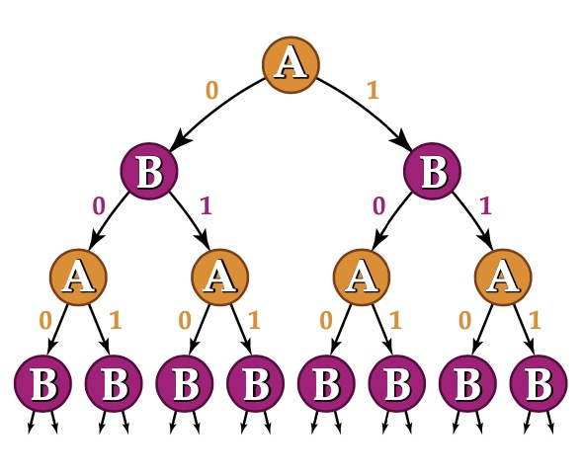
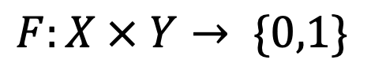
Protocol tree
$$F:X × Y→ \{0,1\}$$
Alice and Bob who speak
Depends on inputs and received messages
leaf nodes: Alice and Bob get the answers
For any protocol tree $Π$ compute $F$， $CC\left(Π\right)=$ The depth of protocol tree $π$
$CC\left(F\right)=min_{Π} CC\left(Π\right)≥log of t\text{he} \text{numbers} \text{of} \text{leaf} \text{nodes} \text{in} \text{optimal} \text{protocol} \text{tree}$

Slide 6
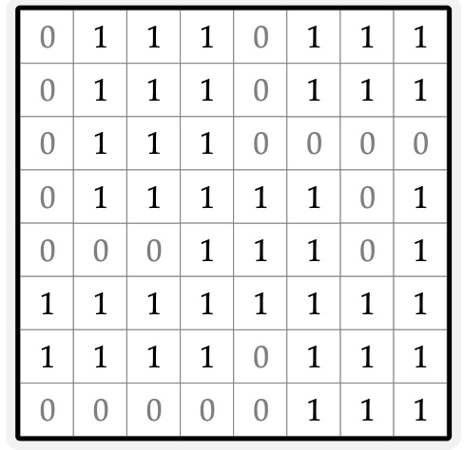
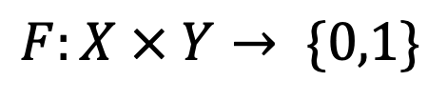
Deterministic protocols
$P^{CC}\left(F\right):$ Deterministic communication complexity of F
Communication by Alice or Bob
$$F:X × Y→ \{0,1\}$$
Deterministic protocol partitions the true value table of $F$ into monochromatic rectangles
$P^{CC}\left(F\right)≥log of t$he numbers of leaf nodes in protocol tree = log of $t$he numbers of monochromatic rectangles

Slide 7
Randomized protocols
${BPP}^{CC}\left(F\right):$ Randomized communication complexity of F
Communication by Alice or Bob
$$F:X × Y→ \{0,1\}$$
Randomized protocol partitions the true value table of $F$ into near monochromatic rectangles
${BPP}^{CC}\left(F\right)≥\text{log} \text{of} \text{t}\text{he} \text{numbers} \text{of}$ leaf nodes $≈log t\text{he} \text{numbers} \text{of} \text{near} \text{monochromatic} \text{rectangles} \text{under} \text{input} \text{distribution}$

Slide 8



Examples: Equality
$$X=Y ?$$
0
1
0
1
0
1
1
1
Alice
Bob
$$X∈{\left\{0,1\right\}}^{n}$$
$$Y∈{\left\{0,1\right\}}^{n}$$

Slide 9


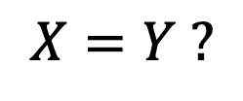
Examples: Equality
$${\left\{0,1\right\}}^{n}$$
$$X=Y ?$$
1
0
1
1
0
1
0
1
$${\left\{0,1\right\}}^{n}$$
1
1
1
1
1
Alice
Bob
1
$$X∈{\left\{0,1\right\}}^{n}$$
$$Y∈{\left\{0,1\right\}}^{n}$$
For any deterministic protocol,
1-inputs is the set $\{\left(x,y\right)∈{\left\{0,1\right\}}^{n}×{\left\{0,1\right\}}^{n}:F\left(x,y\right)=1\}$
The numbers of monochromatic rectangles of 1-inputs is $2^{n}$
$P^{CC}\left(equality\right)=n$
The size of monochromatic rectangles of 1-inputs is 1

Slide 10



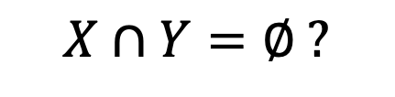

Examples: Set Disjointness
$$X∩Y=∅ ?$$
0
1
0
1
0
1
1
1
Alice
Bob
$$X⊆[n]$$
$$Y⊆[n]$$
$$\{1,4,7\}$$
$$\{2,4,6\}$$
1 2 3 4 5 6 7
1 2 3 4 5 6 7
1 | 0 | 0 | 1 | 0 | 0 | 1
0 | 1 | 0 | 1 | 0 | 1 | 0

Slide 11
Examples: Set Disjointness
canonical $NP^{cc}$-complete problem [complexity zoo]
${BPP}^{CC}\left(Set disjointness\right)=Ω(n)$
”Cook-Levin Theorem” of Communication complexity
Previous proofs:
Entropy argument [Raz92] and Information Complexity [BJKS03]
We give a simple proof via a new simulation method !
Applications:
Streaming: Frequency moments streaming lower bound [AMS96]
Data structures: Cell probe lower bounds for high-dimensional problems[Patrascu08]
Circuit complexity: Monotone circuit depth lower bound [HN12,GP14]
Proof complexity: Length–space lower bounds for semi-algebraic proof systems[HN12,GP14]
Game theory: Communication complexity of pure Nash equilibrium [CS04]
Cryptography: Communication complexity of key agreement [HMOYR18]
Property testing: query lower bound of k-linear [BBM11]
Learning theory: Distributed Learning of Halfspaces [BKMS19]

Slide 12
Part 2: Simulation method
Proof of $Ω\left(n\right)$ randomized lower bound for Set Disjointness. (Technical part)

Slide 13






Previous Simulation method
$$g:\left[q\right]×\left[q\right]→\{0,1\}$$
Communication by Alice or Bob
Query
0
1
Convert any communication protocol of
$${f∘g}^{n}$$
0
$$(X,Y)$$
1
0
1
0
1
$$Z_i$$
to decision tree for
0
$$f:\{0,1\}^{n}→\{0,1\}$$
1
0
1
$P^{cc}\left(f∘g\right)=Ω\left(P^{dt}\left(f\right)⋅log q\right)$ [RM99,GPW15]
Gadget size barrier [Koz18]:
The best known simulation methods [LMMPZ20] requires q= Ω(n)
Gadget size is a fundamental parameter in lifting theorems and their applications [GP14, GJW16, GR18].
$$set disjointness=OR∘AND^{n}$$
Previous simulation method don’t works when $g$ is AND function

Slide 14










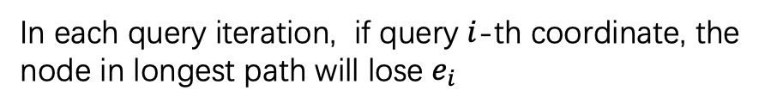
Decision tree of OR function
Our simulation methods (informal)
Analysis of long path in decision tree
$${ z}_{1}$$
1
0
The string in longest path is
$$0^{n}$$
$$e_{1}$$
$$z_{3}$$
In each query iteration, if query $i$-th coordinate, the node in longest path will lose $e_{i}$
1
0
$$e_{3}$$
$${ z}_{2}$$
0
1
$$e_{2}$$
$${ z}_{4}$$
$$e_{4}$$
0
$$⋱$$
Notes:
In order to prove $Ω\left(n\right)$lower bound for Set Disjointness, we prove the following main lemma. We note that the main lemma will imply $Ω\left(n\right)$lower bound.
For main lemma, the key point is to prove that when the rectangle is biased toward D_0, then the probability of Rectangle on D_0 is small enough.

Slide 15






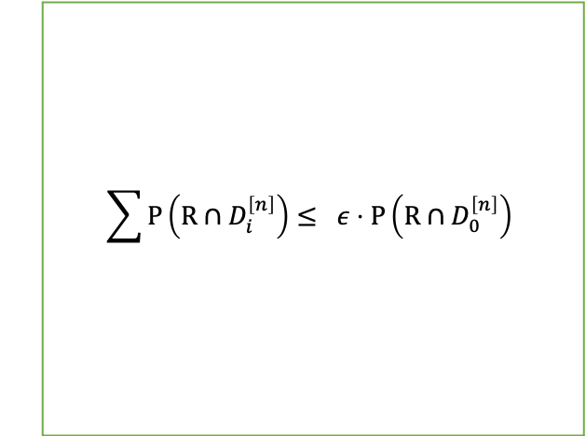






Our simulation methods (informal)
Intuition:
Communication complexity
Query Complexity
$$OR:\{0,1\}^{n}→\{0,1\}$$
$${OR∘AND}^{n}:{\{0,1\}}^{n}×\{0,1\}^{n}→\{0,1\}$$
$$D_{0}^{\left[n\right]}= \{\left(x,y\right)∈{\left\{0,1\right\}}^{n}×{\left\{0,1\right\}}^{n}:{ AND}^{n}\left(x,y\right)=0^{n}\}$$
$$0^{n} and { e}_{i}$$
$$D_{i}^{\left[n\right]}= \{\left(x,y\right)∈{\left\{0,1\right\}}^{n}×{\left\{0,1\right\}}^{n}:{AND}^{n}\left(x,y\right)=e_{i}\}$$
$${ z}_{1}$$
Near monochromatic rectangle
1
$$e_{1}$$
0
$$\sum{P\left(R∩D_{i}^{\left[n\right]}\right)}≤ ε⋅P\left(R∩D_{0}^{\left[n\right]}\right)$$
$$z_{3}$$
imitate
1
$$e_{3}$$
0
$${ z}_{2}$$
0
1
$$e_{2}$$
$${ z}_{4}$$
$$e_{4}$$
0
$$⋱$$
Do projection on each bias coordinate $i$
Notes:
In order to prove $Ω\left(n\right)$lower bound for Set Disjointness, we prove the following main lemma. We note that the main lemma will imply $Ω\left(n\right)$lower bound.
For main lemma, the key point is to prove that when the rectangle is biased toward D_0, then the probability of Rectangle on D_0 is small enough.

Slide 16
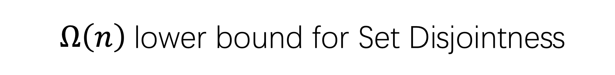



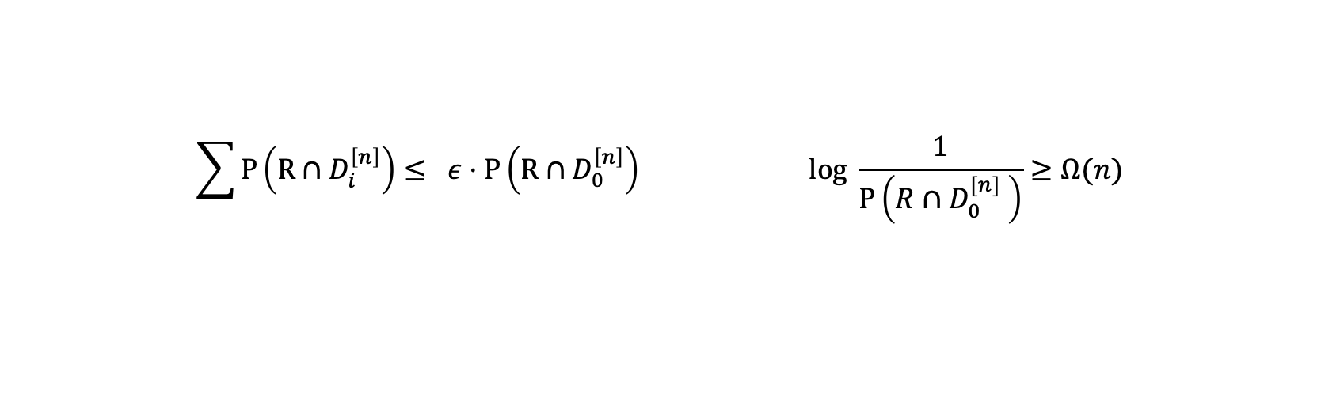
$Ω\left(n\right)$lower bound for Set Disjointness
Let $P$ be the hard input distribution and
$$D_{0}^{\left[n\right]}= \{\left(x,y\right):{ AND}^{n}\left(x,y\right)=0^{n}\}$$
$$D_{i}^{\left[n\right]}= \{\left(x,y\right):{ AND}^{n}\left(x,y\right)=e_{i}\}$$
For any randomized protocol,
The total probabbility of 0-inputs $P\left(D_{0}^{\left[n\right]}\right)$ = $\frac{1}{2}$
$${BPP}^{CC}\left(Set disjointness\right)=Ω(n)$$
For any near monochromatic rectangle $R, P\left(R∩D_{0}^{[n]} \right)≤2^{− Ω(n)}$
Fix a rectangle R with
$$\sum{P\left(R∩D_{i}^{\left[n\right]}\right)}≤ ε⋅P\left(R∩D_{0}^{\left[n\right]}\right) log \frac{1}{P\left(R∩D_{0}^{[n]} \right)}≥Ω(n)$$
Notes:
In order to prove $Ω\left(n\right)$lower bound for Set Disjointness, we prove the following main lemma. We note that the main lemma will imply $Ω\left(n\right)$lower bound.
For main lemma, the key point is to prove that when the rectangle is biased toward D_0, then the probability of Rectangle on D_0 is small enough.

Slide 17

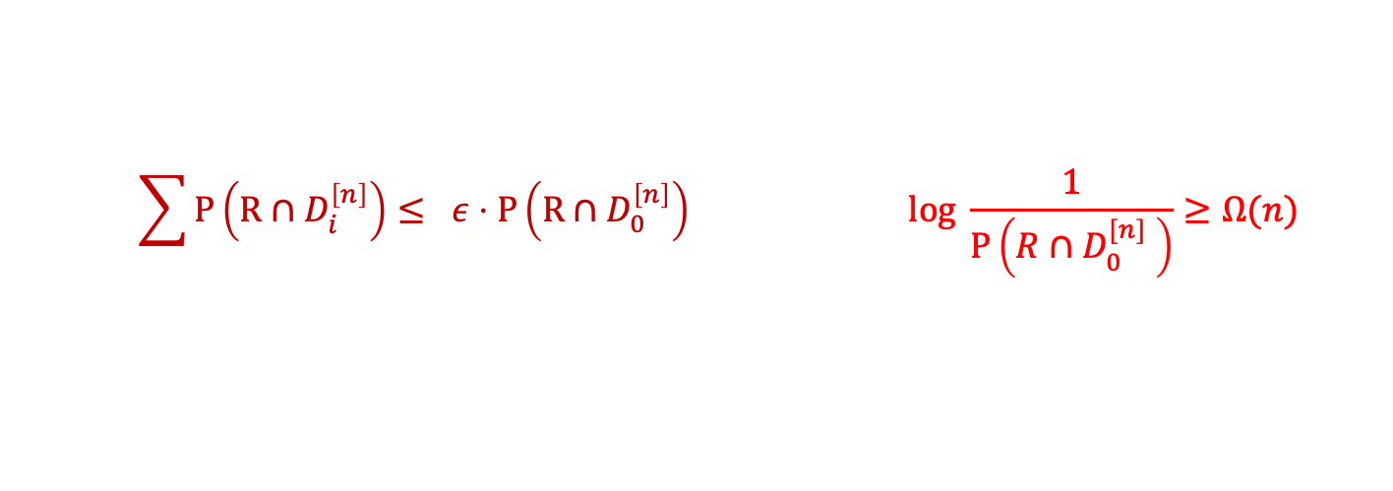
Proof outline
$$\sum{P\left(R∩D_{i}^{\left[n\right]}\right)}≤ ε⋅P\left(R∩D_{0}^{\left[n\right]}\right) log \frac{1}{P\left(R∩D_{0}^{[n]} \right)}≥Ω(n)$$
Our goal:
Potential function argument:
1、Define a potential function $E(P,I,R)$ and hard input distribution $P$：
Claim 1 : For any $I⊆\left[n\right]$, $E\left(P,I,R\right)≥0$
Claim 2 : $E\left(P,\left[n\right],R\right)≤ log \frac{1}{P\left(R∩D_{0}^{[n]} \right)}$
2、The numbers of projection rounds：
Claim 3 : $\sum{P\left(R∩D_{i}^{\left[n\right]}\right)}≤ ε⋅P\left(R∩D_{0}^{\left[n\right]}\right)$ $Ω\left(n\right)$coordinates have bias
3、Potential function decrease by at least Ω(1) in each projection round:
Lemma 4 : If coordinate $i$has “bias” $E\left(P,I,R\right)≥E\left(P,I∖i, R\right)+Ω(1)$
$|R∩D_{i}^{\left[n\right]}| ≤ ε_{2}⋅|R∩D_{0}^{[n]}|$
Notes:
We use a potential function argument to prove it. We define a potential function satisfies the four claims.
If the four claims are hold, we finish the proof.

Slide 18
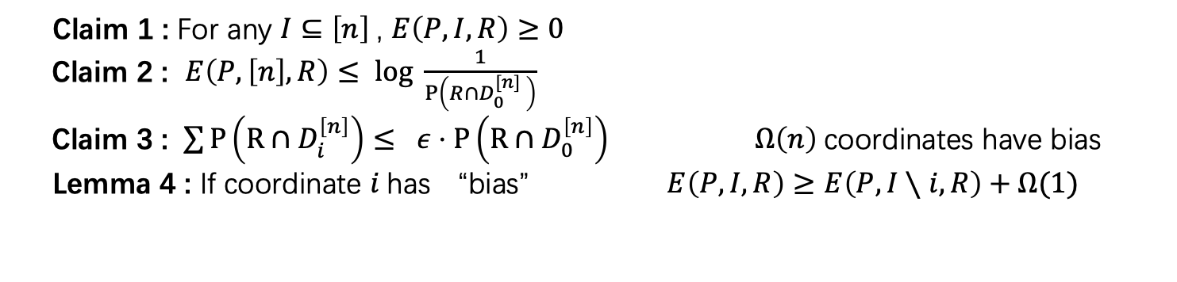
Proof outline
$$\sum{P\left(R∩D_{i}^{\left[n\right]}\right)}≤ ε⋅P\left(R∩D_{0}^{\left[n\right]}\right) log \frac{1}{P\left(R∩D_{0}^{[n]} \right)}≥Ω(n)$$
Our goal:
Claim 1 : For any $I⊆\left[n\right]$, $E\left(P,I,R\right)≥0$
Claim 2 : $E\left(P,\left[n\right],R\right)≤ log \frac{1}{P\left(R∩D_{0}^{[n]} \right)}$
Claim 3 : $\sum{P\left(R∩D_{i}^{\left[n\right]}\right)}≤ ε⋅P\left(R∩D_{0}^{\left[n\right]}\right)$ $Ω\left(n\right)$coordinates have bias
Lemma 4 : If coordinate $i$has “bias” $E\left(P,I,R\right)≥E\left(P,I∖i,R\right)+Ω(1)$
Based on potential function argument:
$$log \frac{1}{P\left(R∩D_{0}^{\left[n\right]} \right)}≥E\left(P,I,R\right)≥E\left(P,I∖i,R\right)+Ω\left(1\right)≥…≥E\left(P,\left[n\right]∖J,R\right)+Ω\left(\left|J\right|\right)≥\left|J\right|=Ω(n)$$
Claim 2
Lemma 4
biased coordinates
Claim 1
Claim 3
Notes:
We use a potential function argument to prove it. We define a potential function satisfies the four claims.
If the four claims are hold, we finish the proof.

Slide 19

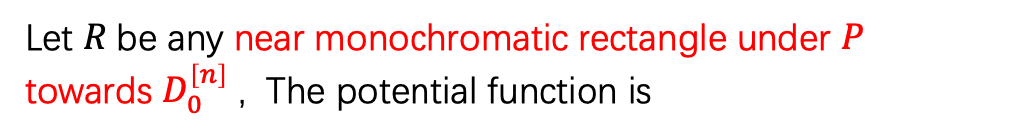
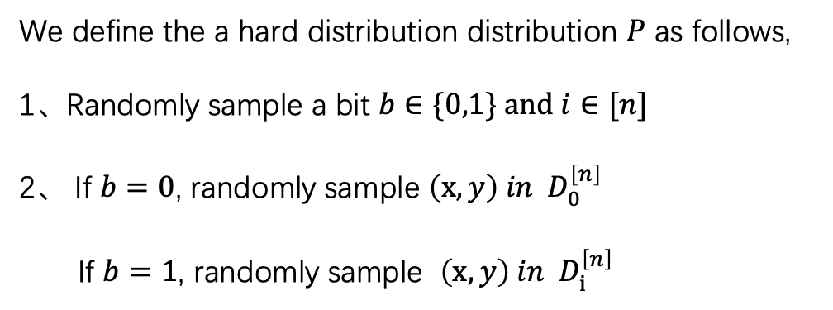
Definitions
$$D_{0}^{I}= \{\left(x,y\right):AND^{I}\left(x,y\right)=0^{I}\}$$
$$D_{i}^{I}= \{\left(x,y\right):AND^{I}\left(x,y\right)=e_{i}\}$$
Hard input distribution:
Potential function
We define the a hard distribution distribution $P$ as follows,
1、Randomly sample a bit $b∈\{0,1\} and i∈[n]$
2、 If $b=0$, randomly sample $\left(x,y\right) in D_{0}^{\left[n\right]}$
If $b=1$, randomly sample $\left(x,y\right) in D_{i}^{\left[n\right]}$
Let $R$be any near monochromatic rectangle under $P$ towards $D_{0}^{\left[n\right]}$ , The potential function is
$$E\left(P,I,R\right)=H\left(Q_{I}\right)−H\left(Q_{I}|R\right)$$
$Q_{I}$ be the distribution of $P$condition on $D_{0}^{I}$

Slide 20
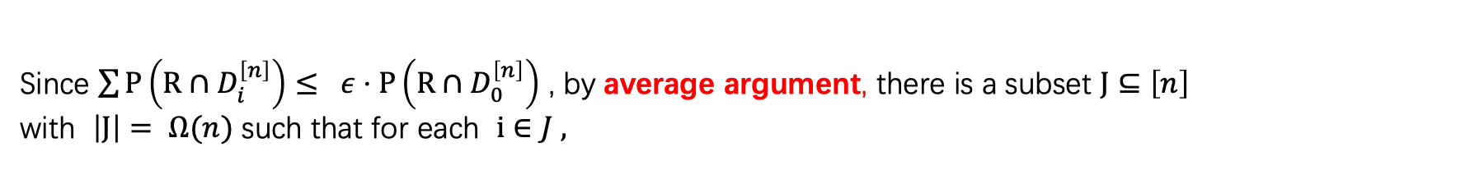
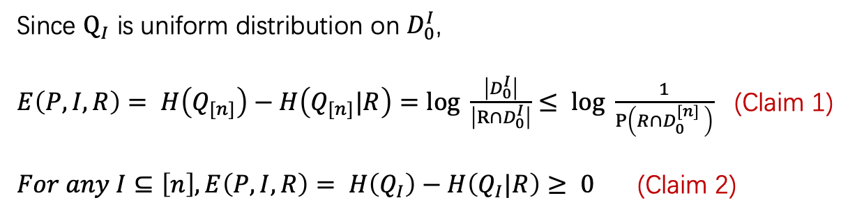
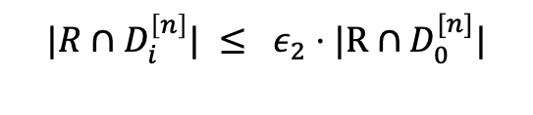

Proofs
Since $Q_{I}$ is uniform distribution on $D_{0}^{I}$,
$E\left(P,I,R\right)= H\left(Q_{[n]}\right)−H\left(Q_{[n]}|R\right)=log \frac{\left|D_{0}^{I}\right|}{\left|R∩D_{0}^{I}\right|}≤ log \frac{1}{P\left(R∩D_{0}^{[n]} \right)}$ (Claim 1)
$For any I⊆\left[n\right], E\left(P,I,R\right)= H\left(Q_{I}\right)−H\left(Q_{I}|R\right)≥ 0$ (Claim 2)
Since $\sum{P\left(R∩D_{i}^{\left[n\right]}\right)}≤ ε⋅P\left(R∩D_{0}^{\left[n\right]}\right)$ , by average argument, there is a subset $J⊆\left[n\right]$
with $\left|J\right|= Ω(n)$ such that for each $i∈J$,
$$|R∩D_{i}^{\left[n\right]}| ≤ ε_{2}⋅|R∩D_{0}^{[n]}|$$
(Claim 3)
That is, all coordinates in $J$ have bias.
Key Lemma:
Lemma 4 : If coordinate $i$has “bias”($|R∩D_{i}^{\left[n\right]}| ≤ ε_{2}⋅|R∩D_{0}^{[n]}|$), then $E\left(P,I,R\right)≥E\left(P,I∖i,R\right)+Ω(1)$

Slide 21
Intuition of Lemma 4 (bias imply entropy loss)
Lemma 4 : If coordinate $i$has “bias”, then $E\left(P,I,R\right)≥E\left(P,I∖i,R\right)+Ω(1)$
Y = 0
Y = 1
${ P}_{i}$ is the uniform distribution on $\{0,1\}×\{0,1\}$
X = 0
0
0
X = 1
0
1
If coordinate $i$has “bias”,
either condition on X=0, Y is biased or condition on Y=0, X is biased.
Property of AND gadget
So, we can do projection either on Alice’s side (fix X=0 ) or Bob’s side (fix Y = 0) to decrease potential function

Slide 22











Projection
Lemma 4 : If coordinate $i$has “bias”, then $E\left(P,I,R\right)≥E\left(P,I∖i, R\right)+Ω(1)$
$$R$$
$$Q_{\left[n\right]}$$
$$Q_{\left[n\right]∖i}$$
Do projection on Alice’s side
$$R_{0}$$
$$X_{i}=0$$
at coordinate $i$
$$Q_{\left[n\right]∖i}$$
$$R_{1}$$
Similarly, we can do projection on Bob’s side
$$X_{i}=1$$
$$E\left(P,I,R\right)=H\left(Q_{[n]}\right)−H\left(Q_{[n]}|R\right)$$
$$E\left(P,I∖i,R\right)=H\left(Q_{I/i}\right)−H\left(Q_{I∖i}\right|X_{i},R)$$
or
$$E\left(P,I∖i,R\right)=H\left(Q_{I/i}\right)−H\left(Q_{I∖i}\right|Y_{i},R)$$
The bias of other coordinates can be keep after projection (Omitted proof for simplicity)
Notes:
We build the connection between Q_I and Q_{I\i} by doing projection.

Slide 23

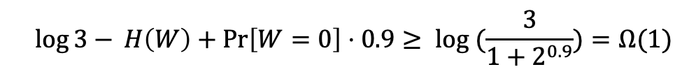

Analysis of Projection ($I=[n]$)
$$E\left(P,[n],R\right)≥E\left(P,[n]∖i, R\right)+Ω(1)$$
By definition of projection, $E\left(Q_{I}\right)=n\log{3}$ - $H\left(Q_{[n]}|R\right)$ and $E\left(Q_{[n]∖i}\right)=(n−1)\log{3 −H\left(Q_{[n]∖i}\right|R,W)}$
By chain rule of entropy:
$$H\left(Q_{[n]}|R\right)=H\left(W\right)+ H\left(Q_{[n]∖i}\right|W,R)+ H\left(Q_{i} \right|Q_{[n]∖i},W,R)$$
$E\left(Q_{\left[n\right]}\right) −E\left(Q_{[n]∖i}\right)= log{3 − }$ $H\left(W\right)−H\left(Q_{i} \right|Q_{[n]∖i},W,R)$
Since $H\left(Q_{[n]} \right|Q_{[n]∖i},W =1,R)=0$ , we need bound $\log{3− }H\left(W\right)−\operatorname{Pr}\left[W=0\right]⋅H\left(Q_{[n]}\right|Q_{[n]∖i},W=0,R)$
Assume $H\left(Q_{[n]} \right|Q_{[n]∖i},W=0,R)≤0.9$
Gadget lemma
$$\log{3− }H\left(W\right)+\operatorname{Pr}\left[W=0\right]⋅0.9≥ log (\frac{3}{1+2^{0.9}})=Ω(1)$$

Slide 24
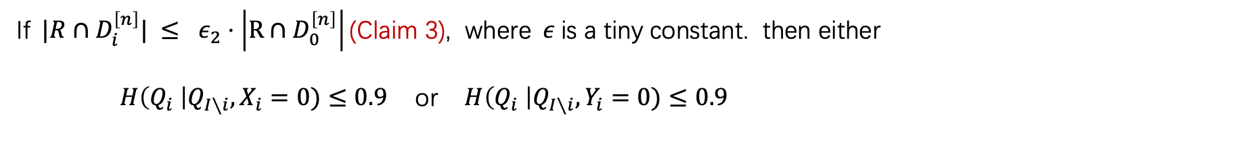

Gadget Lemma (Connections between bias and potential function)
Our goal : $H\left(Q_{[n]} \right|Q_{[n]∖i},W=0)≤0.9$
Y = 0
Y = 1
X = 0
0
0
Intuition: If rectangle is biased then
either condition on X=0, Y is biased or condition on Y=0, X is biased.
X = 1
0
1
Property of AND gadget
[Gadget Lemma]
If$|R∩D_{i}^{\left[n\right]}| ≤ ε_{2}⋅\left|R∩D_{0}^{\left[n\right]}\right|\text{(}\text{Claim} \text{3}\text{)}$, where$ε$is a tiny constant. then either
$H\left(Q_{i} \right|Q_{I∖i}, X_{i}=0)≤0.9$ or $H\left(Q_{i} \right|Q_{I∖i}, Y_{i}=0)≤0.9$
So, we can do projection either on Alice’s side or Bob’s side to decrease potential function

Slide 25

Our Results
New simple proof of $Ω\left(n\right)$randomized communication lower bound of set disjointness
${BPP}^{CC}\left(Set disjointness\right)=Ω(n)$
The corruption bound of $f∘g^{n}$is lower bounded by block sensitivity of $f$
Corruption bound is lower bound
of randomized communication complexity
Block sensitivity is lower bound
of randomized query complexity
$$Curr\left(f∘g^{n}\right)=Ω(bs\left(f\right))$$
Low-discrepancy constant gadgets
Thank you all for attending. I am open to questions and discussions.

