Slide 1

INTRODUCTION TO DATA SCIENCE
Elias Gonzalez
Lecture #14 – 03/01/2022
CMSC320
Mondays & Wednesdays
3:30-4:45 https://cmsc320.github.io/

Slide 2
THE DATA LIFECYCLE
Data collection
Data processing
Exploratory analysis
&
Data viz
Analysis, hypothesis testing, & ML
Insight & Policy Decision
(Mainly.)

Slide 3
TODAY’S LECTURE
Hypothesis Testing
What is it?
What are we looking to prove?
How can we use it to justify our hypothesis?
p-Values
p Hacking
Bayesian Inference

Slide 4
How we use probability in Data Analysis
Probabilistic model of data generation
Population
has a parameter of interest
Data
What we observe
Inverse Problem
Infer parameter of interest from data

Slide 5
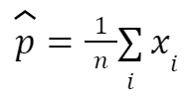
How we use probability in Data Analysis
Independent equally likely sampling of tweets
Population
p: Proportion of spam tweets
Data
110 tweet sample
Inverse Problem
Notes:
Law of Large Numbers tells us that our parameter p hat will be close to p on average, the CLT lets us answer how confident are we that we found
p

Slide 6
Confidence Intervals
A confidence interval is way to describe probability.
More mathematically, it is the mean of an estimate minus the variation.
For example, you can construct a confidence interval with a 95% confidence level. In other words you are confident that 95 out of 100 times the estimate will fall between the upper and lower values of the confidence interval.

Slide 7
More concretely
You must know:
The point estimate of the confidence interval
Critical values for the test statistic
Standard Deviation
Sample Size
SampleStatistic ± Margin of Error*
*there are multiple ways of calculating margin of error

Slide 8
Hypothesis Testing
It’s easy to maker claims and hypothesize, but how can we test the likelihood that the hypothesis is true?
H₀- Null Hypothesis that represents the default position
H₁- Alternative Hypothesis that we are comparing to
p-Value: Compute the probability that H₀ is true, that we will see a value at least as extreme as those we observed

Slide 9
p-values
Instead of looking at our data based on some probability cutoff– can we compute the probability assuming that H₀ is true?
Calculated by adding together the probability that random chance generated the data, something else that is equals and something else that is rarer. For normally distributed values, use a density function.
Smaller the p-value the stronger the evidence to reject the null hypothesis.
Typically our p-value cutoff will be 5%

Slide 10
Hypothesis Testing- Flipping a Coin
Let’s imagine we want to test to see if a coin flip is fair.
We can assume that the coin has a probability p and if we assume that it is fair, it should have a probability of .5
That means:
H₀- p = 0.5
H₁- p ≠ 0.5

Slide 11
Let’s look at this in action
Let’s go back to out Distribution notebook!

Slide 12
p-Hacking
How are p values “hackable” or manipulated?
If we remove enough of the “right” outliers we might be left with data that gets your p-value below the 0.05 threshold.
Notes:
CDF vs PDF

Slide 13

p-Hacking- Examples
ESP is real?
According to a peer-reviewed study…yes!
How can it be? Start with wanting to show an effect, and reverse engineer a study to get a result without faking anything!

Slide 14
p-Hacking- Examples
How can we avoid p-hacking (or even help us notice it)?
Determine your hypothesis before looking at the data!
Clean the data without the hypothesis in mind (harder to manage)
p-values are not a substitute for common sense!
Any examples of this?
You can’t Trust What You Read About Nutrition

Slide 15
Type of Errors
Type l
Incorrectly rejecting the null hypothesis
Type ll
Failing to reject a null hypothesis that is false
Type lll
Correctly rejecting the null hypothesis but doing so for the wrong reasons
Examples?

Slide 16
Running an A/B Test
If we have two ads, and we would like to see which is more effective in getting clicks. We can conduct a Z-Test, which will result in a corresponding p-value
Null hypothesis: There is no difference in proportions between the two ads.
def estimated_parameters(N, n) -> Tuple[float,float]:
p = n/N
sigma = math.sqrt(p*(1-p)/N)
return p, sigma
def a_b_test_statistic(N-A, n_A, N_B, n_B) ->float: # will return z
p_A, sigma_A = estimated_parameters(N_A, n_A)
p_B, sigma_B = estimated_parameters(N_B, n_B)
return (p_B - p_A)/math.sqrt(sigma_A **2 + sigma_B**2)

Slide 17
A/B Test
Ad A had 200 clicks from 1000 views, Ad B had 180 clicks from 1000 views:
z = a_b_test_statistic(1000, 200, 1000, 180)
print (z)
-1.14

Slide 18
A/B Test
If we then calculate the resulting p-value:
z = a_b_test_statistic(1000, 200, 1000, 180)
p = two_sided_p_value(z)
print (p)
0.254
Large enough that we can conclude there is no difference!

Slide 19
Bayesian Inference
Making a guess based on prior knowledge or data. Use observed data and Bayes theorem for an updated posterior distribution.
Rather than making probability judgements about the tests, make probability judgements about the parameters.
Tips for practically using Bayesian Inference:
We use beta distribution to model a continuous distribution bounded between 0 and 1
We can then adjust what the distribution is centered around based on the observed data
Bayes Theorem:
P(A|B) = P(B|A) P(A)/P(B)

Slide 20
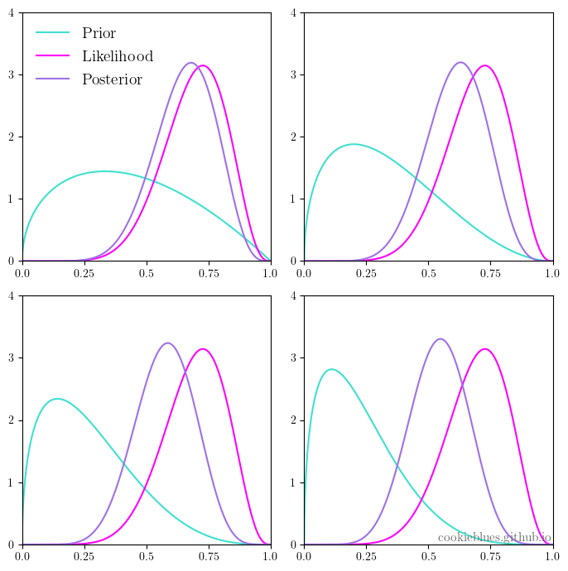
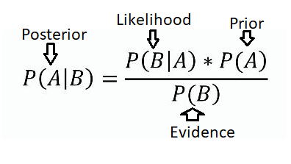
Bayesian Inference
Show the examples from the book
Now we can make claims like: “Based on the prior and the observed data there is only a _____ likelihood that the _____ probability is between ____% and ___%.
Which is different from: “If the coin is fair, we would
expect to observe data so extreme only 5% of the time”

