Slide 1
QUERYING A RESTFUL API
Stateless: with every request, you send along a token/authentication of who you are
GitHub is more than a GETHub:
PUT/POST/DELETE can edit your repositories, etc.
Try it out: https://github.com/settings/tokens/new
token = ”super_secret_token”
r = requests.get(“https://github.com/user”,
params={”access_token”: token})
print( r.content )
{"login":”JoseBabydeer","id":472985,"avatar_url":"ht…

Slide 2
AUTHENTICATION AND OAUTH
Old and busted:
New hotness:
What if I wanted to grant an app access to, e.g., my Facebook account without giving that app my password?
OAuth: grants access tokens that give (possibly incomplete) access to a user or app without exposing a password
r = requests.get(“https://api.github.com/user”,
auth=(“JoseBabydeer”, “ILoveKittens”))

Slide 3
“… I WILL RETURN INFORMATION IN A STRUCTURED FORMAT.”
So we’ve queried a server using a well-formed GET request via the requests Python module. What comes back?
General structured data:
Comma-Separated Value (CSV) files & strings
Javascript Object Notation (JSON) files & strings
HTML, XHTML, XML files & strings
Domain-specific structured data:
Shapefiles: geospatial vector data (OpenStreetMap)
RVT files: architectural planning (Autodesk Revit)
You can make up your own! Always document it.

Slide 4
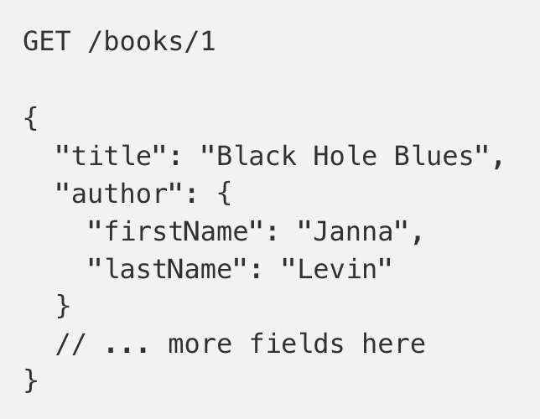
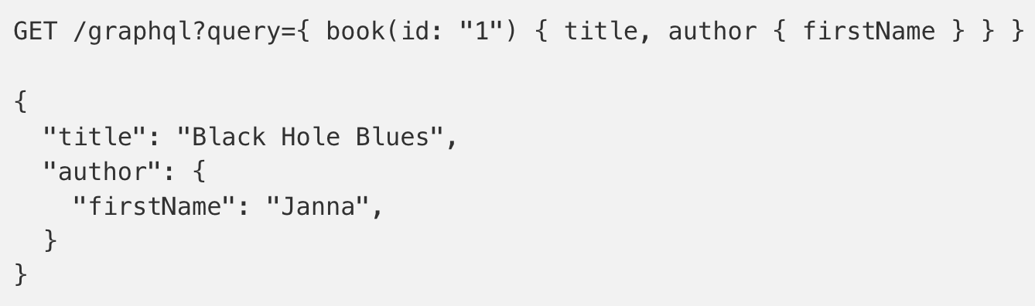
GRAPHQL?
An alternative to REST and ad-hoc webservice architectures
Developed internally by Facebook and released publicly
Unlike REST, the requester specifies the format of the response
https://dev-blog.apollodata.com/graphql-vs-rest-5d425123e34b

Slide 5
CSV FILES IN PYTHON
Any CSV reader worth anything can parse files with any delimiter, not just a comma (e.g., “TSV” for tab-separated)
1,26-Jan,Introduction,—,"pdf, pptx",Dickerson, 2,31-Jan,Scraping Data with Python,Anaconda's Test Drive.,,Dickerson, 3,2-Feb,"Vectors, Matrices, and Dataframes",Introduction to pandas.,,Dickerson, 4,7-Feb,Jupyter notebook lab,,,"Denis, Anant, & Neil", 5,9-Feb,Best Practices for Data Science Projects,,,Dickerson,
Don’t write your own CSV or JSON parser
(We’ll use pandas to do this much more easily and efficiently)
import csv
with open(“schedule.csv”, ”rb”) as f:
reader = csv.reader(f, delimiter=“,”, quotechar=’”’)
for row in reader:
print(row)

Slide 6
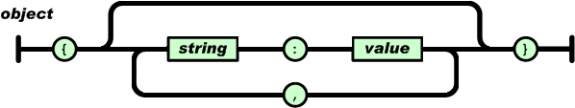
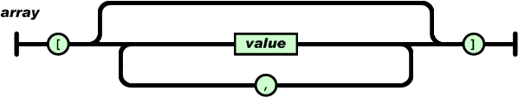
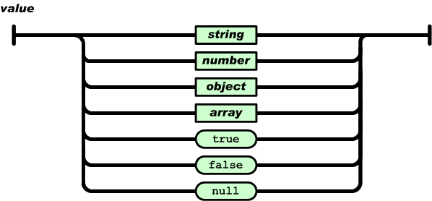
JSON FILES & STRINGS
JSON is a method for serializing objects:
Convert an object into a string (done in Java in 131/132?)
Deserialization converts a string back to an object
Easy for humans to read (and sanity check, edit)
Defined by three universal data structures
Python dictionary, Java Map, hash table, etc …
Python list, Java array, vector, etc …
Python string, float, int, boolean, JSON object, JSON array, …
Images from: http://www.json.org/

Slide 7

JSON IN PYTHON
Some built-in types: “Strings”, 1.0, True, False, None
Lists: [“Goodbye”, “Cruel”, “World”]
Dictionaries: {“hello”: “bonjour”, “goodbye”: “au revoir”}
Dictionaries within lists within dictionaries within lists:
[1, 2, {“Help”:[ “I’m”, {“trapped”: “in”}, “CMSC320” ]}]

Slide 8
JSON FROM TWITTER
GET https://api.twitter.com/1.1/friends/list.json?cursor=-1&screen_name=twitterapi&skip_status=true&include_user_entities=false
{ "previous_cursor": 0,
"previous_cursor_str": "0",
"next_cursor": 1333504313713126852,
"users": [{
"profile_sidebar_fill_color": "252429",
"profile_sidebar_border_color": "181A1E",
"profile_background_tile": false,
"name": "Sylvain Carle",
"profile_image_url": "http://a0.twimg.com/profile_images/2838630046/4b82e286a659fae310012520f4f756bb_normal.png",
"created_at": "Thu Jan 18 00:10:45 +0000 2007", …

Slide 9
PARSING JSON IN PYTHON
Repeat: don’t write your own CSV or JSON parser
https://news.ycombinator.com/item?id=7796268
rsdy.github.io/posts/dont_write_your_json_parser_plz.html
Python comes with a fine JSON parser
import json
r = requests.get( “https://api.twitter.com/1.1/statuses/user_timeline.json?screen_name=JoseBabydeer&count=100”, auth=auth )
data = json.loads(r.content)
json.load(some_file) # loads JSON from a file
json.dump(json_obj, some_file) # writes JSON to file
json.dumps(json_obj) # returns JSON string

Slide 10
XML, XHTML, HTML FILES AND STRINGS
Still hugely popular online, but JSON has essentially replaced XML for:
Asynchronous browser 🡨🡪 server calls
Many (most?) newer web APIs
XML is a hierarchical markup language:
<tag attribute=“value1”> <subtag> Some content goes here </subtag> <openclosetag attribute=“value2” /> </tag>
You probably won’t see much XML, but you will see plenty of HTML, its substantially less well-behaved cousin …
Example XML from: Zico Kolter

Slide 11
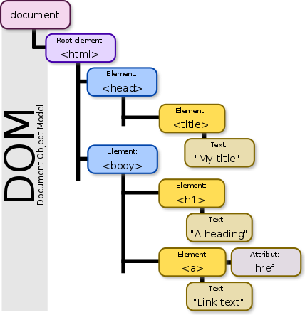
DOCUMENT OBJECT MODEL (DOM)
XML encodes Document-Object Models (“the DOM”)
The DOM is tree-structured.
Easy to work with! Everything is encoded via links.
Can be huge, & mostly full of stuff you don’t need …

Slide 12
SAX
SAX (Simple API for XML) is an alternative “lightweight” way to process XML.
A SAX parser generates a stream of events as it parses the XML file. The programmer registers handlers for each one.
It allows a programmer to handle only parts of the data structure.
Example from John Canny

Slide 13

SCRAPING HTML IN PYTHON
HTML – the specification – is fairly pure
HTML – what you find on the web – is horrifying
We’ll use BeautifulSoup:
conda install -c asmeurer beautiful-soup=4.3.2
import requests
from bs4 import BeautifulSoup
r = requests.get( “https://cmsc320.github.io” )
root = BeautifulSoup( r.content )
root.find(“div”, id=“schedule”)\
.find(“table”)\ # find all schedule
.find(“tbody”).findAll(“a”) # links for CMSC320

Slide 14
BUILDING A WEB SCRAPER IN PYTHON
Totally not hypothetical situation:
You really want to learn about data science, so you choose to download all of last semester’s CMSC320 lecture slides to wallpaper your room …
… but you now have carpal tunnel syndrome from clicking refresh on Piazza last night, and can no longer click on the PDF and PPTX links.
Hopeless? No! Earlier, you built a scraper to do this!
Sort of. You only want PDF and PPTX files, not links to other websites or files.
lnks = root.find(“div”, id=“schedule”)\
.find(“table”)\ # find all schedule
.find(“tbody”).findAll(“a”) # links for CMSC320

Slide 15
REGULAR EXPRESSIONS
Given a list of URLs (strings), how do I find only those strings that end in *.pdf or *.pptx?
Regular expressions!
(Actually Python strings come with a built-in endswith function.)
What about .pDf or .pPTx, still legal extensions for PDF/PPTX?
Regular expressions!
(Or cheat the system again: built-in string lower function.)
“this_is_a_filename.pdf”.endswith((“.pdf”, “.pptx”))
“tHiS_IS_a_FileNAme.pDF”.lower().endswith( (“.pdf”, “.pptx”))

Slide 16
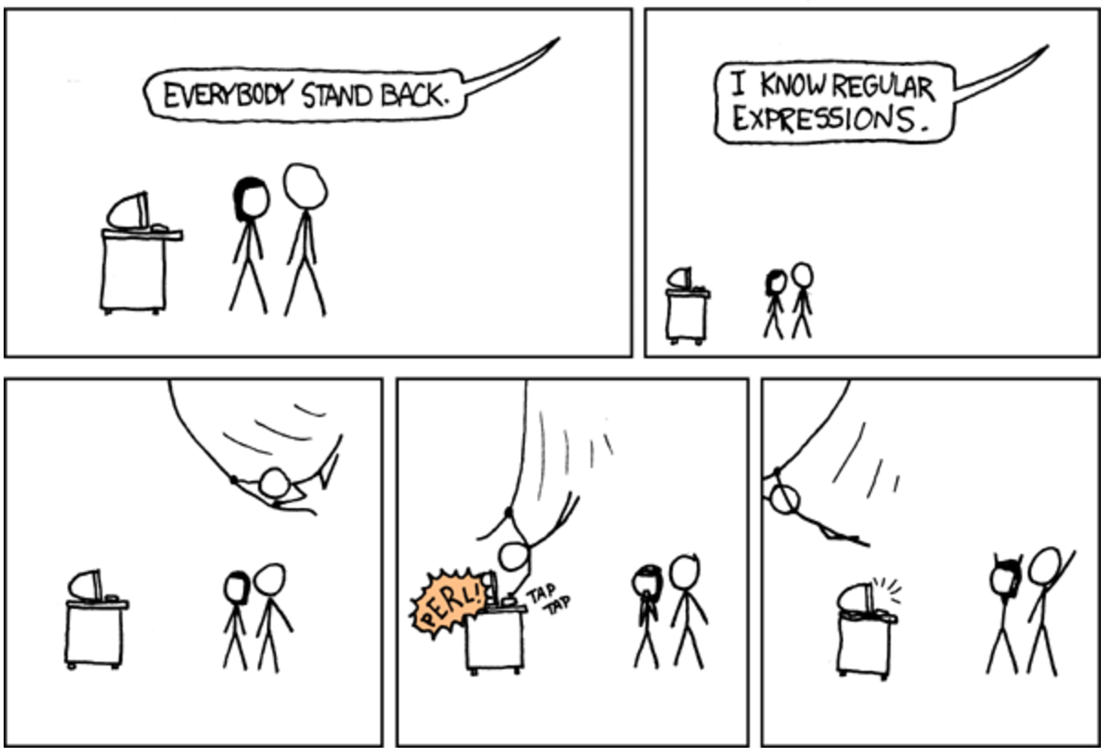


Slide 17
REGULAR EXPRESSIONS
Used to search for specific elements, or groups of elements, that match a pattern
Indispensable for data munging and wrangling
Many constructs to search a variety of different patterns
Many languages/libraries (including Python) allow “compiling”
Much faster for repeated applications of the regex pattern
https://blog.codinghorror.com/to-compile-or-not-to-compile/

Slide 18
REGULAR EXPRESSIONS
Used to search for specific elements, or groups of elements, that match a pattern
import re
# Find the index of the 1st occurrence of “cmsc320”
match = re.search(r”cmsc320”, text)
print( match.start() )
# Does start of text match “cmsc320”?
match = re.match(r”cmsc320”, text)
# Iterate over all matches for “cmsc320” in text
for match in re.finditer(r”cmsc320”, text):
print( match.start() )
# Return all matches of “cmsc320” in the text
match = re.findall(r”cmsc320”, text)

Slide 19
MATCHING MULTIPLE CHARACTERS
Can match sets of characters, or multiple and more elaborate sets and sequences of characters:
Match the character ‘a’: a
Match the character ‘a’, ‘b’, or ‘c’: [abc]
Match any character except ‘a’, ‘b’, or ‘c’: [^abc]
Match any digit: \d (= [0123456789] or [0-9])
Match any alphanumeric: \w (= [a-zA-Z0-9_])
Match any whitespace: \s (= [ \t\n\r\f\v])
Match any character: .
Special characters must be escaped: .^$*+?{}\[]|()
Thanks to: Zico Kolter

Slide 20
MATCHING SEQUENCES AND REPEATED CHARACTERS
A few common modifiers (available in Python and most other high-level languages; +, {n}, {n,} may not):
Match character ‘a’ exactly once: a
Match character ‘a’ zero or once: a?
Match character ‘a’ zero or more times: a*
Match character ‘a’ one or more times: a+
Match character ‘a’ exactly n times: a{n}
Match character ‘a’ at least n times: a{n,}
Example: match all instances of “University of <somewhere>” where <somewhere> is an alphanumeric string with at least 3 characters:
\s*University\sof\s\w{3,}

Slide 21
GROUPS
What if we want to know more than just “did we find a match” or “where is the first match” …?
Grouping asks the regex matcher to keep track of certain portions – surrounded by (parentheses) – of the match
\s*([Uu]niversity)\s([Oo]f)\s(\w{3,})
regex = r”\s*([Uu]niversity)\s([Oo]f)\s(\w{3,})”
m = re.search( regex, “university Of Maryland” )
print( m.groups() )
('university', 'Of', 'Maryland')

Slide 22
SIMPLE EXAMPLE: PARSE AN EMAIL ADDRESS
(?:(?:\r\n)?[ \t])*(?:(?:(?:[^()<>@,;:\\".\[\] \000-\031]+(?:(?:(?:\r\n)?[ \t] )+|\Z|(?=[\["()<>@,;:\\".\[\]]))|"(?:[^\"\r\\]|\\.|(?:(?:\r\n)?[ \t]))*"(?:(?: \r\n)?[ \t])*)(?:\.(?:(?:\r\n)?[ \t])*(?:[^()<>@,;:\\".\[\] \000-\031]+(?:(?:( ?:\r\n)?[ \t])+|\Z|(?=[\["()<>@,;:\\".\[\]]))|"(?:[^\"\r\\]|\\.|(?:(?:\r\n)?[ \t]))*"(?:(?:\r\n)?[ \t])*))*@(?:(?:\r\n)?[ \t])*(?:[^()<>@,;:\\".\[\] \000-\0 31]+(?:(?:(?:\r\n)?[ \t])+|\Z|(?=[\["()<>@,;:\\".\[\]]))|\[([^\[\]\r\\]|\\.)*\ ](?:(?:\r\n)?[ \t])*)(?:\.(?:(?:\r\n)?[ \t])*(?:[^()<>@,;:\\".\[\] \000-\031]+ (?:(?:(?:\r\n)?[ \t])+|\Z|(?=[\["()<>@,;:\\".\[\]]))|\[([^\[\]\r\\]|\\.)*\](?: (?:\r\n)?[ \t])*))*|(?:[^()<>@,;:\\".\[\] \000-\031]+(?:(?:(?:\r\n)?[ \t])+|\Z |(?=[\["()<>@,;:\\".\[\]]))|"(?:[^\"\r\\]|\\.|(?:(?:\r\n)?[ \t]))*"(?:(?:\r\n) ?[ \t])*)*\<(?:(?:\r\n)?[ \t])*(?:@(?:[^()<>@,;:\\".\[\] \000-\031]+(?:(?:(?:\ r\n)?[ \t])+|\Z|(?=[\["()<>@,;:\\".\[\]]))|\[([^\[\]\r\\]|\\.)*\](?:(?:\r\n)?[ \t])*)(?:\.(?:(?:\r\n)?[ \t])*(?:[^()<>@,;:\\".\[\] \000-\031]+(?:(?:(?:\r\n) ?[ \t])+|\Z|(?=[\["()<>@,;:\\".\[\]]))|\[([^\[\]\r\\]|\\.)*\](?:(?:\r\n)?[ \t] )*))*(?:,@(?:(?:\r\n)?[ \t])*(?:[^()<>@,;:\\".\[\] \000-\031]+(?:(?:(?:\r\n)?[ \t])+|\Z|(?=[\["()<>@,;:\\".\[\]]))|\[([^\[\]\r\\]|\\.)*\](?:(?:\r\n)?[ \t])* )(?:\.(?:(?:\r\n)?[ \t])*(?:[^()<>@,;:\\".\[\] \000-\031]+(?:(?:(?:\r\n)?[ \t] )+|\Z|(?=[\["()<>@,;:\\".\[\]]))|\[([^\[\]\r\\]|\\.)*\](?:(?:\r\n)?[ \t])*))*) *:(?:(?:\r\n)?[ \t])*)?(?:[^()<>@,;:\\".\[\] \000-\031]+(?:(?:(?:\r\n)?[ \t])+ |\Z|(?=[\["()<>@,;:\\".\[\]]))|"(?:[^\"\r\\]|\\.|(?:(?:\r\n)?[ \t]))*"(?:(?:\r \n)?[ \t])*)(?:\.(?:(?:\r\n)?[ \t])*(?:[^()<>@,;:\\".\[\] \000-\031]+(?:(?:(?: \r\n)?[ \t])+|\Z|(?=[\["()<>@,;:\\".\[\]]))|"(?:[^\"\r\\]|\\.|(?:(?:\r\n)?[ \t ]))*"(?:(?:\r\n)?[ \t])*))*@(?:(?:\r\n)?[ \t])*(?:[^()<>@,;:\\".\[\] \000-\031 ]+(?:(?:(?:\r\n)?[ \t])+|\Z|(?=[\["()<>@,;:\\".\[\]]))|\[([^\[\]\r\\]|\\.)*\]( ?:(?:\r\n)?[ \t])*)(?:\.(?:(?:\r\n)?[ \t])*(?:[^()<>@,;:\\".\[\] \000-\031]+(? :(?:(?:\r\n)?[ \t])+|\Z|(?=[\["()<>@,;:\\".\[\]]))|\[([^\[\]\r\\]|\\.)*\](?:(? :\r\n)?[ \t])*))*\>(?:(?:\r\n)?[ \t])*)|(?:[^()<>@,;:\\".\[\] \000-\031]+(?:(? :(?:\r\n)?[ \t])+|\Z|(?=[\["()<>@,;:\\".\[\]]))|"(?:[^\"\r\\]|\\.|(?:(?:\r\n)? [ \t]))*"(?:(?:\r\n)?[ \t])*)*:(?:(?:\r\n)?[ \t])*(?:(?:(?:[^()<>@,;:\\".\[\] \000-\031]+(?:(?:(?:\r\n)?[ \t])+|\Z|(?=[\["()<>@,;:\\".\[\]]))|"(?:[^\"\r\\]| \\.|(?:(?:\r\n)?[ \t]))*"(?:(?:\r\n)?[ \t])*)(?:\.(?:(?:\r\n)?[ \t])*(?:[^()<> @,;:\\".\[\] \000-\031]+(?:(?:(?:\r\n)?[ \t])+|\Z|(?=[\["()<>@,;:\\".\[\]]))|" (?:[^\"\r\\]|\\.|(?:(?:\r\n)?[ \t]))*"(?:(?:\r\n)?[ \t])*))*@(?:(?:\r\n)?[ \t] )*(?:[^()<>@,;:\\".\[\] \000-\031]+(?:(?:(?:\r\n)?[ \t])+|\Z|(?=[\["()<>@,;:\\ ".\[\]]))|\[([^\[\]\r\\]|\\.)*\](?:(?:\r\n)?[ \t])*)(?:\.(?:(?:\r\n)?[ \t])*(? :[^()<>@,;:\\".\[\] \000-\031]+(?:(?:(?:\r\n)?[ \t])+|\Z|(?=[\["()<>@,;:\\".\[ \]]))|\[([^\[\]\r\\]|\\.)*\](?:(?:\r\n)?[ \t])*))*|(?:[^()<>@,;:\\".\[\] \000- \031]+(?:(?:(?:\r\n)?[ \t])+|\Z|(?=[\["()<>@,;:\\".\[\]]))|"(?:[^\"\r\\]|\\.|( ?:(?:\r\n)?[ \t]))*"(?:(?:\r\n)?[ \t])*)*\<(?:(?:\r\n)?[ \t])*(?:@(?:[^()<>@,; :\\".\[\] \000-\031]+(?:(?:(?:\r\n)?[ \t])+|\Z|(?=[\["()<>@,;:\\".\[\]]))|\[([ ^\[\]\r\\]|\\.)*\](?:(?:\r\n)?[ \t])*)(?:\.(?:(?:\r\n)?[ \t])*(?:[^()<>@,;:\\" .\[\] \000-\031]+(?:(?:(?:\r\n)?[ \t])+|\Z|(?=[\["()<>@,;:\\".\[\]]))|\[([^\[\ ]\r\\]|\\.)*\](?:(?:\r\n)?[ \t])*))*(?:,@(?:(?:\r\n)?[ \t])*(?:[^()<>@,;:\\".\ [\] \000-\031]+(?:(?:(?:\r\n)?[ \t])+|\Z|(?=[\["()<>@,;:\\".\[\]]))|\[([^\[\]\ r\\]|\\.)*\](?:(?:\r\n)?[ \t])*)(?:\.(?:(?:\r\n)?[ \t])*(?:[^()<>@,;:\\".\[\] \000-\031]+(?:(?:(?:\r\n)?[ \t])+|\Z|(?=[\["()<>@,;:\\".\[\]]))|\[([^\[\]\r\\] |\\.)*\](?:(?:\r\n)?[ \t])*))*)*:(?:(?:\r\n)?[ \t])*)?(?:[^()<>@,;:\\".\[\] \0 00-\031]+(?:(?:(?:\r\n)?[ \t])+|\Z|(?=[\["()<>@,;:\\".\[\]]))|"(?:[^\"\r\\]|\\ .|(?:(?:\r\n)?[ \t]))*"(?:(?:\r\n)?[ \t])*)(?:\.(?:(?:\r\n)?[ \t])*(?:[^()<>@, ;:\\".\[\] \000-\031]+(?:(?:(?:\r\n)?[ \t])+|\Z|(?=[\["()<>@,;:\\".\[\]]))|"(? :[^\"\r\\]|\\.|(?:(?:\r\n)?[ \t]))*"(?:(?:\r\n)?[ \t])*))*@(?:(?:\r\n)?[ \t])* (?:[^()<>@,;:\\".\[\] \000-\031]+(?:(?:(?:\r\n)?[ \t])+|\Z|(?=[\["()<>@,;:\\". \[\]]))|\[([^\[\]\r\\]|\\.)*\](?:(?:\r\n)?[ \t])*)(?:\.(?:(?:\r\n)?[ \t])*(?:[ ^()<>@,;:\\".\[\] \000-\031]+(?:(?:(?:\r\n)?[ \t])+|\Z|(?=[\["()<>@,;:\\".\[\] ]))|\[([^\[\]\r\\]|\\.)*\](?:(?:\r\n)?[ \t])*))*\>(?:(?:\r\n)?[ \t])*)(?:,\s*( ?:(?:[^()<>@,;:\\".\[\] \000-\031]+(?:(?:(?:\r\n)?[ \t])+|\Z|(?=[\["()<>@,;:\\ ".\[\]]))|"(?:[^\"\r\\]|\\.|(?:(?:\r\n)?[ \t]))*"(?:(?:\r\n)?[ \t])*)(?:\.(?:( ?:\r\n)?[ \t])*(?:[^()<>@,;:\\".\[\] \000-\031]+(?:(?:(?:\r\n)?[ \t])+|\Z|(?=[ \["()<>@,;:\\".\[\]]))|"(?:[^\"\r\\]|\\.|(?:(?:\r\n)?[ \t]))*"(?:(?:\r\n)?[ \t ])*))*@(?:(?:\r\n)?[ \t])*(?:[^()<>@,;:\\".\[\] \000-\031]+(?:(?:(?:\r\n)?[ \t ])+|\Z|(?=[\["()<>@,;:\\".\[\]]))|\[([^\[\]\r\\]|\\.)*\](?:(?:\r\n)?[ \t])*)(? :\.(?:(?:\r\n)?[ \t])*(?:[^()<>@,;:\\".\[\] \000-\031]+(?:(?:(?:\r\n)?[ \t])+| \Z|(?=[\["()<>@,;:\\".\[\]]))|\[([^\[\]\r\\]|\\.)*\](?:(?:\r\n)?[ \t])*))*|(?: [^()<>@,;:\\".\[\] \000-\031]+(?:(?:(?:\r\n)?[ \t])+|\Z|(?=[\["()<>@,;:\\".\[\ ]]))|"(?:[^\"\r\\]|\\.|(?:(?:\r\n)?[ \t]))*"(?:(?:\r\n)?[ \t])*)*\<(?:(?:\r\n) ?[ \t])*(?:@(?:[^()<>@,;:\\".\[\] \000-\031]+(?:(?:(?:\r\n)?[ \t])+|\Z|(?=[\[" ()<>@,;:\\".\[\]]))|\[([^\[\]\r\\]|\\.)*\](?:(?:\r\n)?[ \t])*)(?:\.(?:(?:\r\n) ?[ \t])*(?:[^()<>@,;:\\".\[\] \000-\031]+(?:(?:(?:\r\n)?[ \t])+|\Z|(?=[\["()<> @,;:\\".\[\]]))|\[([^\[\]\r\\]|\\.)*\](?:(?:\r\n)?[ \t])*))*(?:,@(?:(?:\r\n)?[ \t])*(?:[^()<>@,;:\\".\[\] \000-\031]+(?:(?:(?:\r\n)?[ \t])+|\Z|(?=[\["()<>@, ;:\\".\[\]]))|\[([^\[\]\r\\]|\\.)*\](?:(?:\r\n)?[ \t])*)(?:\.(?:(?:\r\n)?[ \t] )*(?:[^()<>@,;:\\".\[\] \000-\031]+(?:(?:(?:\r\n)?[ \t])+|\Z|(?=[\["()<>@,;:\\ ".\[\]]))|\[([^\[\]\r\\]|\\.)*\](?:(?:\r\n)?[ \t])*))*)*:(?:(?:\r\n)?[ \t])*)? (?:[^()<>@,;:\\".\[\] \000-\031]+(?:(?:(?:\r\n)?[ \t])+|\Z|(?=[\["()<>@,;:\\". \[\]]))|"(?:[^\"\r\\]|\\.|(?:(?:\r\n)?[ \t]))*"(?:(?:\r\n)?[ \t])*)(?:\.(?:(?: \r\n)?[ \t])*(?:[^()<>@,;:\\".\[\] \000-\031]+(?:(?:(?:\r\n)?[ \t])+|\Z|(?=[\[ "()<>@,;:\\".\[\]]))|"(?:[^\"\r\\]|\\.|(?:(?:\r\n)?[ \t]))*"(?:(?:\r\n)?[ \t]) *))*@(?:(?:\r\n)?[ \t])*(?:[^()<>@,;:\\".\[\] \000-\031]+(?:(?:(?:\r\n)?[ \t]) +|\Z|(?=[\["()<>@,;:\\".\[\]]))|\[([^\[\]\r\\]|\\.)*\](?:(?:\r\n)?[ \t])*)(?:\ .(?:(?:\r\n)?[ \t])*(?:[^()<>@,;:\\".\[\] \000-\031]+(?:(?:(?:\r\n)?[ \t])+|\Z |(?=[\["()<>@,;:\\".\[\]]))|\[([^\[\]\r\\]|\\.)*\](?:(?:\r\n)?[ \t])*))*\>(?:( ?:\r\n)?[ \t])*))*)?;\s*)
Mail::RFC822::Address Perl module for RFC 822

Slide 23
NAMED GROUPS
Raw grouping is useful for one-off exploratory analysis, but may get confusing with longer regexes
Much scarier regexes than that email one exist in the wild …
Named groups let you attach position-independent identifiers to groups in a regex
(?P<some_name> …)
regex = "\s*[Uu]niversity\s[Oo]f\s(?P<school>(\w{3,}))"
m = re.search( regex, “University of Maryland” )
print( m.group(‘school’) )
'Maryland'

Slide 24
SUBSTITUTIONS
The Python string module contains basic functionality for find-and-replace within strings:
For more complicated stuff, use regexes:
Can incorporate groups into the matching
”abcabcabc”.replace(“a”, ”X”)
‘XbcXbcXbc`
text = “I love Introduction to Data Science”
re.sub(r”Data Science”, r”Schmada Schmience”, text)
‘I love Introduction to Schmada Schmience`
re.sub(r”(\w+)\s([Ss]cience”, r”\1 \2hmience”, text)
Thanks to: Zico Kolter

Slide 25
COMPILED REGEXES
If you’re going to reuse the same regex many times, or if you aren’t but things are going slowly for some reason, try compiling the regular expression.
https://blog.codinghorror.com/to-compile-or-not-to-compile/
Interested? CMSC330, CMSC430, CMSC452, talk to me.
# Compile the regular expression “cmsc320”
regex = re.compile(r”cmsc320”)
# Use it repeatedly to search for matches in text
regex.match( text ) # does start of text match?
regex.search( text ) # find the first match or None
regex.findall( text ) # find all matches

Slide 26
DOWNLOADING A BUNCH OF FILES
Import the modules
import re
import requests
from bs4 import BeautifulSoup
try:
from urllib.parse import urlparse
except ImportError:
from urlparse import urlparse
Get some HTML via HTTP
# HTTP GET request sent to the URL url
r = requests.get( url )
# Use BeautifulSoup to parse the GET response
root = BeautifulSoup( r.content )
lnks = root.find("div", id="schedule")\
.find("table")\
.find("tbody").findAll("a")

Slide 27
DOWNLOADING A BUNCH OF FILES
Parse exactly what you want
# Cycle through the href for each anchor, checking
# to see if it's a PDF/PPTX link or not
for lnk in lnks:
href = lnk['href']
# If it's a PDF/PPTX link, queue a download
if href.lower().endswith(('.pdf', '.pptx')):
Get some more data?!
urld = urlparse.urljoin(url, href)
rd = requests.get(urld, stream=True)
# Write the downloaded PDF to a file
outfile = path.join(outbase, href)
with open(outfile, 'wb') as f:
f.write(rd.content)

Slide 28
THE DATA LIFECYCLE
Data collection
Data processing
Exploratory analysis
&
Data viz
Analysis, hypothesis testing, & ML
Insight & Policy Decision

Slide 29


NEXT CLASS: NUMPY, SCIPY, AND DATAFRAMES

