Slide 1

INTRODUCTION TO DATA SCIENCE
Elias Gonzalez
Lecture #8 – 02/16/2022
CMSC320
Monday & Wednesday
3:30pm – 4:45pm https://cmsc320.github.io/

Slide 2
THE DATA LIFECYCLE
Data collection
Data processing
Exploratory analysis
&
Data viz
Analysis, hypothesis testing, & ML
Insight & Policy Decision
Version control for tracking code/data and for managing collaboration.

Slide 3
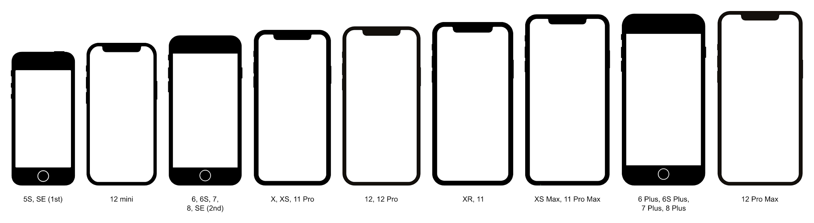
TODAY’S LECTURE
By popular request …
Version control primer!
Specifically, git via GitHub and GitLab
Thanks: Mark Groves (Microsoft), Ilan Biala & Aaron Perley (CMU), Sharif U., & the HJCB Senior Design Team!

Slide 4
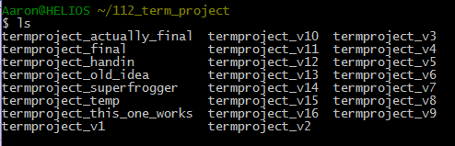
WHAT IS VERSION CONTROL?

Slide 5
DEVELOPMENT TOOL
When working with a team, the need for a central repository is essential
Need a system to allow versioning, and a way to acquire the latest edition of the code
A system to track and manage bugs was also needed

Slide 6
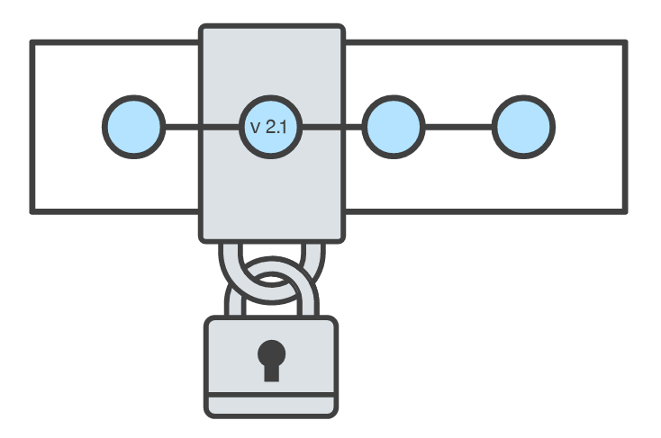
GOALS OF VERSION CONTROL
Be able to search through revision history and retrieve previous versions of any file in a project
Be able to share changes with collaborators on a project
Be able to confidently make large changes to existing files
atlassian.com/git/tutorials/what-is-version-control

Slide 7
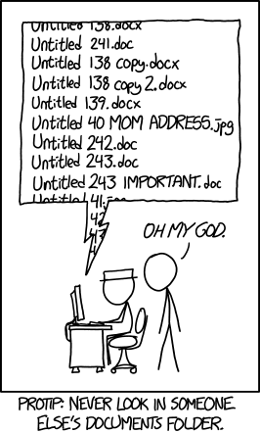
NAMED FOLDERS APPROACH
Can be hard to track
Memory-intensive
Can be slow
Hard to share
No record of authorship

Slide 8
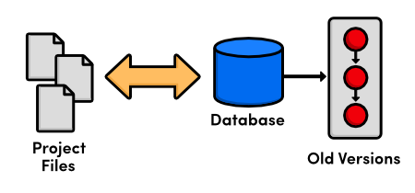
LOCAL DATABASE OF VERSIONS APPROACH
Provides an abstraction over finding the right versions of files and replacing them in the project
Records who changes what, but hard to parse that
Can’t share with collaborators

Slide 9
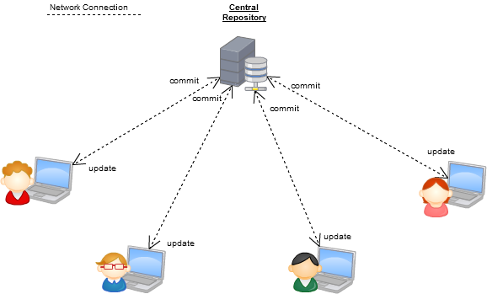
CENTRALIZED VERSION CONTROL SYSTEMS
A central, trusted repository determines the order of commits (“versions” of the project)
Collaborators “push” changes (commits) to this repository.
Any new commits must be compatible with the most recent commit. If it isn’t, somebody must “merge” it in.
Examples: SVN, CVS, Perforce

Slide 10
DISTRIBUTED VERSION CONTROL SYSTEMS (DVCS)
No central repository
Every repository has every commit
Examples: Git, Mercurial
Developer A’s local files
Developer B’s local files
Commit
Dev C’s Repo
Commit
Dev A’s Repo
Push/Fetch
Commit
Commit
Checkout
Central Repository
Checkout
Push/Fetch
Push/Fetch
Push/Fetch
Commit
Commit
Commit
Dev D’s Repo
Developer C’s local files
Checkout
Checkout
Developer D’s local files
Push/Fetch
Dev B’s Repo
Push/Fetch
Centralized Version Control System
Distributed Version Control System
Commit

Slide 11

WHAT IS GIT
Git is a version control system
Developed as a repository system for both local and remote changes
Allows teammates to work simultaneously on a project
Tracks each commit, allowing for a detailed documentation of the project along every step
Allows for advanced merging and branching operations

Slide 12

A SHORT HISTORY OF GIT
Linux kernel development
1991-2002
Changes passed around as archived file
2002-2005
Using a DVCS called BitKeeper
2005
Relationship broke down between two communities (BitKeeper licensing issues)

Slide 13
A SHORT HISTORY OF GIT
Goals:
Speed
Simple design
Strong support for non-linear development (thousands of parallel branches)
Fully distributed – not a requirement, can be centralized
Able to handle large projects like the Linux kernel efficiently (speed and data size)

Slide 14
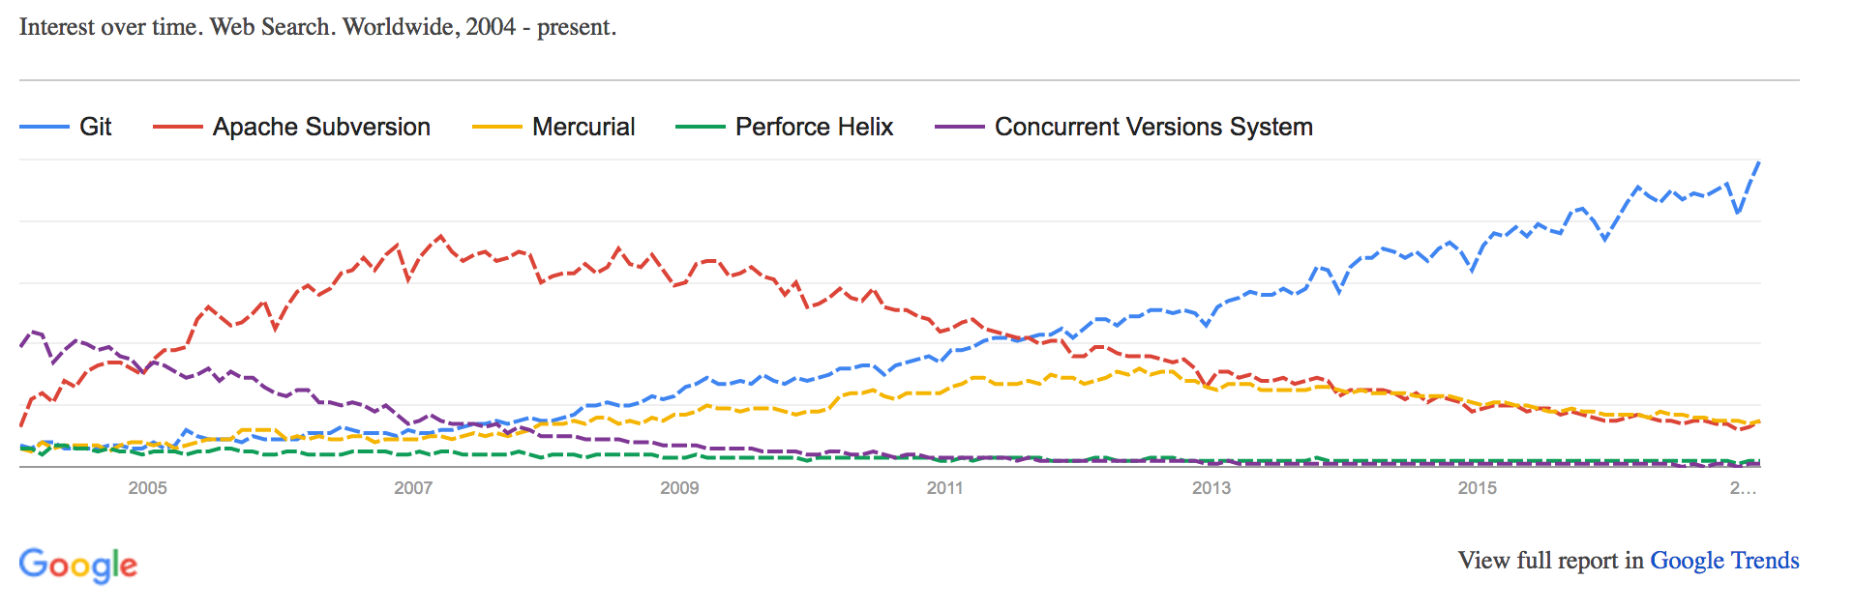
A SHORT HISTORY OF GIT
Popularity:
Git is now the most widely used source code management tool
50% of professional software developers use Git (often through GitHub) as their primary source control system
[citation needed, IMO much more ☺]

Slide 15

GIT IN INDUSTRY
Companies and projects currently using Git
Google
Android
Facebook
GitHub
Microsoft
Netflix
Linux
Ruby on Rails
Gnome
KDE
Eclipse
X.org

Slide 16
GIT BASICS
Snapshots, not changes
A picture of what all your files look like at that moment
If a file has not changed, store a reference
Nearly every operation is local
Browsing the history of project
See changes between two versions

Slide 17
WHY GIT IS BETTER
Git tracks the content rather than the files
Branches are lightweight, and merging is a simple process
Allows for a more streamlined offline development process
Repositories are smaller in size and are stored in a single .git directory
Allows for advanced staging operations, and the use of stashing when working through troublesome sections

Slide 18
Important Command Line Commands!
cd
ls
git
sudo
code

Slide 19
Important Command Line Commands!
cd- Change directory, must be followed by a folder to enter
ls - List files and folders in current directory
git- Must precede any git commands
Sudo- On linux machines, used whenever permission is needed to execute command
code- Followed by a folder or file, opens it in VScode

Slide 20
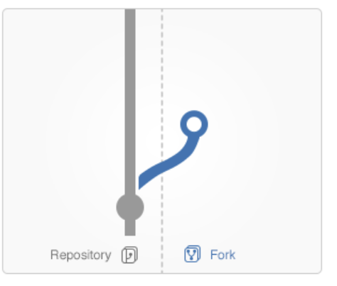
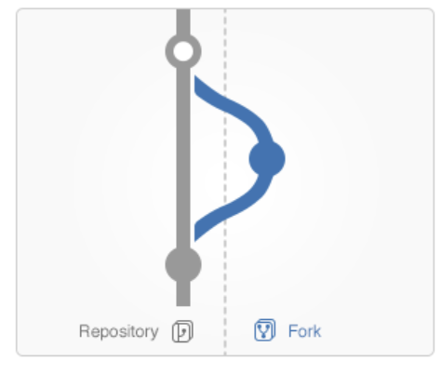
Other Vocab
Fork- Making a copy of a branch and allowing you to make changes freely
Branch- The stream you create by forking
Master/Main- Main Branch
Merge- Merges the stream you forked back into the master

Slide 21
Other Vocab
git status → To see if there are any changes to commit

Slide 22
Other Vocab
git status → To see if there are any changes to commit
git fetch [remote]→ See if there is anything to pull
git pull → Actually pulling from upstream

Slide 23
GIT VS {CVS, SVN, …}
Why you should care:
Many places use legacy systems that will cause problems in the future – be the change you believe in!
Git is much faster than SVN:
Coded in C, which allows for a great amount of optimization
Accomplishes much of the logic client side, thereby reducing time needed for communication
Developed to work on the Linux kernel, so that large project manipulation is at the forefront of the benchmarks

Slide 24

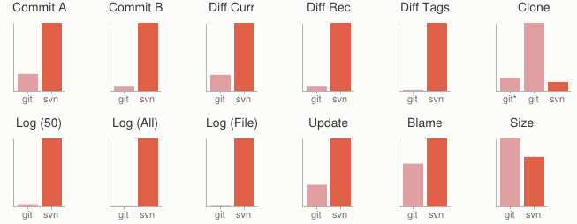

GIT VS {CVS, SVN, …}
Speed benchmarks:
Benchmarks performed by

Slide 25


GIT VS {CVS, SVN, …}
Git is significantly smaller than SVN
All files are contained in a small decentralized .git file
In the case of Mozilla’s projects, a Git repository was 30 times smaller than an identical SVN repository
Entire Linux kernel with 5 years of versioning contained in a single 1 GB .git file
SVN carries two complete copies of each file, while Git maintains a simple and separate 100 bytes of data per file, noting changes and supporting operations
Nice because you can (and do!) store the whole thing locally

Slide 26
GIT VS {CVS, SVN, …}
Git is more secure than SVN
All commits are uniquely hashed for both security and indexing purposes
Commits can be authenticated through numerous means
In the case of SSH commits, a key may be provided by both the client and server to guarantee authenticity and prevent against unauthorized access

Slide 27
GIT VS {CVS, SVN, …}
Git is decentralized:
Each user contains an individual repository and can check commits against itself, allowing for detailed local revisioning
Being decentralized allows for easy replication and deployment
In this case, SVN relies on a single centralized repository and is unusable without

Slide 28
GIT VS {CVS, SVN, …}
Git is flexible:
Due to it’s decentralized nature, git commits can be stored locally, or committed through HTTP, SSH, FTP, or even by Email
No need for a centralized repository
Developed as a command line utility, which allows a large amount of features to be built and customized on top of it

Slide 29
GIT VS {CVS, SVN, …}
Data assurance: a checksum is performed on both upload and download to ensure sure that the file hasn’t been corrupted.
Commit IDs are generated upon each commit:
Linked list style of commits
Each commit is linked to the next, so that if something in the history was changed, each following commit will be rebranded to indicate the modification

Slide 30
GIT VS {CVS, SVN, …}
Branching:
Git allows the usage of advanced branching mechanisms and procedures
Individual divisions of the code can be separated and developed separately within separate branches of the code
Branches can allow for the separation of work between developers, or even for disposable experimentation
Branching is a precursor and a component of the merging process
Will give an example shortly.

Slide 31
GIT VS {CVS, SVN, …}
Merging
The process of merging is directly related to the process of branching
Individual branches may be merged together, solving code conflicts, back into the default or master branch of the project
Merges are usually done automatically, unless a conflict is presented, in which case the user is presented with several options with which to handle the conflict
Will give an example shortly.

Slide 32
GIT VS {CVS, SVN, …}
Merging: content of the files is tracked rather than the file itself:
This allows for a greater element of tracking and a smarter and more automated process of merging
SVN is unable to accomplish this, and will throw a conflict if, e.g., a file name is changed and differs from the name in the central repository
Git is able to solve this problem with its use of managing a local repository and tracking individual changes to the code

Slide 33


INITIALIZATION OF A GIT REPOSITORY
C:\> mkdir CoolProject
C:\> cd CoolProject
C:\CoolProject > git init
Initialized empty Git repository in C:/CoolProject/.git
C:\CoolProject > notepad README.txt
C:\CoolProject > git add .
C:\CoolProject > git commit -m 'my first commit'
[master (root-commit) 7106a52] my first commit
1 file changed, 1 insertion(+)
create mode 100644 README.txt
john@Johns-MBP ~ % mkdir cmsc320 && cd cmsc320
john@Johns-MBP cmsc320 % git init
Initialized empty Git repository in /Users/john/cmsc320/.git/
john@Johns-MBP cmsc320 % touch README.md
john@Johns-MBP cmsc320 % git add .
john@Johns-MBP cmsc320 % git commit -m "First commit!"
-based systems such as MacOS (more related to FreeBSD) and Linux (e.g., the Ubuntu distros many of you are running)
Notes:
After you install git on your machine to get started you will need to initialize a repository.
You can do this by going into your file system, creating a folder and doing git init within the folder.
All the magic happens in the Dot Git folder. This folder IS GIT. You can copy this folder to another machine and it will work.
When I first started playing with git, I had setup a new machine, and was having a hell of a time trying to figure out how I should move my git projects over to the new machine. It was kind of embarrassing. Eventually I just tried to copy it over and it worked.
At this point you really don’t have much. You need to do your first commit to make this light up.
You create a file. When then stage it, but telling git the track this file. In this case I told git to add all files.
Then I was able to commit with a message say this is my first commit.

Slide 34
GIT BASICS I
The three (or four) states of a file:
Modified:
File has changed but not committed
Staged:
Marked to go to next commit snapshot
Committed:
Safely stored in local database
Untracked!
Newly added or removed files

Slide 35
GIT BASICS II
Three main areas of a git project:
Working directory
Single checkout of one version of the project.
Staging area
Simple file storing information about what will go into your next commit
Git directory
What is copied when cloning a repository

Slide 36

GIT BASICS III
Three main areas of a git project:

Slide 37
BRANCHES ILLUSTRATED
(Default branch is called “master”; your first commit will be on this branch. Starting October 1, 2020, this will be called “main” on GitHub.)
master
A
> git commit –m ‘my first commit’
Notes:
Now lets see what this visually looks like.
On my first commit I have A.
The default branch that gets created with git is a branch names Master.
This is just a default name. As I mentioned before, most everything in git is done by convention. Master does not mean anything special to git.

Slide 38
BRANCHES ILLUSTRATED
master
A
B
C
> git commit (x2)
Notes:
We make a set of commits, moving master and our current pointer (*) along

Slide 39
BRANCHES ILLUSTRATED
master
A
B
C
bug123
> git checkout –b bug123
Notes:
Suppose we want to work on a bug. We start by creating a local “story branch” for this work.
Notice that the new branch is really just a pointer to the same commit (C) but our current pointer (*) is moved.

Slide 40
BRANCHES ILLUSTRATED
master
A
B
C
D
E
bug123
> git commit (x2)
Notes:
Now we make commits and they move along, with the branch and current pointer following along.

Slide 41
BRANCHES ILLUSTRATED
master
A
B
C
D
E
bug123
> git checkout master
Notes:
We can “checkout” to go back to the master branch.
This is where I was freaked out the first time I did this. My IDE removed the changes I just made. It can be pretty startling, but don’t worry you didn’t lose anything.

Slide 42
BRANCHES ILLUSTRATED
master
A
B
C
D
E
bug123
> git merge bug123
Notes:
And then merge from the story branch, bringing those change histories together.

Slide 43
Typical Git Version Control
Upstream
(Us instructors)
Origin
(on GitHub)

Slide 44
Upstream
Origin
(on GitHug)
Your Computer
(With Git)
clone git.github@XXXXXXX

Slide 45
Upstream
Origin
(on GitHub)
Your Computer
(With Git)
git remote add upstream addressHere

Slide 46
Upstream
Origin
(on GitHub)
git pull upstream master
Your Computer
(With Git)

Slide 47
Upstream
Origin
(on GitHub)
Your Computer
(With Git)
Make your changes!

Slide 48
Upstream
Origin
(on GitHub)
Your Computer
(With Git)
git push origin master

Slide 49
Upstream
Your Computer
(With Git)

Slide 50
BRANCHES ILLUSTRATED
master
A
B
C
D
E
> git branch -d bug123
Notes:
And since we’re done with the story branch, we can delete it. This all happened locally, without affecting anyone upstream.

Slide 51
BRANCHES ILLUSTRATED
master
A
B
C
D
E
F
G
bug456
Notes:
Let’s consider another scenario. Here we created our bug story branch back off of (C). But some changes have happened in master (bug 123 which we just merged) since then.
And we made a couple of commits in bug 456.

Slide 52
BRANCHES ILLUSTRATED
master
A
B
C
D
E
F
G
bug456
> git checkout master
Notes:
Again, to merge, we checkout back to master which moves our (*) pointer.

Slide 53
BRANCHES ILLUSTRATED
master
A
B
C
D
E
H
F
G
bug456
> git merge bug456
Notes:
And now we merge, connecting the new (H) to both (E) and (G). Note that this merge, especially if there are conflicts, can be unpleasant to perform.

Slide 54
BRANCHES ILLUSTRATED
master
A
B
C
D
E
H
F
G
> git branch -d bug456
Notes:
Now we delete the branch pointer.
But notice the structure we have now. This is very non-linear. That will make it challenging to see the changes independently. And it can get very messy over time.

Slide 55
BRANCHES ILLUSTRATED
master
A
B
C
D
E
F
G
bug456
Notes:
Rebase flow - Let’s go back in time and look at another approach that git enables. So here we are ready to merge.

Slide 56
BRANCHES ILLUSTRATED
master
A
B
C
D
E
F’
G’
bug456
> git rebase master
Notes:
Instead of merging, we “rebase”.
What this means is something like this:
1. Take the changes we had made against (C) and undo them, but remember what they were
2. Re-apply them on (E) instead

Slide 57
BRANCHES ILLUSTRATED
master
A
B
C
D
E
F’
G’
bug456
> git checkout master
> git merge bug456
Notes:
Now when we merge them, we get a nice linear flow.
Also, the actual changeset ordering in the repository mirrors what actually happened. (F’) and (G’) come after E rather than in parallel to it. Also, there is one fewer snapshots in the repository.

Slide 58

WHEN TO BRANCH?
General rule of thumb:
Anything in the master branch is always deployable.
Local branching is very lightweight!
New feature? Branch!
Experiment that you won’t ever deploy? Branch!
Good habits:
Name your branch something descriptive (add-like-button, refactor-jobs, create-ai-singularity)
Make your commit messages descriptive, too!

Slide 59



SO YOU WANT SOMEBODY ELSE TO HOST THIS FOR YOU …
Git: general distributed version control system
GitHub / BitBucket / GitLab / …: hosting services for git repositories
In general, GitHub is the most popular:
Lots of big projects (e.g., Python, Bootstrap, Angular, D3, node, Django, Visual Studio)
Lots of ridiculously awesome/“awesome” projects (e.g., https://github.com/maxbbraun/trump2cash)
There are reasons to use the competitors (e.g., private repositories, access control)

Slide 60
REVIEW: HOW TO USE
Git commands for everyday usage are relatively simple
git pull
Get the latest changes to the code
git add .
Add any newly created files to the repository for tracking
git add –u
Remove any deleted files from tracking and the repository
git commit –m ‘Changes’
Make a version of changes you have made
git push
Deploy the latest changes to the central repository
Make a repo on GitHub and clone it to your machine:
https://guides.github.com/activities/hello-world/

Slide 61
STUFF TO CLICK ON
Git
http://git-scm.com/
GitHub
https://github.com/
https://guides.github.com/activities/hello-world/
^-- Just do this one. You may need it for your tutorial ☺.
GitLab
http://gitlab.org/
https://gitlab.cs.umd.edu/
Git and SVN Comparison

Slide 62
Plotting

Slide 63
THE DATA LIFECYCLE
Data collection
Data processing
Exploratory analysis
&
Data viz
Analysis, hypothesis testing, & ML
Insight & Policy Decision

Slide 64
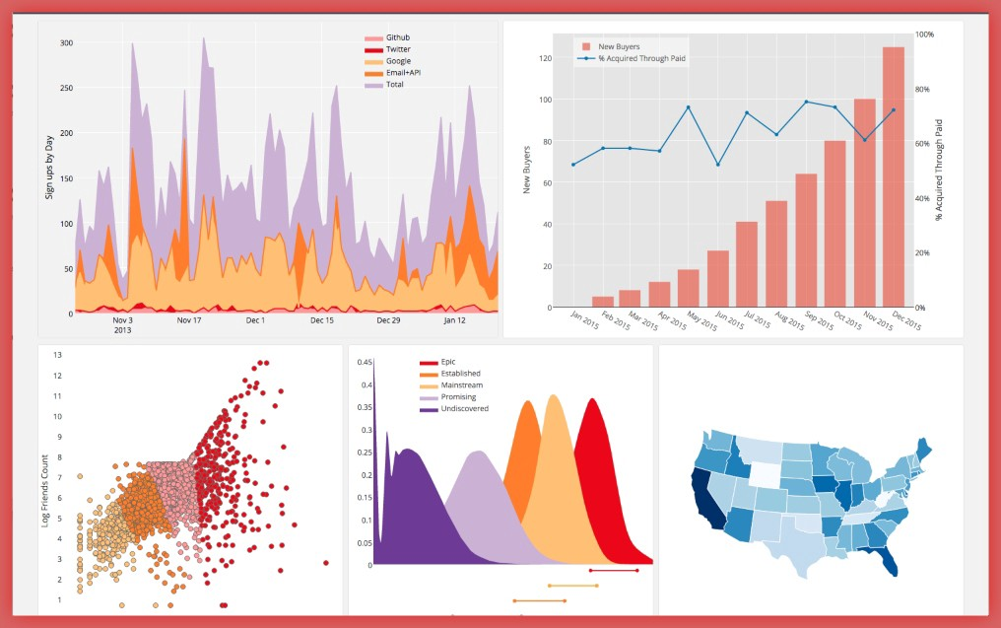
Visualization
Source
Two primary purposes:
To explore our data
To communicate our data
There are a million different ways to visualize our data, but how do we do it effectively?

Slide 65
Matplotlib
Included with our Docker image and through Anaconda
Import into your notebook using:
Developed in 2002 by John Hunter to have Matlab-style plotting from the python command line.
# Installing Independently
python -m pip install matplotlib
# Importing, don’t forget to use numpy too!
from matplotlib import pyplot as plt

Slide 66
Core Matplotlib
Bar Charts
Line Charts
Scatterplots

Slide 67
Core Matplotlib
Matplotlib use a notion of a 'Figure' as its main abstraction. This abstraction is presented as an object (in the object-oriented sense), so manipulating your figures and plots means interacting with your Figure object (and others, as we'll see). You can create a figure with the plt.subplots() function.
For our purposes today, we just need to know that with plt.subplots() we can create a single figure with one or more plots. If we pass it no arguments, we get a Figure with a single subplot, otherwise we can provide it with the dimensions of how we would like our subplots to divide the figure.

Slide 68
Example
# Create some x values that would give us two periods of a standard sin wave
xs = np.arange(0,4*np.pi,0.1)
# y values for the standard sin
sin1 = np.sin(xs)
# y values for an amplified sin
sin2 = 2 * np.sin(xs)
# y values for an attenuated sin
sin3 = 0.5 * np.sin(xs)
# y values for a squashed sin
sin4 = np.sin(2*xs)

Slide 69
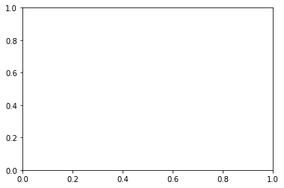
On to the Plotting
???
## create a single figure with a single subplot:
# fig <- The figure that contains all of our subplots
# ax <- the subplot (if there's only one)
# or the list of subplots (if there's more than one)
fig, ax = plt.subplots()

Slide 70
On to the Plotting
???
## create a single figure with a single subplot:
# fig <- The figure that contains all of our subplots
# ax <- the subplot (if there's only one)
# or the list of subplots (if there's more than one)
fig, ax = plt.subplots()

Slide 71
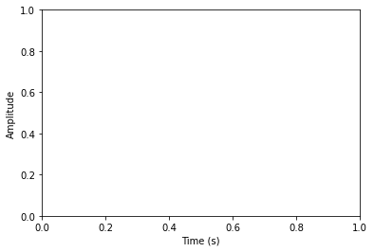
And my Ax[e]
#Setting up my labels
ax.set_xlabel('Time (s)')
ax.set_ylabel('Amplitude')
fig

Slide 72
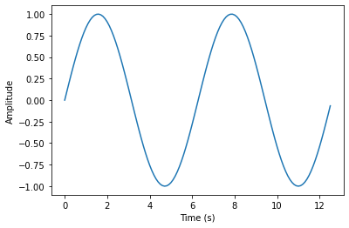
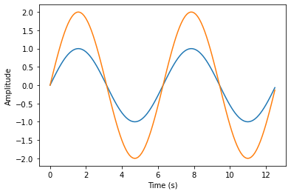
Finally!
#Setting up my labels
ax.plot(xs,sin1)
fig
#Setting up my labels
ax.plot(xs,sin2)
fig

Slide 73
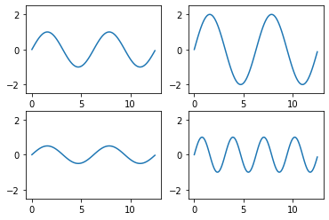
Plotting on Separate Subplots
#Setting up my labels
data_set = [sin1, sin2, sin3, sin4]
fig, axes = plt.subplots(nrows=num_rows, ncols=num_cols)
#Plotting using a loop
i = 0
for x in range(0,num_rows):
for y in range (0, num_cols):
axes[x,y].plot(xs,data_set[i])
i += 1
#Setting Axis Limits
for ax in axes.reshape(-1):
ax.set_ylim([-2.5,2.5])

Slide 74
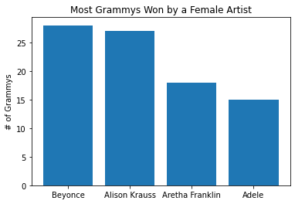
Bar Charts
#Setting up my Data
artists = ["Beyonce", "Alison Krauss", "Aretha Franklin", "Adele"]
num_grammys = [28, 27, 18, 15]
plt.bar(range(len(artists)), num_grammys)
#Plotting the bar graph
plt.title("Most Grammys Won by a Female Artist")
plt.ylabel("# of Grammys")
plt.xticks(range(len(artists)), artists)
plt.show()

Slide 75
Scatterplots
#Setting up my labels
ice_cream_sales = [215, 325, 185, 332, 406, 522, 412, 614, 544, 421, 445, 408]
temp = [14.2, 16.4, 11.9, 15.2, 18.5, 22.1, 19.4, 25.1, 23.4, 18.1, 22.6 17.2]
labels = [‘a’,’b’,’c’,’d’,’e’,’f’,’g’,’h’,’i’,’j’,’k’]
plt.scatter(temp, ice_cream_sales)
#Labeling using a loop
for label, temp_count, sales_count in zip(labels, temp, ice_cream_sales):
plt.annotate(label,
xy=(temp_count, sales_count),
xytext=(5, -5),
textcoords=’offset points’)
plt.show

Slide 76
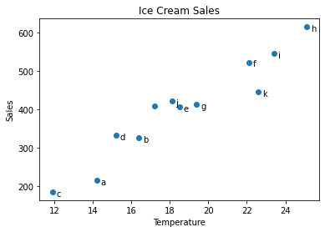
Scatterplots

Slide 77
MORE COMPLICATED EXAMPLE
# Formatting
df["week"] = df['week'].str.extract('(\d+)’,
expand=False).astype(int)
df["rank"] = df["rank"].astype(int)
[…, “x2nd.week”, 63.0] 🡪 […, 2, 63]
# Cleaning out unnecessary rows
df = df.dropna()
# Create "date" columns
df['date'] = pd.to_datetime(
df['date.entered']) +
pd.to_timedelta(df['week'], unit='w') –
pd.DateOffset(weeks=1)

Slide 78

NEXT CLASS: EXPLORATORY ANALYSIS

