Slide 1
TODAY’S LECTURE
Data collection
Data processing
Exploratory analysis
&
Data viz
Analysis, hypothesis testing, & ML
Insight & Policy Decision

Slide 2
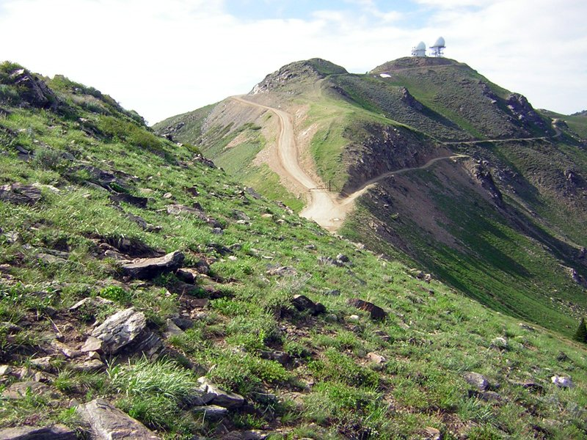
FILLING IN THE GAPS: NONLINEAR REGRESSION & REGULARIZATION
Thanks: Zico Kolter

Slide 3
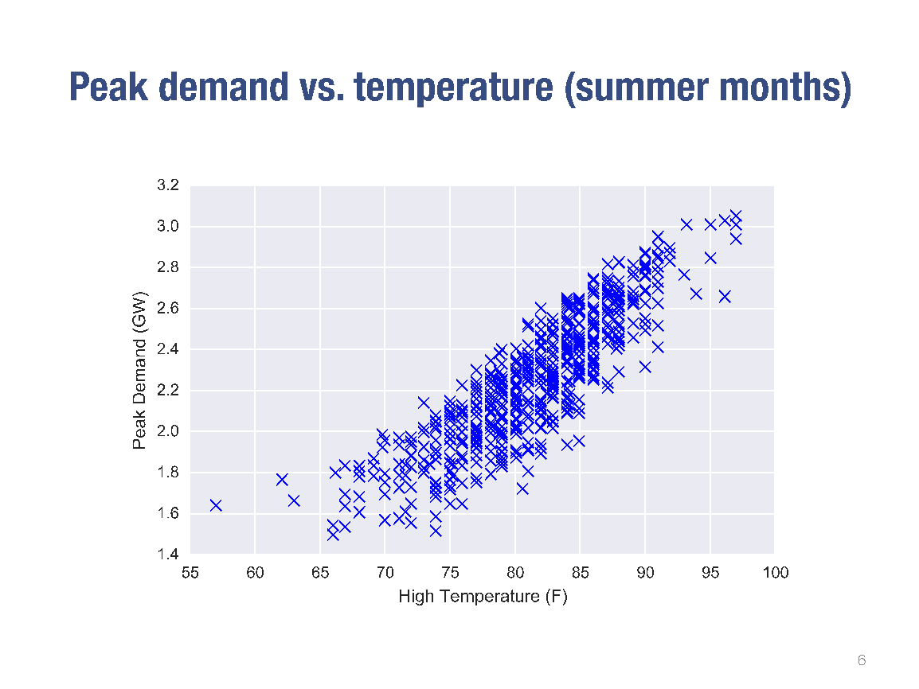

Slide 4
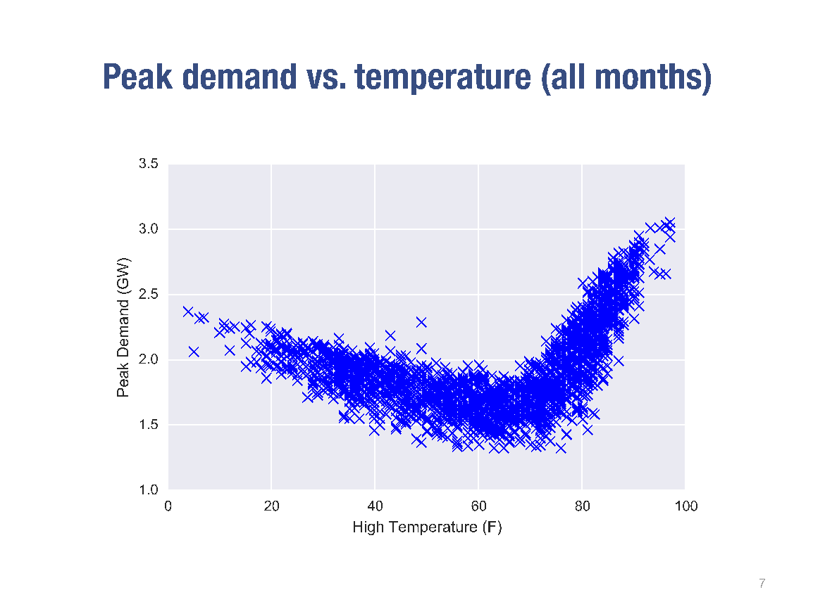

Slide 5
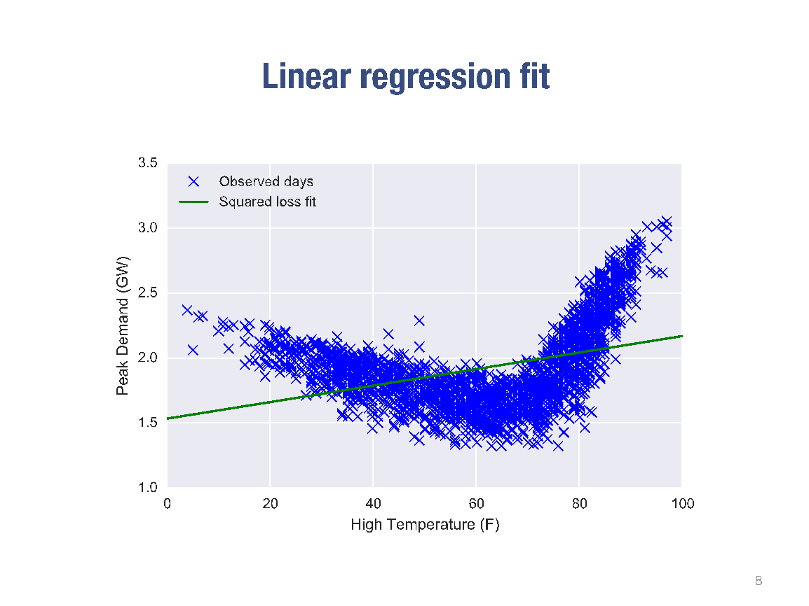

Slide 6
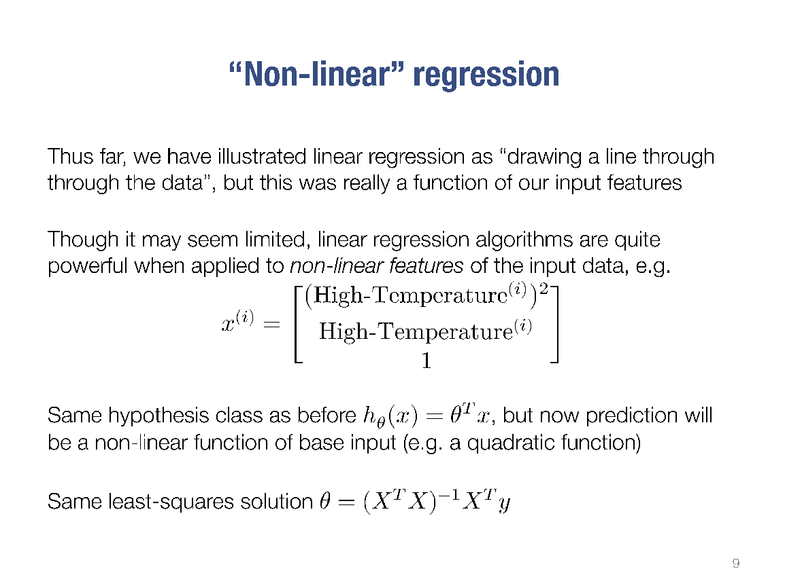

Slide 7
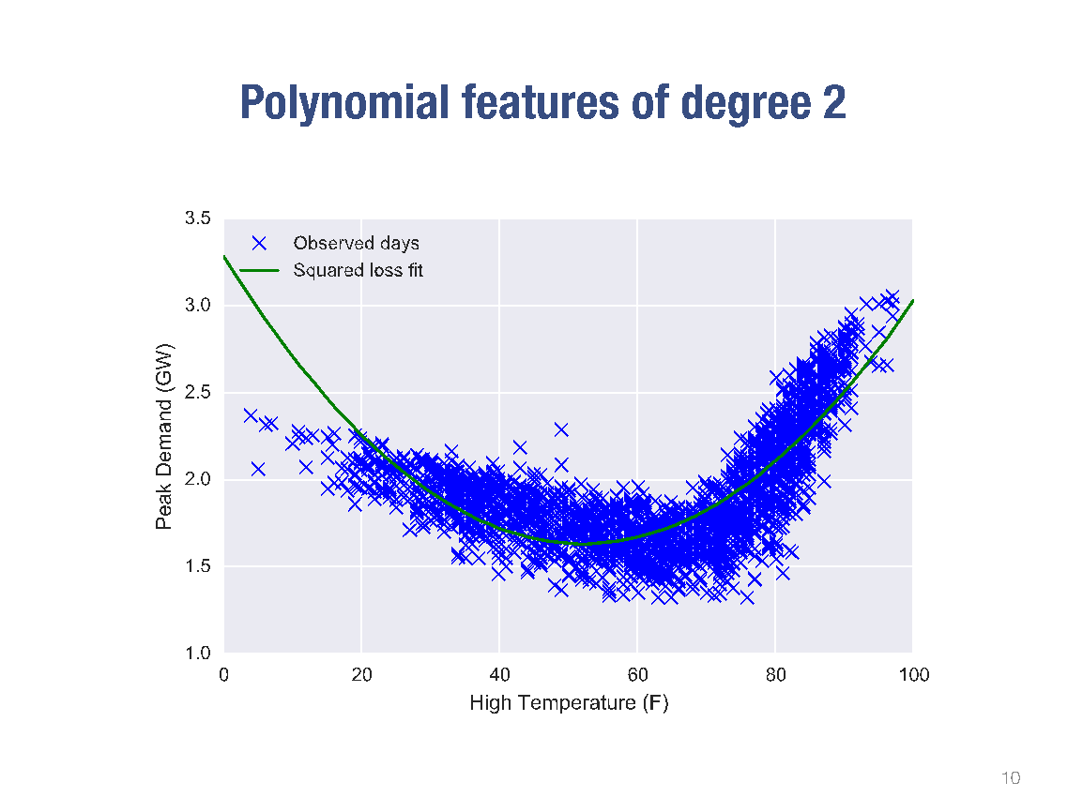

Slide 8
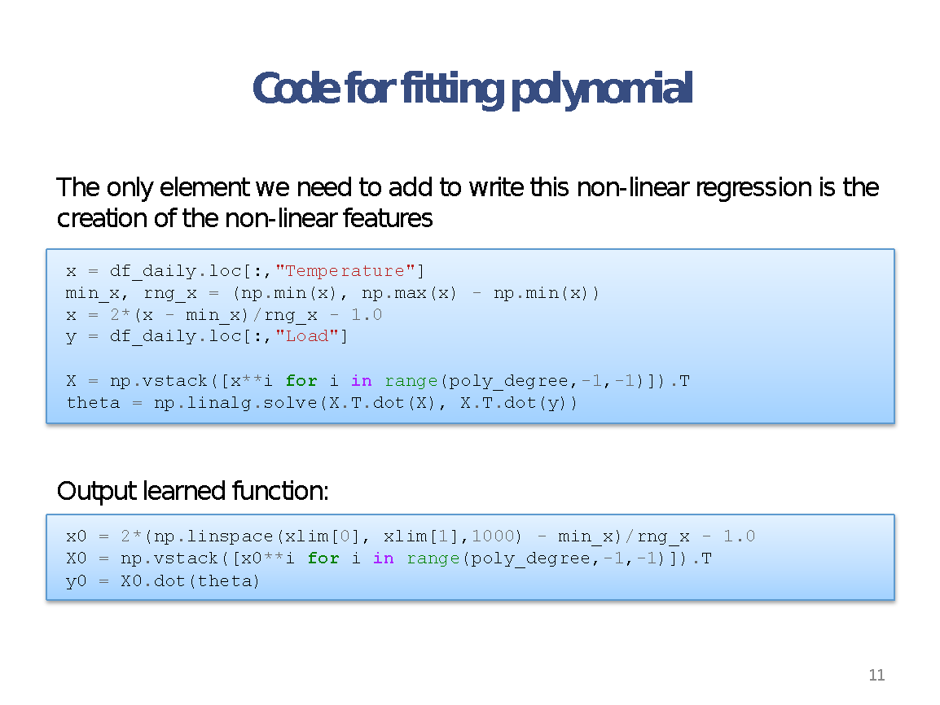

Slide 9


Slide 10


Slide 11


Slide 12


Slide 13
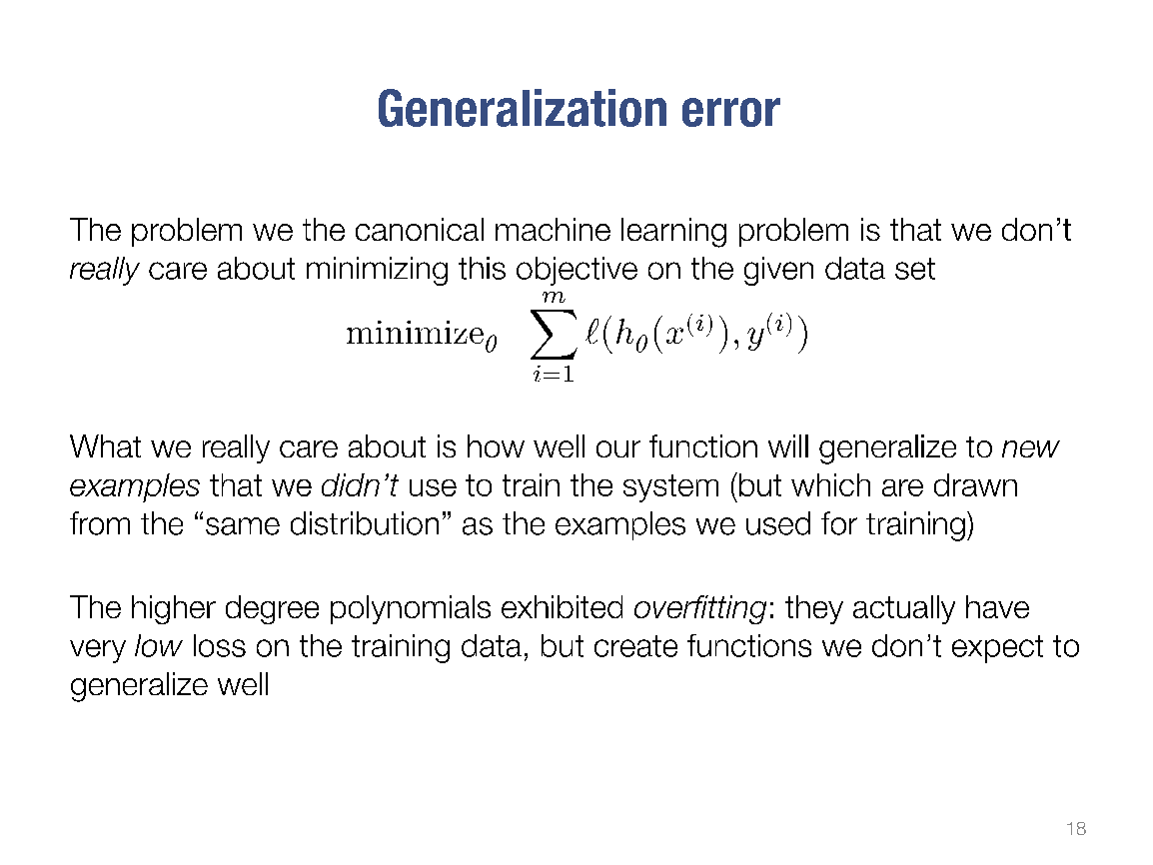

Slide 14
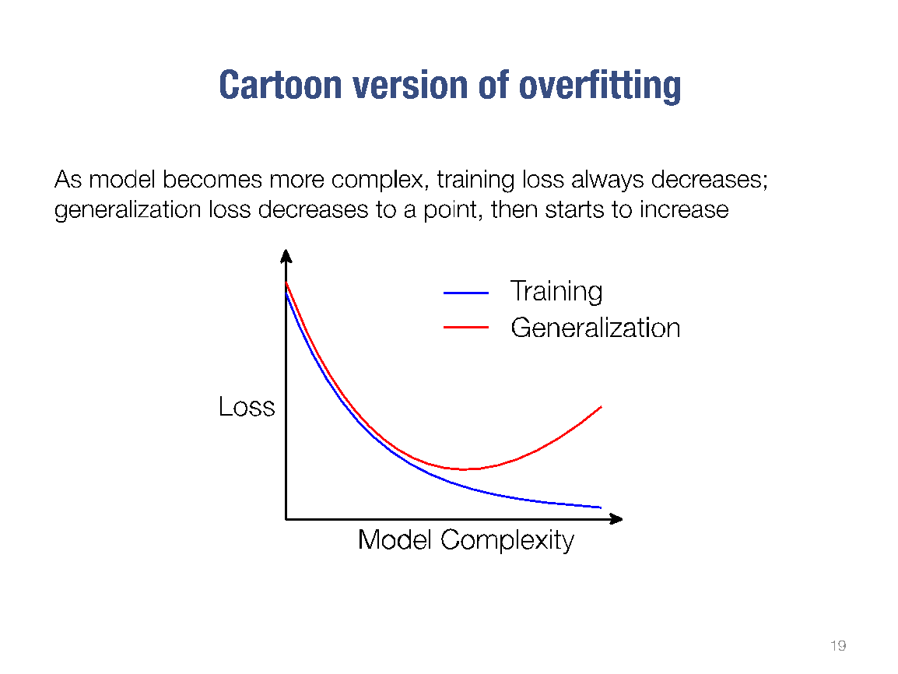

Slide 15
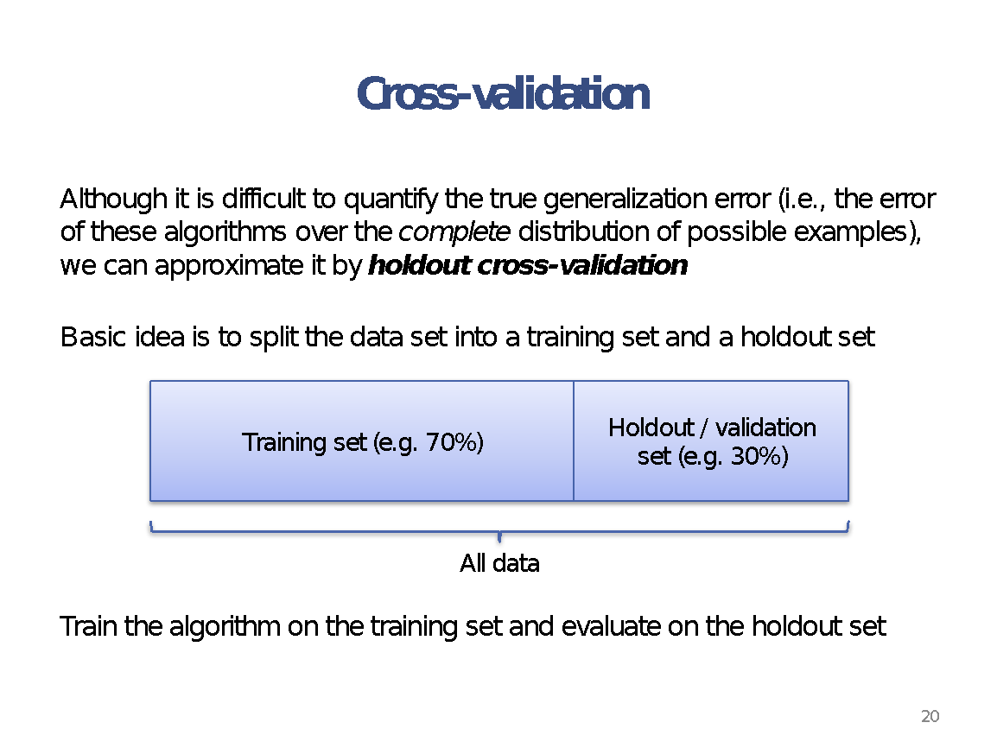

Slide 16


Slide 17
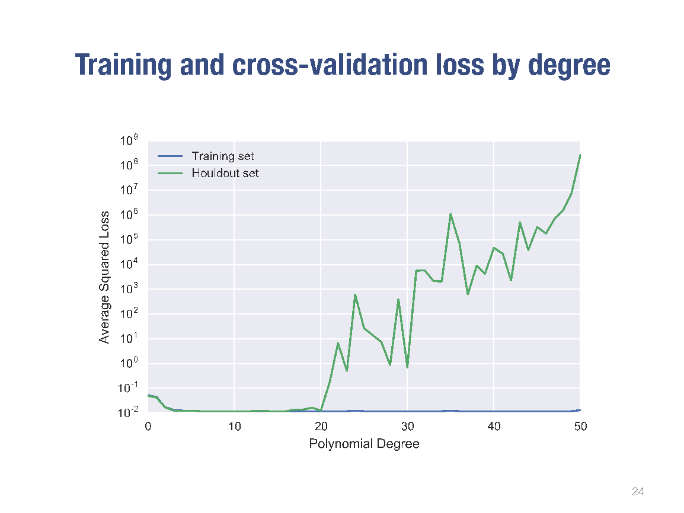

Slide 18
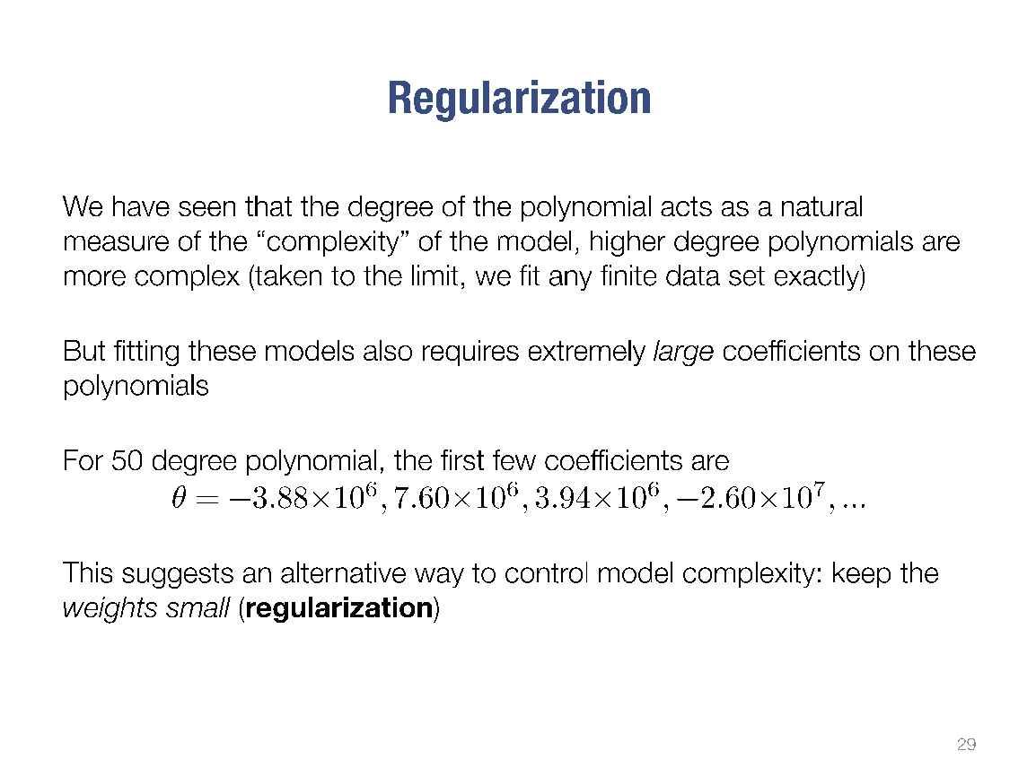

Slide 19
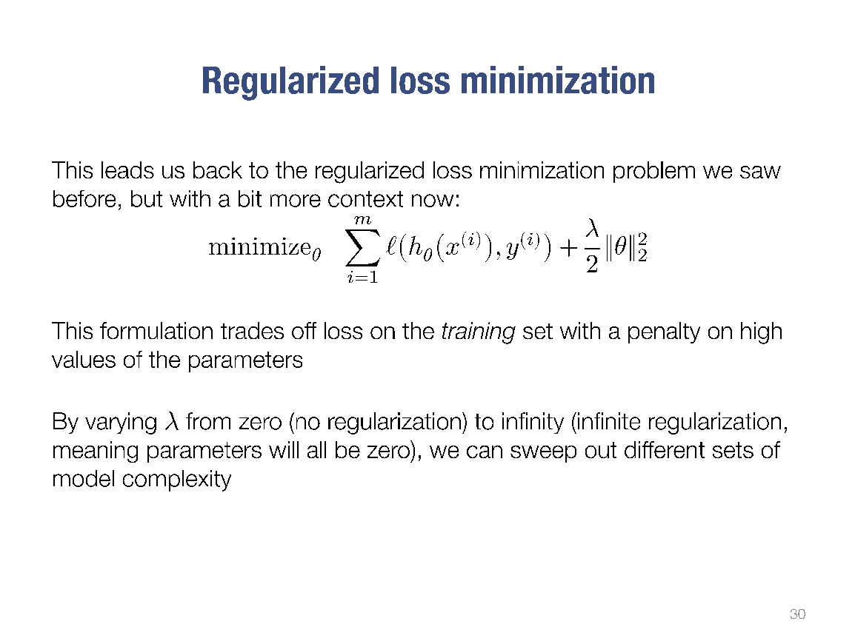

Slide 20
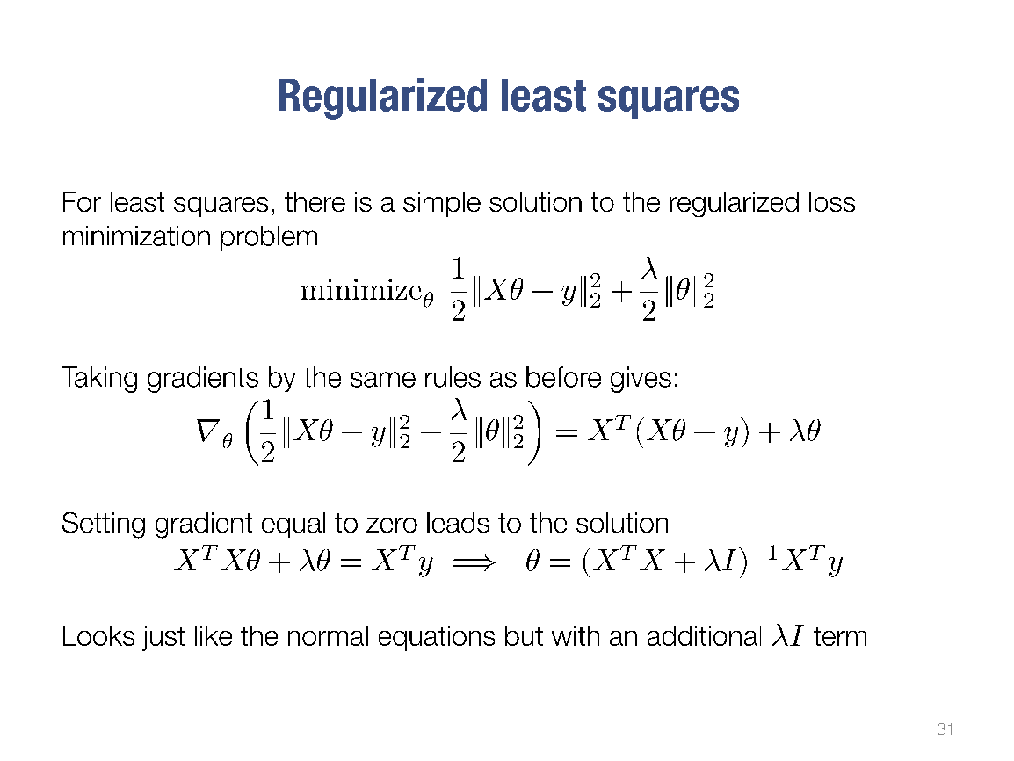

Slide 21
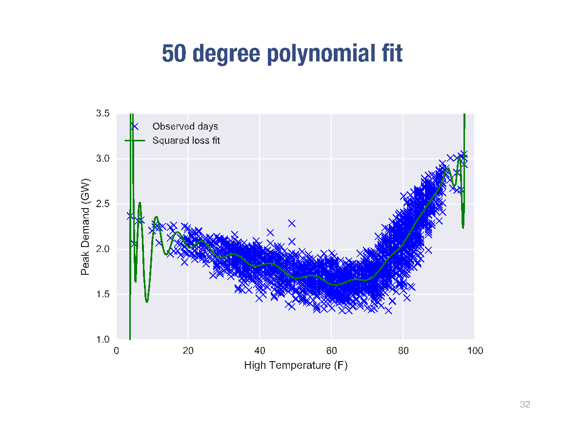

Slide 22


Slide 23
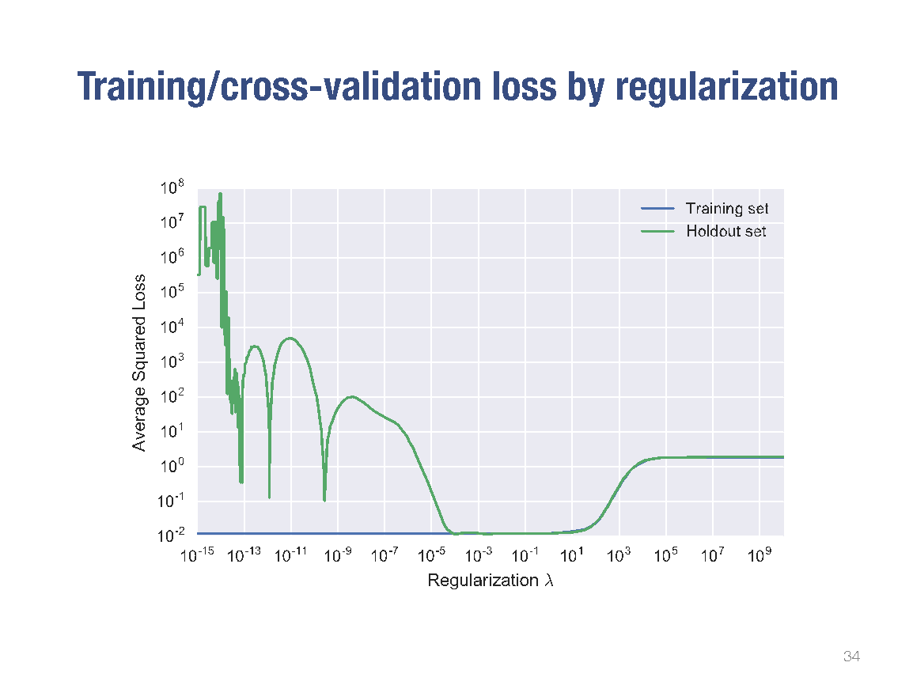

Slide 24
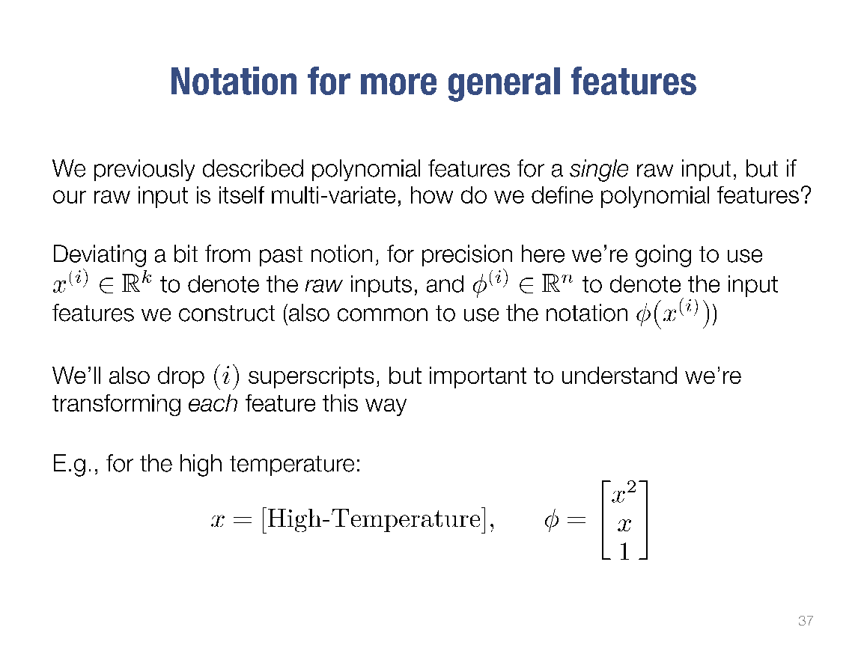

Slide 25
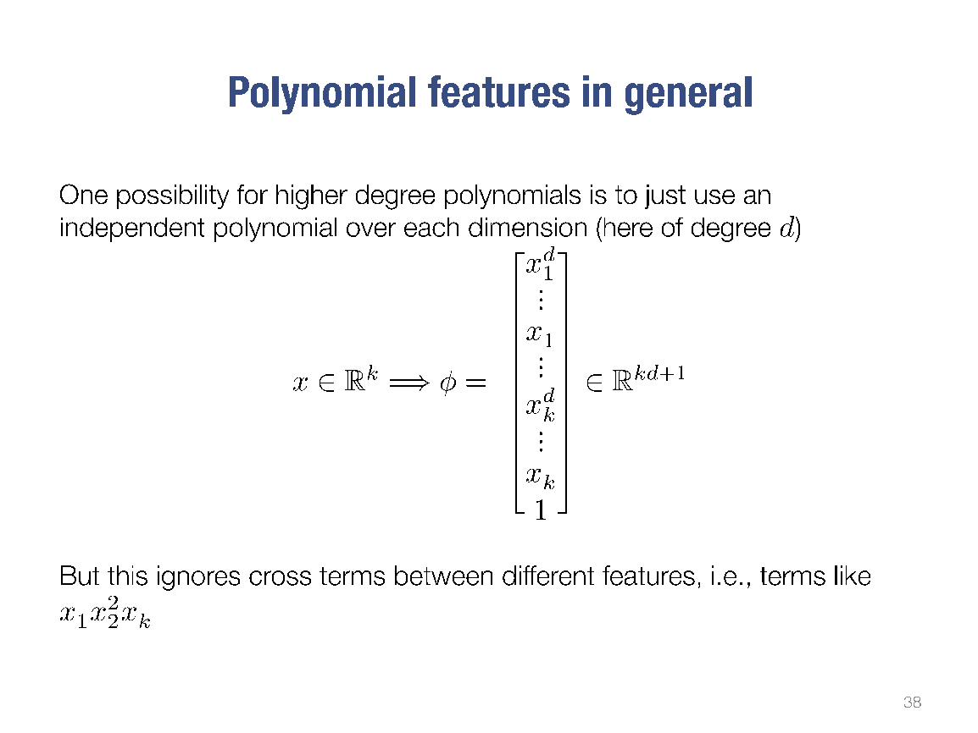

Slide 26
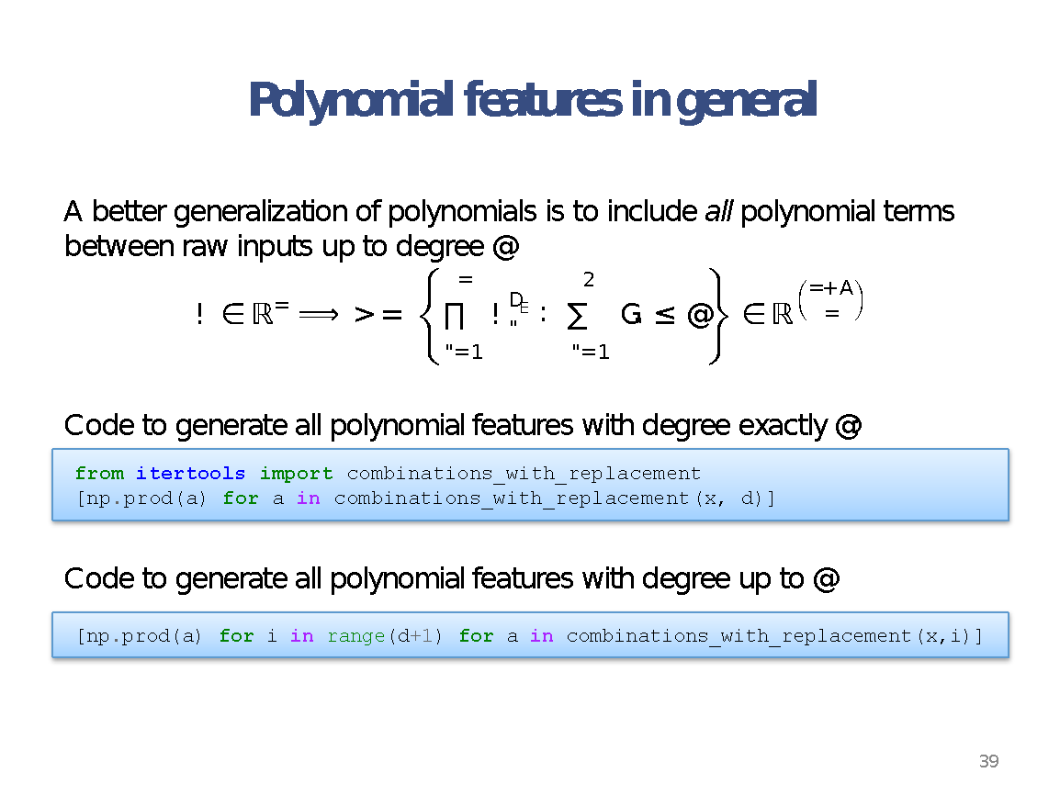
combinations_with_replacement(p,r):
r-length tuples, in sorted order, with replacement

Slide 27
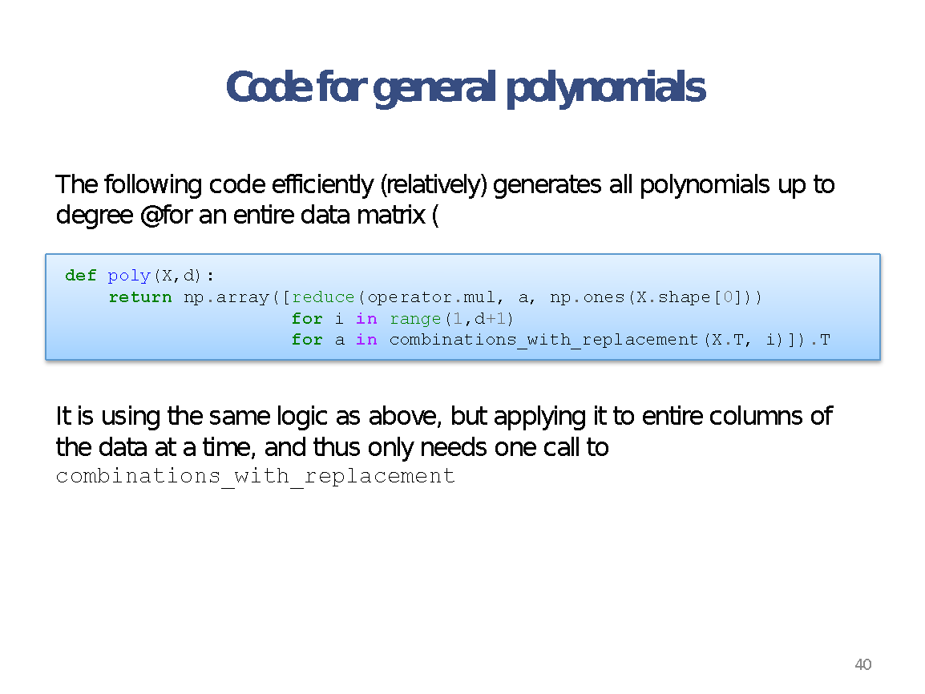

Slide 28
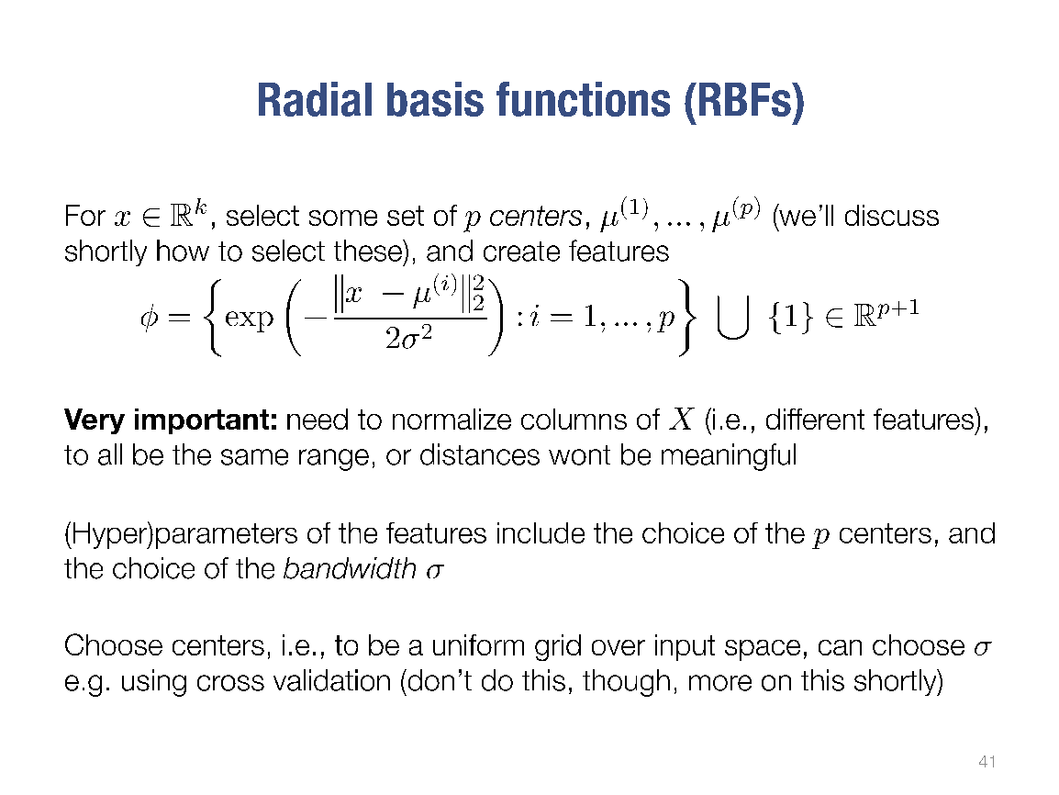

Slide 29
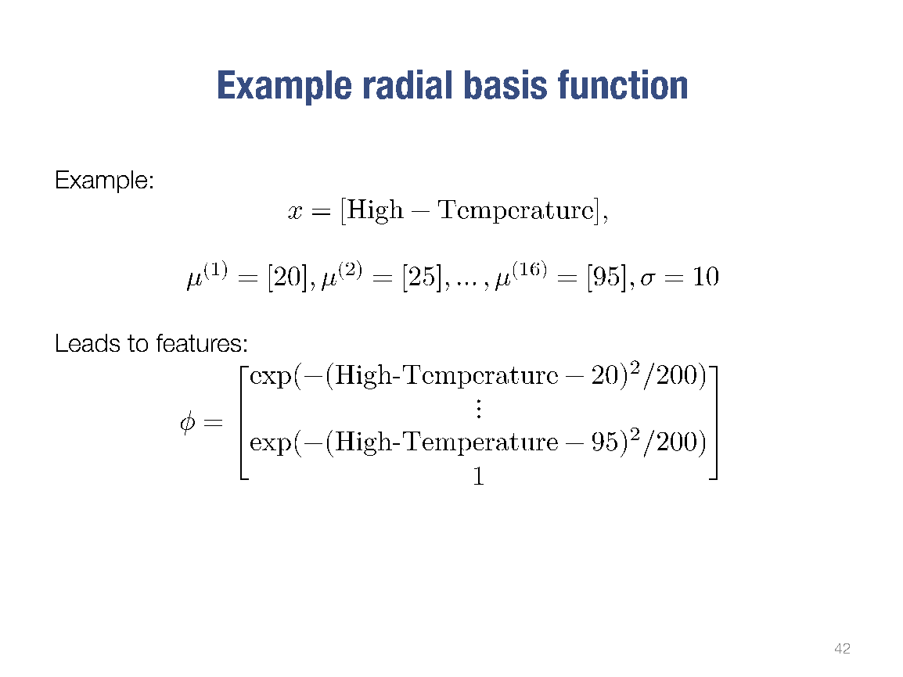

Slide 30
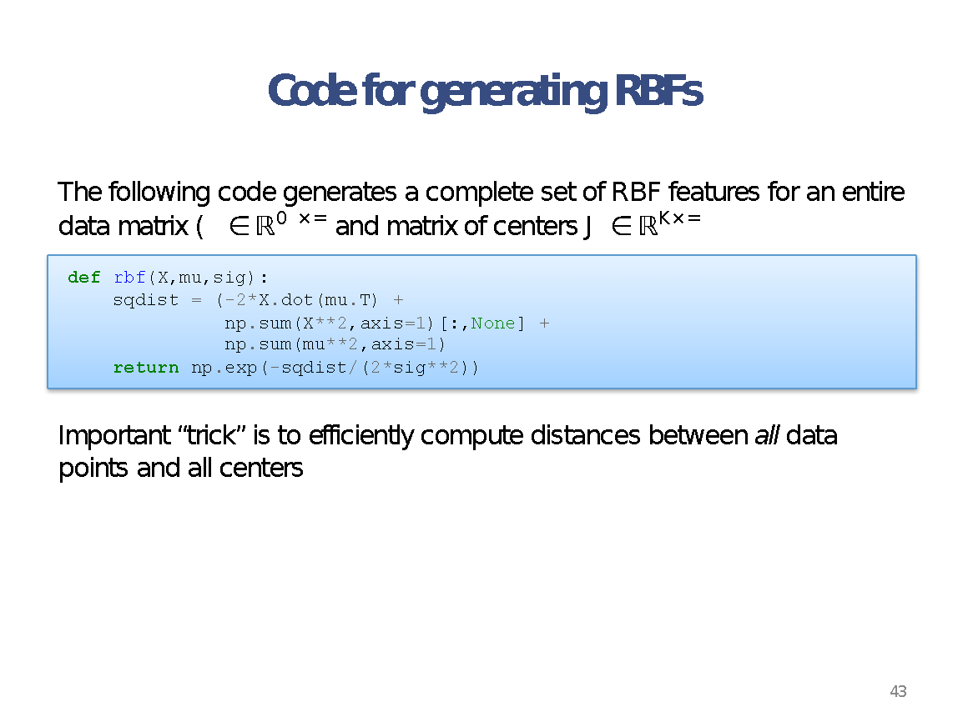

Slide 31
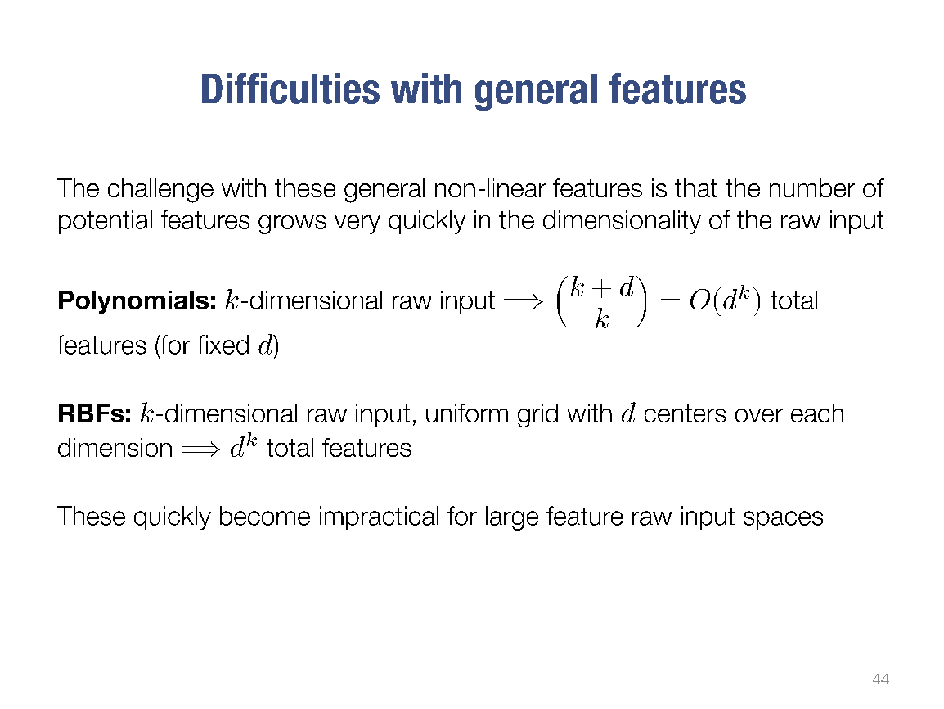

Slide 32
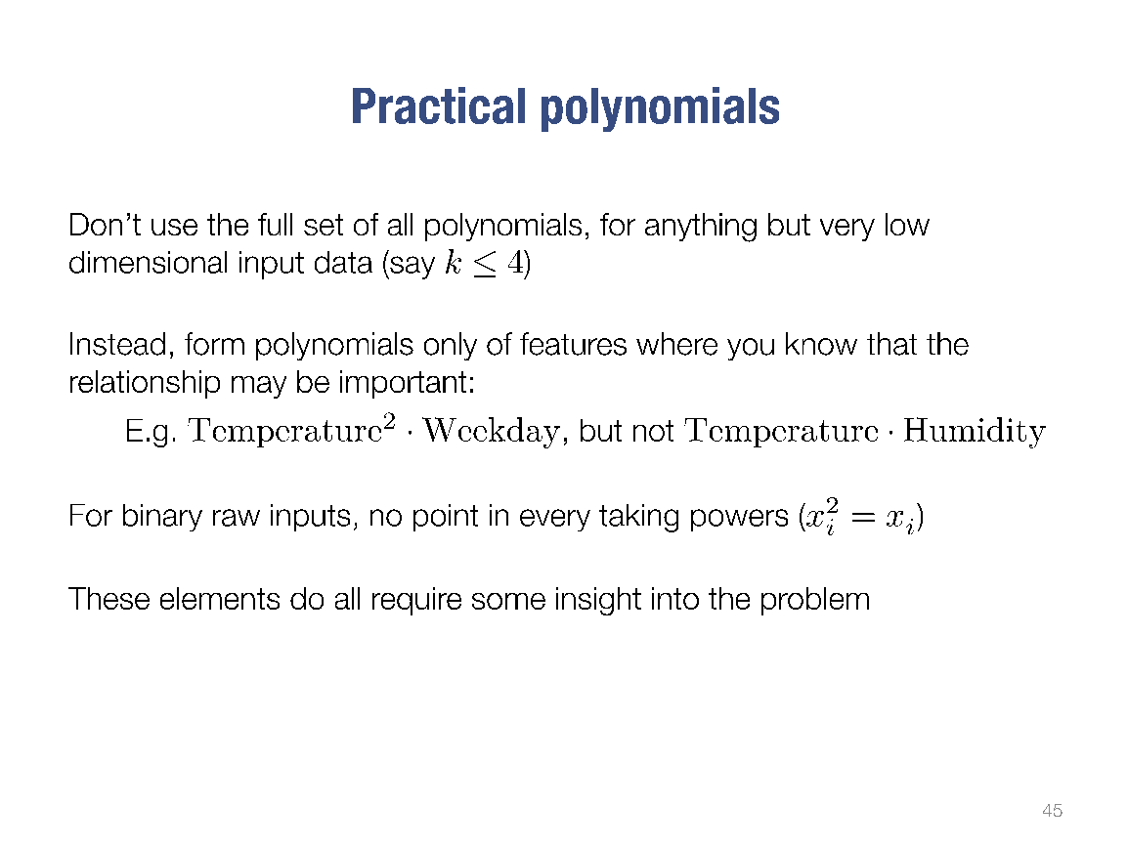

Slide 33
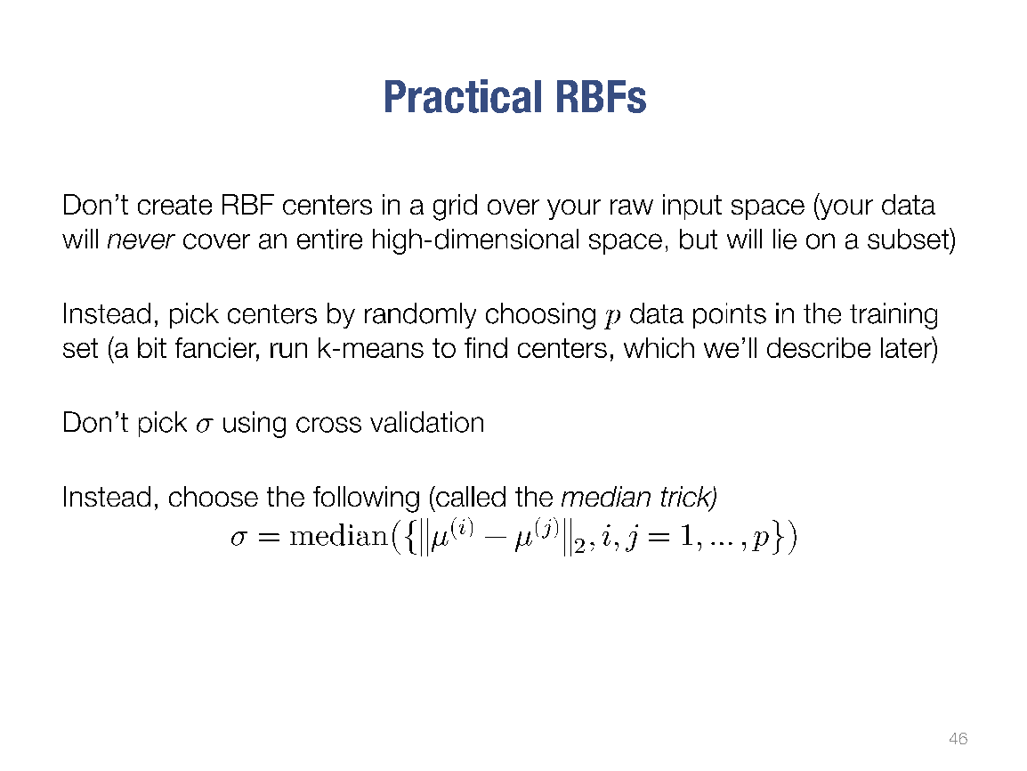

Slide 34
K-Folds Cross Validation
Cross Validation is good! Let’s do more of it!
Split the data set into ‘k’ folks (5-10)
Fit your model using k-1 of the folds
Validate the model using the kth fold (remember your error)
Repeat steps 2 and 3, changing with one of the folds being used for validation
Average of the errors

Slide 35
K-Folds Cross Validation
Things to consider:
What we have described is “leave on out” (LOO) CV
There is also “Leave P Out”
LOO lets you train the model better but have fewer tests. LPO better tests but if its a steep learning curve, you might overestimate the error
Random sampling can be bad (what about class labels)
StratifiedKFold helps you ensure that each fold as a similar proportion of various class labels

Slide 36
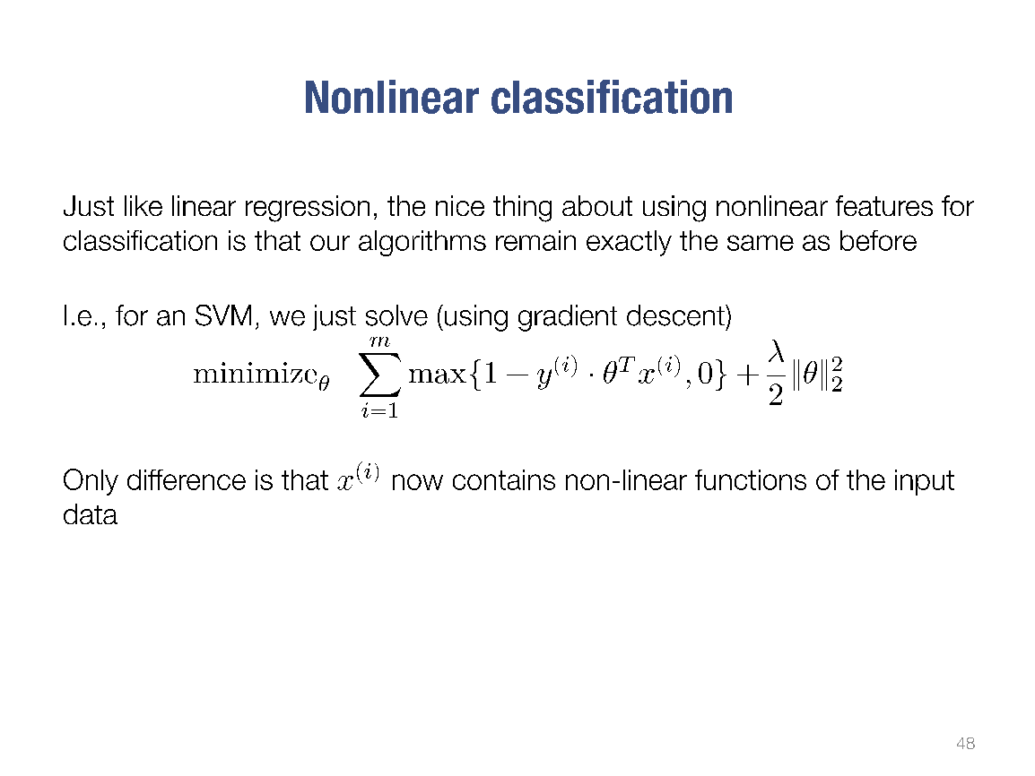

Slide 37
Support Vector Machines (SVM)
Linear Regressions are great but sometimes we don’t want a ‘predicative’ line. Sometimes we want a dividing line.
Idea is to find the hyperplane that best divides the dataset
If linear regressions can be thought of a statistical, SVMs are geometric
Good for ‘medium’ sized datasets (low 10’s of thousands)
Has classification (SVC) and regression (SVR) variants
SKLearn has implementations!

Slide 38
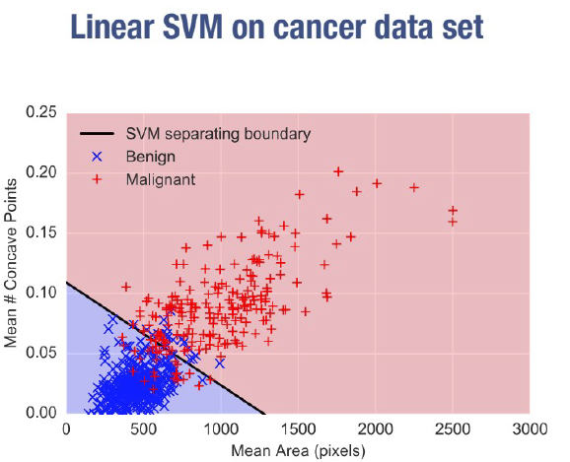

Slide 39
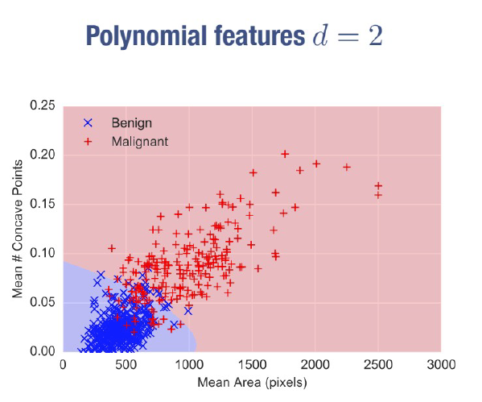

Slide 40
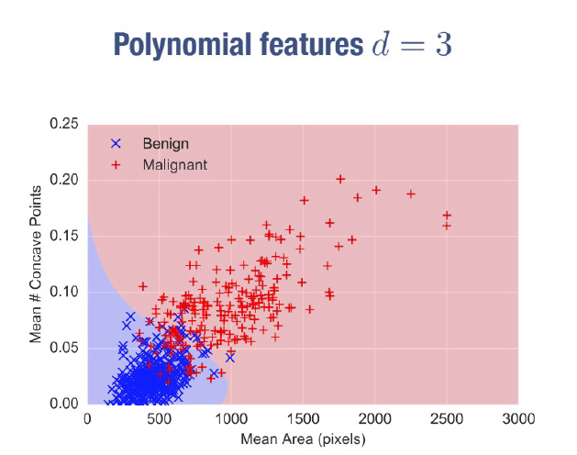

Slide 41
