Slide 1

TODAY’S LECTURE
Data collection
Data processing
Exploratory analysis
&
Data viz
Analysis, hypothesis testing, & ML
Insight & Policy Decision
with
Thanks: Zico Kolter’s 15-388, Amol Deshpande, Nick Mattei

Slide 2
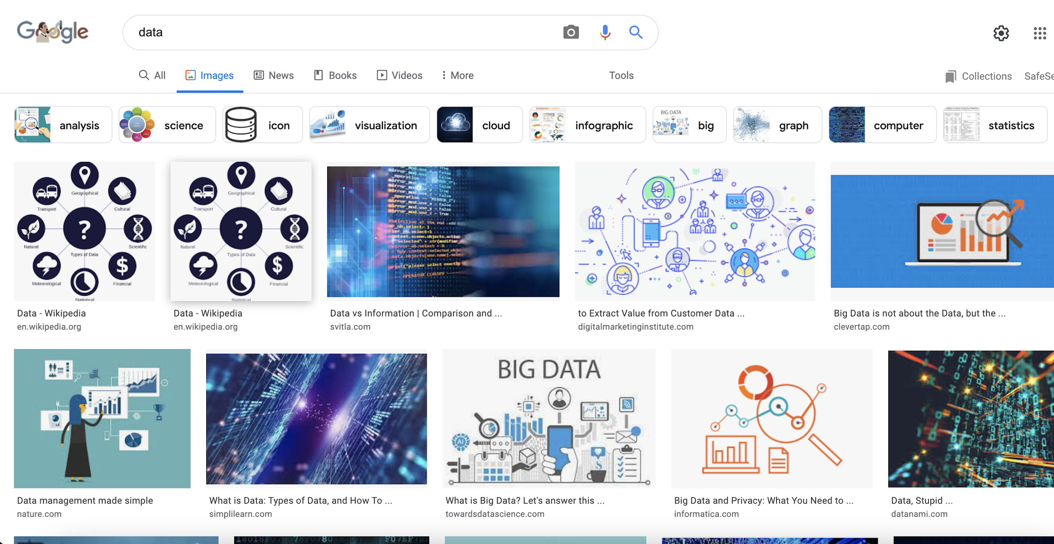
WHAT IS THIS “DATA”?

Slide 3
TABULAR DATA
Quick teaser. We’ll go into greater depth when discussing tidy data.
Data is an abstraction of some real world entity.
Also called: instance, example, record, object, case, individual.
Each of these entities is described by a set of features.
Sometimes called variables, features, attributes, …
Can be processed into an n (number of entities) by m (number of attributes) matrix.
Result of merging & processing different records!
Picking the data that goes into this table has both technical and ethical concerns (recall: Target, Netflix, AOL examples)
ID | Title | Author | Year | Cover | Edition | Price
1 | Emma | Austen | 1815 | Paper | 20th | $5.75
2 | Dracula | Stoker | 1897 | Hard | 15th | $12.00
3 | Ivanhoe | Scott | 1820 | Hard | 8th | $25.00
4 | Kidnapped | Stevenson | 1886 | Paper | 11th | $5.00

Slide 4
CLASSICAL STATISTICAL VIEW OF DATA
There are four classical types of data
Nominal
Categorical
Ordinal
Data Types
Interval
Numerical
Ratio

Slide 5


CATEGORICAL DATA: TAKES A VALUE FROM A FINITE SET
Nominal (aka Categorical) Data:
Values have names: describe the categories, classes, or states of things
Marital status, drink type, or some binary attribute
Cannot compare easily, thus cannot naturally order them
Ordinal Data:
Values have names: describe the categories, classes, or states of things
However, there is an ordering over the values:
Strongly like, like, neutral, strongly dislike
Lacks a mathematical notion of distance between the values
This distinction can be blurry…
Is there an ordering over: sunny, overcast, rainy?

Slide 6
NUMERICAL DATA: MEASURED USING INTEGERS OR REALS
Interval Scale:
Scale with fixed but arbitrary interval (e.g., dates)
The difference between two values is meaningful:
Difference between 9/1/2019 and 10/1/2019 is the same as the difference between 9/1/2018 and 10/1/2018
Can’t compute ratios or scales: e.g., what unit is 9/1/2019 * 8/2/2020?
Ratio Scale:
All the same properties as interval scale data, but the scale of measurement also possesses a true-zero origin
Can look at the ratio of two quantities (unlike interval)
E.g., zero money is an absolute, one money is half as much as two money, and so on

Slide 7


NUMERICAL DATA: EXAMPLES
Temperatures:
Celsius / Fahrenheit: interval or ratio scale ???????????
Interval: 0C is not 0 heat, but is an arbitrary fixed point
Hence, we can’t say that 30F is twice as warm as 15F.
Kelvin (K): interval or ratio scale ???????????
Ratio: 0K is assumed to mean zero heat, a true fixed point
Weight:
Grams: interval or ratio scale ??????????
Ratio: 0g served as fixed point, 4g is twice 2g, …

Slide 8
GENERAL RULES
OK to compute.... | Nominal | Ordinal | Interval | Ratio
frequency distribution | Yes | Yes | Yes | Yes
median and percentiles | No | Yes | Yes | Yes
add or subtract | No | No | Yes | Yes
mean, standard deviation, standard error of the mean | No | No | Yes | Yes
ratio, or coefficient of variation | No | No | No | Yes
?
?
?
?
Thanks to GraphPad

Slide 9
GENERAL RULES
OK to compute.... | Nominal | Ordinal | Interval | Ratio
frequency distribution | Yes | Yes | Yes | Yes
median and percentiles | No | Yes | Yes | Yes
add or subtract | No | No | Yes | Yes
mean, standard deviation, standard error of the mean | No | No | Yes | Yes
ratio, or coefficient of variation | No | No | No | Yes
?
?
?
?

Slide 10
GENERAL RULES
OK to compute.... | Nominal | Ordinal | Interval | Ratio
frequency distribution | Yes | Yes | Yes | Yes
median and percentiles | No | Yes | Yes | Yes
addition or subtraction | No | No | Yes | Yes
mean, standard deviation, standard error of the mean | No | No | Yes | Yes
ratio, or coefficient of variation | No | No | No | Yes
?
?
?
?

Slide 11
GENERAL RULES
OK to compute.... | Nominal | Ordinal | Interval | Ratio
frequency distribution | Yes | Yes | Yes | Yes
median and percentiles | No | Yes | Yes | Yes
addition or subtraction | No | No | Yes | Yes
mean or standard deviation | No | No | Yes | Yes
ratio, or coefficient of variation | No | No | No | Yes
?
?
?
?

Slide 12
GENERAL RULES
OK to compute.... | Nominal | Ordinal | Interval | Ratio
frequency distribution | Yes | Yes | Yes | Yes
median and percentiles | No | Yes | Yes | Yes
addition or subtraction | No | No | Yes | Yes
mean or standard deviation | No | No | Yes | Yes
ratio, or coefficient of variation | No | No | No | Yes
?
?
?
?
Notes:
Coefficient of variation aka “relative standard deviation” – generally the ratio of the standard deviation to the mean of the sample – 0% = point (stdev 0 divided by mean), higher is more variable

Slide 13
GENERAL RULES
OK to compute.... | Nominal | Ordinal | Interval | Ratio
frequency distribution | Yes | Yes | Yes | Yes
median and percentiles | No | Yes | Yes | Yes
addition or subtraction | No | No | Yes | Yes
mean or standard deviation | No | No | Yes | Yes
ratio, or coefficient of variation | No | No | No | Yes
Notes:
Coefficient of variation aka “relative standard deviation” – generally the ratio of the standard deviation to the mean of the sample – 0% = point (stdev 0 divided by mean), higher is more variable

Slide 14
DATA MANIPULATION AND COMPUTATION
Data Science == manipulating and computing on data
Large to very large, but somewhat “structured” data
We will see several tools for doing that this semester
Thousands more out there that we won’t cover
Need to learn to shift thinking from:
Imperative code to manipulate data structures
to:
Sequences/pipelines of operations on data
Should still know how to implement the operations themselves, especially for debugging performance (covered in classes like 420, 424), but we won’t cover that much

Slide 15
DATA MANIPULATION AND COMPUTATION
Data Representation, i.e., what is the natural way to think about given data
Data Processing Operations, which take one or more datasets as input and produce one or more datasets as output
One-dimensional Arrays, Vectors
Indexing
Slicing/subsetting
Filter
‘map’ 🡪 apply a function to every element
’reduce/aggregate’ 🡪 combine values to get a single scalar (e.g., sum, median)
Given two vectors: Dot and cross products
0.1 | 2 | 3.2 | 6.5 | 3.4 | 4.1
“data” | ”representation” | ”i.e.”

Slide 16
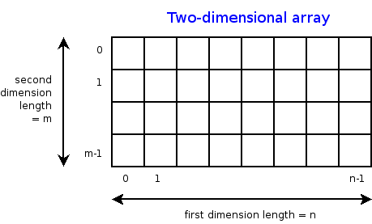
DATA MANIPULATION AND COMPUTATION
Data Representation, i.e., what is the natural way to think about given data
Data Processing Operations, which take one or more datasets as input and produce one or more datasets as output
n-dimensional arrays
Indexing
Slicing/subsetting
Filter
‘map’ 🡪 apply a function to every element
’reduce/aggregate’ 🡪 combine values across a row or a column (e.g., sum, average, median etc..)

Slide 17
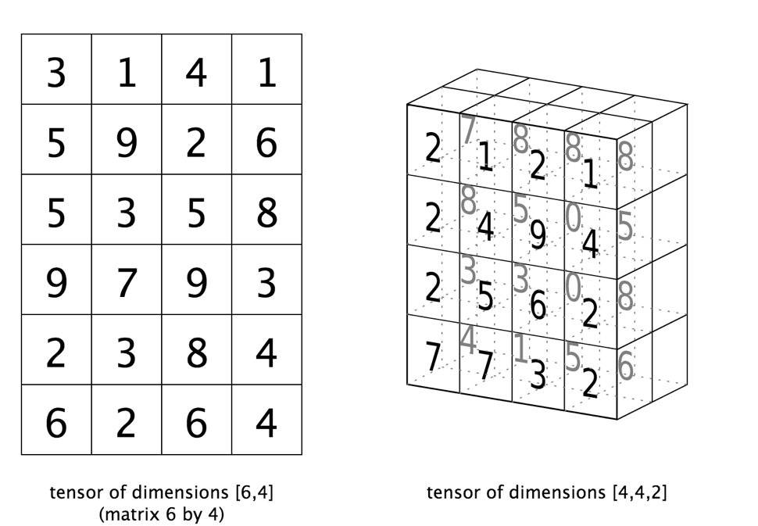
DATA MANIPULATION AND COMPUTATION
Data Representation, i.e., what is the natural way to think about given data
Data Processing Operations, which take one or more datasets as input and produce one or more datasets as output
Matrices, Tensors
n-dimensional array operations
+
Linear Algebra
Matrix/tensor multiplication
Transpose
Matrix-vector multiplication
Matrix factorization

Slide 18
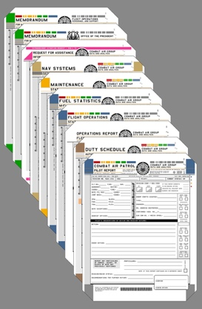

DATA MANIPULATION AND COMPUTATION
Data Representation, i.e., what is the natural way to think about given data
Data Processing Operations, which take one or more datasets as input and produce one or more datasets as output
Sets: of Objects
Filter
Map
Union
Reduce/Aggregate
Given two sets, Combine/Join using “keys”
Group and then aggregate
Sets: of (Key, Value Pairs)
(amol@cs.umd.edu,(email1, email2,…))
(john@cs.umd.edu,(email3, email4,…))

Slide 19
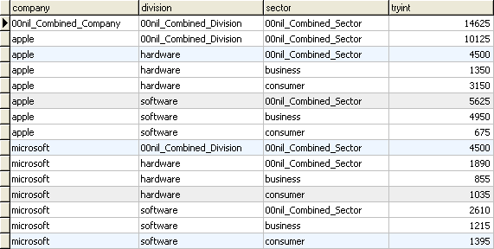
DATA MANIPULATION AND COMPUTATION
Data Representation, i.e., what is the natural way to think about given data
Data Processing Operations, which take one or more datasets as input and produce one or more datasets as output
Filter rows or columns
”Join” two or more relations
”Group” and “aggregate” them
Relational Algebra formalizes some of them
Structured Query Language (SQL)
Many other languages and constructs, that look very similar
Tables/Relations == Sets of Tuples

Slide 20
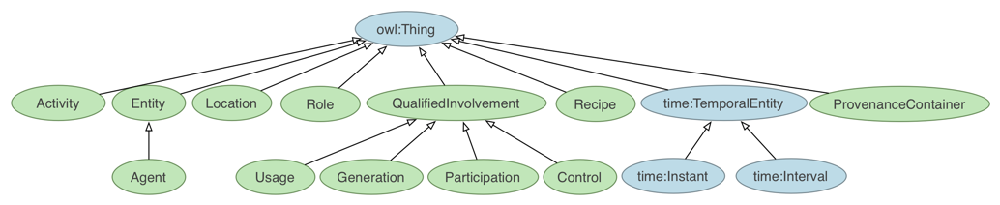
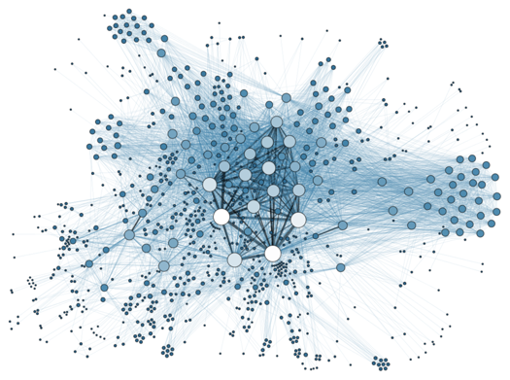
DATA MANIPULATION AND COMPUTATION
Data Representation, i.e., what is the natural way to think about given data
Data Processing Operations, which take one or more datasets as input and produce one or more datasets as output
Hierarchies/Trees/Graphs
“Path” queries
Graph Algorithms and Transformations
Network Science
Somewhat more ad hoc and special-purpose
Changing in recent years

Slide 21
DATA MANIPULATION AND COMPUTATION
Data Representation, i.e., what is the natural way to think about given data
Data Processing Operations, which take one or more datasets as input and produce
Why?
Allows one to think at a higher level of abstraction, leading to simpler and easier-to-understand scripts
Provides ”independence” between the abstract operations and concrete implementation
Can switch from one implementation to another easily
For performance debugging, useful to know how they are implemented and rough characteristics

Slide 22
THE REST OF TODAY’S LECTURE
Data collection
Data processing
Exploratory analysis
&
Data viz
Analysis, hypothesis testing, & ML
Insight & Policy Decision
… on to the “collection” part of things …

Slide 23

GOTTA CATCH ‘EM ALL
Five ways to get data:
Direct download and load from local storage
Generate locally via downloaded code (e.g., simulation)
Query data from a database (covered in a few lectures)
Query an API from the intra/internet
Scrape data from a webpage
Covered today.

Slide 24
WHEREFORE ART THOU, API?
A web-based Application Programming Interface (API) like we’ll be using in this class is a contract between a server and a user stating:
“If you send me a specific request, I will return some information in a structured and documented format.”
(More generally, APIs can also perform actions, may not be web-based, be a set of protocols for communicating between processes, between an application and an OS, etc.)
Notes:
”Wherefore” means “why”, not “where”!

Slide 25
“SEND ME A SPECIFIC REQUEST”
Most web API queries we’ll be doing will use HTTP requests:
conda install –c anaconda requests=2.12.4
r = requests.get( 'https://api.github.com/user', auth=('user', 'pass') )
r.status_code
200
r.headers[‘content-type’]
‘application/json; charset=utf8’
r.json()
{u'private_gists': 419, u'total_private_repos': 77, ...}
http://docs.python-requests.org/en/master/

Slide 26

HTTP REQUESTS
https://www.google.com/?q=cmsc320&tbs=qdr:m
HTTP GET Request:
GET /?q=cmsc320&tbs=qdr:m HTTP/1.1 Host: www.google.com User-Agent: Mozilla/5.0 (X11; Linux x86_64; rv:10.0.1) Gecko/20100101 Firefox/10.0.1
??????????
params = { “q”: “cmsc320”, “tbs”: “qdr:m” }
r = requests.get( “https://www.google.com”, params = params )
*be careful with https:// calls; requests will not verify SSL by default

Slide 27

RESTFUL APIS
This class will just query web APIs, but full web APIs typically allow more.
Representational State Transfer (RESTful) APIs:
GET: perform query, return data
POST: create a new entry or object
PUT: update an existing entry or object
DELETE: delete an existing entry or object
Can be more intricate, but verbs (“put”) align with actions

