Slide 1

INTRODUCTION TO DATA SCIENCE
JC and EG
Special Thanks to Dr. Arlo Clark-Foos of the University of Michigan for some of today’s slides!
Lecture #17 – 03/27/2022
CMSC320
Mondays & Wednesdays
3:30-4:45 https://cmsc320.github.io/

Slide 2
THE DATA LIFECYCLE
Data collection
Data processing
Exploratory analysis
&
Data viz
Analysis, hypothesis testing, & ML
Insight & Policy Decision
(Mainly.)

Slide 3
TODAY’S LECTURE
Hypothesis Testing
What is it?
What are we looking to prove?
How can we use it to justify our hypothesis?
z-Score
t-Score

Slide 4
Hypothesis Testing
It’s easy to maker claims and hypothesize, but how can we test the likelihood that the hypothesis is true?
H₀- Null Hypothesis that represents the default position, status quo
H₁- Alternative Hypothesis that we are comparing to
p-Value: Compute the probability that H₀ is true, that we will see a value at least as extreme as those we observed

Slide 5
p-values
Instead of looking at our data based on some probability cutoff– can we compute the probability assuming that H₀ is true?
Calculated by adding together the probability that random chance generated the data, something else that is equals and something else that is rarer. For normally distributed values, use a density function.
Smaller the p-value the stronger the evidence to reject the null hypothesis.
Typically our p-value cutoff will be 5%

Slide 6
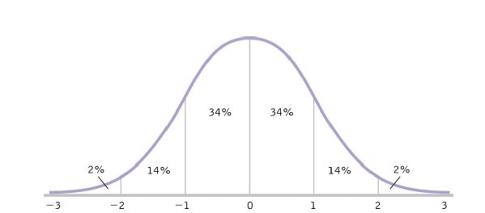
Review: Standardization
Allows us to easily see how one score (or sample) compares with all other scores (or a population).

Slide 7
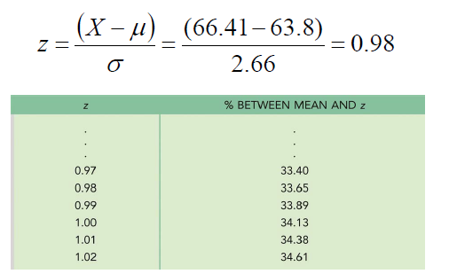
CDC Example
Jessica is 15 years old and 66.41 in. tall
For 15 year old girls, μ = 63.8, σ = 2.66

Slide 8

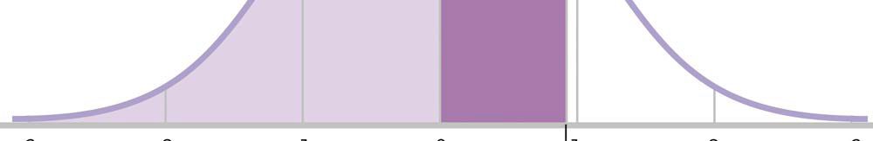
CDC Example: Jessica
1. Percentile: How many 15 year old girls are
shorter than Jessica?
50% + 33.65% = 83.65%

Slide 9

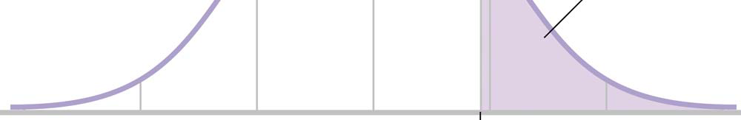
CDC Example: Jessica
2. What percentage of 15 year old girls are taller
than Jessica?
50% - 33.65% OR 100% - 83.65% = 16.35%

Slide 10
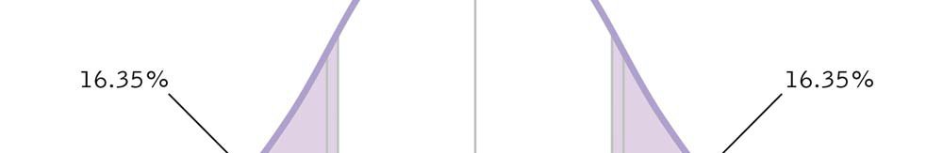
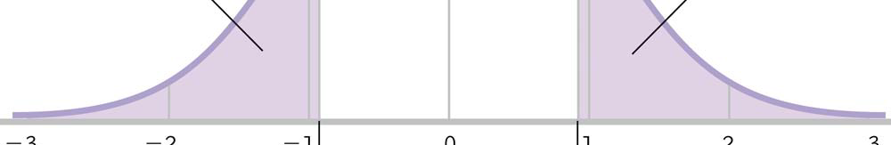
CDC Example: Jessica
3. What percentage of 15 year old girls are as far
from the mean as Jessica (tall or short)?
16.35 % + 16.35% = 32.7%

Slide 11
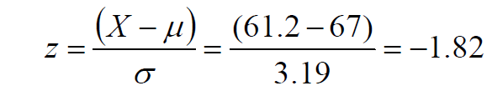
CDC Example: Manuel
Manuel is 15 years old and 61.2 in. tall
For 15 year old boys, μ = 67, σ = 3.19
Consult z table for 1.82 -> 46.56%

Slide 12


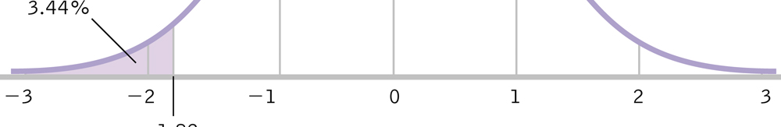
CDC Example: Manuel
1. Percentile
Negative z, below mean: 50% - 46.56% = 3.44%

Slide 13


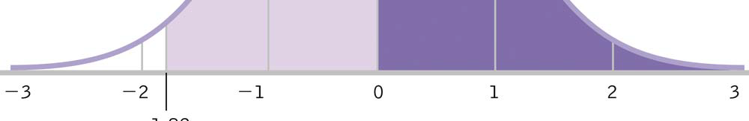
CDC Example: Manuel
2. Percent Above Manuel
100% - 3.44% = 96.56 %

Slide 14

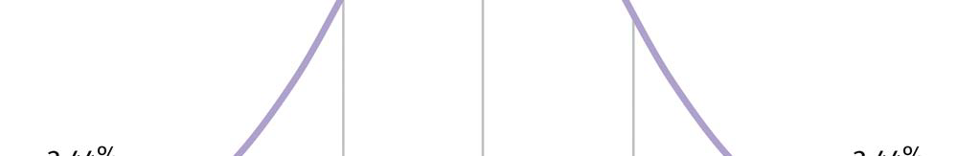
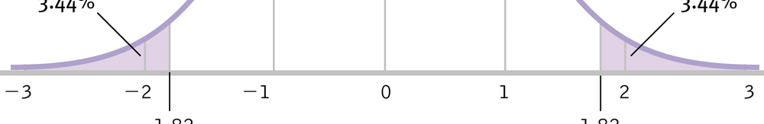
CDC Example: Manuel
3. Percent as extreme as Manuel
3.44% + 3.44% = 6.88%

Slide 15
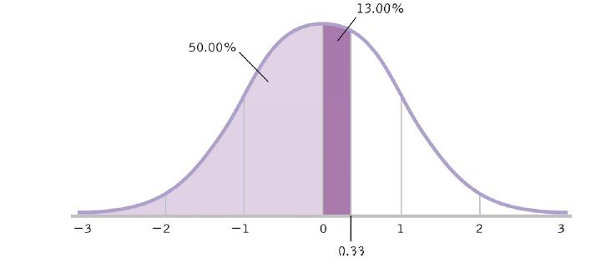
Percentages to Z-Scores
SAT Example: μ = 500, σ = 100
You find out you are at 63rd percentile
Consult z table for 13% -> z = .33
X = .33(100) + 500 = 533

Slide 16
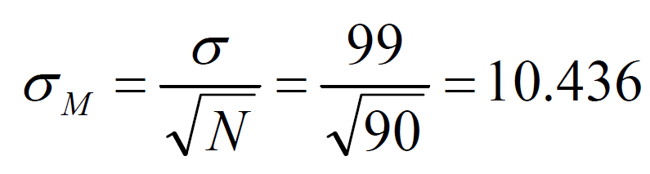
Z-Table and Distribution of Means
Remember that if we use distribution of means, we
are using a sample and need to use standard error.
How do UMD students measure up on the GRE?
μ = 554, σ = 99 M = 568, N = 90
μ_{M} = μ = 554

Slide 17
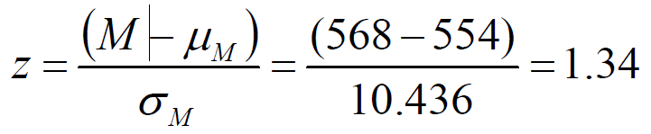


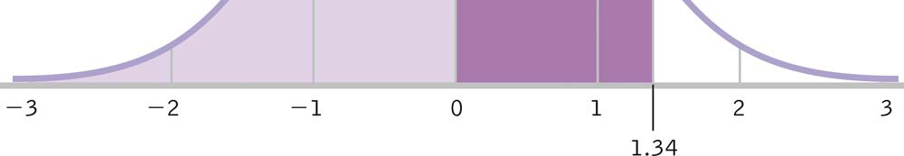
UMich Dearborn & GRE Scores
Consult z table for z = 1.34 -> 40.99 %
50% + 40.99% = 90.99%

Slide 18
Assumptions of Hypothesis Testing
The DV is measured on an interval scale
Participants are randomly selected
The distribution of the population is approximately normal
Robust: These hyp. tests are those that produce fairly accurate results even when the data suggest that the population might not meet some of the assumptions.
Parametric Tests
Nonparametric Tests

Slide 19
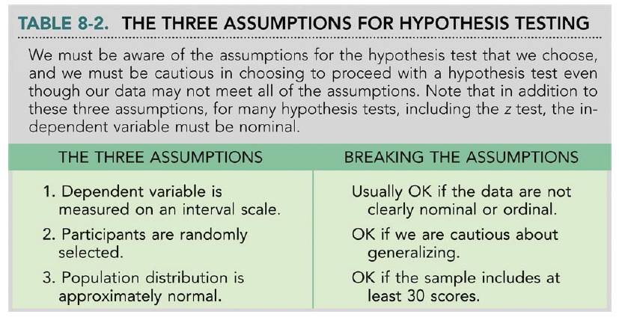
Assumptions of Hypothesis Testing

Slide 20
Testing Hypotheses (6 Steps)
Identify the population, comparison distribution, inferential test, and assumptions
State the null and research hypotheses
Determine characteristics of the comparison distribution
Whether this is the whole population or a control group, we need to find the mean and some measure of spread (variability).

Slide 21
Testing Hypotheses (6 Steps)
Determine critical values or cutoffs
How extreme must our data be to reject the null?
Critical Values: Test statistic values beyond which we will reject the null hypothesis (cutoffs)
p levels (α): Probabilities used to determine the critical value
Calculate test statistic (e.g., z statistic)
Make a decision
Statistically Significant: Instructs us to reject the null hypothesis because the pattern in the data differs from what we would expect by chance alone.

Slide 22
The z Test: An Example
μ = 156.5, σ = 14.6, M = 156.11, N = 97
Populations, distributions, and assumptions
Populations:
All students at UMD who have taken the test (not just our sample)
All students nationwide who have taken the test
Distribution: Sample -> distribution of means
Test & Assumptions: z test
Data are interval
We hope random selection (otherwise, less generalizable)
Sample size > 30, therefore distribution is normal

Slide 23
The z Test: An Example
State the null and research hypotheses
H₀: μ1 ≤ μ2
H₁: μ1 > μ2
or
H₀: μ1 = μ2
H₁: μ1 ≠ μ2

Slide 24
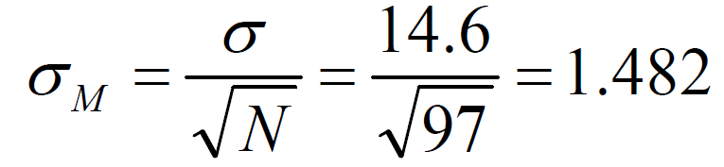
The z Test: An Example
Determine characteristics of comparison distribution.
Population: μ = 156.5, σ = 14.6
Sample: M = 156.11, N = 97

Slide 25
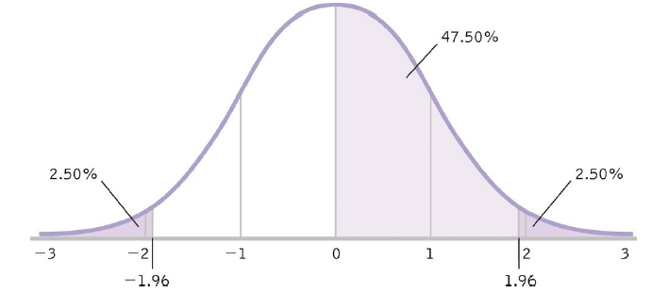
The z Test: An Example
Determine critical value (cutoffs)
In Data Science, we use p = .05
p = .05 = 5% -> 2.5% in each tail
50% - 2.5% = 47.5%
Consult z table for 47.5% -> z = 1.96

Slide 26
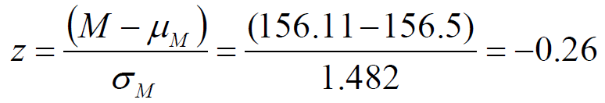
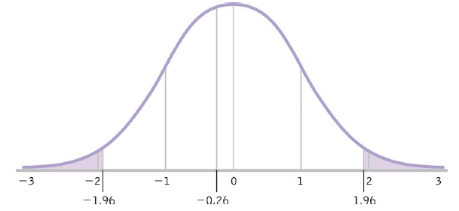
The z Test: An Example
Calculate test statistic
Make a Decision

Slide 27
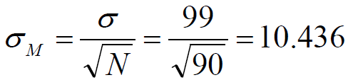
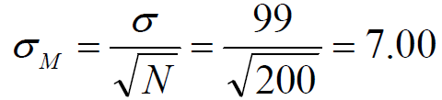
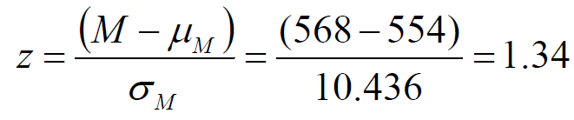
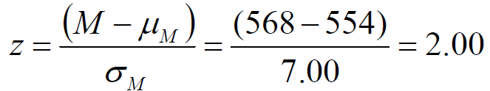
Increasing Sample Size
By increasing sample size, one can increase the value of the test statistic, thus increasing probability of finding a significant effect
Example: Psychology GRE scores:
Population: μ = 554, σ = 99
Sample: M = 568, N = 90
Population: μ = 554, σ = 99
Sample: M = 568, N = 200

Slide 28

Calculating t-Statistic
Because our sample size is less than 30, this will
now have a t distribution!
We can then use the t-Score to calculate the probability of getting a t value at least t extreme. Look it up on a t-table!

Slide 29
z-Score and t-Scores in Python
Use SciPy!
import scipy.stats as stats
values = [4,5,6,6,6,7,8,12,13,13,14,18]
zscores = stats.zscore(values)
import scipy.stats as stats
stats.t.ppf(q=1-.05/2,df=22)

Slide 30
Two Sample z and t-Test
Bivariate independent variable (A, B groups)
Continuous dependent variable
Each observation of the dependent variable is independent of the other observations of the dependent variable (its probability distribution isn't affected by their values).
**Exception: For the paired t-test, we only require that the pair-differences (Ai - Bi) be independent from each other (across i). [Note: "independent" and "dependent" are used in two different senses here. Just think of a "dependent variable" as one thing, and "observations that are dependent" as another thing.]

Slide 31
Two Sample z and t-Test
Dependent variable has a normal distribution, with the same variance, σ2, in each group (as though the distribution for group A were merely shifted over to become the distribution for group B, without changing shape):

Slide 32
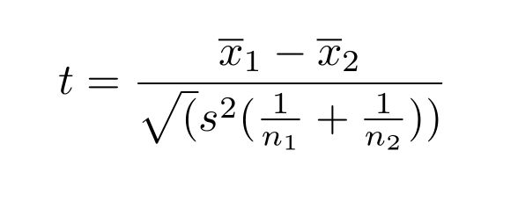
Two Sample z and t-Test
Used for determining if there is a statistical difference between two the means of two groups.

