Slide 1
THE DATA LIFECYCLE
Data collection
Data processing
Exploratory analysis
&
Data viz
Analysis, hypothesis testing, & ML
Insight & Policy Decision

Slide 2
NEXT FEW CLASSES
NumPy: Python Library for Manipulating nD Arrays
Multidimensional Arrays, and a variety of operations including Linear Algebra
Pandas: Python Library for Manipulating Tabular Data
Series, Tables (also called DataFrames)
Many operations to manipulate and combine tables/series
Relational Databases
Tables/Relations, and SQL (similar to Pandas operations)
4. Apache Spark
Sets of objects or key-value pairs
MapReduce and SQL-like operations

Slide 3
NEXT FEW CLASSES
NumPy: Python Library for Manipulating nD Arrays
Multidimensional Arrays, and a variety of operations including Linear Algebra
Pandas: Python Library for Manipulating Tabular Data
Series, Tables (also called DataFrames)
Many operations to manipulate and combine tables/series
Relational Databases
Tables/Relations, and SQL (similar to Pandas operations)
4. Apache Spark
Sets of objects or key-value pairs
MapReduce and SQL-like operations

Slide 4
NUMERIC & SCIENTIFIC APPLICATIONS
Number of third-party packages available for numerical and scientific computing
These include:
NumPy/SciPy – numerical and scientific function libraries.
numba – Python compiler that support JIT compilation.
ALGLIB – numerical analysis library.
pandas – high-performance data structures and data analysis tools.
pyGSL – Python interface for GNU Scientific Library.
ScientificPython – collection of scientific computing modules.
Many, many thanks to: FSU CIS4930

Slide 5
NUMPY AND FRIENDS
By far, the most commonly used packages are those in the NumPy stack. These packages include:
NumPy: similar functionality as Matlab
SciPy: integrates many other packages like NumPy
Matplotlib & Seaborn – plotting libraries
iPython via Jupyter – interactive computing
Pandas – data analysis library
SymPy – symbolic computation library
[FSU]

Slide 6
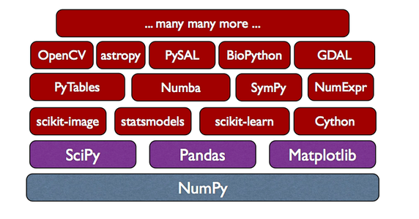
THE NUMPY STACK
Mid- & Late-semester
Today/next class
Later
Image from Continuum Analytics
Notes:
NumPy = low-level LinAlg storage and manipulation
SciPy = scientific computing & stats algorithms built on top of NumPy
Pandas = friendlier version of NumPy backed by raw NumPy

Slide 7
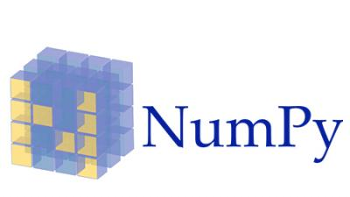
NUMPY
Among other things, NumPy contains:
A powerful n-dimensional array object.
Sophisticated (broadcasting/universal) functions.
Tools for integrating C/C++ and Fortran code.
Useful linear algebra, Fourier transform, and random number capabilities, etc.
Besides its obvious scientific uses, NumPy can also be used as an efficient multi-dimensional container of generic data.
[FSU]

Slide 8
NUMPY
ndarray object: an n-dimensional array of homogeneous data types, with many operations being performed in compiled code for performance
Several important differences between NumPy arrays and the standard Python sequences:
NumPy arrays have a fixed size. Modifying the size means creating a new array.
NumPy arrays must be of the same data type, but this can include Python objects – may not get performance benefits
More efficient mathematical operations than built-in sequence types.
[FSU]

Slide 9
NUMPY DATATYPES
Wider variety of data types than are built-in to the Python language by default.
Defined by the numpy.dtype class and include:
intc (same as a C integer) and intp (used for indexing)
int8, int16, int32, int64
uint8, uint16, uint32, uint64
float16, float32, float64
complex64, complex128
bool_, int_, float_, complex_ are shorthand for defaults.
These can be used as functions to cast literals or sequence types, as well as arguments to NumPy functions that accept the dtype keyword argument.
[FSU]

Slide 10
NUMPY DATATYPES
>>> import numpy as np >>> x = np.float32(1.0) >>> x 1.0 >>> y = np.int_([1,2,4]) >>> y array([1, 2, 4]) >>> z = np.arange(3, dtype=np.uint8) >>> z array([0, 1, 2], dtype=uint8) >>> z.dtype dtype('uint8')
[FSU]

Slide 11
NUMPY ARRAYS
There are a couple of mechanisms for creating arrays in NumPy:
Conversion from other Python structures (e.g., lists, tuples)
Any sequence-like data can be mapped to a ndarray
Built-in NumPy array creation (e.g., arange, ones, zeros, etc.)
Create arrays with all zeros, all ones, increasing numbers from 0 to 1 etc.
Reading arrays from disk, either from standard or custom formats (e.g., reading in from a CSV file)
[FSU]

Slide 12
NUMPY ARRAYS
In general, any numerical data that is stored in an array-like container can be converted to an ndarray through use of the array() function. The most obvious examples are sequence types like lists and tuples.
>>> x = np.array([2,3,1,0])
>>> x = np.array([2, 3, 1, 0])
>>> x = np.array([[1,2.0],[0,0],(1+1j,3.)])
>>> x = np.array([[ 1.+0.j, 2.+0.j], [ 0.+0.j, 0.+0.j], [ 1.+1.j, 3.+0.j]])
[FSU]

Slide 13
NUMPY ARRAYS
Creating arrays from scratch in NumPy:
zeros(shape)– creates an array filled with 0 values with the specified shape. The default dtype is float64.
ones(shape) – creates an array filled with 1 values.
arange() – like Python’s built-in range
>>> np.zeros((2, 3)) array([[ 0., 0., 0.], [ 0., 0., 0.]])
>>> np.arange(10) array([0, 1, 2, 3, 4, 5, 6, 7, 8, 9]) >>> np.arange(2, 10, dtype=np.float) array([ 2., 3., 4., 5., 6., 7., 8., 9.]) >>> np.arange(2, 3, 0.2) array([ 2. , 2.2, 2.4, 2.6, 2.8])
[FSU]

Slide 14
NUMPY ARRAYS
linspace()– creates arrays with a specified number of elements, and spaced equally between the specified beginning and end values.
random.random(shape) – creates arrays with random floats over the interval [0,1).
>>> np.linspace(1., 4., 6) array([ 1. , 1.6, 2.2, 2.8, 3.4, 4. ])
>>> np.random.random((2,3)) array([[ 0.75688597, 0.41759916, 0.35007419], [ 0.77164187, 0.05869089, 0.98792864]])
[FSU]

Slide 15
NUMPY ARRAYS
>>> import numpy as np >>> a = np.arange(3) >>> print(a) [0 1 2] >>> a array([0, 1, 2]) >>> b = np.arange(9).reshape(3,3) >>> print(b) [[0 1 2] [3 4 5] [6 7 8]] >>> c = np.arange(8).reshape(2,2,2) >>> print(c) [[[0 1] [2 3]] [[4 5] [6 7]]]
Printing an array can be done with the print
statement (Python 2)
function (Python 3)
[FSU]

Slide 16
INDEXING
Single-dimension indexing is accomplished as usual.
Multi-dimensional arrays support multi-dimensional indexing.
>>> x = np.arange(10) >>> x[2] 2 >>> x[-2] 8
>>> x.shape = (2,5) # now x is 2-dimensional >>> x[1,3] 8 >>> x[1,-1] 9

Slide 17
INDEXING
Using fewer dimensions to index will result in a subarray:
This means that x[i, j] == x[i][j] but the second method is less efficient.
>>> x = np.arange(10) >>> x.shape = (2,5) >>> x[0] array([0, 1, 2, 3, 4])

Slide 18
INDEXING
Slicing is possible just as it is for typical Python sequences:
>>> x = np.arange(10) >>> x[2:5]
array([2, 3, 4])
>>> x[:-7]
array([0, 1, 2])
>>> x[1:7:2]
array([1, 3, 5])
>>> y = np.arange(35).reshape(5,7)
>>> y[1:5:2,::3]
array([[ 7, 10, 13], [21, 24, 27]])

Slide 19
ARRAY OPERATIONS
Basic operations apply element-wise. The result is a new array with the resultant elements.
>>> a = np.arange(5) >>> b = np.arange(5)
>>> a+b
array([0, 2, 4, 6, 8])
>>> a-b
array([0, 0, 0, 0, 0])
>>> a**2
array([ 0, 1, 4, 9, 16])
>>> a>3
array([False, False, False, False, True], dtype=bool)
>>> 10*np.sin(a)
array([ 0., 8.41470985, 9.09297427, 1.41120008, -7.56802495]) >>> a*b array([ 0, 1, 4, 9, 16])

Slide 20
ARRAY OPERATIONS
>>> a = np.zeros(4).reshape(2,2) >>> a array([[ 0., 0.], [ 0., 0.]]) >>> a[0,0] = 1 >>> a[1,1] = 1 >>> b = np.arange(4).reshape(2,2) >>> b array([[0, 1], [2, 3]]) >>> a*b array([[ 0., 0.], [ 0., 3.]]) >>> np.dot(a,b) array([[ 0., 1.], [ 2., 3.]])
Since multiplication is done element-wise, you need to specifically perform a dot product to perform matrix multiplication.

Slide 21
ARRAY OPERATIONS
>>> a = np.random.random((2,3)) >>> a array([[ 0.68166391, 0.98943098, 0.69361582], [ 0.78888081, 0.62197125, 0.40517936]]) >>> a.sum() 4.1807421388722164 >>> a.min() 0.4051793610379143 >>> a.max(axis=0) array([ 0.78888081, 0.98943098, 0.69361582]) >>> a.min(axis=1) array([ 0.68166391, 0.40517936])
There are also some built-in methods of ndarray objects. Universal functions which may also be applied include exp, sqrt, add, sin, cos, etc.

Slide 22
ARRAY OPERATIONS
>>> a = np.floor(10*np.random.random((3,4))) >>> print(a) [[ 9. 8. 7. 9.] [ 7. 5. 9. 7.] [ 8. 2. 7. 5.]] >>> a.shape (3, 4) >>> a.ravel() array([ 9., 8., 7., 9., 7., 5., 9., 7., 8., 2., 7., 5.])
>>> a.shape = (6,2) >>> print(a) [[ 9. 8.] [ 7. 9.] [ 7. 5.] [ 9. 7.] [ 8. 2.] [ 7. 5.]] >>> a.transpose() array([[ 9., 7., 7., 9., 8., 7.], [ 8., 9., 5., 7., 2., 5.]])
An array shape can be manipulated by a number of methods.
resize(size) will modify an array in place.
reshape(size) will return a copy of the array with a new shape.

Slide 23
LINEAR ALGEBRA
One of the most common reasons for using the NumPy package is its linear algebra module.
It’s like Matlab, but free!
>>> from numpy import * >>> from numpy.linalg import * >>> a = array([[1.0, 2.0],
[3.0, 4.0]]) >>> print(a) [[ 1. 2.] [ 3. 4.]] >>> a.transpose() array([[ 1., 3.], [ 2., 4.]]) >>> inv(a) # inverse array([[-2. , 1. ], [ 1.5, -0.5]])

Slide 24
LINEAR ALGEBRA
>>> u = eye(2) # unit 2x2 matrix; "eye" represents "I"
>>> u
array([[ 1., 0.], [ 0., 1.]])
>>> j = array([[0.0, -1.0], [1.0, 0.0]]) >>> dot(j, j) # matrix product array([[-1., 0.], [ 0., -1.]]) >>> trace(u) # trace (sum of elements on diagonal) 2.0 >>> y = array([[5.], [7.]]) >>> solve(a, y) # solve linear matrix equation array([[-3.], [ 4.]]) >>> eig(j) # get eigenvalues/eigenvectors of matrix (array([ 0.+1.j, 0.-1.j]), array([[ 0.70710678+0.j, 0.70710678+0.j], [ 0.00000000-0.70710678j, 0.00000000+0.70710678j]]))
(We’ll talk about this stuff as needed in the March/April machine learning and statistics lectures.)

Slide 25

SCIPY?
In its own words:
Basically, SciPy contains various tools and functions for solving common problems in scientific computing.
SciPy is a collection of mathematical algorithms and convenience functions built on the NumPy extension of Python. It adds significant power to the interactive Python session by providing the user with high-level commands and classes for manipulating and visualizing data.

Slide 26
SCIPY
SciPy gives you access to a ton of specialized mathematical functionality.
Just know it exists. We won’t use it much in this class.
Some functionality:
Special mathematical functions (scipy.special) -- elliptic, bessel, etc.
Integration (scipy.integrate)
Optimization (scipy.optimize)
Interpolation (scipy.interpolate)
Fourier Transforms (scipy.fftpack)
Signal Processing (scipy.signal)
Linear Algebra (scipy.linalg)
Compressed Sparse Graph Routines (scipy.sparse.csgraph)
Spatial data structures and algorithms (scipy.spatial)
Statistics (scipy.stats)
Multidimensional image processing (scipy.ndimage)
Data IO (scipy.io) – overlaps with pandas, covers some other formats

Slide 27
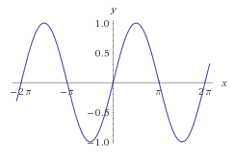
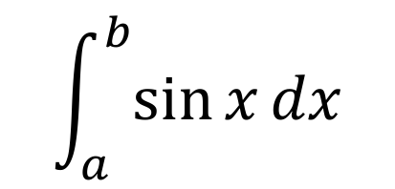
ONE SCIPY EXAMPLE
We can’t possibly tour all of the SciPy library and, even if we did, it might be a little boring.
Often, you’ll be able to find higher-level modules that will work around your need to directly call low-level SciPy functions
Say you want to compute an integral:

Slide 28
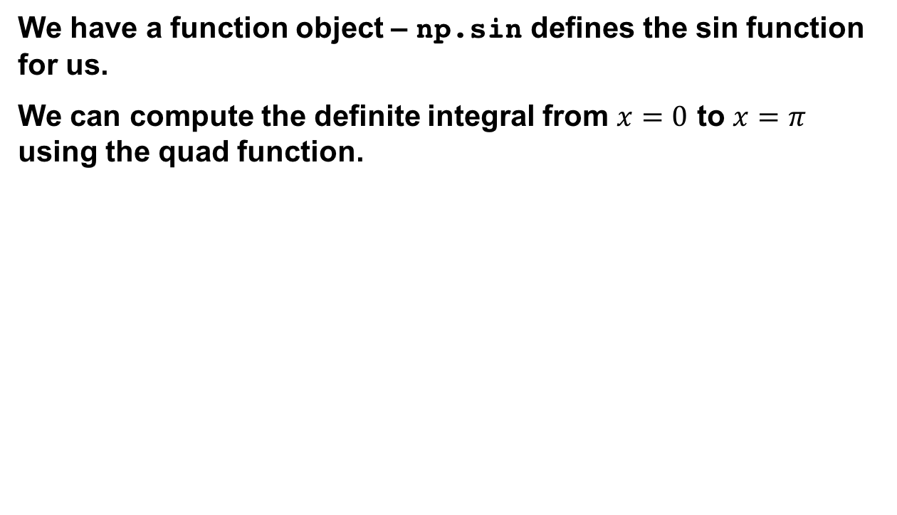
SCIPY.INTEGRATE
>>> res = scipy.integrate.quad(np.sin, 0, np.pi) >>> print(res) (2.0, 2.220446049250313e-14) # 2 with a very small error margin! >>> res = scipy.integrate.quad(np.sin, -np.inf, +np.inf) >>> print(res) (0.0, 0.0) # Integral does not converge

Slide 29
SCIPY.INTEGRATE
Let’s say that we don’t have a function object, we only have some (x,y) samples that “define” our function.
We can estimate the integral using the trapezoidal rule.
>>> sample_x = np.linspace(0, np.pi, 1000) >>> sample_y = np.sin(sample_x) # Creating 1,000 samples >>> result = scipy.integrate.trapz(sample_y, sample_x) >>> print(result) 1.99999835177
>>> sample_x = np.linspace(0, np.pi, 1000000) >>> sample_y = np.sin(sample_x) # Creating 1,000,000 samples >>> result = scipy.integrate.trapz(sample_y, sample_x) >>> print(result) 2.0

Slide 30
WRAP UP: FIRST PART
Shift thinking from imperative coding to operations on datasets
Numpy: A low-level abstraction that gives us really fast multi-dimensional arrays
Next class:
Pandas: Higher-level tabular abstraction and operations to manipulate and combine tables
Reading Homework focuses on Pandas and SQL

