Slide 1
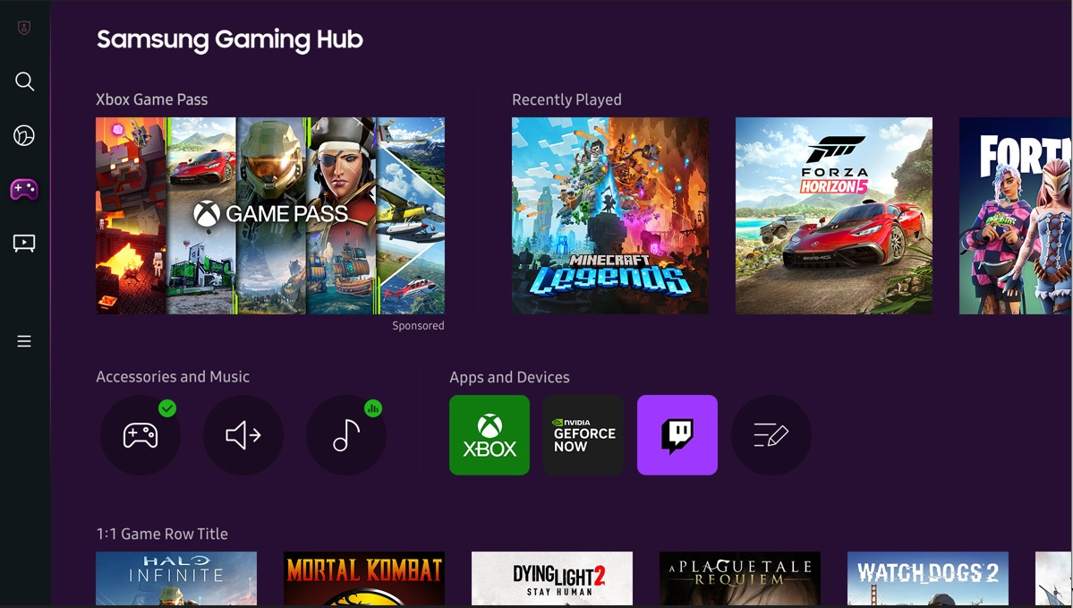

AEGIS NEXUS
AI-Enabled Cloud Asset Streaming
Play Anytime. Skip the Loading.
RSM 8542 Analytics for Marketing Strategy · Spring 2026 · Tony Chen

Slide 2

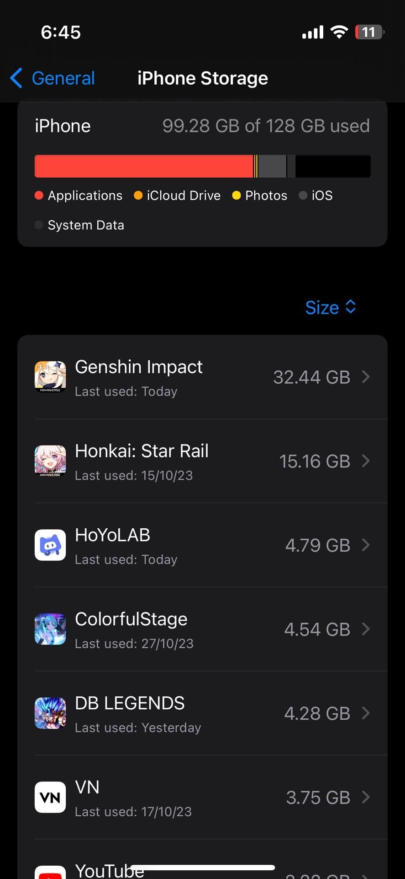
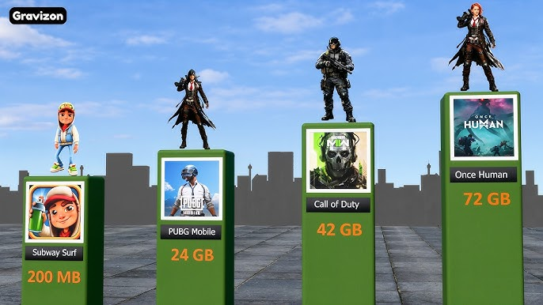


THE PROBLEM
Storage Crisis
AAA mobile games: 24–72 GB. Mid-range phones: 64–128 GB total.
Who Gets Hurt
Mid-range smartphone users — the largest & fastest-growing mobile gamer segment.
Publisher Pain
Large file sizes = abandoned installs, lower retention, lost revenue.
Sources: Gravizon / Coherent Market Insights / HoYoLAB

Slide 3
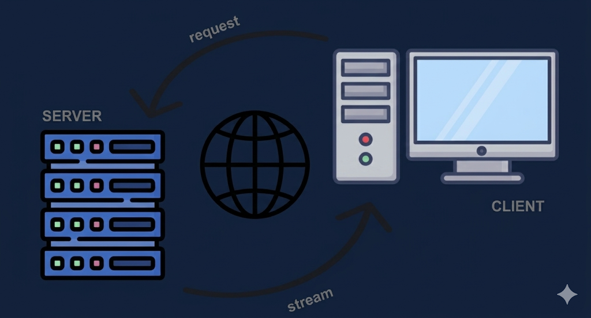

PRODUCT & POSITIONING
NOT full-game cloud streaming
Unlike GeForce NOW or Xbox Cloud Gaming — no server-side rendering, no video stream. Latency is near-zero because compute stays local.
Streams only assets (textures, audio, geometry) — NOT full video
Game logic runs locally → minimal latency
Instant play: about 50 MB client shell vs. 20–72 GB full install
Works on mid-range smartphones and PC without hardware upgrades
WHAT IT IS
POSITIONING
For mobile gamers with limited storage who refuse to compromise on game quality, Aegis Nexus is the only asset-streaming platform that delivers instant, full-fidelity gameplay — WITHOUT THE DOWNLOAD.
vs. Full-game cloud: lower latency · vs. Local install: zero storage burden
Source: STL Partners cloud gaming value chain

Slide 4

PRICING & CHANNEL STRATEGY
BASIC
PREMIUM
Revenue Model
Monthly subscription + publisher revenue share from participating titles. Platform captures margin after cloud infra costs.
$11.99/mo
$18.99/mo
Standard streaming quality
High fidelity + priority access
Lower cloud priority
Competitive with GeForce NOW
Partnership Channel: Samsung Gaming Hub (Xbox, GeForce NOW precedent)
CLV $43 · CAC $27
CLV $94 · CAC $35
CHANNEL STRATEGY
Discover
Evaluate
Install
Subscribe
Retain
Playable ads
Meta · TikTok
Streamed demo
in-ad experience
App Store
~50 MB client
In-app upgrade
prompt at D3
AI churn model
win-back offers

Slide 5
CLV and CAC
CLV - The total revenue or margin a business can expect from a single customer account throughout their relationship
CAC - The total marketing and sales expenses required to acquire one new customer
CLV: CAC - relationship between the CLV and the CAC, determining business profitability
1:1 – Breakeven
3:1 – Balanced
>= 5:1 – Spending too little and miss opportunities to reach new customers

Slide 6

MARKETING COMMUNICATIONS
Campaign Theme: "Your Game, Your Device — No Storage, No Compromise"
Playable Ad (Primary)
Influencer Seeding
App Store + Search
60-sec streamed demo inside Meta/TikTok ad
Gaming micro-influencers (100K–1M followers)
ASO: keywords 'play without downloading'
User plays before install — self-selects high-intent
Focus: 'I freed up 70 GB on my phone' narrative
Google UAC targeting heavy-gaming genres
CTA: 'Start Playing Now — 50 MB Install'
Platform: TikTok + YouTube Shorts
Retargeting lapsed mobile gamers
Message hierarchy: Storage freedom (rational) → Instant play (emotional) → Publisher breadth (social proof)

Slide 7
ANALYTICS: CLV-DRIVEN TARGETING DECISION
$57.52
2.02×
95.1%
3.32×
Avg CLV
CLV:CAC
Pay Back
Premium|Heavy
contribution-margin
portfolio average
within 12 months
CLV:CAC (priority)
Segment (ad activity strength) | CLV:CAC | Max CAC | Tier
Prem | Heavy | 3.32× | $55.22 | Priority
Prem | Medium | 2.93× | $48.38 | Priority
Prem | Light | 2.43× | $40.38 | Priority
Basic | Med | 1.74× | $15.54 | Secondary
Basic | Heavy | 1.73× | $15.44 | Secondary
Basic | Light | 1.63× | $14.58 | Secondary
Launch decision: All Premium segments → Priority playable-ad campaigns. Basic segments → lower-cost social retargeting only.

Slide 8


AI IN MARKETING · MEASUREMENT PLAN
Bid Optimisation
Creative Generation
Churn Prediction
AUTO
AUTO
AUTO
Real-time CPI bids within CAC ceiling
AI generates ad variants; auto-rejects low-CTR
Monthly scoring; auto win-back if Pr(churn) > threshold
HUMAN
HUMAN
HUMAN
Human sets CLV:CAC floor (2.0× Priority, 1.5× Secondary)
Human approves all new concepts & final variant
Human sets threshold; Premium|Heavy at-risk → manual review
A/B TEST: Playable Ads vs. Standard Video · Segment: Premium | Heavy
1,059
+3 pp D30 retention
$53.50
$113,303
n per arm
MDE
CLV uplift / user
Total cohort uplift

Slide 9
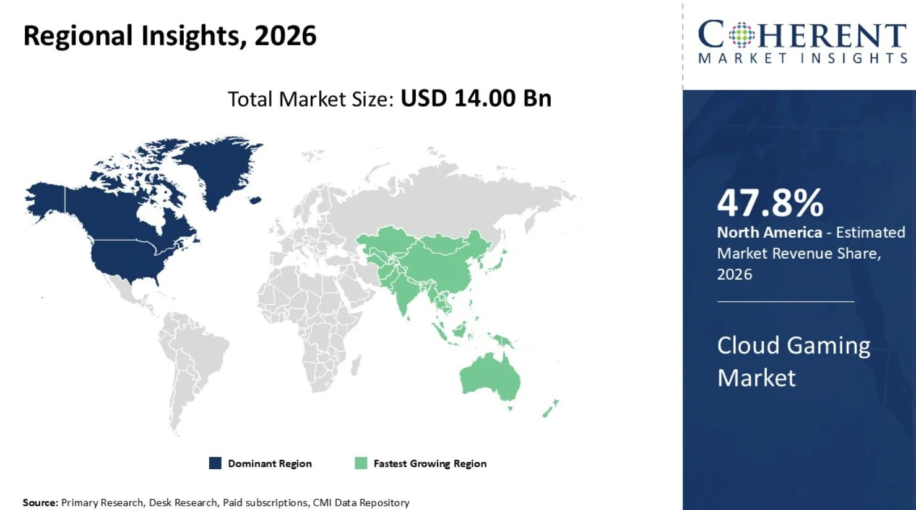
PHASED ROLLOUT · WHY NOW
Phase 1 · Month 1–3
Phase 2 · Month 4–9
Phase 3 · Month 10+
Premium | Heavy
(mobile-first)
Prem|Med + Basic|Heavy
PC beta launch
All segments
Publisher expansion
GATE
GATE
GATE
CLV:CAC ≥ 2.0×
on 500 users
CLV:CAC ≥ 1.5×
across segments
Stable 1.5×
at 90-day cohort
A/B test runs here → results ready for Phase 2
WHY NOW
$14 Bn cloud gaming market in 2026 to $241 Bn by 2033 (50% CAGR)
5G rollout reduces latency risk for asset streaming
Smartphones = 38.7% of cloud gaming device share
Sources: Coherent Market Insights 2026 · Simulation: n = 100,000 users, seed = 42

Slide 10
References
Coherent Market Insights. (2026, March 16). Cloud gaming market analysis & forecast: 2026–2033 (Report No. CMI4600). https://www.coherentmarketinsights.com/market-insight/cloud-gaming-market-4600
Gravizon. (n.d.). Mobile game storage size comparison [Video]. YouTube. https://www.youtube.com/
HoYoLAB. (2023). iPhone storage: Genshin Impact and HoYoverse games [User screenshot]. HoYoLAB Community. https://www.hoyolab.com/article/22376334
Kim, R. (2026, February 25). Cloud gaming: A viable alternative, or a cloudy future? USC Viterbi Illumin. https://illumin.usc.edu/cloud-gaming-a-viable-alternative-or-a-cloudy-future/
Osborne, H. (2023, April). What's the problem with cloud gaming? STL Partners. https://stlpartners.com/articles/consumer/whats-the-problem-with-cloud-gaming/
Samsung Newsroom Australia. (n.d.). Samsung levels up cloud gaming experiences by unleashing Gaming Hub down under [Photograph]. Samsung. https://news.samsung.com/au/samsung-levels-up-cloud-gaming-experiences-by-unleashing-gaming-hub-down-under
Stockton, M. D. (2023, December 4). Understanding cloud gaming: Pros and cons. Medium. https://medium.com/@stocktonmattdavies/understanding-cloud-gaming-pros-and-cons-f0c77ff1a743

