Slide 1
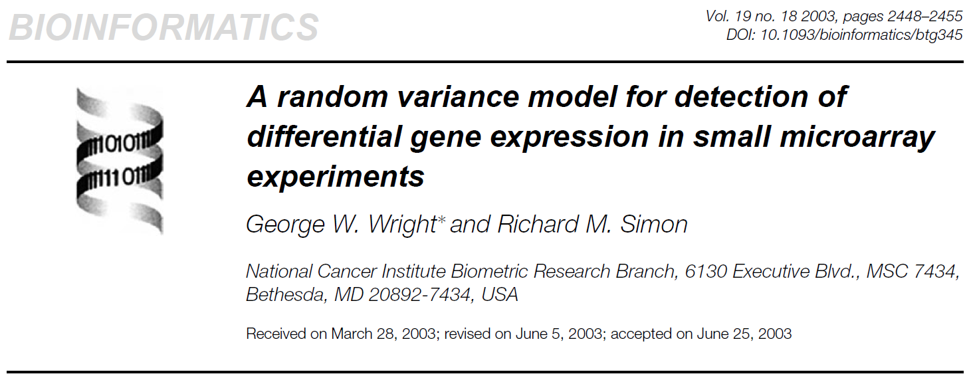
Guannan Shen
9/25/2018
BIOS 7659

Slide 2
Outline
Motivation
Approaches
Method
Model formulation
Hypothesis testing for β
Application to t, F tests and ANOVA
Estimation of a, b
Results
Simulation results
Experimental results
Discussion

Slide 3
MOTIVATION
Conduct differential expression (DE) analysis.
Expense and limited specimen availability often lead to studies with small sample sizes.
The need of testing a multitude of hypotheses relating gene expression to other characteristics of the samples.
Using a linear model framework to model gene expression
The t-test, paired t-test and F-test, and Analysis of Variance (ANOVA)
How to estimate residual error (variance)?

Slide 4
APPROACHES
Small sample size
Simple thoughts
1. Pooled the residual sum of squares across all genes
Assumption: all genes share equal variance, which is unlikely to be true
2. Estimate the gene-specific residual variance, individually
No information shared between genes
Reduce the degree of freedom
Less power
Random Variance Model (RVM)

Slide 5
Method
A hybrid approach:
It is assumed that the variance of the residuals change from gene to gene, but represent random selections from a single distribution (inverse gamma distribution), whose parameters are estimated across all genes.
Boost the residual degrees of freedom, more power
Similar in form with standard linear model

Slide 6

Model formulation
Build up the linear regression framework
The t-test, paired t-test and F-test, and Analysis of Variance (ANOVA) are actually special cases
Equation
Notations:
y_{ij}: normalized log intensity; x_{i}: designed characteristics vectors
ε_{ij} encompass both measurement error and biological variability
n: the number of samples m: the number of genes k: the dimension of β_{j}
i is the index for samples, and j is for genes
X the n×k dimensional design matrix, assuming it is full rank

Slide 7

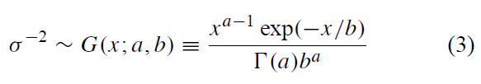
RESIDUALS
Unknown parameters a and b.
E[σ⁻²] = ab
Inverse-Gamma distribution as a prior distribution of variance is a standard choice in Bayesian analysis.
Computational convenience, the conjugate prior
They showed later, this distribution appears to be correct in actual experimental data

Slide 8



HYPOTHESIS TESTING FOR β
Performed on a gene by gene basis. So from now on, they suppress the j subscript.
Temporary assumption, a and b are known.
The number of linear constraints imposed by ω.

Slide 9
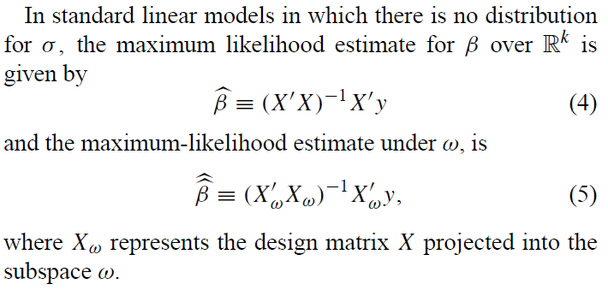
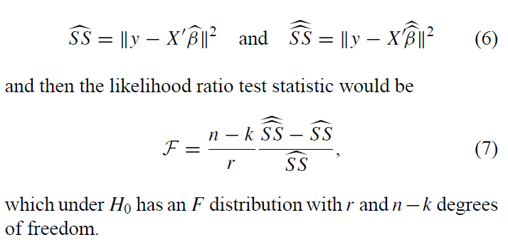
Standard linear model
Under H₁
Under H₀
Sum of square residuals

Slide 10
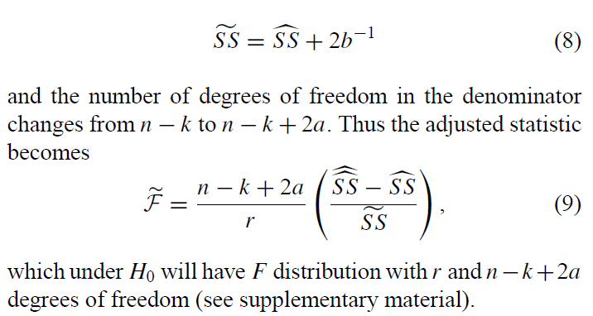
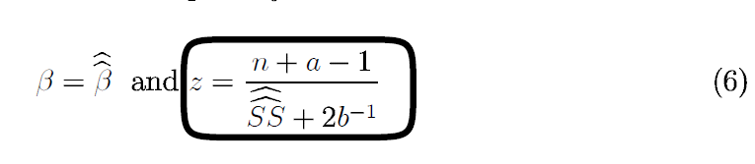
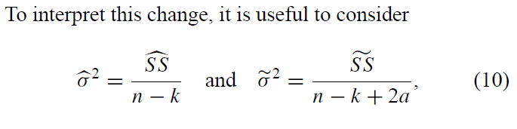
Under RVM assumption
Sum of square residuals

Slide 11

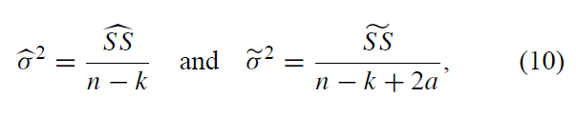
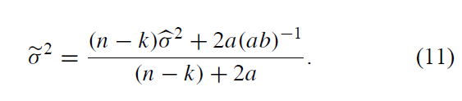
RVM Residual variance
(ab)⁻¹could be thought of as an estimate of σ² based on the shared variance distribution
(n-k) and 2a can be considered as weighting parameters
Weighted average of (ab)⁻¹and the sample variance for the specific gene.

Slide 12

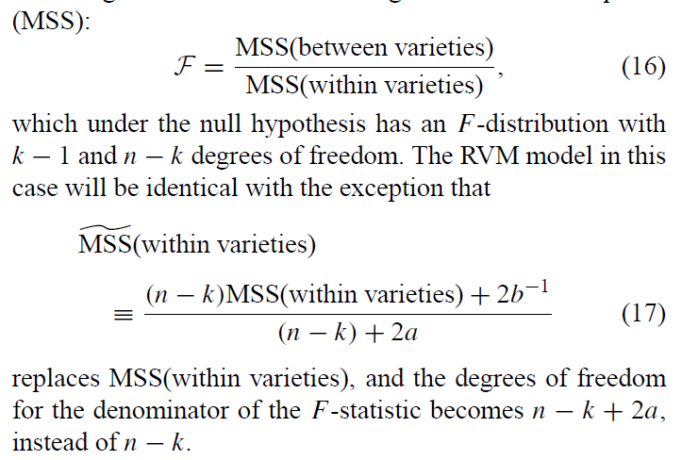
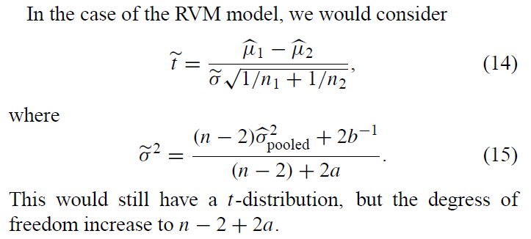
Application
t-test
F-test

Slide 13
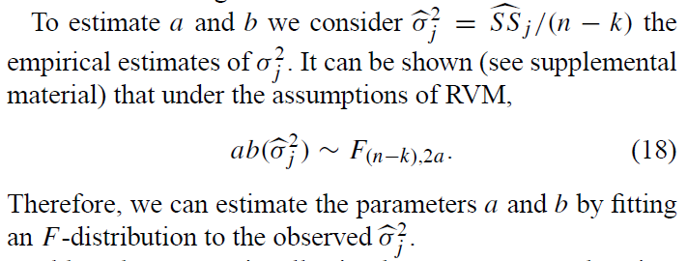
Estimation of parameters
The values a and b are assumed constant across genes, so it is possible to use the data from all genes to form an estimate.
They recommend numerically maximizing the likelihood under the F-distribution with respect to a and b. This provides more accurate estimates for a and b.
Correlation between genes will influence the estimation of a and b.

Slide 14
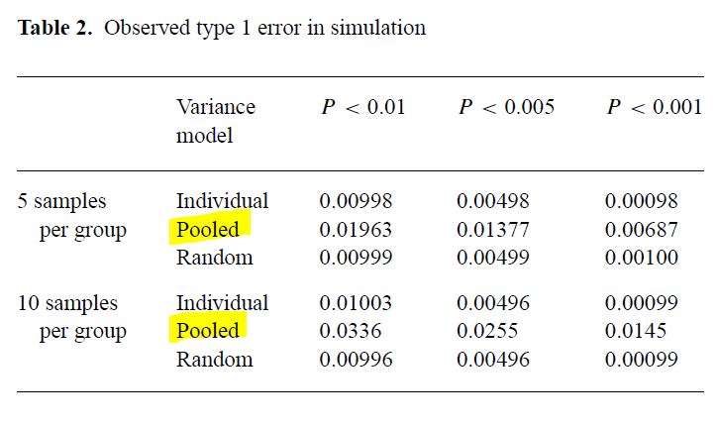
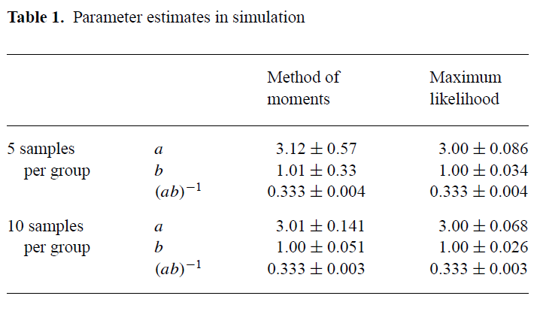
SIMULATION RESULTS
2000 simulated data sets, of the expressions of 6000 genes from 2 groups of 5/10 samples each.
The values a = 3, b = 1, based on their experience.

Slide 15
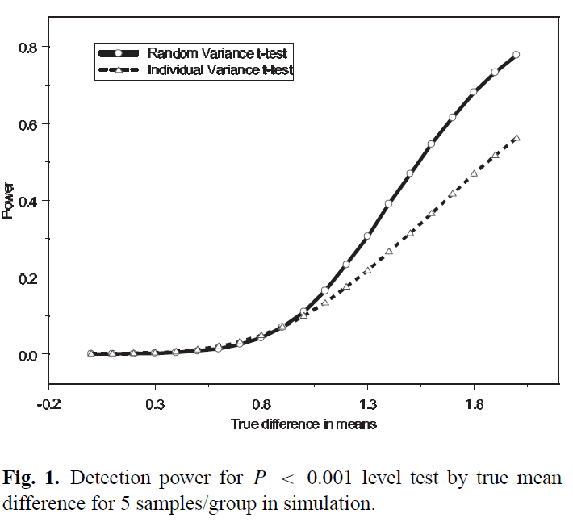
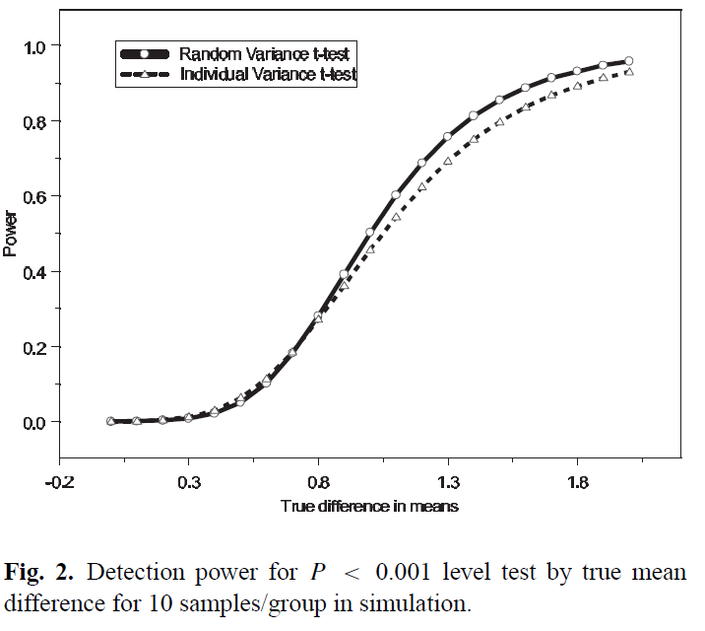
SIMULATION RESULTS

Slide 16
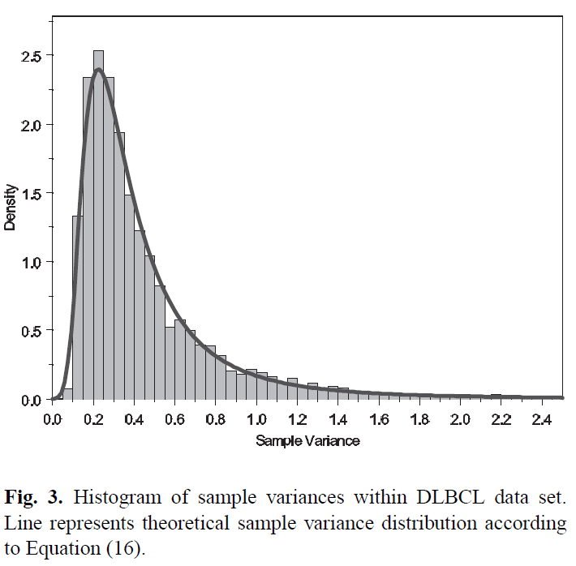
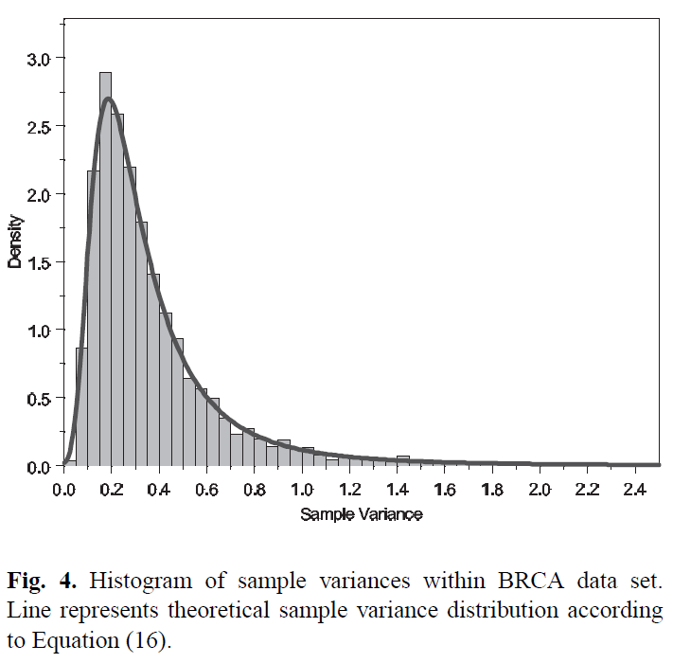


TEST OF assumption

Slide 17
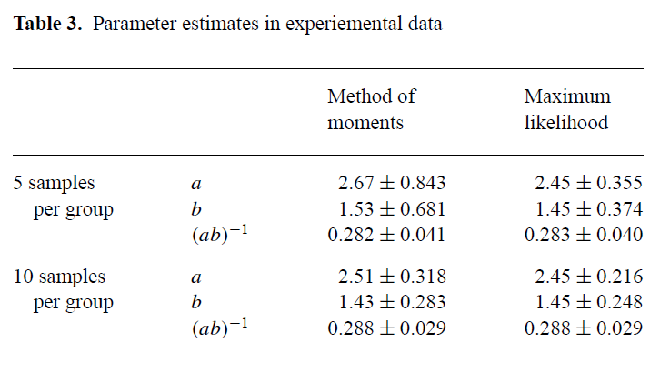
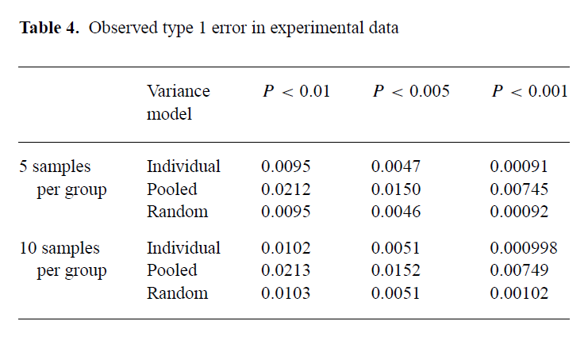
EXPERIMENTAL DATA
The DLBCL data, and in particular the 83 ABC patients and 134 GCB patients.
Repeatedly took sub-samples of size 10 (5 GCB, 5 ABC) and 20 (10 GCB, 10 ABC), 2000 times.
Excluded all missing values, resulted in 6027 genes, to estimate of a and b.

Slide 18
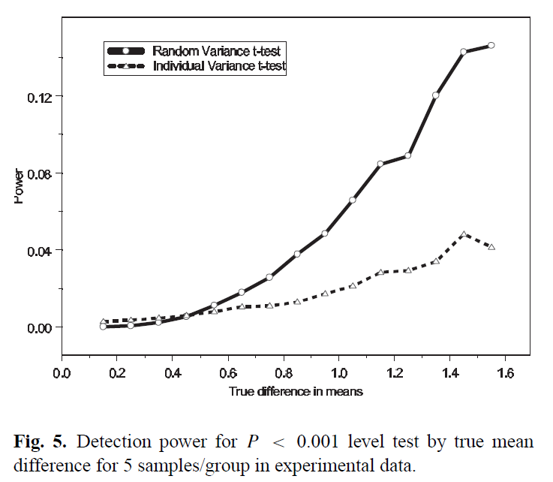
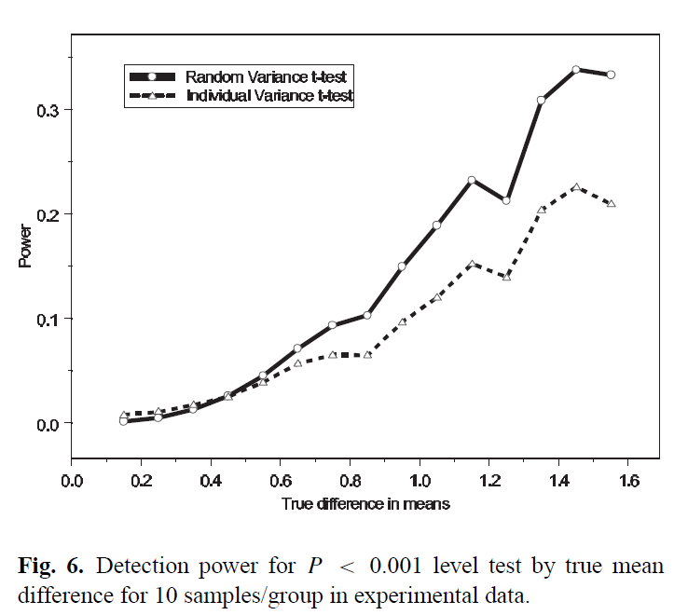
Experimental data

Slide 19
Discussion
This method works.
Easy implementation.
Recommended to use in the context of controlling the false discoveries (FDR).
Control correctly for type 1 error, while increasing the power, especially in small sample size, small p-value and large fold change.
Concerns:
The primary assumption of the RVM model is that the within group variance is distributed according to an inverse gamma distribution, this assumption appears to be correct.
Large fold change for more power.
Variability in parameters estimation. (a and b)
Normalized log intensity, log2?
The experimental data was tailored in the way as the scope of the simulation data.

Slide 20
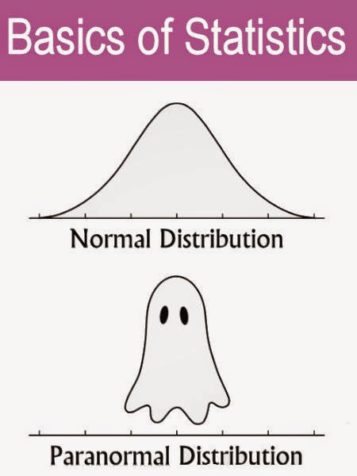
QUESTIONs?

