Slide 1
Cario: The Mucosal HIV-1 Interferome
Guannan Shen
11-26-2018

Slide 2
Outline
Datasets
Analysis methods
Results
Summary
References
Questions
Notes:
"H124" "H132" "H154" "H188" "H217" "H286" "H307" "H323" "H391" "H428" "H594" "H622" "H648" "H683" "H819" "H825" "H839" "H965" "H998"
"C138" "C178" "C255" "C278" "C361" "C404" "C493" "C582" "C708" "C716" "C914" "C947" "C972"

Slide 3

Datasets processed
RNA-Seq Data 1
RNA-Seq Data 2
Clinical Data
ISGs list (Interferon stimulated genes)

Slide 4
RNA-Seq 1: HIV Infection vs. Control
HIV Infection vs. Health Control
HIV infection sample: 19 subjects.
H124 H132 H154 H188 H217 H286 H307 H323 H391 H428 H594 H622 H648 H683 H819 H825 H839 H965 H998
Health control: 13 subjects.
C138 C178 C255 C278 C361 C404 C493 C582 C708 C716 C914 C947 C972.
3 digits ID will be used to merge datasets, such as clinical data.
43297 genes in the raw data.
Annotated with gene symbol.
Gut mucosal sample
19890 genes left after filtering by genes must have at least 5 counts per sample, on average
Notes:
"H124" "H132" "H154" "H188" "H217" "H286" "H307" "H323" "H391" "H428" "H594" "H622" "H648" "H683" "H819" "H825" "H839" "H965" "H998"
"C138" "C178" "C255" "C278" "C361" "C404" "C493" "C582" "C708" "C716" "C914" "C947" "C972"

Slide 5
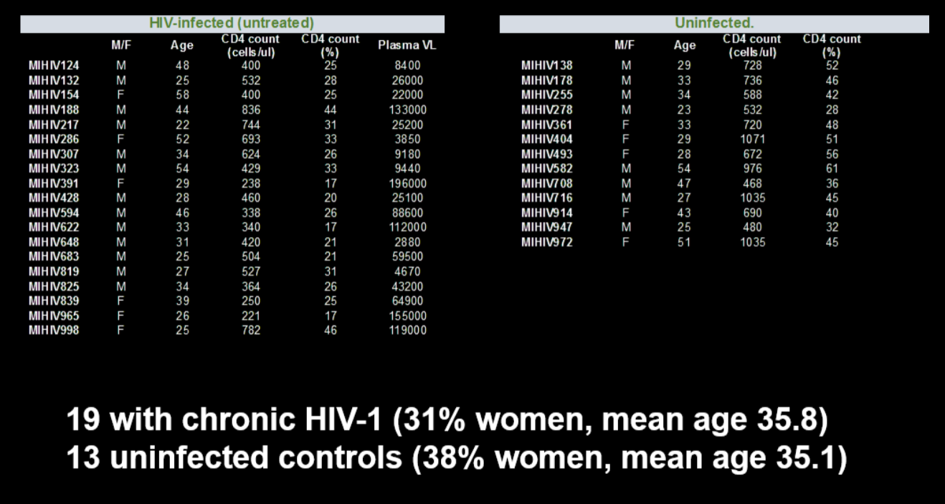

Slide 6
RNA-Seq 2: HIV treated vs. Untreated
HIV treated vs. Untreated
Notes:
"H124" "H132" "H154" "H188" "H217" "H286" "H307" "H323" "H391" "H428" "H594" "H622" "H648" "H683" "H819" "H825" "H839" "H965" "H998"
"C138" "C178" "C255" "C278" "C361" "C404" "C493" "C582" "C708" "C716" "C914" "C947" "C972"

Slide 7
ISGs list (Interferon stimulated genes)
229 genes stimulated by interferon alpha/beta. This gene list was summarized from the result of in vitro studies, the preliminary study.
Notes:
"H124" "H132" "H154" "H188" "H217" "H286" "H307" "H323" "H391" "H428" "H594" "H622" "H648" "H683" "H819" "H825" "H839" "H965" "H998"
"C138" "C178" "C255" "C278" "C361" "C404" "C493" "C582" "C708" "C716" "C914" "C947" "C972"

Slide 8
Clinical Data
Data was stored in a multi-sheets Excel file.
Notes:
"H124" "H132" "H154" "H188" "H217" "H286" "H307" "H323" "H391" "H428" "H594" "H622" "H648" "H683" "H819" "H825" "H839" "H965" "H998"
"C138" "C178" "C255" "C278" "C361" "C404" "C493" "C582" "C708" "C716" "C914" "C947" "C972"

Slide 9
Questions of interest
1. For Patients vs. Health control Interferome study
Notes:
"H124" "H132" "H154" "H188" "H217" "H286" "H307" "H323" "H391" "H428" "H594" "H622" "H648" "H683" "H819" "H825" "H839" "H965" "H998"
"C138" "C178" "C255" "C278" "C361" "C404" "C493" "C582" "C708" "C716" "C914" "C947" "C972"

Slide 10
Primary Goals
Test the association between targeted genes and clinical outcomes such as viral load and CD4 T cell counts.
The genes are significantly differential expressed and included in the ISGs gene list.
Using normalized counts of genes as design matrix for linear regression
The outcome, viral load and CD4 counts, continuous, log10 transformation?
Not adjusting for age, gender? Because previously, they didn't.
Notes:
"H124" "H132" "H154" "H188" "H217" "H286" "H307" "H323" "H391" "H428" "H594" "H622" "H648" "H683" "H819" "H825" "H839" "H965" "H998"
"C138" "C178" "C255" "C278" "C361" "C404" "C493" "C582" "C708" "C716" "C914" "C947" "C972"

Slide 11
Secondary Goals
1. The investigator wants the normalized the count table.
2. The merge list of ISGs genes and sig. DE genes, the sig. Genes should be defined with several cutoffs, FDR 0.05, 0.1, raw P value.
Notes:
"H124" "H132" "H154" "H188" "H217" "H286" "H307" "H323" "H391" "H428" "H594" "H622" "H648" "H683" "H819" "H825" "H839" "H965" "H998"
"C138" "C178" "C255" "C278" "C361" "C404" "C493" "C582" "C708" "C716" "C914" "C947" "C972"

Slide 12
Methods
DESeq2
R
Bioconductor
Notes:
"H124" "H132" "H154" "H188" "H217" "H286" "H307" "H323" "H391" "H428" "H594" "H622" "H648" "H683" "H819" "H825" "H839" "H965" "H998"
"C138" "C178" "C255" "C278" "C361" "C404" "C493" "C582" "C708" "C716" "C914" "C947" "C972"

Slide 13
DESeq2 (Technical Details, FYI)
DESeq2 normalization and differential expression testing methods were used.​
Some Assumptions of DESeq2​
Typically, the number of replicates is small​.
Most genes do not change across samples.
No batch effects, all samples were sequenced on the same day. Need to make sure!
Interpretation of size factor normalization (DESeq2)​
Median ratio method to estimate size factors.
Then just dividing the raw counts by the size factor for each sample to get the normalized counts.
Test for differential expression
By fitting normalized counts with negative binomial generalized linear models.
Then performing the negative binomial Wald tests to get p-values.
Finally, using the Benjamini & Hochberg correction (FDR) to get the adjusted p-values (multiple comparison). And p.adj can be 0.05 or 0.1.
Notes:
"H124" "H132" "H154" "H188" "H217" "H286" "H307" "H323" "H391" "H428" "H594" "H622" "H648" "H683" "H819" "H825" "H839" "H965" "H998"
"C138" "C178" "C255" "C278" "C361" "C404" "C493" "C582" "C708" "C716" "C914" "C947" "C972"

Slide 14
Normalized Counts
dds <- estimateSizeFactors(dds) counts(dds, normalized=TRUE)

Slide 15
Targeted Feature selection
Get the differential expressed gene list from HIV patients vs. Health control, RNA-Seq data.
Filter genes
DESeq2 normalization and differential expression test.
Significant genes.
The ISGs gene list.
229 genes stimulated by interferon alpha/beta. This gene list was summarized from the result of in vitro studies.
Notes:
"H124" "H132" "H154" "H188" "H217" "H286" "H307" "H323" "H391" "H428" "H594" "H622" "H648" "H683" "H819" "H825" "H839" "H965" "H998"
"C138" "C178" "C255" "C278" "C361" "C404" "C493" "C582" "C708" "C716" "C914" "C947" "C972"

Slide 16
RESULTS
Notes:
"H124" "H132" "H154" "H188" "H217" "H286" "H307" "H323" "H391" "H428" "H594" "H622" "H648" "H683" "H819" "H825" "H839" "H965" "H998"
"C138" "C178" "C255" "C278" "C361" "C404" "C493" "C582" "C708" "C716" "C914" "C947" "C972"

Slide 17
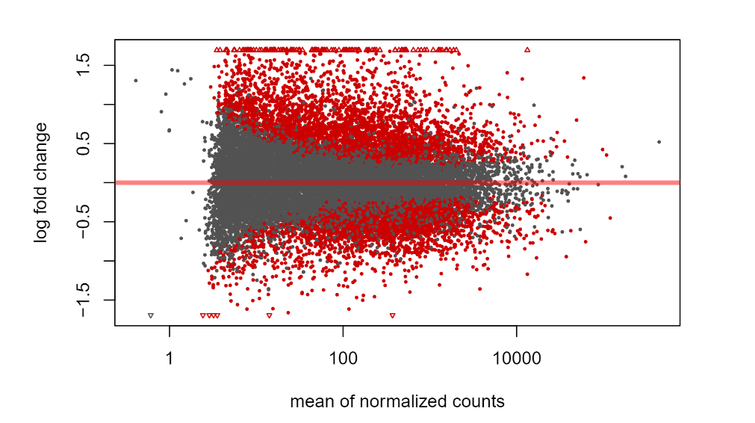
11-29-2018
Notes:
"H124" "H132" "H154" "H188" "H217" "H286" "H307" "H323" "H391" "H428" "H594" "H622" "H648" "H683" "H819" "H825" "H839" "H965" "H998"
"C138" "C178" "C255" "C278" "C361" "C404" "C493" "C582" "C708" "C716" "C914" "C947" "C972"

Slide 18
References
1. A comparison of per sample global scaling and per gene normalization methods for differential expression analysis of RNA-seq data, PLos One. 2017.
2. Differential expression analysis for sequence count data, Genome Biology, Anders and Huber (2010).
3. Controlling the False Discovery Rate: A Practical and Powerful Approach to Multiple Testing, Yoav Benjamini and Yosef Hochberg, Journal of the Royal Statistical Society. Series B (Methodological), Vol. 57, No. 1 (1995).
Notes:
"H124" "H132" "H154" "H188" "H217" "H286" "H307" "H323" "H391" "H428" "H594" "H622" "H648" "H683" "H819" "H825" "H839" "H965" "H998"
"C138" "C178" "C255" "C278" "C361" "C404" "C493" "C582" "C708" "C716" "C914" "C947" "C972"

Slide 19
Questions
Notes:
"H124" "H132" "H154" "H188" "H217" "H286" "H307" "H323" "H391" "H428" "H594" "H622" "H648" "H683" "H819" "H825" "H839" "H965" "H998"
"C138" "C178" "C255" "C278" "C361" "C404" "C493" "C582" "C708" "C716" "C914" "C947" "C972"

Slide 20
11-29-2018
Can this be my thesis?
I have convinced Mario to use normalized counts from DESeq2, not TPM and using DESeq2 to do DE test plus the FDR correction. Is it worth it? And is it the right way to get the normalized counts?
By doing above approach, they were worried it would be too stringent. I got 1/3 genes of the filtered 19000 genes to be FDR < 0.1 in HIV vs Health control. Does this violate the assumption of most genes unchanged? If not, can I give them gene list with FDR 0.05 or 0.1 cutoff for them to choose?
The two population seems to be very different (gut sample).
IF SO
To test the association, can I try simple inear regression with most significant genes in the ISGs list with the outcomes. Gene should be put in the regression one by one.
IF this no work, build linear regression with PC components.
The form of the linear regression.
Notes:
"H124" "H132" "H154" "H188" "H217" "H286" "H307" "H323" "H391" "H428" "H594" "H622" "H648" "H683" "H819" "H825" "H839" "H965" "H998"
"C138" "C178" "C255" "C278" "C361" "C404" "C493" "C582" "C708" "C716" "C914" "C947" "C972"

Slide 21
Resutls
Notes:
"H124" "H132" "H154" "H188" "H217" "H286" "H307" "H323" "H391" "H428" "H594" "H622" "H648" "H683" "H819" "H825" "H839" "H965" "H998"
"C138" "C178" "C255" "C278" "C361" "C404" "C493" "C582" "C708" "C716" "C914" "C947" "C972"

