Slide 1
Cario Interferome: Core ISGs and IFN-beta Genes
By RNA-Seq Data
Guannan Shen
1/8/2019

Slide 2
Outline
Questions of Interest (QOI)
RNASeq Data and Clinical Data
Normalization of RNASeq Data
Differential Expression Analysis (DE): HIV Infected Untreated vs. Health Control
DESeq2
edgeR
Core ISGs, IFN-beta Genes and DE
Core ISGs, IFN-beta Genes and Clinical Outcomes, differences between gene lists
References

Slide 3
QOI: 3 main questions from Mario
How Genes in the gene lists (Core ISGs and IFN-beta genes) are significantly altered in gut biopsies (HIV Infected vs. Health Control), and what are the directions of the regulations?
Differential expression (DE) analysis then take the intersection
How are the altered genes associated with clinical outcomes such as plasma viral load, CD4 counts, inflammation, while adjusting for age and sex of participants?
Linear regression
Show some PCA plots with the effects of key genes.
Are the scopes of the associations different between Core ISGs and IFN-beta genes?
Descriptive table and plots

Slide 4
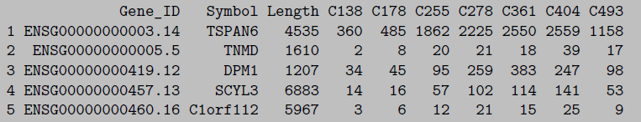
RNA-Seq Data: HIV Infected vs. Health Control
HIV infected sample: 19 subjects.
H124 H132 H154 H188 H217 H286 H307 H323 H391 H428 H594 H622 H648 H683 H819 H825 H839 H965 H998
Health control: 13 subjects.
C138 C178 C255 C278 C361 C404 C493 C582 C708 C716 C914 C947 C972.
43297 genes in the raw data.
Annotated with gene symbol.
Gut mucosal sample
19890 genes left with filtering criteria: each gene must have at least 5 counts per sample, on average.

Slide 5
Clinical Data
For each participant
Age, Gender, Plasma Viral load, CD4 Counts …
IL-6 (pg/ml), CRP(ug/ml), iFABP (pg/ml), sCD27 (U/ml), CD14 (ng/ml) …
There are missing values in several measurements for some participants.

Slide 6
Predefined Gene lists
ISGs list (Interferon stimulated genes)
230 genes stimulated by interferon alpha/beta. This gene list was summarized from the result of in vitro studies, the preliminary study.
IFN-beta specific genes
423 genes that were induced specifically by IFN-beta, but not the IFN-alpha subtypes tested.

Slide 7
Normalization of RNA-Seq Data
The data normalization is one of the most crucial steps of data processing and the choice of normalization procedure affects the results of DE (Differential Expression) analysis¹.
The top commonly used methods are DESeq (median-of-ratios) and TMM (Trimmed Mean of M values)-edgeR. DESeq and TMM-edgeR were reported to have overall better performance, based on the false positive rate and detection power.
Here I compared 3 normalization methods: DESeq2, TMM and TPM, based on quality control (QC) plots

Slide 8
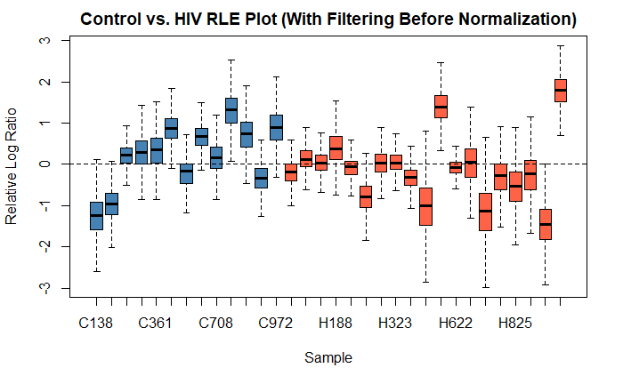
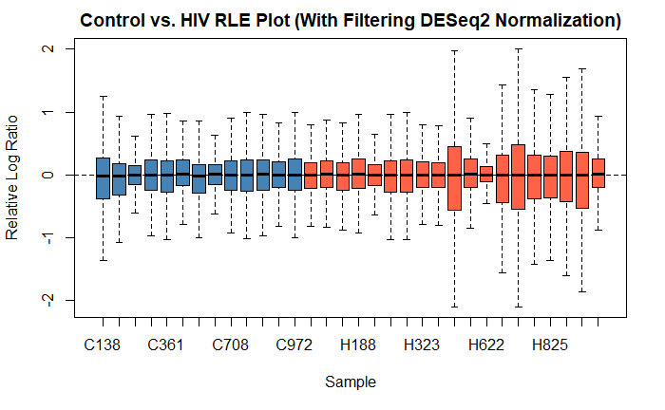
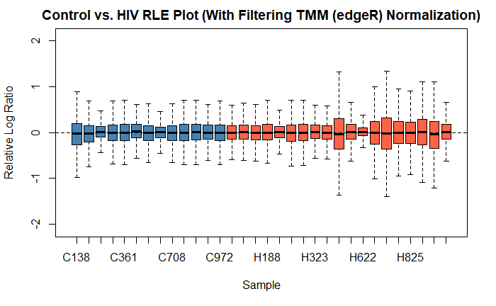
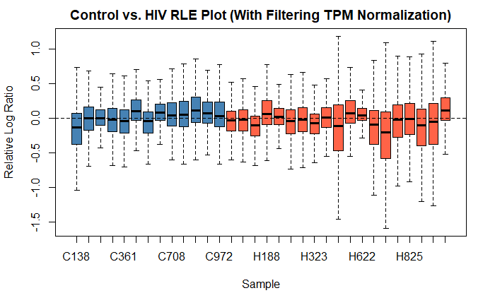
RLE Plots
Boxplots of the log-ratios of the gene-level read counts of each sample to the median across the samples.
We want
The median of each sample close to 0.
Equal and narrow spread across samples.

Slide 9
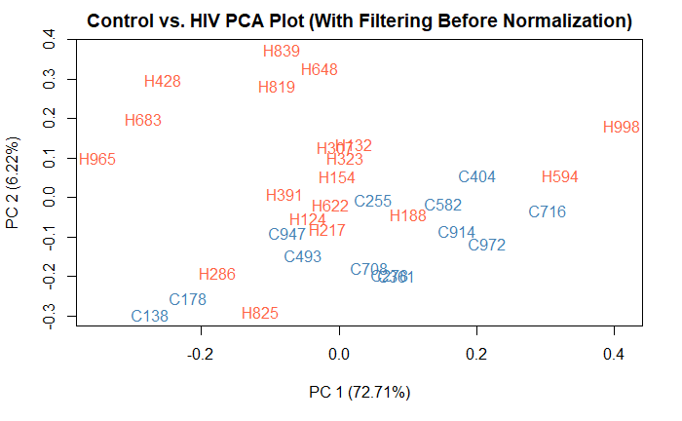
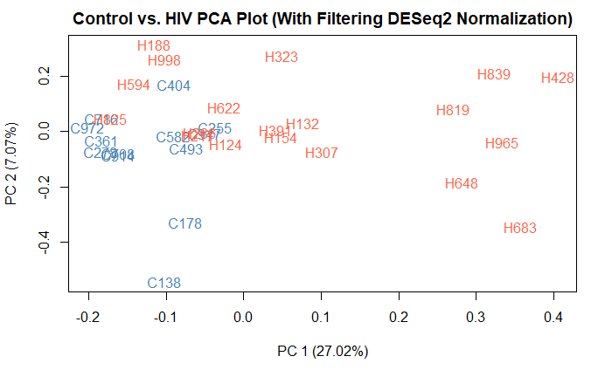
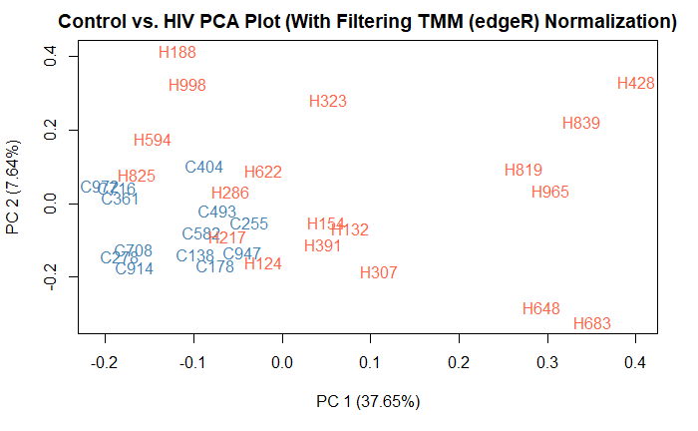
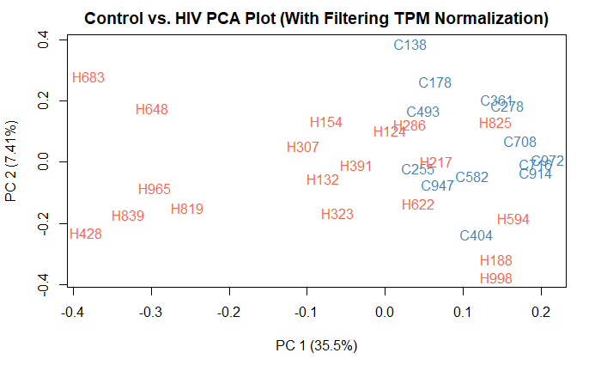
PCA plots

Slide 10
DESeq2 Differential Expression Analysis

Slide 11
Normalization: DESeq2
The performance of DESeq2 and TMM (edgeR) are close.
DESeq2
Interpretation of size factor normalization (DESeq2)​
Median ratio method to estimate size factors for each sample.
Then just dividing the raw counts by the size factor for each sample to get the normalized counts.
Test for differential expression
By fitting normalized counts with negative binomial generalized linear models.
Then performing the negative binomial Wald tests to get p-values.
Finally, using the Benjamini & Hochberg correction (FDR) to get the adjusted p-values (multiple comparison)⁴. And p.adj can be 0.05 or 0.1.

Slide 12
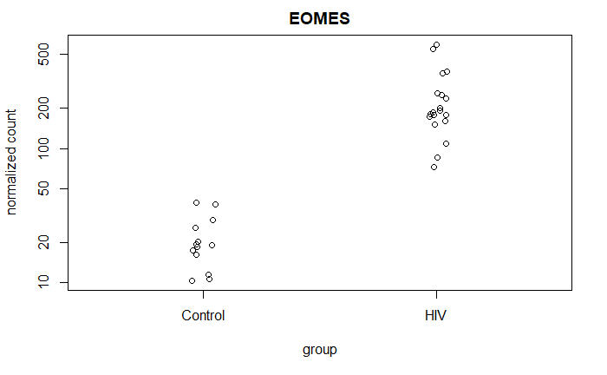
Differential Expression Analysis (DE)
HIV Infected Untreated vs. Health Control
Significantly differential expressed genes:
FDR (adjusted p value) cutoff 0.1, 6585 genes out of 19890 are significant.
FDR cutoff 0.05, 4730 genes out of 19890 are significant.
Example:
EOMES has the smallest adjusted p value.

Slide 13
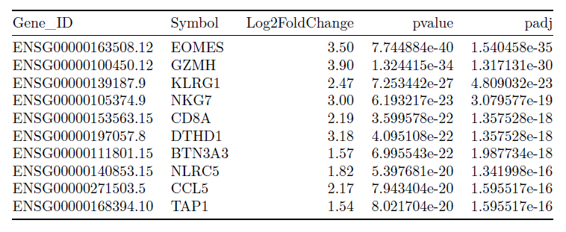
DE, Top 10 Genes out of 19890 genes

Slide 14
edgeR, TMM, Differential Expression Analysis

Slide 15
Normalization: TMM
More on normalization in RNA-seq data.
It’s crucial to remove sample-specific technical noise by normalization, while keeping biological signals.
Total RNA counts per sample vary across samples.
A small number of genes are very highly expressed in some samples, while the levels of most genes don’t change across samples.
TMM: a trimmed mean of M-values (TMM)
Taking above factors into account, by a sample-specific scaling factor and the total RNA counts per sample.

Slide 16
Differential Expression Analysis (DE)
HIV Infected Untreated vs. Health Control
Significantly differential expressed genes, more up-regulated:
FDR (adjusted p value) cutoff 0.05: 4246 genes out of 19890 are significant.
1706 down regulated, 2540 up regulated
FDR cutoff 0.05, log2 Fold Change cutoff 1: 837 genes out of 19890 are significant.
157 down regulated, 680 up regulated
FDR cutoff 0.05, log2 Fold Change cutoff 2: 104 genes out of 19890 are significant.
7 down regulated, 97 up regulated
Example: Top 10 genes normalized counts

Slide 17
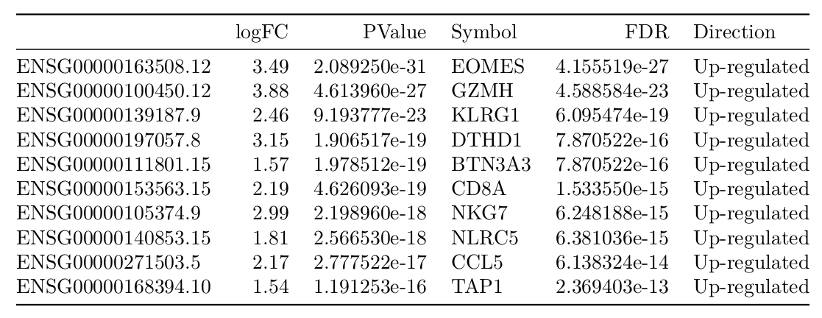
edgeR DE Analysis Top 10 genes

Slide 18
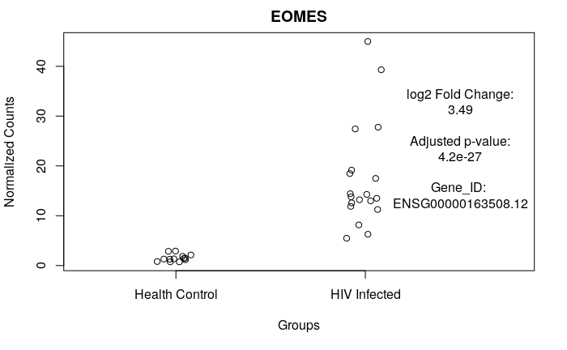
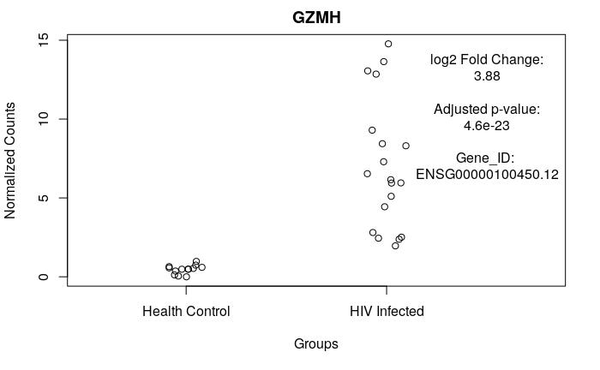
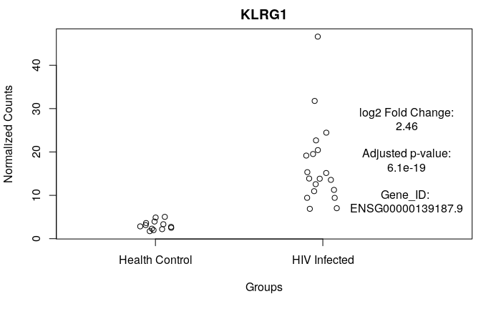
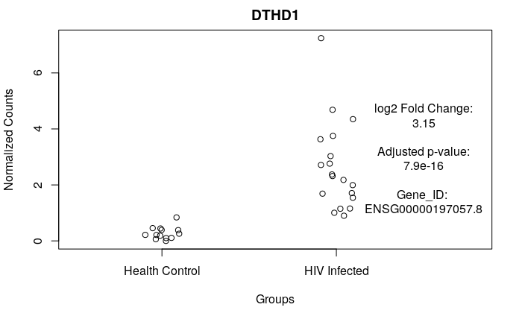
TMM normalized counts

Slide 19
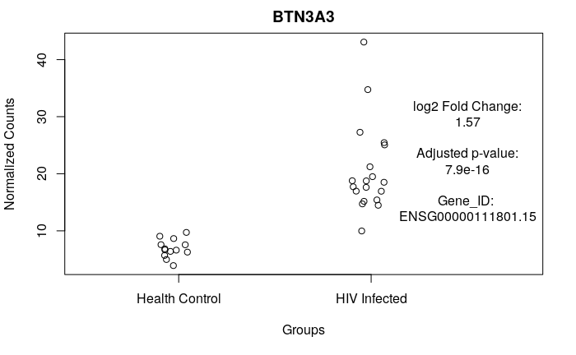
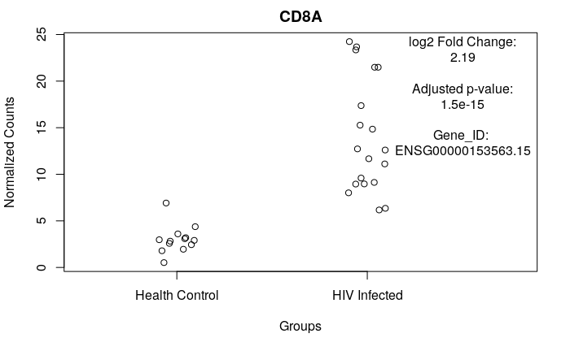

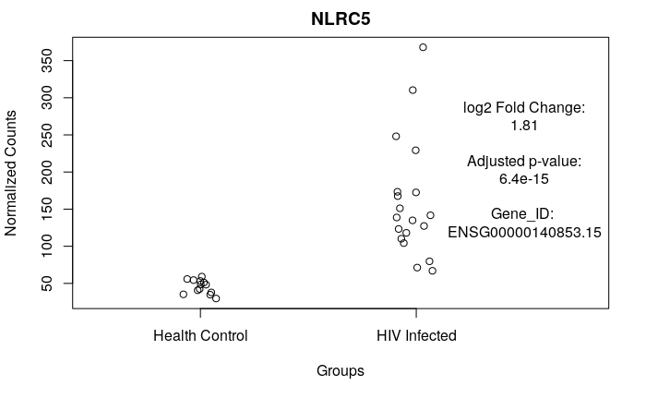
TMM normalized counts

Slide 20
DESeq2 DE and Gene Lists

Slide 21
Core ISGs, IFN-beta Genes and DE
With FDR cutoff 0.1,
All 230 genes in Core ISGs are significant.
All 423 genes in IFN-beta genes are significant.
For downstream
With FDR cutoff 0.05 by DESeq2
124 genes in ISGs.
137 genes in IFN-beta genes.

Slide 22
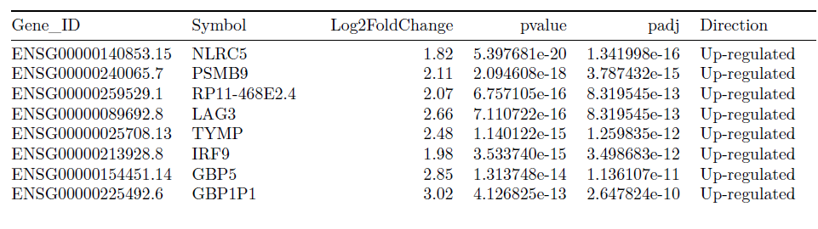
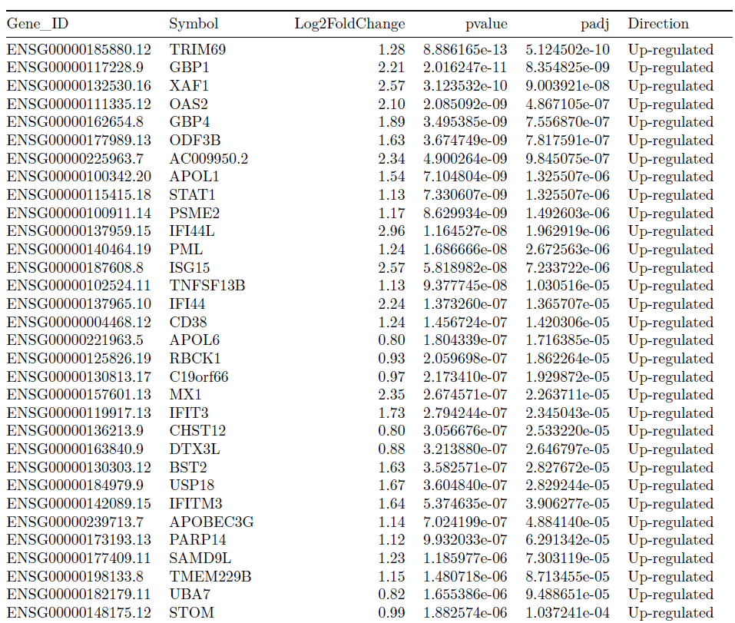
Top genes in Core ISGs by DE

Slide 23
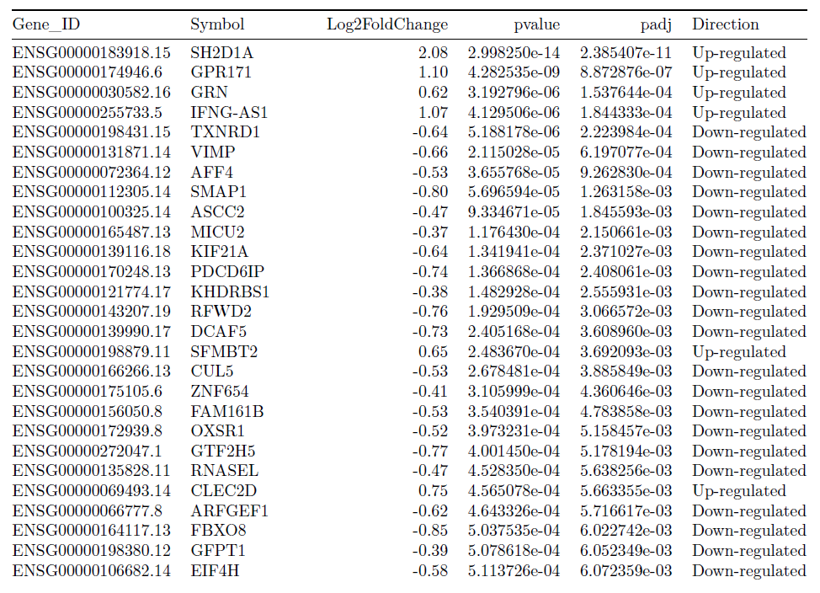
Top genes in IFN-beta list by DE

Slide 24
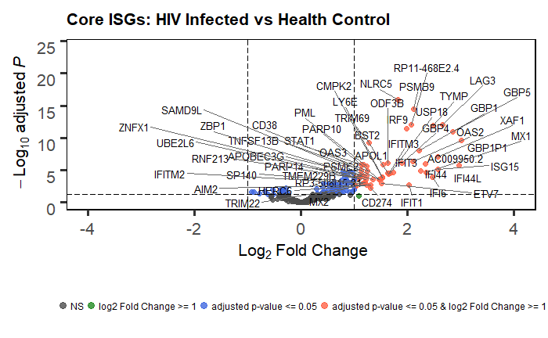
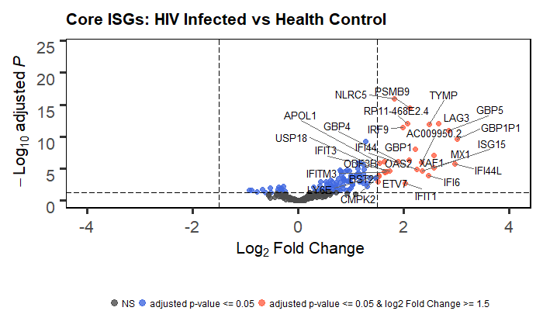
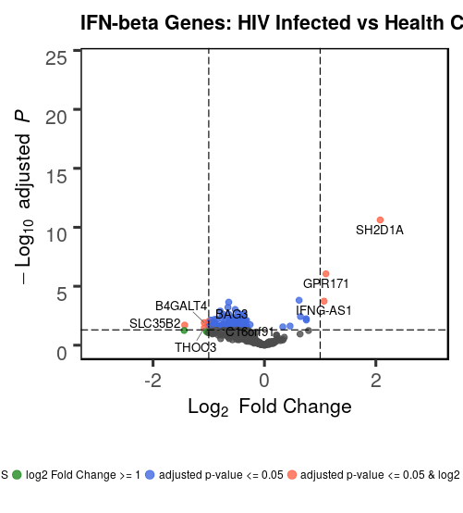
Volcano Plots by DE and gene lists
Core ISGs Trend:
up-regulation
and larger fold changes, overall.
IFN-beta Genes Trend:
Down-regulation

Slide 25
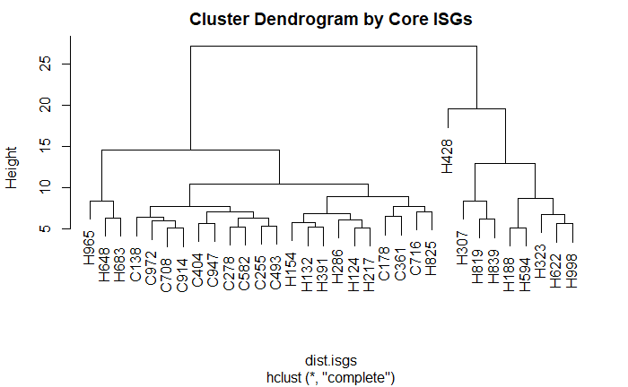
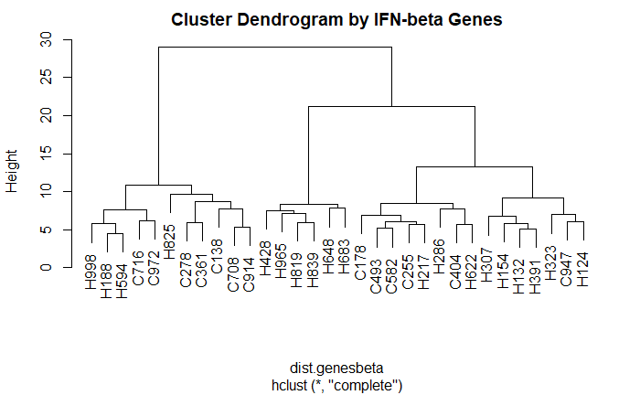
Core ISGs, IFN-beta Genes and DE: clustering

Slide 26
Association with the clinical outcomes

Slide 27
Regularized log transformation
Transformed normalized counts (gene by gene) ~ clinical outcome + age + gender
Transformed normalized counts
Regularized log transformation
Prepare RNA-seq genes counts ready for the test of associations with the clinical outcomes
QC plots
Multiple testing/comparison correction: BH controlling FDR.

Slide 28
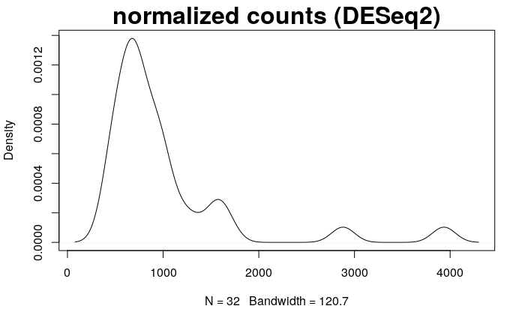
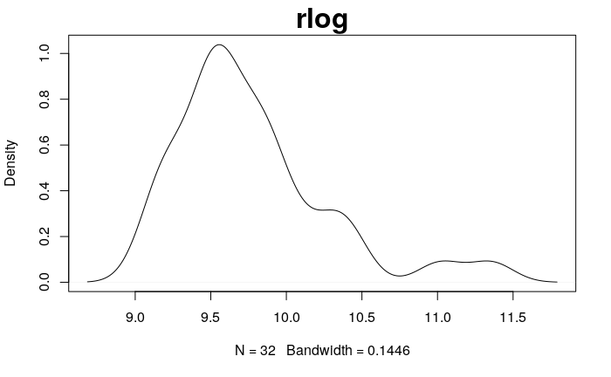
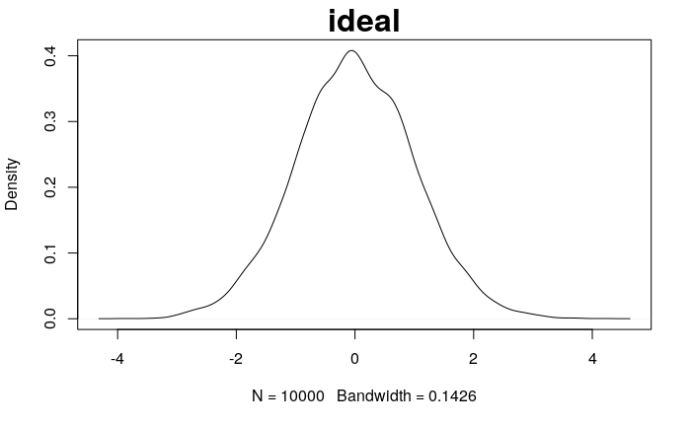
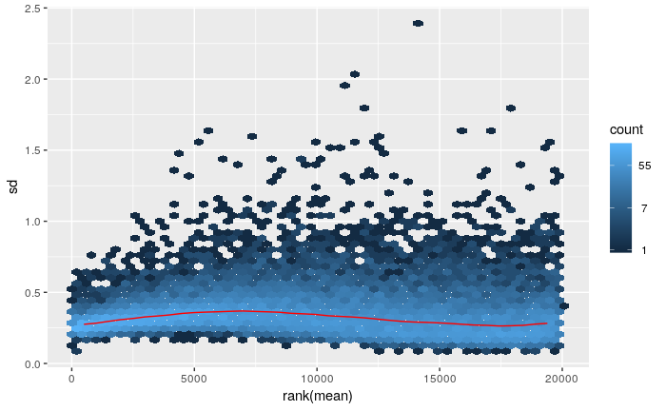
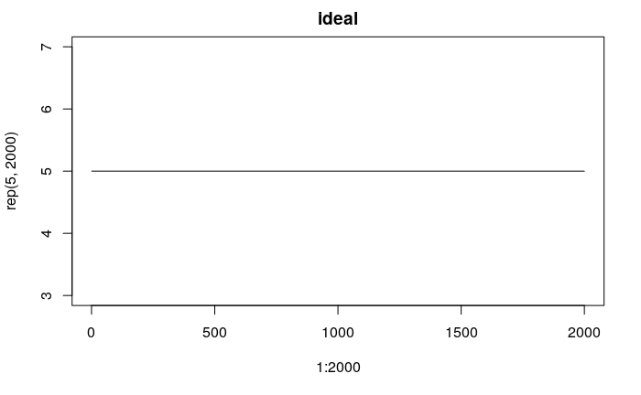
Regularized log Transformation QC

Slide 29
All genes in the lists for association test

Slide 30
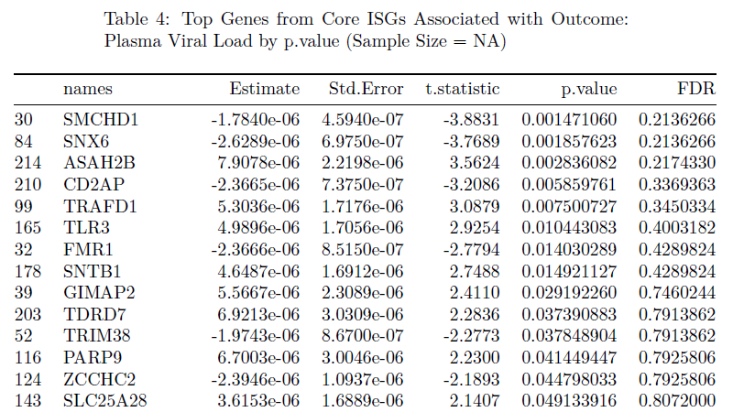
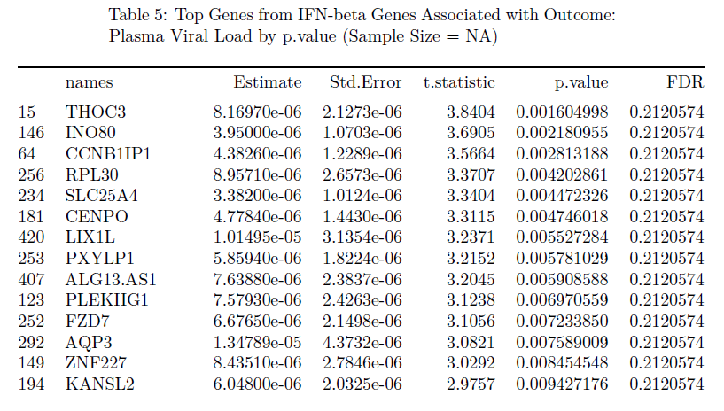
Core ISGs, IFN-beta Genes and Viral Load
Genes associated with plasma viral load, while adjusting for age and sex of participants.
Transformed normalized counts ~ plasma viral load + age + gender
Summary table of the coefficient and p-value of plasma viral load.

Slide 31
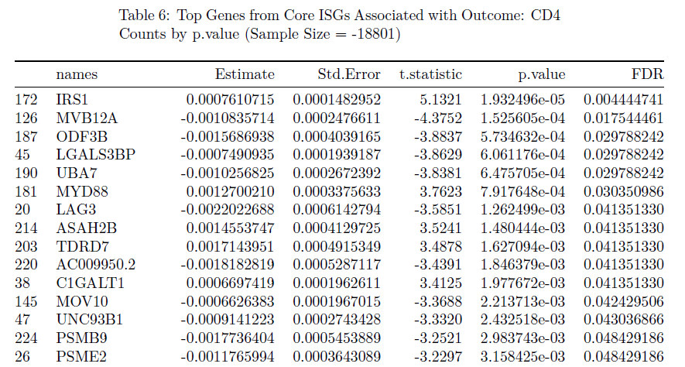
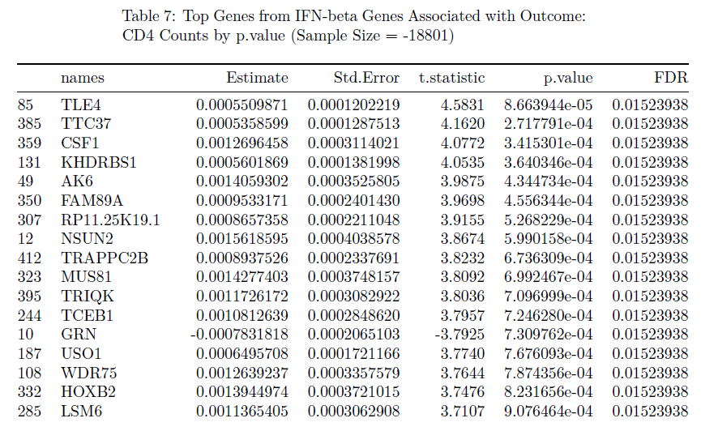
Core ISGs, IFN-beta Genes and CD4
Genes associated with CD4 counts, while adjusting for age and sex of participants.
Transformed normalized counts ~ CD4 counts + age + gender
Summary table of the coefficient and p-value of CD4 counts.

Slide 32
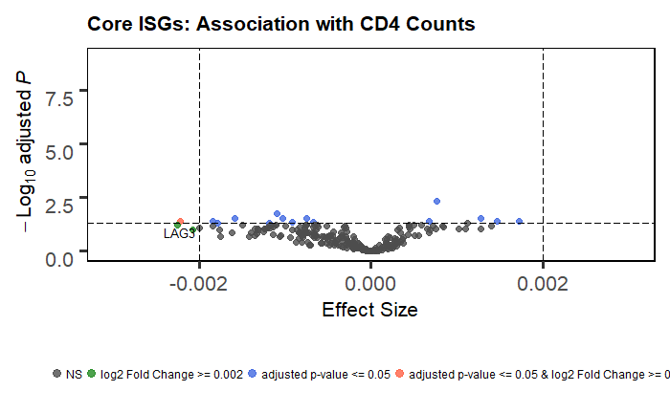
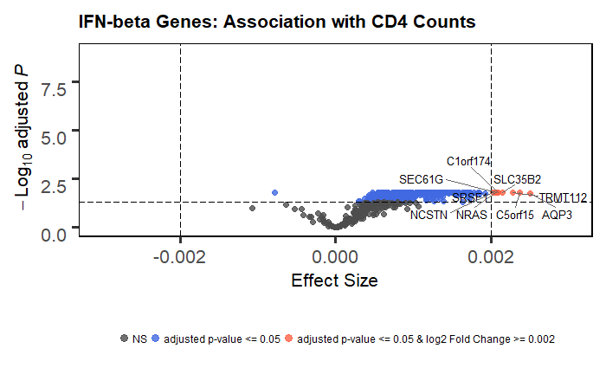
Differences between gene lists

Slide 33
edgeR, TMM, DE and Gene Lists

Slide 34
Core ISGs, IFN-beta Genes and DE
With FDR cutoff 0.05 by edgeR
117 genes out of 230 in ISGs.
130 genes out of 423 in IFN-beta genes.
Filtered and then test the association with outcomes
With FDR cutoff 0.05 and log2 Fold Change 1 by edgeR
52 genes out of 230 in ISGs.
8 genes out of 423 in IFN-beta genes.
Filtered and then test the association with outcomes

Slide 35
Filtered Predefined gene lists

Slide 36
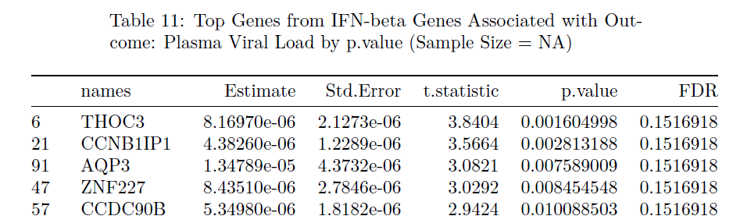
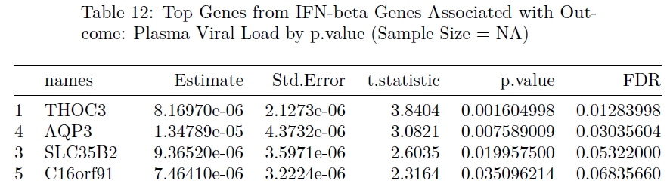
Core ISGs, IFN-beta Genes and Viral Load
8 genes out of 423 in IFN-beta genes.
130 genes out of 423 in IFN-beta genes.
Genes associated with plasma viral load, while adjusting for age and sex of participants.
Transformed normalized counts ~ plasma viral load + age + gender
Summary table of the coefficient and p-value of plasma viral load.

Slide 37
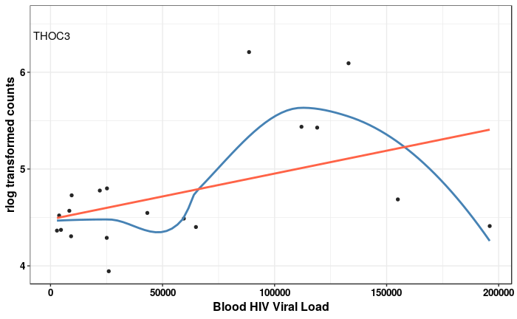
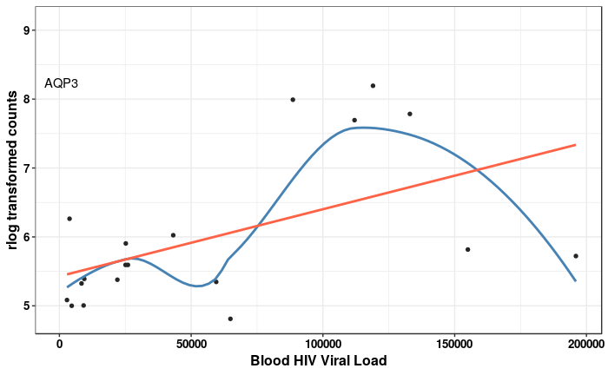
Blood HIV Viral Load and IFN-beta (0.05 and log2FC 1)

Slide 38
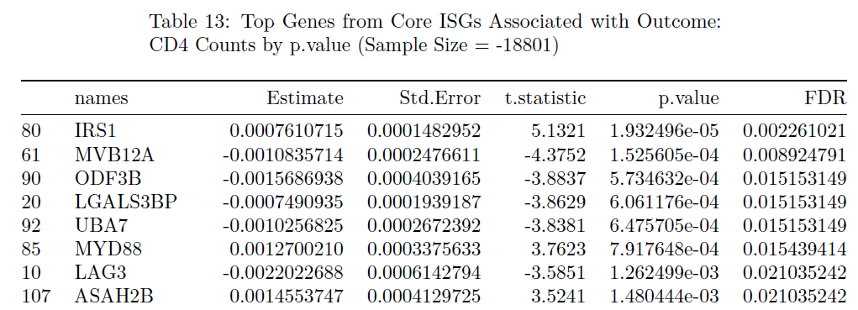
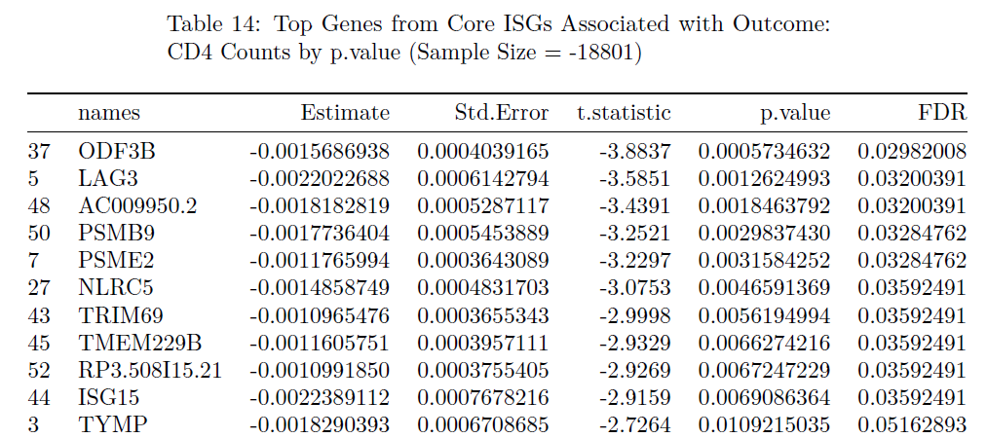
Core ISGs, IFN-beta Genes and CD4
117 genes out of 230 in ISGs.
52 genes out of 230 in ISGs.
Genes associated with CD4 counts, while adjusting for age and sex of participants.
Transformed normalized counts ~ CD4 counts + age + gender
Summary table of the coefficient and p-value of CD4 counts.

Slide 39
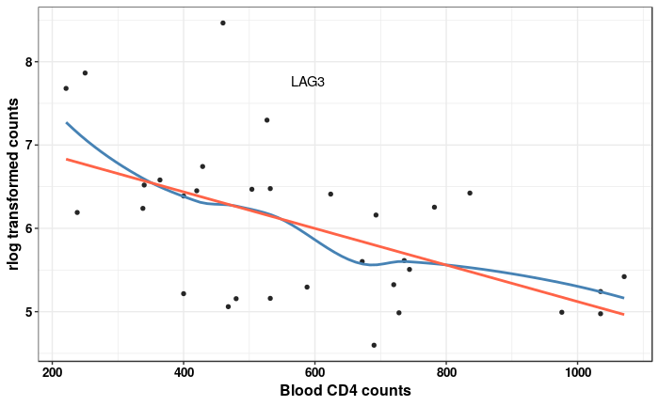
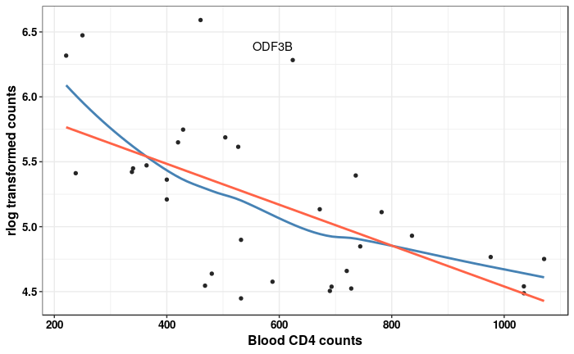
Blood CD4 counts and Core-ISGs (In both filtered lists)

Slide 40
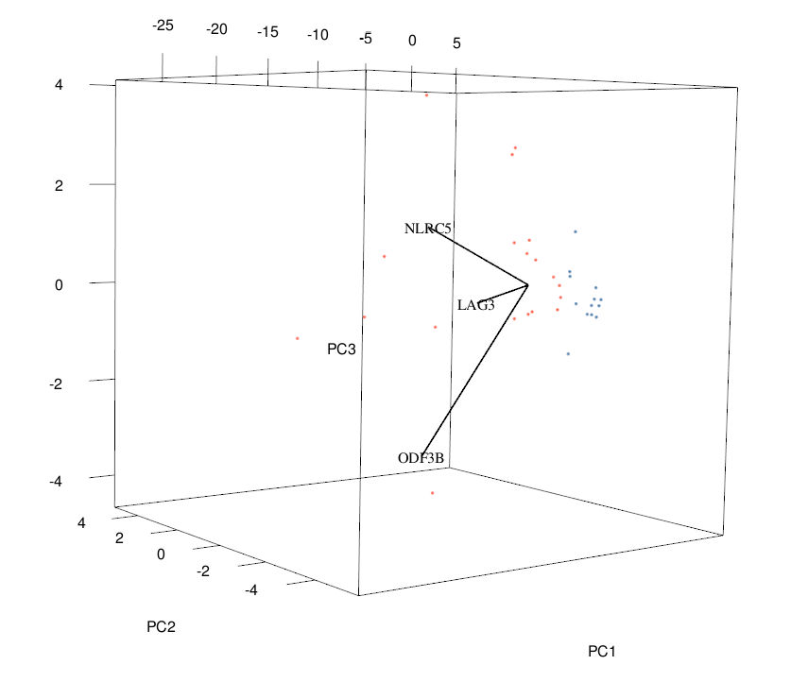
PCA clustering by ISGs (0.05, log2 FC 2 filtered),
52 genes out of 230 in ISGs.
The scales of those 3 vectors were multiplied by 20
Red dots: HIV Infected
Blue dots: Health Control

Slide 41
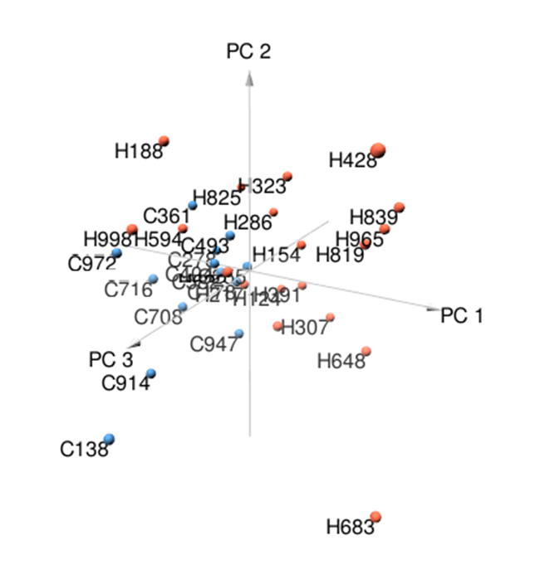
Questions and To-do
Are there batch effects among RNA-Seq samples?
This is to confirm if I used the right normalization method here.
How to filter/intersect predefined genes list? Subset of gene lists for downstream.
Some blood CD4 counts in HIV infected group are higher than health control?
Decide the clinical outcomes to be tested.
Participants’ ID, double check between dataset.
gif to show 3d PCA plots or just the snapshot?

Slide 42
References
1. Biomed Res Int.2015 Jun 15. doi: 10.1155/2015/621690, The Impact of Normalization Methods on RNA-Seq Data Analysis, J. Zyprych-Walczak, A. Szabelska, L. Handschuh, K. Górczak, K. Klamecka, M. Figlerowicz, and I. Siatkowski
2. A comparison of per sample global scaling and per gene normalization methods for differential expression analysis of RNA-seq data, PLos One. 2017.
3. Voom: precision weights unlock linear model analysis tools for RNA-seq read counts, Charity W Law, Yunshun Chen, Wei Shi and Gordon K Smyth, Genome Biology, 2014 15:R29.
4. Michael I Love, Wolfgang Huber, Simon Anders: Moderated estimation of fold change and dispersion for RNA-seq data with DESeq2. Genome Biology 2014, 15:550.
5. Controlling the False Discovery Rate: A Practical and Powerful Approach to Multiple Testing, Yoav Benjamini and Yosef Hochberg, Journal of the Royal Statistical Society. Series B (Methodological), Vol. 57, No. 1 (1995), pp. 289-300

