Slide 1
Cario Project: V genes and Mutations
Guannan Shen
3/19/2019

Slide 2
Questions
V genes RNAseq expression = X + age + gender
X can be clinical parameters: CD4 T cells (% viable), or microbiome relative abundance, such as Prevotellaceae at family level
Microbiome relative abundance, targeted approach:
phylum
"Actinobacteria" "Bacteroidetes" "Cyanobacteria" "Firmicutes"
"Fusobacteria" "Proteobacteria" "Spirochaetes" "Tenericutes"
"Verrucomicrobia
One by one
Stratified by HIV status
Test the correlation between the outcome and X
#. Single mutations (per unique seq) = X + age + gender

Slide 3
Data
Remapped RNAseq data (counts table) with relaxed Hi-SAT2 threshold
This is to have more V genes in the RNAseq counts table.
V genes list, heavy chain, light chain K and light chain Lambda
IgA, IgK, IgLambda, #. single mutations per unique sequence
Clinical parameters
Microbiome relative abundance, Phylum, family, genus and species levels.

Slide 4
Methods
To use the RNAseq counts as the outcome, rlog transformation was used to stabilize the variance.
#. single mutations per unique sequence is also continuous.
multiple linear regression
I have tried different cutoffs for the filtering of the RNAseq counts.
Each gene must have at least 3 read counts per sample on average (sum of counts across all sample divided by the number of sample >= 3)
Guarantee the rlog transformed counts > 0.

Slide 5
Results: V genes expression level & #. Single mutations (per unique seq)

Slide 6
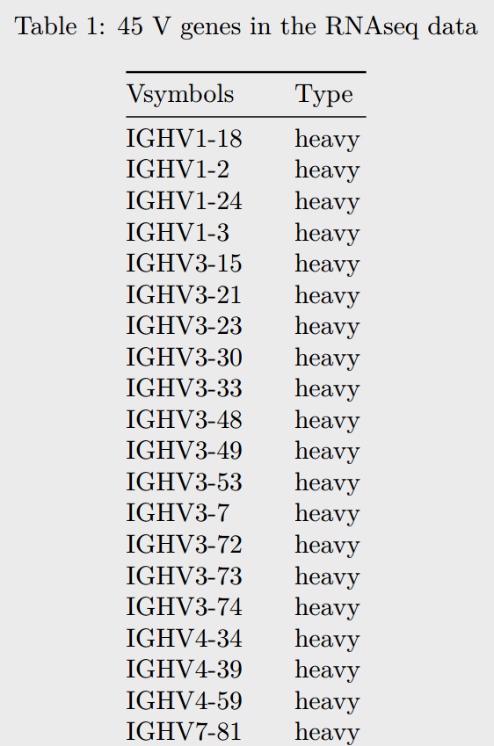
V genes in the RNAseq data

Slide 7
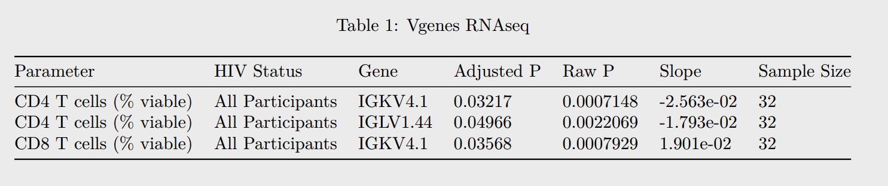

Slide 8
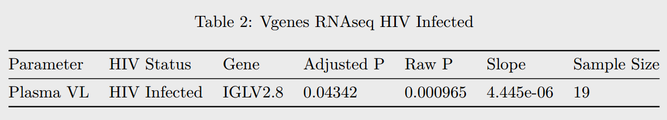

Slide 9
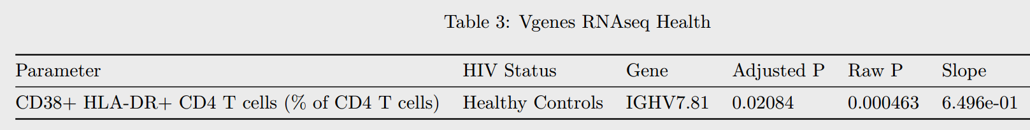

Slide 10
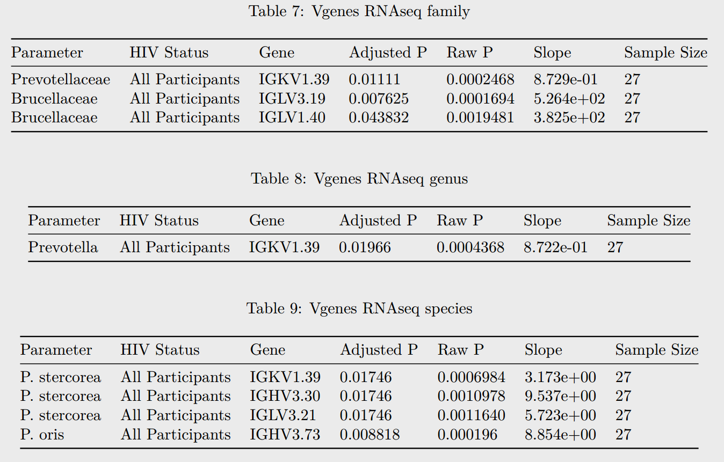

Slide 11
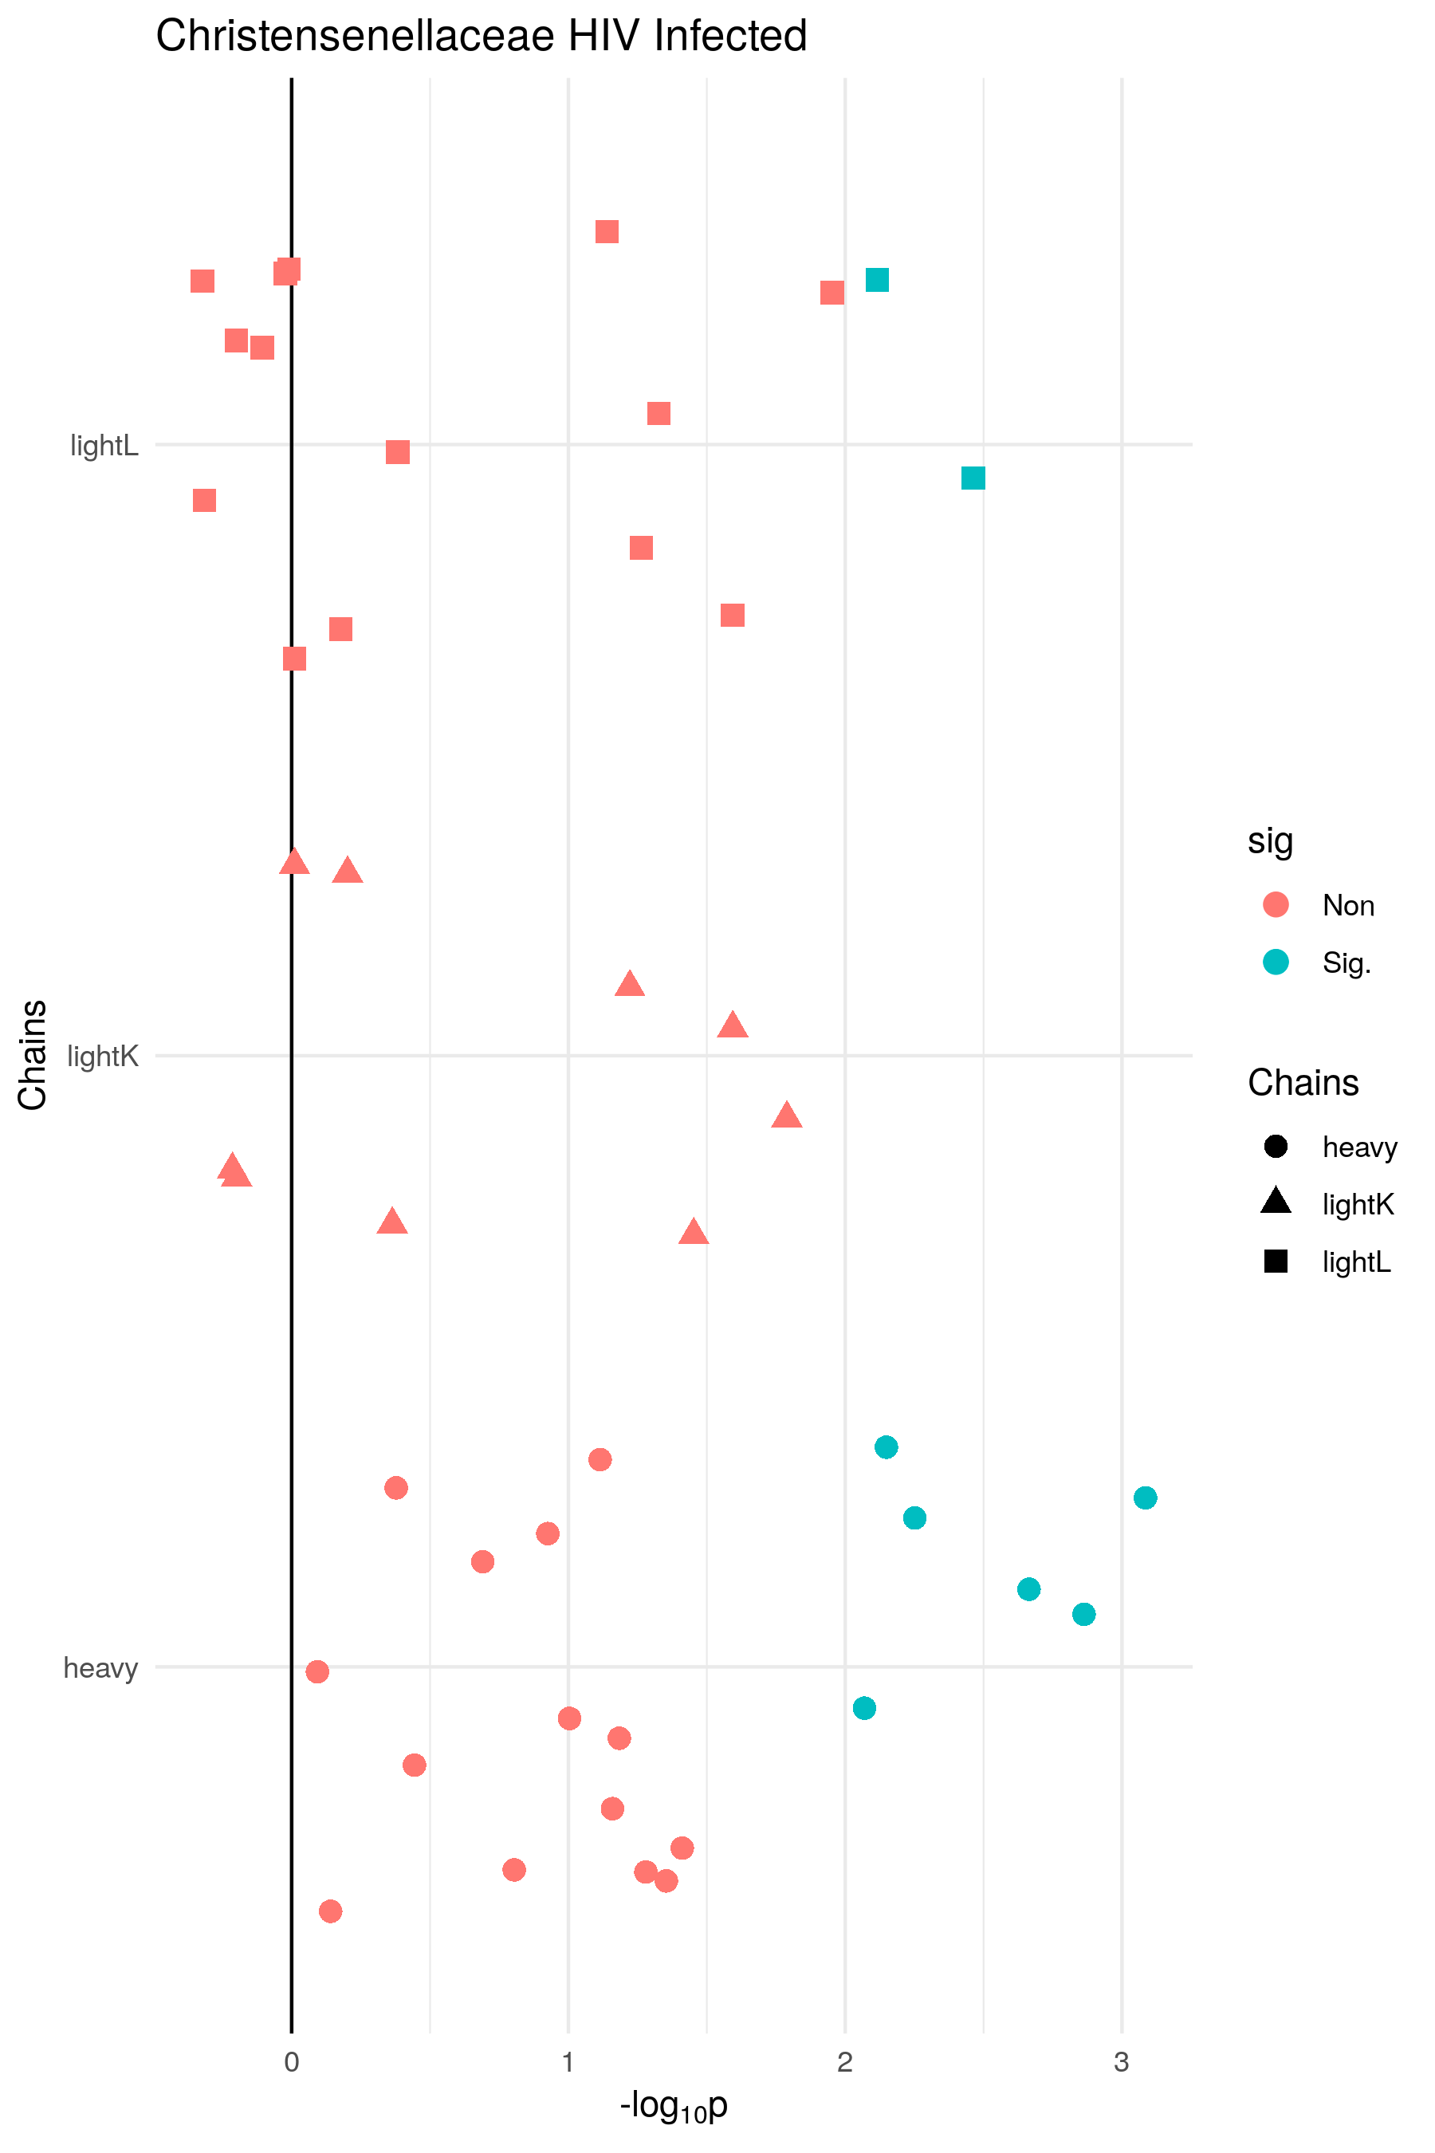
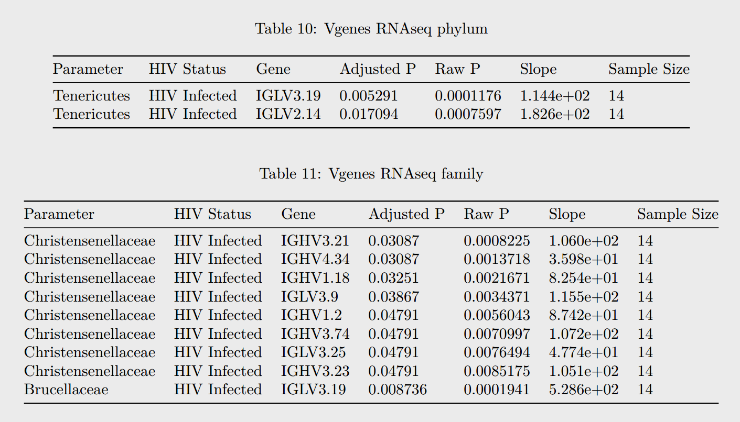

Slide 12
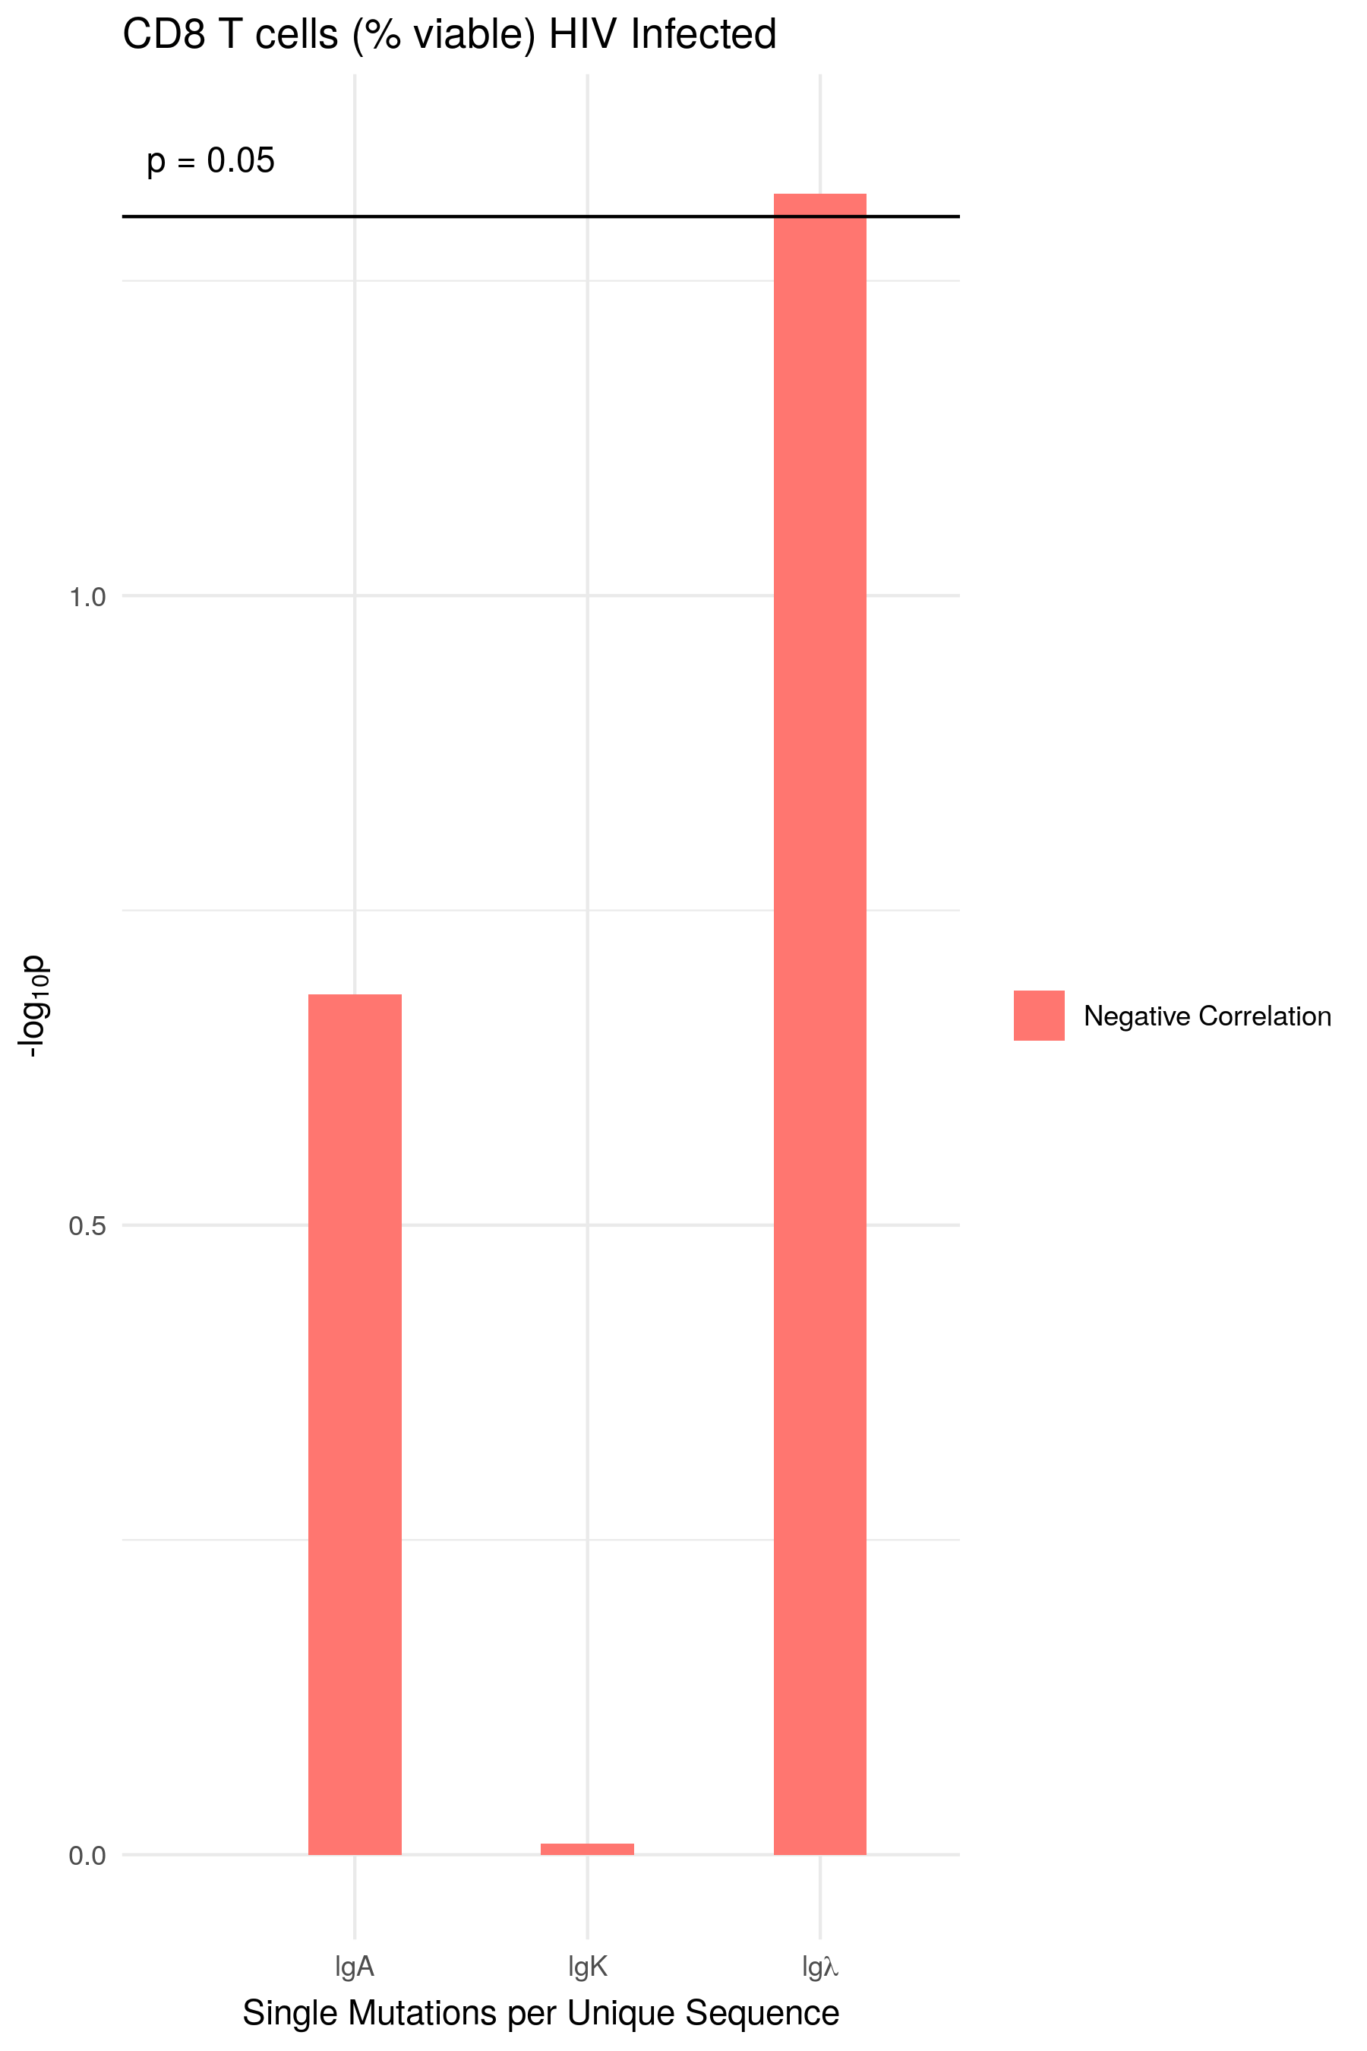
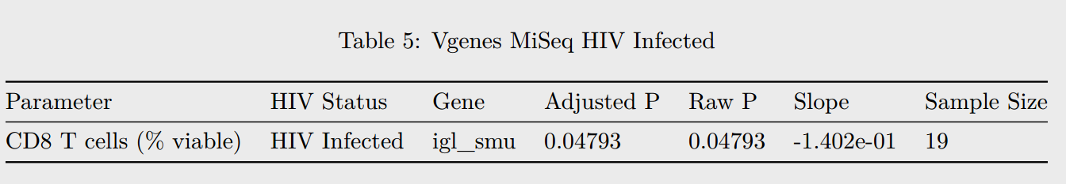
Single Mutations

Slide 13
