Slide 1
Cario Project: Core ISGs and IFN-beta Genes
By RNA-Seq Data
Guannan Shen
1/8/2019

Slide 2
Outline
Questions of Interest (QOI)
RNASeq Data and Clinical Data
Normalization of RNASeq Data
Differential Expression Analysis (DE): HIV Infected Untreated vs. Health Control
Core ISGs, IFN-beta Genes and DE
Core ISGs, IFN-beta Genes and Clinical Outcomes, differences between gene lists
References

Slide 3
QOI: 3 main questions
How Genes in the gene lists (Core ISGs and IFN-beta genes) are significantly altered in gut biopsies (HIV Infected vs. Health Control), and what are the directions of the regulations?
How are the altered genes associated with clinical outcomes such as plasma viral load, CD4 counts, inflammation, while adjusting for age and sex of participants?
Show some PCA plots with the effects of key genes.
Are the scopes of the associations different between Core ISGs and IFN-beta genes?

Slide 4
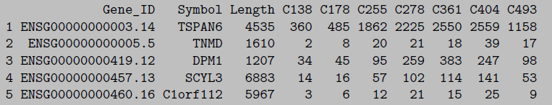
RNA-Seq Data: HIV Infected vs. Health Control
HIV infected sample: 19 subjects.
H124 H132 H154 H188 H217 H286 H307 H323 H391 H428 H594 H622 H648 H683 H819 H825 H839 H965 H998
Health control: 13 subjects.
C138 C178 C255 C278 C361 C404 C493 C582 C708 C716 C914 C947 C972.
43297 genes in the raw data.
Annotated with gene symbol.
Gut mucosal sample
19890 genes left with filtering criteria: each gene must have at least 5 counts per sample, on average.

Slide 5
Clinical Data
Age, Gender, Plasma Viral load, CD4 Counts …
IL-6 (pg/ml), CRP(ug/ml), iFABP (pg/ml), sCD27 (U/ml), CD14 (ng/ml) …

Slide 6
Gene lists
ISGs list (Interferon stimulated genes)
230 genes stimulated by interferon alpha/beta. This gene list was summarized from the result of in vitro studies, the preliminary study.
IFN-beta specific genes
423 genes that were induced specifically by IFN-beta, but not the IFN-alpha subtypes tested.

Slide 7
Normalization of RNA-Seq Data
The data normalization is one of the most crucial steps of data processing and the choice of normalization procedure affects the results of DE (Differential Expression) analysis¹.
The top commonly used methods are DESeq (median-of-ratios) and TMM (Trimmed Mean of M values)-edgeR. DESeq and TMM-edgeR were reported to have overall better performance, based on the false positive rate and detection power.
Here I compared 3 normalization methods: DESeq2, TMM and TPM, based on quality control (QC) plots

Slide 8
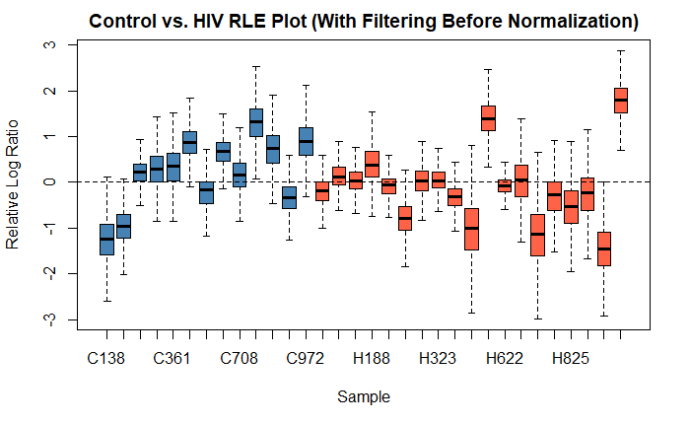
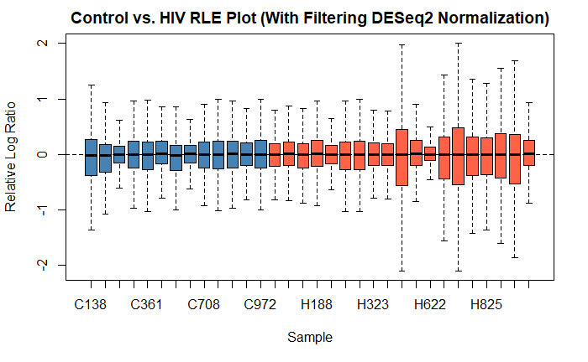
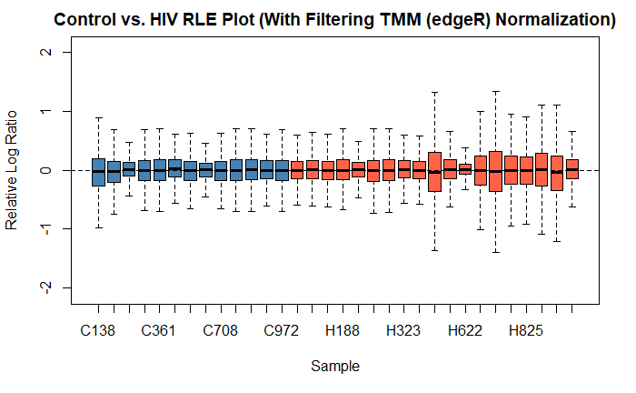
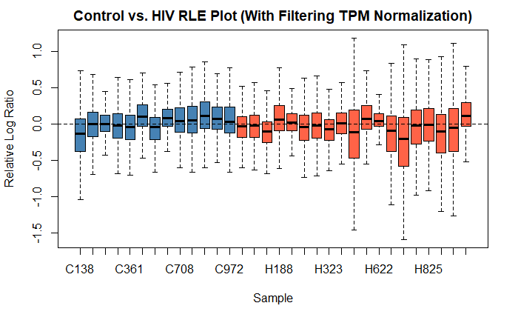
RLE Plots
boxplots of the log-ratios of the gene-level read counts of each sample to the median across the samples.
We want the median of each sample close to 0 and equal spread across samples.

Slide 9
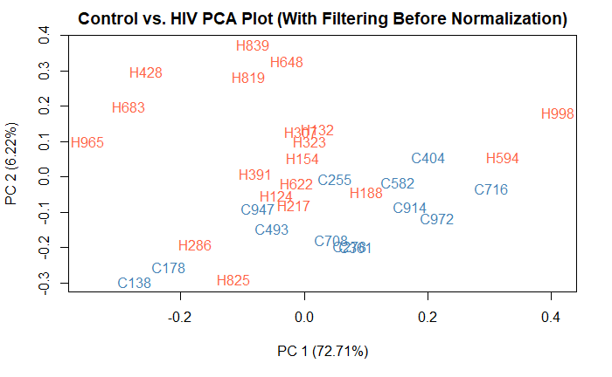
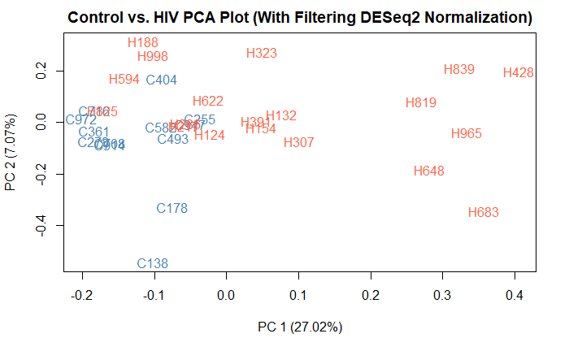
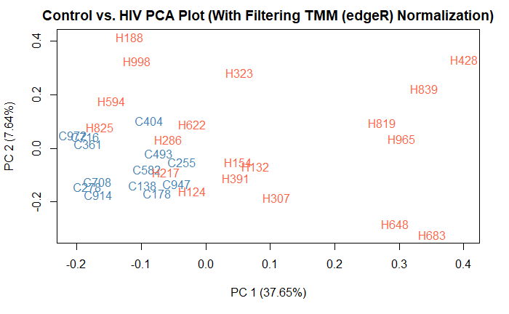
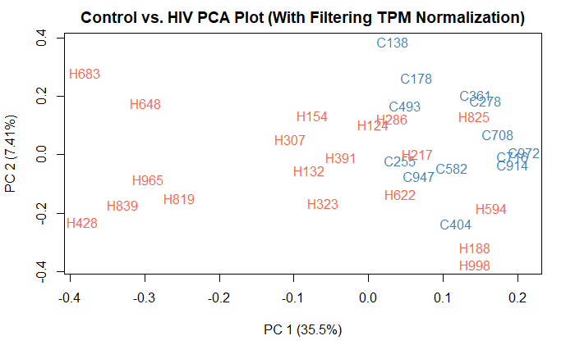
PCA plots

Slide 10
Normalization: DESeq2
The performance of DESeq2 and TMM (edgeR) are close.
DESeq2
Interpretation of size factor normalization (DESeq2)​
Median ratio method to estimate size factors for each sample.
Then just dividing the raw counts by the size factor for each sample to get the normalized counts.
Test for differential expression
By fitting normalized counts with negative binomial generalized linear models.
Then performing the negative binomial Wald tests to get p-values.
Finally, using the Benjamini & Hochberg correction (FDR) to get the adjusted p-values (multiple comparison)⁴. And p.adj can be 0.05 or 0.1.

Slide 11
Normalization: TMM
More on normalization in RNA-seq data.
It’s crucial to remove sample-specific technical noise by normalization, while keeping biological signals.
Total RNA counts per sample vary across samples.
A small number of genes are very highly expressed in some samples, while the levels of most genes don’t change across samples.
TMM: a trimmed mean of M-values (TMM)
Taking above factors into account, by a sample-specific scaling factor and the total RNA counts per sample.

Slide 12
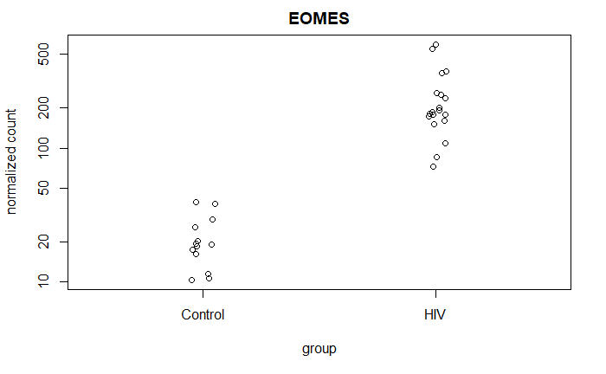
Differential Expression Analysis (DE)
HIV Infected Untreated vs. Health Control
Significantly differential expressed genes:
FDR (adjusted p value) cutoff 0.1, 6585 genes out of 19890 are significant.
FDR cutoff 0.05, 4730 genes out of 19890 are significant.
Example:
EOMES has the smallest adjusted p.

Slide 13
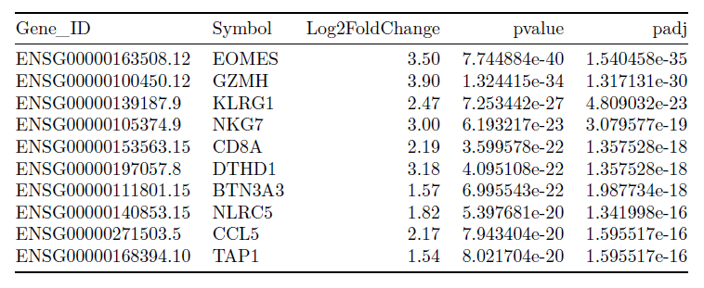
DE, Top 10 Genes out of 19890 genes

Slide 14
Core ISGs, IFN-beta Genes and DE
With FDR cutoff 0.1,
All 230 genes in Core ISGs are significant.
All 423 genes in IFN-beta genes are significant.
With cutoff 0.05
124 genes in ISGs.
137 genes in IFN-beta genes.

Slide 15
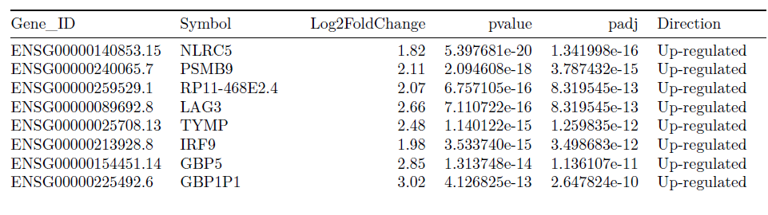
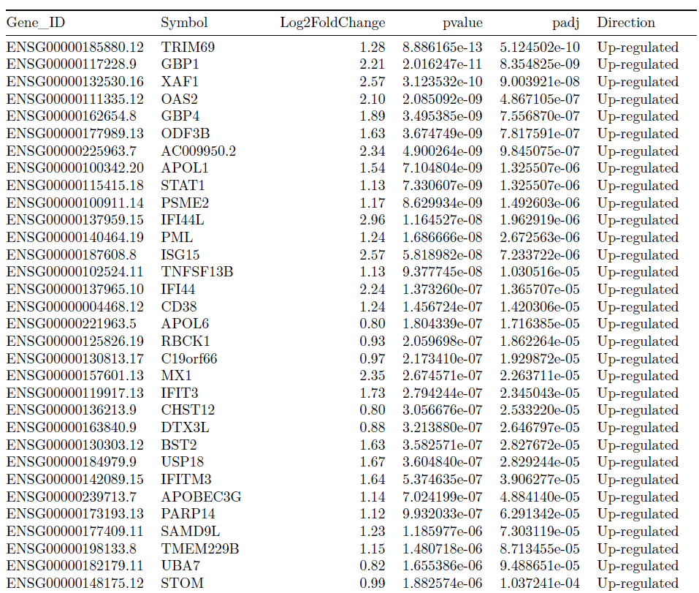
Top genes in Core ISGs by DE

Slide 16
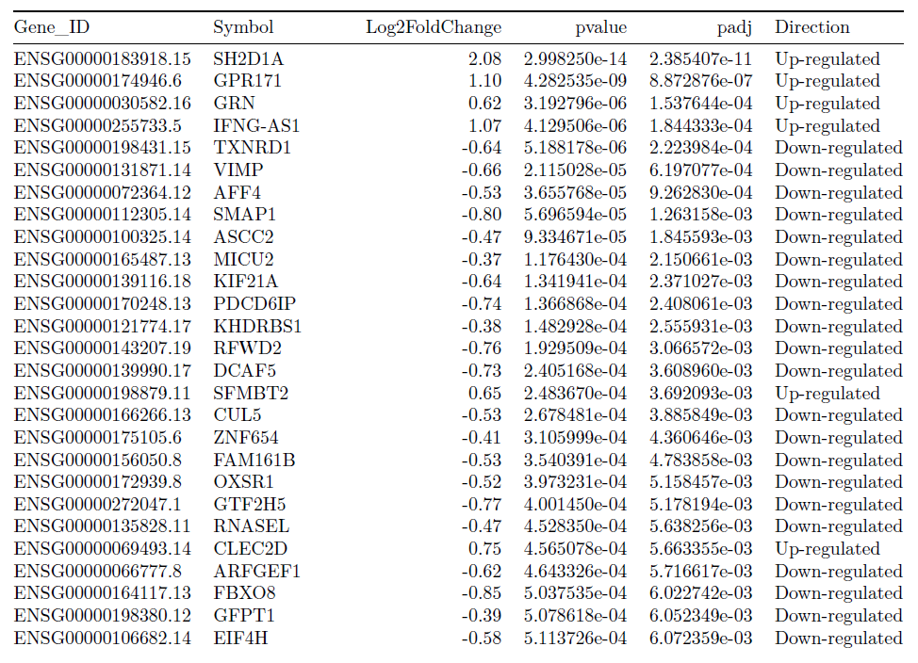
Top genes in IFN-beta list by DE

Slide 17
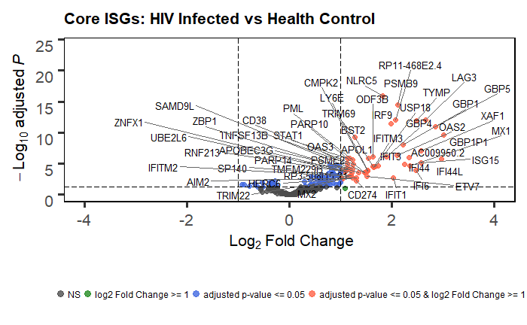
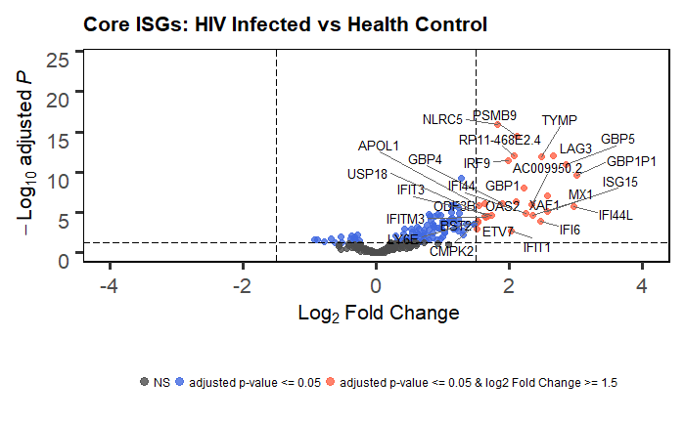
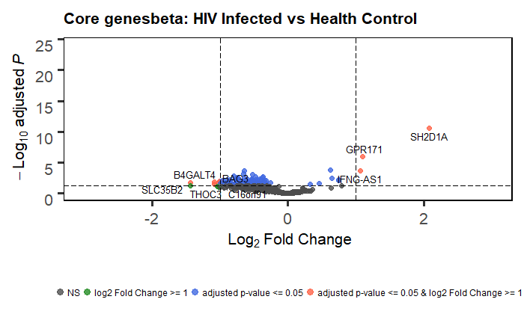
Volcano Plots by DE and gene lists
From here, I just used all Core ISGs list and IFN-beta genes for downstream analysis, since all genes are FDR <= 0.1
Results are also available for subsets of gene lists by FDR 0.05.

Slide 18
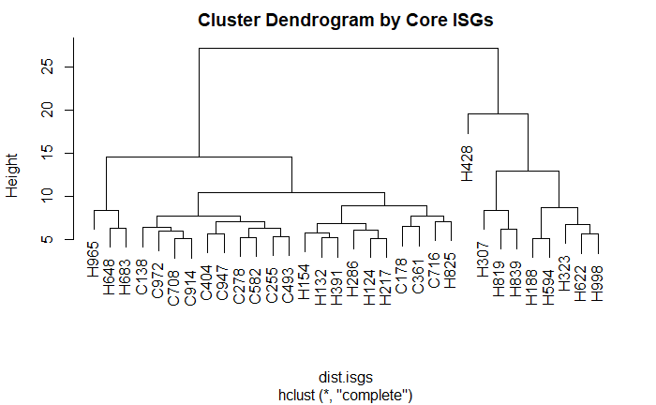
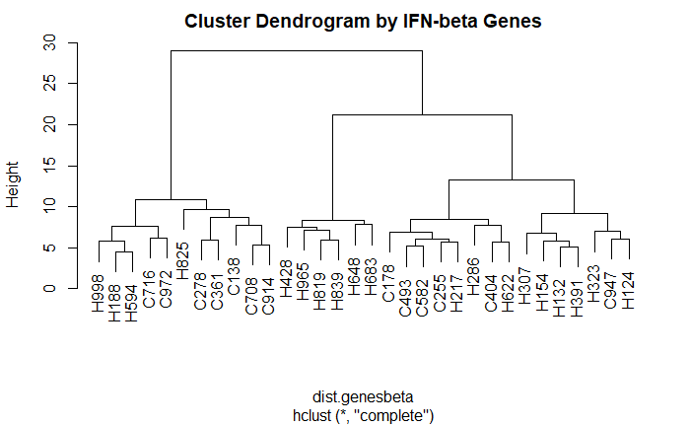
Core ISGs, IFN-beta Genes and DE: clustering

Slide 19
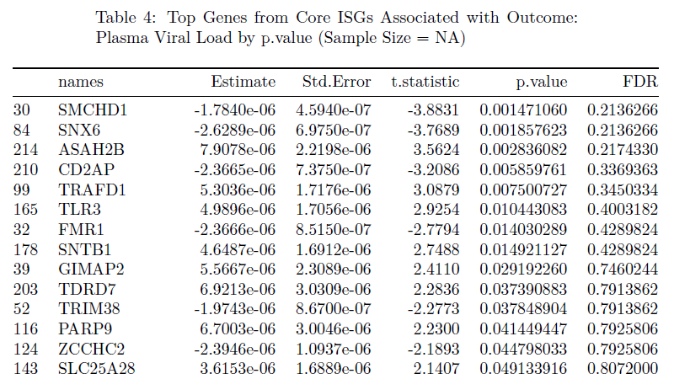
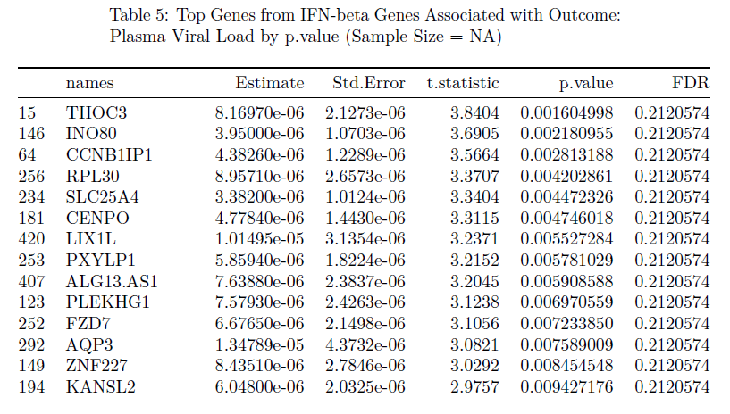
Core ISGs, IFN-beta Genes and Viral Load
Genes associated with plasma viral load, while adjusting for age and sex of participants.
Transformed of normalized counts ~ plasma viral load + age + gender
Summary table of the coefficient and p-value of plasma viral load.

Slide 20
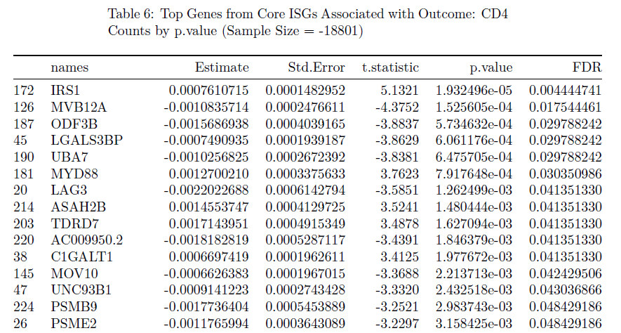
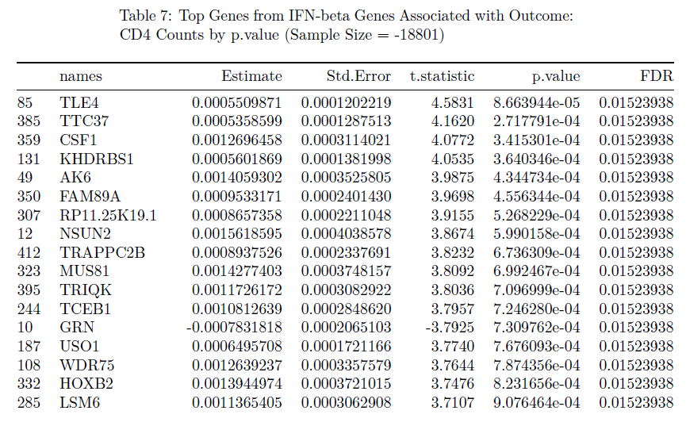
Core ISGs, IFN-beta Genes and CD4
Genes associated with CD4 counts, while adjusting for age and sex of participants.
Transformed of normalized counts ~ CD4 counts + age + gender
Summary table of the coefficient and p-value of CD4 counts.

Slide 21
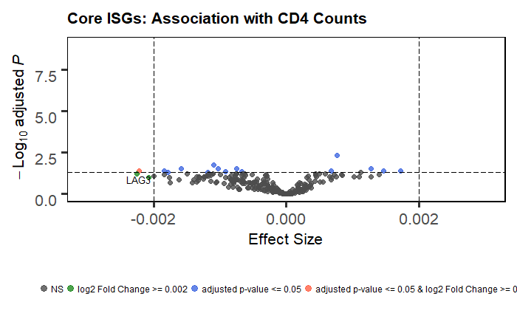
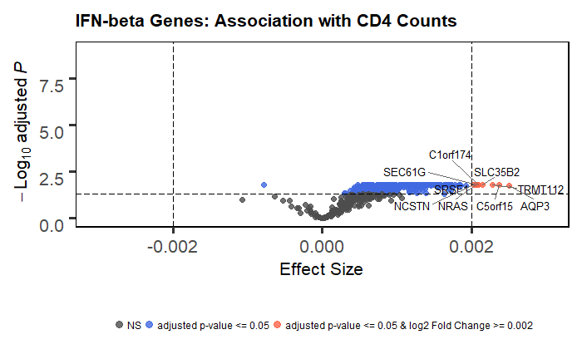
Differences between gene lists

Slide 22
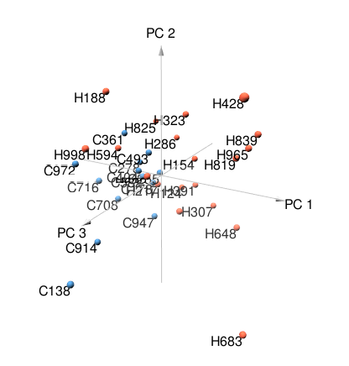
To do
3d PCA plots with key genes.
2d PCA plot does not have a very clear separation.
Key genes to show in the 3d PCA plots.
Key genes defined by the rank of the association with CD4 counts?
.gif to show 3d PCA plots or just the snapshot?
Association with other clinical outcomes?

Slide 23
References
1. Biomed Res Int.2015 Jun 15. doi: 10.1155/2015/621690, The Impact of Normalization Methods on RNA-Seq Data Analysis, J. Zyprych-Walczak, A. Szabelska, L. Handschuh, K. Górczak, K. Klamecka, M. Figlerowicz, and I. Siatkowski
2. A comparison of per sample global scaling and per gene normalization methods for differential expression analysis of RNA-seq data, PLos One. 2017.
3. Voom: precision weights unlock linear model analysis tools for RNA-seq read counts, Charity W Law, Yunshun Chen, Wei Shi and Gordon K Smyth, Genome Biology, 2014 15:R29.
4. Michael I Love, Wolfgang Huber, Simon Anders: Moderated estimation of fold change and dispersion for RNA-seq data with DESeq2. Genome Biology 2014, 15:550.
5. Controlling the False Discovery Rate: A Practical and Powerful Approach to Multiple Testing, Yoav Benjamini and Yosef Hochberg, Journal of the Royal Statistical Society. Series B (Methodological), Vol. 57, No. 1 (1995), pp. 289-300

Slide 24
Questions?
Are there batch effects among RNA-Seq samples?
FDR 0.1 or 0.05? Subset of gene lists for downstream?
CD4 counts in some HIV gut biopsies are higher than health control?

