Slide 1
PFOA Concentration and CpG Correlation Plots
Guannan Shen
1-24-2019

Slide 2
Volcano Plots

Slide 3
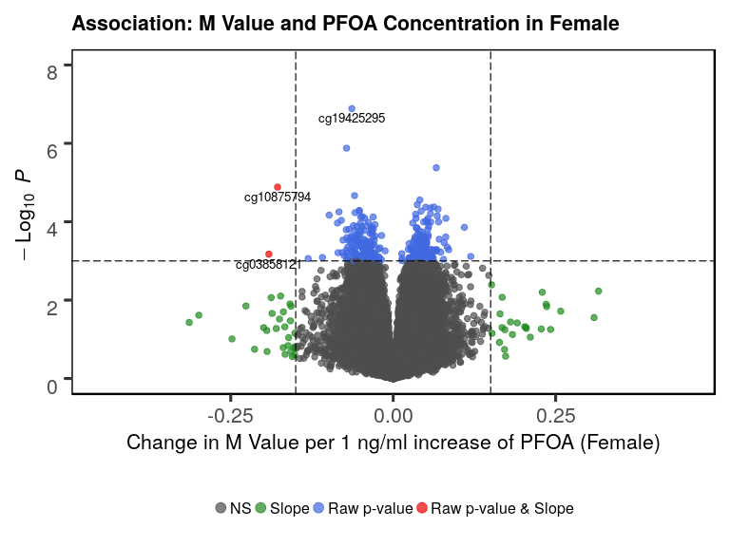
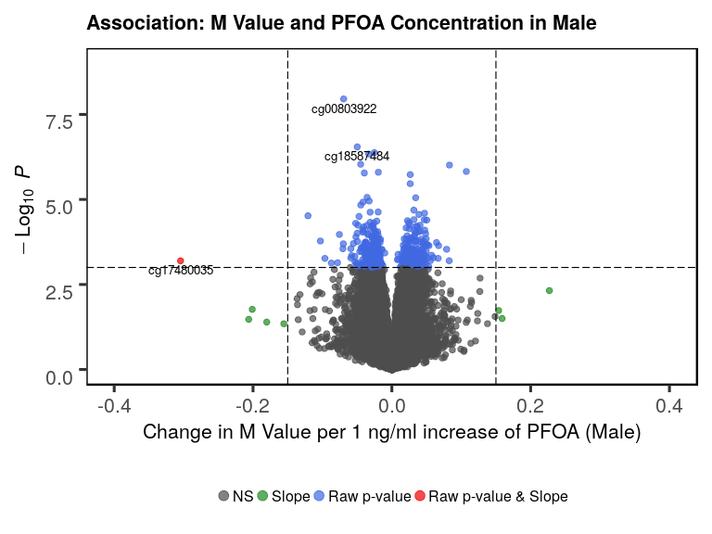
M values

Slide 4
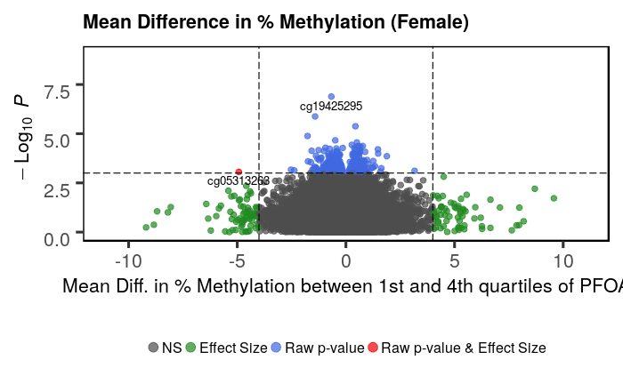
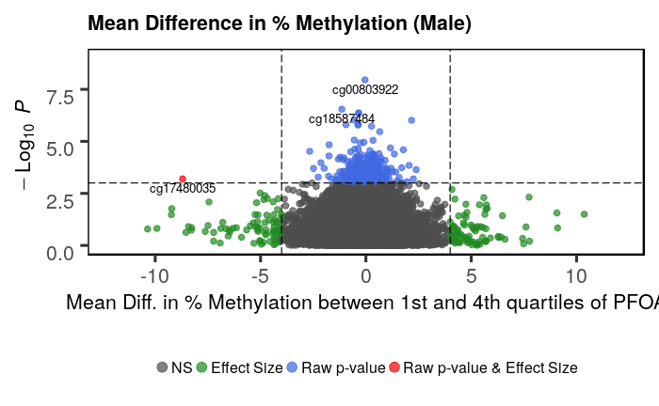
%Methylation, Mean Diff in Beta value between 1st and 4th quartiles of PFOA concentration

Slide 5
Scatter Plots Female

Slide 6
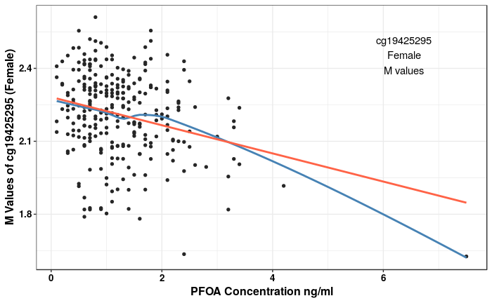
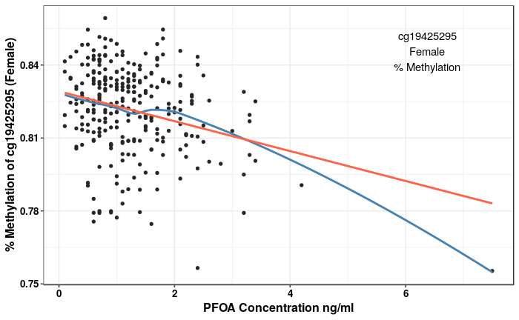
cg19425295 (top1 pvalue Female) Most significantly correlated with PFOA

Slide 7
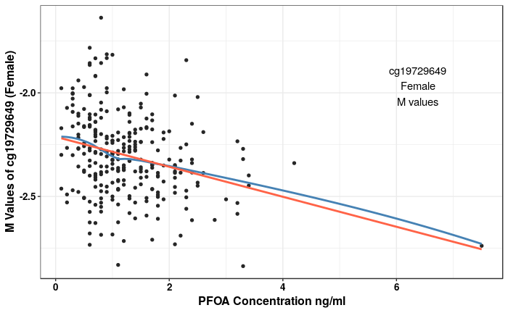
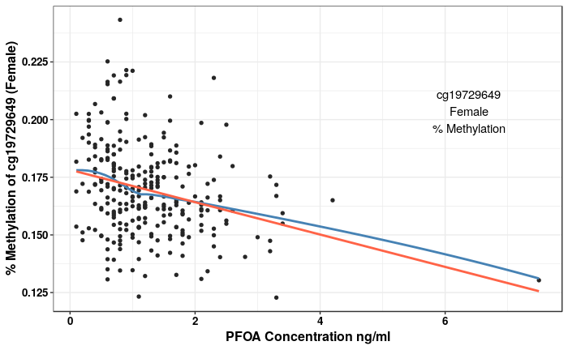
cg19729649 (2nd pvalue Female)

Slide 8
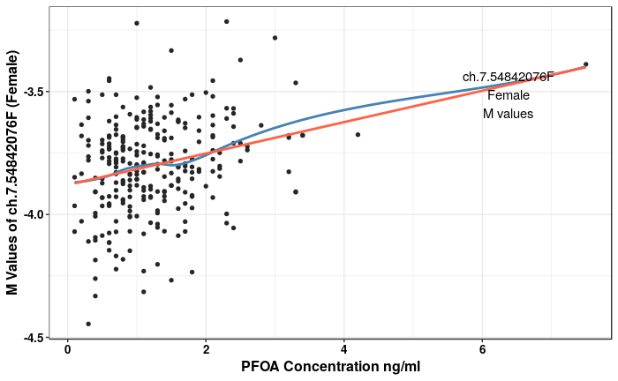
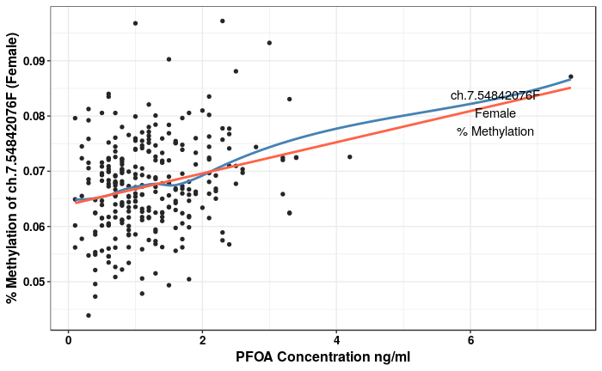
ch.7.54842076F (3rd pvalue Female)

Slide 9
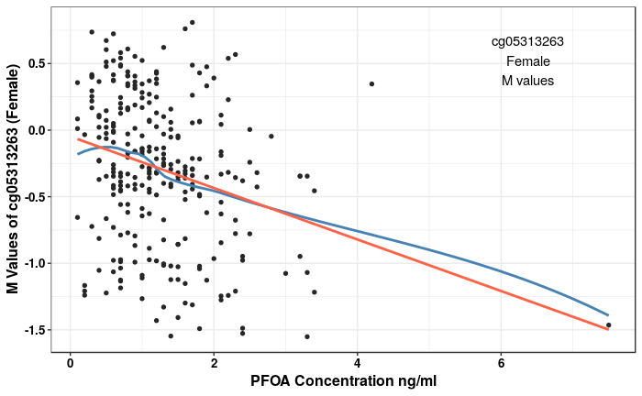
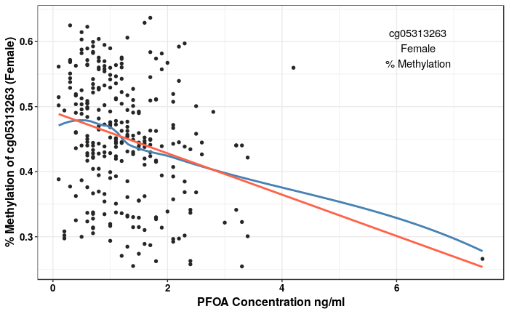
cg05313263 (top1 beta value change Female)

Slide 10
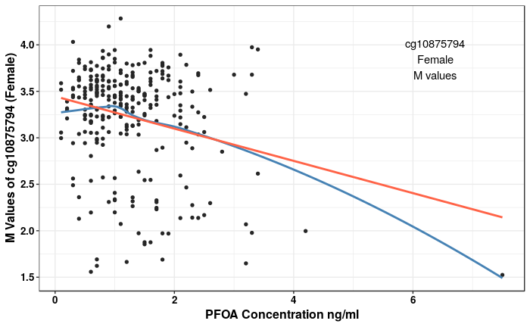
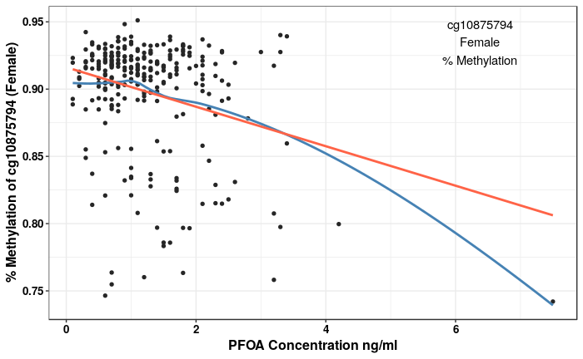
"cg10875794" (Largest Slope Female)

Slide 11
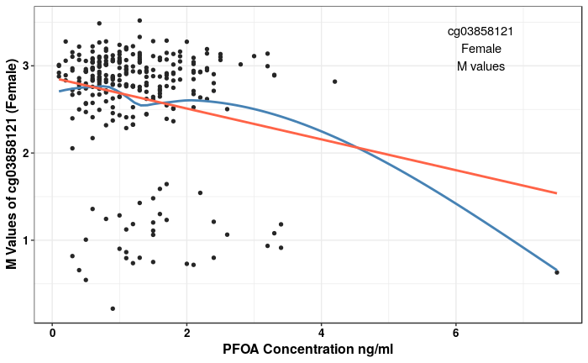
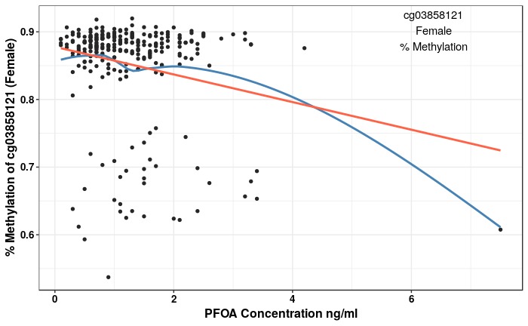
"cg03858121" (Large Slope Female)

Slide 12
Scatter Plots Male

Slide 13
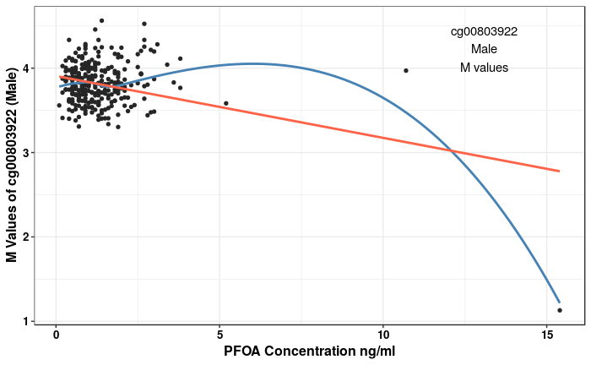
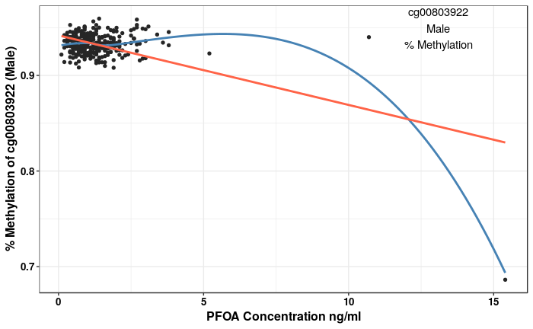
cg00803922 (top1 pvalue Male) Most significantly correlated with PFOA

Slide 14
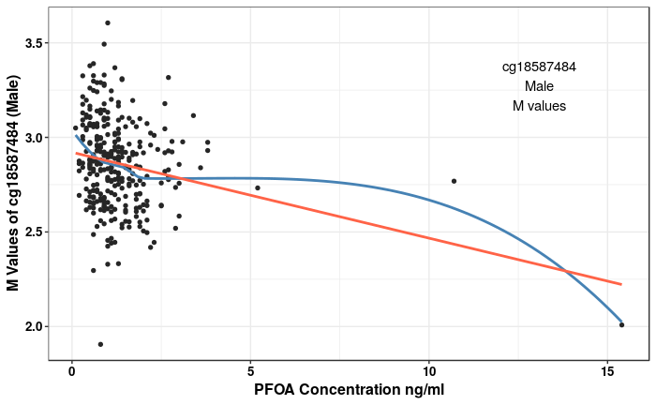
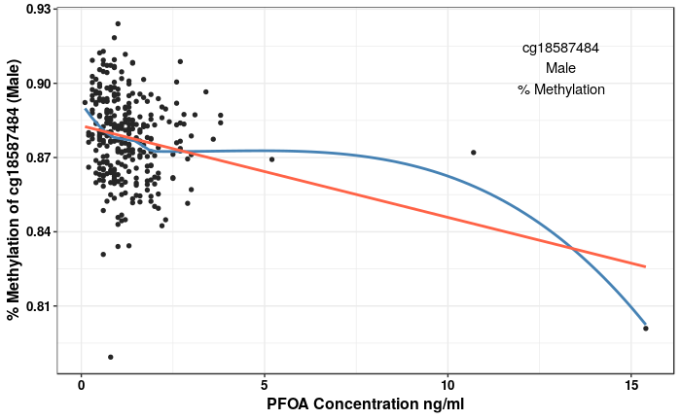
cg18587484 (2nd pvalue Male)

Slide 15
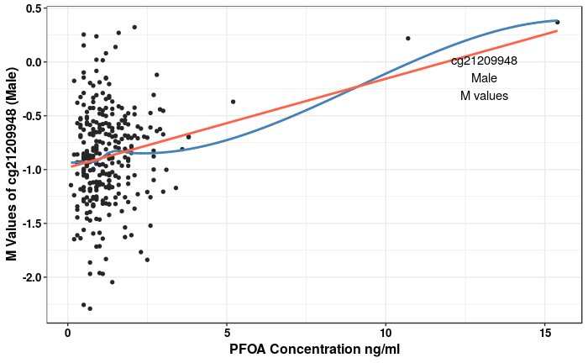
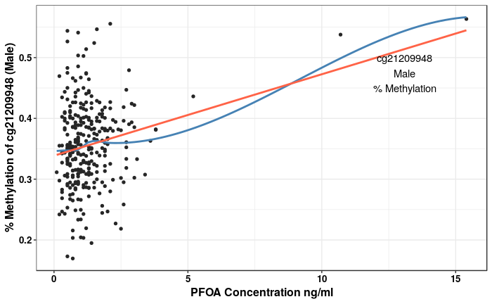
Cg21209948 (top10 by pvalue, Male)

Slide 16
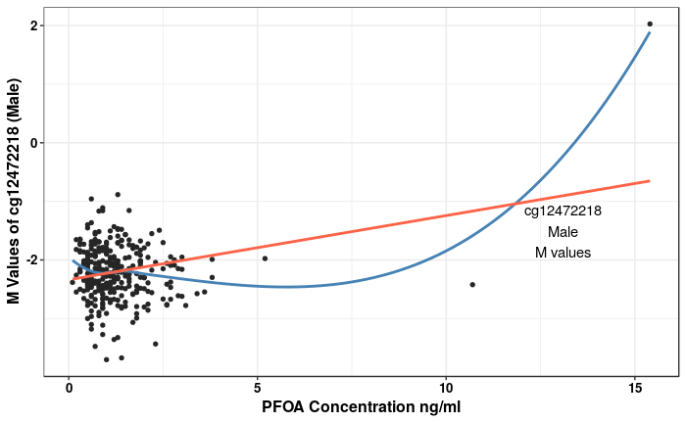
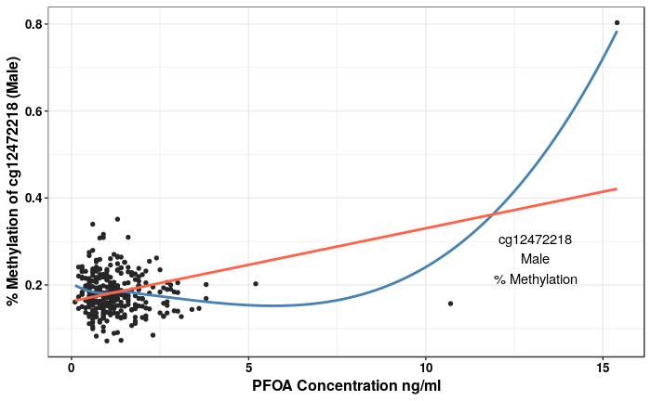
"cg12472218" (Top10 by p Male)

Slide 17
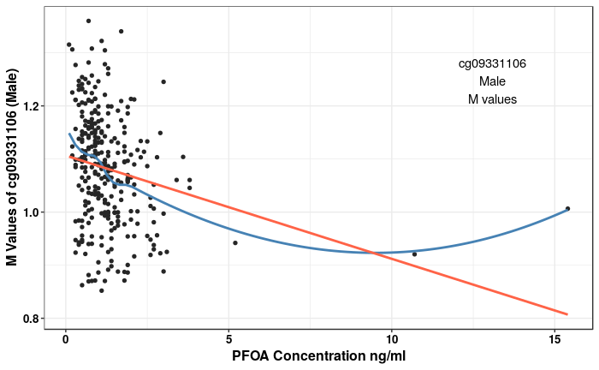
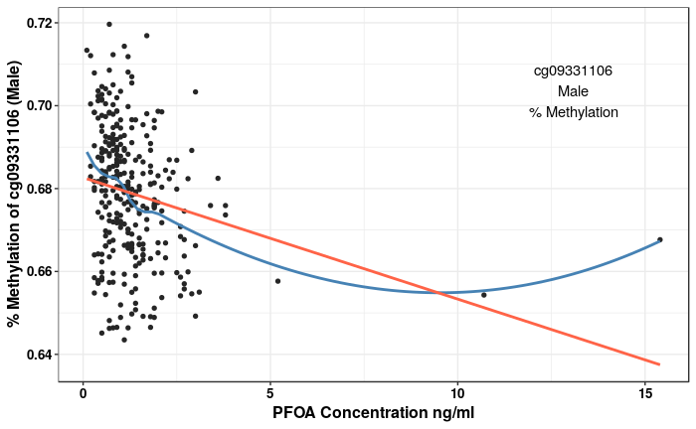
"cg09331106" (Top10 by p Male)

Slide 18
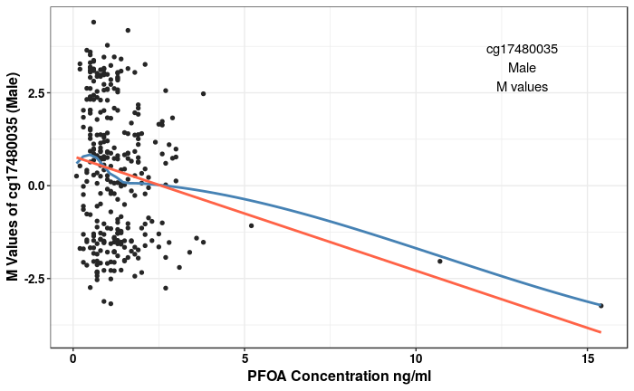
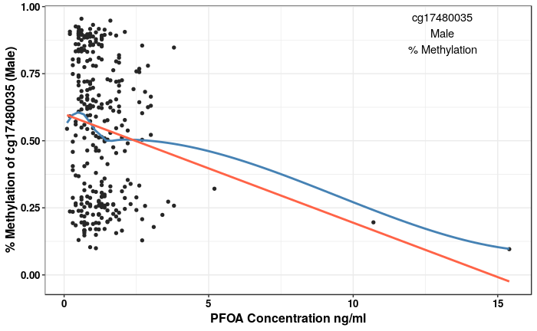
"cg17480035" (Largest Slope in Male)

