Slide 1

ImageNet Classification with Deep Convolutional Neural Networks: Alexnet
GUANNAN SHEN
4-24-2019

Slide 2
Outline
Authors
Background
Novel Ideas
Architecture and Training
More Details
Results
Summary

Slide 3
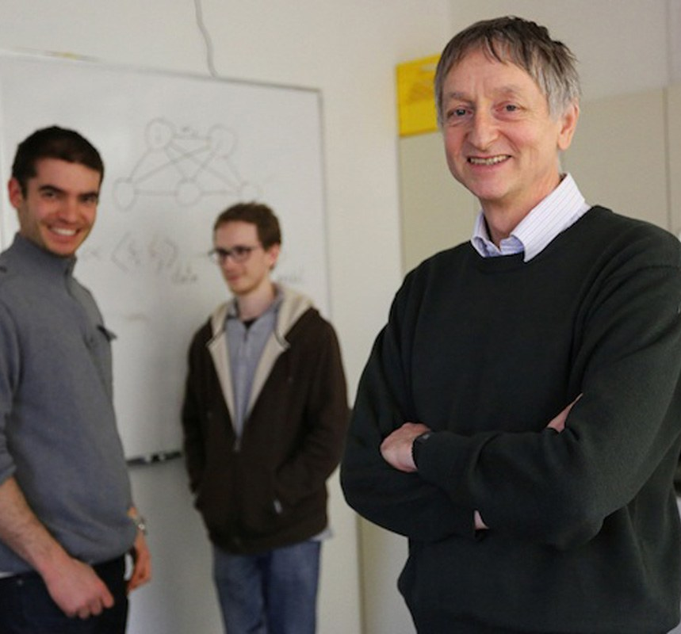
Authors
Geoffrey E. Hinton
Ilya Sutskever
Alex Krizhevsky
Ilya Sutskever
Geoffrey E. Hinton
University of Toronto
Alex Krizhevsky

Slide 4
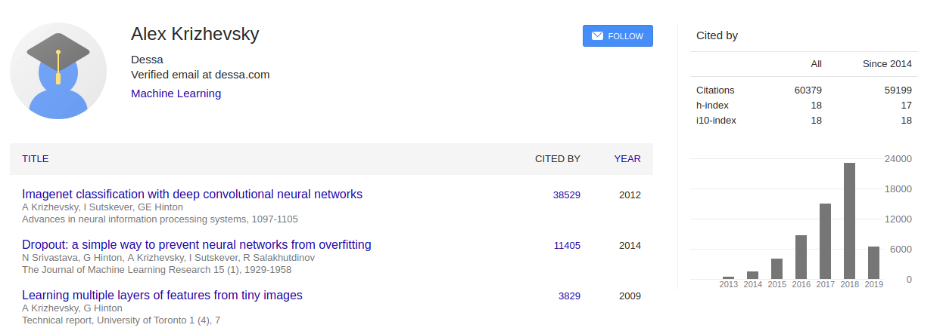
Alex Krizhevsky

Slide 5
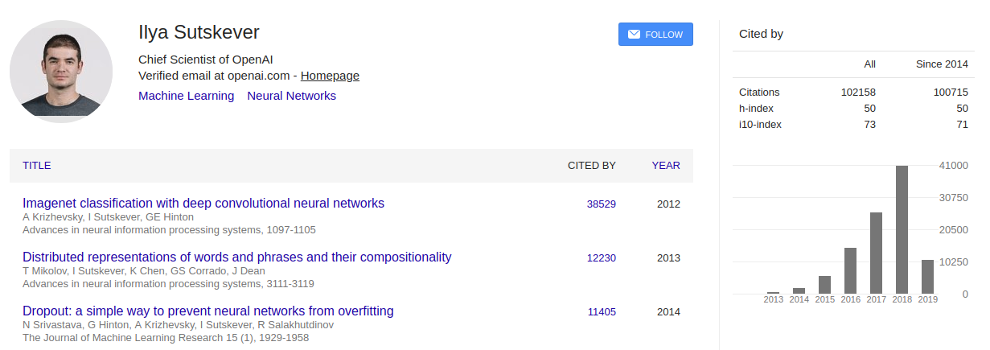
Ilya Sutskever

Slide 6
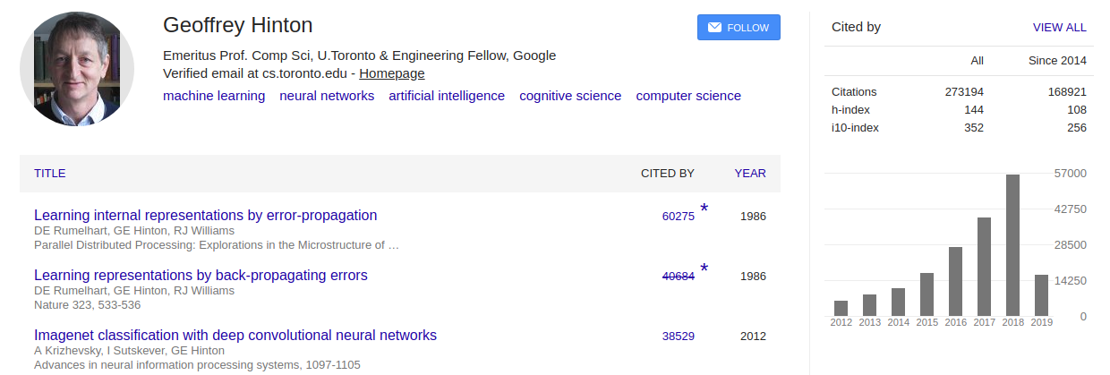
Geoffrey Hinton

Slide 7
Background
History
The resultant architecture is somewhat similar to that of the “columnar” CNN employed by Ciresan et al. [5]. In fact, both are improved upon the CNN designs introduced by Yann Lecun et al. (1989)
Dataset
ImageNet is a dataset of over 15 million labeled high-resolution images belonging to roughly 22,000 categories.
An annual competition called the ImageNet Large-Scale Visual Recognition Challenge (ILSVRC) has been held. ILSVRC uses a subset of ImageNet with roughly 1000 images in each of 1000 categories. In all, there are roughly 1.2 million training images, 50,000 validation images, and 150,000 testing images.
Top-1 and top-5 error rates:
Where the top-5 error rate is the fraction of test images for which the correct label is not among the five labels considered most probable by the model.

Slide 8
Novel Ideas
What makes Alexnet powerful

Slide 9
Convolutional neural networks (CNNs). Their learning capacity can be controlled by varying their depth and breadth.
Correct assumptions about the nature of images (stationarity of statistics and locality of pixel dependencies)
2D convolution
Depth of convolutional layers
ReLU Nonlinearity
Overlapping Max Pooling
Dropout regularization technique
PCA Color Augmentation
Training on Multiple GPUs
Two GTX 580 GPUs, each has 3GB of memory
Local Response Normalization
But following studies found the normalization layer cannot improve accuracy.

Slide 10
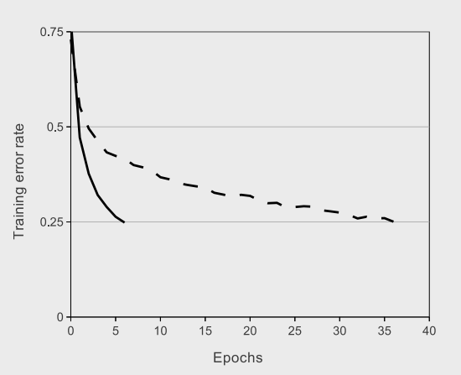
Relu
Non-saturating nonlinearity: Rectified Linear Units (ReLUs).
f(x) = max(0, x).
Previously, tanh(x) or sigmoid function (saturating nonlinearity) is the standard way.
Faster learning:
Six times faster than an equivalent network with tanh neurons.

Slide 11
Overlapping Max Pooling
Pooling windows of size 3×3 with a stride of 2 between the adjacent windows.
This overlapping nature of pooling helped reduce the top-1 error rate by 0.4% and top-5 error rate by 0.3% respectively when compared to using non-overlapping pooling windows of size 2×2 with a stride of 2.

Slide 12
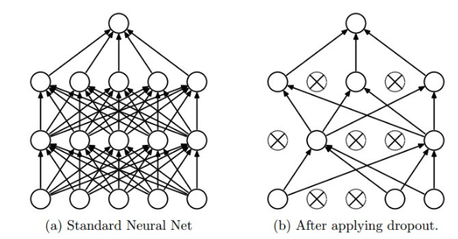
DROPout
Setting to zero the output of each hidden neuron with probability 0.5.
Dropout roughly doubles the number of iterations required to converge.
Can be considered as combining the predictions of many different models.
Those "dropped out" neurons do not contribute to either forward or backward propagation
This is an extremely effective and simple regularization technique. This technique reduces complex co-adaptations of neurons and overfitting.
http://cs231n.github.io/neural-networks-2/

Slide 13



PCA Color augmentation
This is to alter the color balance of the image. Images with heavy red values and minimal green values will have their red values altered the most through PCA Color Augmentation.
PCA was performed on the set of RGB pixel values throughout the ImageNet training set.
Therefore to each RGB image pixel
Add
Where alpha a random variable drawn from a Gaussian with mean zero and standard deviation 0.1.
Simple method: horizontal reflections and Random Crops of 227 * 227 image patches from 256 * 256 images. This increases the size of the training set by a factor of 2048.
Enlarge the dataset by Label preserving transformations to reduce overfitting.

Slide 14

Multiple GPUs
A single GTX 580 GPU has only 3GB of memory, which limits the maximum size of the networks that can be trained on it.
The parallelization scheme that we employ essentially puts half of the kernels (or neurons) on each GPU, with one additional trick: the GPUs communicate only in certain layers.

Slide 15
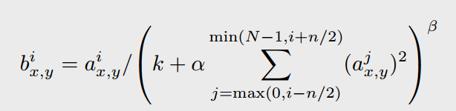
Local Response Normalization
The constants k; n; α, and β are hyper-parameters whose values are determined using a validation set; we used k = 2, n = 5, α = 10−4, and β = 0.75.
This is not common right now.

Slide 16
Architecture and Training

Slide 17
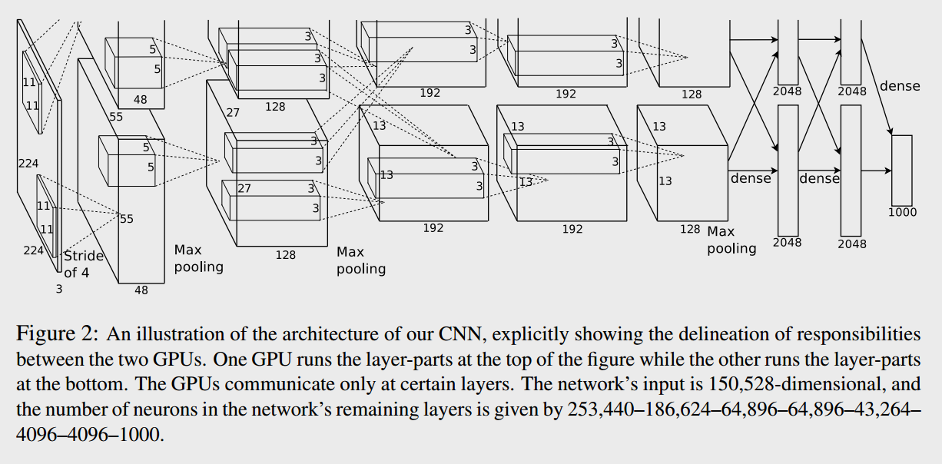
architecture

Slide 18
Details of learning
Abatch size of 128 examples, momentum of 0.9, roughly 90 cycles, and weight decay of 0.0005.
Initialized the weights in each layer from a zero-mean Gaussian distribution with standard deviation 0.01.
Initialized the neuron biases with the constant 1, in the second, fourth, and fifth convolutional layers, as well as in the fully-connected hidden layers. Otherwise, 0.
Divided the learning rate by 10 when the validation error rate stopped improving with the current learning rate. The learning rate was initialized at 0.01 and reduced three times prior to termination.

Slide 19
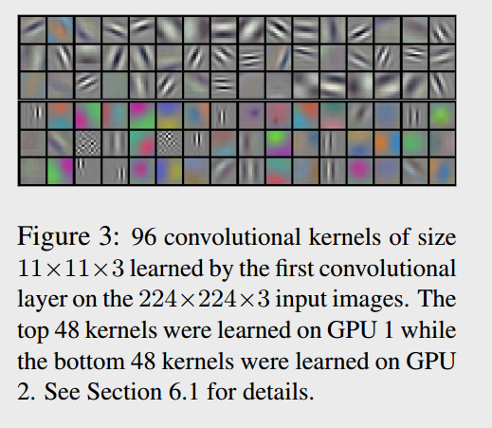
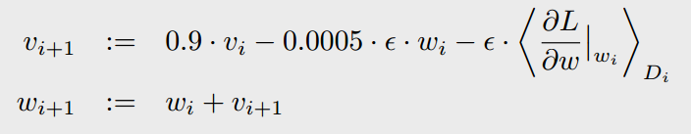

Details of learning

Slide 20
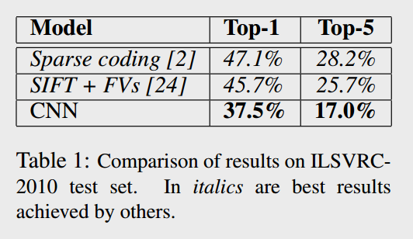
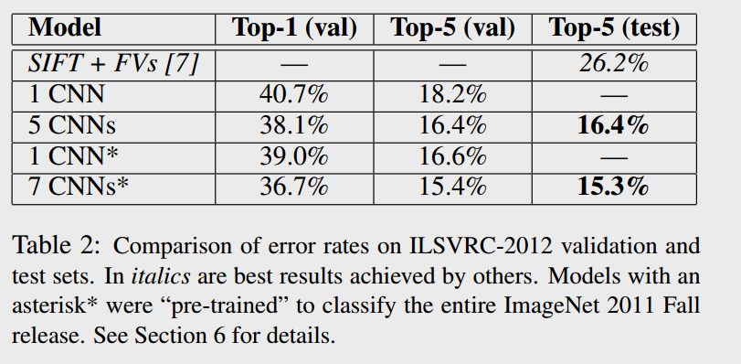
results

Slide 21
Summary
Showed that a large, deep convolutional neural network is capable of achieving recordbreaking results on a highly challenging dataset using purely supervised learning.
Activation function
ReLU
Max Pooling Layer
Reducing Overfitting
Dropout
Data Augmentation
Initialization of parameters.
Pretrained weights are available.

