Slide 1
for Business Owners
Yelper
Aspect Based Sentimental Analysis on Yelp reviews
Group 1
Xinkai Chen
Wenbo Fei
Guanqi Lu
Lokeswar Sadasivuni

Slide 2
Outline Presentation 2
Problem Statement
Score Grading & Evaluation
Shiny APP - Yelper
Questions & Answers

Slide 3
Problem Statement

Slide 4
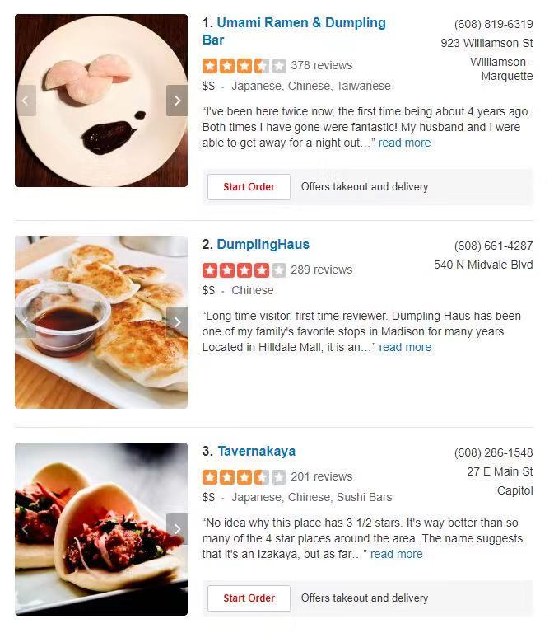
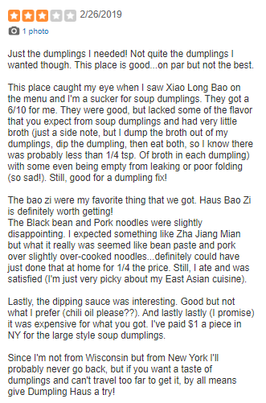
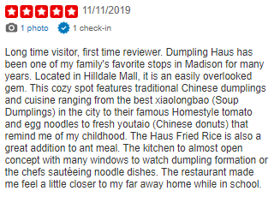
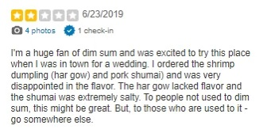

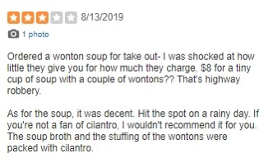
Problem Statement

Slide 5
Prediction & Evaluation

Slide 6
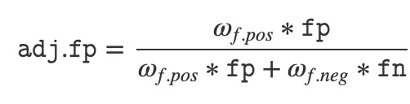

Score Grading
Each business receives 5 category scores :
Miscellaneous
Price
Ambience
Service
Food
* Take “Food” as an example :
* adj.fp: score for Food; adj.fp will be normalized to 0-5 scale;
$ω_{f.pos}$: weight of fp; fp: positive sentimental score for Food.

Slide 7


Model Evaluation
Miscellaneous
Price
Ambience
Service
Food
5/5 Significant*
75%
ACCURACY** :
*Statistically significant detecting whether a restaurant is good;
**Accuracy calculated by leave-one-out cross validation;
Note: Evaluation based on GLM: star ~ category scores.

Slide 8
Shiny APP - Yelper

Slide 9
Questions & Answers

Slide 10
Thank You !

Slide 11
Yelper

