Slide 1

Yelp Data Challenge
Wednesday Group 5
Guanxu Su, Shurong Gu, Yuwei Sun

Slide 2
Outline
Introduction
Data background
Data Preprocessing
Data acquisition
Text preprocessing
Feature Extraction
Exploratory analysis
Feature creation
More on Feature Extraction
Model Building
Model Comparison
Results

Slide 3
Data Description
Stars | 5
Name | Red Lobster
Text | I had the opportunity to try out the red lobster lobsterfest the other night my server a jeanne and she is amazing loved her and the great service she provided started the night out with lobster crab e seafood stuffed mushroom lobster pizza and sweet chile shrimp now everything tasted great but i have to say my favourite of those where the sweet chile…
Date | 2014-02-06
City | Mesa
… | …

Slide 4
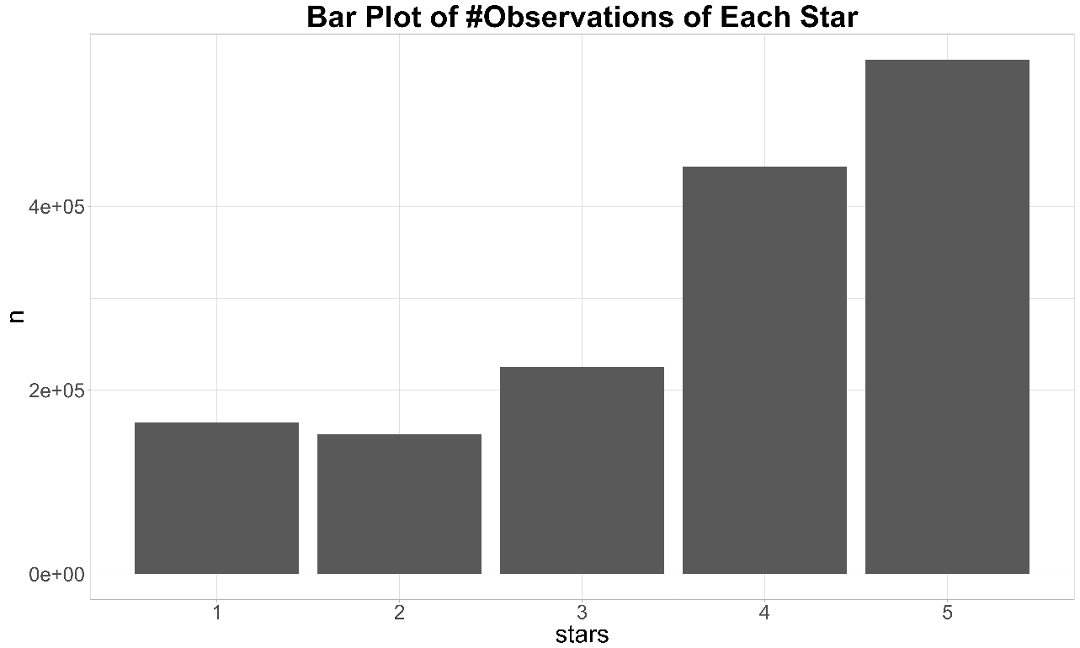
Sampling
Reduce sample size
Raw data: 1,500,000 reviews in total
Balance number of reviews per star
Raw data: highly imbalanced
We take a stratified sample,
100,000 reviews per star
n
Stars

Slide 5
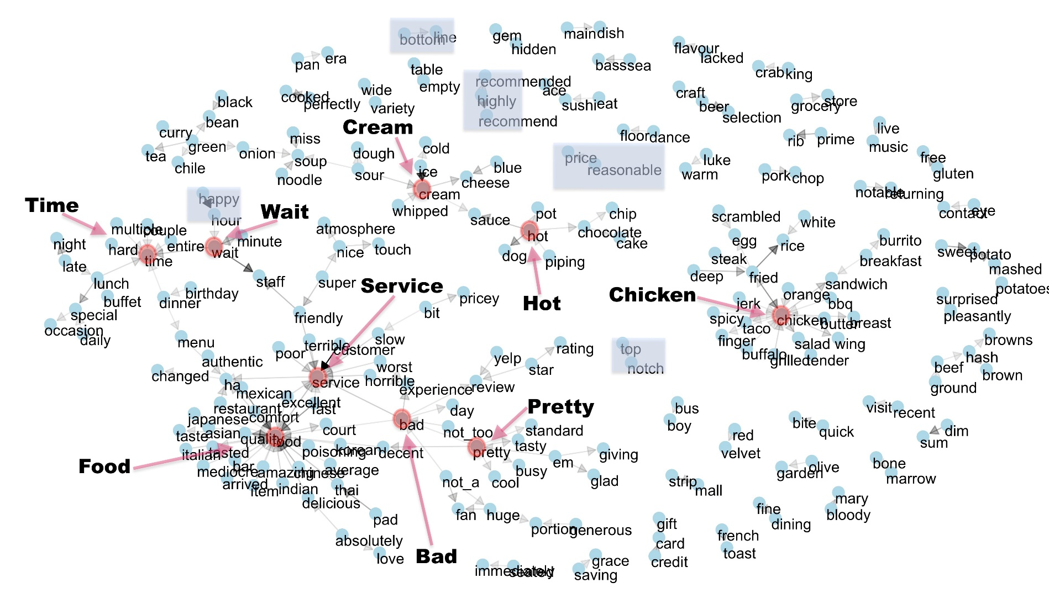
Data Preprocessing
Raw Text
Remove punctuations, digits and extra spaces,
Transform cases
Correct spelling
Text Cleaning
Lemmatization
Context
e.g. “don’t like” “not_like”
Phrases
Final Vocabulary

Slide 6
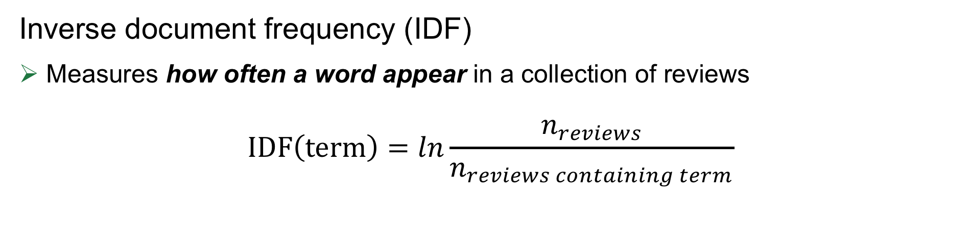
Feature Extraction
Uncommon words
Occur in fewer reviews:
High IDF (thump, cray, coho etc.)
IDF
Extremely Common words
Occur in most reviews:
Low IDF (food, chicken, menu, restaurant etc.)

Slide 7
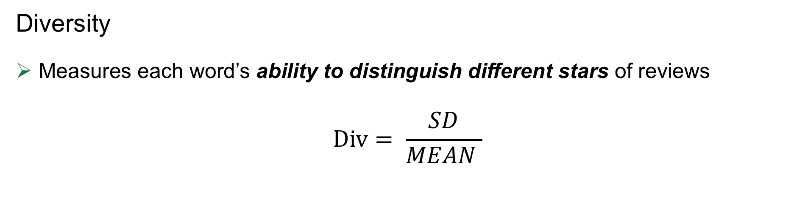
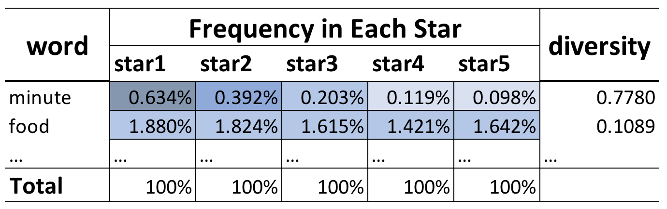
Feature Extraction
Discriminative Words
Div
Meaningless Words

Slide 8
Feature Extraction
Discriminative Words
High degree of distinction:
High Div (Worst_food_poisoning, Racism, Worst_customer_service etc.)
Div
Meaningless Words
No information about star rating:
LOW Div (Invite, Muscle, Meal, etc.)

Slide 9
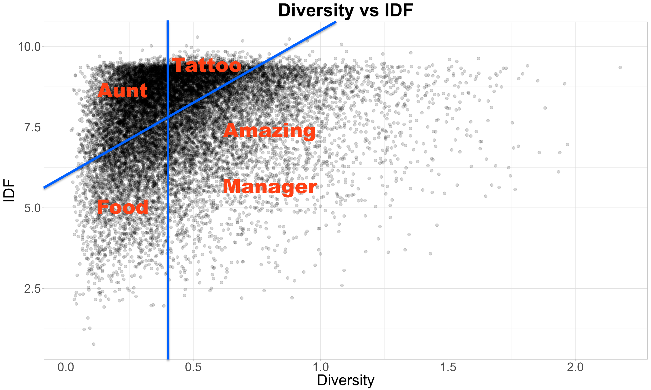
Feature Extraction
Remove the words with:
1. Low diversity
2. High IDF
Only keep words that fall on right bottom corner
5814 unique words, covering 99% reviews

Slide 10
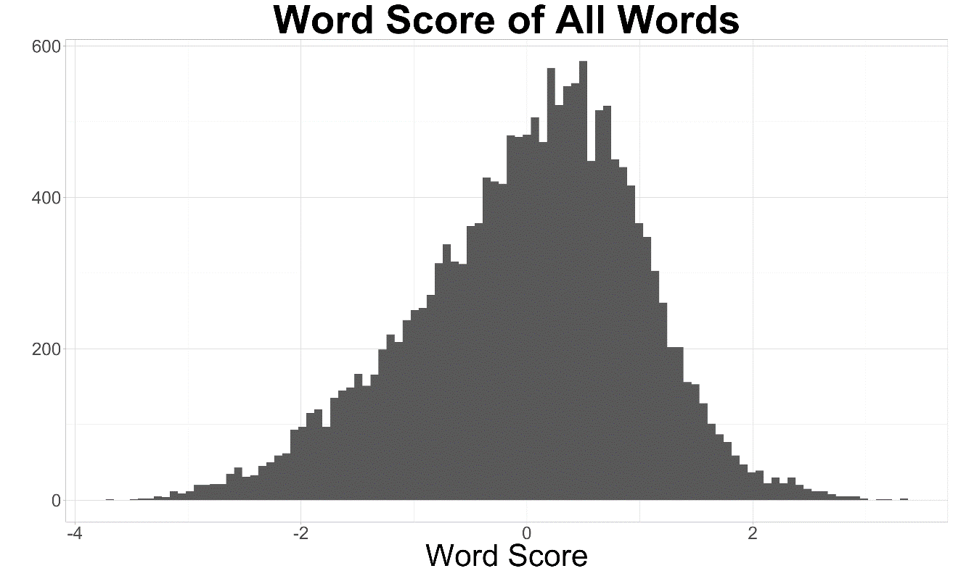
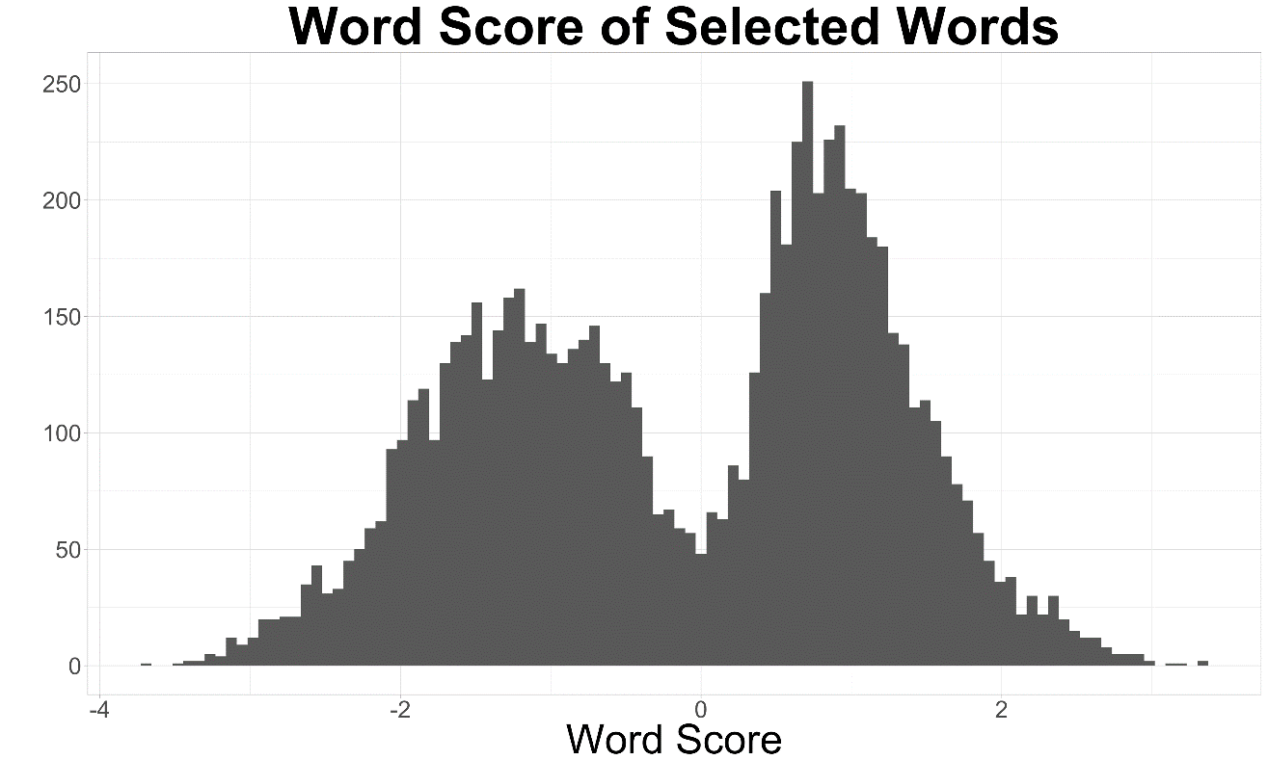
Feature Extraction
Word Score
Average star of the reviews containing the word (standardized)
Notes:
We obtain a new feature word score, word score is the Average star of the reviews containing the word after standardization. This left image is the histogram of all the words in our train set. As we can see, most of the words are concentrated around 0, which does not provide much information about interpreting review stars. However, after selecting the 5800 bottom right words mentioned before, we see an obvious bimodal distribution. Some of the words are negative while some are positive. We think this result is very useful for the following analysis.

Slide 11
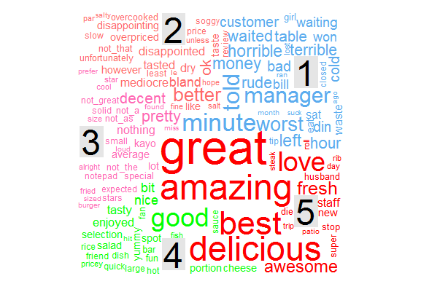
Typical words by star
Word cloud
The size of each word indicates its frequency
Extreme reviews are all alike;
Neutral reviews contain more information
Notes:
This is a word cloud of each star rate. The size of each word indicates its frequency. There is an interesting finding that the words in star5 are extremely large. Overall speaking, Extreme reviews are all alike, while neutral reviews contain more information.

Slide 12
Data Analysis Plan
More on feature engineering
Review Text: [word1, word2, word3,word4,…]
Score vector: [score1, score2, score3, score4,…]
Final Features and interpretable model (8 features with RMSE 0.86).
Other machine learning methods of high accuracy.
Notes:
In our future analysis, we would like to transfer the raw review text into a score vector, obtain some features based on the score vectors and interpret a final model.
Also, we will try to use other machine learning methods to build high accuracy models.

Slide 13
Questions?

Slide 14
Feature Creation – Minimum, Average and Maximum Score
Word Score (Recap)
Average star of the reviews containing the word (standardized)
Review Text: [word1, word2, word3, …]
Score vector: [score1, score2, score3,…]
Each review
Min word score
Average word score
Max word score

Slide 15
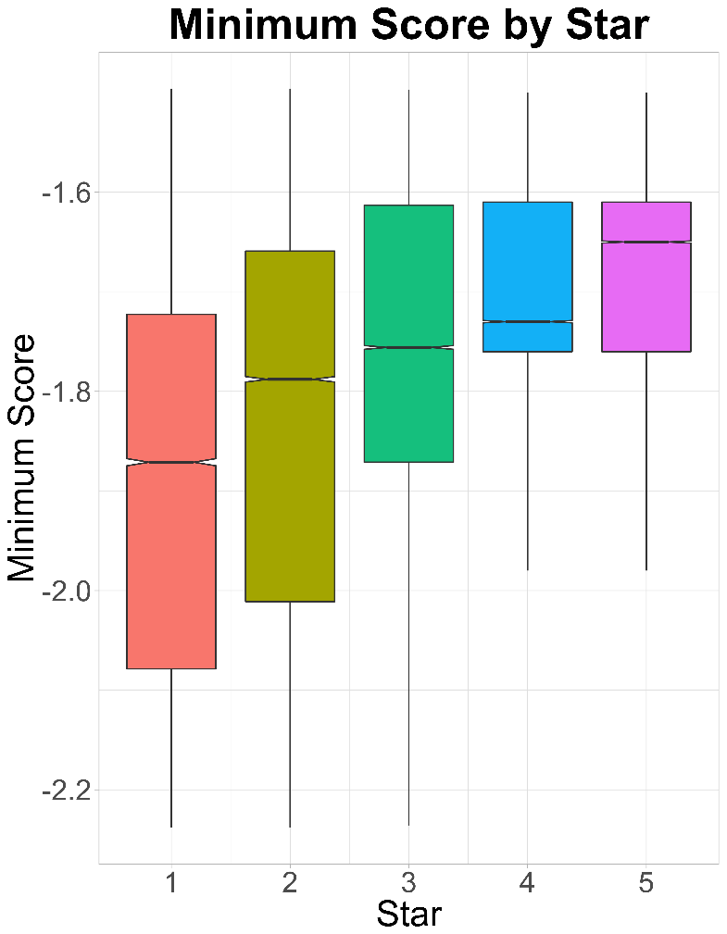
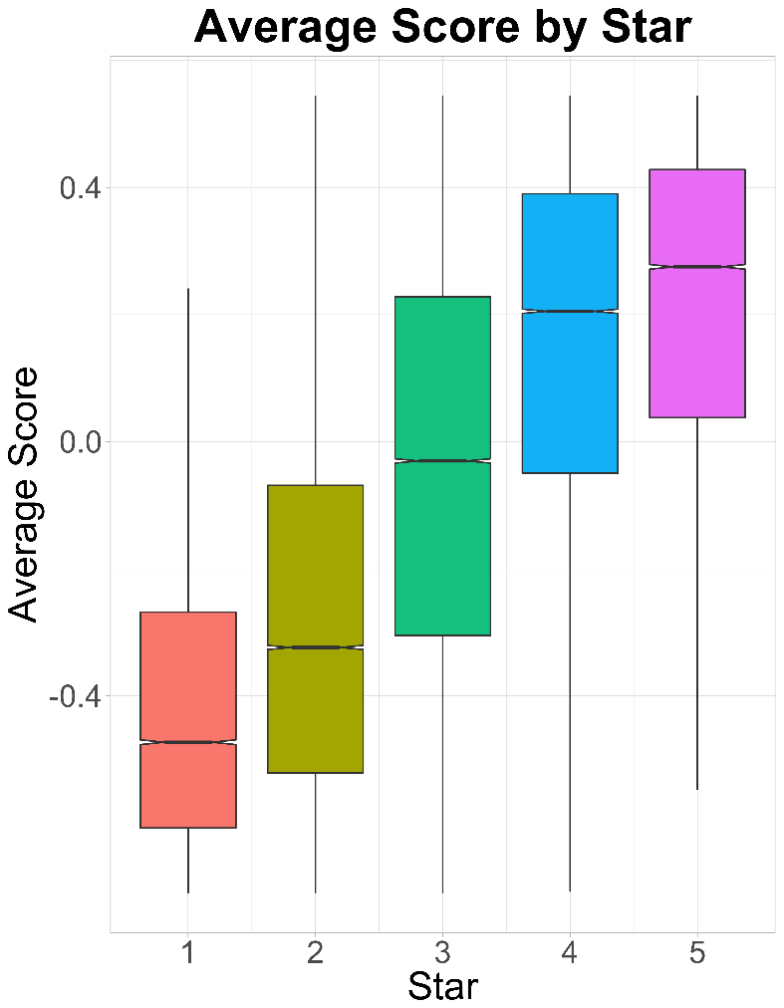
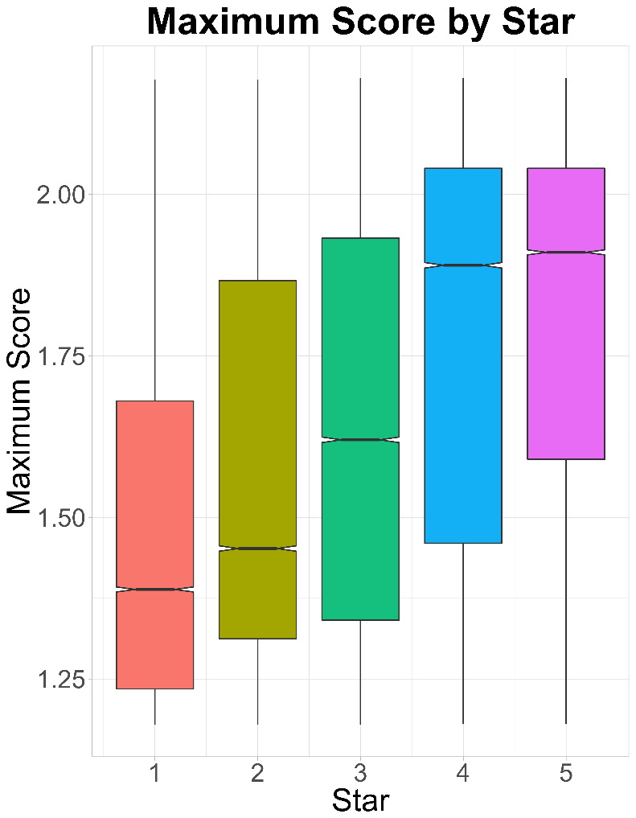
Feature Creation – Minimum, Average and Maximum Score
Stars
Stars
Stars

Slide 16

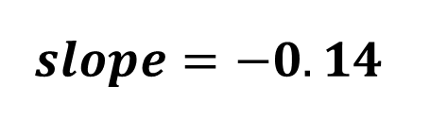

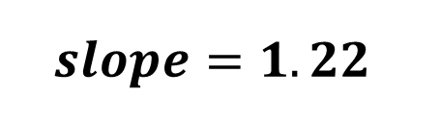




Feature Creation – Emotion Trend
One star off because the service is miss but their curry make up for everything else seriously the best curry in town.
Emotion Trend
Emotion Trend
Ambience was awesome but service a so terrible. We didn’t even get a chance to try anything except for our first round of drinks

Slide 17
Feature Creation – Emotion Trend
Review Text: [word1, word2, word3,word4,…]
Score vector: [score1, score2, score3, score4,…]
Words Index: [ 1 , 2 , 3 , 4 , …]
Emotion Trend: The slope of regression line of Y vs X
It measures the trend of emotion in words
(Positive to Negative | Negative to Positive)
Y
X

Slide 18
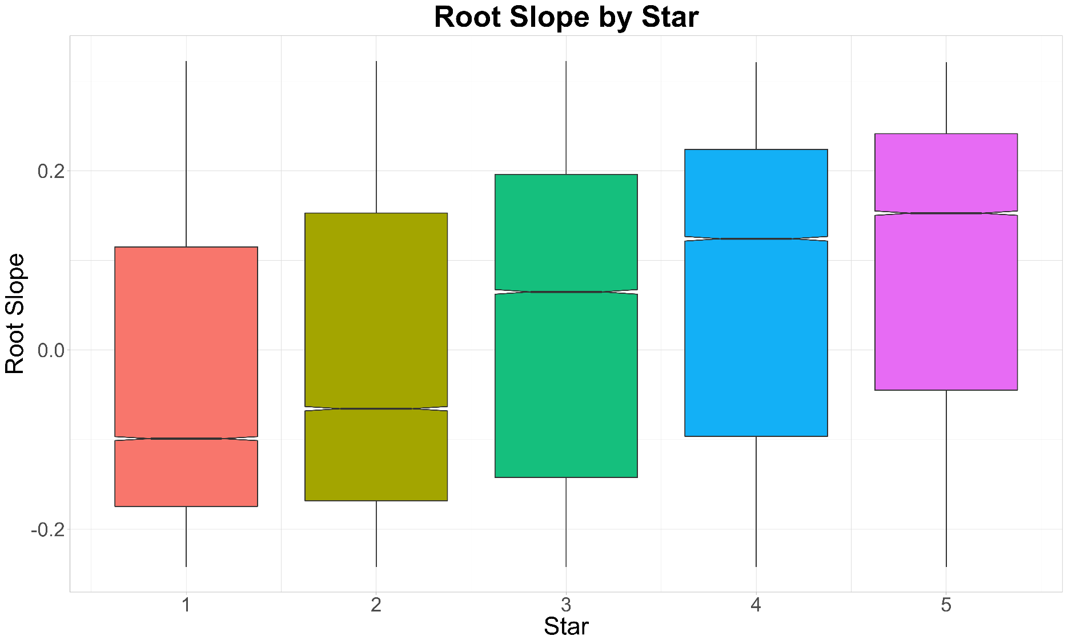
Feature Creation – Emotion Trend by Star
Stars

Slide 19
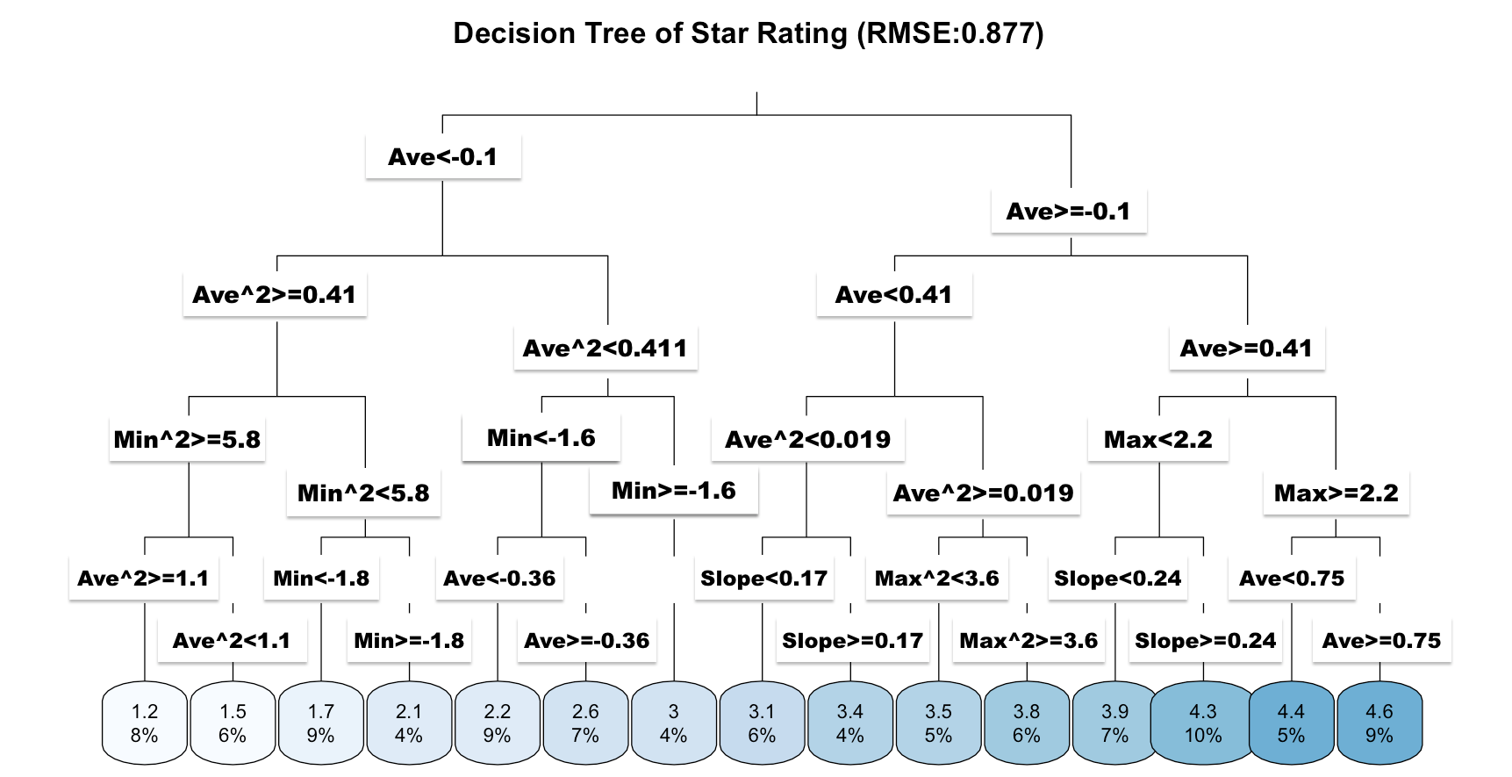
Interpretable Model – Decision Tree

Slide 20
Interpretable Model – Result
Average score of review‘s words------Positive or Negative
Maximum score of review‘s words------How positive a review is
Minimum score of review‘s words------How negative a review is
Emotion trend of review‘s words------Matters on neutral reviews

Slide 21
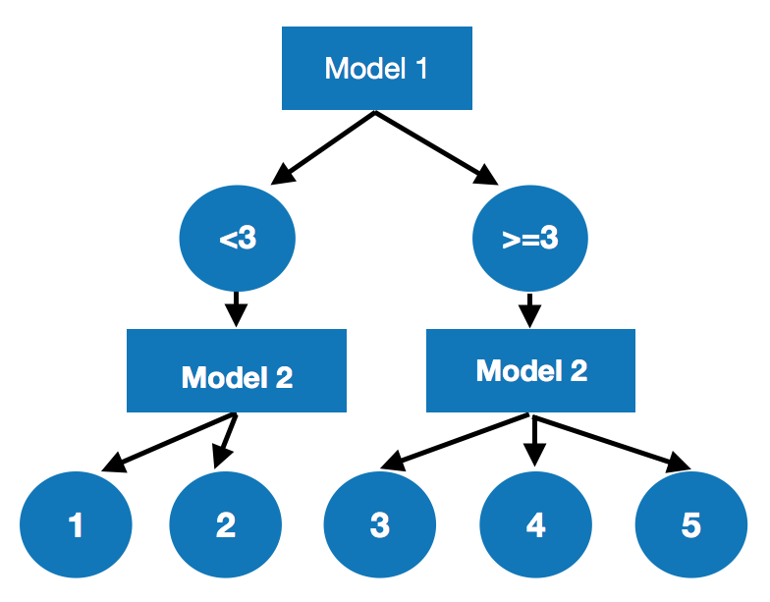
Machine Learning Models
Model Structure of two step models
Classification
Regression

Slide 22
Machine Learning Models – Model Comparison
Model | RMSE on Test Set (Kaggle)
SVC | 0.752
Naïve Bayes | 0.840
SVC + Linear | 0.665
SVC + SVC | 0.716
one - Step
two - Steps

Slide 23
Pros & Cons
Data Preparation
Feature extraction
Modeling
Pros: Take context into consideration Balanced the star distribution
Cons: May lose information due to limited sample size
Pros: Interpretability Get more insight of how review text contributes to its star rating
Cons: Subjectivity
Pros: Good performance on test data Time efficient: about 10 min per round
Cons: For decision tree model: not accurate, no consideration of high order interaction Some violation of assumptions
All numbers above are just random values for demonstration, not real values

