Slide 1

What Can We Get from Numbers
Is Mathematics Innovation or Discovery?
LI GUANYU
Mathematics and Applied Mathematics

Slide 2
01
A Paradox
02
A Valuation
PPT模板下载：www.1ppt.com/moban/ 行业PPT模板：www.1ppt.com/hangye/
节日PPT模板：www.1ppt.com/jieri/ PPT素材下载：www.1ppt.com/sucai/
PPT背景图片：www.1ppt.com/beijing/ PPT图表下载：www.1ppt.com/tubiao/
优秀PPT下载：www.1ppt.com/xiazai/ PPT教程： www.1ppt.com/powerpoint/
Word教程： www.1ppt.com/word/ Excel教程：www.1ppt.com/excel/
资料下载：www.1ppt.com/ziliao/ PPT课件下载：www.1ppt.com/kejian/
范文下载：www.1ppt.com/fanwen/ 试卷下载：www.1ppt.com/shiti/
教案下载：www.1ppt.com/jiaoan/ PPT论坛：www.1ppt.cn
Infinite sum
Weird divergence
CONTENTS
03
An Obstruction
04
More
Another Definition of Distance
Answer the final question

Slide 3
PART
ONE
PPT模板下载：www.1ppt.com/moban/ 行业PPT模板：www.1ppt.com/hangye/
节日PPT模板：www.1ppt.com/jieri/ PPT素材下载：www.1ppt.com/sucai/
PPT背景图片：www.1ppt.com/beijing/ PPT图表下载：www.1ppt.com/tubiao/
优秀PPT下载：www.1ppt.com/xiazai/ PPT教程： www.1ppt.com/powerpoint/
Word教程： www.1ppt.com/word/ Excel教程：www.1ppt.com/excel/
资料下载：www.1ppt.com/ziliao/ PPT课件下载：www.1ppt.com/kejian/
范文下载：www.1ppt.com/fanwen/ 试卷下载：www.1ppt.com/shiti/
教案下载：www.1ppt.com/jiaoan/ PPT论坛：www.1ppt.cn
A Paradox

Slide 4
Zeno’s Trick
A turtle and XX are in the race
The process of deduction
The Conclusion
XX starts from the origin, the turtle starts from 10. At speeds 10 and 5 respectively
1 second after…
Another 0.5 second after… Another
The chasing process continues, and XX can never catch the turtle.

Slide 5
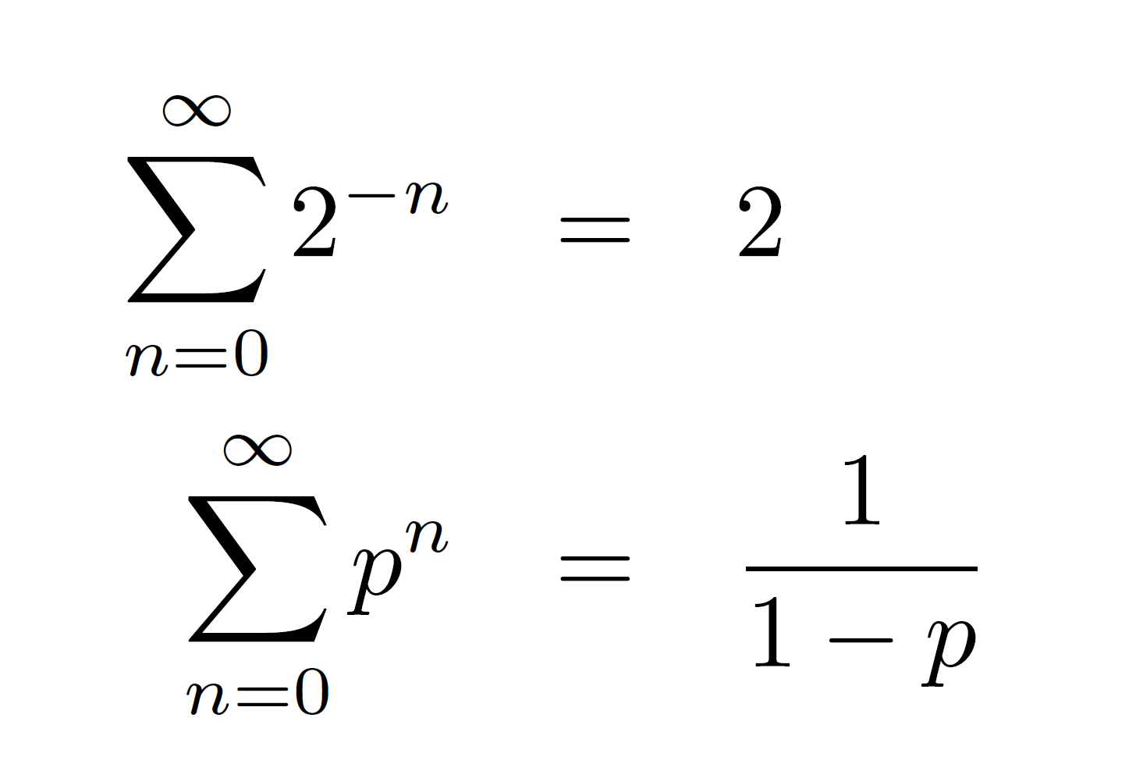
Even an idiot knows it is not true
But where is the trick that leads to the fuzzy conclusion?
Q1: What does the word “NEVER” mean?
Q2: Why it should not be “NEVER”?

Slide 6
PART
TWO
A Valuation

Slide 7
Is the equation always true?
Every one who study mathematics know the notion of divergence.
Divergent
Give a explanation
However we have some explanation of the equation
What does the equation mean?
|p|<1
p=2
p=-1
Maybe that’s what we want
Always work
Really? Can we get a negative number after infinite sum?
The point lies in the convergent disk.

Slide 8
PART
THREE
A Obstruction

Slide 9
What can we change in the equation?
SUM
Should we change the definition of the sum of two natural numbers?
What is the meaning of the sum of infinitely many numbers?
Infinity

Slide 10
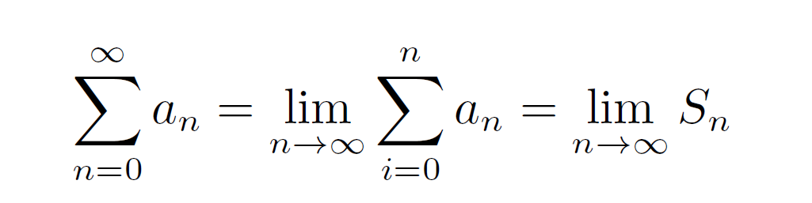
In mathematics we cannot do infinitely many operations
Translation
Infinite sum means the limit of terminated sum.
What does limit mean
A kind of relation describing “very close”.
If we want to make this meaningful, we have to change the notion of distance/topology.

Slide 11
DO NOT arrange the numbers in a line
01
Imagine we have plenty of boxes and it represents the topology
02
The relation can be described as “in the same box”.
Shift invariance and something else.
03

Slide 12
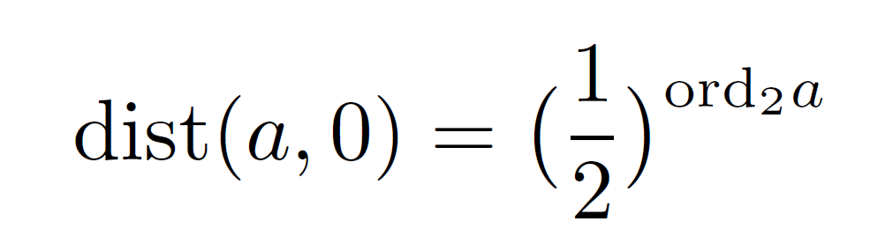
A visualized interpretation

Slide 13
PART
FOUR
What’s more

Slide 14
More questions
Can we get a distance function like this of rational numbers?
Is this topological space complete? What is the completion?
What is the algebraic closure of the completion?
Why we choose prime numbers?

Slide 15
Go back to the story
01
02
03
Have a new formula.
Need to change something to explain the result.
Get a new definition of distance.

Slide 16
Ultimate Conclusion
Discovery v.s. Invention
Rigorous
terms and logic
Discovery
Innovation
Non-rigorous
truth

Slide 17
THANKS

