Slide 1
GLCM & Color + GBM
Team 11
Guanzhong You; Yinxiang Gao;
Shuli Song; Cen Zeng; Yifei Hu

Slide 2
In Brief
Change SIFT to GLCM+Color
Change key point selection in SIFT to clustering
Add random forest for feature selection
All others are the same
Accuracy: around 80%

Slide 3
In Detail
Divide: Divide the training image data into two parts:
One for forming feature pool: pool_image;
The other for supervised feature selection: learn_image.
Resize: Resize all large images to around 30000 pixels
Calculate statistics: For each p*p window, calculate its statistics (glcm and color)
Cluster: Cluster the windows by their statistics, keep 100 cluster means for each image
Generate words: Pool cluster means from all pool_image together and form a dictionary; each statistics (column) is scaled
Word Frequency: For each learn_image, calculate word frequency
Feature Selection: Find the most useful words in distinguishing chicken and dog (Random Forest)
Train Model: Still use GBM

Slide 4
Resize
If image size>30000 pixels
then resize it to 30000 pixels

Slide 5
Get features
GLCM (Gray-Level Co-Occurrence Matrix):
"mean", "variance", "homogeneity", "contrast", "dissimilarity", "entropy", "second_moment", "correlation“
Color Pattern:
R, G, B (mean)
R, G, B (variance)
So for each window cluster: 8+6 features
Each window cluster mean is a “word”
All words in pool_image form a BIG dictionary

Slide 6
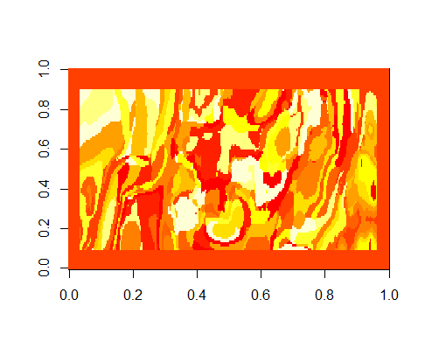
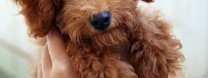
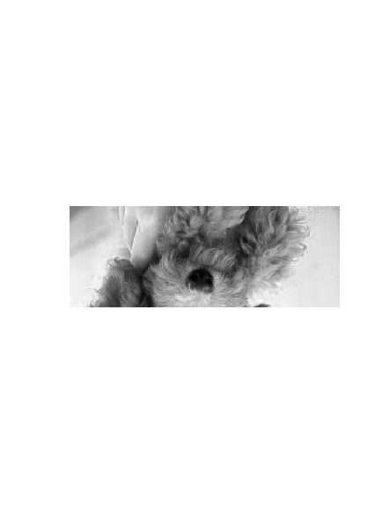
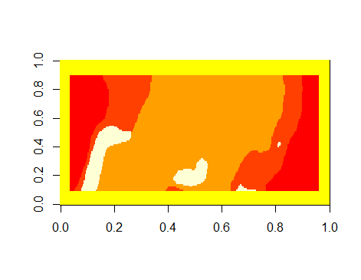
Cluster
Original
Cluster 100
Gray
Cluster 5

Slide 7
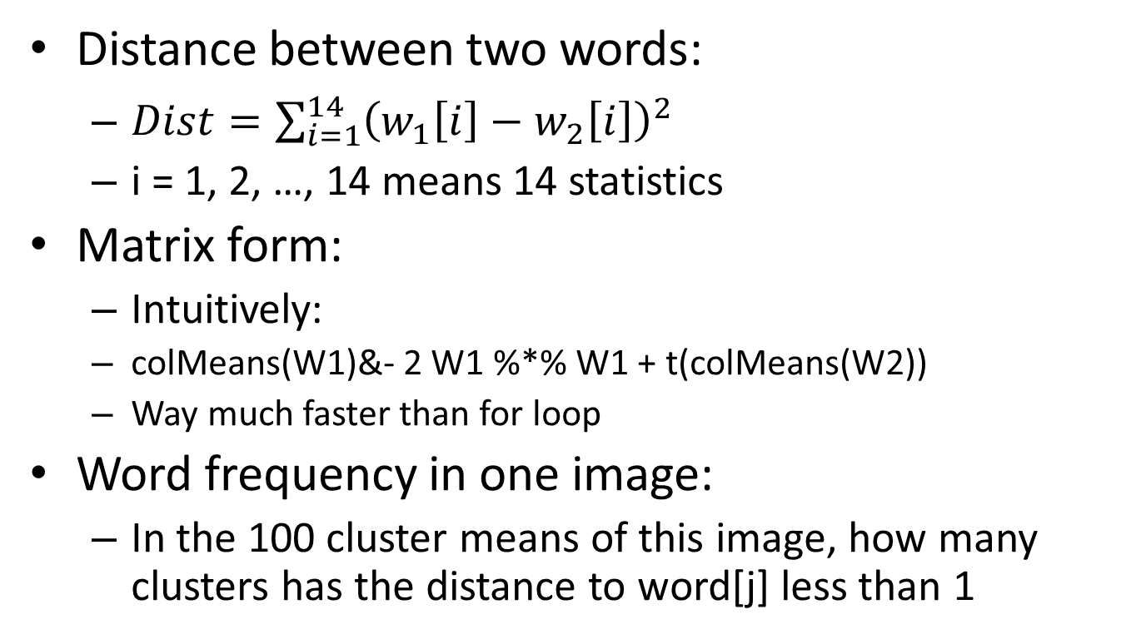
Word Frequency
Distance between two words:
$Dist=\sum_{i=1}^{14}{{\left(w_{1}\left[i\right]−w_{2}\left[i\right]\right)}^{2} }$
i = 1, 2, …, 14 means 14 statistics
Matrix form:
Intuitively:
colMeans(W1)&- 2 W1 %*% W1 + t(colMeans(W2))
Way much faster than for loop
Word frequency in one image:
In the 100 cluster means of this image, how many clusters has the distance to word[j] less than 1

Slide 8
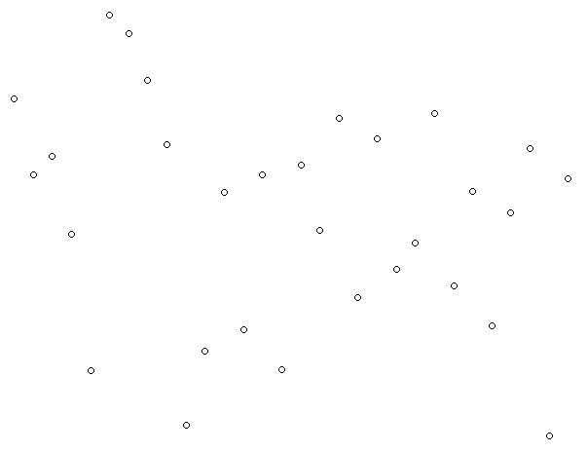
Word Frequency
3
4

Slide 9
Word Frequency
BIG Dictionary | Word 1 | Word 2 | Word 3 | … | Word10000
Learn_image[i]
Word 1 | 1 | 6 | 0 | … | 7
Word 2 | 0 | 0 | 5 | … | 8
Word 3 | 4 | 0 | 0 | … | 0
….. | … | … | … | … | …
Word 100 | 0 | 0 | 8 | … | 2

Slide 10
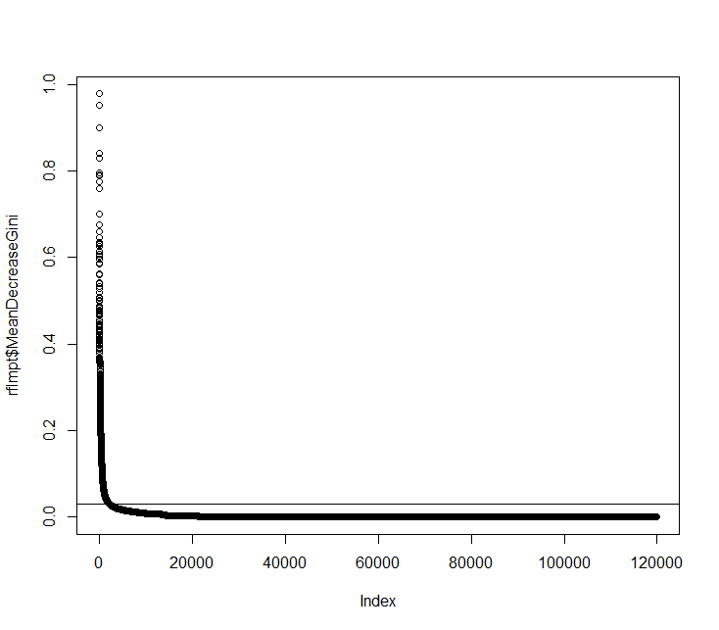
Feature Selection
Random Forest: Mean Gini Decreasing > 0.03
About 2.5 times the number of learn_image (2500 features for 1000 images)

Slide 11
Train Model
GBM + SIFT:
67% , Slow feature extraction
GBM + GLCM & COLOR (Our model):
80% + 3.5%, Not so slow (2K pic within 20 min)
NNET + GLCM & COLOR :
80% + 3.5%, Nothing different but unstable
Other+ GLCM & COLOR :
80% + 3.5%, Nothing different, but longer time

Slide 12
Titbits
Directly use color as feature: about 70% accuracy
R>2B; G>B; R>G
Filter out 500+ dog pictures (95% accurate)
Leave 1400+ pictures undetermined
Use the filtered pictures and then apply glcm+gbm: about 75%

