Slide 1
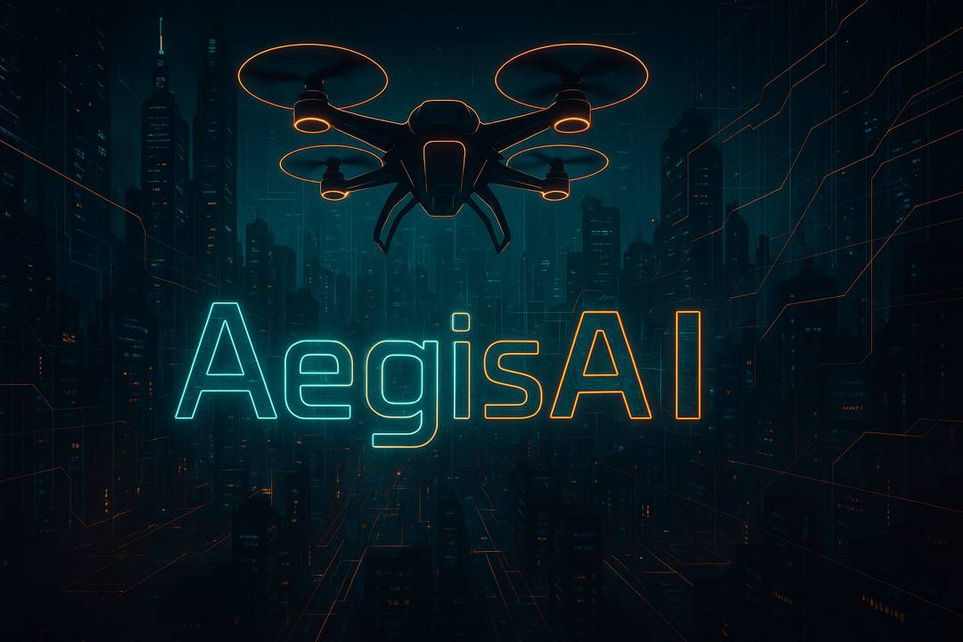
Autonomous AI-Powered Security Drones
Security of the Future — Affordable Today

Slide 2
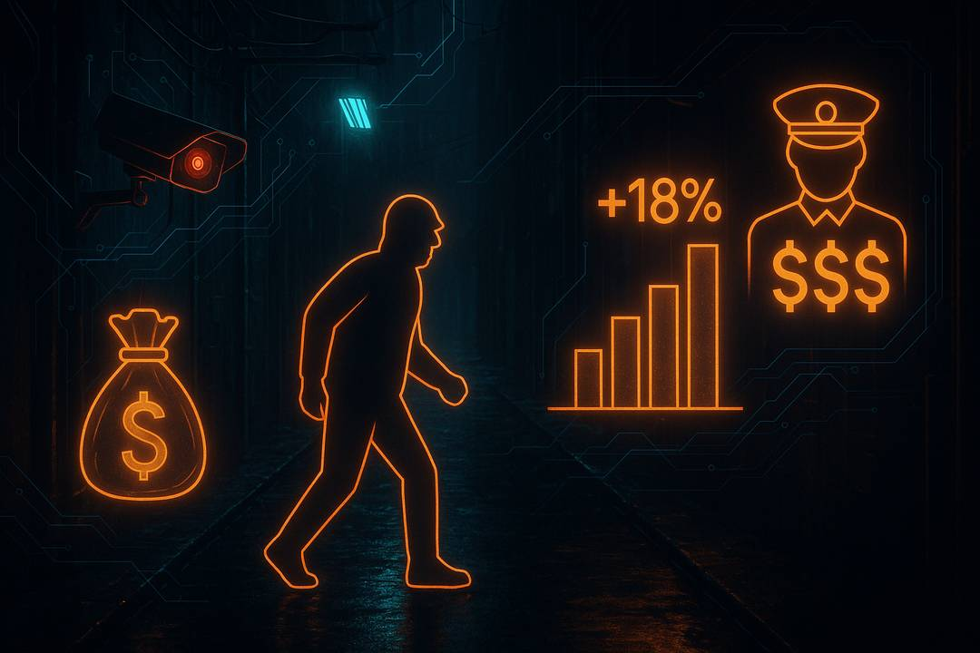
Problem
• Private security is too expensive ($1.5k–2k/month in the UK)
• Cameras & alarms only record incidents, don’t prevent them
• Crime is rising: +18% burglaries in 2025 (UK)

Slide 3
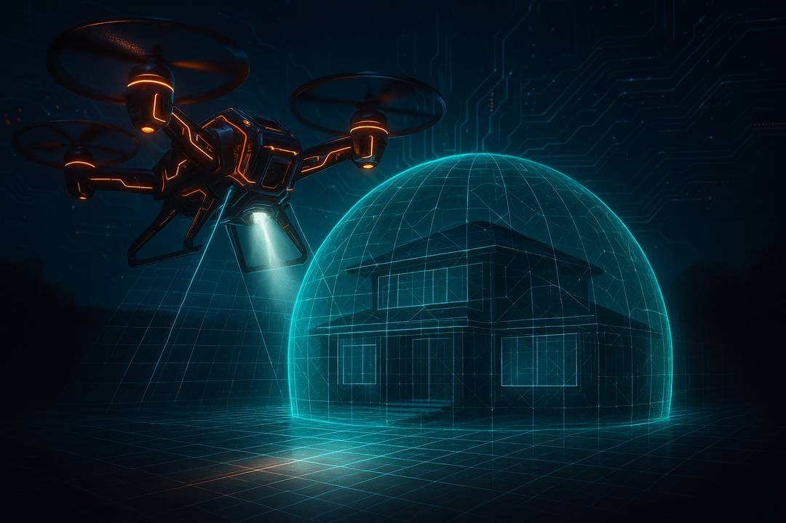
Solution
• AI-powered autonomous drone patrols
• 24/7 protection at 5× lower cost
• Seamless integration with alarms & smart homes

Slide 4
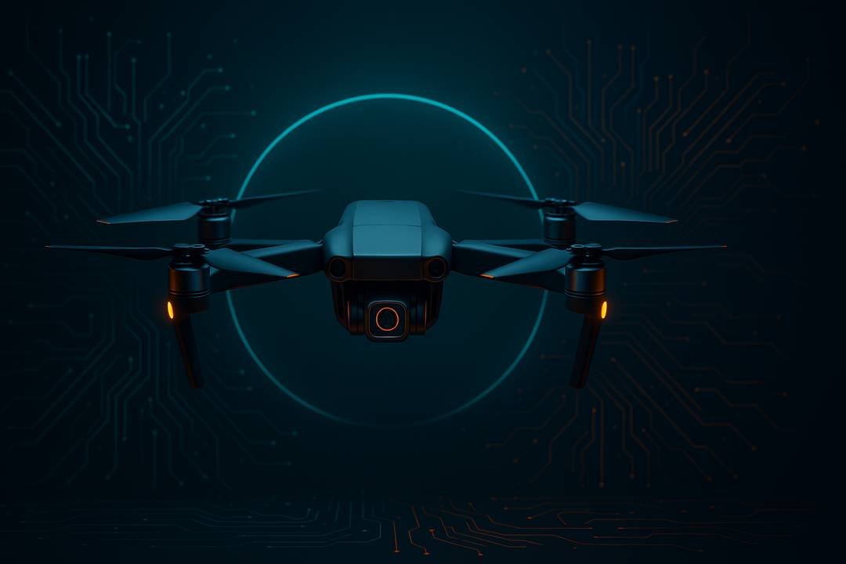
Product (MVP)
• Off-the-shelf drone + proprietary software
• Features: autonomous patrols, human/motion detection, real-time alerts
• Next: charging station, intruder tracking, voice warnings

Slide 5
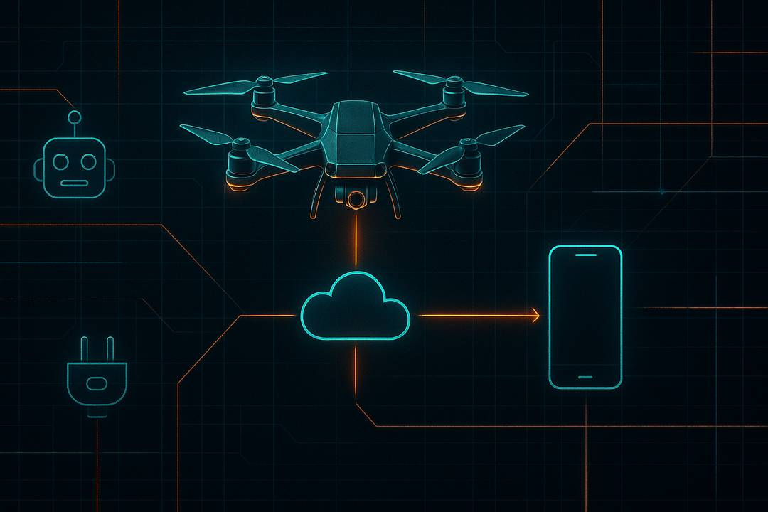
Technology
• Computer Vision (YOLOv8/9)
• Edge AI processing on-board
• Cloud analytics + mobile app
• IoT & Smart Home integration API

Slide 6
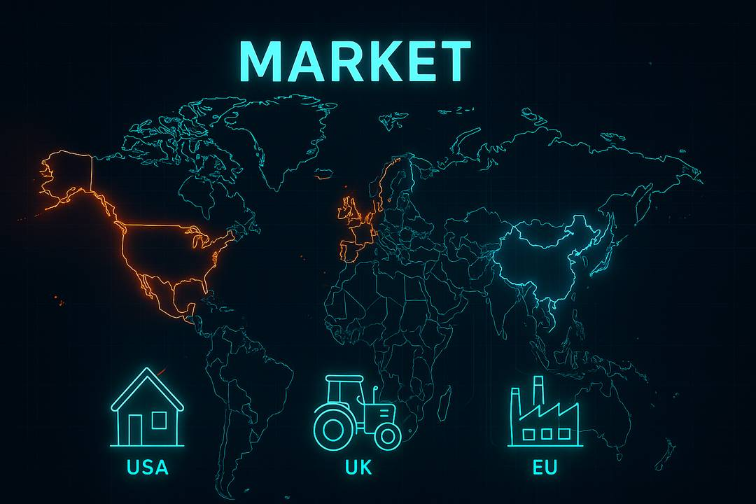
• Global Security Market: $240B
• Drone Security Market: $10B (20% CAGR)
• Segments:
– B2C: homes, farms
– B2B: warehouses, construction, logistics hubs

Slide 7
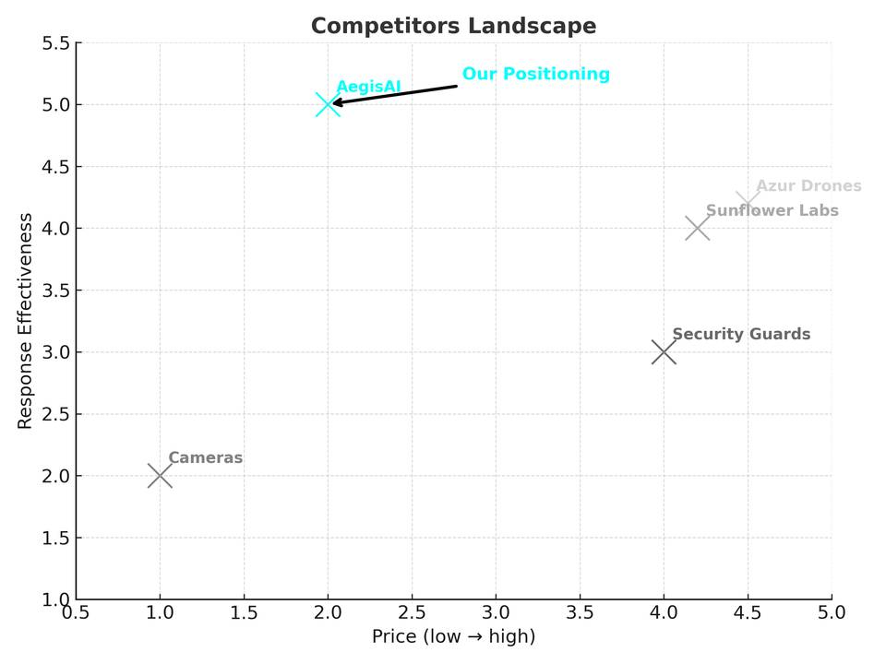
Competitors
• Guards → expensive, limited
• Cameras → cheap, but reactive
• Drone startups (Sunflower Labs, Azur) → high-cost, B2B niche
• AegisAI → affordable, scalable, B2C+B2B

Slide 8

Unique Value Proposition
• 5× cheaper than guards
• Works 24/7 without fatigue
• Scalable across drones
• Plug & play setup in 15 minutes

Slide 9

Business Model
• Subscription:
– B2C: $200/month
– B2B: $500–1000/month
• Hardware-as-a-Service (rental)
• Upsell: advanced AI modules, analytics, SLA

Slide 10

Financials
• Year 1: 20 clients = $48k ARR
• Year 2: 200 clients = $480k ARR
• Year 3: 1000 clients = $2.4M ARR
• UK potential (5% market) = $500M

Slide 11

Roadmap
• Q3 2025 → Website + Pitch Deck
• Q4 2025 → MVP
• Q1 2026 → First pilots
• Q2 2026 → Seed ($0.5–1M)
• 2026–27 → UK/EU scaling

Slide 12
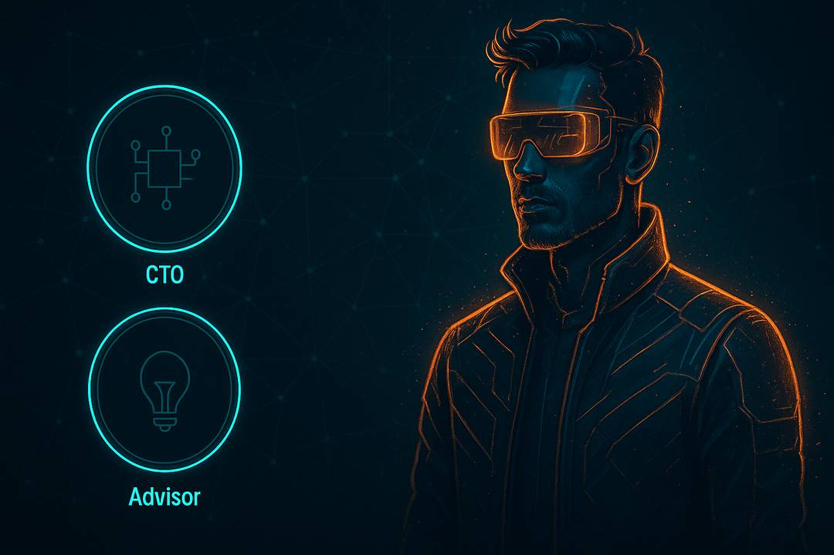
Team
• JV (Founder): Engineer, 8 years (drones, security systems)
• Looking for: CTO (AI/ML), Advisor (security), Business co-founder

Slide 13
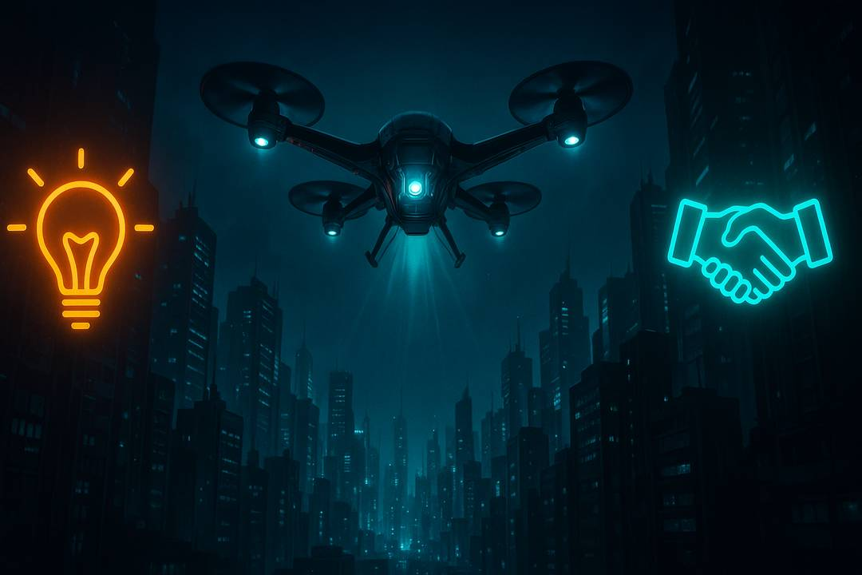
Ask
• Funding: $50–100k for MVP & pilots
• Support: mentorship + accelerator
• Opportunity: enter the emerging autonomous security market

Slide 14
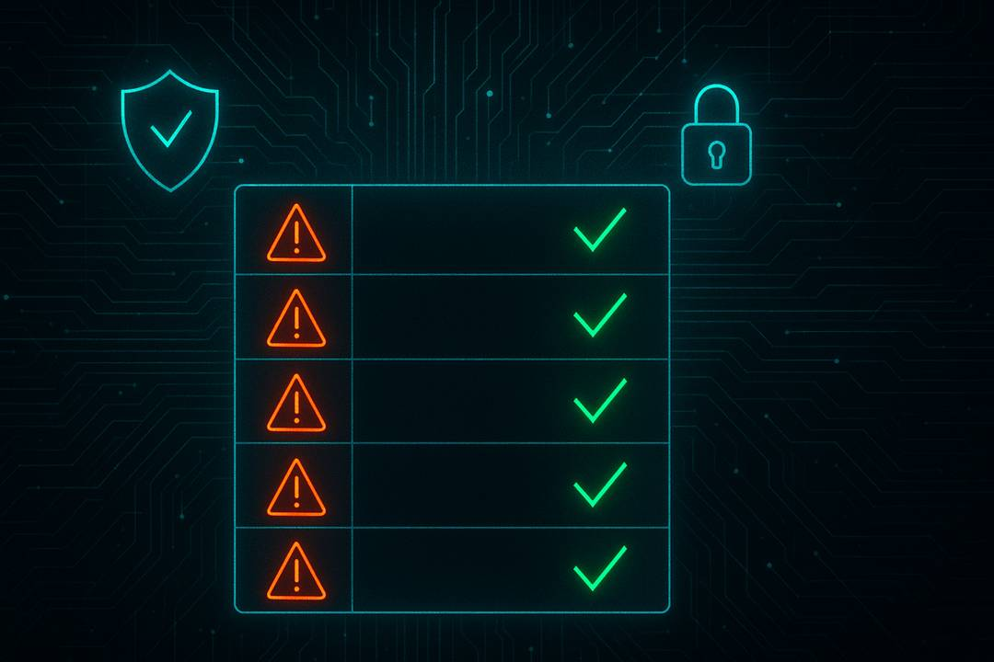
Risks & Mitigation
1. Tech MVP with existing drones
2. Finance phased funding, HaaS
3. Legal private territory pilots
4. Competition mass-market B2C
5. Team attract CTO & advisors

Slide 15
