Slide 1
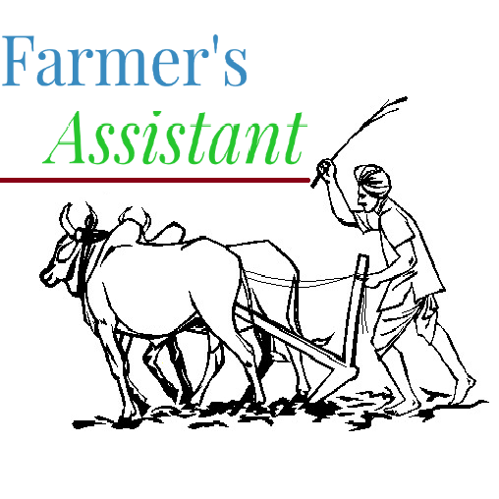
BY-
SIMHADRI GOVINDAPPA
KOUSHIK PHANI
VIGNESH A

Slide 2
Recap of Abstract
Abstract title:
An automated Intelligent assistant to present day farmers to maximize yield and streamline the process of buying and selling using IoT.

Slide 3
Problem Statement:
We often read about the problems faced by present generation farmers such as lack of exposure regarding what, when and how to cultivate.
Basic awareness regarding changing composition of soil before every crop, overview of expected rains and climate for coming months would avoid this and increase yield significantly.
They even fall prey for greedy pesticide dealers who scare them into using more than required medicines for the expected diseases which will reduce the standard of the crop .
It is also quite common that farmers find it difficult to make a good business model out of their cultivation.

Slide 4
Proposed Solution
This is a simple looking three-point solution which take data collected by sensors using IoT could be very effective when it is genuinely implemented:
1. Know what grows best.
2. Grow what you can sell.
3. Sell what you have grown.

Slide 5
IoT implementation using nodemcu
Technology Used:
NodeMCU for interfacing sensors and for sending data to the server
pH, NPK soil sensor to gather soil information
Arable sensors for gathering information on rainfall, biomass and chlorophyll content.

Slide 6
Implementation Procedure
i. We first gather vital soil information such as rainfall content, moisture content, biomass and soil nutrition using the required soil and rainfall sensors.
ii. Next we interface this with our NodeMCU device.
iii. This device is used to send data to the server.
iv. The collected data is then sent to a mongoDB database where is it analysed by a machine learning model to predict a crop the gives maximum yield.

Slide 7
Expected Outcome
The end result of the implementation of the IoT device is the following:
Server is automatically updated with soil information for every farmer.
This automates the prediction model for the user without the need for them to input data.

Slide 8
The app - Part 0 : Authentication page
Here we ask the user/farmer to sign up and then login.
A simple authentication system with mail id and password is used. This is validate in a server set up with meteor.JS

Slide 9
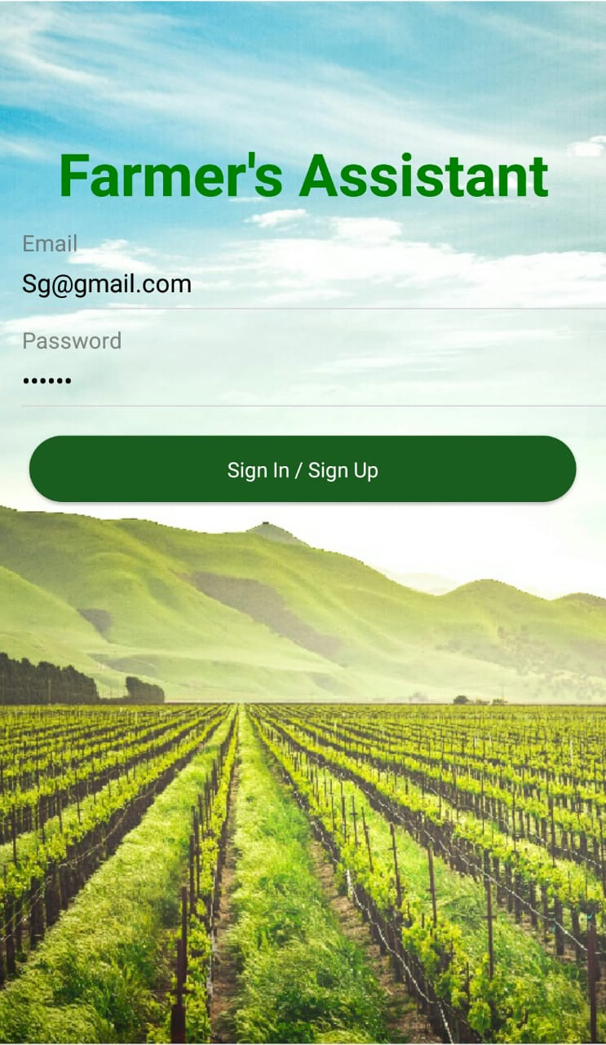

Slide 10
The App - Part 1: Know what grows best.
Here we used the data on soil nature, crops, climate and weather and trained a machine learning model to predict which crops need to be grown on a given soil for maximum yield and minimize cost.
We have implemented this using Soil moisture, N-P-K ratio, Dry matter (manure) already present in soil as parameter to ML model.
The model uses a decision tree based learning algorithm.

Slide 11
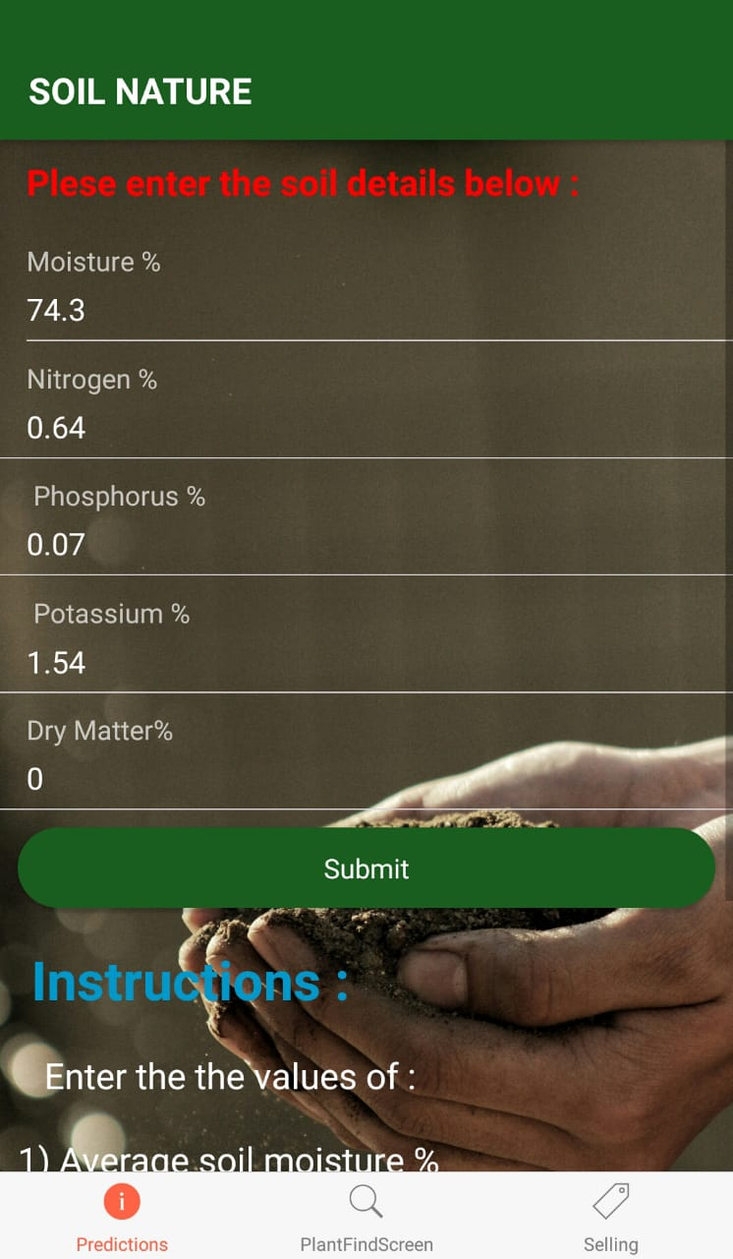
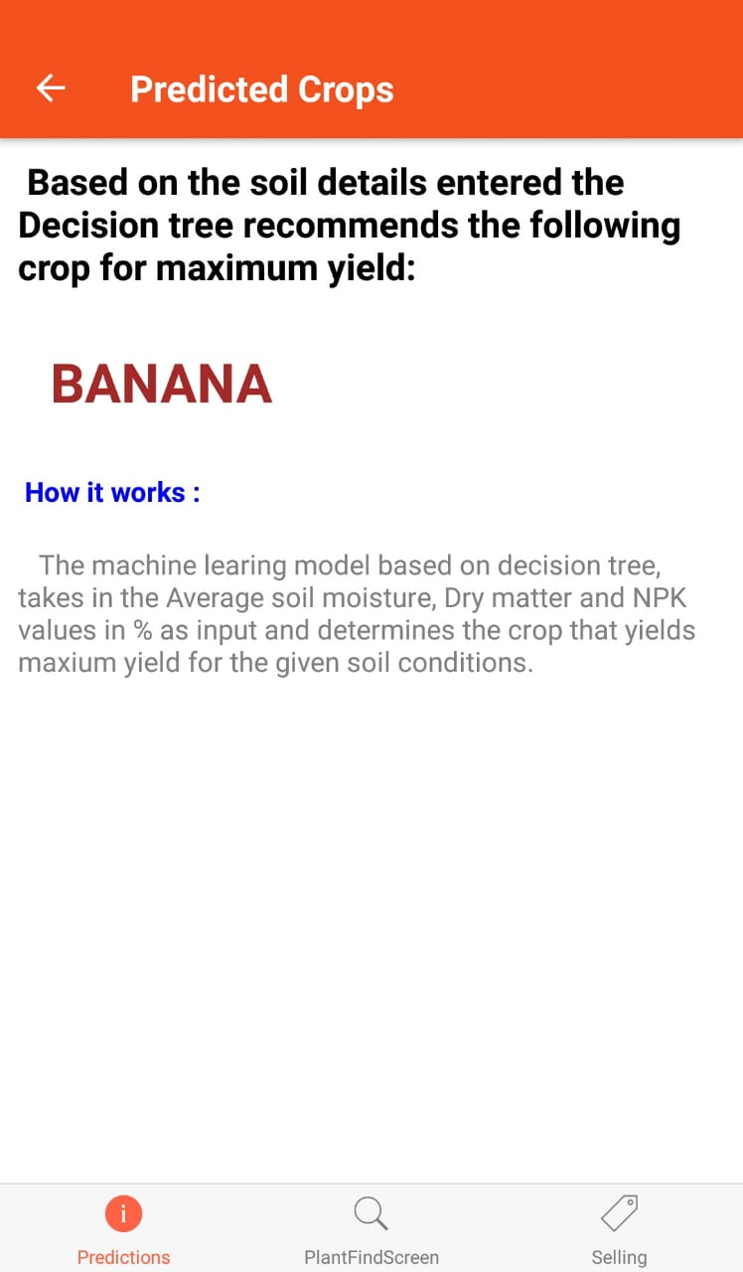

Slide 12

Validation of result
10:2:22 N:P:K fertiliser may be used for bananas cultivation.
https://www.daf.qld.gov.au/business-priorities/plants/fruit-and-vegetables/fruit-and-nuts/bananas/frequently-asked-questions-about-bananas/fertilising

Slide 13
Continued…
Therefore, in our case, N = 0.64% , P = 0.0778%, K = 1.24 %, this implies a N-P-K ratio of 10:2:24

Slide 14
Advantages of such approach
Fertilizers are added to get the soil nutrient levels to the ratio required by crop the farmer plans to grow leading to lots of expensive base work of cultivating soil.
But as our model already predicts which crop grows best given present condition , we are eliminating a major step of cultivating the soil to get it up to the required level.

Slide 15
The App-part 2: Grow what you can sell :
This platform can provide information of step by step procedure for cultivating a particular crop, possible diseases, and setbacks with the appropriate diagnosis based on soil, season and locality.
By doing this a very likable product can be achieved which is more likely to be sold since it's meeting the requirements of a buyer.

Slide 16
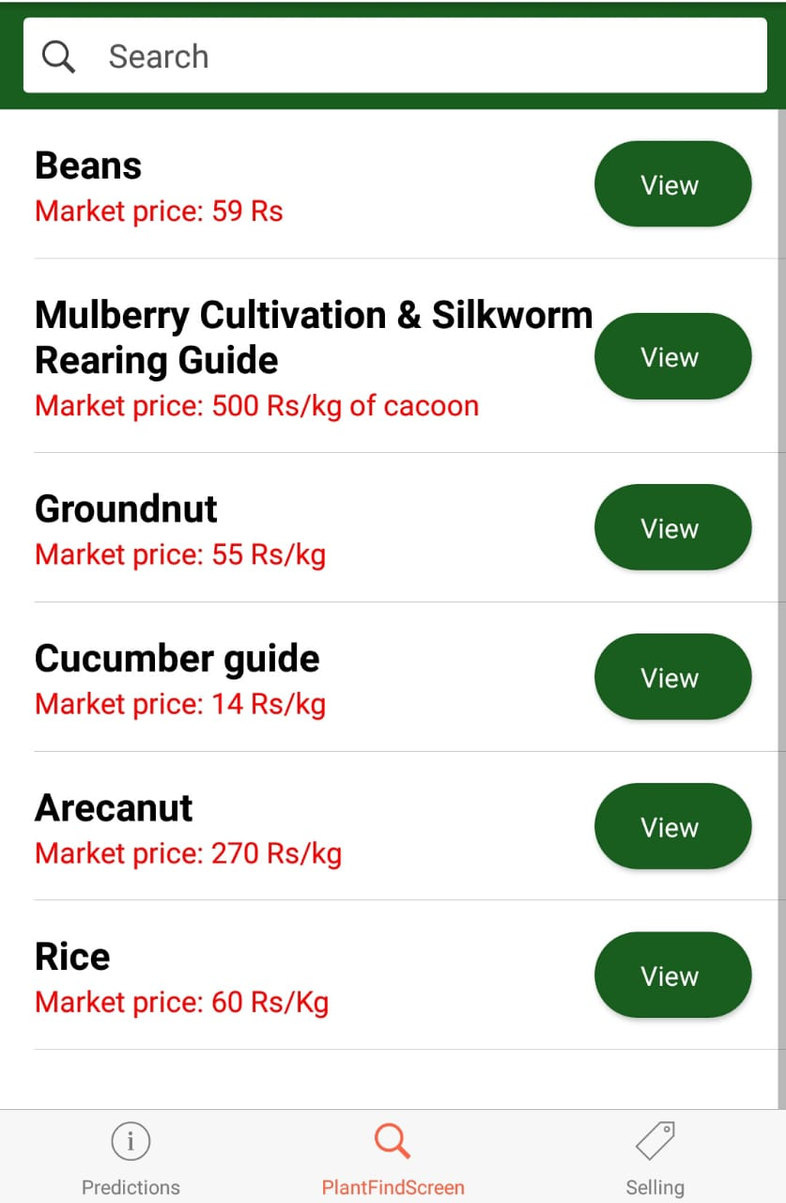
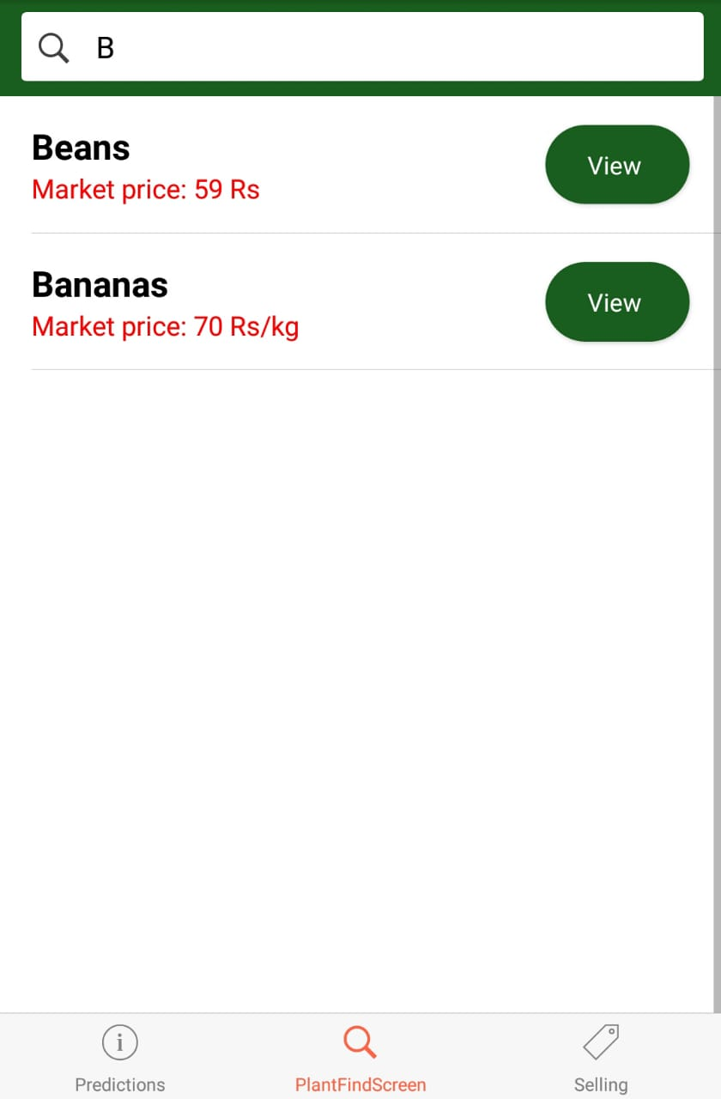

Slide 17
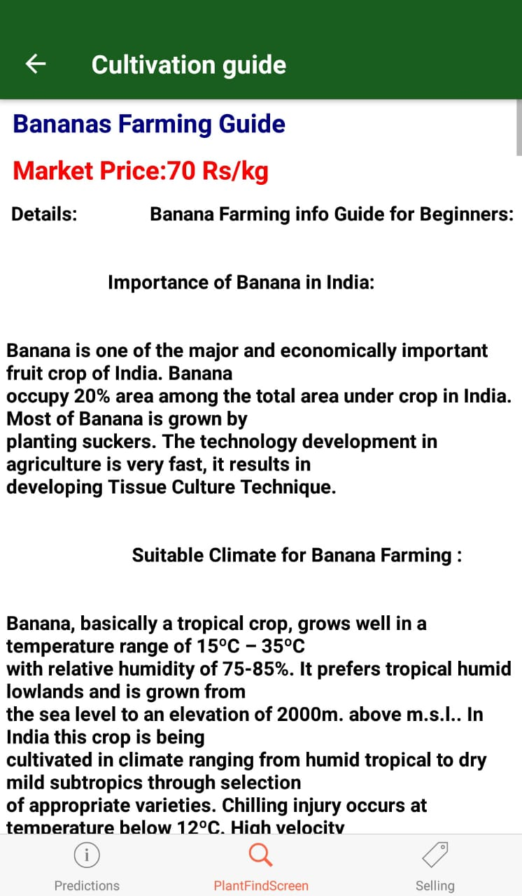

Slide 18
Adding crop data to data base
A web page is used to add or correct data about the crops on the server.
The access to this web page is give to only authorized / verified experts who can give accurate information about the crops. Thus our model is easily scalable.

Slide 19
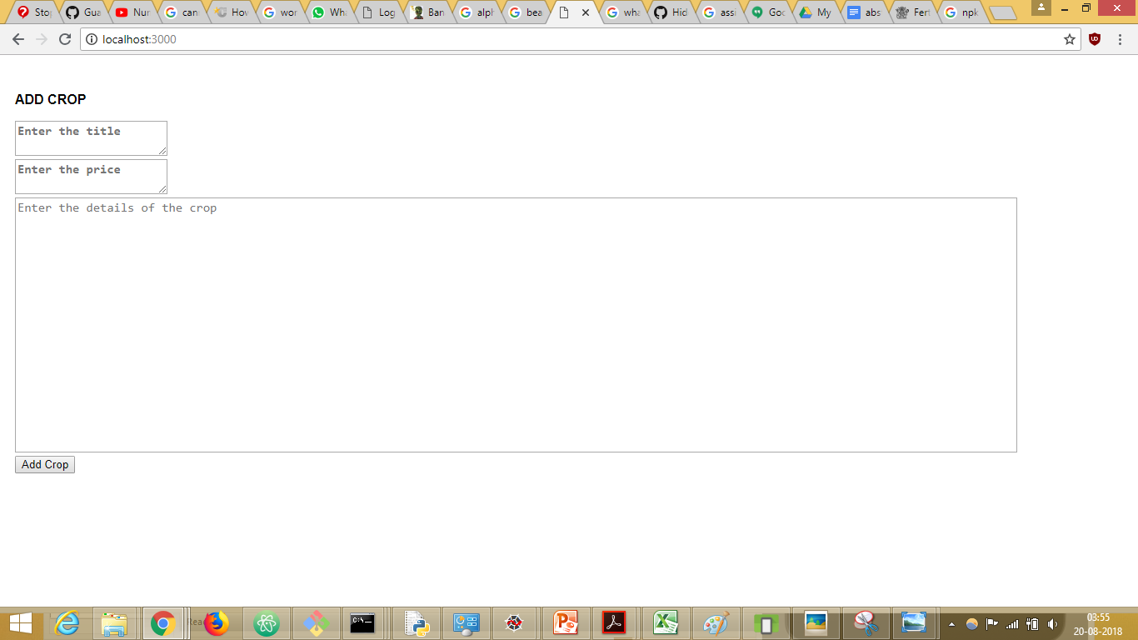

Slide 20
The App-part 3: Sell what you have grown:
We have provided information of the big players of the market such as big basket, scrap the retail prices from an authentic source and allow farmers to make their bargain and send quotation.

Slide 21
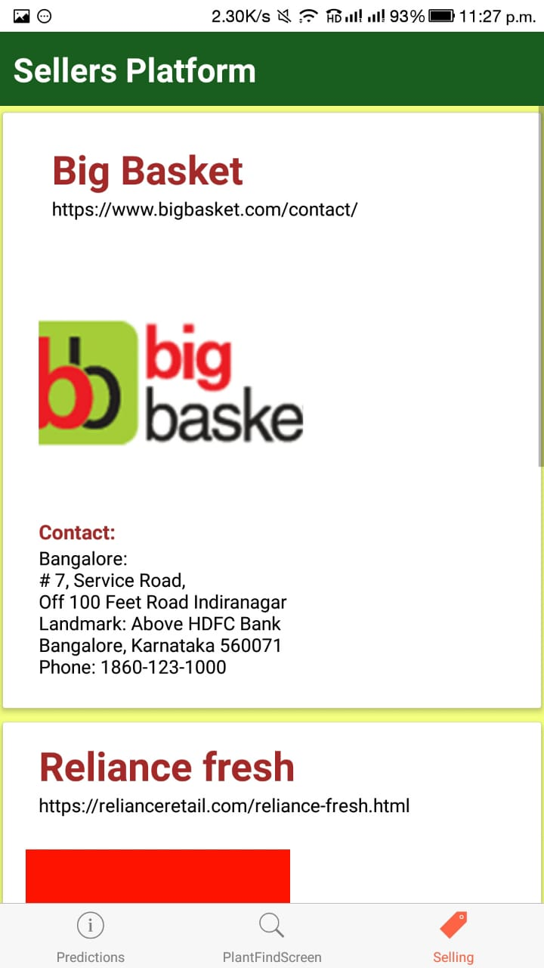

Slide 22
Technology stack
React Native
MeteorJS(nodeJS)
MongoDB
Python.
Flask.

Slide 23
Outcome
An amateur farmer can choose the crop with best yield based on his soil composition , Cultivate with best practices to obtain industry accepted standard and get exposed to right market.
Thus the objectives of our abstract are met.

Slide 24
THANK YOU

