Slide 1
Surveillance Assistance
Using Facial Recognition

Slide 2
Things we focussed on :
Face Detection
Database Management for Images and Respective ID
TimeStamp collection
DataBase Checker for the UNKNOWN detection
Using a minimum of 2 cameras together with a common server

Slide 3
Tech Used :
OpenCV
Python and Libraries
HTML/CSS (for web dev)

Slide 4
Things We could Implement :
Face Detection
Database Management for Images and Respective ID
TimeStamp collection
DataBase Checker for the UNKNOWN detection

Slide 5
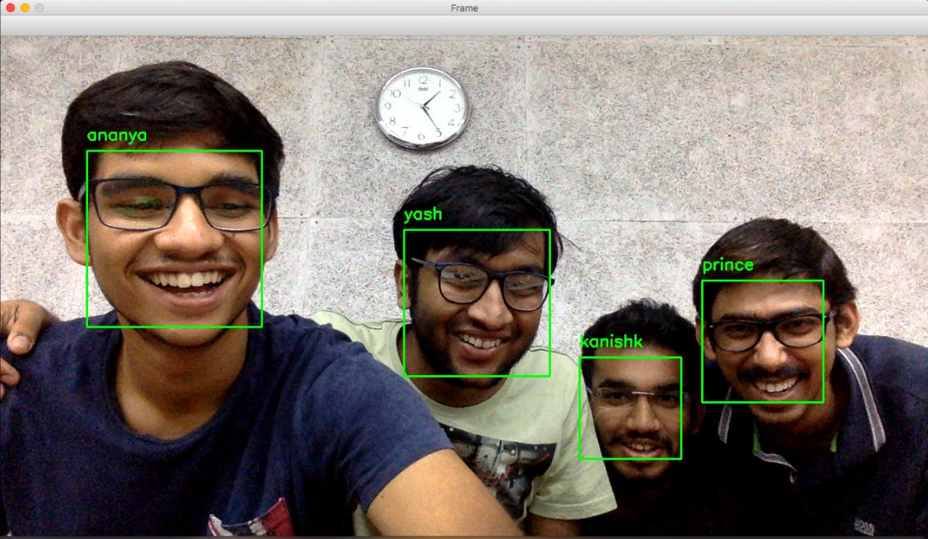
Things We could Implement :

Slide 6
Why we chose to make this project :
Image Recognition is one of the leading used-technology today in various fields in all kind of industries.
We wanted to make something which can be readily used without much dependency of the human interference.

Slide 7
Future Prospectus ::
Feasibility of manual feeding of “Unknown” person’s details by the customer.
Using Multiple Cameras in Sync to get the location of the “Unknown” person to get the Time vs Position graph.

