Slide 1

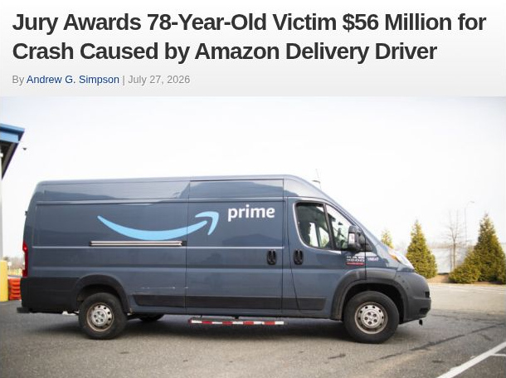
Physiological intelligence for work
Rafael Pradillo & Aoi Sugimoto
September 27, 2026
Notes:
NeuraSign interprets physiological signals into context for work applications.
Visual: original 3D geometry derived from the approved NeuraSign symbol. Art direction informed by the two reference collages supplied by the user.
Team members supplied by the team: Rafael Pradillo and Aoi Sugimoto. Presentation date: September 27, 2026.

Slide 2
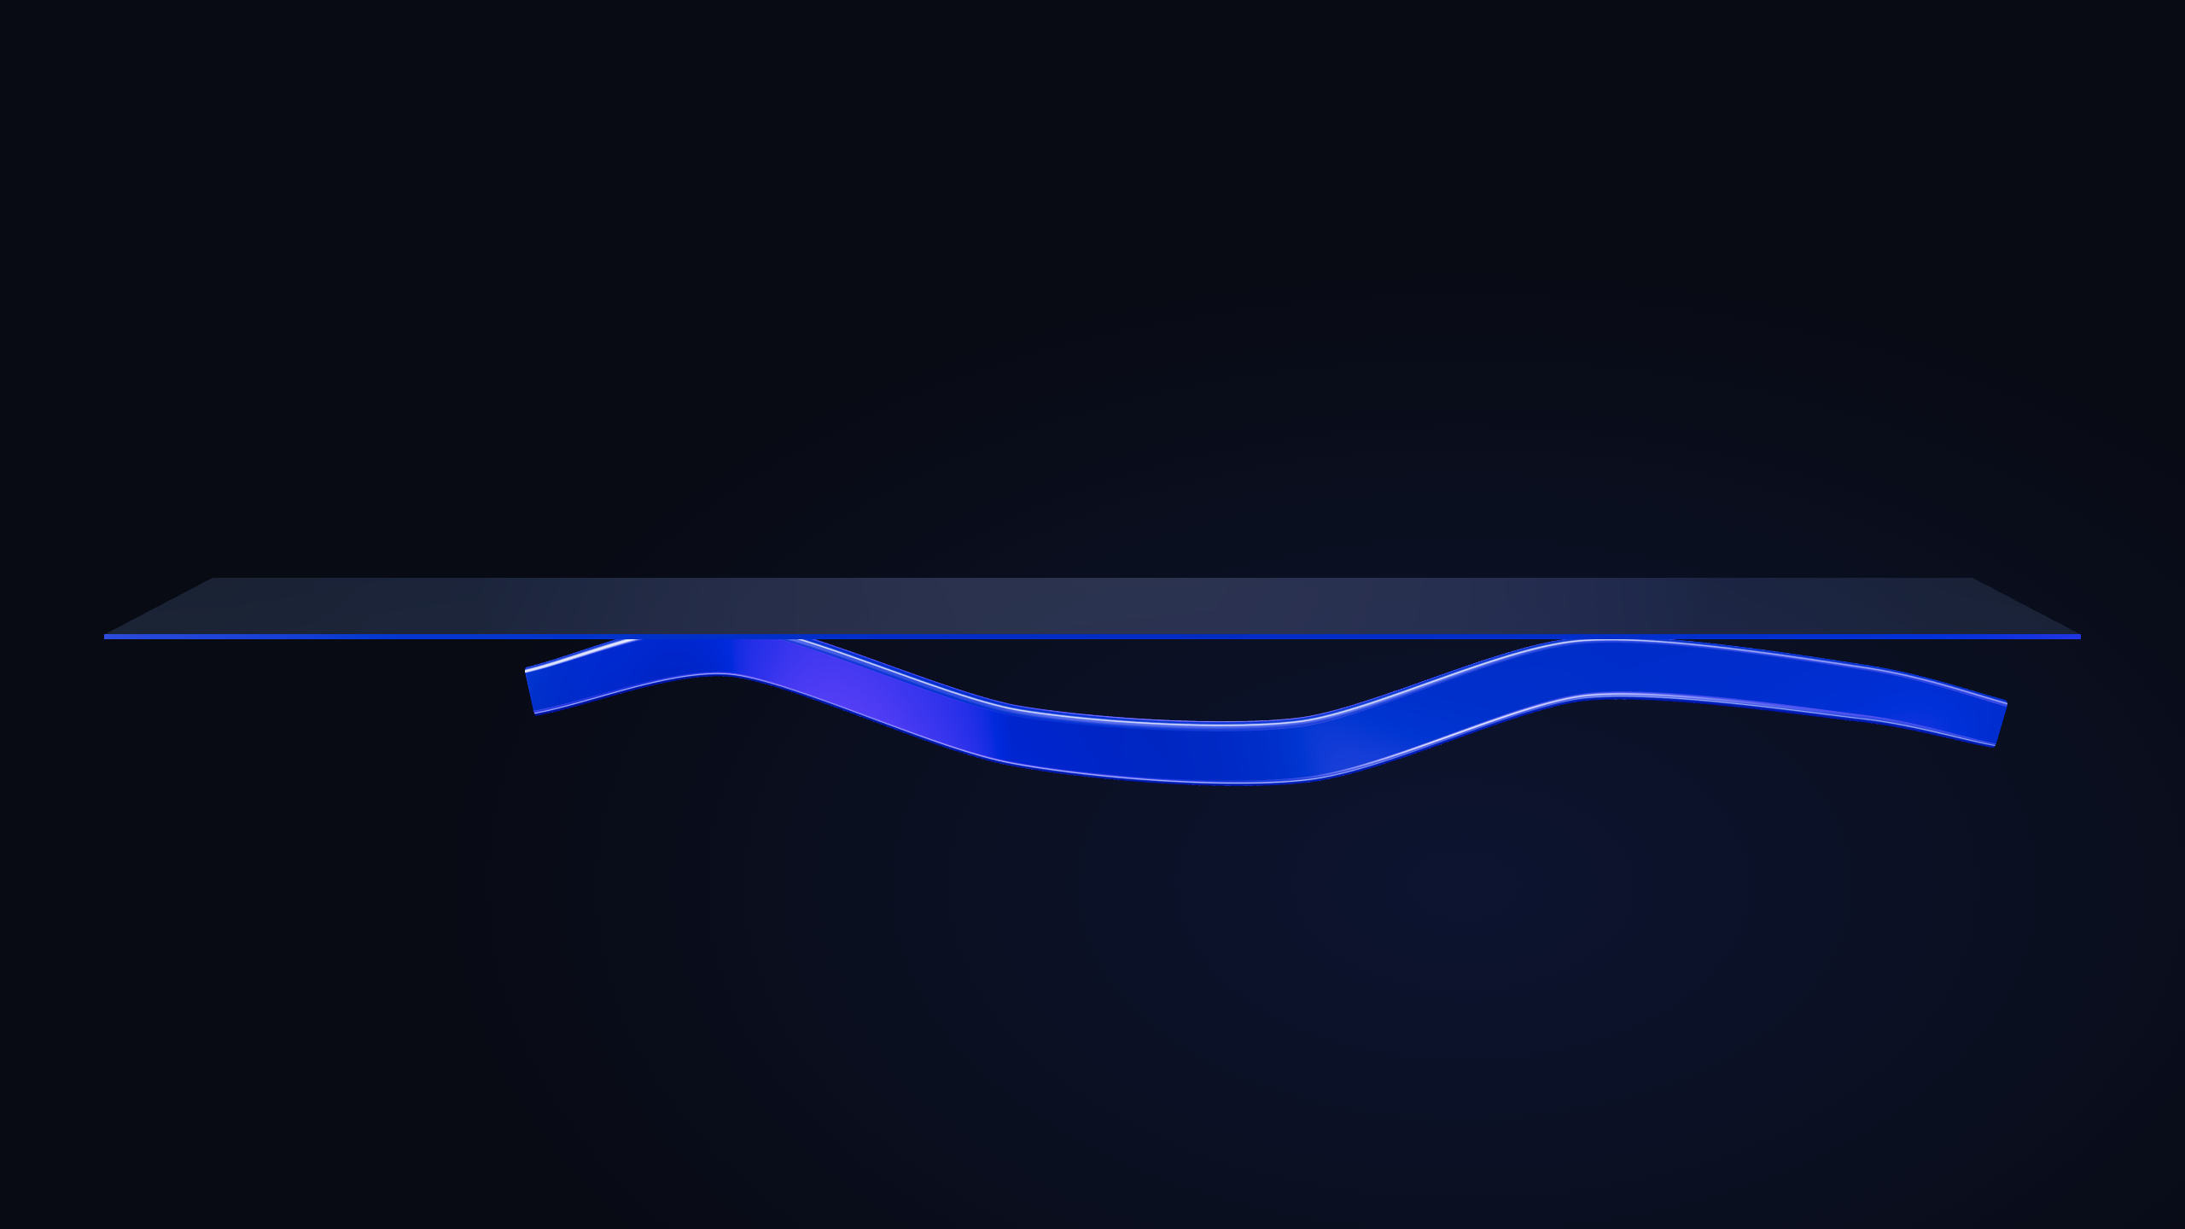
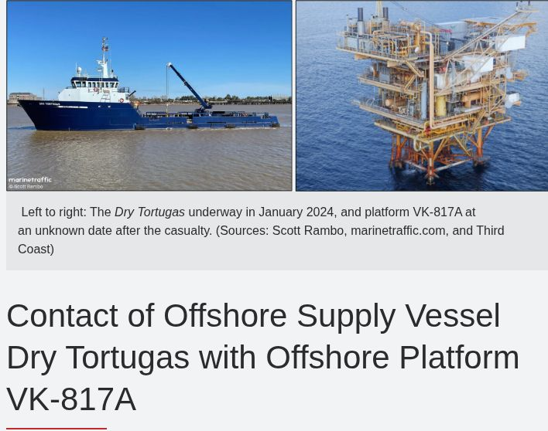
PROBLEM
Work is dynamic.
So is human capacity.
WHAT COMPANIES KNOW
Skills
Role
Calendar
Deadlines
THE MISSING CONTEXT
Fatigue
Focus
Stress
Cognitive load
Readiness
The risk: lost time and costly errors.
Notes:
Work demands change, and human capacity changes too. Companies commonly plan with skills, roles, calendars and deadlines. The product thesis is that many work decisions omit time-varying human context such as fatigue, focus, stress, cognitive load and readiness. This is not a claim that every employer ignores these factors; some sectors already run fatigue-management programs.
Missing this context can contribute to slower work and errors, with potentially costly consequences. No monetary figure or quantified benefit is asserted on this slide. The following planned slides will provide concrete external examples.
The glass plane and changing ribbon are a conceptual illustration, not measurements or a physiological signal. The named states do not imply that the prototype can directly or accurately measure each mental state.
Evidence:
CDC/NIOSH, Fatigue and Work: https://www.cdc.gov/niosh/fatigue/about/index.html (accessed 2026-09-27). Describes fatigue-related reductions in attention, memory, judgment and reaction speed.
HSE, Workload: https://www.hse.gov.uk/humanfactors/topics/workload.htm (accessed 2026-09-27). Describes changing workload, slower performance and errors under excessive workload.
Icon assets: Lucide, ISC license. https://lucide.dev/ . Icons represent the labeled concepts; they do not assert validated measurements.

Slide 3
Amazon
INSURANCE JOURNAL
$56M
Jury award
Loss of alertness.
Head-on collision.
Amazon delivery partner driver
Crash 16 Nov 2024
Verdict Jul 2026
Article photo: Amazon
Notes:
A Massachusetts jury awarded $56 million to Malcolm Carnwath after a delivery van struck his car in New Hampshire. This amount is a jury damages award, not a fine, physical repair cost, settlement, or confirmation of payment. The jury focused on damages after the driver admitted negligence and Agora Logistics and Amazon accepted liability. The driver worked for Agora Logistics LLC, an Amazon delivery service partner, rather than directly for Amazon.
Insurance Journal, Andrew G. Simpson, July 27, 2026: https://www.insurancejournal.com/news/east/2026/07/27/879162.htm (accessed September 27, 2026). Main source for the award and employment/liability context. Screenshot is a crop of the genuine article headline, byline, date, and article photograph. Article image credit: Amazon; the photograph shows an illustrative delivery vehicle, not the collision scene.
Boston Globe, July 24, 2026: https://www.bostonglobe.com/2026/07/24/metro/amazon-jury-verdict-malcolm-carnwath-middlesex-superior-court/ (accessed September 27, 2026). Court filings place the crash on November 16, 2024 and describe the driver falling asleep.
The case illustrates the consequences of drowsiness while driving. It does not establish a specific underlying physiological cause or demonstrate the effectiveness of NeuraSign.

Slide 4
Dry Tortugas
NATIONAL TRANSPORTATION SAFETY BOARD
$5M
Vessel and platform damage
Extra workload.
Asleep at the helm.
Reported sleep: 8–9 hours a day
Collision 16 Aug 2025
NTSB report 26 Aug 2026
Notes:
NTSB report MIR-26-27, dated August 26, 2026, concerns the August 16, 2025 collision of Dry Tortugas with offshore platform VK-817A. Total property damage was $5 million: $500,000 to the vessel and $4.5 million to the platform. This is a damage estimate, not a jury award or penalty.
The NTSB determined the probable cause was the on-watch captain falling asleep due to fatigue from work completed outside his scheduled 12-hour watch. He reported 8–9 hours of sleep per day during the preceding three days, while also volunteering for 2–3 hours of bilge cleaning during off-watch time each day. The report explains that additional physical work can raise fatigue despite sufficient sleep; the early-morning circadian low likely further increased his fatigue. The sleep duration is self-reported, not an objective measurement.
Primary report: https://www.ntsb.gov/investigations/AccidentReports/Reports/MIR2627.pdf, pages 1–2 and 6–8. Official investigation: https://www.ntsb.gov/investigations/Pages/DCA25FM054.aspx (both accessed September 27, 2026). The displayed report date is the date printed on the report, not the accident date or a claim about web publication.
Screenshot is a genuine crop from the NTSB investigation webpage. The original photo caption remains visible: vessel photograph Scott Rambo / MarineTraffic; platform photograph Third Coast. The ship photo predates the collision.
This case supports the problem of fatigue beyond nominal sleep duration. It does not demonstrate that NeuraSign could have detected or prevented this incident.

Slide 5
INSIGHT
Same skills.
Different capacity.
Same person, different moments
Lower cognitive load
Higher cognitive load
Physiological signals
State estimates
Work decisions
+ personal baseline
Notes:
INSIGHT
The same person's qualifications do not change from one moment to the next, but their physiological condition and experienced workload can. The two person icons are deliberately identical, including the skill badge. Lower and higher load are an illustrative comparison, not observed readings, scores, a fixed daily pattern or a claim that high load always means poor performance. The time arrow expresses change between moments, not an inevitable decline.
The opportunity is to use physiological observations, interpreted against the individual and context, as information for estimating aspects of changing human state and supporting work decisions. These estimates have uncertainty and differ by target. The diagram is the product thesis, not a claim that the prototype already estimates every state reliably, integrates models with the dashboard, or improves workplace outcomes. It does not claim that NeuraSign invented physiological state estimation or that no other organization considers human state.
Research basis retained from the original insight slide: Anders et al., Unobtrusive measurement of cognitive load and physiological signals in uncontrolled environments, Scientific Data 11, 1000 (2024), DOI 10.1038/s41597-024-03738-7. https://pmc.ncbi.nlm.nih.gov/articles/PMC11399273/ . The UNIVERSE study combines wearable physiology and task information, with personal workload labels and classification experiments. Performance varies by individual, task and signal quality. It does not validate NeuraSign or general-purpose readiness prediction.
The current research results and their limits are shown in the proof and model-evaluation slides. Workload experiments have not yet established a useful improvement over a rest/activity comparator. Personal baseline is part of the product/research approach; the illustration does not claim every reported model uses the same baseline.
Icons: Lucide, ISC license, https://lucide.dev/ . Native diagram elements and labels are editable.

Slide 6
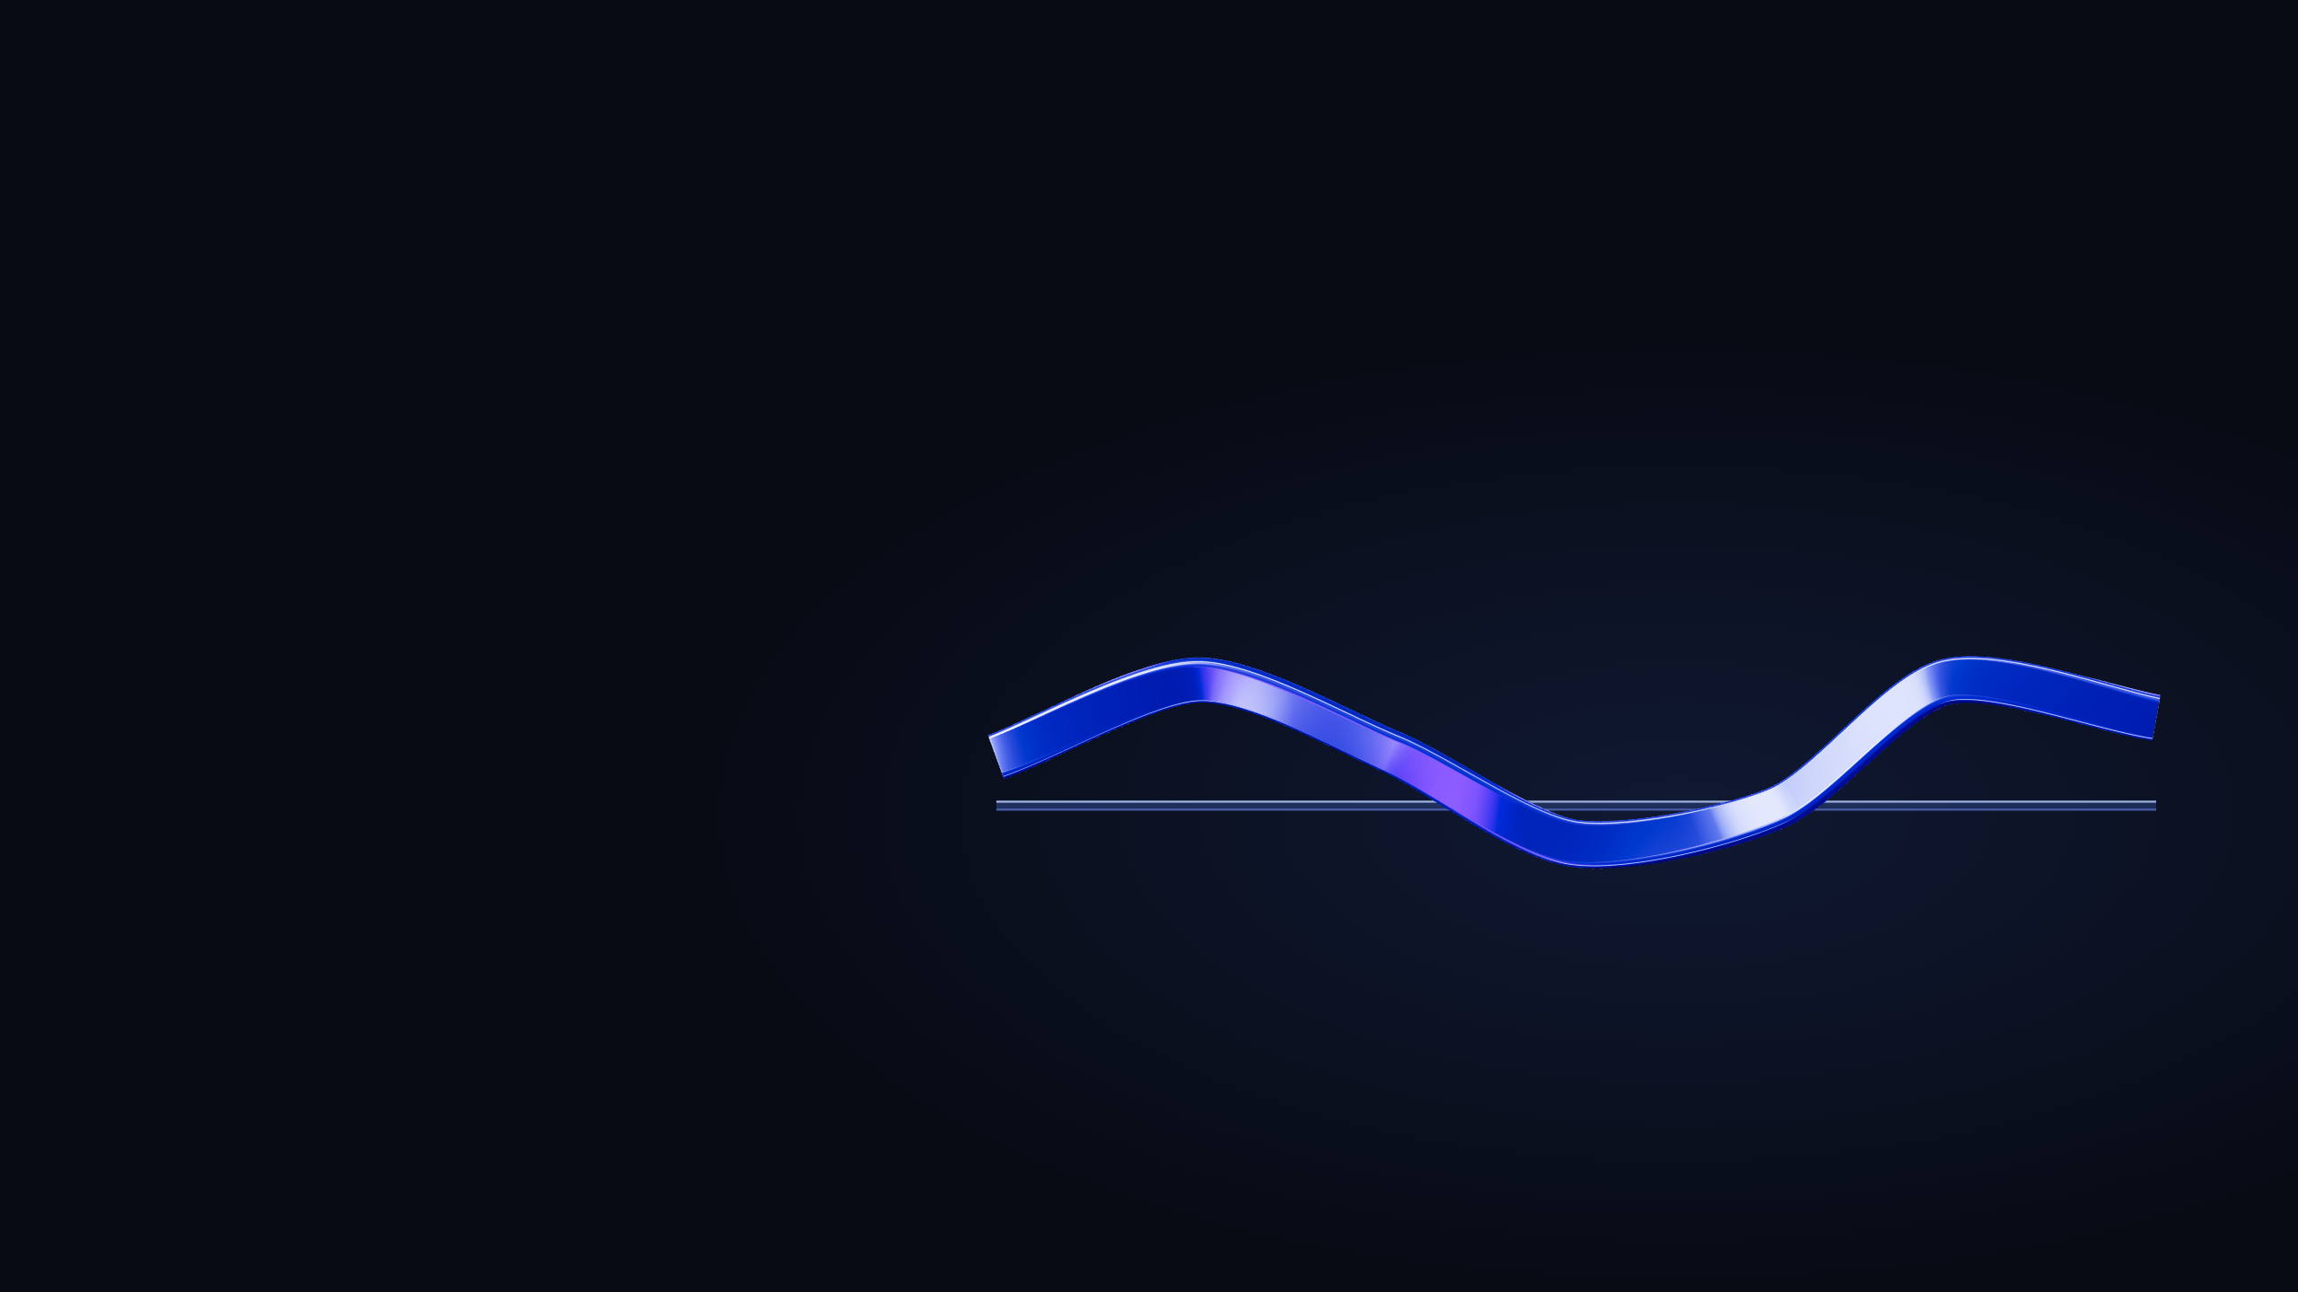
SOLUTION
Human-state intelligence
for adaptive work.
Work applications
Physiology
Work context
Personal baseline
Goal: adapt tasks, breaks and shifts to each person’s capacity.
TARGET PRIORITY
01
High-risk
03
02
High-pressure
operations
environments
High-performance
teams
Notes:
NeuraSign is a shared physiological intelligence layer for work applications. It combines physiological observations with work context, compares signals with a personal baseline and makes relative estimates of current human state available for work decisions. This enables work to adapt to current capacity, with people in control of consequential actions.
The open application constellation is illustrative, not exhaustive. Its symbols indicate task allocation, scheduling, safety workflows, focus support, team coordination and breaks. The plus marks additional application possibilities. Scheduling and wider operational integrations are product opportunities, not a claim that all of them ship in the current demo.
Target priority, descending: 1. High-risk operations: manufacturing, mining, logistics, energy. 2. High-pressure environments: healthcare, emergency response, aviation. 3. High-performance teams: engineering, security operations, consulting. All three are target markets. Their relative visual emphasis represents the user's stated priority, not measured market size, customer counts or proven suitability.
The demo uses HR, HRV, EDA, skin temperature and movement plus work context such as skills, availability, task priority and time-on-task. The current replay uses deterministic synthetic physiology and handcrafted relative heuristics; outputs are estimates, not direct measurements of cognitive state or a clinically validated model. The incident demo supports human, AI, human-plus-AI and wait options with critical human approval. Focus/break features provide optional local suggestions. No sleep monitoring is represented.
Sources: supplied target-market brief; local repository Neurasign/neurasign_server_dashboard, docs/demo-workspace.md, docs/architecture.md, docs/company-workspace.md; https://github.com/Guayamose/Neurasign. NeuraSign logo: original approved cobalt brand asset. Standard icon shapes: Lucide, ISC license, https://lucide.dev/.
USER OUTCOME
The product goal is to help managers adapt task assignment, breaks and shifts to people’s changing capacity. The diagram communicates the intended connected product. Current operational workflows use confirmed work context and human-reported concerns. Physiological model integration is a next step, as stated on the architecture slide. This outcome statement is a product goal, not a claim of measured productivity or safety improvement.

Slide 7
PROOF / VALIDATION
Scientific evidence
Market adoption
Our proof
Evidence for state estimates
Lab stress / WESAD
Stress
94.2%
HRV + EDA
Schmidt et al. (2018)
Selected-model accuracy
Mental fatigue
~300
HR / HRV
80% train / 20% test (people)
Matuz et al. (2021)
96.5% logistic reference
Workload
HRV + EDA
EGA workers
Daily Oura score
Hirachan et al. (2022)
Physiological wearables
~4
Readiness*
points / 100
HRV
Industrial heat safety
Reported prediction error
Kiviniemi et al. (2007)
Summer 2024
* Indirect support from
Emirates Global Aluminium
physical-training research.
Offline research
Dashboard integration pending
Notes:
SCIENTIFIC EVIDENCE
The research supports using physiological signals as inputs to estimates of specific states under studied conditions. Associations vary with context and person; none of these papers validates the NeuraSign model or directly measures a universal work-readiness variable.
STRESS: Schmidt, Reiss, Dürichen, Marberger and Van Laerhoven (2018), Introducing WESAD, a Multimodal Dataset for Wearable Stress and Affect Detection, ACM ICMI. DOI:10.1145/3242969.3242985. Original: https://www.eti.uni-siegen.de/ubicomp/papers/ubi_icmi2018.pdf . Wrist pulse-derived HR/HRV, EDA and temperature supported discrimination of induced stress from neutral/amusement conditions in15 lab participants. No benchmark percentage is used on this slide.
MENTAL FATIGUE: Matuz, van der Linden, Kisander, Hernádi, Karádi and Csathó (2021), Enhanced cardiac vagal tone in mental fatigue: Analysis of heart rate variability in Time-on-Task, recovery, and reactivity, PLOS ONE16(3):e0238670. DOI:10.1371/journal.pone.0238670. https://journals.plos.org/plosone/article?id=10.1371/journal.pone.0238670 . Forty-one analyzed participants completed sustained cognitive effort or a documentary-viewing control. Changes in heart rate and vagally mediated HRV accompanied time-on-task and subjective fatigue. This supports an association, not a direct or universal fatigue measurement; HRV also changed under some less-fatiguing conditions. No universal direction or cutoff is claimed. The lab used ECG; performance with NeuraSign wrist signals needs separate validation.
WORKLOAD: Hirachan, Mathews, Romero and Fernandez Rojas (2022), Measuring Cognitive Workload Using Multimodal Sensors, IEEE EMBC. https://pubmed.ncbi.nlm.nih.gov/36085818/ ; author manuscript https://arxiv.org/abs/2205.04235 . Twelve participants performed cognitive tasks at differing difficulty levels. Cardiac interval/HRV features from ECG and EDA features provided information for distinguishing workload conditions. This supports a physiological association and estimation approach; ECG-to-wrist transfer and deployment generalization require their own validation.
READINESS: Kiviniemi, Hautala, Kinnunen and Tulppo (2007), Endurance training guided individually by daily heart rate variability measurements, European Journal of Applied Physiology101:743-751. DOI:10.1007/s00421-007-0552-2. https://link.springer.com/article/10.1007/s00421-007-0552-2 . A4-week randomized study in26 moderately fit men used personal HRV trends to choose daily training intensity or rest. It supports HRV-informed adaptation of physical training. This is explicitly indirect support for a readiness concept, not proof of workplace cognitive readiness or the NeuraSign readiness score.
Skin temperature and movement provide additional physiological/context information; the slide does not imply that every input is a standalone validated measure of every target state.
MARKET EVIDENCE
EGA reported on22October2024 that approximately300 employees wore Kenzen devices during summer2024 to monitor indicators including heart rate and estimated core temperature, with feedback to wearer and safety staff. This demonstrates an adjacent industrial deployment, not a NeuraSign customer, paid contract amount or proven willingness to pay for NeuraSign. Heat safety differs from cognitive state. EGA's programme also included hydration, cooling and breaks; its illness outcomes cannot be attributed solely to wearables. Primary customer source: https://media.ega.ae/ega-achieved-third-consecutive-summer-of-zero-heat-related-illnesses/ . EGA reported further wearable trials on3June2025 without a new user count: https://media.ega.ae/ega-trialling-new-wearable-technology-as-part-of-annual-beat-the-heat-safety-programme/ .
OUR EVIDENCE
SOURCE AND STATUS
Updated from the founder's training and evaluation summary supplied in this conversation on 26 September 2026 (America/Los_Angeles). These are team-reported research results. The new experiment reports were not independently rerun or inspected for this edit. They supersede the older experiment examples previously shown in the deck; they must not be attributed to the earlier pinned repository commit. No workplace benefit, accident prevention, or universal mental-state accuracy has been validated by these numbers.
MODELLING APPROACH
Supervised learning in Python, using scikit-learn and CatBoost. Inputs are physiological signals and derived features; targets are known responses such as experimental conditions, questionnaires, the daily Oura score or NASA-TLX, depending on the dataset. Available signals include pulse, heart-rate variability, skin conductance, temperature, motion, sleep and physiological history, as applicable. Not every signal is used for every target or experiment.
Feature extraction includes means, variation, trends, peaks and physiological history as relevant. Missing values and scaling are fitted only on the training data. Hyperparameter/configuration comparisons include tree depth, regularization and selected signals. Selection optimizes balanced accuracy for classification or lower regression error, according to the experiment. People are separated across training and evaluation; records from one person do not simultaneously appear on both sides of a given split.
ALGORITHMS
Stress: ExtraTrees with 300 decision trees and logistic regression as a reference. SVM and gradient boosting were also compared.
Readiness: score regression. The original ensemble combines SVR and two CatBoost models. The latest variant combines two CatBoost models and HistGradientBoosting. The briefing does not establish that the approximate 4-point result is the score of every variant.
Fatigue: low/high classification and intensity regression. Compared ExtraTrees, CatBoost, linear models, SVM and ensembles.
Workload: NASA-TLX score regression. Compared Ridge, SVR, ExtraTrees, CatBoost and ensembles.
An ensemble combines predictions from multiple models. ExtraTrees aggregates decision trees. CatBoost trains successive boosting stages. Training or model complexity alone does not establish superior predictive performance.
STRESS / WESAD
The selected model achieved 94.2% reported accuracy, while the logistic reference achieved 96.5%. Do not call the selected model superior to the reference. The task distinguishes rest from laboratory-induced stress. It does not establish continuous workplace stress estimation, fatigue or alertness detection.
434 windows of 60 seconds, with 57 extracted features. Twelve people were used for development and selection among 32 configurations with four person-grouped validation folds. Three other people were reserved for the final test. The 434 windows are not 434 independent people. The briefing calls the stress result accuracy; do not relabel it balanced accuracy.
READINESS / DAILY OURA SCORE
Approximately 4 points of reported error on a 100-point scale when approximating the daily Oura score. This is a vendor-score approximation, not validation of instantaneous workplace readiness. The supplied updated summary does not name the error statistic, so the slide says reported error and does not introduce MAE, RMSE or a percentage accuracy. Do not infer the exact experiment version or reuse an older held-out sample count without supporting documentation.
FATIGUE
63.7% balanced accuracy compared with 66.7% for the earlier model in the same evaluation. New variants did not improve this result. A sufficiently reliable fatigue detector has not yet been demonstrated. Balanced accuracy gives equal importance to the low and high fatigue classes. Do not relabel this ordinary accuracy, or present the earlier-model comparator as a constant baseline.
WORKLOAD
Approximately 13 points of reported error on a 100-point NASA-TLX scale. A comparator that distinguishes only rest from activity has practically the same error, so useful additional predictive value from physiological signals has not been demonstrated. The updated summary does not identify the error statistic; do not label it MAE or RMSE without the experiment report.
LATEST NESTED EVALUATION
Latest readiness, fatigue and workload experiments use four outer folds for evaluation and three inner folds for model/configuration selection. Whole people remain separated across splits. Outer evaluation results do not choose the winning configuration. This is a nested process, not a claim of twelve independent final tests or twelve production models. The WESAD development/final-test setup is described separately and must not be relabeled as this same nested experiment.
DEPLOYMENT
The trained models are saved and documented in the research engine. The dashboard still uses experimental formulas. These trained artifacts are not yet integrated into the dashboard. Research evaluation is not a deployed end-to-end performance claim.
Graphical assets: Lucide ISC icons, https://lucide.dev/ .
Participant split shown as 80% train / 20% test: 12 of 15 participants formed the development/training pool, including person-grouped model-selection cross-validation; 3 of 15 participants were reserved for final testing. Percentages count participants, not windows.

Slide 8
IMPACT
Stress and readiness
Classical supervised learning. No deep learning.
STRESS
DAILY READINESS
94%
3.98
correct predictions
points average error / 100
81 correct / 86 one-minute samples
Average gap from Oura’s daily score
Rest vs lab stress (WESAD)
4 unseen people / 684 test days
ExtraTrees
SVR + two CatBoost models
300 decision trees
IFH Affect dataset
Test participants excluded from training. Offline results; workplace impact awaits pilots.
Notes:
IMPACT: STRESS AND DAILY READINESS
These are predictive model results from offline evaluation. Both prediction systems use classical supervised machine learning with extracted numerical features, not neural networks or deep learning. This statement describes the prediction models, not every component of the broader application. Workplace outcomes and prospective business impact remain to be measured in pilots.
STRESS: WHERE 94% COMES FROM
ExtraTrees, 300 decision trees, selected using development data before inspecting the held-out test. 81 correct predictions out of 86 non-overlapping 60-second test windows: 81 / 86 × 100 = 94.186%, reported as 94.19% in the experiment, 94.2% to one decimal, and rounded to 94% on this slide. The slide calls windows one-minute samples, not independent participants.
Task: distinguish WESAD baseline/rest from the experimentally induced TSST laboratory stress condition. This is protocol-condition recognition, not independently measured instantaneous employee stress. Other activities and transition windows were excluded.
WESAD evaluation: 15 people and 434 eligible windows in total. 12 people (80%) used for development and model selection, with 3 other people (20%) reserved for the final test. Four person-disjoint development folds select among 32 fixed configurations. There are 57 extracted features from synchronized Empatica E4 wrist BVP, EDA, temperature and accelerometer signals. Preprocessing fits training data only.
Selected model balanced accuracy is 92.23%, a separate metric. A fixed logistic-regression reference scored 96.51% ordinary accuracy on the same test, higher than the selected ExtraTrees model. The model was not switched after the test results. We do not claim superiority to that reference or population reliability from three held-out people.
Sources:
https://github.com/Guayamose/Neurasign/blob/1286e55bf4cb1b56aecf2a32fda3cc1415a4a386/neurasign%20engine/experiments/022-wesad-stress-results.md
https://github.com/Guayamose/Neurasign/blob/1286e55bf4cb1b56aecf2a32fda3cc1415a4a386/neurasign%20engine/src/neurasign_engine/wesad_stress_022.py
READINESS: WHERE 3.98 POINTS COMES FROM
Original experiment 016, IFH Affect data, predicting Oura's vendor-generated daily Readiness Score on its 1–100 scale. This is a daily score approximation, not an independently validated estimate of immediate workplace readiness.
Model: combine predictions from one SVR regressor and two CatBoost regressors. Development compares 30 configurations of Ridge, SVR, ExtraTrees and CatBoost using four person-disjoint folds. The selected ensemble consists of SVR C10 and CatBoost depths 5 and 3, and is frozen before the held-out evaluation. The reported result must not be attributed to the newer CatBoost/HistGradientBoosting refinement.
Data: 18 retained participants with 3,472 daily observations. Development uses 14 people / 2,788 days. The final test uses 4 other people / 684 days. Predictors include completed-sleep physiology, sleep duration/stages, prior activity and strictly earlier histories; target scores and other vendor scores are excluded.
Calculation: for every test day, calculate the absolute difference between our prediction and Oura's daily score. Average those differences within each of the four test people, then average the four person-level means with equal weight. This produces 3.98 points mean absolute error (MAE), described on the slide as the average gap. It is not a pooled average of all 684 days, a guaranteed error bound, or 96.02% accuracy. RMSE is 5.30, a different metric.
Source:
https://github.com/Guayamose/Neurasign/blob/1286e55bf4cb1b56aecf2a32fda3cc1415a4a386/neurasign%20engine/experiments/016-readiness-oura-results.md
Dataset source recorded in that report: https://zenodo.org/records/10458511
Both models are research artifacts. Production/company-workflow integration of these physiological models and prospective validation of workplace outcomes remain pending. Sources checked 2026-09-27.

Slide 9
USE CASES
01
02
03
Dynamic task
Overload
Safety-critical
assignment
prevention
operations
SOC + hospital emergencies
Long hospital shifts
Surgery
Suggest the next
Prompt a break
Support a pre-op
responder.
or rotation.
team check-in.
Illustrative workflows
Notes:
USE CASES — ILLUSTRATIVE WORKFLOWS
These are proposed applications requested by the founder, not claims of existing deployments, clinical validation or demonstrated outcomes.
1. Dynamic task assignment. During an incident in a security operations centre (SOC) or hospital emergency response, combine qualified staff availability, skills, urgency and work context with physiological state estimates to suggest a responder or reassignment. A coordinator reviews the suggestion; the slide does not imply that physiology overrides clinical qualifications or triage. The bars are schematic capacity cues, not measured scores.
2. Overload prevention. During a long hospital shift, changes relative to a personal baseline can supply context for a suggested break or rotation, subject to human review and staffing constraints. The plotted line is an illustrative diagram, not research data, a model result, a risk threshold or a claim that overload has been prevented. No sleepiness monitoring is implied.
3. Safety-critical operations. Before surgery, relevant state context could support a team check-in about workload, staffing and task allocation. NeuraSign does not determine surgical fitness, certify readiness, authorise surgery, diagnose a condition or replace clinical judgement. The conversation symbol represents a human team discussion.
Graphic assets: Lucide ISC vector icons, https://lucide.dev/. Native editable slide text and diagram connectors; vector illustrations are schematic.

Slide 10


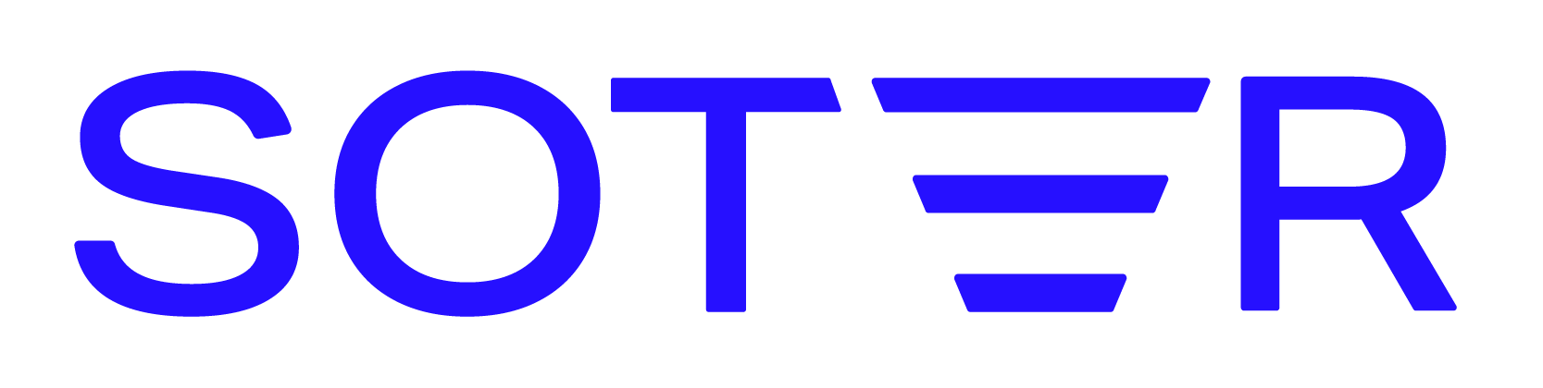








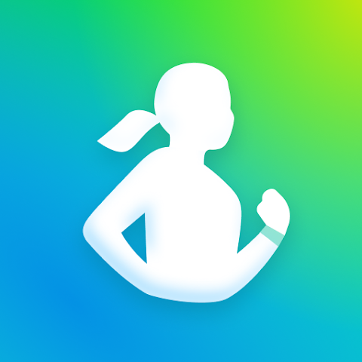

COMPETITION & DIFFERENTIATION
Vision: combine physiology and work context to guide team decisions.
Orchestration
Safety workflows
Fatigue management
Athlete workload
Watch
Samsung Health
Monitoring
Individual optimization
Workforce optimization
Planned advantage: workplace datasets tied to real outcomes and workflow integrations.
Qualitative product positioning. NeuraSign shows product vision.
Notes:
COMPETITION & DIFFERENTIATION
This map is our qualitative interpretation of product emphasis, not a scored feature comparison or an empirical ranking. Horizontal positions distinguish personal use from collective or organizational use. Vertical positions describe a spectrum from monitoring, through guidance/coaching and intervention support, to coordinated workflows. The broad labels simplify capabilities and are not mutually exclusive. All named consumer brands have some guidance or recommendations; lower positions do not mean that they only collect data. Products and editions vary. NeuraSign's upper-right position shows the proposed product direction, not a claim of deployment scale, market leadership, validated outcomes or functionality beyond the existing demo.
DIFFERENTIATION
NeuraSign's intended focus is combining physiological state estimates, skills and work context to support task coordination across a team. Existing providers already convert data into recommendations or operational interventions. We do not claim to be the only provider in workforce action or orchestration.
PERSONAL PRODUCTS
WHOOP provides personalized guidance from recovery, strain and other health data: https://support.whoop.com/s/article/How-to-Use-the-AI-Powered-WHOOP-Coach . Oura consumer provides readiness insights and personalized Advisor guidance: https://ouraring.com/blog/oura-advisor/ . Garmin offers readiness-informed daily suggested workouts: https://www.garmin.com/en-US/garmin-technology/running-science/physiological-measurements/daily-suggested-workouts-feature/ . Polar FitSpark recommends daily workouts using training history and recovery: https://support.polar.com/en/fitspark-daily-training-guide . Apple Watch includes vitals, training load and Workout Buddy: https://support.apple.com/guide/watch/use-workout-buddy-apd65c7938e6/watchos . Fitbit devices also support readiness and personal coaching via Google's health app: https://support.google.com/googlehealth/answer/14236710?hl=en and https://support.google.com/googlehealth/answer/16961408?hl=en . The Fitbit logo identifies the requested device brand. Samsung Health includes energy insights and personalized guidance: https://www.samsung.com/us/apps/samsung-health/ . Ultrahuman provides recovery insights and workout recommendations, including its Les Mills integration: https://cyborg.ultrahuman.com/press-releases/ultrahuman-and-les-mills-launch-les-mills-powerplug .
COLLECTIVE PRODUCTS
Oura's current business offering is Oura for Organizations / Oura Enterprise Platform, rather than a separate invented Teams logo. It supplies group dashboards, role-based access, export and an API: https://organizations.ouraring.com/ . Catapult supplies athlete monitoring, team data and coaching support for training-load decisions: https://www.catapult.com/solutions/athlete-monitoring . Fatigue Science Readi supplies worker forecasts, supervisor alerts, interventions and task/schedule planning support: https://fatiguescience.com/readisupervise-fatigue-interventions and https://fatiguescience.com/how-it-works . SoterAI supplies safety/ergonomics workflows with owners and follow-up, while SoterCoach supports ergonomic feedback: https://www.soter.com/workflows and https://www.soter.com/sotercoach . SmartCap provides EEG fatigue alerts, group reporting, escalation and integration with Wencomine FMS; customers also use its data to inform rostering and task rotation: https://www.wencomine.com/our-solutions/safety . We do not infer automatic staff assignment from dashboard or API capabilities alone.
LOGO SOURCES
Logos are authentic supplied brand assets or faithful rasterizations of official website vector assets. Oura Enterprise reuses Oura's master brand plus a native product label. NeuraSign reuses the approved original imagotype. Source provenance:
[
{
"company": "Samsung Health",
"file": "samsung-health.png",
"source_webpage": "https://play.google.com/store/apps/details?id=com.sec.android.app.shealth",
"official_parent_webpage": "https://www.samsung.com/us/apps/samsung-health/",
"asset_url": "https://play-lh.googleusercontent.com/OS7TGfRDIg8sbKxzYpsAr6fcg8vWPBV6Wx85alc0EQivKZY4I6VQuFRNaFSyi07ZydngVcxFkmVUUkr32khBVg=w480-h960",
"note": "Current Samsung Electronics app icon from official Google Play listing linked by Samsung. Original pixels converted to PNG; not recolored."
},
{
"company": "Ultrahuman",
"file": "ultrahuman.png",
"source_webpage": "https://www.ultrahuman.com/",
"asset_url": "https://www.ultrahuman.com/",
"asset_location": "inline SVG wordmark, footer, viewBox 0 0 1280 118; saved as ultrahuman-inline-24.svg",
"note": "Exact official inline SVG geometry, currentColor resolved as white, rasterized to transparent PNG. No standalone asset URL exists for this inline SVG."
},
{
"company": "Fatigue Science",
"file": "fatigue-science-white.png",
"source_webpage": "https://fatiguescience.com/identity-guidelines",
"asset_url": "https://fatiguescience.com/hubfs/FatigueScience_June2024/Images/FatigueScience_White-1.svg",
"note": "Official white SVG from identity guideline page footer, rasterized faithfully to transparent PNG."
},
{
"company": "Catapult",
"file": "catapult.png",
"source_webpage": "https://www.catapult.com/newsroom",
"asset_url": "https://www.catapult.com/newsroom",
"asset_location": "inline SVG header, selector svg.brand-logo; saved as catapult-official.svg",
"note": "Exact official white header SVG rasterized to PNG. No standalone asset URL for this inline SVG; linked press zip did not download as valid archive."
}
]
{
"retrieved_at": "2026-09-27T02:48:15.426Z",
"assets": [
{
"brand": "Apple Watch",
"source_page": "https://www.apple.com/watch/",
"asset_url": "https://images.apple.com/v/watch/a/images/logo_watch_hero.svg",
"svg": "/workspace/scratch/b6859d146926/.build/competition/logos/apple-watch.svg",
"png": "/workspace/scratch/b6859d146926/.build/competition/logos/apple-watch.png",
"color": "Original near-black #010202",
"notes": "Official Apple-hosted generic Apple Watch lockup. Original colors unchanged; transparent. Use on a light backing if needed."
},
{
"brand": "Polar",
"source_page": "https://www.polar.com/en/media-room",
"asset_url": "https://www.polar.com/img/footer/polar-footer-logo.svg",
"svg": "/workspace/scratch/b6859d146926/.build/competition/logos/polar-footer.svg",
"png": "/workspace/scratch/b6859d146926/.build/competition/logos/polar-footer.png",
"color": "Official white wordmark with red accent",
"notes": "Official website footer version. Original colors unchanged; transparent. Preferred on dark #080B14."
},
{
"brand": "Polar",
"source_page": "https://www.polar.com/en/media-room",
"asset_url": "https://www.polar.com/img/polar-logo.svg",
"svg": "/workspace/scratch/b6859d146926/.build/competition/logos/polar.svg",
"png": "/workspace/scratch/b6859d146926/.build/competition/logos/polar.png",
"color": "Official black wordmark with red accent",
"notes": "Alternate official website header version. Original colors unchanged; transparent."
},
{
"brand": "Apple",
"source_page": "https://www.apple.com/macbook-pro/",
"asset_url": "https://www.apple.com/macbook-pro/ (inline globalnav Apple SVG)",
"css_url": "https://www.apple.com/api-www/global-elements/global-header/v1/assets/globalheader.css",
"svg": "/workspace/scratch/b6859d146926/.build/competition/logos/apple-white.svg",
"png": "/workspace/scratch/b6859d146926/.build/competition/logos/apple-white.png",
"notes": "Official inline Apple navigation path, resolved using official dark-theme hover CSS: --r-globalnav-color-hover:#FFFFFF; .globalnav-link:hover color uses this variable; svg fill:currentColor. Original path untouched. Transparent bounds cropped after rasterization. Source page body explicitly has globalheader-dark."
}
]
}
{
"retrieved_at": "2026-09-27T02:49:04.101238+00:00",
"assets": [
{
"brand": "WHOOP",
"source_page": "https://developer.whoop.com/docs/developing/design-guidelines/",
"asset_url": "https://developer.whoop.com/assets/files/WHOOP%20-%20Logos-771dd7bce35d93f93653f2ae3225916a.zip",
"archive_member": "Logo/Wordmark/WHOOP Logo White@3x.png",
"png": "/workspace/scratch/b6859d146926/.build/competition/logos/whoop.png",
"conversion": "None. Original official transparent PNG copied unchanged.",
"color": "Official white",
"dimensions_px": [
600,
96
],
"transparent": true,
"tight_png": "/workspace/scratch/b6859d146926/.build/competition/logos/whoop-tight.png",
"tight_conversion": "Only fully transparent margins removed; logo artwork/color unchanged."
},
{
"brand": "Fitbit",
"source_page": "https://www.fitbit.com/dev",
"asset_url": "https://www.fitbit.com/static/FitbitLogosAndGuidelines.zip",
"archive_member": "fitbit-logo-2016-10-31/Fitbit_logo_2C_reversed/Fitbit_logo_reversed_RGB.png",
"png": "/workspace/scratch/b6859d146926/.build/competition/logos/fitbit.png",
"conversion": "None. Original official transparent PNG copied unchanged.",
"color": "Official reversed turquoise/white",
"notes": "2016 logo package still linked by official developer website at retrieval.",
"dimensions_px": [
2304,
600
],
"transparent": true,
"tight_png": "/workspace/scratch/b6859d146926/.build/competition/logos/fitbit-tight.png",
"tight_conversion": "Only fully transparent margins removed; logo artwork/color unchanged."
},
{
"brand": "Garmin",
"source_page": "https://www.garmin.com/it-IT/creative/styleguide/",
"asset_url": "https://static.garmincdn.com/gdc/style-guide/Garmin-Logo-Without-Delta.zip",
"archive_member": "Garmin Logo Without Delta/PNG/Garmin Logo Without Delta-white-high-res.png",
"png": "/workspace/scratch/b6859d146926/.build/competition/logos/garmin.png",
"conversion": "None. Original official transparent PNG copied unchanged.",
"color": "Official white logo without delta",
"dimensions_px": [
2177,
732
],
"transparent": true,
"tight_png": "/workspace/scratch/b6859d146926/.build/competition/logos/garmin-tight.png",
"tight_conversion": "Only fully transparent margins removed; logo artwork/color unchanged."
},
{
"brand": "Oura",
"asset_url": "https://ouraring.com/newsroom",
"source_selector": "footer svg[viewBox=\"0 0 993 311\"]",
"css_source_url": "https://ouraring.com/b/a/ecom-website/v1.135.0/_next/static/css/4d1b67b966e5ee79.css",
"css_inherited_color": "#838280",
"conversion": "Official inline SVG extracted without path changes; inherited official footer text-gray-400 currentColor resolved from published CSS, then transparent PNG rasterization.",
"png": "/workspace/scratch/b6859d146926/.build/competition/logos/oura.png",
"svg": "/workspace/scratch/b6859d146926/.build/competition/logos/oura.svg",
"color": "Official footer gray #838280",
"notes": "Asset is an inline SVG in the official webpage; no independent image URL exists. Source selector and CSS URL are provided. Sharp rasterization at 1200px preserves paths/proportions.",
"source_page": "https://ouraring.com/newsroom",
"dimensions_px": [
1200,
376
],
"transparent": true,
"tight_png": "/workspace/scratch/b6859d146926/.build/competition/logos/oura-tight.png",
"tight_conversion": "Only fully transparent margins removed; logo artwork/color unchanged.",
"asset_type": "Inline SVG embedded in source webpage; no separate SVG URL",
"alternatives": [
{
"brand": "Oura for Organizations",
"source_page": "https://organizations.ouraring.com/",
"asset_url": "https://organizations.ouraring.com/_assets/header-logo-desktop.svg",
"svg": "/workspace/scratch/b6859d146926/.build/competition/logos/oura-organizations.svg",
"png": "/workspace/scratch/b6859d146926/.build/competition/logos/oura-organizations.png",
"dimensions_px": [
1800,
208
],
"transparent": true,
"conversion": "Official SVG rasterized unchanged with Sharp.",
"color": "Official #F1F0EE",
"notes": "Full organization offering lockup, landscape."
},
{
"brand": "Oura for Organizations",
"source_page": "https://organizations.ouraring.com/",
"asset_url": "https://organizations.ouraring.com/_assets/header-logo-mobile.svg",
"svg": "/workspace/scratch/b6859d146926/.build/competition/logos/oura-white.svg",
"png": "/workspace/scratch/b6859d146926/.build/competition/logos/oura-white.png",
"dimensions_px": [
1200,
352
],
"transparent": true,
"conversion": "Official SVG rasterized unchanged with Sharp.",
"color": "Official #F1F0EE",
"notes": "Full organization offering lockup, stacked. Not generic Oura-only."
}
]
},
{
"brand": "Apple Watch",
"source_page": "https://www.apple.com/watch/",
"asset_url": "https://images.apple.com/v/watch/a/images/logo_watch_hero.svg",
"svg": "/workspace/scratch/b6859d146926/.build/competition/logos/apple-watch.svg",
"png": "/workspace/scratch/b6859d146926/.build/competition/logos/apple-watch.png",
"color": "Original near-black #010202",
"notes": "Official Apple-hosted generic Apple Watch lockup. Original colors unchanged; transparent. Use on a light backing if needed.",
"dimensions_px": [
1200,
265
],
"transparent": true,
"tight_png": "/workspace/scratch/b6859d146926/.build/competition/logos/apple-watch-tight.png",
"tight_conversion": "Only fully transparent margins removed; logo artwork/color unchanged.",
"conversion": "Official SVG rasterized unchanged using Sharp at 1200px wide; original SVG retained.",
"alternatives": [
{
"brand": "Apple",
"source_page": "https://www.apple.com/macbook-pro/",
"asset_url": "https://www.apple.com/macbook-pro/",
"css_url": "https://www.apple.com/api-www/global-elements/global-header/v1/assets/globalheader.css",
"svg": "/workspace/scratch/b6859d146926/.build/competition/logos/apple-white.svg",
"png": "/workspace/scratch/b6859d146926/.build/competition/logos/apple-white.png",
"notes": "Official inline Apple navigation path, resolved using official dark-theme hover CSS: --r-globalnav-color-hover:#FFFFFF; .globalnav-link:hover color uses this variable; svg fill:currentColor. Original path untouched. Transparent bounds cropped after rasterization. Source page body explicitly has globalheader-dark.",
"asset_type": "Inline globalnav SVG; exact embedded source is this official webpage",
"dimensions_px": [
648,
796
],
"transparent": true,
"conversion": "Official path rendered with official dark-page hover CSS color #FFFFFF; transparent margins trimmed only.",
"use": "White Apple icon + native Watch text; this PNG is not an Apple Watch lockup."
}
]
},
{
"brand": "Polar",
"source_page": "https://www.polar.com/en/media-room",
"asset_url": "https://www.polar.com/img/footer/polar-footer-logo.svg",
"svg": "/workspace/scratch/b6859d146926/.build/competition/logos/polar-footer.svg",
"png": "/workspace/scratch/b6859d146926/.build/competition/logos/polar-footer.png",
"color": "Official white wordmark with red accent",
"notes": "Official website footer version. Original colors unchanged; transparent. Preferred on dark #080B14.",
"dimensions_px": [
1200,
208
],
"transparent": true,
"tight_png": "/workspace/scratch/b6859d146926/.build/competition/logos/polar-footer-tight.png",
"tight_conversion": "Only fully transparent margins removed; logo artwork/color unchanged.",
"conversion": "Official SVG rasterized unchanged using Sharp at 1200px wide; original SVG retained."
}
]
}
[
{
"company": "Samsung Health",
"file": "samsung-health.png",
"source_webpage": "https://play.google.com/store/apps/details?id=com.sec.android.app.shealth",
"official_parent_webpage": "https://www.samsung.com/us/apps/samsung-health/",
"asset_url": "https://play-lh.googleusercontent.com/OS7TGfRDIg8sbKxzYpsAr6fcg8vWPBV6Wx85alc0EQivKZY4I6VQuFRNaFSyi07ZydngVcxFkmVUUkr32khBVg=w480-h960",
"note": "Current Samsung Electronics app icon from official Google Play listing linked by Samsung. Original pixels converted to PNG; not recolored."
},
{
"company": "Ultrahuman",
"file": "ultrahuman.png",
"source_webpage": "https://www.ultrahuman.com/",
"asset_url": "https://www.ultrahuman.com/",
"asset_location": "inline SVG wordmark, footer, viewBox 0 0 1280 118; saved as ultrahuman-inline-24.svg",
"note": "Exact official inline SVG geometry, currentColor resolved as white, rasterized to transparent PNG. No standalone asset URL exists for this inline SVG."
},
{
"company": "Fatigue Science",
"file": "fatigue-science-white.png",
"source_webpage": "https://fatiguescience.com/identity-guidelines",
"asset_url": "https://fatiguescience.com/hubfs/FatigueScience_June2024/Images/FatigueScience_White-1.svg",
"note": "Official white SVG from identity guideline page footer, rasterized faithfully to transparent PNG."
},
{
"company": "Catapult",
"file": "catapult.png",
"source_webpage": "https://www.catapult.com/newsroom",
"asset_url": "https://www.catapult.com/newsroom",
"asset_location": "inline SVG header, selector svg.brand-logo; saved as catapult-official.svg",
"note": "Exact official white header SVG rasterized to PNG. No standalone asset URL for this inline SVG; linked press zip did not download as valid archive."
},
{
"company": "soter-analytics",
"file": "/workspace/scratch/b6859d146926/.build/competition/logos/soter-analytics.png",
"webpage": "https://www.soter.com/",
"asset_url": "https://www.soter.com/soter-logo.png",
"type": "official transparent PNG",
"notes": "Current Soter brand; blue/purple logo. Official white asset not found."
},
{
"company": "smartcap",
"file": "/workspace/scratch/b6859d146926/.build/competition/logos/smartcap.png",
"webpage": "https://www.wencomine.com/case-studies-and-white-papers/base-metal-mining-operation-with-global-interests",
"asset_url": "https://cdn.prod.website-files.com/5fc824c425b87a317aae0642/60cbab3945f5cb75bf9d9fd7_SmartCap%20Case%20Study%20-%20%20Base%20Metal%20Operation.pdf",
"type": "transparent PNG rasterization of official vector logo",
"notes": "Exact official vector logo and tagline rasterized from official PDF p1, with page background rectangle omitted. No logo paths or colors changed. Old smartcaptech.com returns 502; Wenco is owner."
}
]
{
"soter-analytics": {
"file": "/workspace/scratch/b6859d146926/.build/competition/logos/soter-analytics.png",
"webpage": "https://www.soter.com/",
"asset_url": "https://www.soter.com/soter-logo.png",
"type": "official transparent PNG",
"notes": "Current Soter brand; blue/purple logo. Official white asset not found."
},
"smartcap": {
"file": "/workspace/scratch/b6859d146926/.build/competition/logos/smartcap.png",
"webpage": "https://www.wencomine.com/case-studies-and-white-papers/base-metal-mining-operation-with-global-interests",
"asset_url": "https://cdn.prod.website-files.com/5fc824c425b87a317aae0642/60cbab3945f5cb75bf9d9fd7_SmartCap%20Case%20Study%20-%20%20Base%20Metal%20Operation.pdf",
"type": "transparent PNG rasterization of official vector logo",
"notes": "Exact official vector logo and tagline rasterized from official PDF p1, with page background rectangle omitted. No logo paths or colors changed. Old smartcaptech.com returns 502; Wenco is owner."
}
}
DIFFERENTIATION AND FUTURE DEFENSIBILITY
Current evidence: offline classical physiological model experiments and implemented team workflows. These are building blocks, not proof of an integrated physiological allocation system or superior effectiveness. The vision combines human-state estimates with work context to guide decisions across a team.
The planned advantage is a consent-based longitudinal workplace dataset linked to actual task and performance outcomes, together with workflow integrations and feedback from pilot deployments. Those assets would require sustained operational access, data collection and iteration. They do not exist as an established proprietary advantage today. Current public-dataset models are reproducible, and no unique algorithmic moat is claimed. Comparable products already provide some operational fatigue and safety support; the chart remains qualitative positioning.
Evidence for current capability: Guayamose/Neurasign, experiments 016 and 022, and neurasign_server_dashboard/docs/applications.md at commit 1286e55bf4cb1b56aecf2a32fda3cc1415a4a386. Future dataset collection and workplace-outcome validation are planned on the roadmap.

Slide 11




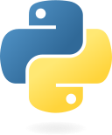
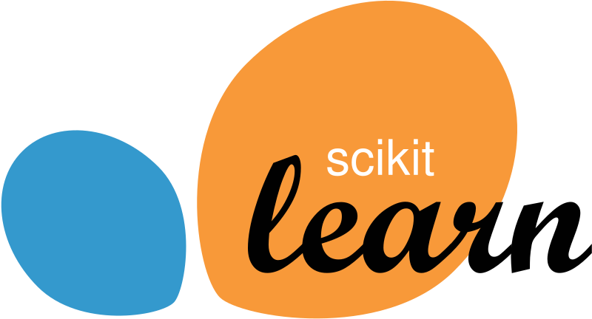

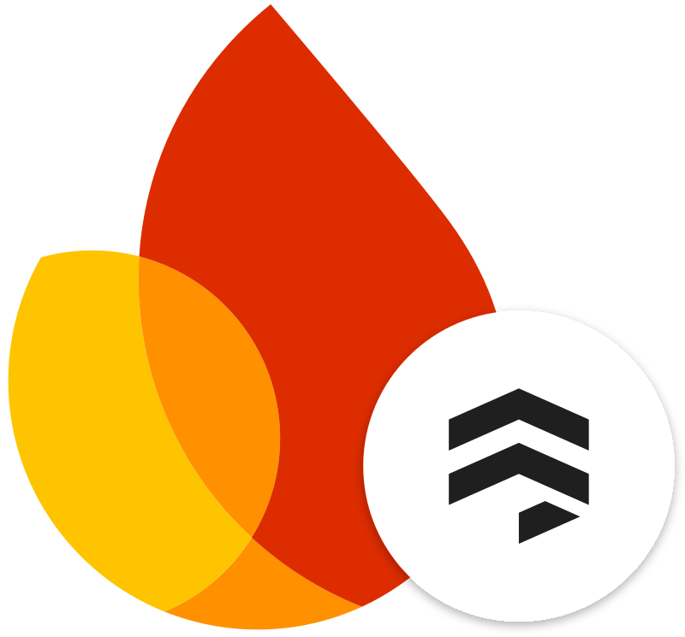
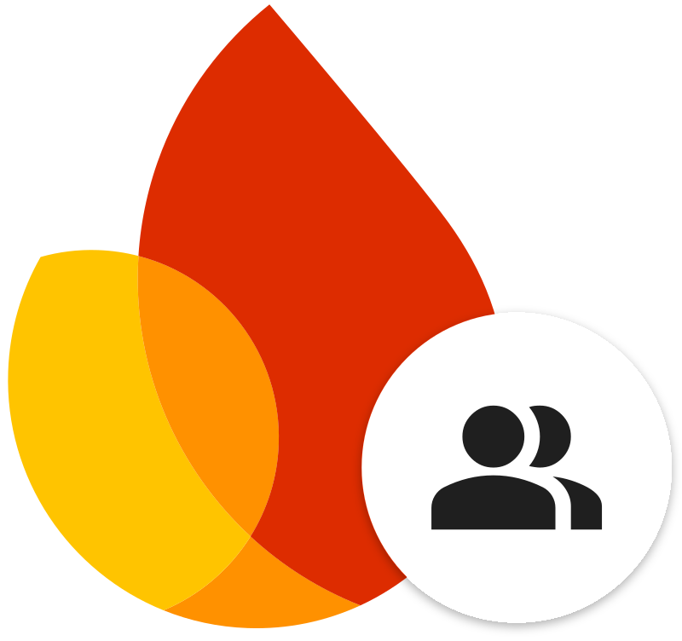
TECHNICAL ARCHITECTURE
IMPLEMENTED PLATFORM
Wearables
Phone app
Server
Dashboard
Next.js ingress
/api/v1 proxy
BLE
React Native / Expo
private HTTP
Next.js / React
BLE sensors
Native bridges
QR enrollment
HTTPS
ID token
Company workspace
SQLCipher + SecureStore
FastAPI / Python
Tasks / support / handover
Raw observations
Batched retries / device token
Pydantic + deduplication
REST polling / 4 seconds
Tenant/team access
Rules + human approval
sign-in
read/write
Research engine
Python / scikit-learn / CatBoost
Firestore
Firebase Auth
Anonymous
records
Fitted
models
Predictions
Observations + team records
Verified user ID tokens
Local only. Workplace integration pending.
Docker Compose + Firebase emulators. Device validation and cloud deployment pending.
Notes:
TECHNICAL ARCHITECTURE
Repository examined at commit 1286e55bf4cb1b56aecf2a32fda3cc1415a4a386, 2026-09-27. This diagram describes the implemented authenticated company platform and its separate local research service. No Cloud Run deployment or physical wearable compatibility is claimed.
CAPTURE
Wearable support is implemented through BLE/native adapters and watch bridges. The primary phone application is React Native, Expo and TypeScript, with react-native-ble-plx, native Kotlin/Swift bridges, Expo SecureStore, and an expo-sqlite SQLCipher offline queue. No physical wearable model has been verified. The phone preserves raw observations, original timestamps and stable observation IDs. It does not calculate HRV or infer employee state.
QR enrollment issues a company/employee-scoped device credential. This is different from Firebase user authentication. SecureStore holds the scoped credential and queue key. SQLCipher encrypts queued records. Batches upload as schema-version-2 JSON via HTTPS to POST /api/v1/observations, at most 60 observations / 100KB. Idempotent retry and server-side deduplication prevent duplicate effects.
PLATFORM
The Next.js same-origin /api/v1 proxy forwards authorization and JSON to a private FastAPI service. In the local Docker network it uses internal HTTP. Prepared Cloud Run configuration places the FastAPI sidecar on localhost:8000 behind the web ingress; Firebase user/device authorization remains enforced at the API. The slide does not claim public plaintext transport. FastAPI/Pydantic validates schema, units and timestamps, normalizes observations, enforces sharing and tenant/team scope, deduplicates and persists.
Dashboard: Next.js, React and TypeScript. Firebase Auth issues user ID tokens. API identity checks reject revoked/disabled users and unverified email. The authenticated company dashboard uses REST polling every four seconds, not the WebSocket used by the optional local /signals example. Firebase Auth supports sign-in/token issuance and Firebase SDK verification on the API. The depicted dashboard-to-auth edge is user authentication, not a data-store connection.
Firestore holds observations plus company/team/employee records, assignments, support cases and handovers. All database access is server-mediated; browser and phone direct Firestore access is denied. API role alone does not disclose physiology: owners/managers receive permitted operational context and connection metadata, with physiological values redacted unless a separate scoped capability is present.
Operational matching evaluates qualifications, confirmed availability, task limits and open support cases using deterministic rules. Managers confirm actions. Transactions recheck eligibility; version checks reject stale writes and idempotency keys prevent duplicate actions. Gemini/Jev do not drive these authenticated company workflows.
RESEARCH SERVICE
Python/scikit-learn/CatBoost run saved fitted artifacts on allowlisted anonymous research records. The model service checks exact model/input hashes and executes the original fitted models. Model artifacts are not trained during an HTTP request. The local /models interface reaches the API through a separate /api/model-engine proxy with a server-only token; the API forwards allowlisted record IDs to the private model worker. The research box is intentionally separate from company flows. Company observations, employee IDs and browser-supplied feature vectors are rejected. Production access is blocked. There is no live integration of the trained physiological models into company state cards, task ranking or workplace alerts. The internal record-to-model-to-prediction chain summarizes research execution, not a workplace input path.
RUNTIME
The demonstrated deployment is local Docker Compose with Firebase emulators. Cloud Run deployment configuration exists but has not been deployed. The optional Jev/Gemini /signals incident example is outside this core architecture and remains disabled in production.
PRIMARY REPOSITORY SOURCES
https://github.com/Guayamose/Neurasign/blob/1286e55bf4cb1b56aecf2a32fda3cc1415a4a386/neurasign_phone_app/mobile/package.json
https://github.com/Guayamose/Neurasign/blob/1286e55bf4cb1b56aecf2a32fda3cc1415a4a386/neurasign_server_dashboard/docs/phone-onboarding.md
https://github.com/Guayamose/Neurasign/blob/1286e55bf4cb1b56aecf2a32fda3cc1415a4a386/neurasign_server_dashboard/docs/telemetry.md
https://github.com/Guayamose/Neurasign/blob/1286e55bf4cb1b56aecf2a32fda3cc1415a4a386/neurasign_server_dashboard/docs/applications.md
https://github.com/Guayamose/Neurasign/blob/1286e55bf4cb1b56aecf2a32fda3cc1415a4a386/neurasign_server_dashboard/docs/model-engine.md
https://github.com/Guayamose/Neurasign/blob/1286e55bf4cb1b56aecf2a32fda3cc1415a4a386/neurasign_server_dashboard/apps/web/package.json
https://github.com/Guayamose/Neurasign/blob/1286e55bf4cb1b56aecf2a32fda3cc1415a4a386/neurasign_server_dashboard/apps/web/app/api/v1/%5B...path%5D/route.ts
https://github.com/Guayamose/Neurasign/blob/1286e55bf4cb1b56aecf2a32fda3cc1415a4a386/neurasign_server_dashboard/services/api/neurasign/main.py
https://github.com/Guayamose/Neurasign/blob/1286e55bf4cb1b56aecf2a32fda3cc1415a4a386/neurasign_server_dashboard/services/api/neurasign/identity.py
https://github.com/Guayamose/Neurasign/blob/1286e55bf4cb1b56aecf2a32fda3cc1415a4a386/neurasign_server_dashboard/services/api/neurasign/company_access.py
https://github.com/Guayamose/Neurasign/blob/1286e55bf4cb1b56aecf2a32fda3cc1415a4a386/neurasign_server_dashboard/services/api/neurasign/applications.py
LOGO SOURCES
Official project brand assets, unchanged colors and proportions. White Expo mark is an official supplied dark-background variant. Python image trims only empty transparent canvas. The generic wearable icon is constructed from editable native vector shapes and does not imply manufacturer compatibility. Full source manifest follows:
{
"retrieved": "2026-09-27",
"use": "Technology identification in NeuraSign technical architecture slide; marks remain properties of respective owners. No endorsement implied.",
"assets": [
{
"technology": "React",
"basename": "react",
"files": [
"react.svg",
"react.png"
],
"download_url": "https://raw.githubusercontent.com/facebook/react/main/fixtures/dom/public/react-logo.svg",
"official_reference": "https://github.com/facebook/react/blob/main/fixtures/dom/public/react-logo.svg",
"processing": "Official React repository asset. SVG rendered to PNG without color or geometry changes."
},
{
"technology": "Expo",
"basename": "expo-mark-white",
"files": [
"expo-mark-white.png"
],
"download_url": "https://codeload.github.com/expo/logos/zip/refs/heads/main",
"official_reference": "https://expo.dev/brand",
"processing": "Official logos repository linked by brand page. File png/logo-type-a-light.png; original white symbol for dark background."
},
{
"technology": "Expo",
"basename": "expo-white",
"files": [
"expo-white.png"
],
"download_url": "https://codeload.github.com/expo/logos/zip/refs/heads/main",
"official_reference": "https://expo.dev/brand",
"processing": "File png/logo-wordmark-light.png; original white full lockup."
},
{
"technology": "FastAPI",
"basename": "fastapi",
"files": [
"fastapi.svg",
"fastapi.png"
],
"download_url": "https://raw.githubusercontent.com/fastapi/fastapi/master/docs/en/docs/img/logo-teal.svg",
"official_reference": "https://github.com/fastapi/fastapi/blob/master/docs/en/docs/img/logo-teal.svg",
"processing": "Official repository logo. SVG rasterized unchanged."
},
{
"technology": "FastAPI",
"basename": "fastapi-icon",
"files": [
"fastapi-icon.png",
"fastapi-icon.svg"
],
"download_url": "https://raw.githubusercontent.com/fastapi/fastapi/master/docs/en/docs/img/icon-white.svg",
"official_reference": "https://github.com/fastapi/fastapi/blob/master/docs/en/docs/img/icon-white.svg",
"processing": "Official repository icon-white.svg. SVG rasterized unchanged."
},
{
"technology": "Next.js",
"basename": "nextjs",
"files": [
"nextjs.svg",
"nextjs.png"
],
"download_url": "https://raw.githubusercontent.com/vercel/next.js/canary/packages/create-next-app/templates/app/ts/public/next.svg",
"official_reference": "https://github.com/vercel/next.js",
"processing": "Official create-next-app black wordmark."
},
{
"technology": "Next.js",
"basename": "nextjs-dark-background",
"files": [
"nextjs-dark-background.png"
],
"download_url": "https://assets.vercel.com/image/upload/v1662130559/nextjs/Icon_dark_background.png",
"official_reference": "https://nextjs.org/",
"processing": "Official Vercel CDN icon intended for dark background; white N on dark circle with grey outline. Original asset unchanged."
},
{
"technology": "Firebase",
"basename": "firebase-inverted",
"files": [
"firebase-inverted.png",
"firebase-inverted.svg"
],
"download_url": "https://firebase.google.com/static/downloads/brand-guidelines/firebase-brand-assets.zip",
"official_reference": "https://firebase.google.com/brand-guidelines",
"processing": "Official Primary_Horizontal_Lockup_Full_Color_Inverted.svg. Original white wordmark and color mark. PNG rendered unchanged."
},
{
"technology": "Firebase",
"basename": "firebase-mark",
"files": [
"firebase-mark.svg",
"firebase-mark.png"
],
"download_url": "https://firebase.google.com/static/downloads/brand-guidelines/firebase-brand-assets.zip",
"official_reference": "https://firebase.google.com/brand-guidelines",
"processing": "Official Logomark_Full Color.svg. SVG rendered unchanged."
},
{
"technology": "Firebase Authentication",
"basename": "firebase-auth",
"files": [
"firebase-auth.svg",
"firebase-auth.png"
],
"download_url": "https://firebase.google.com/static/downloads/brand-guidelines/firebase-brand-assets.zip",
"official_reference": "https://firebase.google.com/brand-guidelines",
"processing": "Official Product_Logomark_Authentication_Full_Color.svg. SVG rendered unchanged."
},
{
"technology": "Cloud Firestore",
"basename": "firestore",
"files": [
"firestore.png",
"firestore.svg"
],
"download_url": "https://firebase.google.com/static/downloads/brand-guidelines/firebase-brand-assets.zip",
"official_reference": "https://firebase.google.com/brand-guidelines",
"processing": "Official Product_Logomark_Cloud_Firestore_Full_Color.svg. SVG rendered unchanged."
},
{
"technology": "Python",
"basename": "python",
"files": [
"python.png",
"python.svg",
"python-trim.png"
],
"download_url": "https://www.python.org/static/community_logos/python-logo-generic.svg",
"official_reference": "https://www.python.org/community/logos/",
"processing": "Official PSF full logo. SVG rendered unchanged. The -trim.png variant removes only empty transparent canvas, retaining the complete mark and original colors."
},
{
"technology": "scikit-learn",
"basename": "scikit-learn-icon",
"files": [
"scikit-learn-icon.png",
"scikit-learn-icon.svg"
],
"download_url": "https://scikit-learn.org/stable/_static/scikit-learn-logo-without-subtitle.svg",
"official_reference": "https://github.com/scikit-learn/scikit-learn/blob/main/doc/logos/README.md",
"processing": "Official documentation logo without tagline. SVG rendered unchanged."
},
{
"technology": "CatBoost",
"basename": "catboost-icon",
"files": [
"catboost-icon.png"
],
"download_url": "https://avatars.mds.yandex.net/get-bunker/49769/a74e0923e4e58febf68787226ef24769aea5a2e5/orig",
"official_reference": "https://catboost.ai/",
"processing": "Official apple-touch-icon linked in website head. Original image unchanged."
},
{
"technology": "Python",
"basename": "python-only",
"files": [
"python-only.svg",
"python-only.png",
"python-only-trim.png"
],
"download_url": "https://s3.dualstack.us-east-2.amazonaws.com/pythondotorg-assets/media/files/python-logo-only.svg",
"official_reference": "https://www.python.org/community/logos/",
"processing": "Official PSF symbol-only logo linked on brand page. SVG rasterized unchanged. The -trim.png variant removes only empty transparent canvas, retaining the complete mark and original colors."
}
]
}

Slide 12
VISION & ROADMAP
Work that adapts to human capacity.
Pilots
Validation
Product
Integrations
0–3 months
3–6 months
6–12 months
9–18 months
Small team pilots
Validate against outcomes
Refine task routing
Connect work systems
03
06
02
04
05
07
01
08
Workplace datasets
New models
Own wearables
Scale
1–6 months
6–9 months
9–18 months
18–24 months
Label workplace data
Train and personalize
Prototype and test
Expand across sites
Proposed months from kickoff. Phases overlap.
Notes:
VISION & ROADMAP
Vision: Work that adapts to human capacity. The timeline expresses the founder's requested proposed product direction. It is a sequence of development priorities, not a dated commitment or evidence of completed deployments. Workstreams can overlap. Existing platform and research-model capabilities are described in the preceding architecture slide. Research models and the company platform still require integration: https://github.com/Guayamose/Neurasign/blob/91bc10cfa388600535807db81827d3cca691fd30/neurasign%20engine/experiments/003-streaming-interface.md and https://github.com/Guayamose/Neurasign/blob/91bc10cfa388600535807db81827d3cca691fd30/neurasign%20engine/MODEL_CARD.md .
01 PILOTS. Complete an appropriate real-device capture and inference path and deploy with small, voluntary operational teams. Begin with narrow high-risk workflows and observation before allowing reviewed recommendations to influence operations. No existing signed pilot customer or rollout is claimed.
02 WORKPLACE DATASETS. Collect real physiological observations, device metadata, task context and suitable outcome labels with appropriate participant agreement. Create reusable datasets with quality controls, provenance, subject/session identifiers, governed access and separate training and evaluation partitions. These datasets are a proposed asset, not an asset claimed to exist today.
03 VALIDATION. Compare predictions with suitable reference measures, task performance and actual operational outcomes. Assess generalization across people, sessions, tasks and devices, calibration and missing-data behavior. Agree baselines and outcome definitions before testing. No accuracy or improvement level is promised by this roadmap.
04 NEW MODELS. Train and evaluate new models using real workplace datasets and pilot evidence, including personal calibration and evaluation on held-out people and sessions. Address the present research limitations rather than assuming transfer to fatigue, readiness, every workforce or every device.
05 PRODUCT. Improve alerts, task allocation suggestions, explanations, controls and usability using pilot feedback. Continue to consider skills, availability, staffing constraints and operator judgement alongside state estimates. Product improvements feed back into the data collection and validation cycle.
06 OWN WEARABLES. Explore the design of NeuraSign's own wearable devices. Scope sensor requirements from validated use cases, then prototype and test comfort, signal quality, battery life and connectivity. This is a design and prototyping goal, not a claim that a device has been manufactured or certified. It can overlap model and product work after field requirements become clearer.
07 INTEGRATIONS. Connect relevant task, scheduling and shift systems and extend support for other suitable wearable devices. Reuse the same source semantics, authorization and data-quality expectations; each additional device requires validation rather than assumed equivalence.
08 SCALE. Expand deployment across teams and sites after repeatable value is demonstrated. Extend to further industries in the founder's stated priority order: high-risk operations, high-pressure environments and high-performance teams. Continue data collection and validation as product and deployment conditions change.
The wavy timeline is a native editable vector diagram. Its shape expresses progression only, not quantitative performance, dates or progress already achieved.
PROPOSED TIMING
These are indicative elapsed months from a future project kickoff, not contracted delivery dates or a claim that pilots are already underway. Phases overlap. Pilot agreements, permissions, adequate signal quality and sufficient outcome data are dependencies.
0–3 months: recruit small operational teams and connect live signals and the research models for a scoped pilot.
1–6 months: collect and label workplace observations and task outcomes with participant consent.
3–6 months: compare predictions with independently measured performance/outcomes and establish appropriate baselines.
6–9 months: train updated models, test generalization and explore personalization.
6–12 months: refine alerts and task routing using pilot feedback.
9–18 months: prototype and test an own wearable for comfort and signal quality; this is not a commitment to certified mass production.
9–18 months: integrate task, shift and additional device systems in parallel.
18–24 months: expand across sites only after validation and operational readiness. Dates were proposed during deck preparation and remain to be confirmed by the team.

Slide 13
Q&A / BUSINESS MODEL
Annual software.
Per active participant.
State insights, work recommendations and workflow integrations
Paid pilot
Annual site contract
Multi-site expansion
Defined scope + success criteria
Per participant + site minimum
More participants + locations
Pilot fee credited on conversion
Recurring software subscription
Reusable workflow integrations
TARGET BUYER
ADDITIONAL SERVICES
HARDWARE
Operations + safety leaders
Onboarding + custom integrations
Compatible devices first
Proposed model. Pricing and contract terms to validate in pilots.
Notes:
BUSINESS MODEL — PROPOSED
The commercial hypothesis is annual B 2 B software priced per active, participating worker, with a site minimum to cover deployment and support. No price, contract, customer revenue or willingness-to-pay result is represented as validated.
The proposed entry offer is a paid pilot with a defined scope, deployment plan and agreed evaluation criteria. A pilot fee could be credited on conversion to an annual site agreement. Onboarding and custom integrations are separately scoped services. Expansion is through additional participants, workflows and sites after evidence supports renewal.
The target budget holder is operations or a site/business-unit leader, with safety/EHS as a likely champion and IT/security and procurement involved in approval. This buying map is a discovery hypothesis, not evidence of existing buyer intent. The software offering aims to combine state estimates with skills, availability and task context; model-to-company integration remains pending.
Use compatible third-party devices initially. Proprietary NeuraSign wearables are a roadmap option, not a prerequisite for every sale or a currently manufactured product. Device costs and services are excluded from the illustrative software-revenue scenarios on the market slide.
Problem/buyer-domain context: https://www.osha.gov/worker-fatigue/prevention and https://www.osha.gov/safety-management/management-leadership . These pages support employer responsibility for workload, staffing, fatigue-risk plans and resources; they do not establish demand for NeuraSign.
Icons: Lucide ISC, https://lucide.dev/.

Slide 14
Q&A / PRIVACY & ETHICS
Control over data and decisions.
IMPLEMENTED IN THE PROTOTYPE
Pause & delete
Scoped access
Protected transfer
Pause sharing or delete readings
Company + team permissions
Encrypted queue + HTTPS
Managers see work context. Physiological data needs separate permission.
PROPOSED PILOT COMMITMENTS
Voluntary participation
Purpose limits
Accountable decisions
No penalty for declining
Minimum necessary data
Human review and challenge
or withdrawing
No ranking or disciplinary use
No fitness-for-work judgments
Before pilots: validate consent, retention and participant access to deletion.
Notes:
PRIVACY AND ETHICS
IMPLEMENTED IN THE CURRENT PROTOTYPE
Pause and deletion: the account-linked employee can pause sharing and delete stored measurements using DELETE /organizations/{org}/me/readings. The API pauses sharing and removes readings, observations, latest values and signal state. Account identity, membership and audit records remain. Cloud backups may retain copies temporarily, up to seven days as described in the repository. This is not a claim of complete account erasure. Confirm an accessible deletion route for every pilot participant, including phone-only enrollment.
Scoped access: company/team authorization controls workflow reads and writes. Owners and managers receive operational identity, permitted work context, actions and connection metadata. Their role alone grants no physiological access. The API removes measurements from unauthorized dashboard responses and denies direct history/observation requests. Physiological access requires self-access or a stored explicit can_view_measurements capability with appropriate scope. There is no capability-granting UI.
Protected transfer: encrypted phone queue and HTTPS. These technical controls do not establish legal compliance or certification.
PROPOSED PILOT COMMITMENTS
Voluntary participation without penalty for declining or withdrawing. Minimum necessary data and purpose limits, including no employee ranking or disciplinary use. Human review and a challenge route, with no fitness-for-work judgments. Human confirmation of operational actions is implemented; these broader pilot governance commitments remain proposed.
BEFORE PILOTS
Validate the consent process, retention policy and participant access to deletion. Existing account-linked deletion must not be described as deletion of every record for every possible enrollment route.
Verified against current main commit 1286e55bf4cb1b56aecf2a32fda3cc1415a4a386.
https://github.com/Guayamose/Neurasign/blob/1286e55bf4cb1b56aecf2a32fda3cc1415a4a386/neurasign_server_dashboard/docs/applications.md
https://github.com/Guayamose/Neurasign/blob/1286e55bf4cb1b56aecf2a32fda3cc1415a4a386/neurasign_server_dashboard/services/api/neurasign/company_access.py
https://github.com/Guayamose/Neurasign/blob/1286e55bf4cb1b56aecf2a32fda3cc1415a4a386/neurasign_server_dashboard/services/api/neurasign/workspace.py
https://github.com/Guayamose/Neurasign/blob/1286e55bf4cb1b56aecf2a32fda3cc1415a4a386/neurasign_server_dashboard/docs/company-workspace.md
Checked 2026-09-27.

Slide 15
Q&A / DATA / MODEL
Model evaluation
Offline tests with people separated across splits
Stress / WESAD
Readiness / daily Oura score
94.2%
~4
accuracy / rest vs lab stress
points error / 100
96.5% logistic reference
Approximation of a daily vendor score
3 held-out people / 60-second windows
Instant readiness remains unvalidated
Fatigue
Workload / NASA-TLX
63.7%
~13
balanced accuracy
points error / 100
66.7% previous model / same evaluation
Similar error using only rest vs activity
Reliability remains insufficient
Added value from physiology unproven
Research models are saved and documented. Dashboard integration remains pending.
Notes:
MODEL EVALUATION
SOURCE AND STATUS
Updated from the founder's training and evaluation summary supplied in this conversation on 26 September 2026 (America/Los_Angeles). These are team-reported research results. The new experiment reports were not independently rerun or inspected for this edit. They supersede the older experiment examples previously shown in the deck; they must not be attributed to the earlier pinned repository commit. No workplace benefit, accident prevention, or universal mental-state accuracy has been validated by these numbers.
MODELLING APPROACH
Supervised learning in Python, using scikit-learn and CatBoost. Inputs are physiological signals and derived features; targets are known responses such as experimental conditions, questionnaires, the daily Oura score or NASA-TLX, depending on the dataset. Available signals include pulse, heart-rate variability, skin conductance, temperature, motion, sleep and physiological history, as applicable. Not every signal is used for every target or experiment.
Feature extraction includes means, variation, trends, peaks and physiological history as relevant. Missing values and scaling are fitted only on the training data. Hyperparameter/configuration comparisons include tree depth, regularization and selected signals. Selection optimizes balanced accuracy for classification or lower regression error, according to the experiment. People are separated across training and evaluation; records from one person do not simultaneously appear on both sides of a given split.
ALGORITHMS
Stress: ExtraTrees with 300 decision trees and logistic regression as a reference. SVM and gradient boosting were also compared.
Readiness: score regression. The original ensemble combines SVR and two CatBoost models. The latest variant combines two CatBoost models and HistGradientBoosting. The briefing does not establish that the approximate 4-point result is the score of every variant.
Fatigue: low/high classification and intensity regression. Compared ExtraTrees, CatBoost, linear models, SVM and ensembles.
Workload: NASA-TLX score regression. Compared Ridge, SVR, ExtraTrees, CatBoost and ensembles.
An ensemble combines predictions from multiple models. ExtraTrees aggregates decision trees. CatBoost trains successive boosting stages. Training or model complexity alone does not establish superior predictive performance.
STRESS / WESAD
The selected model achieved 94.2% reported accuracy, while the logistic reference achieved 96.5%. Do not call the selected model superior to the reference. The task distinguishes rest from laboratory-induced stress. It does not establish continuous workplace stress estimation, fatigue or alertness detection.
434 windows of 60 seconds, with 57 extracted features. Twelve people were used for development and selection among 32 configurations with four person-grouped validation folds. Three other people were reserved for the final test. The 434 windows are not 434 independent people. The briefing calls the stress result accuracy; do not relabel it balanced accuracy.
READINESS / DAILY OURA SCORE
Approximately 4 points of reported error on a 100-point scale when approximating the daily Oura score. This is a vendor-score approximation, not validation of instantaneous workplace readiness. The supplied updated summary does not name the error statistic, so the slide says reported error and does not introduce MAE, RMSE or a percentage accuracy. Do not infer the exact experiment version or reuse an older held-out sample count without supporting documentation.
FATIGUE
63.7% balanced accuracy compared with 66.7% for the earlier model in the same evaluation. New variants did not improve this result. A sufficiently reliable fatigue detector has not yet been demonstrated. Balanced accuracy gives equal importance to the low and high fatigue classes. Do not relabel this ordinary accuracy, or present the earlier-model comparator as a constant baseline.
WORKLOAD
Approximately 13 points of reported error on a 100-point NASA-TLX scale. A comparator that distinguishes only rest from activity has practically the same error, so useful additional predictive value from physiological signals has not been demonstrated. The updated summary does not identify the error statistic; do not label it MAE or RMSE without the experiment report.
LATEST NESTED EVALUATION
Latest readiness, fatigue and workload experiments use four outer folds for evaluation and three inner folds for model/configuration selection. Whole people remain separated across splits. Outer evaluation results do not choose the winning configuration. This is a nested process, not a claim of twelve independent final tests or twelve production models. The WESAD development/final-test setup is described separately and must not be relabeled as this same nested experiment.
DEPLOYMENT
The trained models are saved and documented in the research engine. The dashboard still uses experimental formulas. These trained artifacts are not yet integrated into the dashboard. Research evaluation is not a deployed end-to-end performance claim.

Slide 16
Q&A / MARKET SIZING
U.S. TAM / SAM / SOM
Illustrative pricing: $20 per participant / month
TAM / SECTOR CEILING
TAM
$4.9B
/ year
20.37M U.S. jobs × $240/year
Manufacturing, transport, mining + utilities
SAM
SAM / ELIGIBILITY SCENARIO
$244M
/ year
1.02M eligible seats × $240/year
5% of sector jobs assumed eligible
SOM
SOM / INITIAL ROLLOUT
$240k
/ year
10 sites × 100 participants × $240/year
Illustrative 24-month deployment scenario
BLS QCEW 2025 / Circles not to scale
SAM eligibility and SOM rollout are planning assumptions, not validated demand or a sales forecast.
Notes:
MARKET SIZING — U.S. TAM / SAM / SOM
All figures are illustrative annual software-revenue scenarios at a common hypothetical price of $20 per active participant per month, or $240/year. This is a U.S. sizing exercise limited to four initial target sectors, not a worldwide market estimate. Circles express nested scope, not proportional area. No pricing, eligibility rate, pipeline or rollout date is validated.
TAM — SECTOR CEILING. BLS QCEW reports 20,371,709 annual-average covered private payroll jobs across manufacturing (NAICS 31–33: 12,579,906), transportation/warehousing (48–49: 6,618,917), mining/quarrying/oil-gas (21: 570,806) and utilities (22: 602,080). These mutually exclusive sectors are all from the 2025 annual national data, ownership 5(private), aggregation 14, size 0. Jobs are not unique people or confirmed customers. 20,371,709 × $240 = $4,889,210,160/year, shown as $4.9 B. This is a broad sector revenue ceiling assuming every job could become a paid seat, not observed category spending.
SAM — ELIGIBILITY SCENARIO. The slide assumes 5% of this sector pool is serviceable under an initial product scope: relevant operational roles, suitable signals/devices and feasible deployment requirements. The 5% is a planning assumption, not an occupational count from BLS or a discovered adoption rate. It must be refined through customer discovery and pilot feasibility evidence. 20,371,709 × 0.05 = 1,018,585.45 seat equivalents, shown as approximately 1.02 M; × $240 = $244,460,508/year, shown as $244 M. This explicitly assumed SAM is not a measured market.
SOM — INITIAL ROLLOUT SCENARIO. A proposed 24-month planning scenario of 10 sites with 100 opted-in participants each gives 1,000 seats. 1,000 × $240 = $240,000/year in annualized software revenue at that deployment level, shown as $240 k/year. This is annual recurring revenue potential at the assumed scale, not revenue accumulated over 24 months, existing ARR, a signed pipeline or an adoption forecast. The 24-month horizon is an illustrative planning assumption rather than a confirmed delivery commitment.
Devices, services, discounts, costs, international expansion and later additional sectors are excluded. Capacity to reach the SOM and the serviceable-role share remain to be established. The current prototype's 100-member pilot limit does not establish that a multisite rollout is already deployed.
Numerical source: https://data.bls.gov/cew/data/api/2025/a/area/US000.csv . BLS field definitions: https://www.bls.gov/cew/additional-resources/open-data/csv-data-slices.htm . Coverage: https://www.bls.gov/cew/news-release-technical-note.htm . Sector codes: https://www.bls.gov/cew/classifications/industry/industry-titles.htm . Ownership code: https://www.bls.gov/cew/classifications/ownerships/ownership-titles.htm . Release schedule: https://www.bls.gov/cew/release-calendar.htm .

Slide 17
Q&A / COMPETITOR COMPARISON
Where the products overlap.
Product | Scope | Primary inputs | Decision support
 | Workforce fatigue | Sleep + work schedules | Forecasts, breaks + reassignment
 | Operator alertness | EEG + operational data | Alerts, escalation + task rotation
 | Workplace safety | Motion + task video | Coaching + corrective actions
 | Sports teams | Location, motion + HR | Training load + return to play
 | Organizations | Ring physiology + sleep | Group readiness + resourcing
 | Consumer | Physiology + training | Daily effort + recovery coaching
 | Product vision | Physiology + skills + task context | Work allocation + adaptive workflows
Vendor capabilities shown as documented. NeuraSign row describes the proposed product.
Sources: official product documentation, Sep 2026. Comparative effectiveness has not been established.
Notes:
DETAILED COMPETITOR COMPARISON
These are documented capabilities from current official vendor pages, not independent efficacy comparisons. The NeuraSign row is explicitly product vision. The company's live workspace, research models and incident demo remain separate, and comparative effectiveness has not been established.
FATIGUE SCIENCE / READI. Uses measured or modelled sleep, schedules/work logs and profile information for workforce fatigue forecasts. Supervisor tools provide risk flags, alerts and intervention logs and support breaks and reassignment. Do not say it only monitors. Sources: https://fatiguescience.com/blog/what-is-a-readiscore-and-how-does-it-work ; https://fatiguescience.com/readisupervise-fatigue-interventions .
SMARTCAP / WENCO. EEG-based alertness/microsleep-risk management with operational and GPS context. Alerts can escalate; Wencomine FMS integration exists and fatigue data informs rostering and task rotation. Sources: https://www.wencomine.com/our-solutions/safety ; https://www.wencomine.com/news/smartcap-for-wencomine-one-screen-one-point-of-reference-one-powerful-combination .
SOTER. SoterCoach uses motion/posture IMUs for live ergonomic coaching. The broader SoterAI suite adds task video and safety records with corrective-action ownership and reassessment. The row describes this product family, not one device's complete feature set. Sources: https://www.soter.com/sotercoach ; https://www.soter.com/ergonomic-assessment-software .
CATAPULT. Location, inertial movement, HR and sport/position context support live and later workload/training and return-to-play decisions. Sources: https://www.catapult.com/solutions/athlete-monitoring ; https://www.catapult.com/solutions/vector-pro .
OURA ORGANIZATIONS. Ring physiology, sleep and activity inform individual/group readiness. Its enterprise and government/defense materials describe operational and resourcing decisions and APIs. It is not limited to consumer wellness. Sources: https://organizations.ouraring.com/ ; https://organizations.ouraring.com/solutions/government-defense .
WHOOP. The comparison is specifically the consumer product, not WHOOP Unite. Physiology, sleep and training history feed recovery/strain guidance and adaptive daily effort targets. Sources: https://developer.whoop.com/docs/whoop-101/ ; https://www.whoop.com/us/en/thelocker/strain-coach/ .
NEURASIGN. The proposed focus is adaptive work decisions, including task-person matching and work planning, using physiological state alongside skills and task requirements/context. Several competitors already support meaningful actions. Public pages reviewed do not document exactly this combined workflow, but absence from these pages is not proof that no private product, partner or implementation offers it. Do not claim first, only, superior accuracy, or that competitors lack context or actions.
Logo assets are the original official PNGs or faithful rasterizations retained from the approved competition slide. NeuraSign uses the approved original SVG. Their dimensions and proportions are preserved. Product names in row order: Fatigue Science/Readi, SmartCap/Wenco, Soter Analytics/SoterAI, Catapult/Vector, Oura Organizations, WHOOP consumer, NeuraSign product vision.

Slide 18
Q&A / TRAINING & VALIDATION
Supervised learning
Signals
Features
Train & select
Evaluate
WESAD / held-out test
Latest models / nested validation
12
3
Readiness / Fatigue / Workload
development
held out
4×
Each outer fold
434
60s
57
3 inner folds
Held-out
outer folds
people
windows
per window
features
32 configurations / 4 person-grouped folds
Inner folds select. Outer folds evaluate.
Selection uses development participants only.
People remain separate in every split.
Python / scikit-learn / CatBoost
Preprocessing fitted on training data only.
Notes:
SOURCE AND STATUS
Updated from the founder's training and evaluation summary supplied in this conversation on 26 September 2026 (America/Los_Angeles). These are team-reported research results. The new experiment reports were not independently rerun or inspected for this edit. They supersede the older experiment examples previously shown in the deck; they must not be attributed to the earlier pinned repository commit. No workplace benefit, accident prevention, or universal mental-state accuracy has been validated by these numbers.
MODELLING APPROACH
Supervised learning in Python, using scikit-learn and CatBoost. Inputs are physiological signals and derived features; targets are known responses such as experimental conditions, questionnaires, the daily Oura score or NASA-TLX, depending on the dataset. Available signals include pulse, heart-rate variability, skin conductance, temperature, motion, sleep and physiological history, as applicable. Not every signal is used for every target or experiment.
Feature extraction includes means, variation, trends, peaks and physiological history as relevant. Missing values and scaling are fitted only on the training data. Hyperparameter/configuration comparisons include tree depth, regularization and selected signals. Selection optimizes balanced accuracy for classification or lower regression error, according to the experiment. People are separated across training and evaluation; records from one person do not simultaneously appear on both sides of a given split.
ALGORITHMS
Stress: ExtraTrees with 300 decision trees and logistic regression as a reference. SVM and gradient boosting were also compared.
Readiness: score regression. The original ensemble combines SVR and two CatBoost models. The latest variant combines two CatBoost models and HistGradientBoosting. The briefing does not establish that the approximate 4-point result is the score of every variant.
Fatigue: low/high classification and intensity regression. Compared ExtraTrees, CatBoost, linear models, SVM and ensembles.
Workload: NASA-TLX score regression. Compared Ridge, SVR, ExtraTrees, CatBoost and ensembles.
An ensemble combines predictions from multiple models. ExtraTrees aggregates decision trees. CatBoost trains successive boosting stages. Training or model complexity alone does not establish superior predictive performance.
STRESS / WESAD
The selected model achieved 94.2% reported accuracy, while the logistic reference achieved 96.5%. Do not call the selected model superior to the reference. The task distinguishes rest from laboratory-induced stress. It does not establish continuous workplace stress estimation, fatigue or alertness detection.
434 windows of 60 seconds, with 57 extracted features. Twelve people were used for development and selection among 32 configurations with four person-grouped validation folds. Three other people were reserved for the final test. The 434 windows are not 434 independent people. The briefing calls the stress result accuracy; do not relabel it balanced accuracy.
READINESS / DAILY OURA SCORE
Approximately 4 points of reported error on a 100-point scale when approximating the daily Oura score. This is a vendor-score approximation, not validation of instantaneous workplace readiness. The supplied updated summary does not name the error statistic, so the slide says reported error and does not introduce MAE, RMSE or a percentage accuracy. Do not infer the exact experiment version or reuse an older held-out sample count without supporting documentation.
FATIGUE
63.7% balanced accuracy compared with 66.7% for the earlier model in the same evaluation. New variants did not improve this result. A sufficiently reliable fatigue detector has not yet been demonstrated. Balanced accuracy gives equal importance to the low and high fatigue classes. Do not relabel this ordinary accuracy, or present the earlier-model comparator as a constant baseline.
WORKLOAD
Approximately 13 points of reported error on a 100-point NASA-TLX scale. A comparator that distinguishes only rest from activity has practically the same error, so useful additional predictive value from physiological signals has not been demonstrated. The updated summary does not identify the error statistic; do not label it MAE or RMSE without the experiment report.
LATEST NESTED EVALUATION
Latest readiness, fatigue and workload experiments use four outer folds for evaluation and three inner folds for model/configuration selection. Whole people remain separated across splits. Outer evaluation results do not choose the winning configuration. This is a nested process, not a claim of twelve independent final tests or twelve production models. The WESAD development/final-test setup is described separately and must not be relabeled as this same nested experiment.
DEPLOYMENT
The trained models are saved and documented in the research engine. The dashboard still uses experimental formulas. These trained artifacts are not yet integrated into the dashboard. Research evaluation is not a deployed end-to-end performance claim.
Icons: Lucide, ISC license, https://lucide.dev/ . Cohort and nested-validation diagrams are conceptual depictions of the supplied split design, not measured outcomes.

