Slide 1
Weather APP mock up

Slide 2
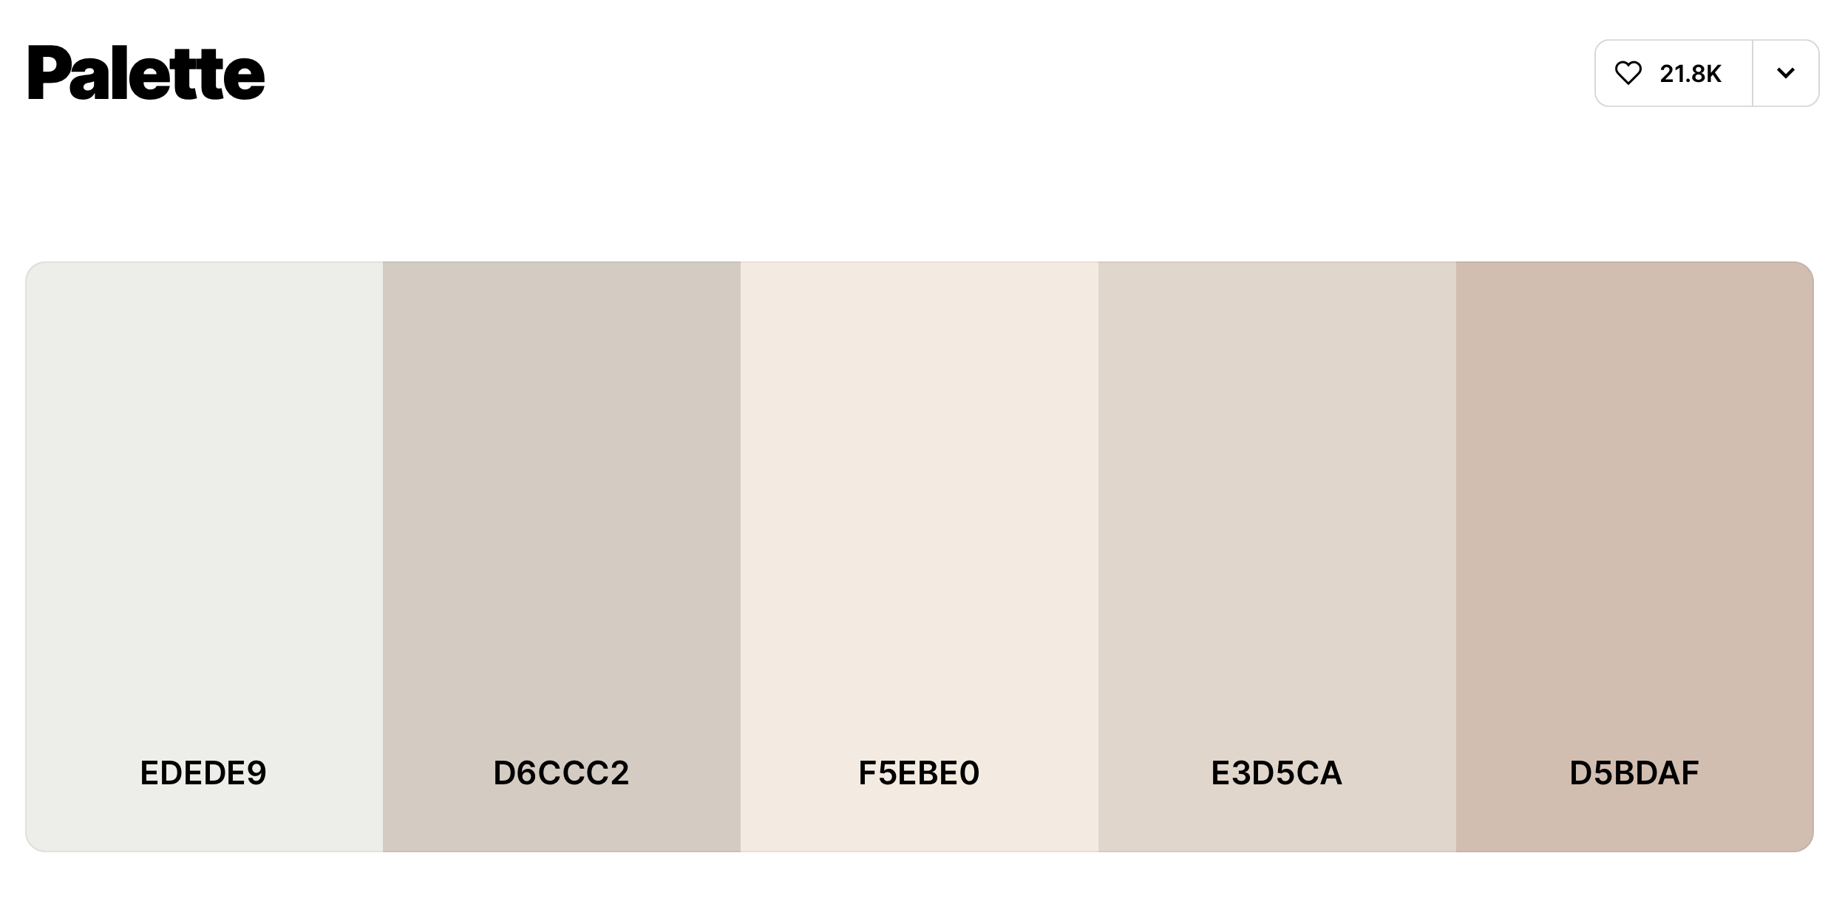

Slide 3



PM 2.5 concentration right now in
Bangkok
Current weather in
Bangkok
Partly Cloudy
23.5 µg/m³
32°c
4.8x higher than WHO annual air quality guideline value

Slide 4








21:26
Ho Chi Minh City
Vietnam
Partly clouds with chance of rain
28°c
Mon
Mon
Mon
Mon
Mon

Slide 5




21:26
Ho Chi Minh City
Vietnam
28°c
Partly clouds with chance of rain
Mon
Mon
Mon
Mon
Mon

Slide 6
21:26
Ho Chi Minh City
Vietnam
28°c
Partly clouds with chance of rain
Mon
Mon
Mon
Mon
Mon

Slide 7
21:26
Ho Chi Minh City
Vietnam
28°c
Partly clouds with chance of rain
Mon
Mon
Mon
Mon
Mon

Slide 8
21:26
Ho Chi Minh City
Vietnam
28°c
Partly clouds with chance of rain
Mon
Mon
Mon
Mon
Mon

Slide 9
21:26
Ho Chi Minh City
Vietnam
28°c
Partly clouds with chance of rain
Mon
Mon
Mon
Mon
Mon

