Slide 1

Customer Retention Analysis & RFM-Based Segmentation
Cohort Retention Trends & K-Means Cluster Insights
Owhondah Oguchi Wonukwube
Data Scientist

Slide 2
Executive Summary
Objective: Analyze customer retention patterns and segment customers using RFM (Recency, Frequency, Monetary) with K-Means clustering.
Key Outputs: ✔ Retention trends from cohort analysis ✔ Four customer segments identified via RFM clustering ✔ Risks, opportunities, and actionable strategies per segment
Goal: Improve retention, increase CLV (Customer Lifetime Value), and optimize engagement strategies.

Slide 3
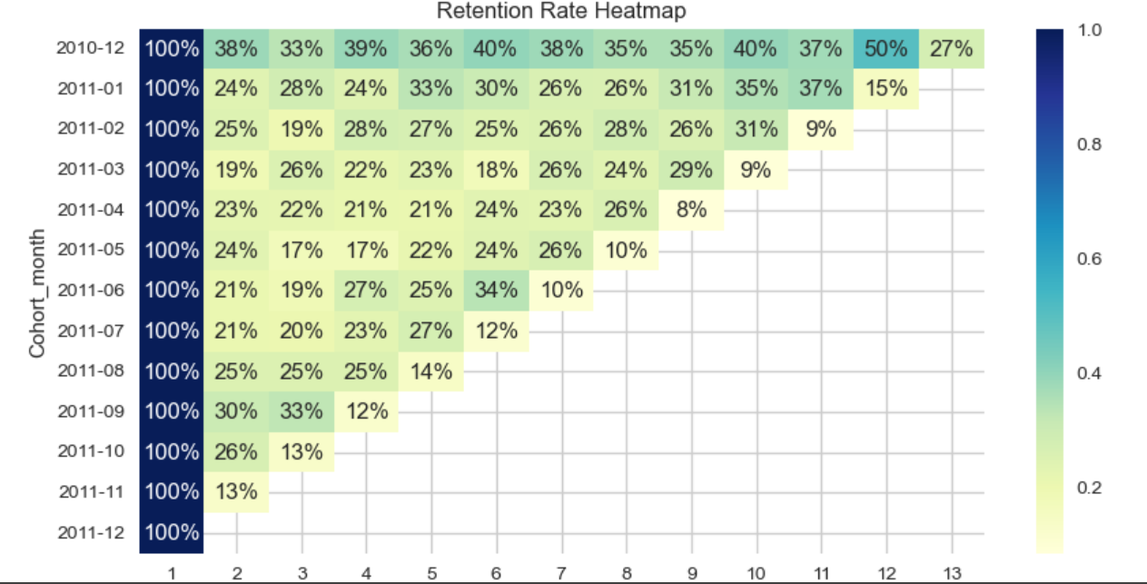
Customer Retention Cohort Analysis
This heatmap shows the retention rates by monthly cohorts over time (e.g., Month 1: 100%, Month 3: 45%, Month 6: 20%).
Insights:
Strong short-term retention (first 1–2 months), steep decline after 3 months.
Long-term retention stabilizes at ~15–20% after 6 months.
Seasonal cohorts show spikes in new acquisitions but lower retention in later months.

Slide 4
Cohorts → Cluster Mapping
Recent Cohorts (joined within 30 days) → Mostly Champions and Loyal Regulars
Older Cohorts (inactive > 180 days) → Primarily At Risk/Lost segment
High-value repeat buyers (small %) → Concentrated in Ultra VIPs cluster Implication: Different cohorts are migrating into clusters over time → need targeted retention strategies per lifecycle stage.

Slide 5
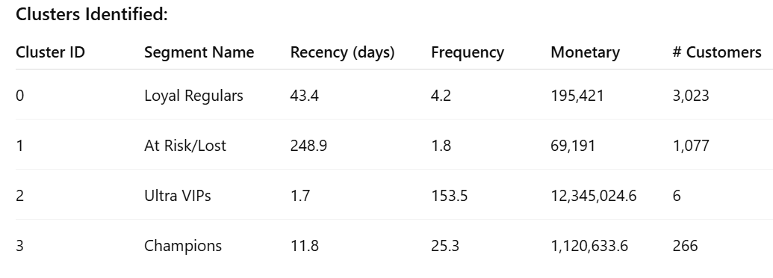
RFM Segmentation Results (Cluster Metrics)
Key Observation:
Cluster 2 (Ultra VIPs) are extremely high-value but very few customers → critical to retain.
Cluster 1 (At Risk/Lost) is large and low engagement → big win-back opportunity.

Slide 6
Segment Profiles & Behavior
Cluster 0 – Loyal Regulars
Recency: ~43 days | Frequency: Moderate | Monetary: High
Behavior: Regular purchases, good engagement.
Risk: Moderate churn if competitors attract them.
Cluster 1 – At Risk/Lost
Recency: 249 days | Frequency: Low | Monetary: Low
Behavior: Inactive or churned customers.
Risk: High churn, low CLV unless reactivated.

Slide 7
Segment Profiles & Behavior Cont’d
Cluster 2 – Ultra VIPs
Recency: 2 days | Frequency: 153 orders | Monetary: Very High
Behavior: Top-tier spenders, extremely loyal.
Risk: Very low churn risk but high revenue impact if lost.
Cluster 3 – Champions
Recency: 12 days | Frequency: High | Monetary: Strong
Behavior: Frequent buyers, strong brand advocates.
Risk: Minimal if engagement continues.

Slide 8
Risks & Opportunities
Opportunities: ✔ Engage Champions as brand promoters (referrals, testimonials). ✔ Upsell Loyal Regulars to higher-value tiers.
Risks: ✖ Losing Ultra VIPs would have major revenue impact. ✖ At Risk/Lost cluster has the largest customer count → needs reactivation.

Slide 9
Strategic Recommendations
For Each Segment:
Loyal Regulars (Cluster 0):
Implement loyalty rewards, personalized product recommendations.
Cross-sell/up-sell campaigns to increase AOV (Average Order Value).
At Risk/Lost (Cluster 1):
Send win-back email campaigns with exclusive offers.
Use retargeting ads and limited-time discounts to re-engage.
Ultra VIPs (Cluster 2):
Assign dedicated account managers or concierge services.
Offer exclusive early access to new products, premium perks.
Champions (Cluster 3):
Build advocacy programs: referrals, reviews, and loyalty points.
Surprise gifts and recognition (e.g., “Top Customer” badge).

Slide 10
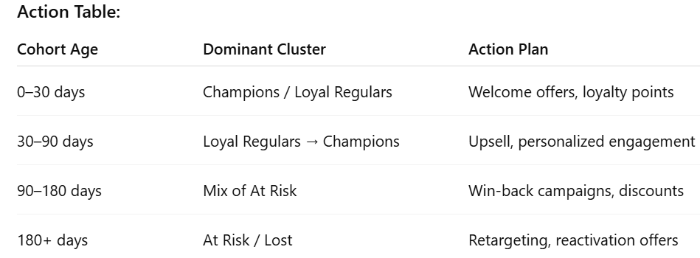
Cohort-Driven Retention Plan

Slide 11
Summary & Next Steps
Retention drops significantly after 3 months → need lifecycle campaigns.
RFM segmentation reveals VIP concentration and large at-risk group.
Next Steps: ✔ Deploy segment-specific marketing automation. ✔ Monitor cluster migration trends monthly. ✔ Evaluate campagn ROI and adjust strategy.

