Slide 1

Customer Retention Analysis
E-Shop Pro – Business Understanding & Cohort Analysis
Owhondah Oguchi Wonukwube
Data Scientist

Slide 2
Business Challenge & Context
E-Shop Pro is a global e-commerce leader facing a major challenge in customer retention. Despite rapid acquisition, the company is observing a decline in repeat purchases and increased churn. This impacts Customer Lifetime Value (CLV) and overall profitability. Key Issues: - High shopping cart abandonment rate - Declining repeat purchase rate after first order - Increased customer churn and low engagement over time

Slide 3
Data Exploration & Preparation
The dataset contained transaction details including CustomerID, InvoiceDate, StockCode, and UnitPrice. Steps Taken: - Converted InvoiceDate to datetime format - Removed missing values and duplicates - Filtered out negative/zero quantities and prices - Engineered features: InvoiceMonth and Revenue - Aggregated monthly sales and unique customers for trend analysis

Slide 4
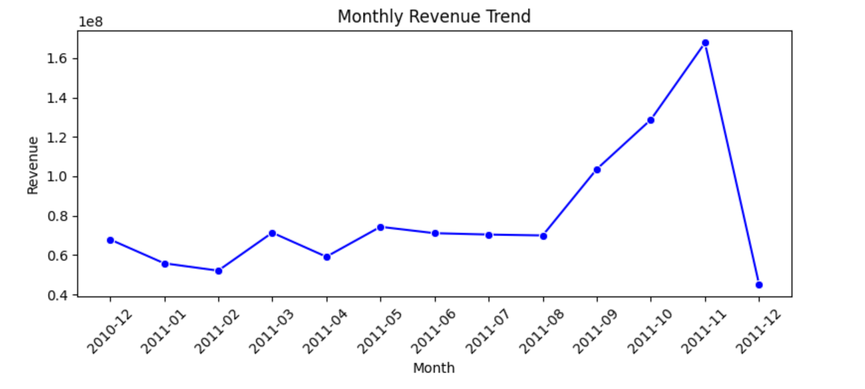
EDA for Monthly Revenue Trend
Business Insights:
Revenue generally increased throughout the observed period (Dec 2010 – Dec 2011), showing a positive trend
November Peak: Likely driven by seasonal factors such as holiday shopping, promotional events, or bulk purchasing.
December Drop: Could indicate data incompleteness for December or perhaps returns and refunds being processed heavily after Black Friday/Cyber Monday.
August Onward Surge: Could be due to marketing campaigns, new product launches, or increased customer acquisition in Q4.

Slide 5
Key Findings from EDA
Exploratory analysis revealed: - Consistent seasonal spikes in monthly revenue - A small segment of customers contributes disproportionately to revenue These insights informed the cohort analysis approach.

Slide 6
Cohort Analysis & Retention Trends
Cohort analysis segmented customers by their first purchase month and tracked retention over time. Key Observations: - Strong retention in the first month post-acquisition - Significant drop in retention from month 2 onwards - Older cohorts show diminishing engagement, indicating lack of loyalty drivers

Slide 7
Insights & Strategic Focus
Insights: - High initial engagement but poor long-term retention - Need for loyalty programs, personalized offers, and better re-engagement tactics

Slide 8
Recommendations
Focus on Improving Retention
Capitalize on High-Performing Cohorts
Reduce Churn in Early Months
Optimize Acquisition During Peak Months
Introduce Subscription or Membership Program

