Slide 1
Python Intermediate Workshops Functions
Eoghan O’Connell
Max Planck Institute for the Science of Light

Slide 2
Functions: What we will cover
What is a function: why/when to use it (DRY, remove interdependence)
Function return (output)
Function parameters/arguments
Required arguments and default arguments
Docstrings
Functions vs. Methods?
Function variable scope
Chaining functions together
Advanced arguments (*positional, **keyword, *, /)
Example video: https://www.youtube.com/watch?v=9Os0o3wzS_I

Slide 3

What is a Function in Python?
Instructions packaged together that perform a specific task
Why do we use functions?
Puts code with specific purpose in a single location
Changing the code only has to be done in one place!
When to use a function?
Anytime you have code that:
Does one thing
Might be reused

Slide 4
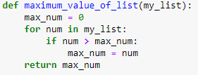
Function Return
Functions can return information/data back to you!
return is the function’s output
Function can operate on data and return the operation’s result
Notes:
Different output would be printing to console/writing to a file

Slide 5
Function Parameters/Arguments
You can pass an argument (value) to a parameter
There are parameters that require an argument (no default)
There are parameters that already have a default value
This is a source of many errors for beginners.
You can have as many input parameters as you like
But try not to have more than ~10
Notes:
Parameter: Placeholder for input
Argument: value of parameter
Source of many errors for beginners

Slide 6
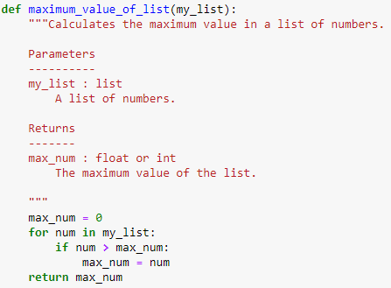
Function Docstrings – not part of code!
A docstring is a “documentation string” that describes the function
Simple docstrings describe briefly what the function does.
Can have section for “Parameters”, “Returns”, “Notes”, “References”…
Can be used to create automated documentation websites easily

Slide 7
Functions vs. Methods!?
Function is a standalone def function
Method is a function that belongs to a class
We will learn more about methods when we tackle Classes

Slide 8
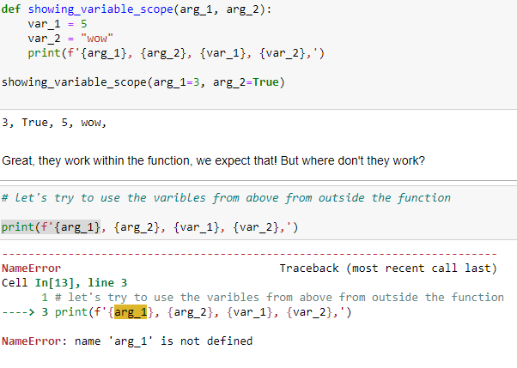
Function variable scope
Variables created within a function are local to that function
Parameters are also local to their function

Slide 9


Advanced parameters: *args, **kwargs
Positional arguments: defined by their order in the function definition
Unlimited positional arguments used via *args
Use *args when you don’t know how many positional arguments can be used
Keyword arguments: Need both a parameter name and value
Unlimited keyword arguments used via **kwargs
Use **kwargs when you don’t know how many keyword arguments can be used

Slide 10
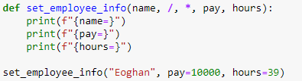
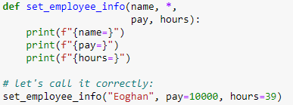
Advanced parameters: * and /
Summary:
def func(pos_only, /, pos or kw, *, kw_only):
* on its own: all following arguments are required
Why? To stop human error –they have to write out the keywords after *
/ on its own: all arguments before the / must be positional
Why? Parameter name is not meaningful e.g. def check_truthy(x, /): - x doesn’t mean anything

Slide 11
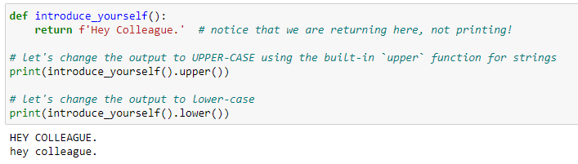
Using functions together and chaining
A nice way to create an analysis pipeline is to use functions together
Output from first function is the input to the next:
Simple: each function on its own line (easier to read)
Chaining: directly use a function on another function
Functions as arguments: use a function as input to another function.

