Slide 1

Decoding Handwriting Development:
Insights from Computational Analysis of children with and without Dysgraphia.
--G .Tharunya varma-
20251A0542

Slide 2

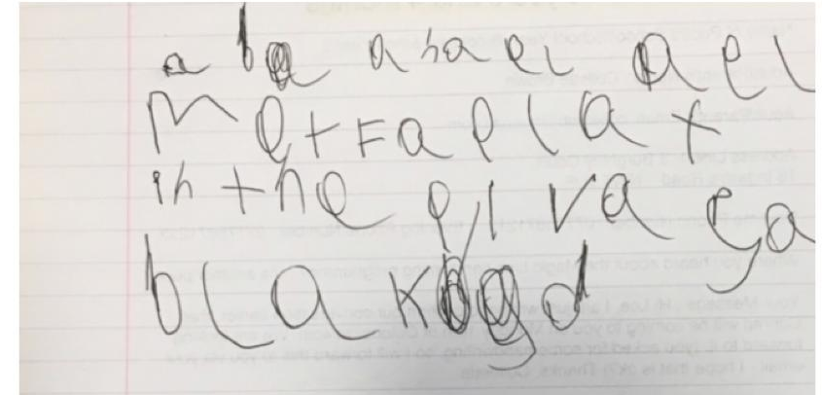
What is Dysgraphia?
Dysgraphia is a learning disability that affects a person's ability to write. It is a neurological condition that can impact a person's handwriting, spelling, and ability to put their thoughts on paper
Fig 1: 4th Grade Dysgraphia children handwriting sample.

Slide 3
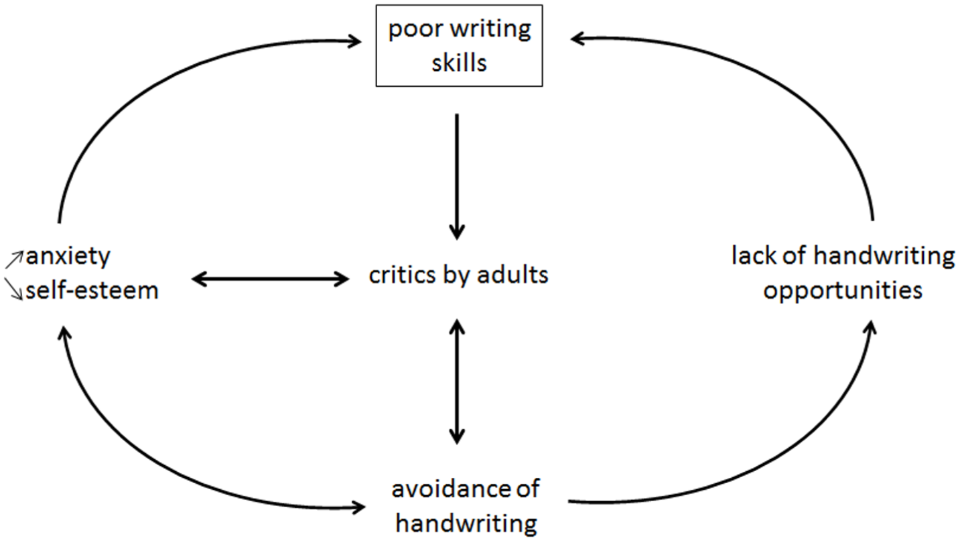
INTRODUCTION
DYSGRAPHIA CAN BE RELATED TO:
1)Language problems.
2)Motor execution.
3)Coordination problems.
4)Attention Deficit.
Fig 2 : Psychopathological model of Dysgraphia

Slide 4
Formal handwriting acquisition begins at the age of five years (preschool) and requires about ten years of practice to reach a level of almost complete automation
Interestingly, a gender effect has been observed in handwriting acquisition, with girls presenting slightly higher quality and speed scores versus their male peers
The Concise Evaluation Scale for Children’s Handwriting (BHK) which is the gold-standard test in France for diagnosing dysgraphia.
The rising availability of digital tablets in the last few decades has allowed for the analysis of new aspects of handwriting such as the dynamics of handwriting (e.g., velocity, acceleration, etc.) and the pressure of the pen or the pen tilt aspects.

Slide 5

To present the learning and acquisition of handwriting from a developmental approach (according to child age.)
2.To identify the best Features ,to diagnose the children with Dysgraphia(acc. To age) both using BHK and as well as Digital Features
OBJECTIVES
3.To perform unsupervised clustering of children with dysgraphia by applying a K means clustering of discriminative digital features, to assess how many clusters of patients had a similar profile and to identify their main characteristics.

Slide 6
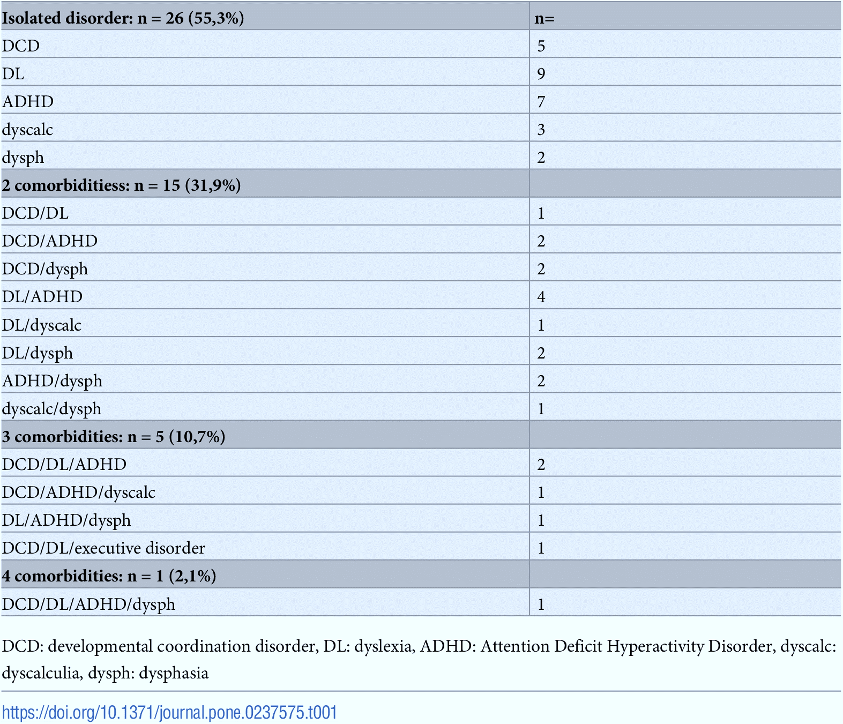
Materials and Methods
Participants
In Total ,N=280 Children.
231 Children were recruited at different Schools from Grenoble Area..
49 Children were recruited from the Reference Centre for Language and Learning Disorder at Grenoble University Hospital.
DCD :Developmental coordination Disorder.
Dl :Dyslexia.
ADHD :Attention Deficit Hyperactivity Disorder.
dyscalc :Dyscalculia.
dysph : Dysphasia.
Table 1:Diagnosis of children in the specialized clinic.

Slide 7
Procedure
 |  | Features
BHK Scores | BHK Quality Score | Writing is too large
 |  | Widening of left-hand margin
 |  | Insufficient word spacing
 |  | Chaotic writing
 |  | Absence of joins
 |  | Collision of letters
 |  | Inconsistent letter size
 |  | Bad letter or word alignment
 |  | Letter distortion
 |  | Unsteady writing trace
 | BHK Speed Score | The number of characters written in 5 min
BHK Test-
1.Five minutes
2.Blank paper
Wacom Graphic Tablet
Weight of pen:
(0g to 400 g).
Table 2: Clinical Gold Standard(BHk Scores)

Slide 8
Main features | Sub Features
Static features | Space between Words
 | Standard deviation of Handwriting Density
 | Median of Power Spectral of Tremor Frequencies
Kinematic features | Median of PS of Speed frequencies
 | Distance to mean of speed frequencies
 | In Air-Time ratio
Pressure features | Mean Pressure
 | Mean speed of pressure change
 | Standard deviation of speed of pressure change
Tilt features | Distance to mean of Tilt-x Frequencies
 | Bandwidth _ tilt x
 | Median of power Spectral of Tilt-y Frequencies.
Table 3: Digital features

Slide 9
Statistical models
Multivariate linear Regression model:( Digital features as continuous variables).
The normalization of each feature was done to ensure that they had equal weight in the regression models.
BHK Score ~ Normalized(feature) + grade + gender + ε
To understand how a given digital feature explaining continuous BHK changes according to a child’s grade, a similar model with interaction [grade*Normalized(feature)] was also created.
BHK Score ~ Normalized(feature) + grade + gender + grade *Normalized(feature) + ε.
Selected grade rather than the age to assess the effect on education, since the writing process is learned at school and not spontaneously.
Performing on TD + D dataset to explore how digital features predict handwriting (BHK) quality and speed in a mixed population that resembles a more realistic situation in the context of school detection of D children

Slide 10
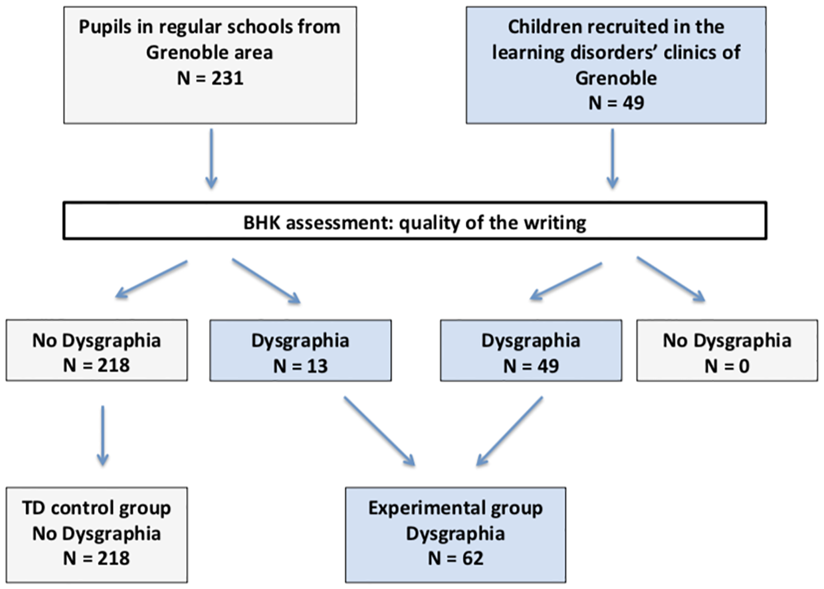
Results
Fig 3: Participant’s Demographics(children and their category).

Slide 11
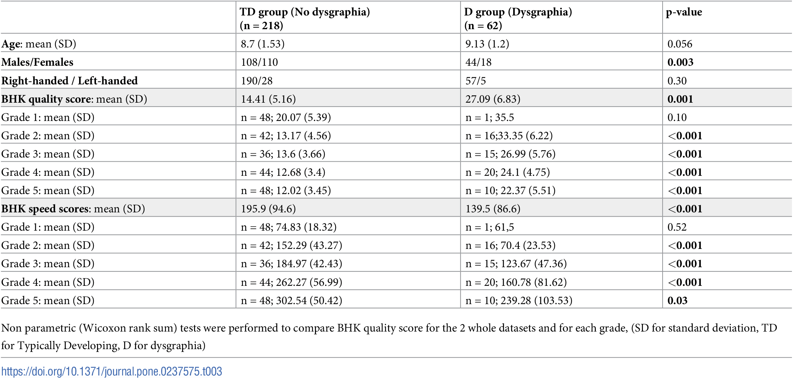
Hand writing explained from the BHK features
Table 4: Descriptive statistics of the participants(TD and D).

Slide 12
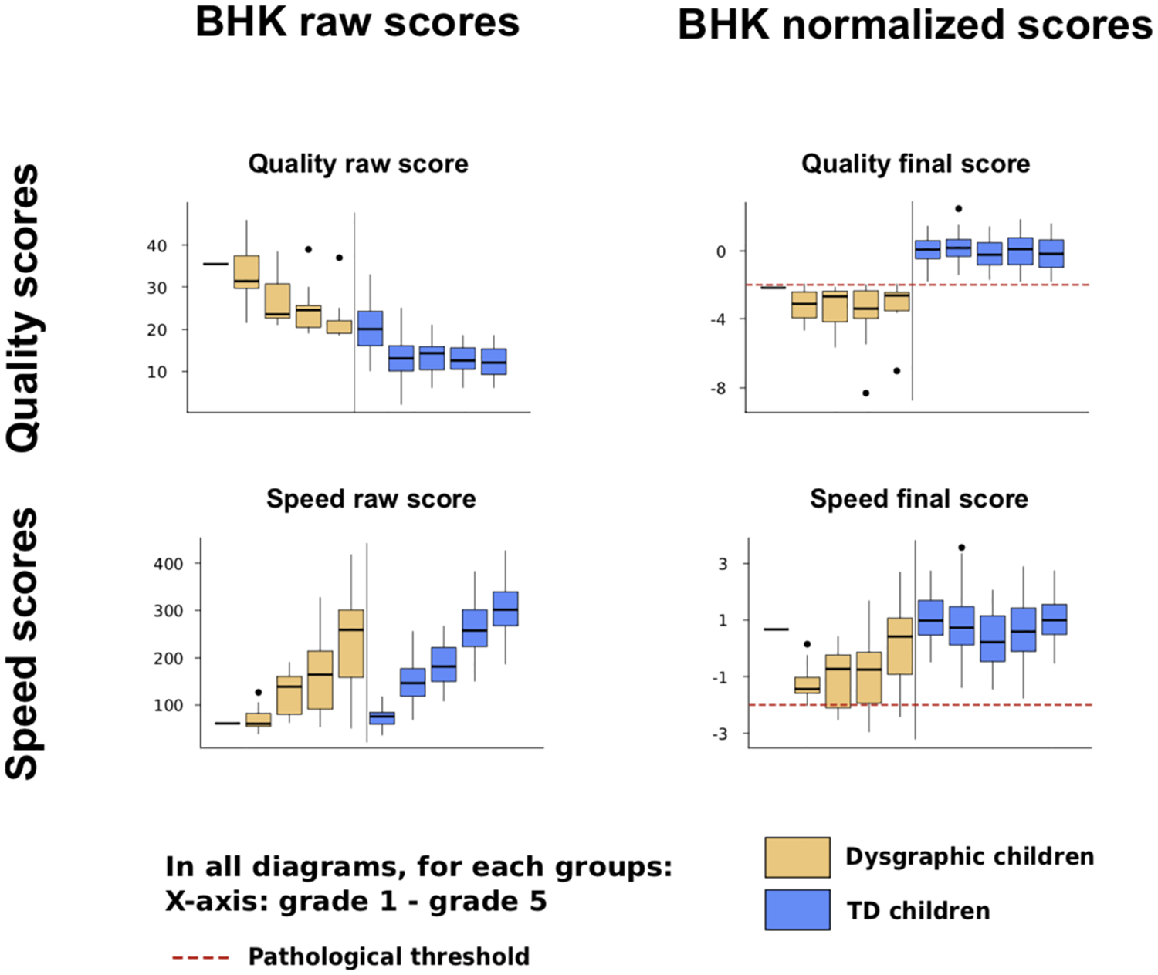
High Quality raw score == poor quality writing skills.
High Speed raw score==more number of characters written in 5 mins.
Normalized score allow comparisons b/w Grades.
The cut-off for a diagnostic of qualitative and Quantitative Dysgraphia is -2.
Fig 4 : BHK Handwriting quality and speed scores according to grade in children with TD(Typical development) and in children with Dysgraphia.

Slide 13
Handwriting Quality Score Association
Category | Feature | Dataset | P value
Static | SD of Handwriting Density | TD | 0.004
 |  | TD+D | <0.001
Kinematic | Median of power Spectral of Speed Freq. | TD | 0.038
 |  | TD+D | <0.001
 | In Air Time Ratio. | TD | 0.006
 |  | TD+D | <0.001
Table 5 :Multivariate models to predict the BHK Handwriting quality raw score for TD and (TD+D) Dataset.
Positive Corelation : In Air Time Ratio and Sd of Handwriting density.(low score==Better Quality)
Negative Corelation:Median of power Spectral of Speed Freq.(High Score ==Better Quality).
P values provide a measure of strength of evidence against HO.(null hypothesis).

Slide 14
Handwriting Speed Association
Category | Feature | Dataset | P value
Static | SD of Handwriting Density | TD | <0.001
 |  | D | <0.001
Kinematic | Median of power Spectral of Speed Freq. | TD | 0.013
 |  | D | <0.001
 | In Air Time Ratio. | TD | <0.001
 |  | D | <0.001
Pressure | SD of speed of pressure Change. | TD | <0.001
 |  | D | <0.001
Table 6: Multivariate models to predict the BHK Handwriting quality raw score for TD and (TD+D) Dataset.
Negative Corelation :Median of power Spectral of Speed Freq, In Air Time Ratio & SD of Handwriting Density
Positive Corelation: SD of speed of pressure Change.

Slide 15
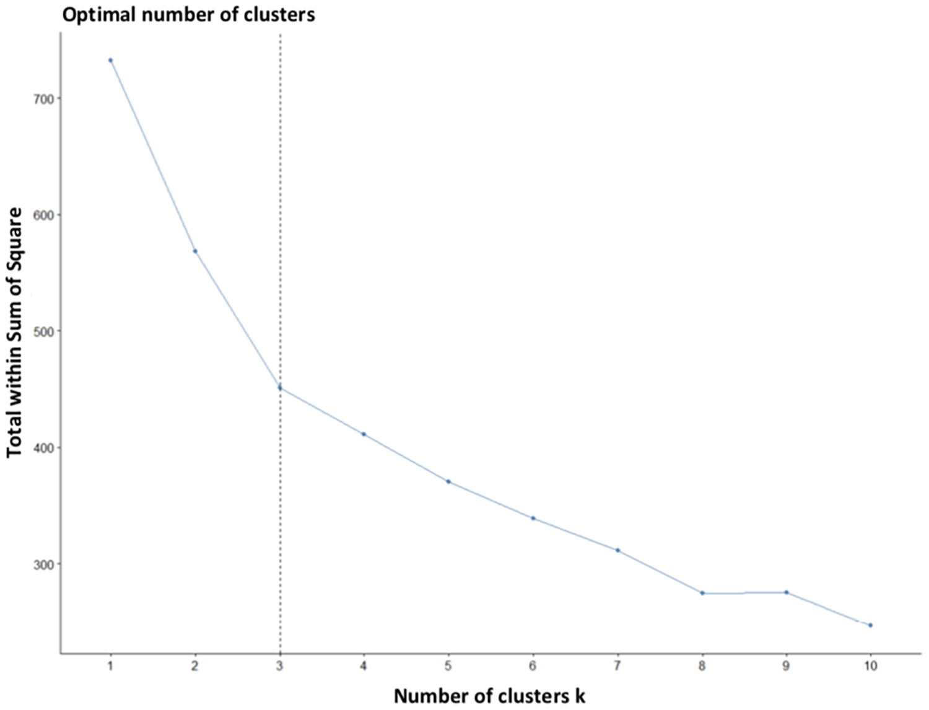
A new Clustering of Dysgraphia.
Fig 6: Elbow method to characterize the optimal number of clusters

Slide 16
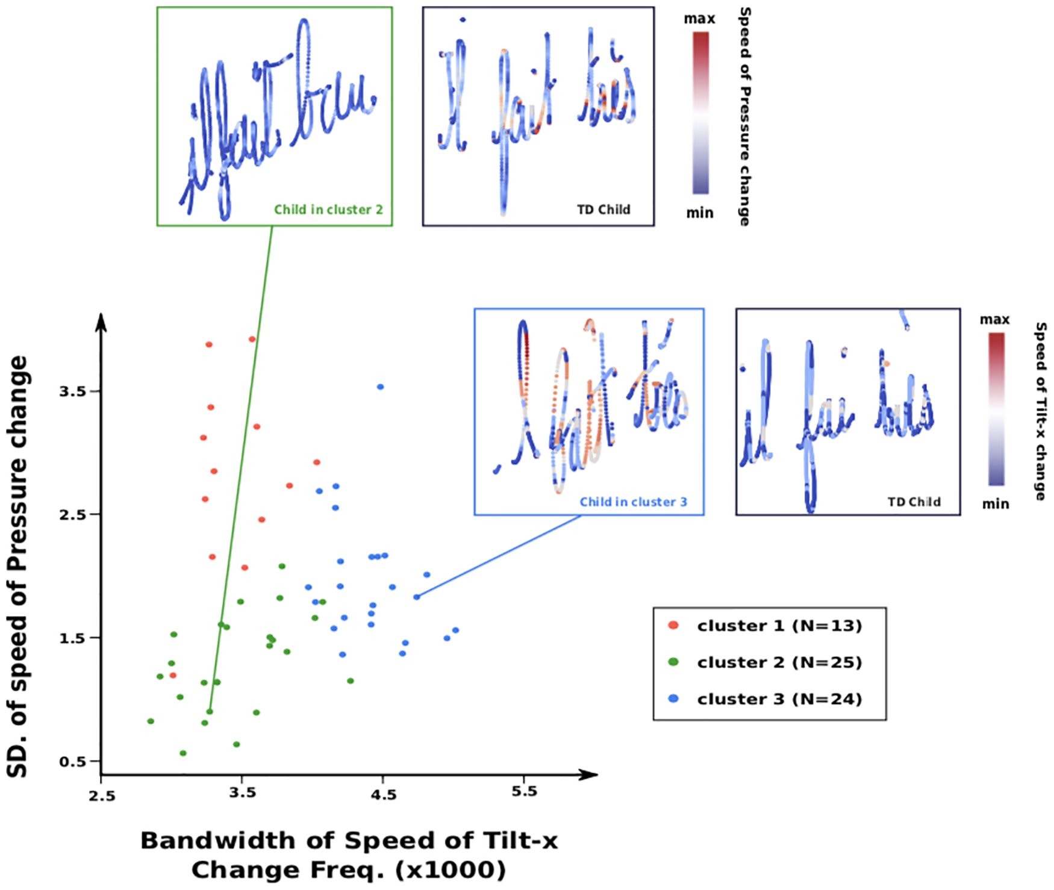
Fig 7. Comparisons of the SD of speed of pressure change and Bandwidth of Speed of Tilt-x Change Frequencies for the children without dysgraphia from the 3 different clusters

Slide 17

The results showed that certain digital features, such as pen pressure and pen speed, were significantly different between the two groups.
Additionally, the study highlighted the importance of considering age and grade when assessing the effect of digital features on handwriting skills.
Overall, these findings may inform the development of new assessment tools and interventions for improving handwriting abilities in children.

Slide 18
THANK YOU

