Slide 1
A Visual Analytics Tool for Exploring a Large Classification Model and Comparing Multiple Large Classification Models
Author : Sai Praneeth Gudala Aung Phyo
Durga Siva
Supervisors: Dr Shah Rukh Humayoun Dr Dragutin Petkovic
San Francisco State University

Slide 2
Agenda
Introduction
Problem Statement
Motivation
Related Work
Dataset Description
Data Preprocessing
Architecture
Visualization System
Live Demo
Conclusion and Future Work

Slide 3
Introduction
Overview of the Project:
This project focuses on analyzing and exploring multi-classification models that operate with datasets containing up to 1,000 classes.
We developed an interactive visual analytics tool to identify and explore misclassifications and patterns in classification models.
Objectives:
Provide an intuitive interface for class-level analysis.
Help users inspect misclassification relationships and identify areas for model improvement.
Enable to analyze the image classification models performance with interactive visualizations and key performance metrics.

Slide 4
Problem Statement
The Challenge:
Multi-classification models often handle datasets with thousands of classes, making it difficult to pinpoint misclassifications.
Comparing of image classification models performance on the same dataset with hundreds of classes can be misinterpreted.
Key Issues:
Complexity: Difficulty in analyzing inter-class relationships and aggregated model performance.
Scalability: Limited tools to handle large-scale datasets effectively.
Actionability: Lack of interactive systems to translate misclassification patterns into actionable insights.

Slide 5

Project Motivation
Why It Matters:
High-Stakes Impact: Misclassifications in fields like image detection, healthcare, finance, and autonomous systems can lead to critical errors.
Growing Model Complexity: Understanding patterns in large-scale, multi-class models is essential for improving performance.
The Gap:
Current tools lack scalability and fail to provide simple and easy to understandable actionable insights for datasets with thousands of classes.
Our Solution:
An interactive tool to explore misclassifications, provide scalable visualizations, and simple and easy to understand on the models performance with data visualization techniques.

Slide 6
Related Work Overview
Visual analytics tools are essential for understanding multi-class classification models.
The system can be able to show the analysis of large datasets with simple and easy to understandable view by using the data visualization techniques.
Recent advancements in visual analytics have introduced interactive tools to address these challenges.

Slide 7
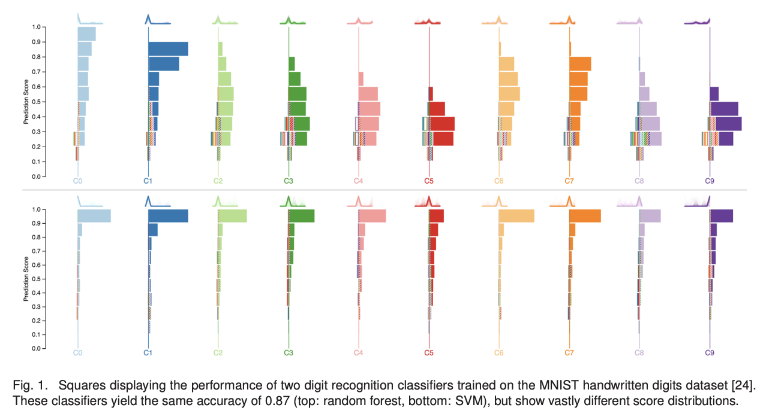
Related Work
Squares Tool: Instance-Level Insights
Supporting Interactive Performance Analysis for Multiclass Classifiers
Developed by Ren et al. (2016), Squares links instance-level data with class-level performance metrics.
This tool allows for detailed exploration of classifier performance, making it easier to identify and prioritize errors.
Ren, D., Amershi, S., Lee, B., Suh, J., Williams, J. D. (2016). "Squares:
Supporting Interactive Performance Analysis for Multiclass Classi-
fiers." IEEE Transactions on Visualization and Computer Graphics, 22(1),
61-70
Notes:
The square boxes in the Squares visualization represent individual data instances in a multiclass classification problem, with specific visual encodings to infer their properties. Here's how you can understand and interpret them:
Structure of the Visualization
Columns: Each column corresponds to a class label.
Boxes: Represent individual instances of data.
Visual Encoding of the Boxes
Position:
Right of the axis: Instances predicted as the column's class.
Left of the axis: Instances labeled as the column's class but misclassified (false negatives).
Fill Color:
The color of a box indicates its true label (the class it belongs to).
Fill Pattern:
Solid: Correctly predicted instances (true positives).
Striped: Incorrectly predicted instances (false positives).
No Fill (Outlined): Misclassified instances of the column's class (false negatives).
Vertical Position:
Reflects the confidence or prediction score for that instance. Higher positions indicate higher confidence.
Steps to Infer Information
Correct Predictions: Look for solid-filled boxes on the right side of the axis.
Errors:
False Positives: Striped boxes on the right.
False Negatives: Outlined boxes on the left.
Confidence Levels:
High-positioned boxes (top of the column) represent high-confidence predictions.
Low-positioned boxes (bottom) indicate low-confidence predictions.
Between-Class Confusion:
A striped box in one column will have a corresponding outlined box in another column, showing confusion between the two classes.
Use Cases
Estimate Class-Level Metrics: Count solid boxes to calculate precision or recall for each class.
Prioritize Errors: Focus on high-confidence errors (striped or outlined boxes at the top) as they are likely more impactful.
Debug Model Behavior: By hovering over or selecting boxes, you can see the instance's details and identify issues like mislabeled data or ambiguous features.
This visualization helps combine aggregate metrics with instance-level insights, offering a more comprehensive understanding of model performance than traditional tools like confusion matrices.

Slide 8
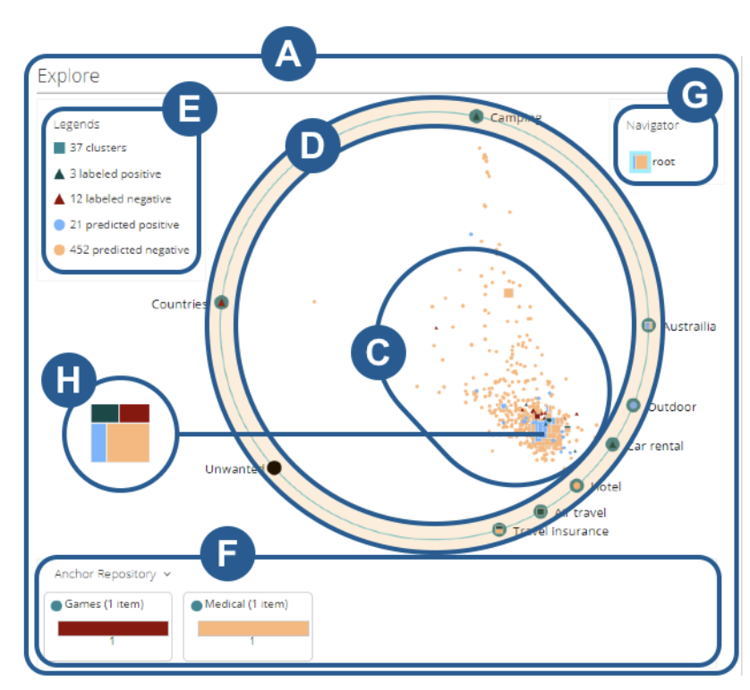
Related Work
AnchorViz – Error Discovery Through Semantic Exploration
Developed by Chen et al. (2018), AnchorViz uses semantic data exploration to identify classifier errors.
It leverages example-based anchors, which spread data points based on their similarity to anchors, uncovering feature-blindness errors.
Chen, T., McDonnell, M. D., & Cai, R. (2018). "AnchorViz: Facilitating
Classifier Error Discovery Through Interactive Semantic Data Explo-
ration." Proceedings of the ACM on Human-Computer Interaction, 2(IUI),
1-22

Slide 9
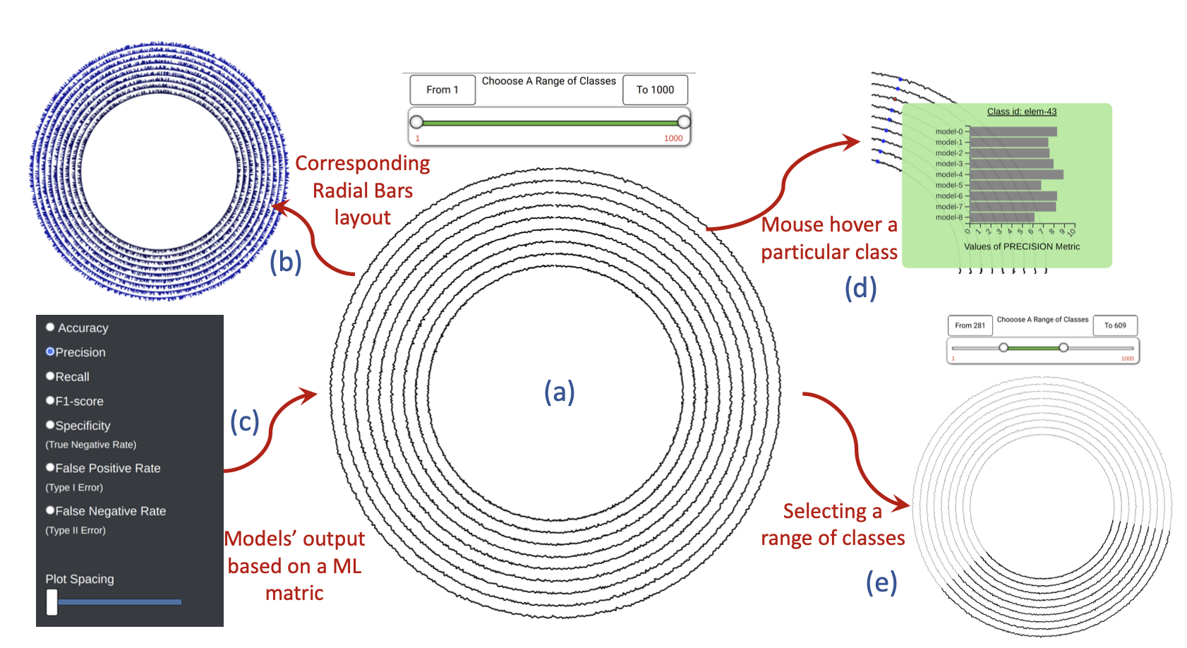
Related Work
Circles – Inter-Model Comparison
The Circles tool (Mir et al., 2023) uses a radial layout for comparing multiple classification models.
It allows users to visualize performance differences across models with high-dimensional data.
Mir, N., AlTarawneh, R., & Humayoun, S. R. (2023). "Circles:
Inter-Model Comparison of Multi-Classification Problems with High
Number of Classes." arXiv preprint arXiv:2309.05672

Slide 10
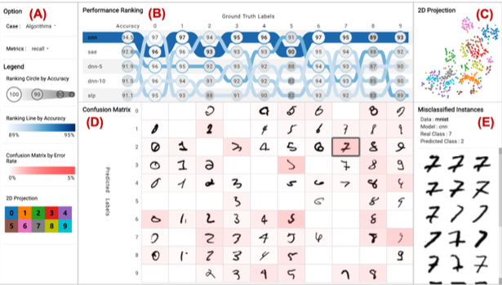
Related Work
Image Classification for small number of classes
In this visualization system only the small number of classes are classifying which is numbers from 0 to 9
The system showing and comparing the misclassification with confusion matrix, but the input dataset is small.
Park C, Kim H, Lee K. "A Visualization System for Performance Analysis of Image Classification Models." Proceedings of Visual Analytics in Machine Learning (VAML), 2023. Available at: https://library.imaging.org/ei/articles/32/1/art00003

Slide 11
Insights from Related Work
Challenges Addressed by reviewed tools:
Scalability: Visually analysis for misclassification of small numbers of classes
Insight: Simple and easy to understandable in identifying misclassifications.
Remaining Gaps:
Comparing and analyzing the misclassification between the large number of classes.
Insufficient support for aggregated data comparison and image-level insights.

Slide 12
The Target Dataset
ImageNet Dataset
ImageNet dataset consists of a collection of over 15 million high resolution labelled images, which belong to an estimated 22k categories.
We use ImageNet Large-Scaled Visual Recognition Challenge (ILSVRC) dataset, a subset of ImageNet, with images belong to 1k categories.
ILSVRC
1.2 million training images
50k validation images
150k testing images

Slide 13
Six Models
All six models are pretrained model and models have been trained on a subset of the ImageNet database
Models are trained on more than a million images, on average of 1000 images for each object categories which are classes, to be able to classify images into 1000 classes.
To test the models and manipulate the data for our visualization system, we randomly pick 1200 images from the testing images dataset.
AlexNet
MobileNet
ShuffleNet
SqueezeNet1_0
SqueezeNet1_1
Mnasnet0_5

Slide 14
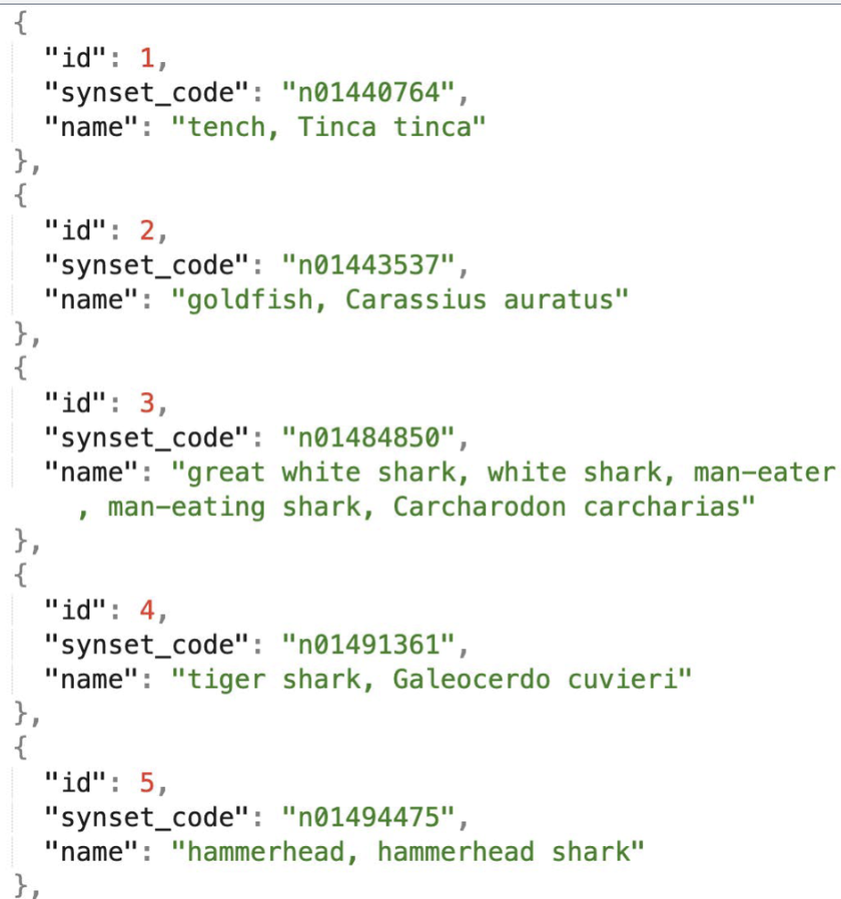
Dataset Overview
Dataset Used:
ILSVRC2012 (ImageNet) curated subset.
Contains 1,200 images across 1,000 distinct classes, representing diverse objects, animals, and entities.
Key Features:
Hierarchically structured using WordNet synsets (e.g., "n01440764: tench, Tinca tinca").
Ground truth labels mapped to images through structured JSON files.
Example Class Hierarchy:
Synset ID n01491361: "tiger shark, Galeocerdo cuvieri."
Hierarchy: Shark → Elasmobranch → Fish → Vertebrate → Chordate → Animal.

Slide 15
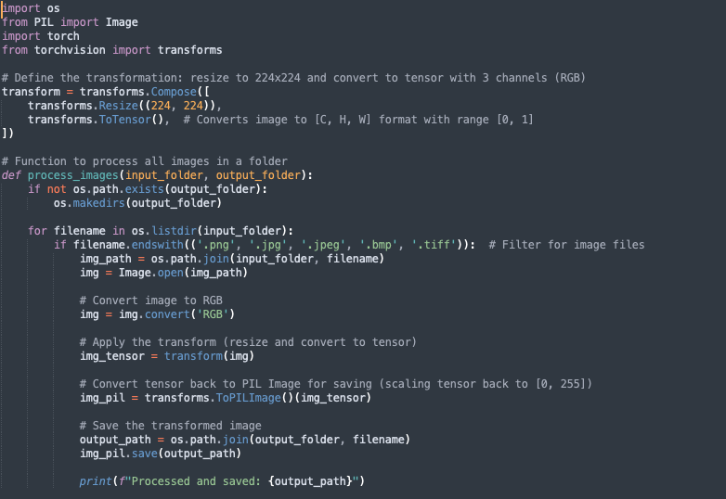
Data Preprocessing
Image Resizing:
All images resized to 224x224 pixels for compatibility with pre-trained models like AlexNet and MobileNet.
Normalization:
Pixel values scaled to [0, 1] range for numerical stability during training and inference.
Data Augmentation:
Random flips, rotations, and color adjustments applied to enhance generalization and prevent overfitting.
Dataset Structure:
Preprocessed results saved in structured JSON files for seamless integration with the backend and visualization layers.

Slide 16
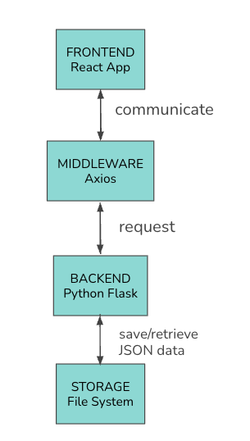
Architecture
System Components:
Frontend: Built with React and D3.js, providing interactive visualizations.
Middleware: Using Axios from the frontend side to communicate with Flask-based API to route requests between the frontend and backend.
Backend: Python with pre-trained models (AlexNet, MobileNet, ShuffleNet) for classification tasks.
Data Storage: Results stored in JSON format for easy retrieval and integration with visualizations.
Workflow:
Image → Preprocessing → Model Inference → JSON Results → Frontend Visualization.

Slide 17
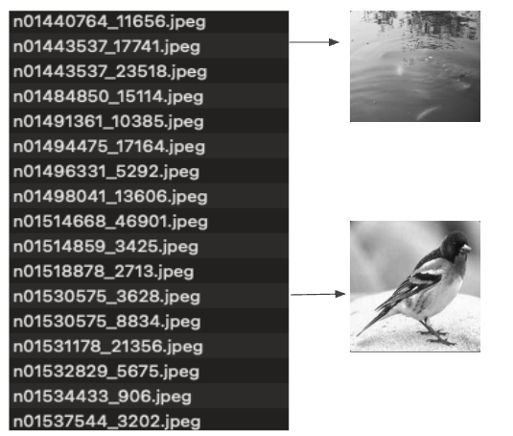
Input Dataset Structure
This is a sample input dataset folder structure and each image file name has the synset code, which represented the true label of an image.
Another input file which is the truth label input json format file is based on the synset code of each image from the dataset folder, and use it for the model accuracy check.

Slide 18
How Models Were Fed and Utilized
Customs Dataset:
User can provide their own dataset to be test on the six trained models
Testing images dataset needs to be in the folder and each image file name should include the synset, e.g “n02422699_3170.jpeg“
Feeding the Models:
Preprocessing:
Images resized to 224x224 pixels and normalized to a range of [0, 1].
Model Inference:
Processed images are passed through selected models, generating predictions and class probabilities.
Output:
Predicted class label and associated confidence score for each image.
Performance metrics like accuracy, precision, recall, and F1 score are computed by comparing predictions with the ground truth.
Storing and Visualizing Results:
Results are saved in JSON format for seamless integration with the frontend for visualization and analysis.

Slide 19
Visualization System Overview
Purpose:
To provide an interactive platform for exploring large-scale multi-class classification models.
Helps users identify misclassification patterns and understanding model performance
Two View:
Over+detailed View: Parallel coordinates views to explore a single model results
Comparison View: Six different confusion matrices and combined confusion matrices
Interaction Option:
Interactive Axis: Visualize model performance with parallel coordinates across multiple classes.
Misclassification Analysis:Allows users to hover tooltips on the classes number to analyze the misclassification of images prediction across multiple classes and click the classes number to visually analyze the misclassification images.
Confusion Matrix: Provides an overview of model performance at both the class and image levels.
Advanced Interactivity: Features such as hover tooltips, dynamic region brushing, and click-based exploration to facilitate data exploration (e.g., viewing images associated with misclassifications).

Slide 20
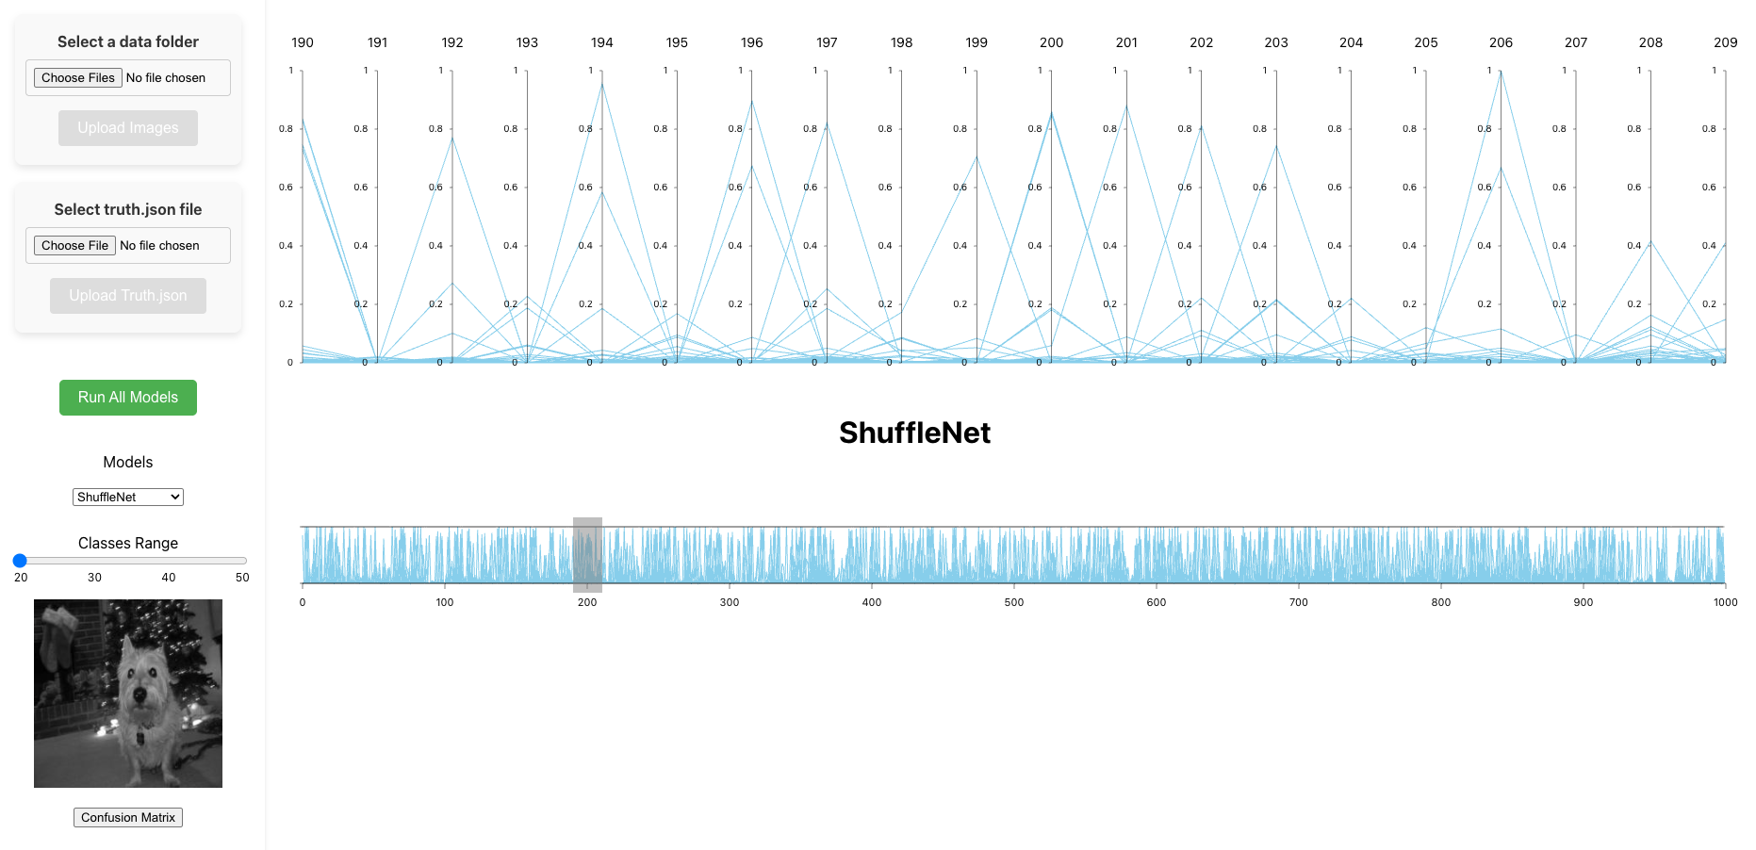
Overview+Detailed View for Single Model Exploration

Slide 21
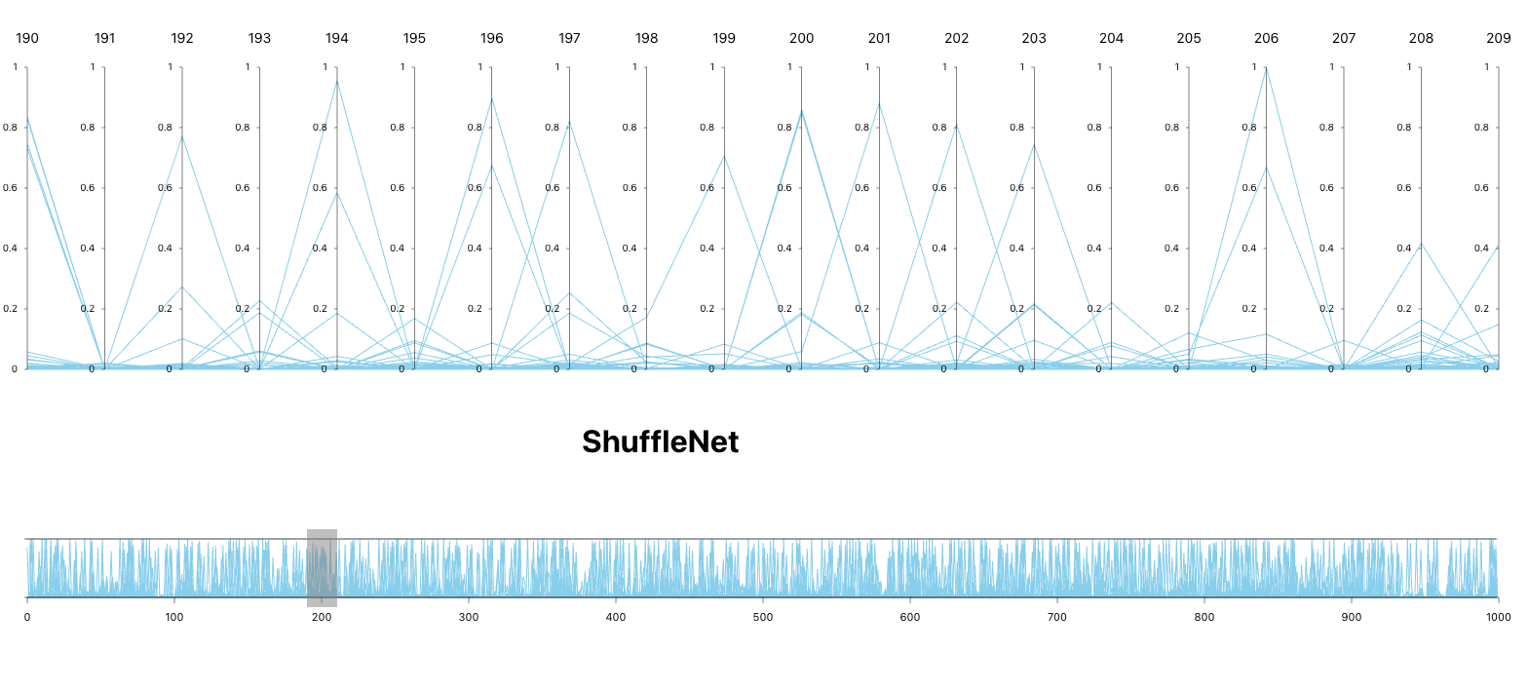
Axis Classes and Image Mapping
The vertical axis represents the 1000 classes from the dataset, with each class labeled accordingly.
Dynamic Positioning:
The yScale positions each class label based on its prediction confidence.
Higher positions correspond to classes where the model has higher confidence and fewer misclassifications.
Lower positions represent classes with lower confidence and more frequent misclassifications.
Purpose of Axis Classes:
Visualize class-level performance by showing where each class stands based on model certainty.
Hover and Click Interactions allow for in-depth analysis of misclassification patterns and model performance.

Slide 22
Image Mapping – Visualizing Misclassifications
When a class label is clicked, the misclassified images related to that class are displayed in the modal.
Filtered by probability threshold (e.g., ≥0.15), focusing on the most confident misclassifications.
Purpose:
Map images to class labels to help users understand why the model misclassified certain instances.
Enhances visual context and aids in spotting patterns in misclassifications.
Visuals:
Display misclassified images linked to the class clicked on the axis.

Slide 23
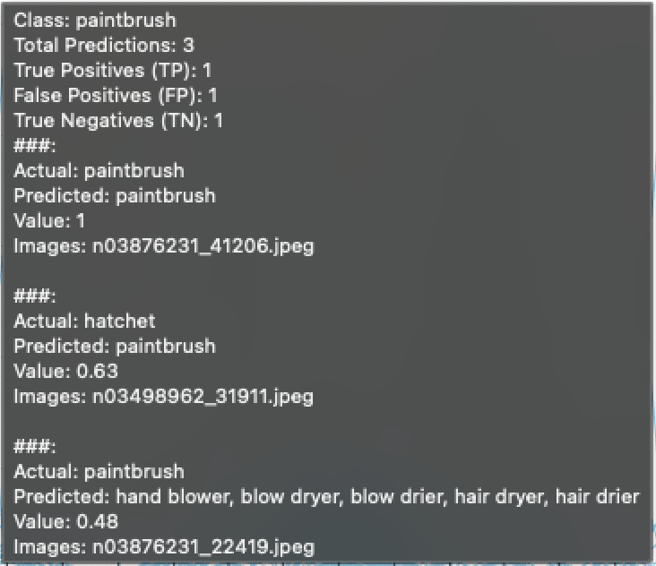
Hover Interaction – Instant Insights
Hovering over a class label displays a tooltip with detailed information, including:
Prediction Confidence: The model's certainty about the classification.
True Positives (TP): The number of correct predictions.
False Positives (FP): The number of misclassifications for the class.
True Negatives (TN): The number of misclassifications for the class.
Purpose:
Quick assessment of each class’s performance without clicking.
Provides immediate feedback on the prediction confidence and model reliability.

Slide 24
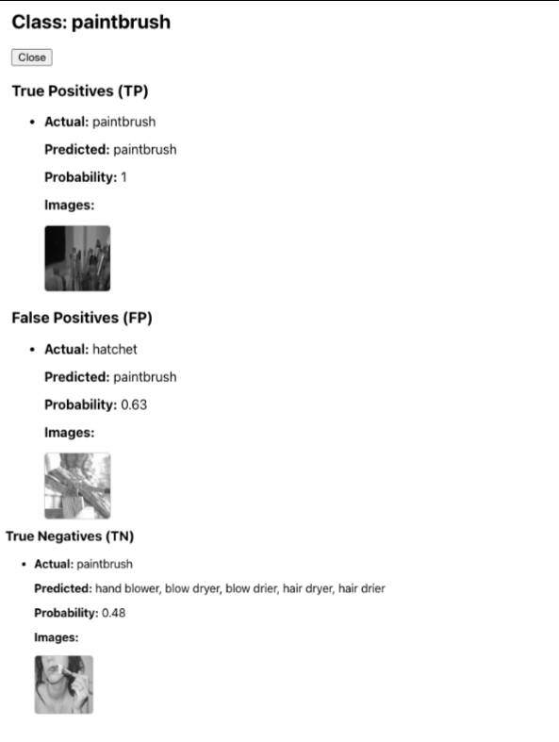
Click Interaction: Explore Misclassifications
Clicking on a class label opens a modal with detailed insights into misclassifications for that class.
The modal displays:
Misclassified Images: Visual examples of the incorrect predictions made by the model.
Top Predictions: Sorted by confidence, showing the most probable misclassifications.
Purpose:
In-depth exploration of where the model made mistakes.
Helps users visualize errors and gain contextual insights for model improvement.

Slide 25
Interactive Matrix Exploration
Purpose:
A matrix-based exploration tool designed for misclassification analysis across multiple classes.
Provides a color-coded grid that highlights misclassifications and correctly classified instances, helping users quickly identify model performance patterns.
Interactive Features:
Model Comparison:
Allows users to compare predictions across multiple models with interactive tooltips providing model-specific insights.
Class-Level and Image-to-Image Mapping:
Links class labels and images to help users understand misclassification patterns on a per-class and per-image basis.
Cumulative Metric Analysis:
Provides aggregate metrics (e.g., precision, recall, F1 score) for each class or image, allowing for a comprehensive view of model performance.

Slide 26
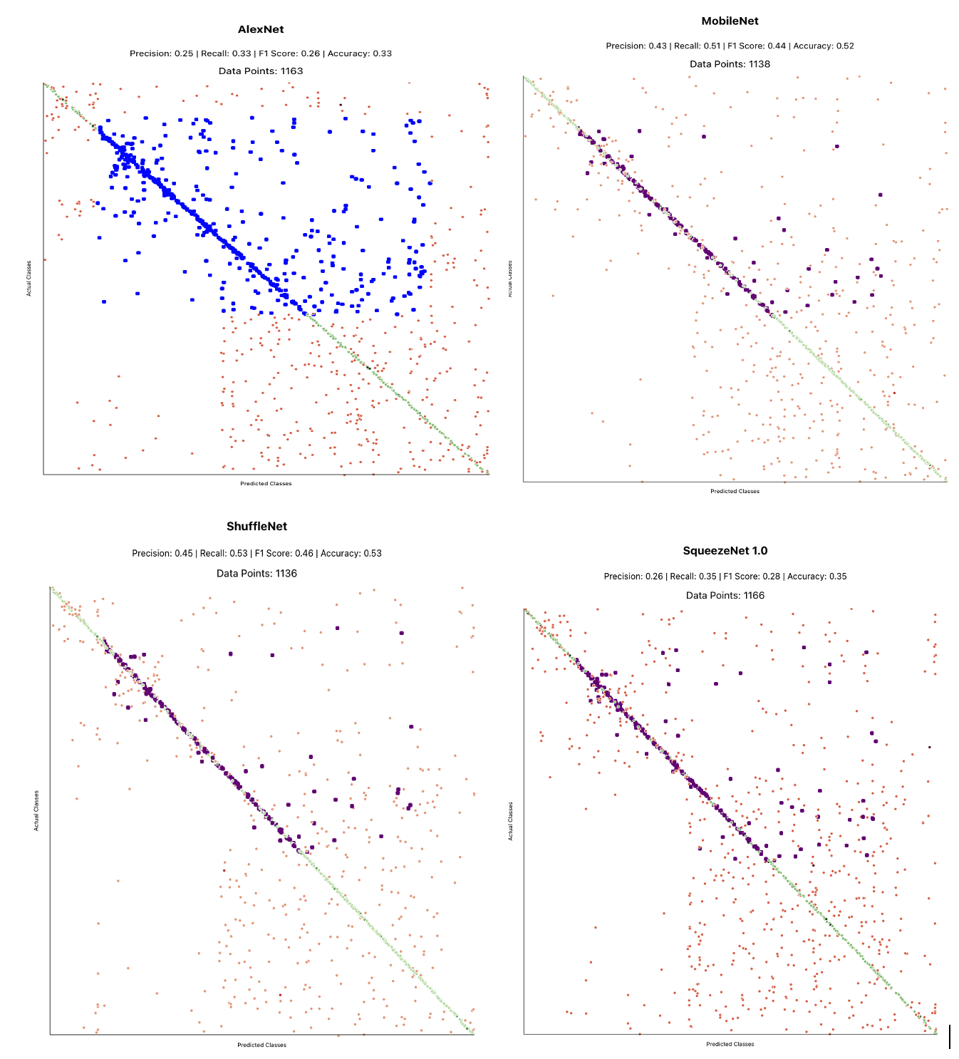
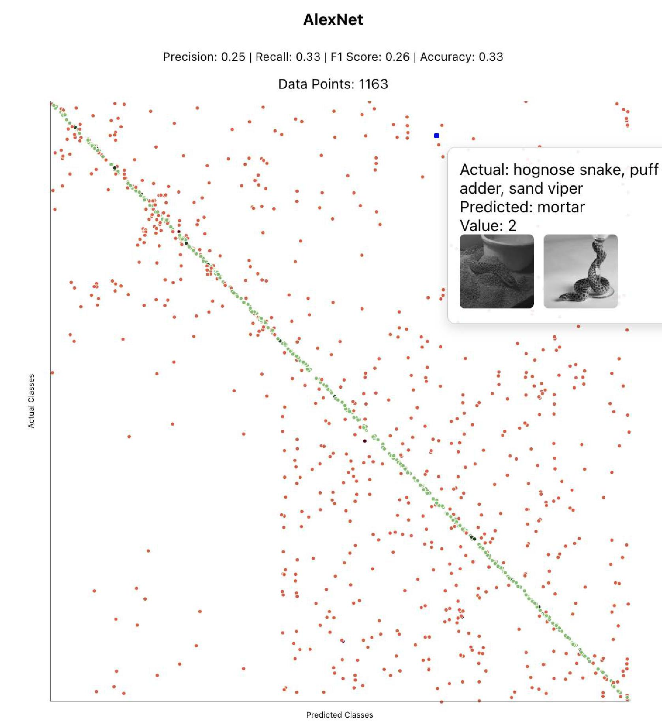

Slide 27


Slide 28

Conclusion
The Visualization System provides an interactive platform for analyzing multi-class classification models.
Hover interactions offer quick insights into prediction confidence and class performance.
Click interactions allow users to explore misclassification patterns, with detailed images and prediction information.
Confusion Matrix Plots allows users to evaluate and compare classifications models
The system helps users:
Exploring a model and comparing it with other models.
Identify areas for improvement and optimize accuracy.
Key Takeaways:
User, especially machine learning experts, can analyze the performance of an individual model
Provides actionable insights to enhance the different models performance.

Slide 29
Future Work
Expand Model Support: Integrate additional models and frameworks.
Enhance Performance: Implement GPU acceleration for faster processing.
Incorporate XAI Techniques: Use Grad-CAM for visual model explanations.
Improve Scalability: Optimize for larger datasets and more classes.
Real-time Updates: Enable live interactions during model updates.
Cloud Deployment: Host the system for remote access and better data handling.

Slide 30

Acknowledgements
Dr. Shah Rukh Humayoun – Mentor and Advisor

Slide 31


