Slide 1
From Data to Decisions: The 2025 Sales Story
Data Storytelling & Statistical Validation | ApexPlanet Internship, Task 4

Slide 2
Business objective
Understand
Validate
Recommend
Where does revenue come from: time, product, city, customer?
Is the Electronics advantage over Fashion statistically real?
Which actions are supported by the evidence?
Key question: Do Electronics orders generate significantly higher sales than Fashion orders?

Slide 3
Dataset overview
1,000
947
8
6 / 5
orders (12 columns)
unique customers
cities
products / categories
Period: 1 Jan 2025 to 1 Jan 2026, one row per order
Fields: customer (ID, age, gender), city, product, category, quantity, unit price, total sales
Categories: Electronics (Laptop, Mobile), Education (Book), Fashion (Shoes), Furniture (Chair), Grocery (Rice)

Slide 4
Data cleaning summary
Issue found | Records | Action taken
Missing Age | 20 | Filled with the median age
Missing City | 13 | Labelled 'Unknown'; left out of city ranking
Order_ID ORD100050 reused for different orders | 9 | Kept (distinct orders) and flagged
Fully duplicated rows | 0 | None found
Total_Sales = Quantity × Unit_Price | 1,000 of 1,000 | Verified: no mismatches
Partial month (1 Jan 2026 only) | 5 orders | In totals; excluded from monthly trend

Slide 5
Key KPIs
₹139.4M
₹139.4K
total revenue
average order value
36%
5%
of revenue from Electronics
of customers ordered twice or more
Top city: Patna | Top product: Laptop | Median order: ₹108.6K | Units sold: 5,435

Slide 6
Sales trend: steady, with a late-summer dip
Average month: ₹11.5M
Peak: March at ₹13.1M
Trough: September at ₹9.2M, about 21% below average
Recovery from October onward, driven by order volume

Slide 7
Customer segmentation: 20% of customers drive 48% of revenue
Segments are based on each customer's lifetime spend (top 20% / middle 40% / bottom 40%)
High Value: 190 customers, ₹66.4M
Low Value: 40% of customers, only 11% of revenue
5% of customers repeat-purchase: retention is the open opportunity

Slide 8
Product and market analysis
Electronics leads on volume, not on order size: 354 orders across two products vs 156 for Fashion. Average order value is ₹143.4K vs ₹127.2K, so is that gap real? Next slide. Top cities: Patna, Kolkata, Bengaluru, Mumbai (all within ₹0.5M).

Slide 9
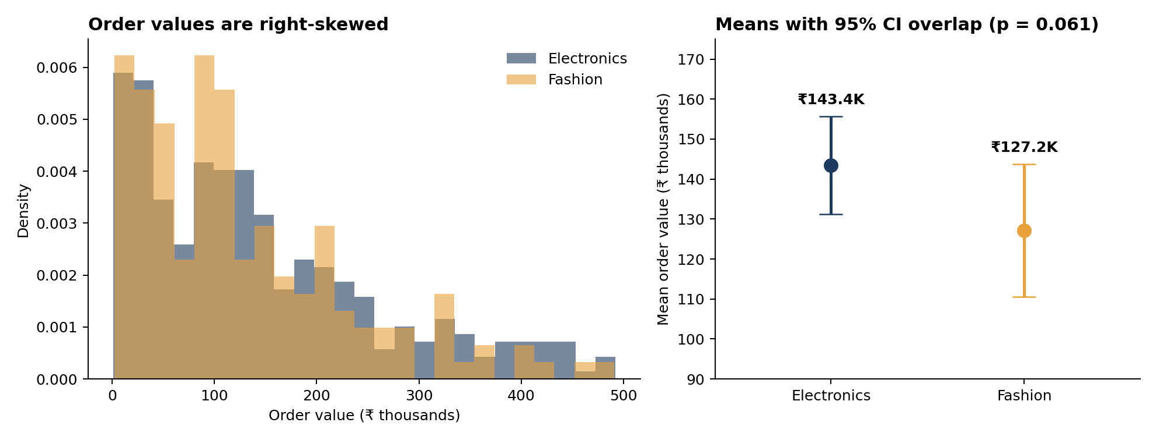
Statistical testing: is Electronics really bigger?
p = 0.061
+₹16.3K
−₹4.3K to +₹36.9K
Welch t = 1.55, df = 329 (one-sided)
Electronics − Fashion mean (+12.8%)
95% CI for the difference
H0: means are equal. H1: Electronics > Fashion. α = 0.05.
Decision: Fail to reject H0. The gap is within sampling noise (Mann–Whitney p = 0.12; the CI includes 0). About 606 orders per category would be needed to confirm an effect this size.

Slide 10
Business recommendations
1. Retain high-value customers
Insight: 20% of customers give 48% of revenue, and only 5% ever reorder.
Action & impact: Loyalty offers and reorder nudges. Illustrative: repeat rate 5% to 10% adds about ₹6.6M (+4.7%).
2. Fix the Aug–Sep dip
Insight: Revenue fell to ₹9.4M and ₹9.2M vs a ₹11.5M average.
Action & impact: Run targeted promotions in these months. Lifting both to average adds about ₹4.5M.
3. Back Electronics by volume, not price
Insight: Its revenue lead comes from order count; order size is not proven higher.
Action & impact: Keep Laptop/Mobile stock and marketing strong; avoid premium pricing assumptions until more data confirms.

Slide 11
Conclusion
The business earned ₹139.4M from 1,000 orders; Electronics is the largest category at 36% of revenue.
Statistically, Electronics' higher average order value (+12.8%) is not significant at the 5% level (p = 0.061): we fail to reject H0.
The real levers are retention of high-value customers and smoothing the Aug–Sep dip.
Next step: collect more orders (about 606 per category) and re-test.

Slide 12
Thank you
Questions and feedback welcome | Code, charts and report on GitHub

