Slide 1

Analysing Recursive Algorithms Using the Recursion Tree Method
Technical Presentation
(CSA0614)-Design and Analysis of Algorithms
Guided by:
Dr. A. Sairam
Presented by:
G Rama Krishna (192565028)

Slide 2


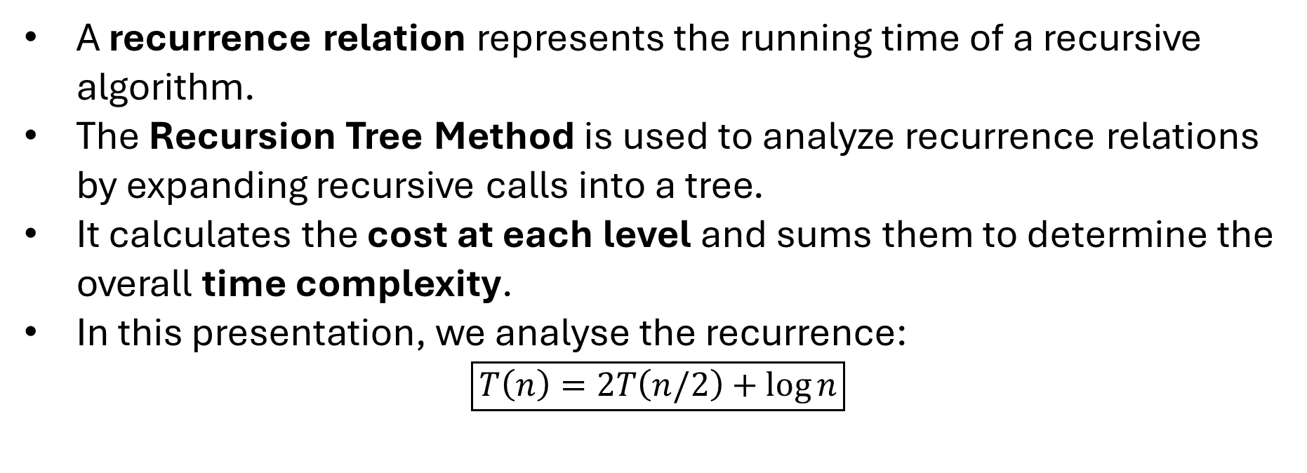
INTRODUCTION
A recurrence relation represents the running time of a recursive algorithm.
The Recursion Tree Method is used to analyze recurrence relations by expanding recursive calls into a tree.
It calculates the cost at each level and sums them to determine the overall time complexity.
In this presentation, we analyse the recurrence:
$$\boxed{T\left(n\right)=2T\left(n/2\right)+\log{n}}$$

Slide 3
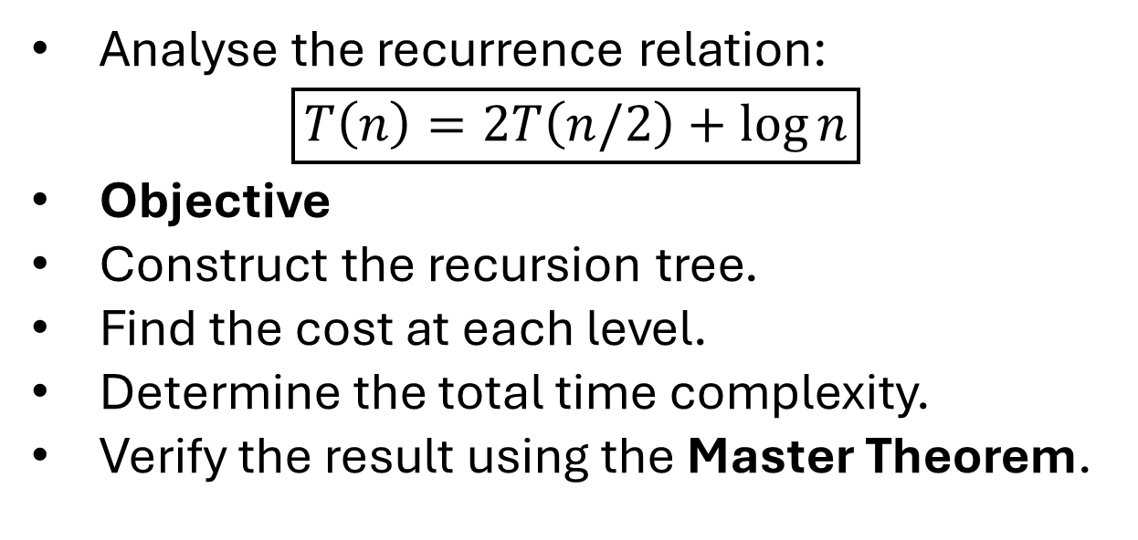
Problem Statement
Analyse the recurrence relation:
$$\boxed{T\left(n\right)=2T\left(n/2\right)+\log{n}}$$
Objective
Construct the recursion tree.
Find the cost at each level.
Determine the total time complexity.
Verify the result using the Master Theorem.

Slide 4
Algorithm Overview
Recursion Tree Method
Draw the recursion tree.
Divide the problem into two subproblems.
Compute the cost at each level.
Add all level costs.
Find the final time complexity.

Slide 5
Algorithm / Pseudocode
Input: T(n)=2T(n/2)+log n
1. Divide problem into two parts.
2. Continue until size becomes 1.
3. Compute cost at each level.
4. Add all costs.
5. Return total complexity.

Slide 6
Working Example:
Recursion Tree
log n
/ \
log(n/2) log(n/2)
/ \ / \
log(n/4) ... log(n/4)
Level-wise Cost
Level 0 → log n
Level 1 → 2log(n/2)
Level 2 → 4log(n/4)
Height = log n

Slide 7
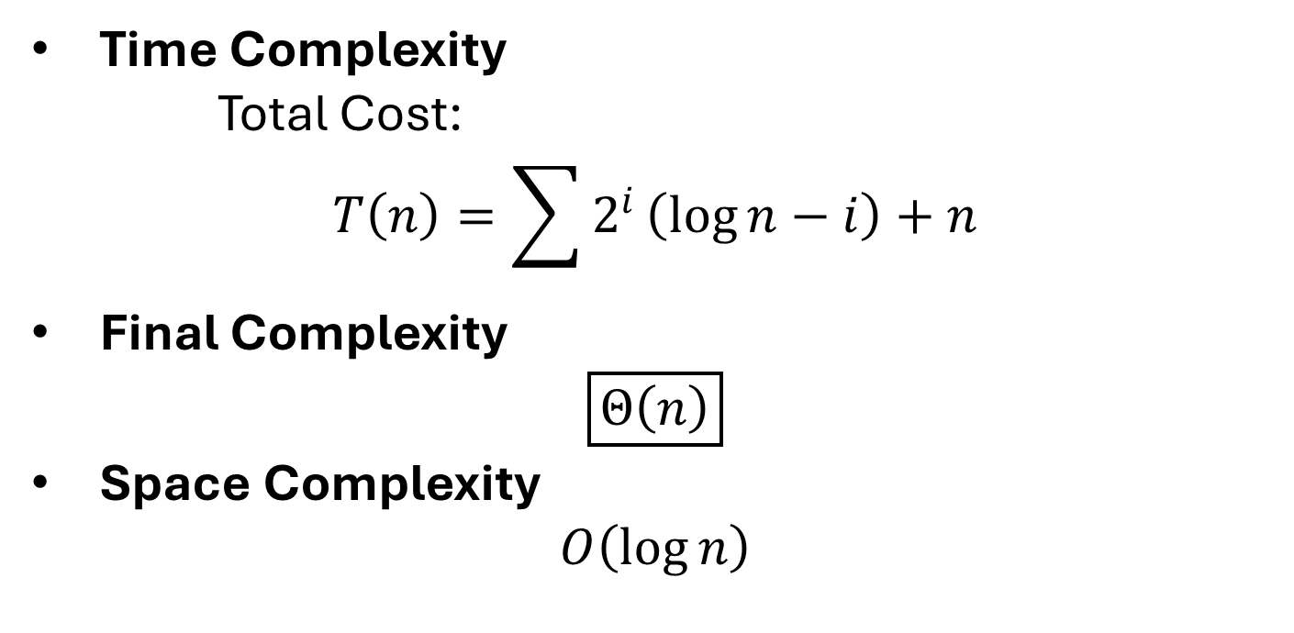
Complexity Analysis
Time Complexity
Total Cost:
$$T\left(n\right)=\sum{2^{i}}\left(\log{n}−i\right)+n$$
Final Complexity
$$\boxed{Θ\left(n\right)}$$
Space Complexity
$$O\left(\log{n}\right)$$

Slide 8
Applications
Merge Sort
Quick Sort
Binary Search
Divide-and-Conquer Algorithms
Algorithm Complexity Analysis

Slide 9
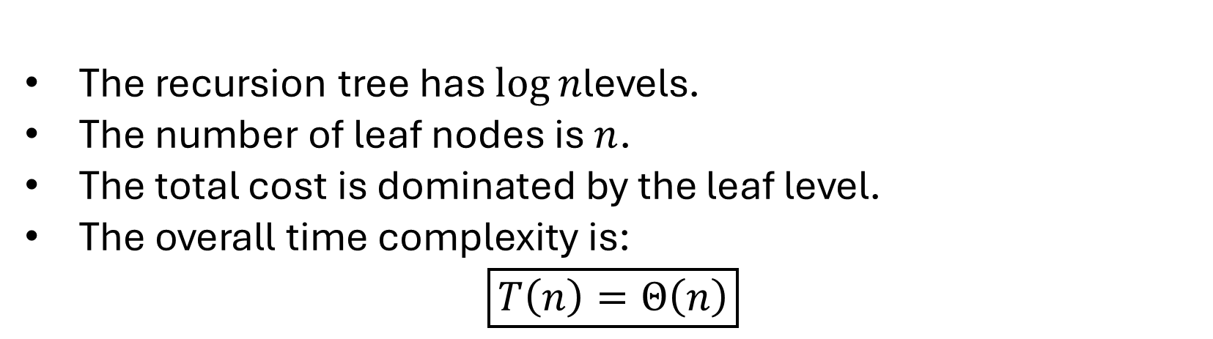
Results
The recursion tree has $\log{n}$levels.
The number of leaf nodes is $n$.
The total cost is dominated by the leaf level.
The overall time complexity is:
$$\boxed{T\left(n\right)=Θ\left(n\right)}$$

Slide 10
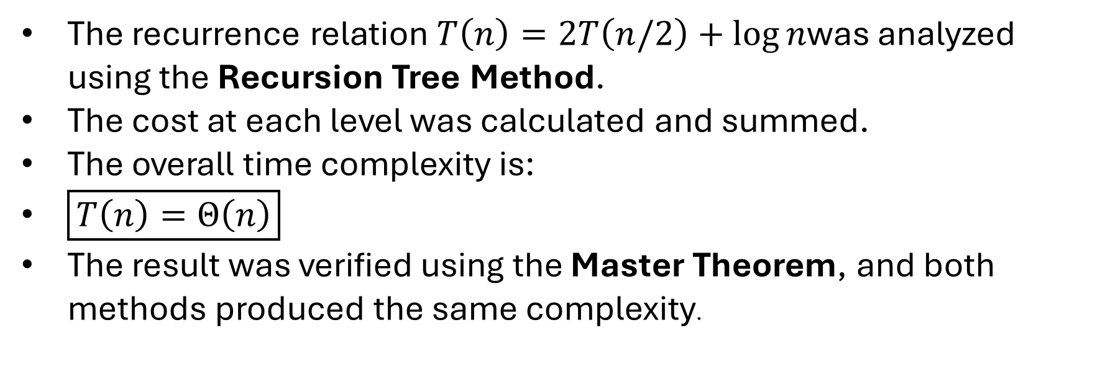
Conclusion
The recurrence relation $T\left(n\right)=2T\left(n/2\right)+\log{n}$was analyzed using the Recursion Tree Method.
The cost at each level was calculated and summed.
The overall time complexity is:
$\boxed{T\left(n\right)=Θ\left(n\right)}$
The result was verified using the Master Theorem, and both methods produced the same complexity.

Slide 11
Thank You

Slide 12

Geotag photo:

