Slide 1
TOOLS TO SUMMARIZE TEXTS

Slide 2
CONTAIN
ABSTRACT
INTRODUCTION
LITERATURE REVIEW
PROBLEM STATEMENT
MODULES TO BE DEVELOPED

Slide 3
ABSTRACT
Due to an exponential growth in the generation of textual data, the need for tools and mechanisms for automatic summarization of documents has become very critical. Text documents are vital to any organization's day-to-day working and as such, long documents often hamper trivial work. Therefore, an automatic summarizer is vital towards reducing human effort. Text summarization is an important activity in the analysis of a high volume text documents and is currently a major research topic in Natural Language Processing. It is the process of generation of the summary of input text by extracting the representative sentences from it. In this project, we present a novel technique for generating the summarization of domain specific text by using Semantic Analysis for text summarization, which is a subset of Natural Language Processing.

Slide 4
INTRODUCTION
Text summarization (or automatic summarization) is the creation of a shortened version of a text by a computer program. The product of this procedure still contains the most important points of the original text and is generally referred to as an abstract or a summary. Broadly, one distinguishes two approaches to text summarization: extraction and abstraction. Extraction techniques merely copy information deemed to be most important by the system to the summary, while abstraction involves paraphrasing sections of the source document. Both techniques exploit the use of natural language processing and/or statistical methods for generating summaries. And, the classical approaches to text summarization proposed by Luhn et al have established the basis for the discipline of text summarization techniques. The applicability of text summarization is increasingly being exploited in the commercial sector, in areas of telecommunications, data mining, information retrieval, and in word processing with high probability rates of success.

Slide 5
LITERATURE REVIEW
1 .Automatic Text Summarization Using Natural Language Processing :
Authors Pratibha Devihosur , Naseer R implemented an automatic text summarization mechanism based on an unsupervised learning system The significance of the generated summary was assessed with the assistance of Simplified Lesk calculation along with an online semantic lexicon Word Net. Based on their evaluation the algorithm provides best summarized outcome ranging from25-50percentwith respect to the source data. In this project they also focussed on ambiguous words because a specific word may have distinctive significance in various setting . Hence they tried to inculcate the principle of word sense disambiguation to decide the right feeling of a word utilized as part of a specific setting.
2. Text Summarization using Natural Language Processing:
In this paper authors Ankit Kumar, Zixin Luo and Ming Xu created an end to end web application which can take an article as input and generate a summary. The model was trained using deep learning approach and trained on Juniper’s datasets. Juniper is a corporate organization that develops and markets networking devices. In order to provide abetter customer experience, Juniper Networks maintains large datasets of articles where in each of these articles can be long and verbose. Hence these datasets were used to train the text summarization model . The model built used abstractive summarization technique and significantly generated excellent human readable sentences from given inputs. However, it did not always generate summaries capturing all the important information in the input documents.

Slide 6
3. Text Summarization Techniques : A Brief Survey:
In this survey Mehdi Allahyari , Elizabeth D. Trippe, Saeid Safaei and others study the main approaches to automatic text summarization and also review the different processes for summarization and describe the effectiveness and shortcomings of different methods . Topics like the impact of context in summarization and semantic analysis are also mentioned.
4. NLP Based Text Summarization Using Semantic Analysis:
In this project paper authors Harsh Desai, Dhairya Pawar, Geet Agrawal reviewed the different methods for text summarization and provided a novel technique generating the summarization of domain specific text by using Semantic Analysis for text summarization.
5. Text Summarization: An Overview:
In this research paper author Samrat Babar provides an analys is about the meaning of text summarization in natural language processing and their types along with the technical and mathematical analysis of text summarization in detail. This paper basically Is a documentation for all the information required to study as well refer through on the topic of automatic text summarization.

Slide 7
PROBLEM STATEMENT
STEP-1: Import all necessary libraries
NLTK (Natural Language toolkit) is a widely used library while we are working with text in python. Stop words contain a list of English stop words, which need to be removed during the pre-processing step.
STEP-2: Generate clean sentences
Text processing is the most important step in achieving a constant and positive approach result. The processing steps removes special digits, word, and characters.
STEP-3: Calculate cosine similarity and generate a matrix
this function takes two sentences, processes them by stemming, removing stop words, and vectorizing them, and then calculates their cosine similarity. The result is a measure of how similar the two sentences are in terms of their word usage.

Slide 8
STEP-4: Score the sentences
PageRank algorithm calculate important scores (PageRank scores) for each node (sentence) in the graph. graph generated from the sentence similarity matrix using these scores will be used to rank the sentences for the purpose of selecting the most important ones for the summary.
STEP-5: Generate the summary
This is the last stage of text summarization. Top sentences are calculated based on the score and retention rate given to the user are included in the summary and finally, a summary is created.

Slide 9
MODULES TO BE DEVELOPED
system as shown in figure uses Latent Semantic Analysis to summarize documents from the user. The user inputs a document to the summarizer which has classes derived from the NLP libraries implemented on it. These classes are a collection of semantic rules (which allows the system to group the content using world knowledge) and dictionaries, which aid in the semantic analysis and SVD phases in the summarizer. The input document is first parsed or pre-processed, wherein there is a removal of unneeded words such as ‘stop words’ which are simply small function words, like “the”, “and”, “a”, which do not contribute meaning to the text summary. The next stage is the generation of a Singular Value Decomposition (SVD) matrix, which is a m x n matrix, where m is the total number of terms in the original text and n is the number of sentences in the original text. The SVD Analysis stage derives the latent semantic structure from the document represented by matrix A. Finally in the summarization process, the system arranges the sentences generated from the SVD Analysis stage by semantically placing them in a way that the summary encompasses all the concepts of the original text. The final summary is then given back to the user.

Slide 10
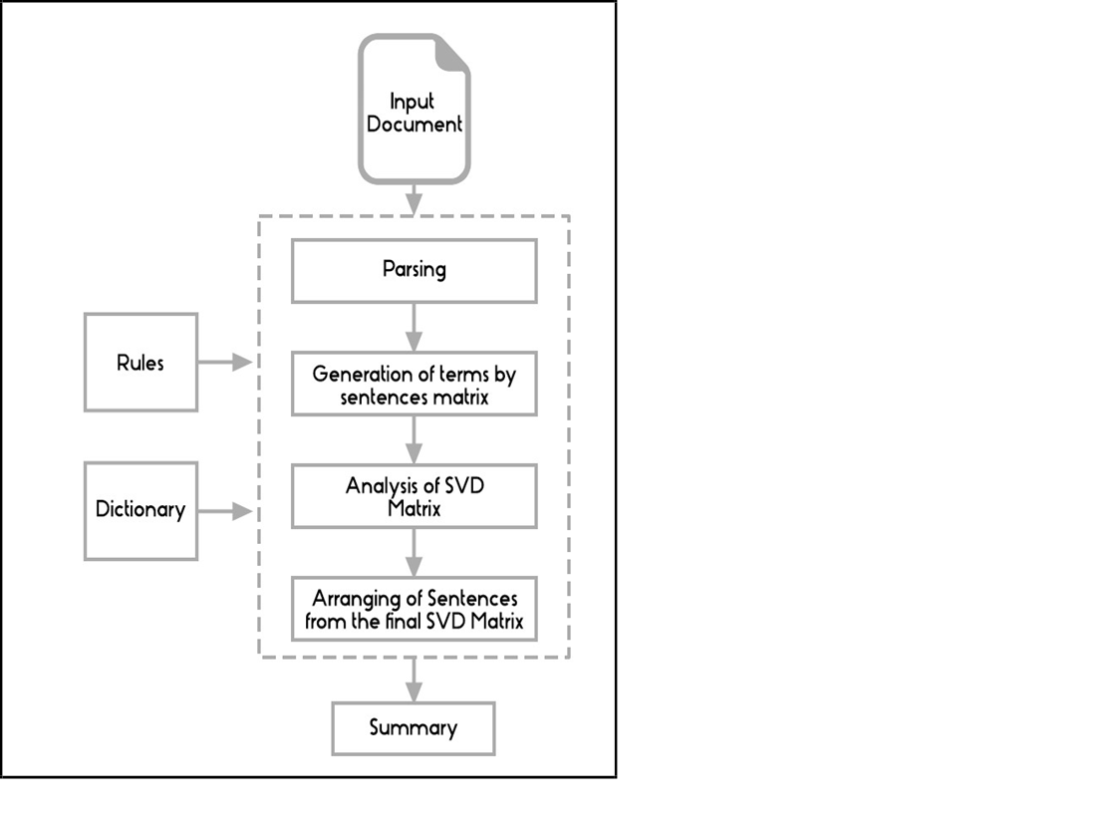

Slide 11
REFERENCES
1. E. Lloret and M. Palomar, "Text summarisation in progress :a literature
review“ in Springer, Springer, pp.1-41,2012.
2. U. Hahn and I. Mani, "of Automatic Researchers are investigating summarization tools and methods that", IEEE Computer33. 11, pp. 29-36, November2000.
3. K. Spärck Jones, "Automatic summarising : The state of the art", Information Processing &Management, vol. 43, pp. 1449-1481, nov2007.
4. V. Gupta and G.S. Lehal ,"A Survey of Text Summarization Extractive techniques", Journal of Emerging Technologies in Web Intelligence, vol.2, no.3, pp. 258-268, 2010.
5. A. Khan and N. Salim, "A review on abstractive summarization methods", Journal of Theoretical and Applied Information Technology, vol. 59, no.1, pp. 64-72,2014.

Slide 12

THANK YOU

