Slide 1
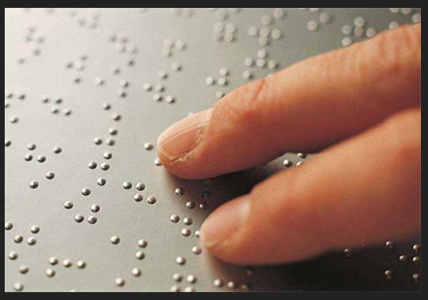
BRAILLE TRANSLATOR (BRAILLE TEXT TO SPEECH) USING PYTHON AND DEEP LEARNING
Submitted by:
Gudladhana Harshith -11903248
Bokam Kusuma-11905583
Jeevnesh Krishan Vyas-11911089
Saurav Kumar-11903912

Slide 2
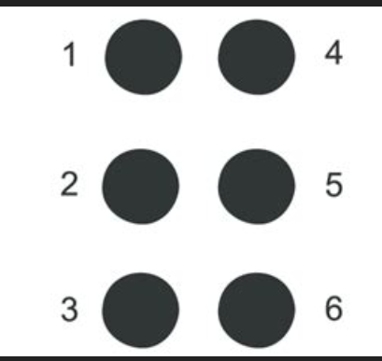
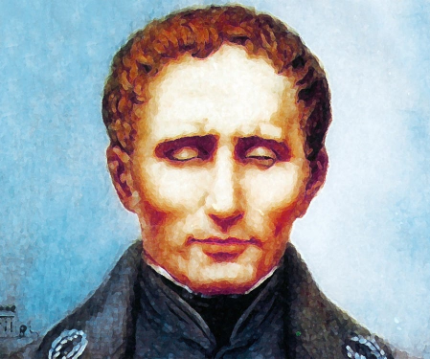
Introduction to Braille
Braille is a system of raised dots that can be felt with the fingertips and used by blind and visually impaired people to read and write.
The Braille system is based on a grid of six dots, arranged in two columns of three dots each. By combining these dots in different ways, the system can represent letters, numbers, and punctuation marks.
Braille is an important tool for blind and visually impaired people, allowing them to access the same information as sighted people.
. It was invented in the early 19th century by a Frenchman named Louis Braille, who lost his sight at a young age.

Slide 3
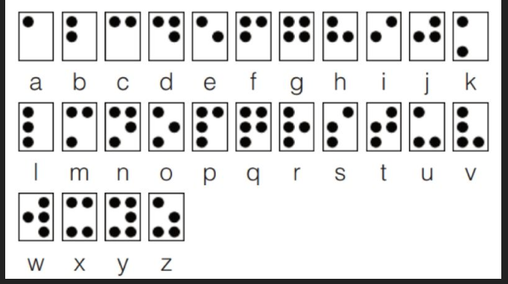
Grade 1 Braille
Grade 1 Braille is the simplest form of Braille and is often the first step for beginners who are learning to read and write using this tactile system.
In Grade 1 Braille, each Braille character is represented by a single cell containing up to six raised dots arranged in two columns of three dots each.
The dots are numbered 1 to 6 from top to bottom, with dot 1 being the top-left dot.

Slide 4
OpenCV
Here we use OpenCV to capture the image uploaded and to extract the characters for the image
The cv2.imread() function is used to read the image as the first step in image processing
OpenCV (Open-Source Computer Vision Library) library is extensively utilized in computer vision and machine learning applications.

Slide 5
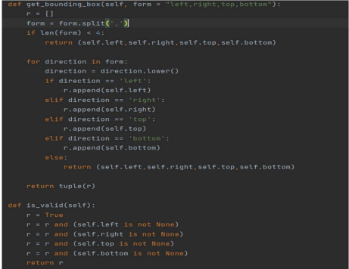
Optical Braille Recognition
After OpenCV, The text is sent to Optical Braille Recognition module.
Here the OBR is an pretrained model that recognizes the braille characters and gives out the output.
This model is able to recognize the most of the braille characters.
After the characters are identified, they are combined into words and sentences that can be output as Braille text.

Slide 6
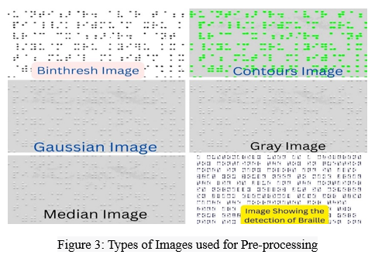
Different types of Pre-processing Images
Image processing uses various techniques to enhance or modify an image for a specific purpose.
Four important techniques used in image processing are binarization, contour detection, Gaussian smoothing, and grayscale transformation.

Slide 7
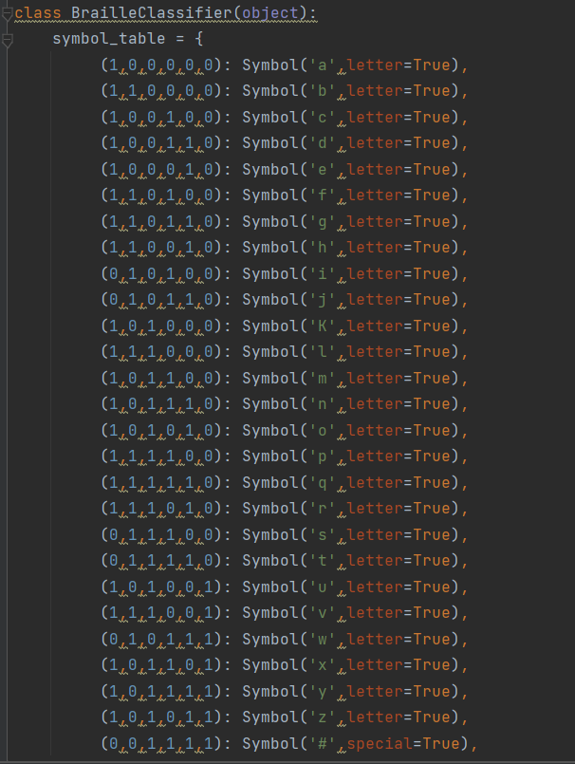
Translation Module
This is module in which we wrote the rules for the detection of the braille characters.
We use rules to detect the braille characters.
The translation module of some Braille translators also includes additional features to boost accuracy and ease of use.
A Braille translator's translation module typically converts the user's input text into Braille code according to predetermined rule.

Slide 8
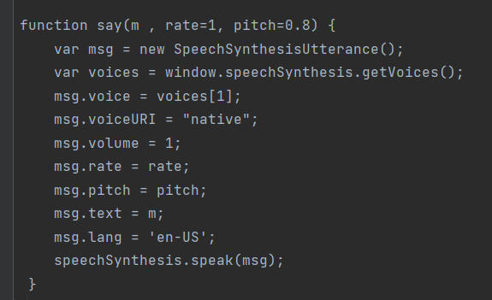
Web Synthesizer
The fourth component is the web synthesizer, which transforms the translated text into vocal output that visually impaired people may access.
Generally, web synthesizers are a flexible and open way for performers and makers to make and share music on the web.
A musical instrument that can be played and controlled through a web browser is called a web synthesizer. Using a browser-based virtual synthesizer, users can create music without requiring any additional hardware or software.

Slide 9
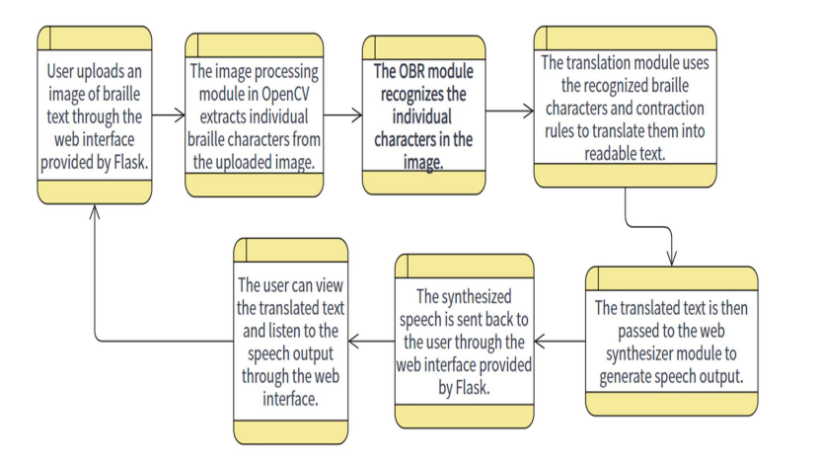
Working of the implementation

Slide 10
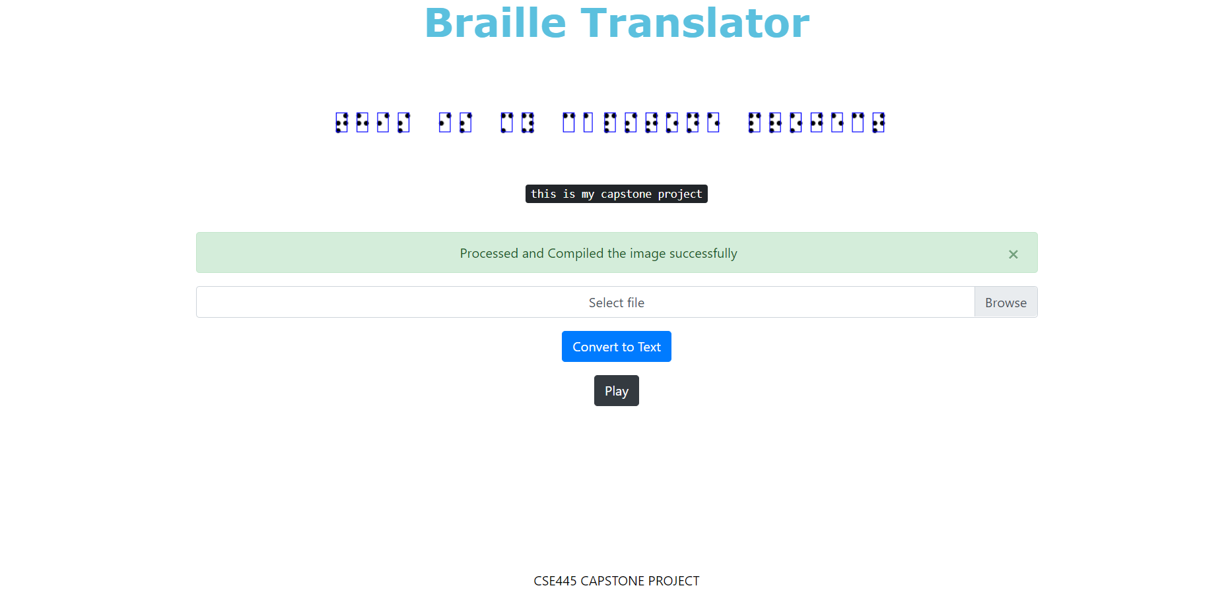
Results
With this implementation that is developed is a web application that can speech out the braille characters using OpenCV, Optical Braille Recognition, Web Synthesizer that is able to detect and draw a detection box against all braille characters and convert it into English Language and convert it into speech, it will be played out into default speaker of the device.
Overall, this implementation is to be aimed at improving accessibility for visually impaired individuals by providing them with a tool to easily convert Braille text into speech.

Slide 11
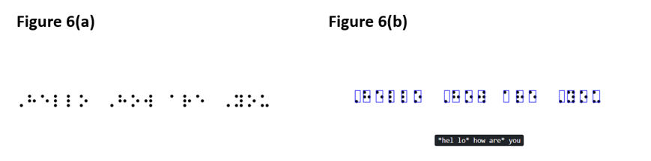
Result Figures
Figure 6(a), showing the scanned image in braille that indicating hello how are you.
Figure 6(b), Showing the output of the braille image that inserted, it will process it with the OpenCV and digest it with the Optical Braille Recognition and shows the output in the English and when play button is clicked then speech output will be played in default speaker.

Slide 12
THANK YOU

