Slide 1

INT248 FAKE NEWS CLASSIFICATION WITH NLP AND LSTM
SUBMITTED BY:
NAME:GUDLADHANA HARSHITH
REG-NO:11903248
SECTION:KM053
ROLL-NO:A06

Slide 2
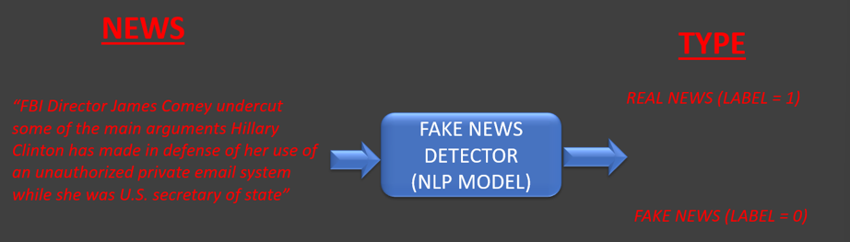
IMPORTANCE OF MODEL AND SOLUTION PROVIDED
Right now, we are living in a world of mis- information and fake news. The goal of this project is to detect the fake news based on recurrent neural networks.
Natural Language Processors(NLP) is used to convert the words into numbers
This model is very useful for the companies and media to automatically detect the fake news.

Slide 3
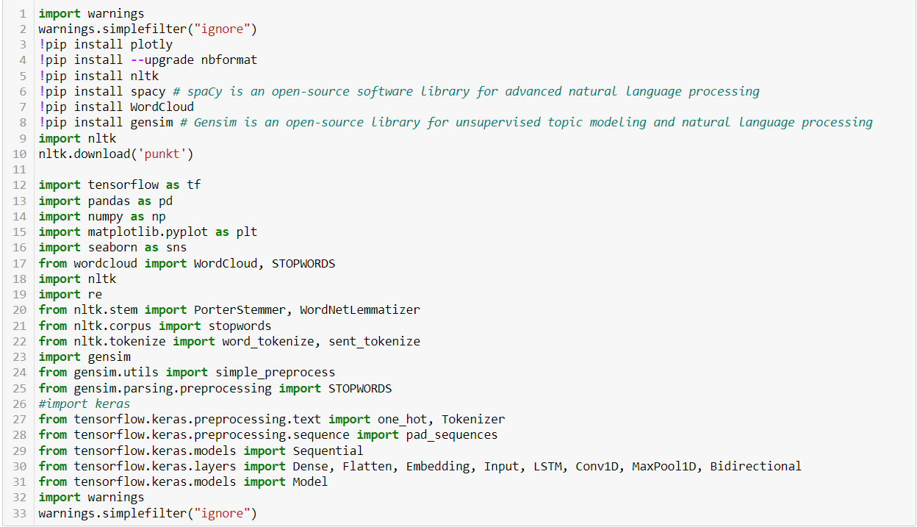
IMPORTING OF LIBRARIES AND DEPENDENCIES

Slide 4

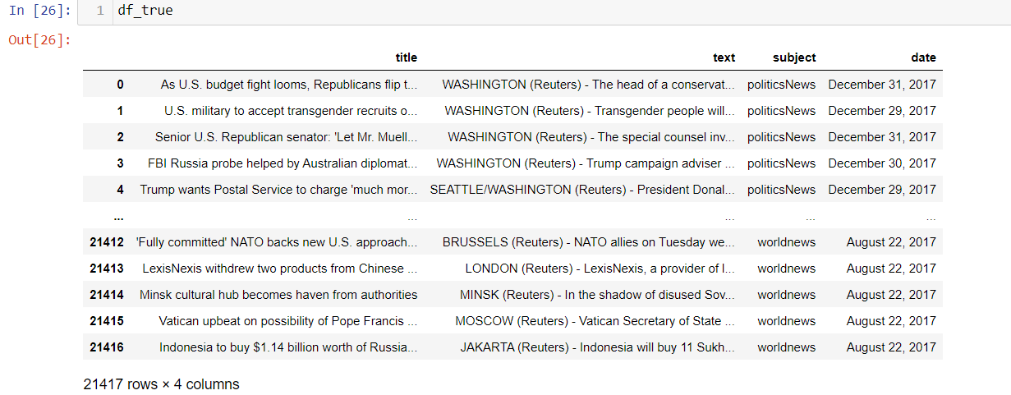
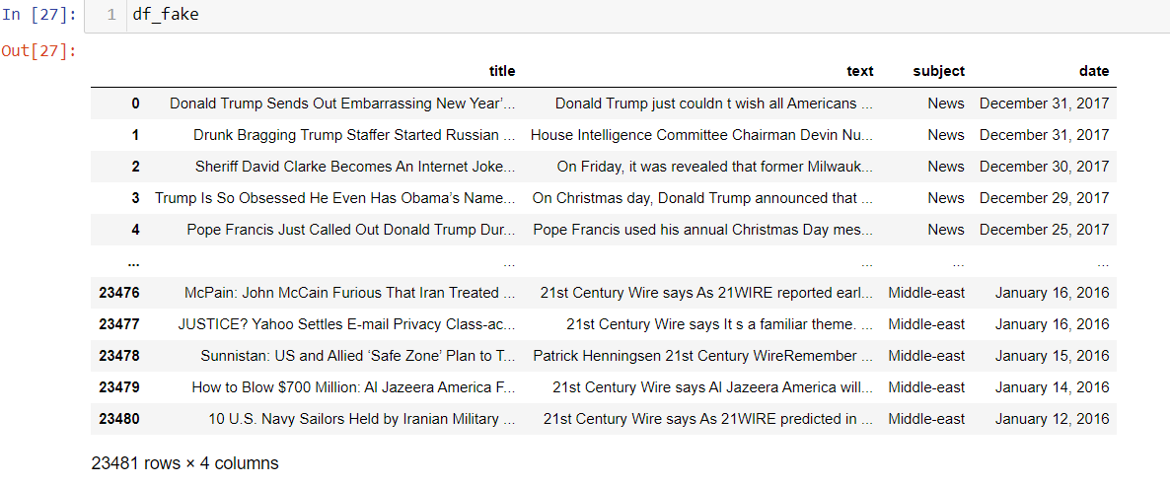
IMPORTING OF DATASETS AND OBSERVATIONS

Slide 5
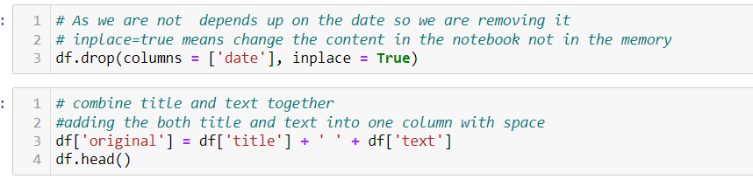
Combine the Fake and True Datasets

Slide 6
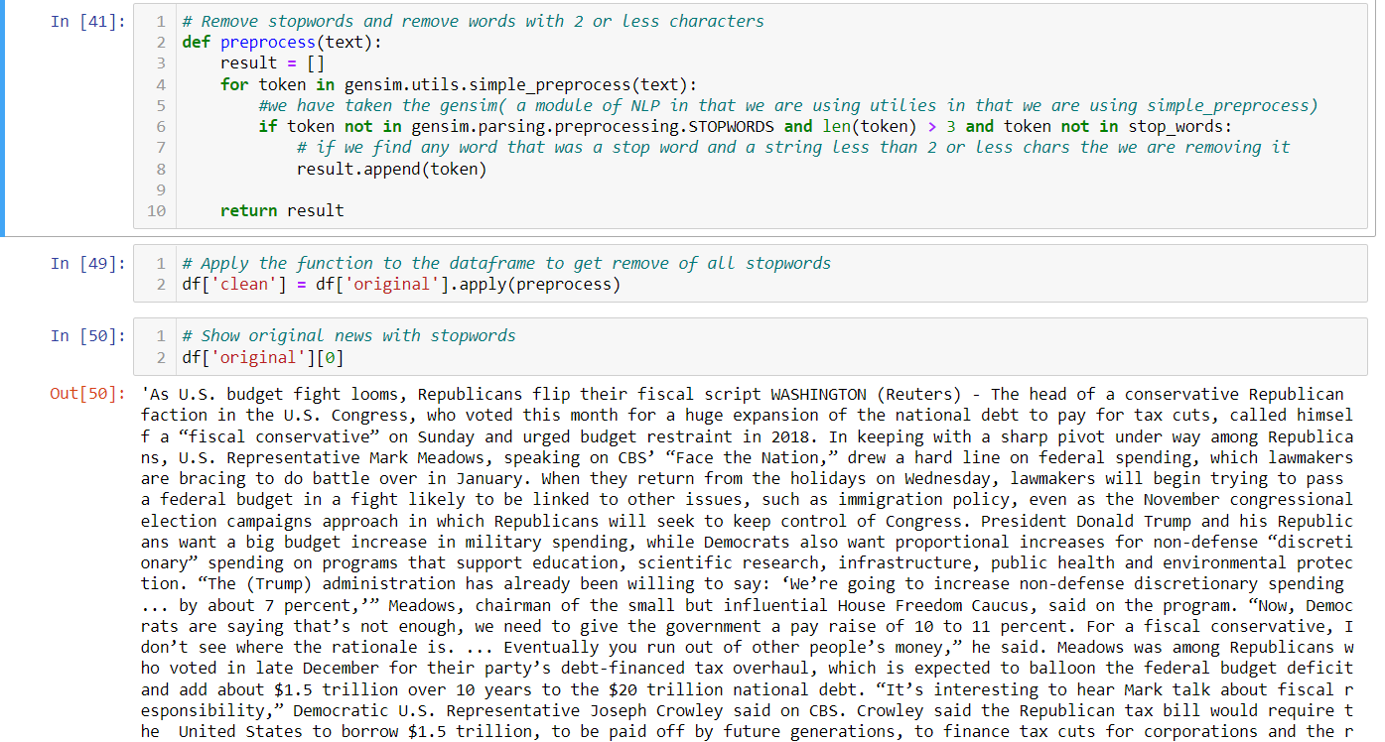
STOPWORDS:

Slide 7
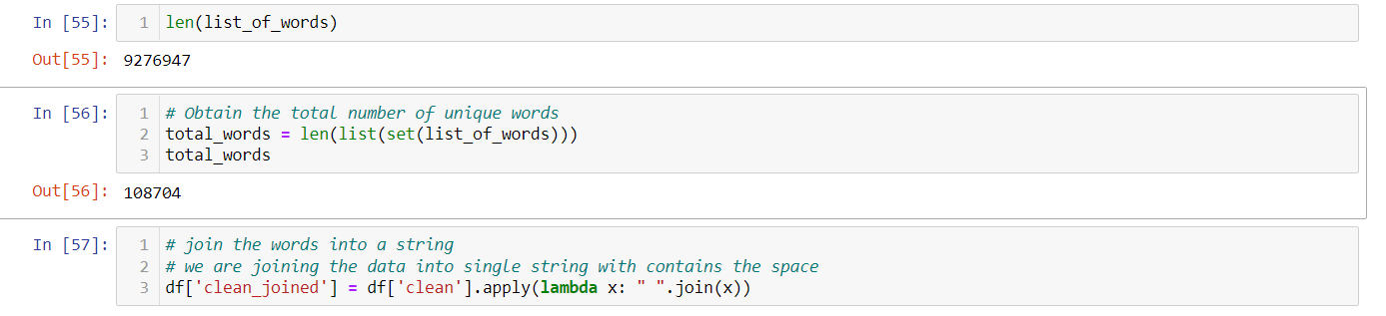
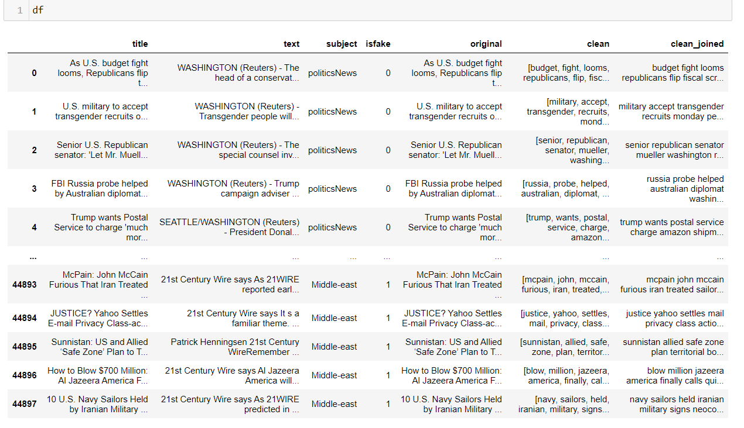
Calculating no of Stop Words and combining the data after removing of Stop Words:

Slide 8
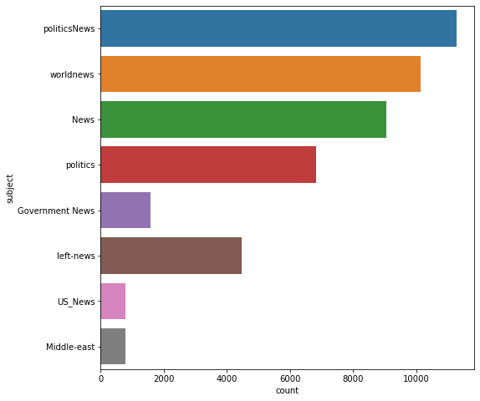
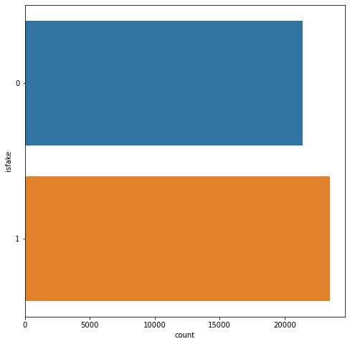
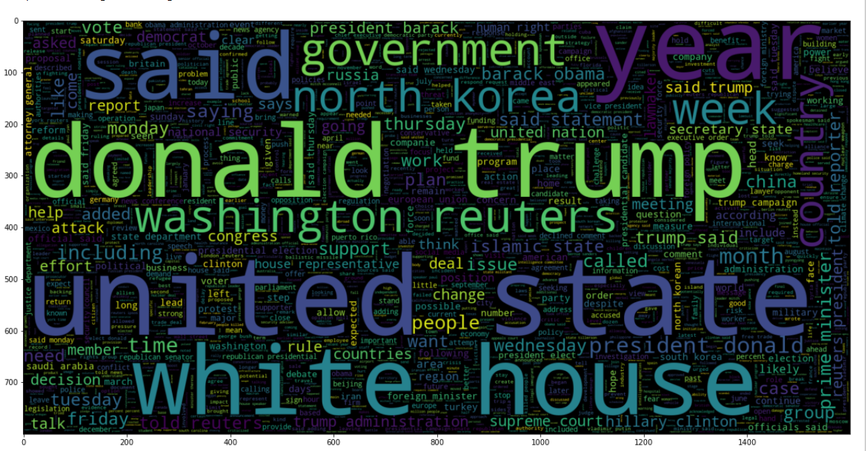
Visualization of Data:

Slide 9
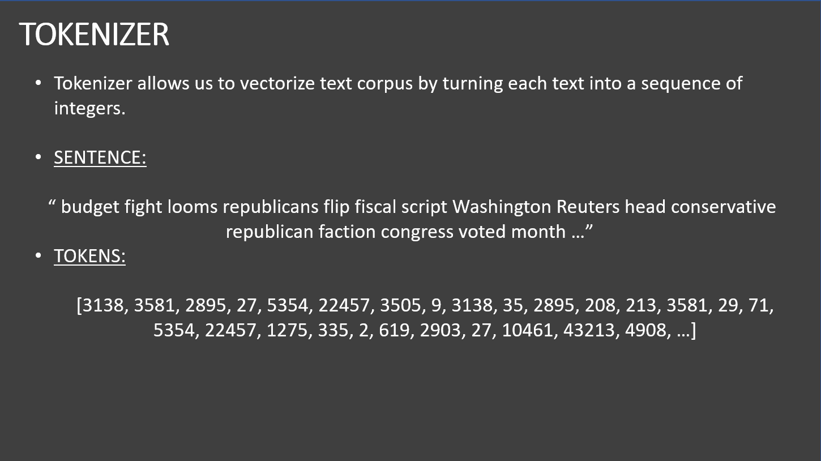
Tokenization of Data:

Slide 10
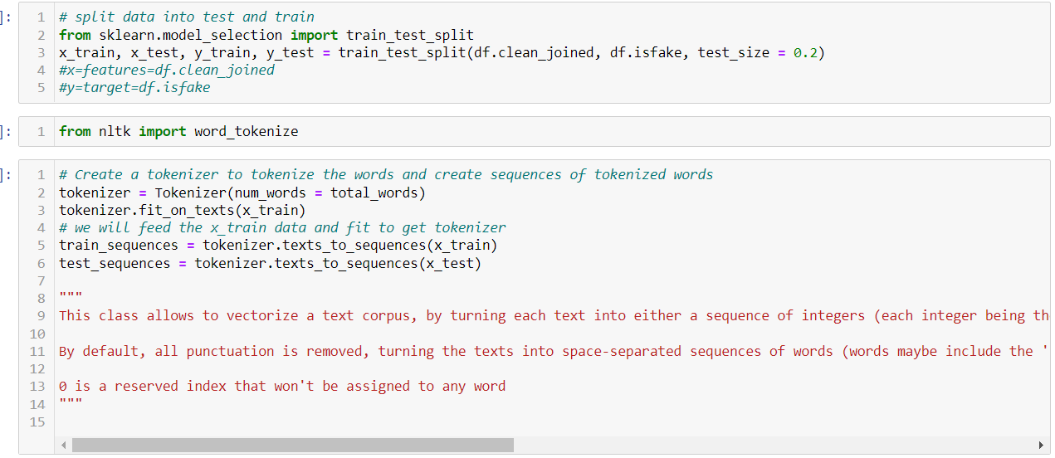
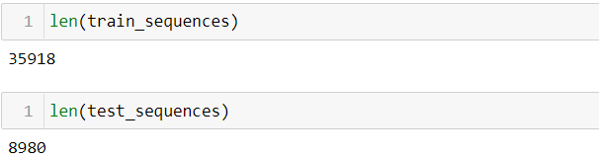
Code for Tokenization and Train_Test_Split::

Slide 11
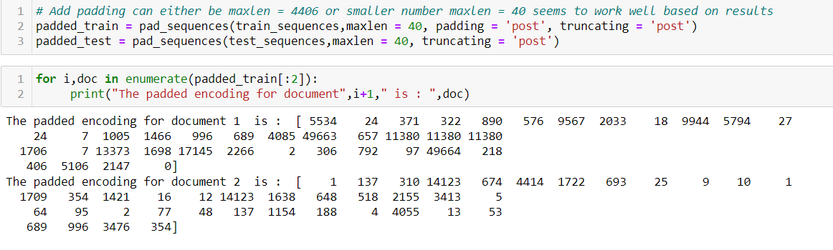
Adding padding to data:

Slide 12
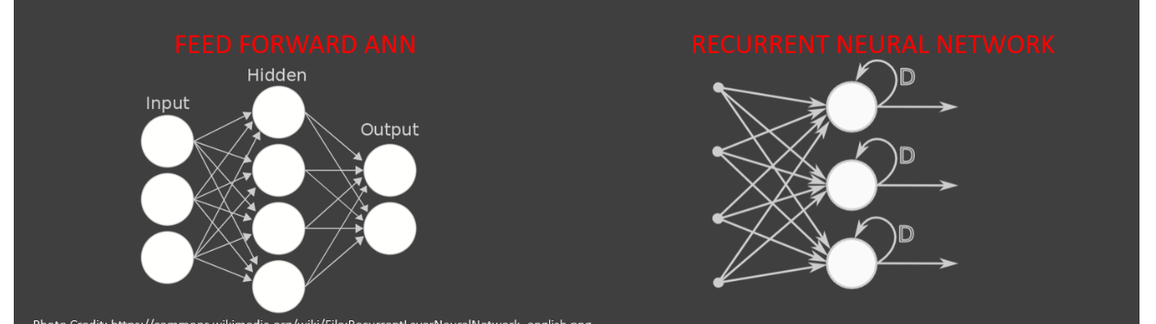
Recurrent Neural Networks Vs Feed Forward Neural Network
A drawback in feedforward Neural Networks(Vanilla Networks) is that they do not have any time dependency or memory effect
A RNN is a type of ANN that is designed to take a temporal dimension into consideration by having a memory (internal state) or(Feedback Loop)

Slide 13
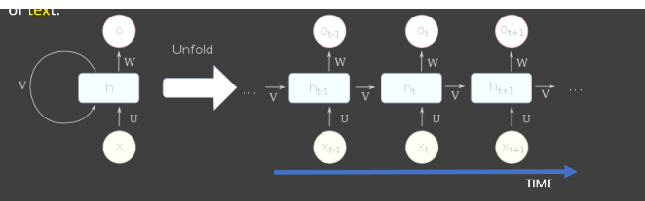
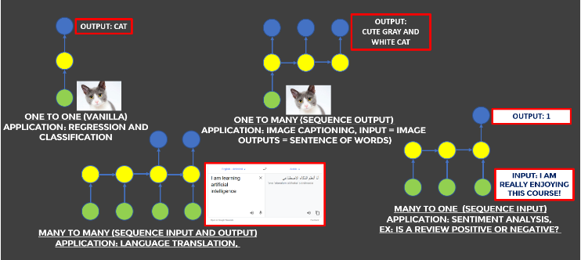
RNN Architecture
A RNN contains a temporal loop in which the hidden layer not only gives an output but it feeds itself as well
An extra dimension is added which is time
RNN can recall what happened in the previous time stamp so that it works great with sequence of text.

Slide 14
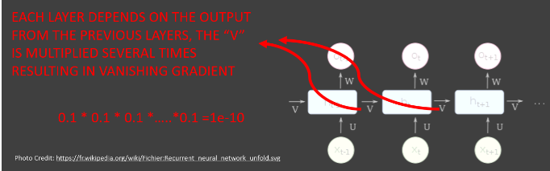
Vanishing Gradient Problem:
LSTM Networks works better compared to vanilla RNN since they overcome the vanishing gradient problem
The error has to propagate through all the previous layers resulting in a vanishing gradient
As the gradient goes smaller, the weight of networks are no longer updated.

Slide 15
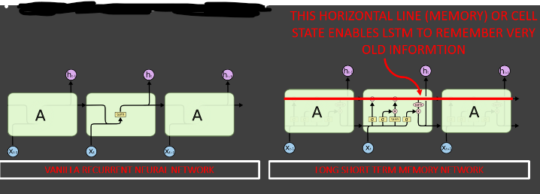
Long Short Term Memory
LSTM networks are type of RNN that are designed to remember long term dependencies by default
LSTM can remember and recall the information for a prolonged period of time.
Each line represents a full vector

Slide 16
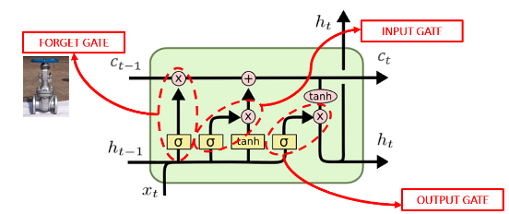
LSTM GATES:
LSTM contains gates that allow or block information from passing by.
Gates consist of a sigmoid neural net layer along with a point wise multiplication operation.
Sigmoid output ranges from 0 to 1:
0 = Don`t allow any flow of data
1 = Allow everything to flow!

Slide 17
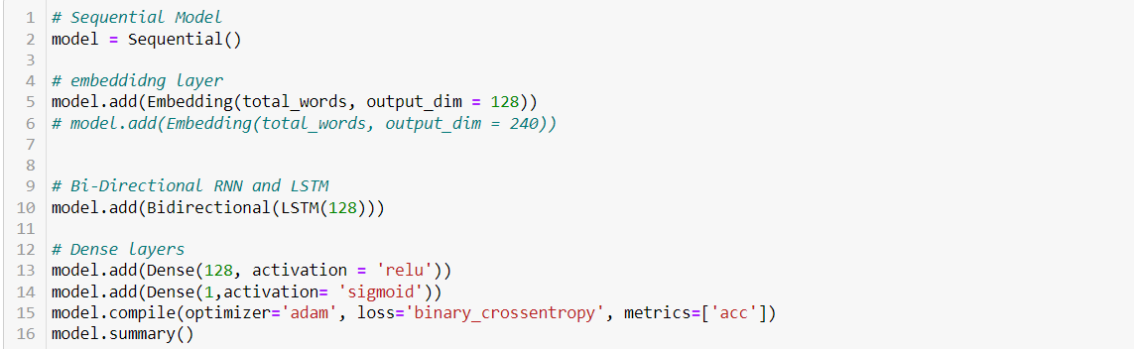
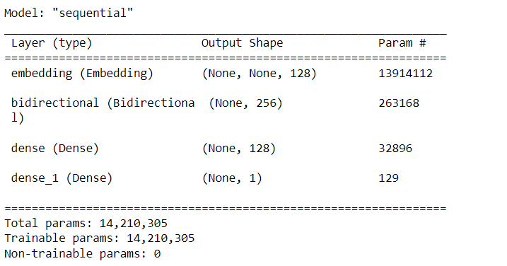
MODEL USED IN PROJECT:

Slide 18
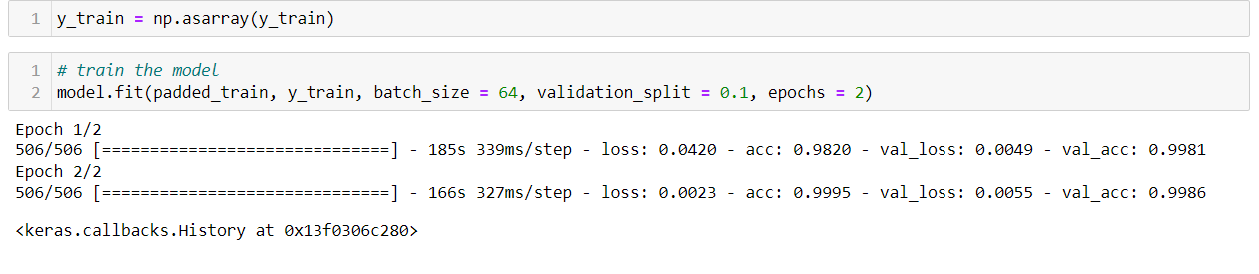
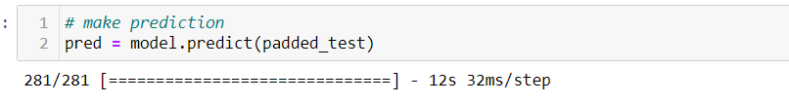
Training of Data: Accessing the Trained Model:

Slide 19
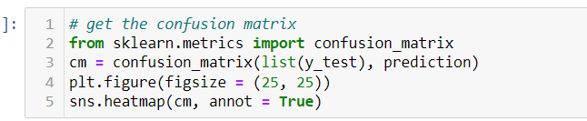
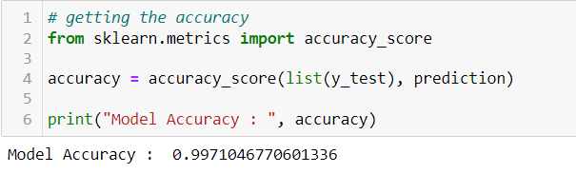

Model Accuracy:

Slide 20
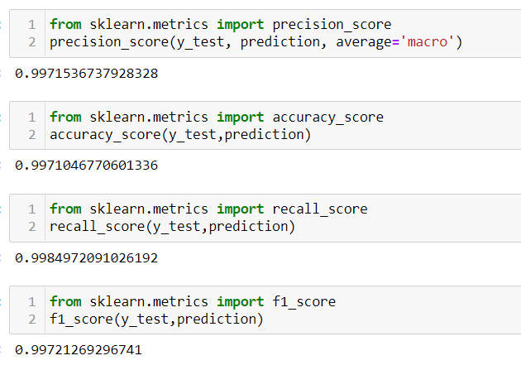
Few more Accuracy Metrics:

Slide 21
-----------------THANK YOU---------------

