Slide 1
CMP 414 & 765 Artificial Intelligence with Machine Learning
Liang Zhao
Lehman College
City University of New York
Spring 2020

Slide 2
Scope of This Course
Artificial Intelligence: A program that can sense, reason, act, and adapt
Machine Learning: Subset of Artificial intelligence, where program is guided by algorithms whose performance improve as they are exposed to more data over time
Deep Learning: Subset of machine learning in which deep neural networks are used to learn from large volume of data
Not included:
Creating AI programs in computer games
- Designing StarWars-type robots

Slide 3
Why machine learning?
1950’s: Can we make computers as smart as human?
2019: Can computers discover patterns from data?
Data:
Numerical data
Images
Sound
Text
Time Series

Slide 4
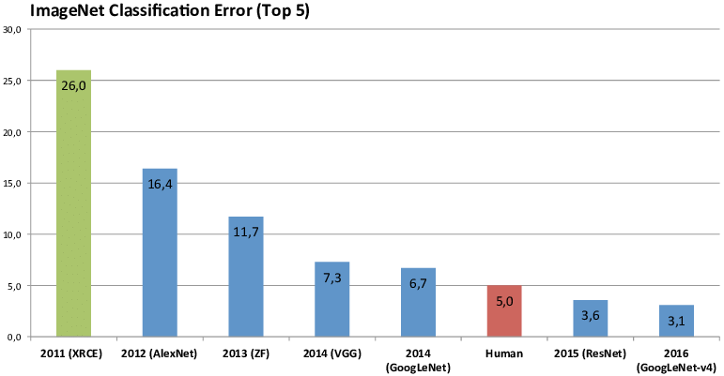
Recent Breakthrough
ImageNet Challenge:

Slide 5
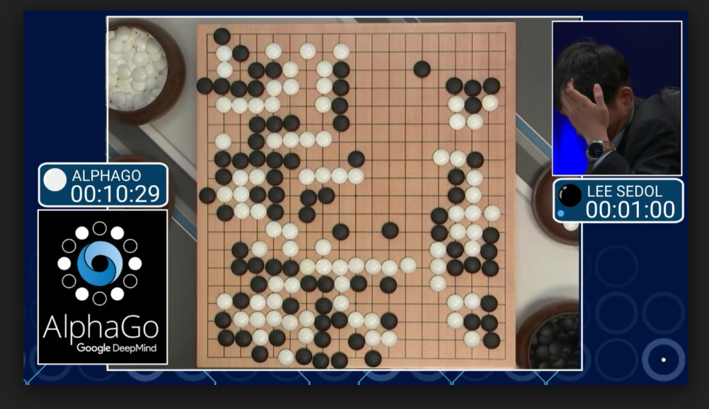
Recent Breakthrough
Game AI
AlphaGo
AlphaZero
AlphaStar
Google Assistant
Auto Piloting
Smart Healthcare

Slide 6
Course Description
This course provides a broad introduction to applied machine learning models and algorithms:
Machine Learning concepts
Essential skills on handling, cleaning, and preparing data
General-purpose machine learning models
Training and tuning process on real-world data
Selecting and engineering features
Improving models using domain-specific knowledge

Slide 7
Course content
This course will introduce models and algorithms through concrete working examples with a moderate amount of theory. Python will be used as the primary programming language.
Mathematical understanding: 20%
Data handling and exploration with python: 20%
Model design and training: 30%
Model evaluation and diagnostics: 30%

Slide 8
Learning Objectives
At the end of the course, students should be able to:
Handle large volume of data using python scientific libraries.
Understand the concepts and procedures for the most common machine learning algorithms.
Given a particular learning task, build a machine learning model and train the model on the training dataset.
Tuning a machine learning model to improve its performance.

Slide 9
Grading Policy
Students are expected to learn both the material covered in class and the material in the textbook and other assigned readings. Completing homework is an essential part of the learning experience.
Participation & In-class activities: 10%
Homework and Quizzes: 30%
Midterm Project: 30%
Final Project: 30%

Slide 10
Main Textbook
Hands-On Machine Learning with Scikit-Learn and TensorFlow Concepts, Tools, and Techniques to Build Intelligent Systems By Aurélien Géron
Publisher: O'Reilly Media
Release Date: March 2017
ISBN-13: 978-1491962299
ISBN-10: 1491962291
Online version of the textbook: http://shop.oreilly.com/product/0636920052289.do

Slide 11
Secondary Textbook
Python for Data Analysis, 2nd Edition
By William McKinney
Publisher: O'Reilly Media
Release Date: October 2017
ISBN-13: 978-1491957660
ISBN-10: 1491957662
Online version of the textbook: http://shop.oreilly.com/product/0636920050896.do

Slide 12
Other Resources
Python tutorial: http://learnpython.org/
Andrew Ng’s ML course on Coursera: https://www.coursera.org/learn/machine-learning
Python codes for the textbook: https://github.com/ageron/handson-ml
Google Machine Learning Crash Course: https://developers.google.com/machine-learning/crash-course/
YouTube

Slide 13
Honor Code
Email
Blackboard
Github
Accommodating Disabilities

Slide 14
Why Python?
Easy to get started
Syntax is much more readable
Has several powerful scientific computing libraries
Has interactive programming environment

Slide 15
Set up Machine Learning Environment
Python 3.x on Anaconda: https://www.anaconda.com/download/
Most data science libraries are pre-installed (numpy, scipy, pandas, sklearn)
Later in this course we will install TensorFlow library for building neural network models
Jupyter notebook
Online options:
Google Colaboratory: (https://colab.research.google.com/notebooks/welcome.ipynb#recent=true)
Kaggle kernel: www.kaggle.com

Slide 16
Python Tutorial
1. Hello world
2. Variable: value, type, swap
3. Arithmetic
4. Comparison operators
5. Logical operators
6. Strings
7. Lists, dictionaries, sets, and tuples
8. Loop
9. List comprehension
10. Function and classes

Slide 17
Example: Visualize Height Growth
1900 | 170
1910 | 172.1
1920 | 173.1
1930 | 173.4
1940 | 176.1
1950 | 177.1
1960 | 177.3
1970 | 178.3
1980 | 179
The table on the right contains the average height for men in the United States between 1900 and 1980. (Source: https://ourworldindata.org/human-height)
Create two python lists containing years and heights.
Plot a graph that illustrate the trend of average heights.
Calculate the percent of change over the previous decade.
Plot a graph that illustrate the rate of change.

Slide 18
Homework:
1. Set up Anaconda environment on your computer
2. Read the first chapter of the textbook
3. Familiarize yourself with python syntax

